Slide 1

Field Trip Application - Version 2.0
Webinar for Requestors
Presenter Names:
Dr. Karen Mercado, Senior Director, Office of the Deputy Superintendent, Instruction
Patricia Chambers, Senior Director, Office of the Deputy Superintendent, Business Services and Operations
Diana Middleton, Project Manager, ITS Enterprise Applications

Slide 2

Agenda
Launch Details & Overview of Version 2.0 Enhancements
Logging in / Dashboard
Requesting a Field Trip
  Non-Athletic Field Trip
  Athletic League and Non-League Trip Field Trip
Modifying, Editing, and Cloning a Field Trip Request
Canceling or Deleting a Field Trip Request
Reference Materials
Live Demo
Questions

Slide 3
Launch Details & Overview of Enhancements

Slide 4
Launch Details
  Version 2.0 released April 11, 2025 (soft launch), but what does that mean?
    Field Trip requests for the current 2024-25 school year (including summer 2025) should be entered on the current platform - https://ifieldtrip.lausd.net
    Field Trip requests for the 2025-26 school year (i.e., trips after August 1, 2025) should be entered on the new 2.0 platform - https://fieldtrip.lausd.net (dropped the "i" in front of "fieldtrip")
  Training materials, such as user guides, training videos and FAQs are available on the Field Trip Resources website: https://riskfinance.lausd.org/apps/pages/index.jsp?uREC_ID=4417428&type=d&pREC_ID=2650488
  These webinars will also be recorded and added to the Field Trip Resources page

Slide 5
Overview of Version 2.0 Enhancements
  Streamlined navigation & approval flow
  Ability to make trip modifications
  Summary screen approvals for multiple departments
  Additional notifications and alerts
  Improved Dashboard
  Filtered Reporting
  Interfaces with multiple departments
  System optimizations, technology upgrades, including migration to the Cloud
Notes:
First, I want to review at a high-level some of the major changes incorporated into version 2 of the Field Trip application:
Streamlined workflow (before there were hidden tabs to enter values, now it is a sequential workflow with capability to upload documents)
Modifications (newly introduced feature--once the request is uploaded by one of the departments, the requestor can now modify a submitted request)
Summary screen approval (before users had to review screen by screen, now reviewers can go directly to the summary screen)
Notifications and alerts to be sent to approvers (included more reminders for a faster approval process)
Approval flow and business rules (before approval flow was sequential, now once the principal approves, subsequent approvers can approve simultaneously)
Dashboard (before all the data was in one page, now users can separate into current / past trips – this also improves performance and load times)
Reporting (before users had to export a file, now the feature is online with filters and queries around specific roles)
Interfaces with multiple departments (one interface is bus ops already integrated & parent portal will be part of V3)
Backend changes (this includes migration to the cloud and will improve performance and storage capabilities)
Also, please note that Graduation and awards used to be part of old system, but it is now treated as a separate module and no longer part of field trip

Slide 6
Logging in / Dashboard

Slide 7
Logging in / New Dashboard
NEW VIEW
  URL for new system https://fieldtrip.lausd.net (dropped the "i" in front of "fieldtrip")
  Users can sort by reference number, trip type, school, destination, departure / return dates, or by status
  Users can also sort by school year, trip type, and status or search for a request by keyword

Slide 8
Logging in / New Dashboard
NEW VIEW
  On the left-side of the Dashboard, users can select one of the following options from the Field Trip Menu:
    Home - Go home back to the main Dashboard page where all active and upcoming field trips are displayed
    Create Field Trip
    Reports
    Legacy Trips - These are trips that originated from the previous (legacy) system before the current platform was implemented (only users with the AdminRM role have permission to view Legacy Trips)
    History – These are trips that have already passed their departure date, they are considered completed or no longer active

Slide 9
Requesting a Non-Athletic Field Trip

Slide 10
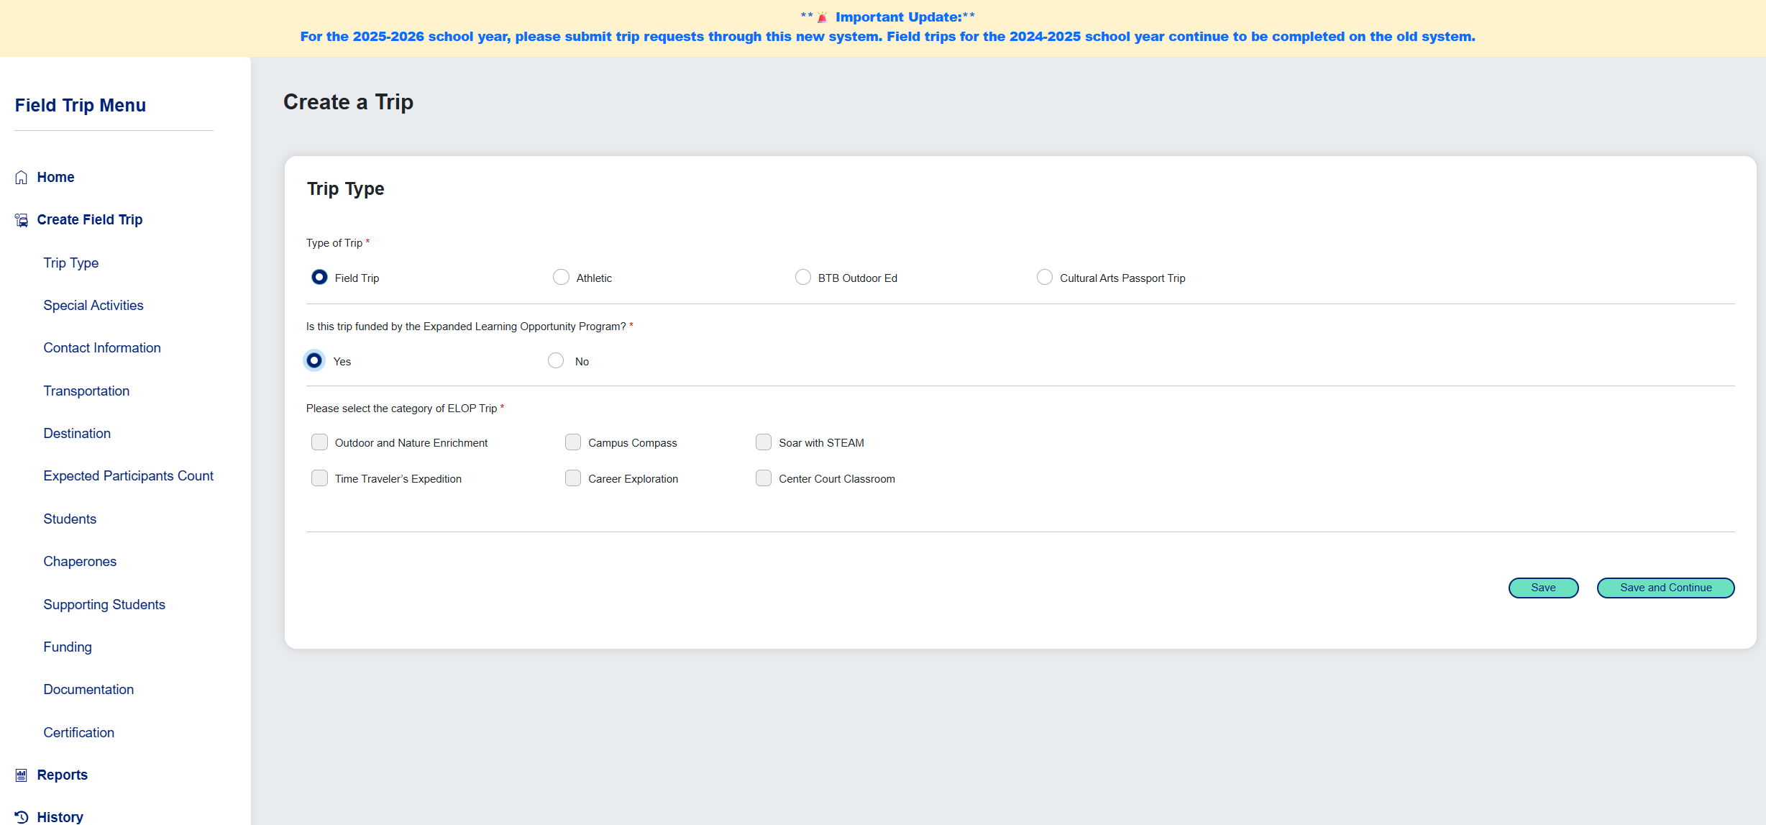
Creating the Request
*If "Cultural Arts Passport Trip" is selected, users will be required to select the relevant VAPA anchor Standards on the next screen, including a description of the pre- and post-trip learning activities that will reinforce student progress toward the listed objective
Users will be required to note if the trip is funded by the Expanded Learning Opportunity Program (ELOP). If it is, they will need to select the appropriate ELOP category.

Slide 11
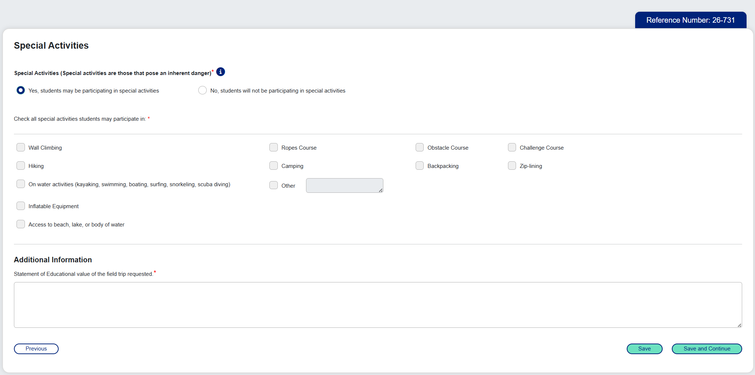
Special Activities
NEW VIEW
Once you complete the first screen, a unique Reference Number will be generated for this trip request.
*An organized activity involving physical engagement that is beyond the routine of a regular educational curriculum and presents potential hazards/risks to the participants. These activities may include but are not limited to: Wall climbing, zip-lining, use of any inflatable equipment, hiking, camping, backpacking, ropes course, obstacle course, challenge course, on water activities (kayaking, swimming, boating, surfing, snorkeling, scuba diving), access to beach, lake, or body of water.
    If "Yes" is selected, user will have to select the type of activity​
    Selecting "Hiking," "Camping," or "Backpacking" will require acknowledgement of additional safety and preparation statements (newly added – see next slide)​
    Selecting "Other" will require a description in the box next to this option​

Slide 12
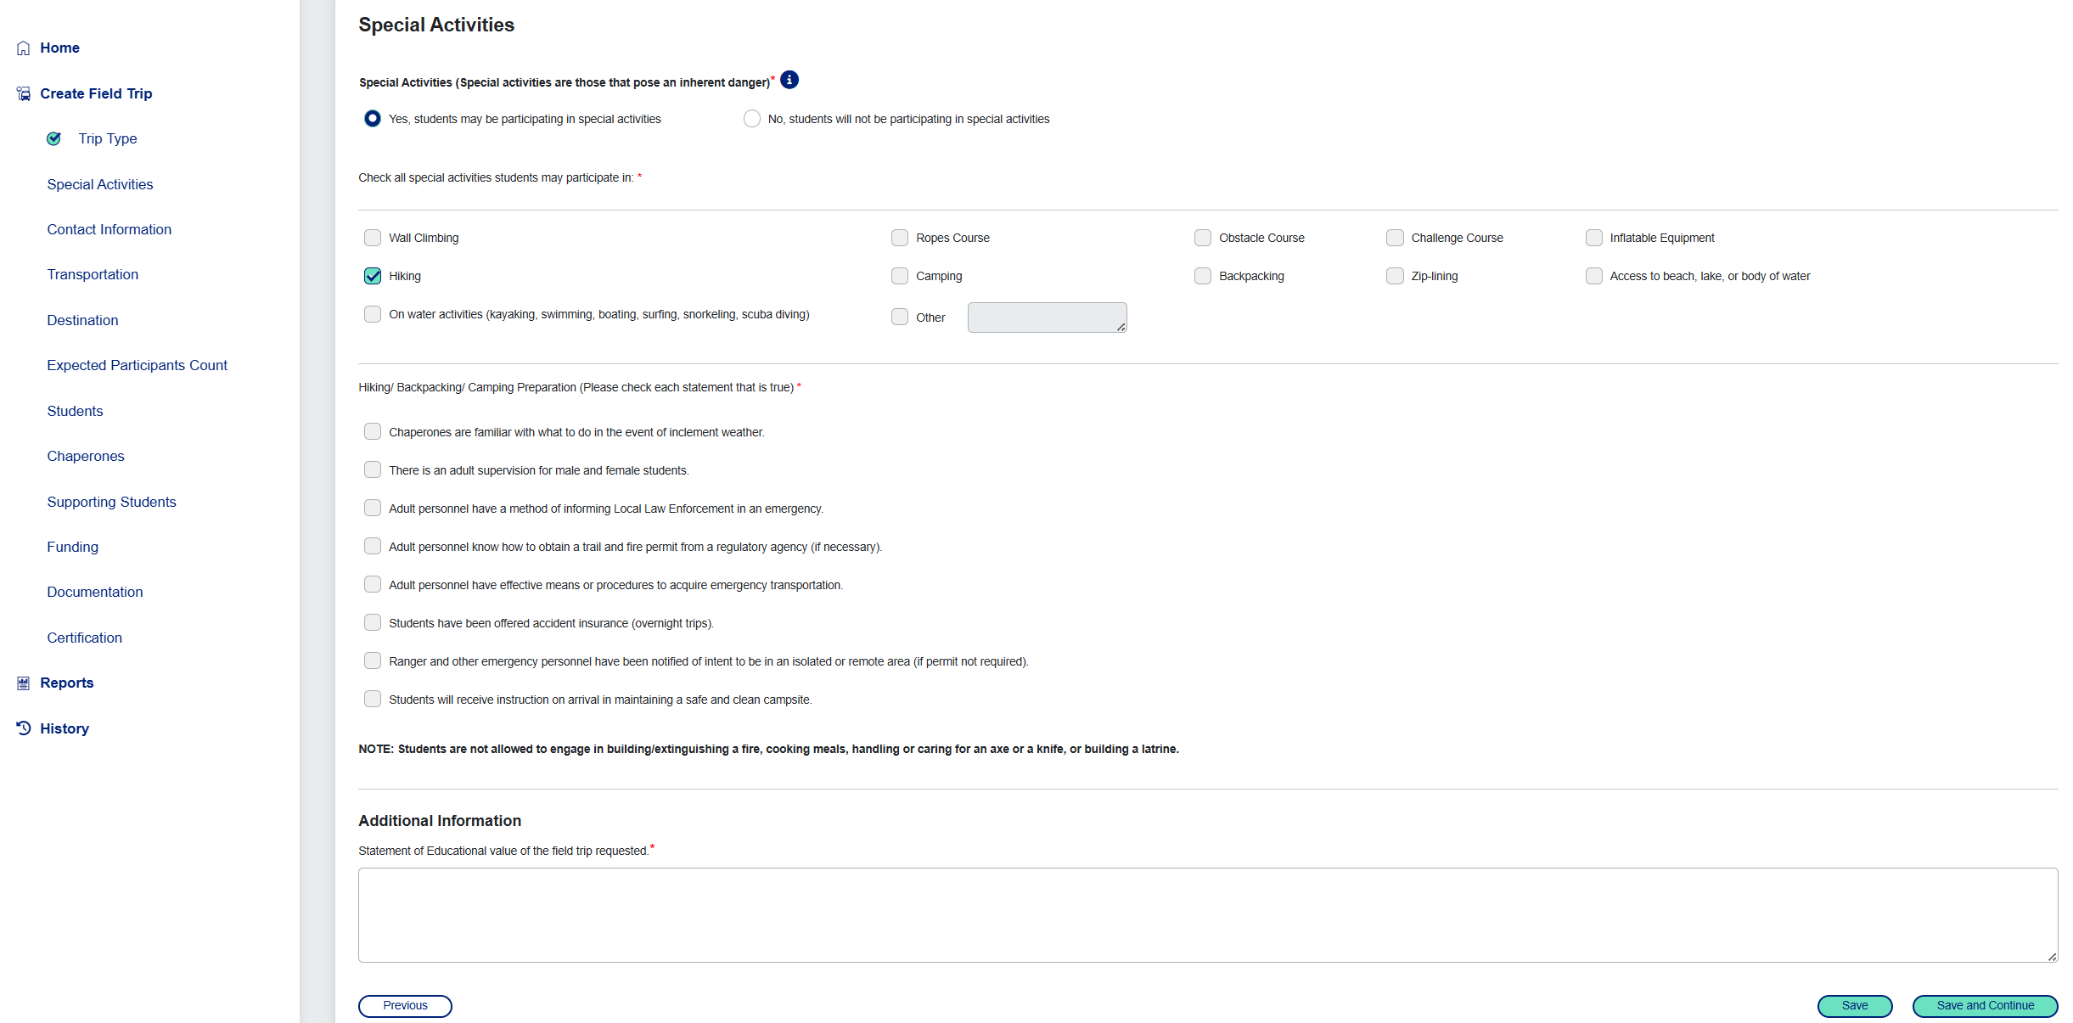
Special Activities – Additional Statements
NEW VIEW
This is just a snapshot of the additional statements required when selecting hiking, camping, or backpacking.

Slide 13
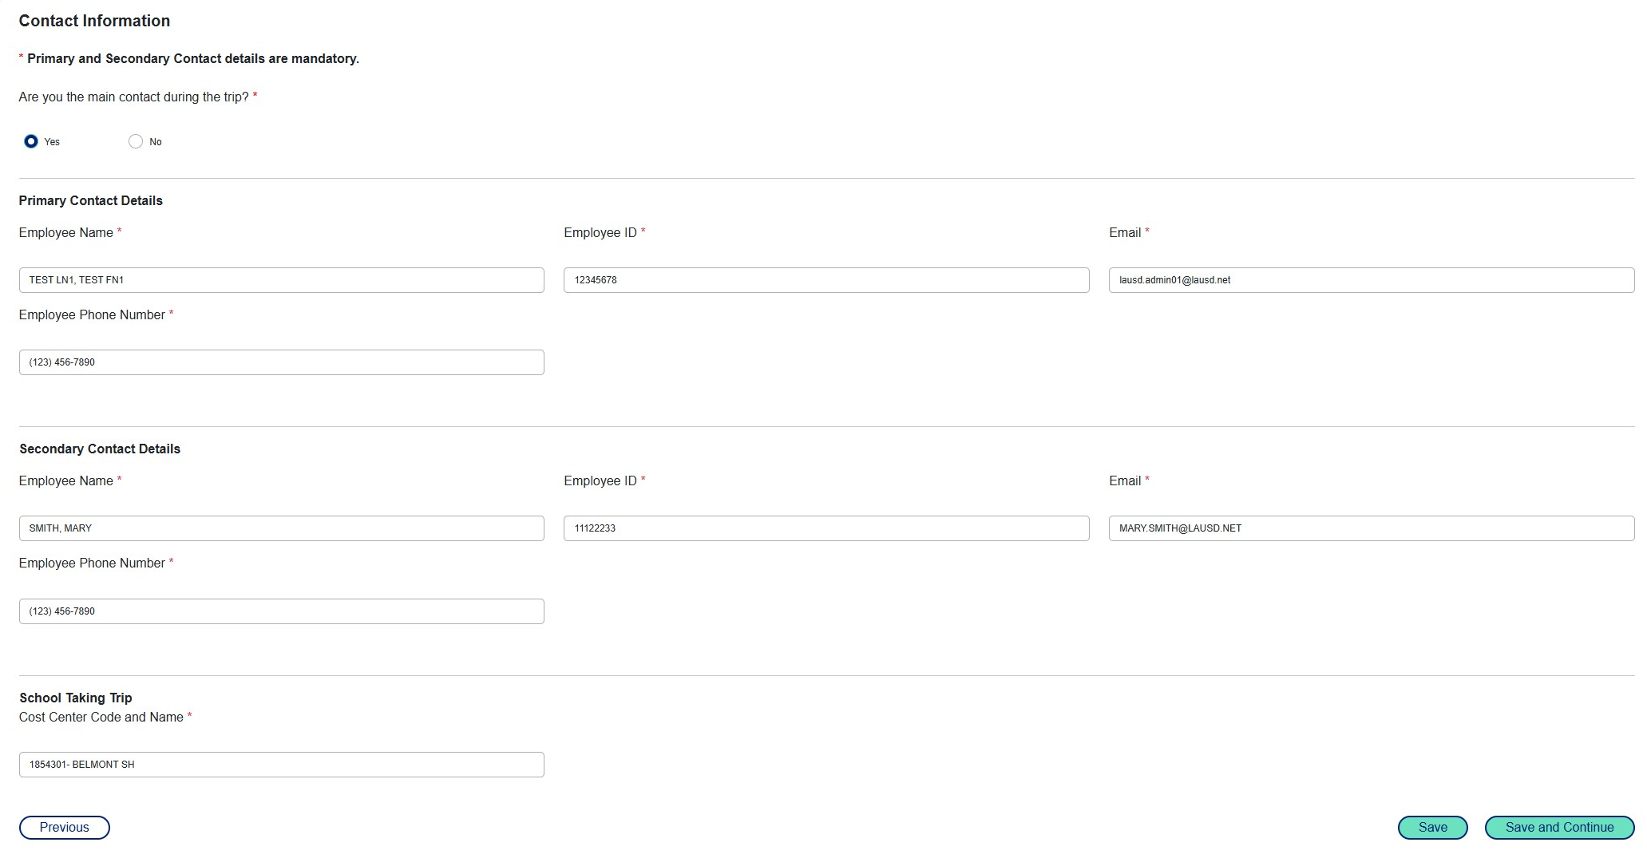
Contact Information
NEW VIEW
  If the user selects "Yes" as the main contact during the trip, the Primary Contact Details will auto populate with their information
  When entering the Employee information, please ensure you select the name from the drop-down list, as it will auto-populate with the employee’s ID.
  The school cost center code and name will auto-populate based on the Primary Contact's information​
​

Slide 14
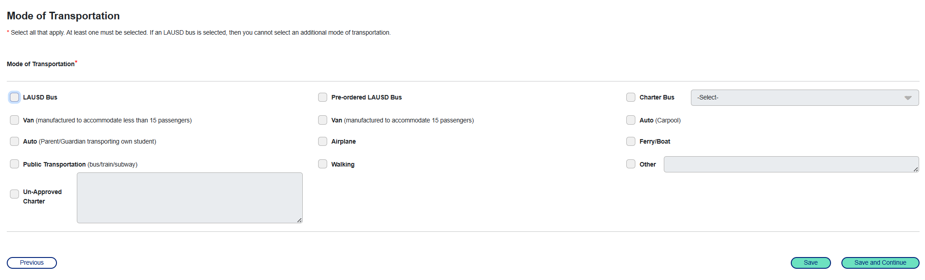
Mode of Transportation
    "Pre-ordered LAUSD Bus" option should be selected only if LAUSD bus arrangements have already been discussed with and approved by the Transportation Department.​
    Selecting "Charter Bus" will require users to select from the provider drop-down list
    Selecting "Van (manufactured to accommodate 15 passengers) will display the following pop-up alert "Employees of school districts who operate a van manufactured to accommodate 15 passengers must have a CDL with a passenger transport vehicle (PV) endorsement."
  Selecting "Other" will require a description in the box next to this option
Selecting "Un-Approved Charter" will display the following pop-up alert and require the user to enter the company details "Approval for a charter bus company that is not currently on the Approved List is contingent upon the company’s compliance with California Department of Transportation (CA DOT) regulations. A comprehensive review of the company's records must be conducted at its facility to ensure compliance. For streamlined approval and compliance assurance, it is recommended to select a charter bus company from the Approved List."

Slide 15
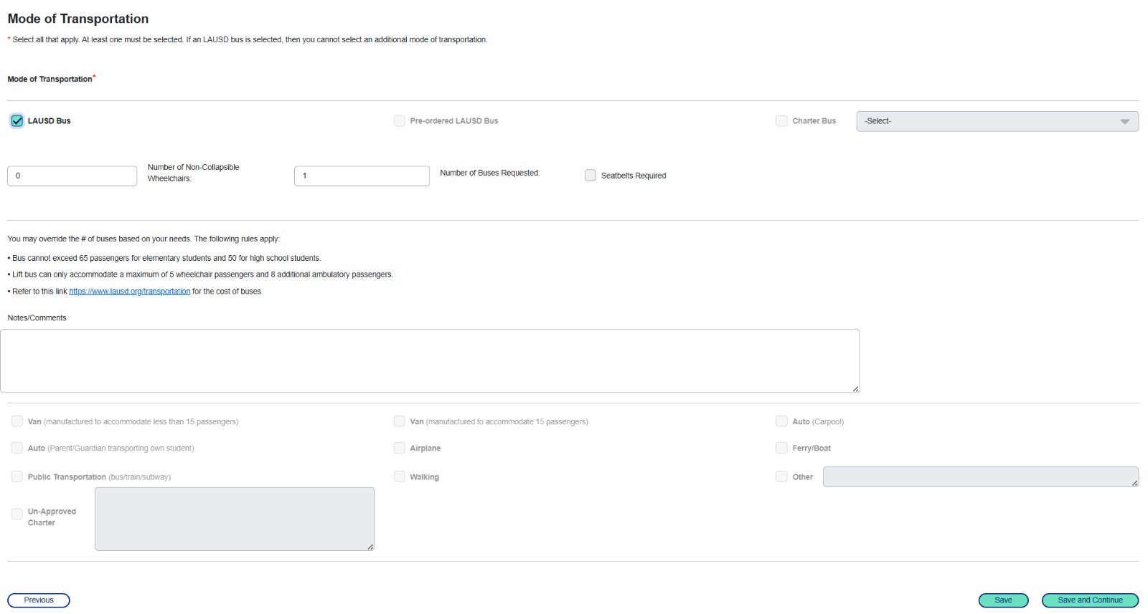
Mode of Transportation
If requesting an LAUSD bus, the trip must be at least 15 calendar days prior to the trip.
Transportation services prioritizes support for morning and afternoon peak travel periods and therefore field trips occurring between 9:00 AM – 2:00 PM are ideal. Requests with start and/or end times between 5:30 AM – 8:30 AM or 2:00 PM – 5:00 PM will be evaluated for approval on a case-by-case basis.
    Additional Notes/Comments can be provided here ​

Slide 16
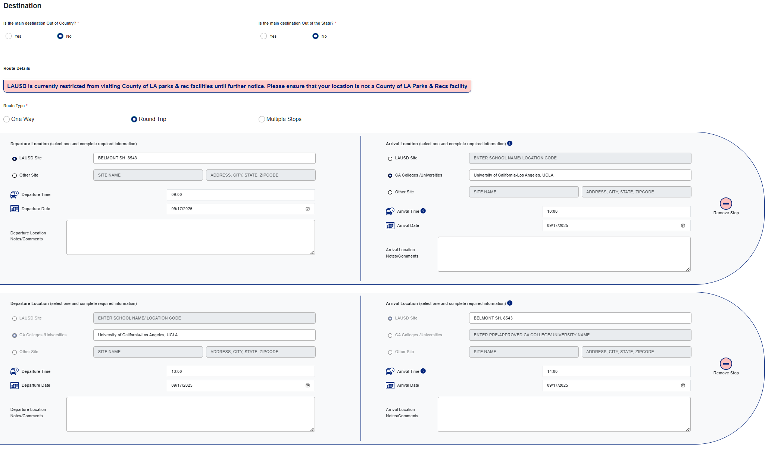
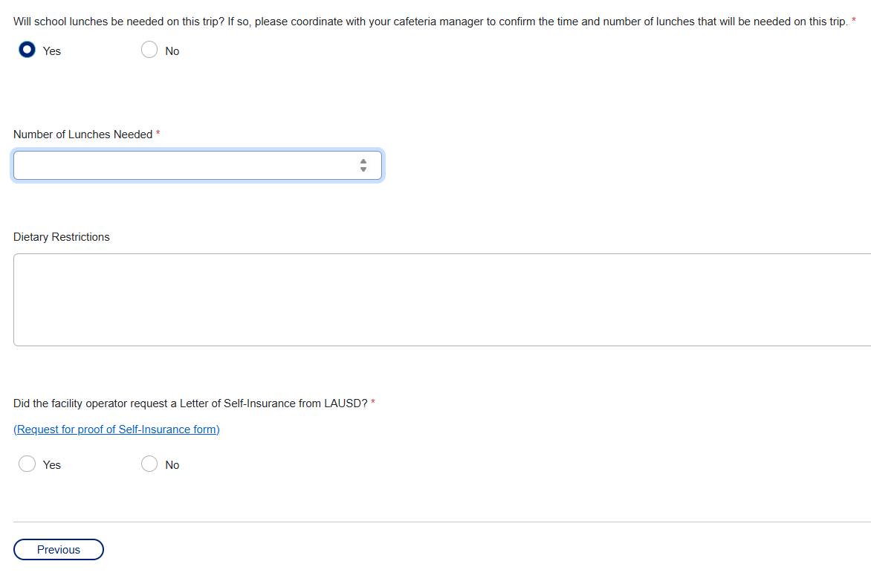
Destination
NEW VIEW
CAP and ELOP field trips must adhere to Extended Learning Opportunity Program rules:
9-hour window on instructional days.
This includes a 6-hour school day + 3 hours after school, i.e., School starts at 8 am, the field trip arrival time must be 5 pm or later, regardless of the departure time for the field trip.
Nursing services cannot guarantee the approval of field trips that are not submitted at least 30 days prior to departure.
LAUSD Site or Other Site & address (the system will use address standardization rules to suggest location addresses for the user to select after entering the first few characters)
NOTE: time now requires military time (e.g., 2:00 PM = 14:00)​
  Select whether school lunches are needed & whether the facility operator requested a Letter of Self-Insurance from LAUSD

Slide 17
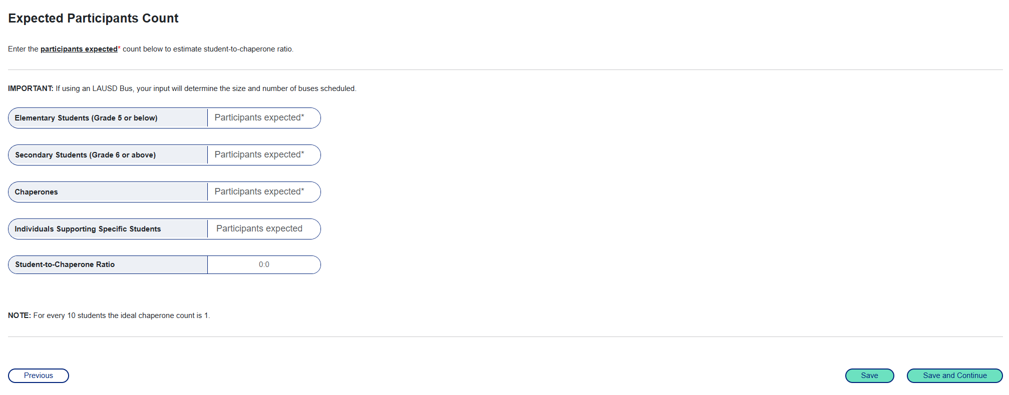
Expected Participant Count
  It is recommended to have a 10:1 Student-to-Chaperone ratio
  Individuals Supporting Specific Students DO NOT count toward the overall Chaperone count

Slide 18
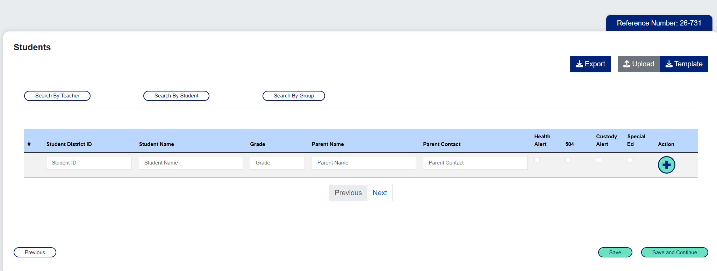
Student Information
NEW VIEW
Option 1: Template Upload Feature
Option 2: Manually entering each student ID
If the Student IDs do not match the school selected or if the file is not formatted correctly, users will receive an error message​

Slide 19
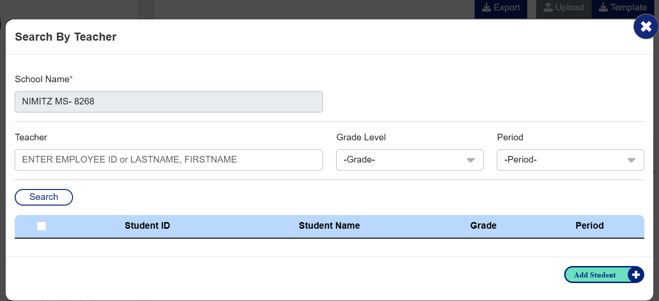
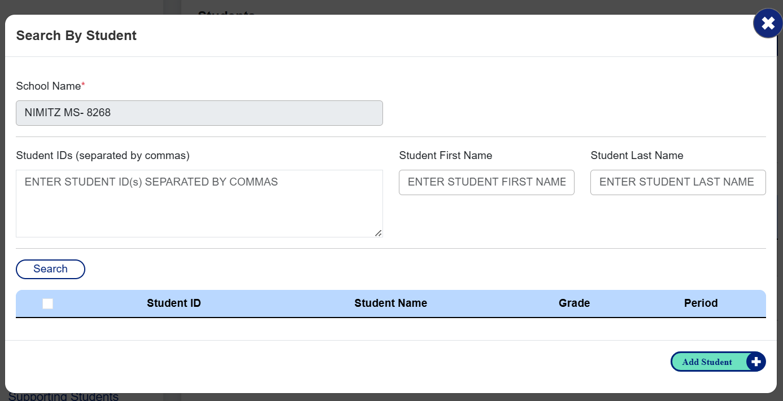
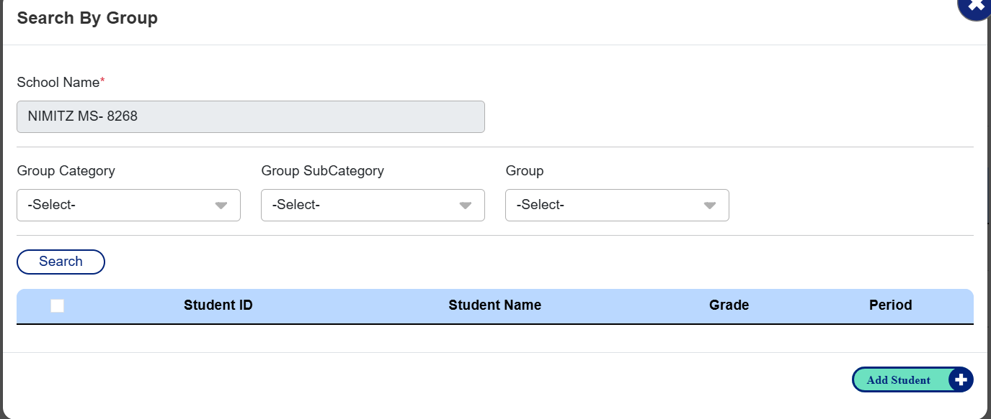
Student Information
NEW VIEW
  Option 3: Using the Search Features – these are pop-up windows when the specific search option is chosen
  If "Search by Teacher" is selected, the system will retrieve data from the selected school:​​
  Type the name of the teacher and wait for teacher names to appear and select the correct teacher​​
  Select the appropriate Grade Level and Period and click "Search"​​
  Check the box next to the correct student's ID, then click the "Add Student" button in the lower right corner of the screen​​
  Click the "X" at the top right corner of the screen​
  If "Search by Student" is selected:​​
  Enter the Student ID, separated by commas, First Name, or Last Name and click "Search"​​
  Check the box next to the correct student's ID, then click the "Add Student" button in the lower right corner of the screen​​
  Click the "X" at the top right corner of the screen​
If "Search by Group" is selected (Group data is provided by schools):​​
  Select Group Category, SubCategory, and Group and click "Search"​​
  Check the box next to the correct student's ID, then click the "Add Student" button in the lower right corner of the screen​​
  Click the "X" at the top right corner of the screen​

Slide 20
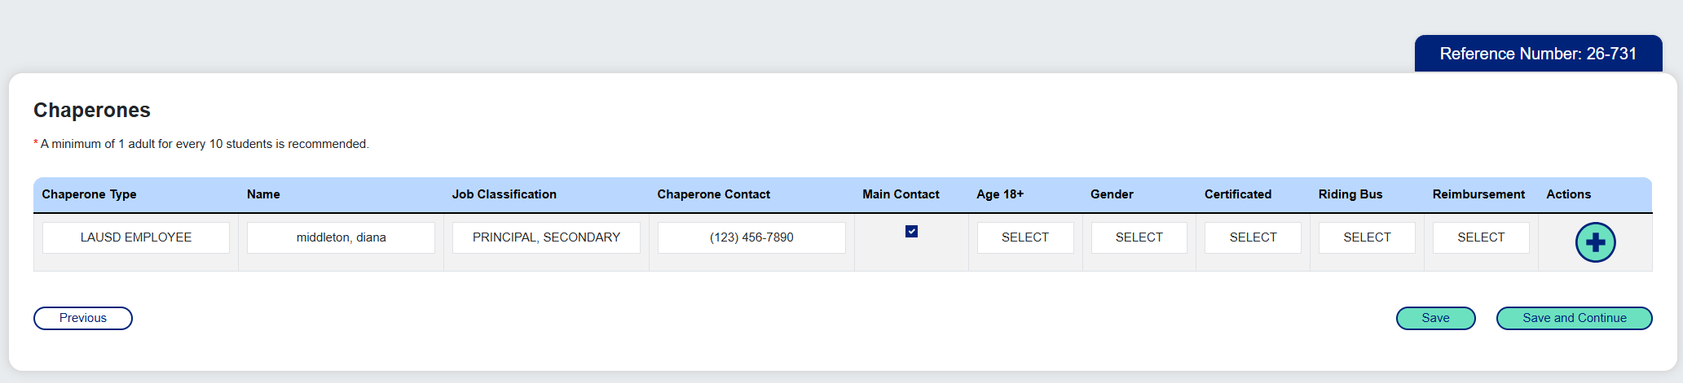
Chaperones
  Ensure all fields are populated when adding new Chaperones:
    Chaperone Type – Dropdown includes:
      LAUSD Employee (will need to enter Employee ID)
      Parent
      Grandparent
      Camp Staff
      Volunteer (Coach)
    Name - Full name
    Job Classification – not required for non-LAUSD staff
    Chaperone Contact – Phone Number
    Age 18+ – Yes or No
    Gender – Male, Female, Other
    Certificated – Yes or No
    Riding Bus – Yes or No
    Reimbursement – Yes or No
Once you add the data and answer the questions, click the "+" Action button to add your chaperone.
To add additional chaperones, a new line will auto appear after you have added the previous chaperone​​
  The user submitting the request will default as the first Chaperone​​

Slide 21
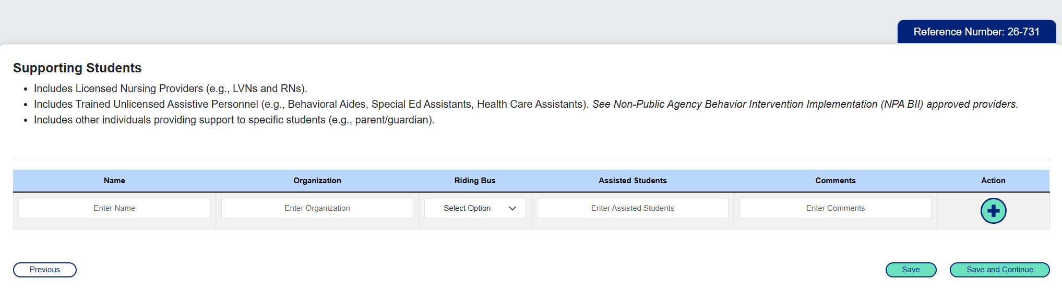
Staff Supporting Students
Once you add the data and answer the questions, click the "+" Action button to add your chaperone.
To add additional staff, a new line will auto appear after you have added the previous supporting staff.
  If there are no staff going to support students, click "Save" to save the form as is, or "Save and Continue" to proceed to the next screen, or "Previous" to go back .

Slide 22
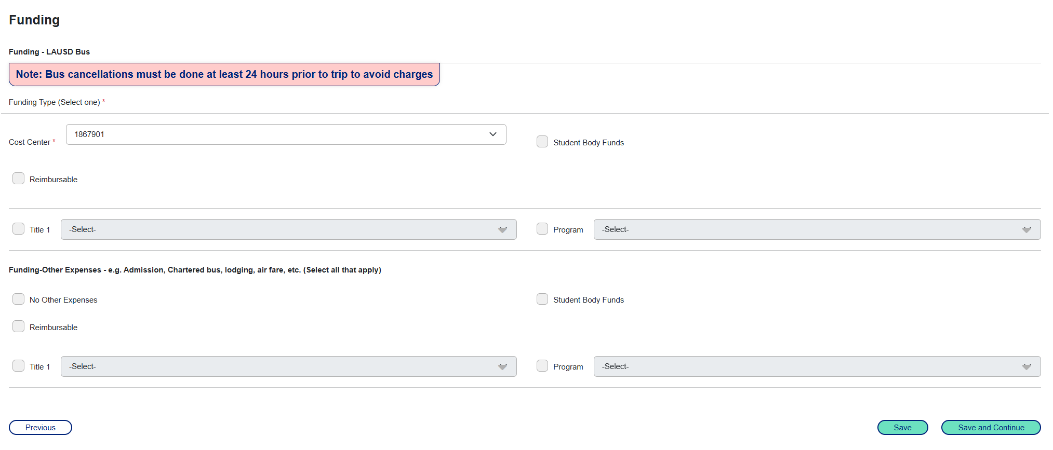
Funding
NEW VIEW
This top section will only appear if “LAUSD bus” is chosen.
This bottom section will appear by itself when "LAUSD bus" is not chosen – so it may be confusing with the wording "other expenses" - ITS is working on updating this screen

Slide 23
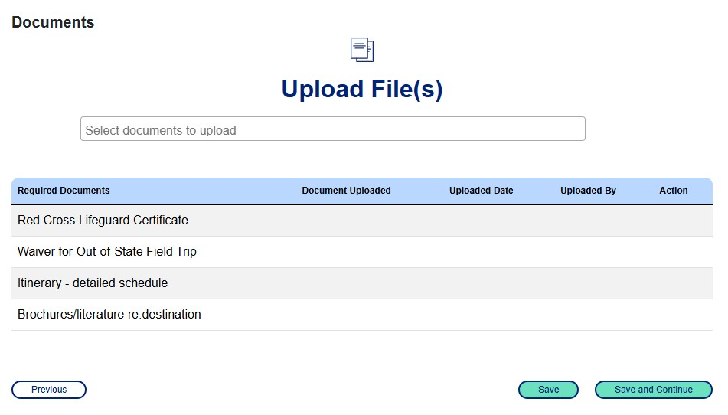
Documentation
  Click on the "Select documents to upload" field under "Upload File(s)"
  Select either "All Documents" or the specific document to be uploaded
  Click on the folder image to the right of the box
  Select the file name, then click "Open" (document will appear in the "Required Documents" list)
  Users can view the document by clicking the View button
  Click "Save" to save the form as is, or "Save and Continue" to proceed to the next screen, or "Previous" to go back

Slide 24
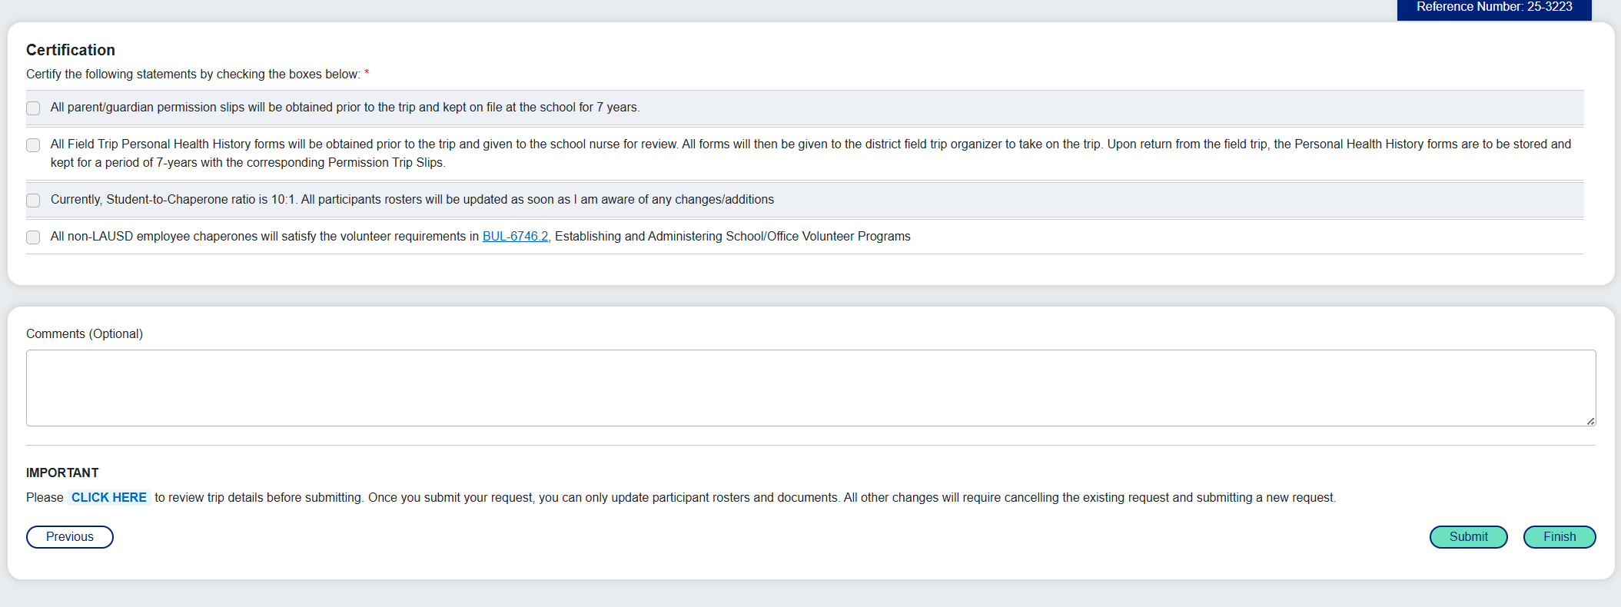
Certification
NEW VIEW
All statements must be certified before proceeding to submit the request​
Users are encouraged to review trip details before submitting ("CLICK HERE" summary link available at bottom of screen)​
Some important things to remember when submitting a field trip request:
There should be a lead time of at least 25-30 days for each field trip request
If all necessary documents are submitted, the approval of a field trip request is expected to take approximately 5-10 business days, though the exact timing depends on the availability of the certifying parties
The principal must be the first approver, then all subsequent approvers (Risk, OEHS, etc.) can certify at the same time, but the final approver will either be the Region or Deputy Superintendent level (depending on type of field trip) and they cannot approve until all others have been submitted
Clicking "Finish" will ONLY SAVE the Trip Request, which will be searchable from the user's Dashboard. Clicking "Submit" will finalize the submission process and begin the approval process. Users will receive a pop-up notification with the Trip Reference Number.

Slide 25
Requesting an Athletic League and Non-League Field Trip

Slide 26
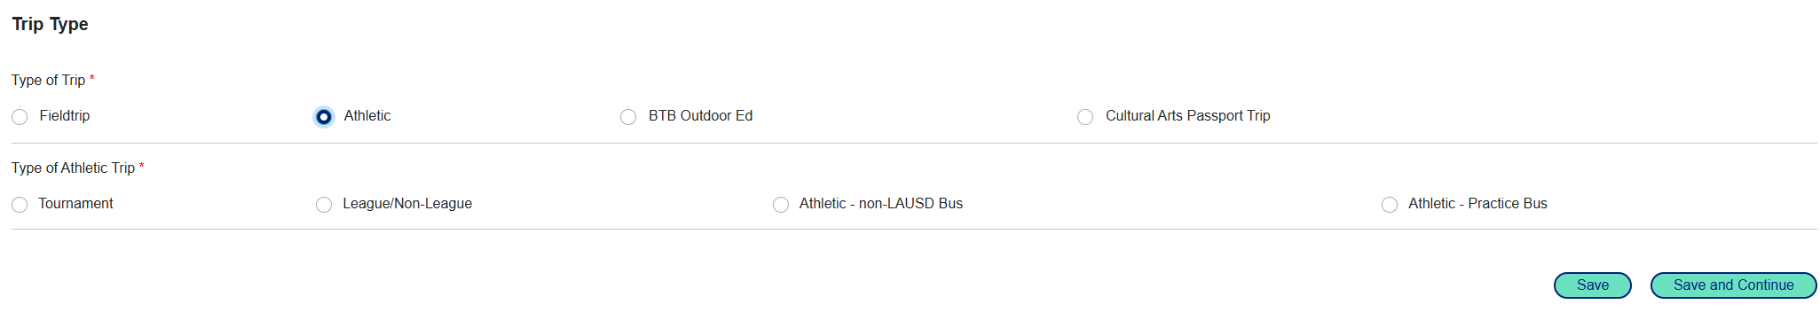
Creating the Request
  From the Field Trip Menu, click on "Create Field Trip"
  Select "Athletic" from the "Type of Trip" section
  See next slides for options for "Type of Athletic Trip"
Please note, that “Athletic non-LAUSD bus” and “Athletic-Practice bus” are special options for the Athletic teams for use in special circumstances, such as the use of a charter bus or for schools with limited or no practice facilities on site. More information on those options can be discussed directly with the Athletics team.

Slide 27
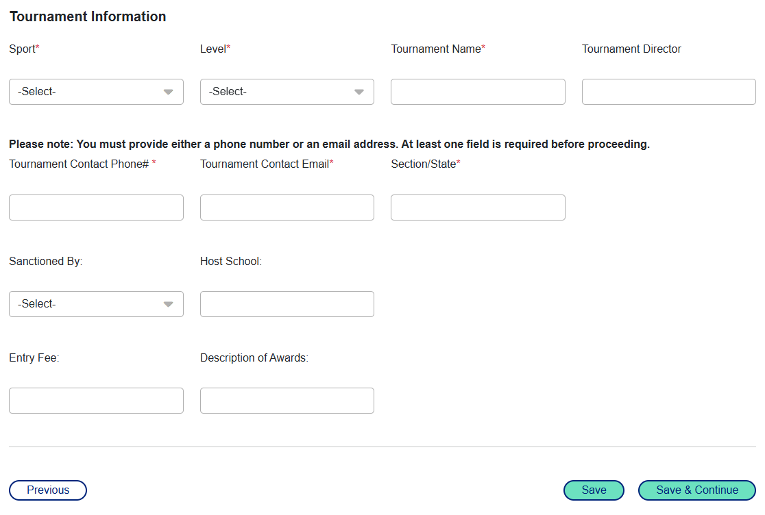
Tournament Trips
  If "Tournament" is selected, users will be required to choose the type of Tournament: "Local/CIF State Playoffs" or "Non-local (75+ miles)/ Overnight" before proceeding to the "Special Activities" section
  After the "Special Activities" section, users will be required to enter the following Tournament information before proceeding to the "Contact Information" section:
      Sport, Level
      Tournament Name
      Tournament Director
      Contact Phone & Email
      Section/State
      Sanctioned By
      Host School
      Entry Fee
      Description of Awards

Slide 28
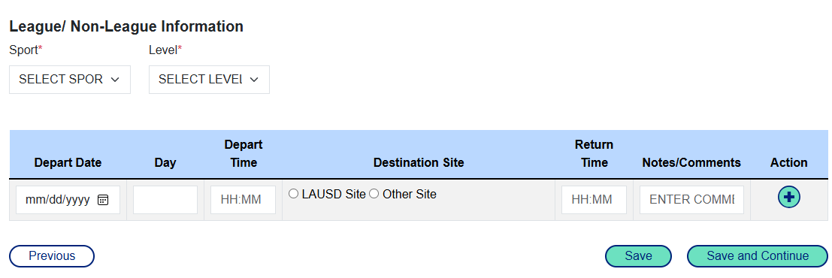
League / Non-League Trips
  If "League/Non-League" is selected, users will be required to enter the following League/Non-League Information:
    Sport, Level, Departure Date & Time, Destination Site, Return Time, and any Notes/Comments (users must click the "+" Action button before proceeding to the "Contact Information" section)

Slide 29
Modifying, Editing, and Cloning a Field Trip Request

Slide 30
Modifying, Editing, and Cloning a Field Trip Request
  Main difference between Modifying, Editing, and Cloning (please note that approvers cannot modify or edit trip requests)
    Edit – Can only be used if the request has not been certified or approved
      Example: You realize that you forgot to add a student, and you notice no one has certified or approved the request. You must use the "edit" button to update the request, add the student, and re-submit.
    Modify – Can only be used on these conditions (because some approvals might need to be resubmitted):
      If the Principal is among the approvers, approved by at least one approver other than Principal and status is “Pending Approval”
      If the Principal is not an approver (for example an athletic trip), approved by one approver and status is “Pending Approval”
      Example: You realize that you forgot to add a student, and you notice the Principal and Risk Management have already approved. You must use the "modify" button to update the request, add the student, and re-submit.
    Cloning – Can only be used to copy the field trip request (users can update fields by using the Editing feature) – this feature should not be used to update fields of a current field trip – as it requires all new approvals.
        Example: You take your class to the aquarium at the beginning of the year and then to the zoo at the end of the year. Everything will mostly stay the same, so you clone the trip and update only the changed fields (location, dates/times, etc.). Then you submit the cloned field as a new field trip request.

Slide 31
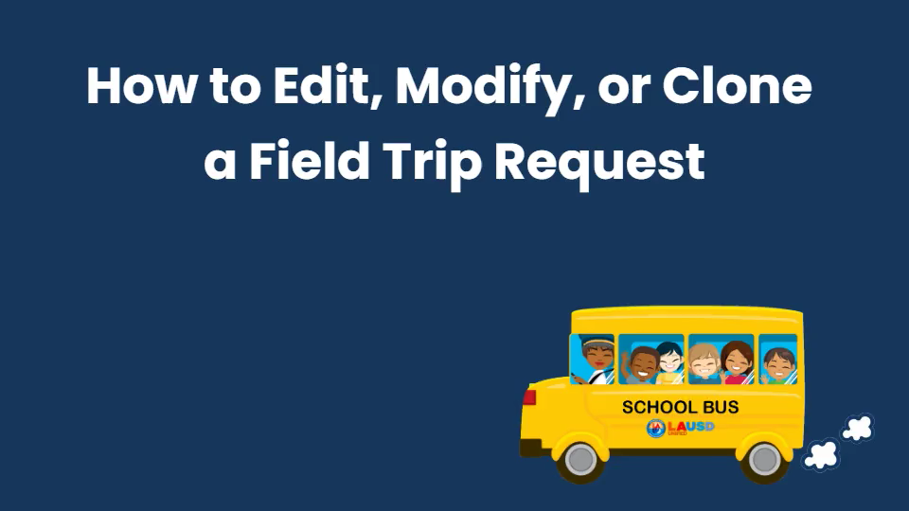
Modifying, Editing, and Cloning a Field Trip Request

Slide 32
Canceling or Deleting a Field Trip Request

Slide 33
Canceling or Deleting a Field Trip Request
  Trips that are currently awaiting approval may be deleted at any time
  However, once the first approver has certified a trip, it can no longer be deleted
  At that point, the only option is to cancel the trip, which is important for maintaining accurate records on the dashboard
  This process ensures that all trip activities are appropriately tracked and accounted for in the system

Slide 34
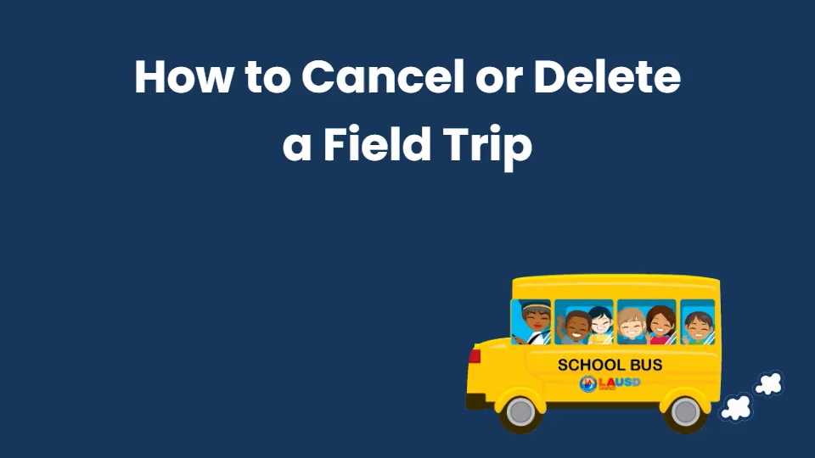
Canceling or Deleting a Field Trip Request

Slide 35
Reference Materials

Slide 36
Reference Materials
  For more information about the Field Trip application, the following information is available in the Resources section of the Fieldtrip System website: Field Trips – Risk Finance – Risk Finance and Insurance Services
  User Guides for:​
How to Log-In and Navigate the Dashboard, Reports, and Trip History
    How to Request a Non-Athletic Field Trip
    How to Request an Athletic Field Trip
    How to Edit, Modify, or Clone a Field Trip Request
    How to Certify and Approve a Field Trip Request
    How to Cancel or Delete a Field Trip Request
    Field Trip Guide for Principals
  Frequently Asked Questions
  Reference Guide (Contact information)
  Video Guides for:
    Field Trip Application
      Overview
      As an Approver
      As a Requestor
How to Edit, Modify or Clone a Field Trip
    How to Cancel or Delete a Field Trip

Slide 37
Live Demonstration

Slide 38
Live Demonstration of Entering Field Trip
  Home page - FieldTrip.Web

Slide 39
Questions

