Slide 1

Field Trip Application - Version 2.0
Webinar for Approvers
Presenter Names:
Dr. Karen Mercado, Senior Director, Office of the Deputy Superintendent, Instruction
Patricia Chambers, Senior Director, Office of the Deputy Superintendent, Business Services and Operations
Diana Middleton, Project Manager, ITS Enterprise Applications

Slide 2

Agenda
Launch Details & Overview of Version 2.0 Enhancements
Logging in / Dashboard
Certifying and Approving Requests
Reporting
Live Demo
Reference Materials
Questions

Slide 3
Launch Details & Overview of Enhancements

Slide 4
Launch Details
  Version 2.0 released April 11, 2025 (soft launch), but what does that mean?
    Field Trip requests for the current 2024-25 school year (including summer 2025) should be entered on the current platform - https://ifieldtrip.lausd.net
    Field Trip requests for the 2025-26 school year (i.e., trips after August 1, 2025) should be entered on the new 2.0 platform - https://fieldtrip.lausd.net (dropped the "i" in front of "fieldtrip")
  Training materials, such as user guides, training videos and FAQs are available on the Field Trip Resources website: https://riskfinance.lausd.org/apps/pages/index.jsp?uREC_ID=4417428&type=d&pREC_ID=2650488
  These webinars will also be recorded and added to the Field Trip Resources page

Slide 5
Overview of Version 2.0 Enhancements
  Streamlined navigation & approval flow
  Ability to make trip modifications
  Summary screen approvals for multiple departments
  Additional notifications and alerts
  Improved Dashboard
  Filtered Reporting
  Interfaces with multiple departments
  System optimizations, technology upgrades, including migration to the Cloud
Notes:
First, I want to review at a high-level some of the major changes incorporated into version 2 of the Field Trip application:
Streamlined workflow (before there were hidden tabs to enter values, now it is a sequential workflow with capability to upload documents)
Modifications (newly introduced feature--once the request is uploaded by one of the departments, the requestor can now modify a submitted request)
Summary screen approval (before users had to review screen by screen, now reviewers can go directly to the summary screen)
Notifications and alerts to be sent to approvers (included more reminders for a faster approval process)
Approval flow and business rules (before approval flow was sequential, now once the Principal approves, subsequent approvers can approve simultaneously)
Dashboard (before all the data was in one page, now users can separate into current / past trips – this also improves performance and load times)
Reporting (before users had to export a file, now the feature is online with filters and queries around specific roles)
Interfaces with multiple departments (one interface is bus ops already integrated & parent portal will be part of V3)
Backend changes (this includes migration to the cloud and will improve performance and storage capabilities)
Also, please note that Graduation and awards used to be part of old system, but it is now treated as a separate module and no longer part of field trip

Slide 6
Logging in / Dashboard

Slide 7
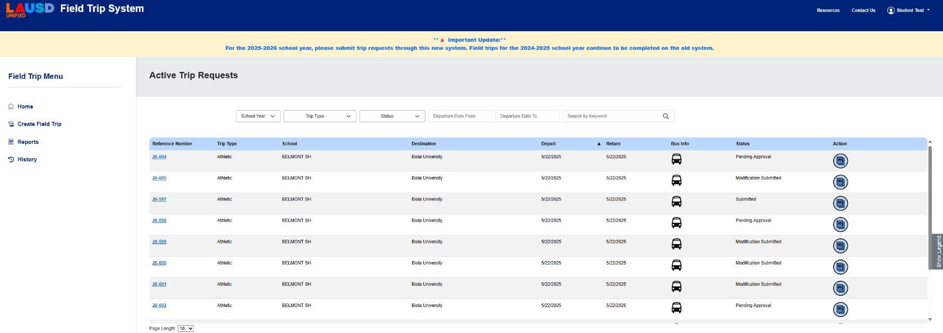
Logging in / New Dashboard
NEW VIEW
  URL for new system https://fieldtrip.lausd.net (dropped the "i" in front of "fieldtrip")
  Users can sort by reference number, trip type, school, destination, departure / return dates, or by status
  Users can also sort by school year, trip type, and status or search for a request by keyword

Slide 8
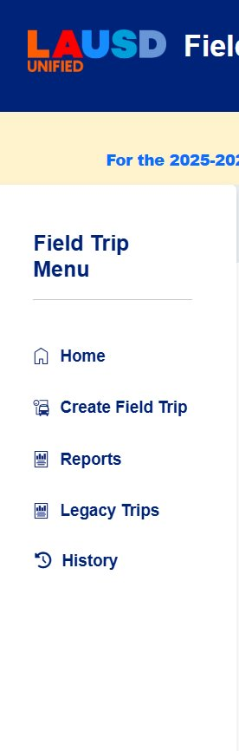
Logging in / New Dashboard
NEW VIEW
  On the left-side of the Dashboard, users can select one of the following options from the Field Trip Menu:
    Home - Go home back to the main Dashboard page where all active and upcoming field trips are displayed
    Create Field Trip
    Reports
    Legacy Trips - These are trips that originated from the previous (legacy) system before the current platform was implemented (only users with the AdminRM role have permission to view Legacy Trips)
    History – These are trips that have already passed their departure date, they are considered completed or no longer active

Slide 9
Certifying and Approving Requests

Slide 10
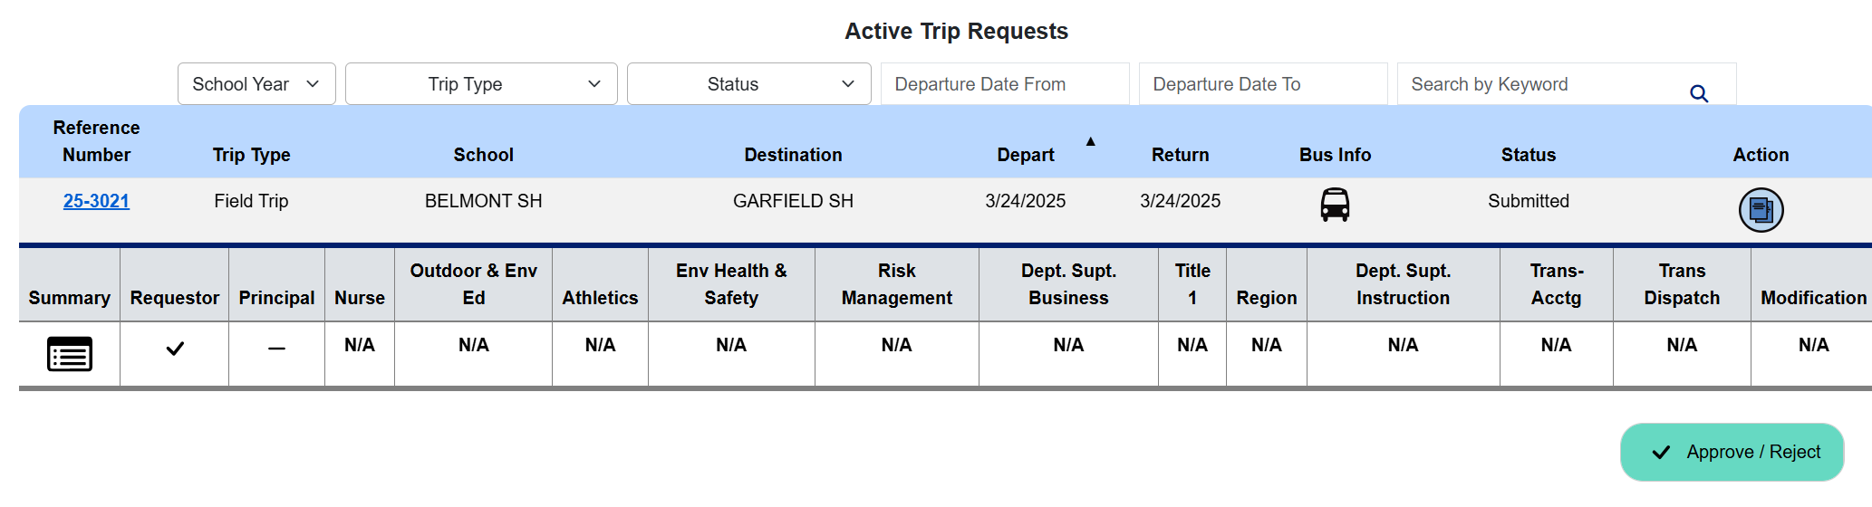
Principal Certification
NEW VIEW
To certify, click the reference number for any request with the status of "Pending Approval" or "Modification Submitted"
To certify, click the reference number for any request with the status of "Pending Approval" or "Modification Submitted"​
Once the reference number is selected, details of the trip will be expanded​
  Click the "Summary" button on the far left to view the field trip request details.
  Click the "Approve / Reject" button on the far right to view the field trip request details, review the Principal certification statements, and/or Approve, Reject, or request further information on the request.

Slide 11
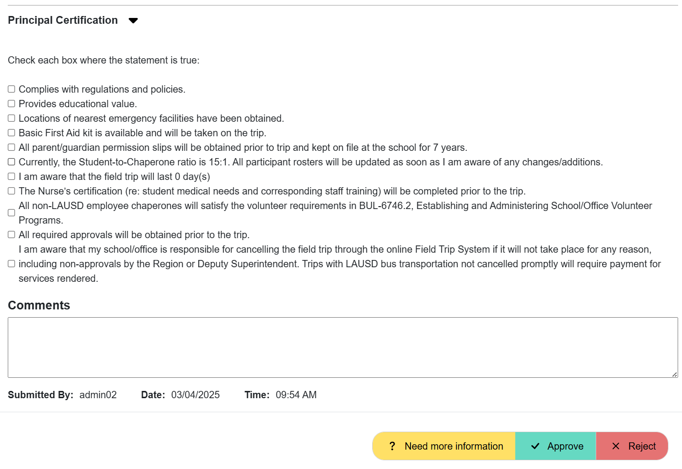
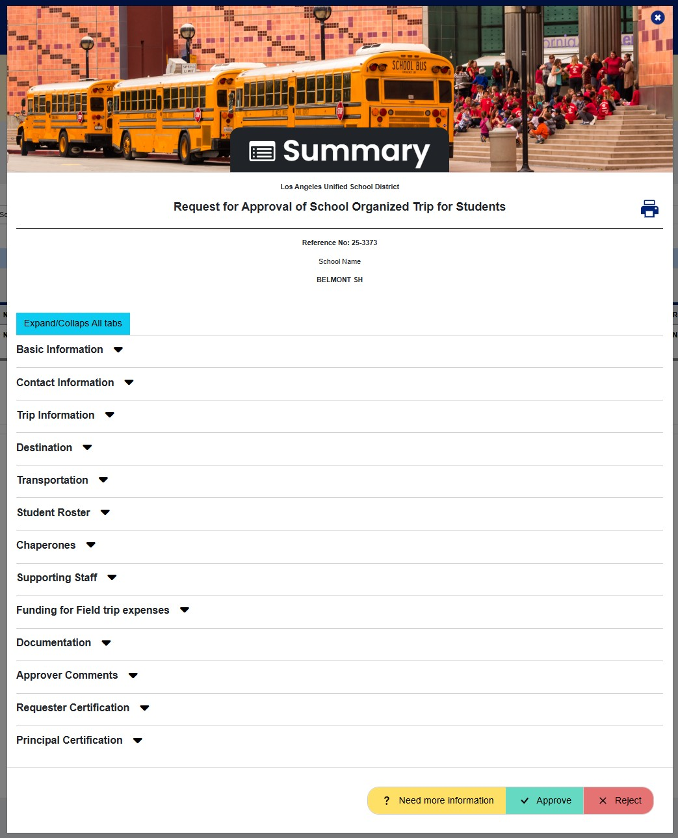
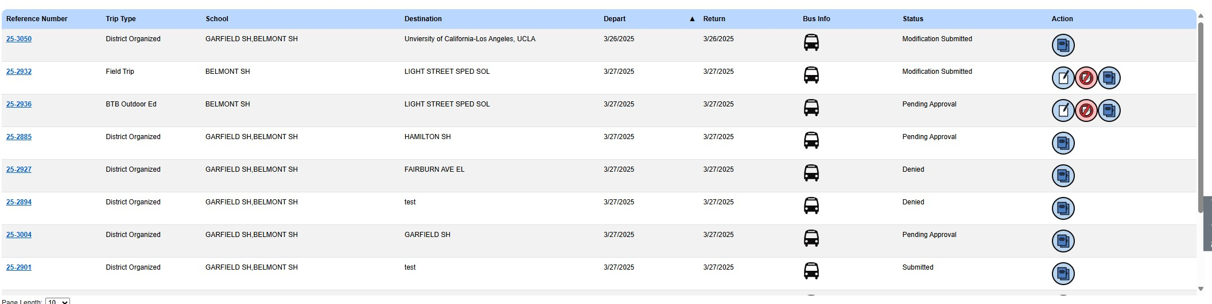
Principal Certification
The certifying Principal will have three options to choose from
Once approved, the request will show as "Pending Approval" until the remaining certifications/approvals are completed. ​But in the summary details, the principal column will have a check mark.
Once the summary screen pops up, the Principal will need to scroll down to the "Principal Certification" section

Slide 12
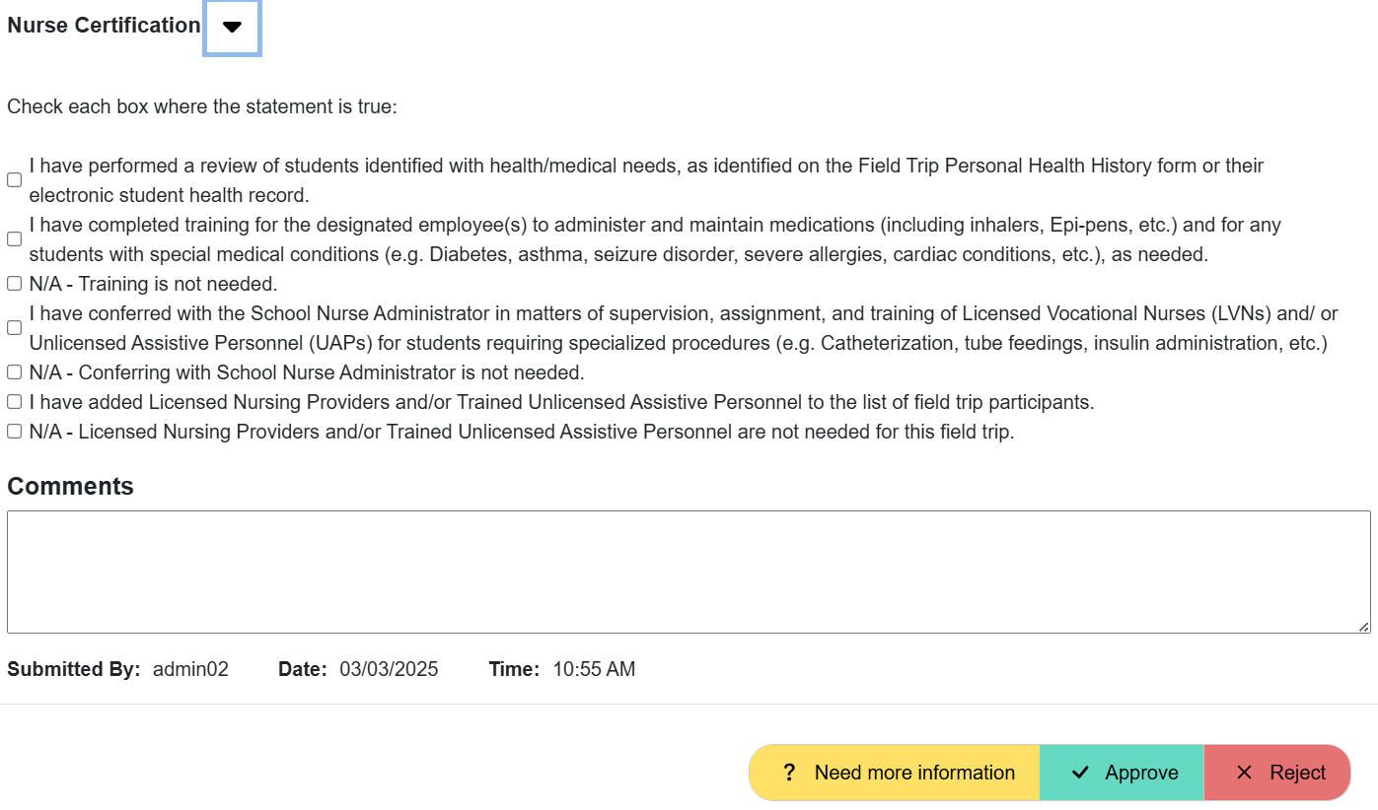
Nurse Certification
Following the same process as noted for Principals, Nurses can click the "Summary" button on the far left to view the field trip request details or click the "Approve / Reject" button on the far right to view the field trip request details, review the Nurse certification statements, and/or Approve, Reject, or request further information on the request.
Once the summary screen pops up, the Nurse will need to scroll down to the "Nurse Certification" section to check each statement is true before certifying the request.

Slide 13
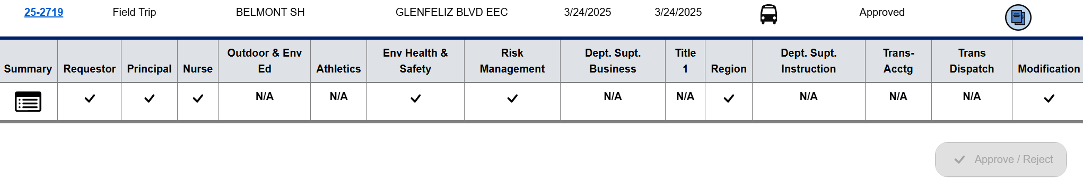
Office Certification
  Offices that are required to certify depend on the characteristics of the field trip request:
        Office of Outdoor & Environmental Education (OOEE)
        Interscholastic Athletics
        Environmental Health & Safety (OEHS)
        Division of Risk Management & Insurance Services
        Student Integration
        Title 1
        Region
        Transportation Services Division
  Users can see which offices require certification by clicking on the field trip reference number

Slide 14
General Approval Flow
NEW VIEW
REQUESTOR
Requestor submits field trip request
SCHOOL
Principal certifies the request first before any other group can
OFFICES & NURSE
Offices and Nurse can certify in any order after the Principal certifies
APPROVAL
Request is approved
Some important things to remember about field trip requests:
There should be a lead time of at least 25-30 days for each field trip request
If all necessary documents are submitted, the approval of a field trip request is expected to take approximately 5-10 business days, though the exact timing depends on the availability of the certifying parties
The principal must be the first approver, then all subsequent approvers (Risk, OEHS, etc.) can certify at the same time, but the final approver will either be the Region or Deputy Superintendent level (depending on type of field trip) and they cannot approve until all others have been submitted
If a request is modified, it may have to go through certain certifications/approvals again depending on which type of information was modified

Slide 15
Reports

Slide 16
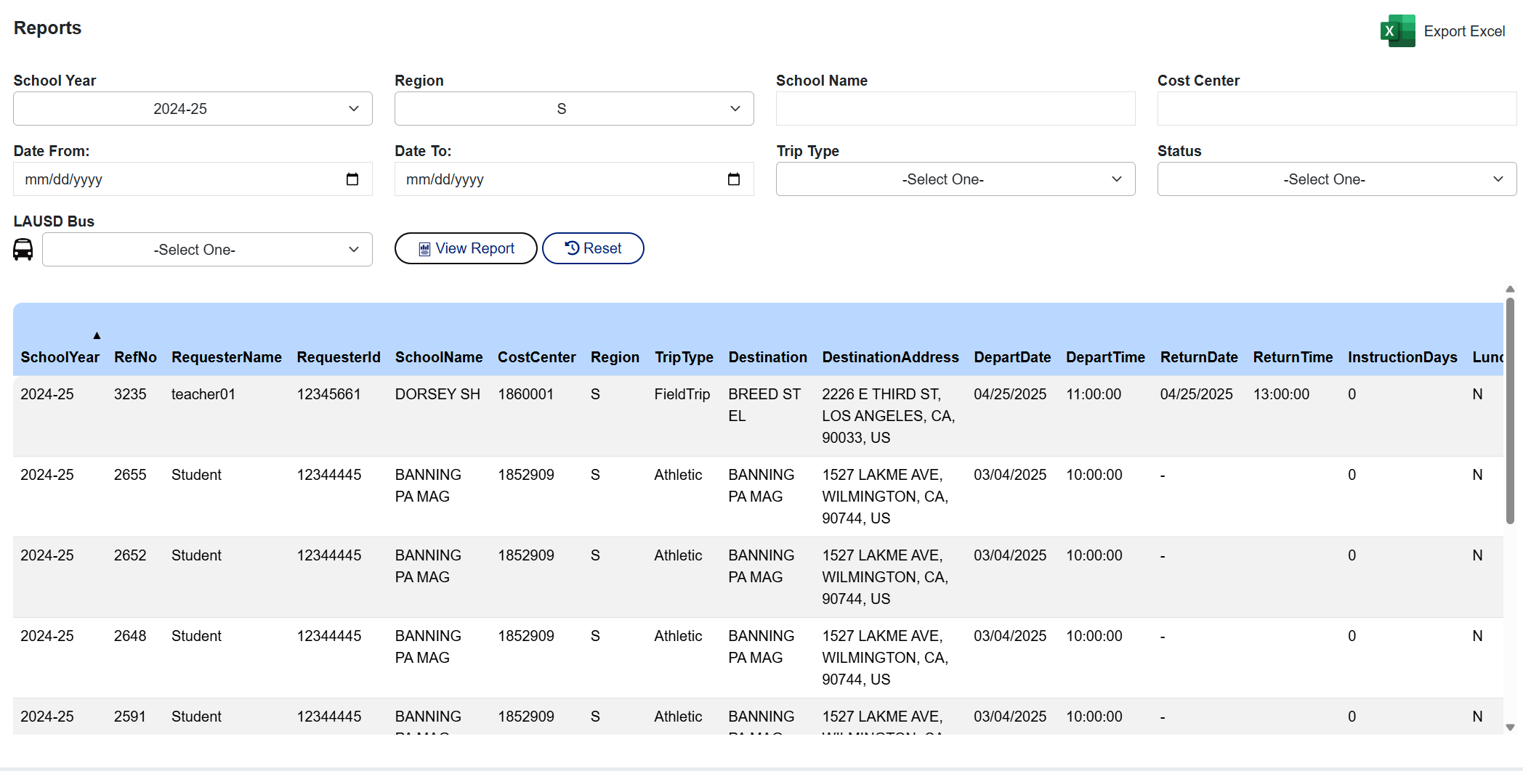
Reports
NEW VIEW
  Users can generate reports based on selected criteria.
  In the example noted here, I'm logged in as a Principal and I queried all field trips that have been submitted for the 2024-25 school year in the South region.
  Results will be displayed once "View Report" is selected or can be exported into an Excel file

Slide 17
Live Demonstration

Slide 18
Live Demonstration of Approving a Field Trip
  https://fieldtrip.lausd.net

Slide 19
Reference Materials

Slide 20
Reference Materials
  For more information about the Field Trip application, the following information is available in the Resources section of the Fieldtrip System website: Field Trips – Risk Finance – Risk Finance and Insurance Services
  User Guides for:​
How to Log-In and Navigate the Dashboard, Reports, and Trip History
    How to Request a Non-Athletic Field Trip
    How to Request an Athletic Field Trip
    How to Edit, Modify, or Clone a Field Trip Request
    How to Certify and Approve a Field Trip Request
    How to Cancel or Delete a Field Trip Request
    Field Trip Guide for Principals
  Frequently Asked Questions
  Reference Guide (Contact information)
  Video Guides for:
    Field Trip Application
      Overview
      As an Approver
      As a Requestor
How to Edit, Modify or Clone a Field Trip
    How to Cancel or Delete a Field Trip

Slide 21
Questions

