Slide 1

SUPPER PROGRAM FOR FOOD SERVICES STAFF
Notes:
PLACEHOLDER

Slide 2
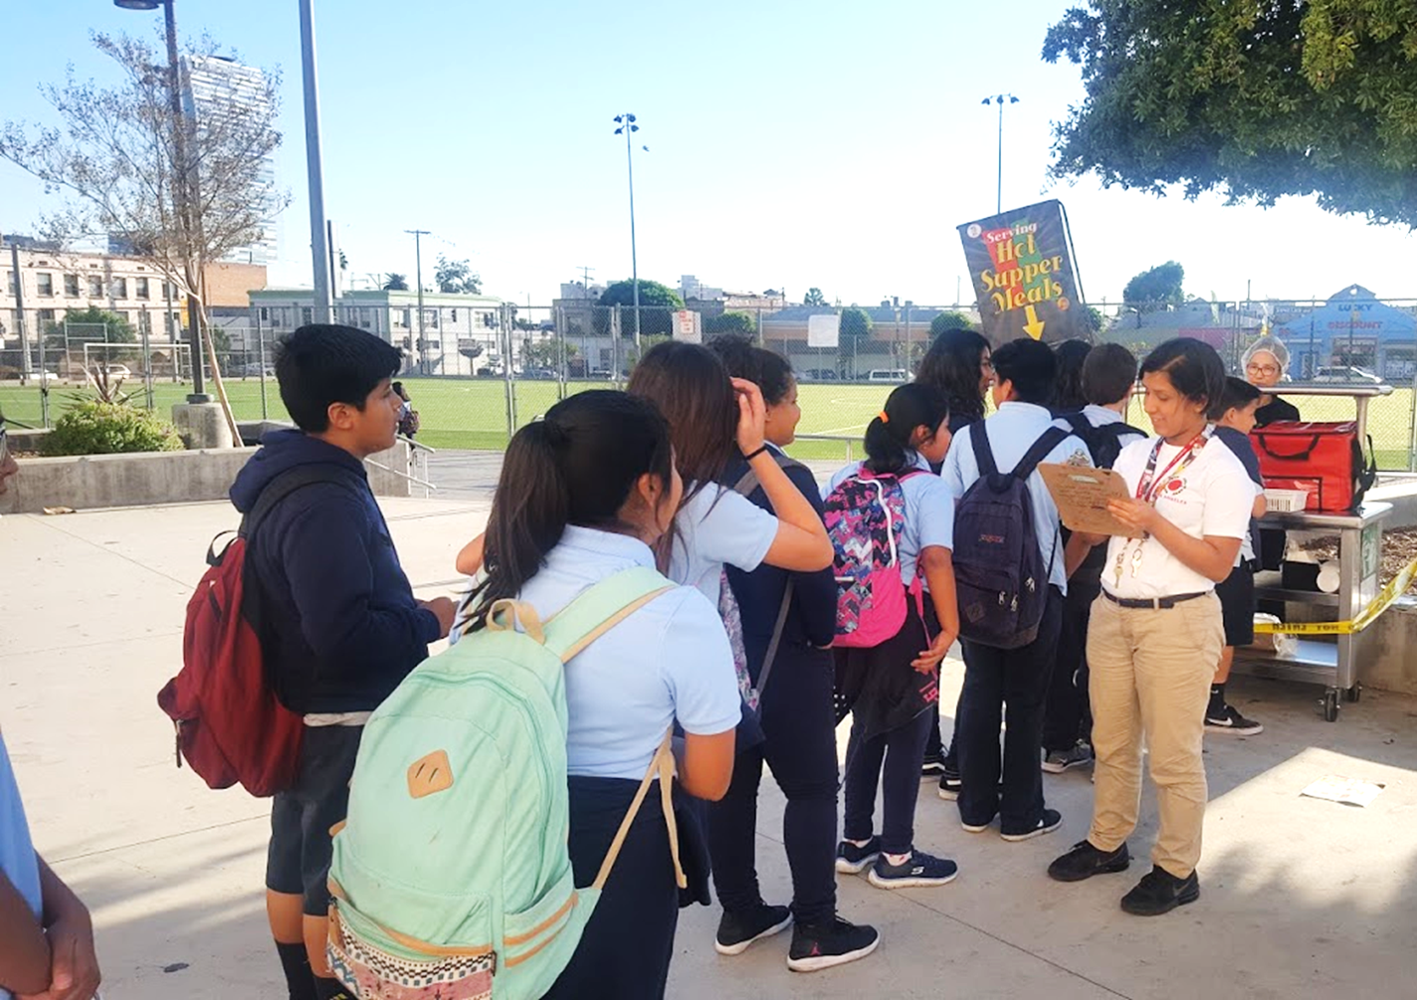
Objective
The goal of the Food Services Division is to provide access to nutritious supper meals to as many students and community participants of eligible schools with afterschool programs.
Notes:
TELL: The goal of the Food Services Division is to provide access to nutritious hot supper meals to as many students and community participants of eligible schools with afterschool programs.

Slide 3
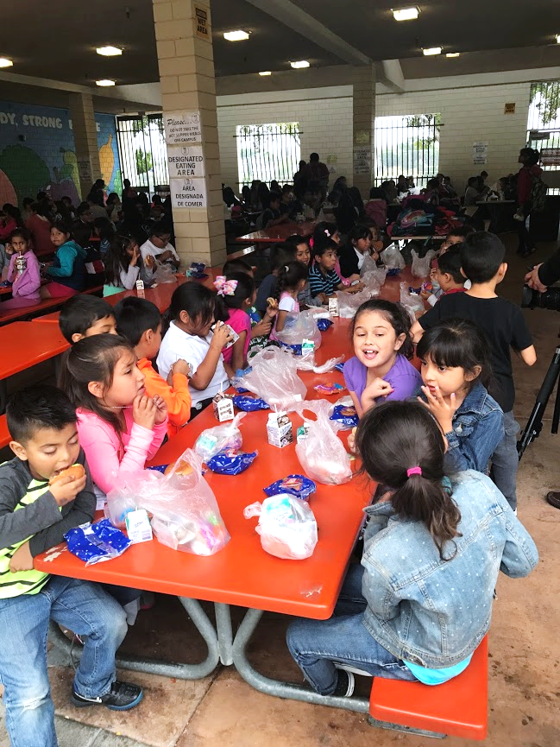
Supper Program Eligibility
There must be an enrichment program on site to offer the Supper Program.
Schools must be greater than 50% eligible
Community children under the age of 18 are eligible
Adults over 18 with disabilities may participate
Notes:
TELL: Participants ages 18 and under are eligible for a free supper meal after school. Participants do not have to be enrolled in an after school program or participate in any offered activities. Disabled individuals of any age may participate.

Slide 4
Annual Training
FSD is required to provide annual CACFP supper training to all Food Services (FS) and After School Program (ASP) staff before the start of every school year, new program, Saturday program, and to new employees.
Notes:
TELL: FSD is required to provide annual CACFP supper training to all Food Services (FS) and After School Program (ASP) staff before the start of every school year, implementation of a new program, and to new employees.

Slide 5
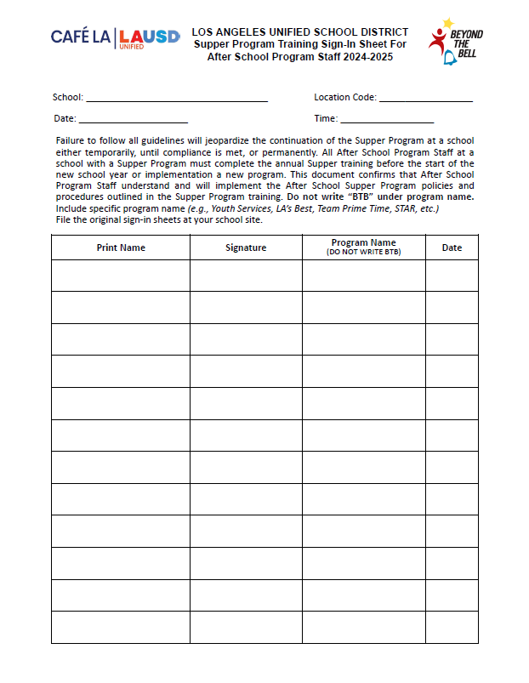
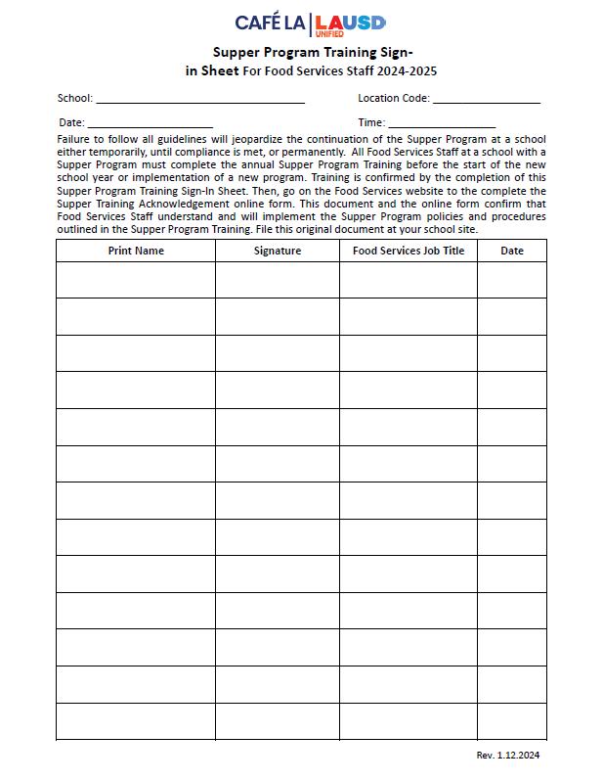
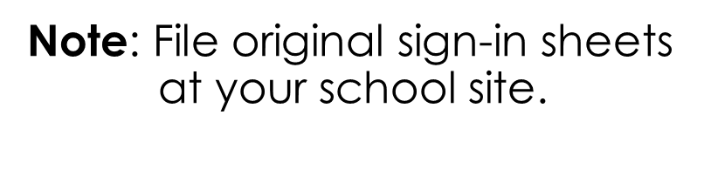
Training Verification Forms
Supper Program Training Sign-In Sheets:
1. FS Staff Form
2. ASP Staff Form
Notes:
TELL: This year, the training verification forms have been customized to a single page, one specifically for FSD and another ASP staff.

Slide 6
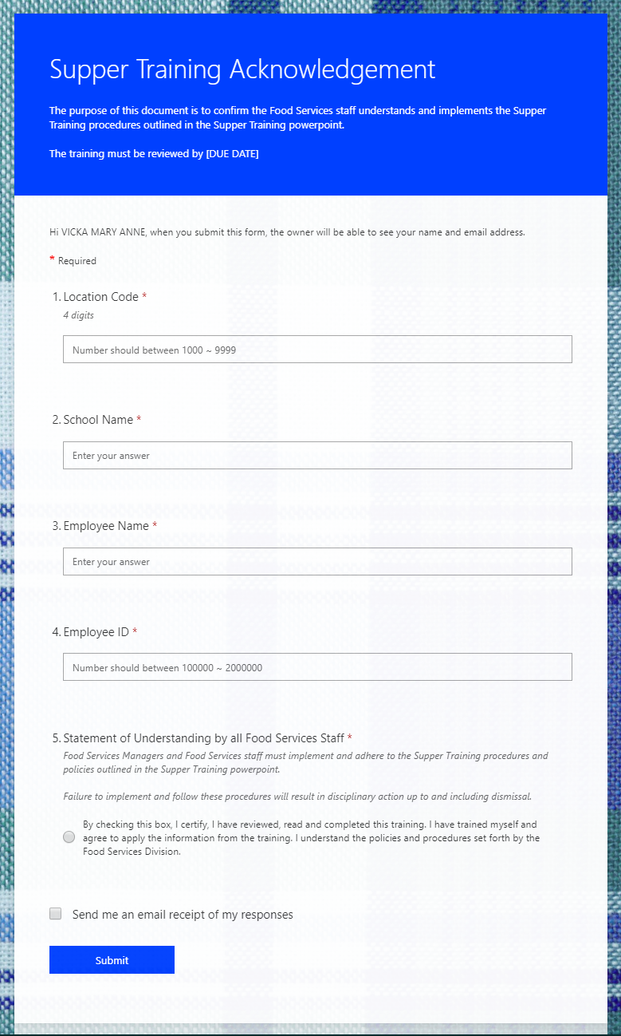
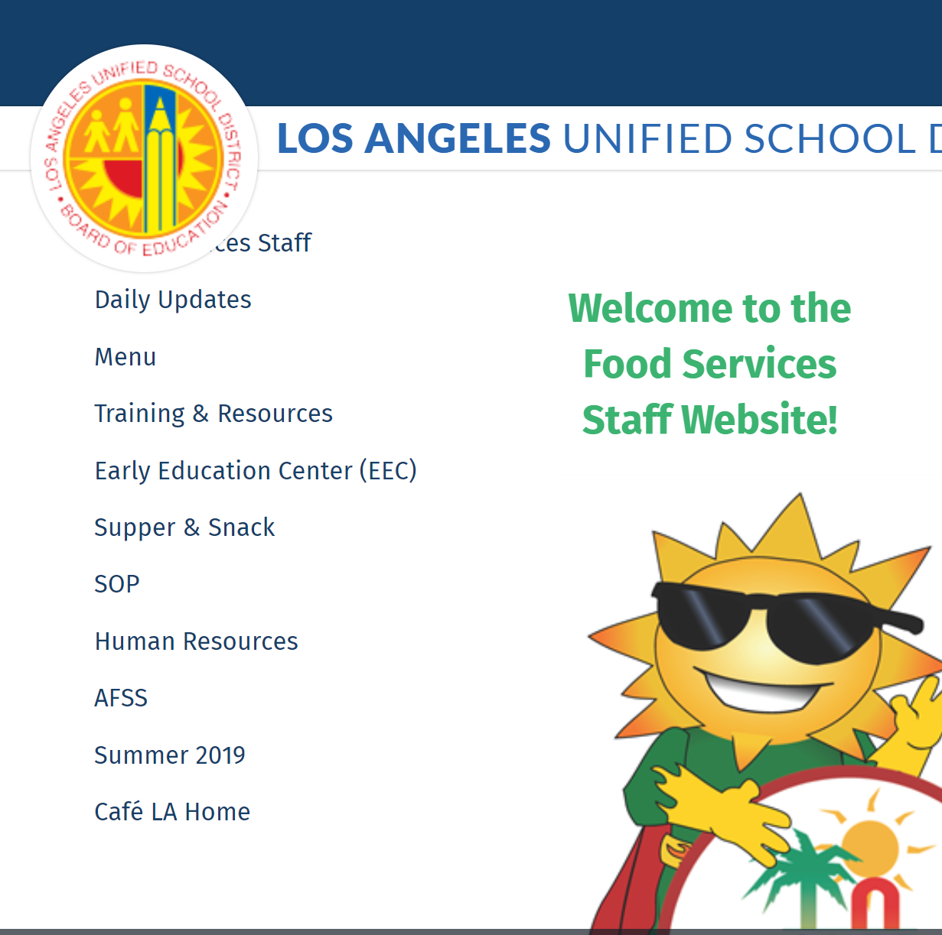

Training Acknowledgement
All trained FS Staff must complete the Supper Training Acknowledgement online form to verify completion of annual training.
One online form per employee
Online form is located on the Supper page on the FS website
Note: Due August 23, 2024
Notes:
TELL: All trained FS Staff must complete the Supper Training Acknowledgement online form to verify completion of annual training. Complete one online form per employee. The Supper Training Acknowledgement online form is located on the Supper page on the FS website. Completion of training acknowledgements are due September 5th, 2019.

Slide 7
For ASP Staff Only
Supper Program Training Sign-In Sheets:
1. FS Staff Form
2. ASP Staff Form
1st day of school is August 12th
Note: File original sign-in sheets at your school site and give a copy to ASP staff for their records.
Do not write BTB
Notes:
TELL: This is the Supper Program Training Sign-In Sheet for ASP staff. All ASP staff must be trained prior to working the Hot Supper Program. Ensure that the specific program name is listed in the program name column. Then, file original sign-in sheets at your school site and give a copy to ASP staff for their records.

Slide 8
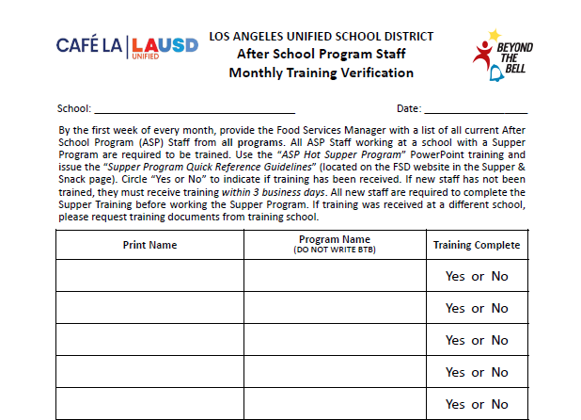
ASP Staff Training Verification
Due to regular ASP staff turnover, complete the ASP Staff Monthly Training Verification.
Compare names with Supper Program Training Sign-In Sheets
Identify staff in need of training
Provide training for new staff
Happy Elementary
10/18/2024
John Miller
Youth Services
Elizabeth Lee
LA’s Best
George Wilson
LA’s Best
Ann Davis
STAR
Michelle Susette
Boys & Girls Club
Do not write BTB
Note: All staff must be trained prior to working in the supper program.
Notes:
TELL: Due to regular ASP staff turnover, complete the ASP Staff Monthly Training Verification. Upon collection, compare names with Supper Program Training Sign-In Sheets. Next, identify any staff in need of training, then provide training for new staff. Please note that all staff must be trained prior to working in the Hot Supper program.

Slide 9
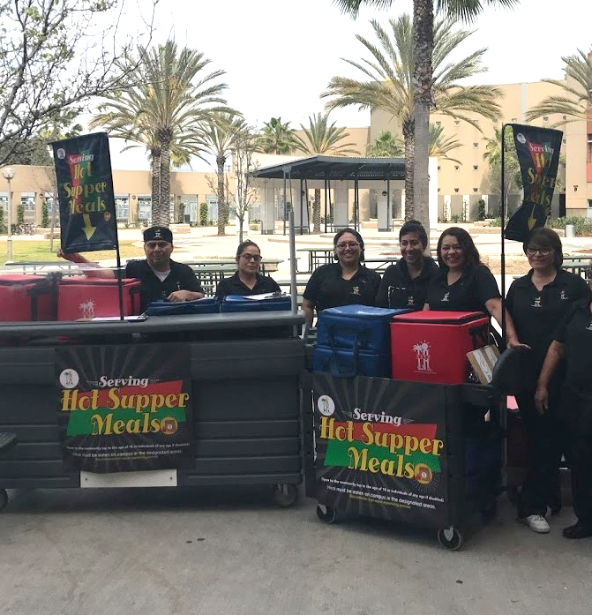
Civil Rights Requirements
All operating sites are required to ensure:
Equal treatment for all participants
Good customer service to decrease complaints
Illegal barriers that prevent participants from receiving benefits are eliminated
“And Justice for All” poster is displayed where the general public can see and read it
General public is informed of program availability
Provide information in the appropriate language
Notes:
TELL: Let’s review the Civil Rights Requirements. All operating sites are required to ensure: equal treatment for all participants, good customer service to decrease complaints, illegal barriers that prevent participants from receiving benefits are eliminated, “And Justice For All” poster is displayed where the general public can see and read it, and that the general public is informed of program availability, if necessary, provide information in the appropriate language.

Slide 10

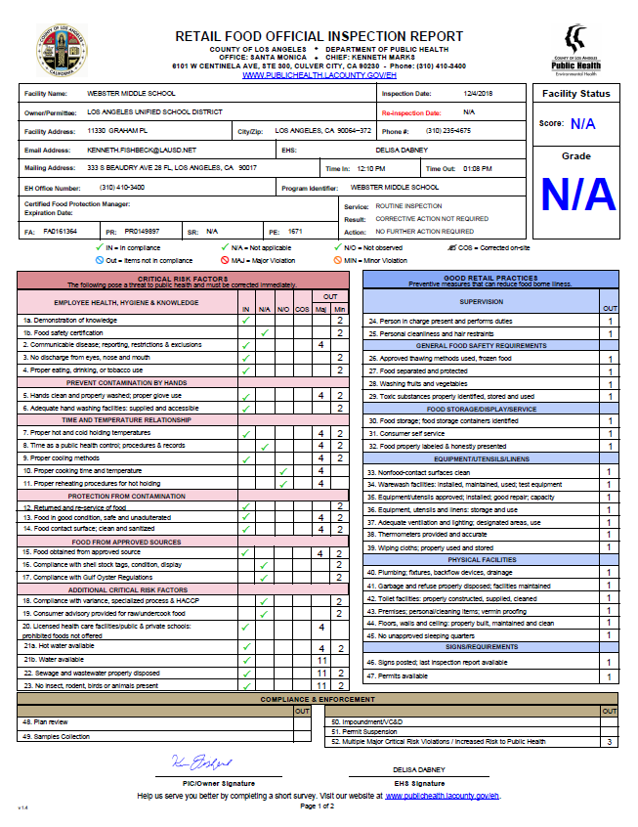
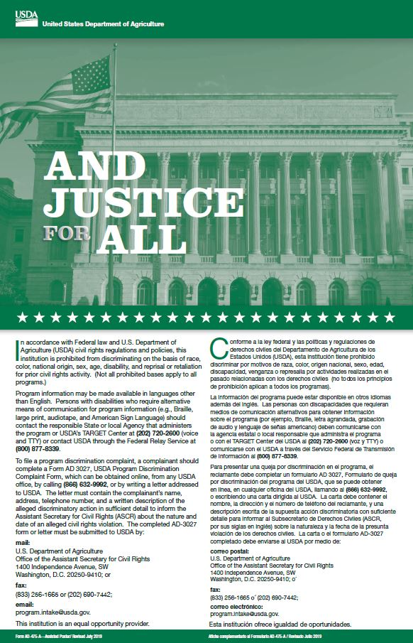
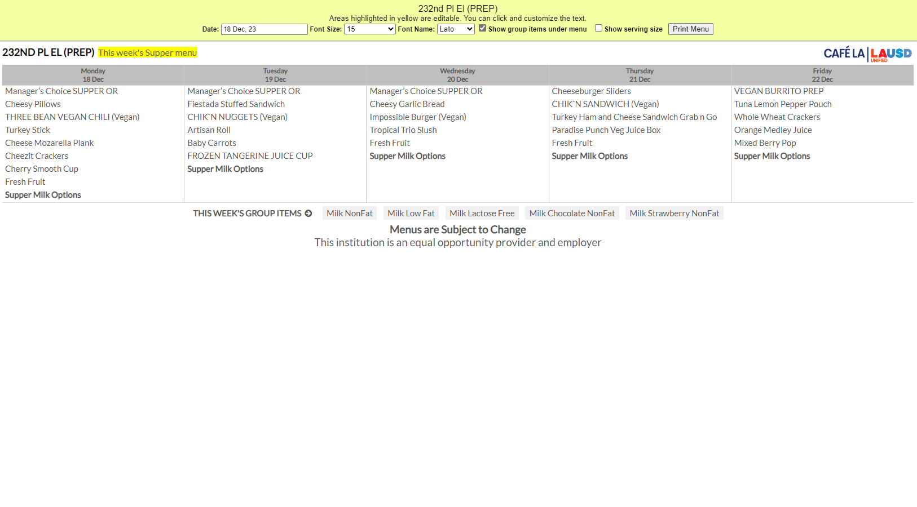
Mandatory Postings
Offer vs Serve Supper Guide
Health Inspection Report
And Justice for All
(11” x17”)
Post all 4 at every service area visible to public view.
Supper Menu
Notes:
TELL: Here are the four required postings for the Hot Supper Program. The Offer vs Serve Supper Guide, the Supper Menu, the Health Inspection Report, and the And Justice for All poster. All three must be posted at every service area visible to public view.

Slide 11
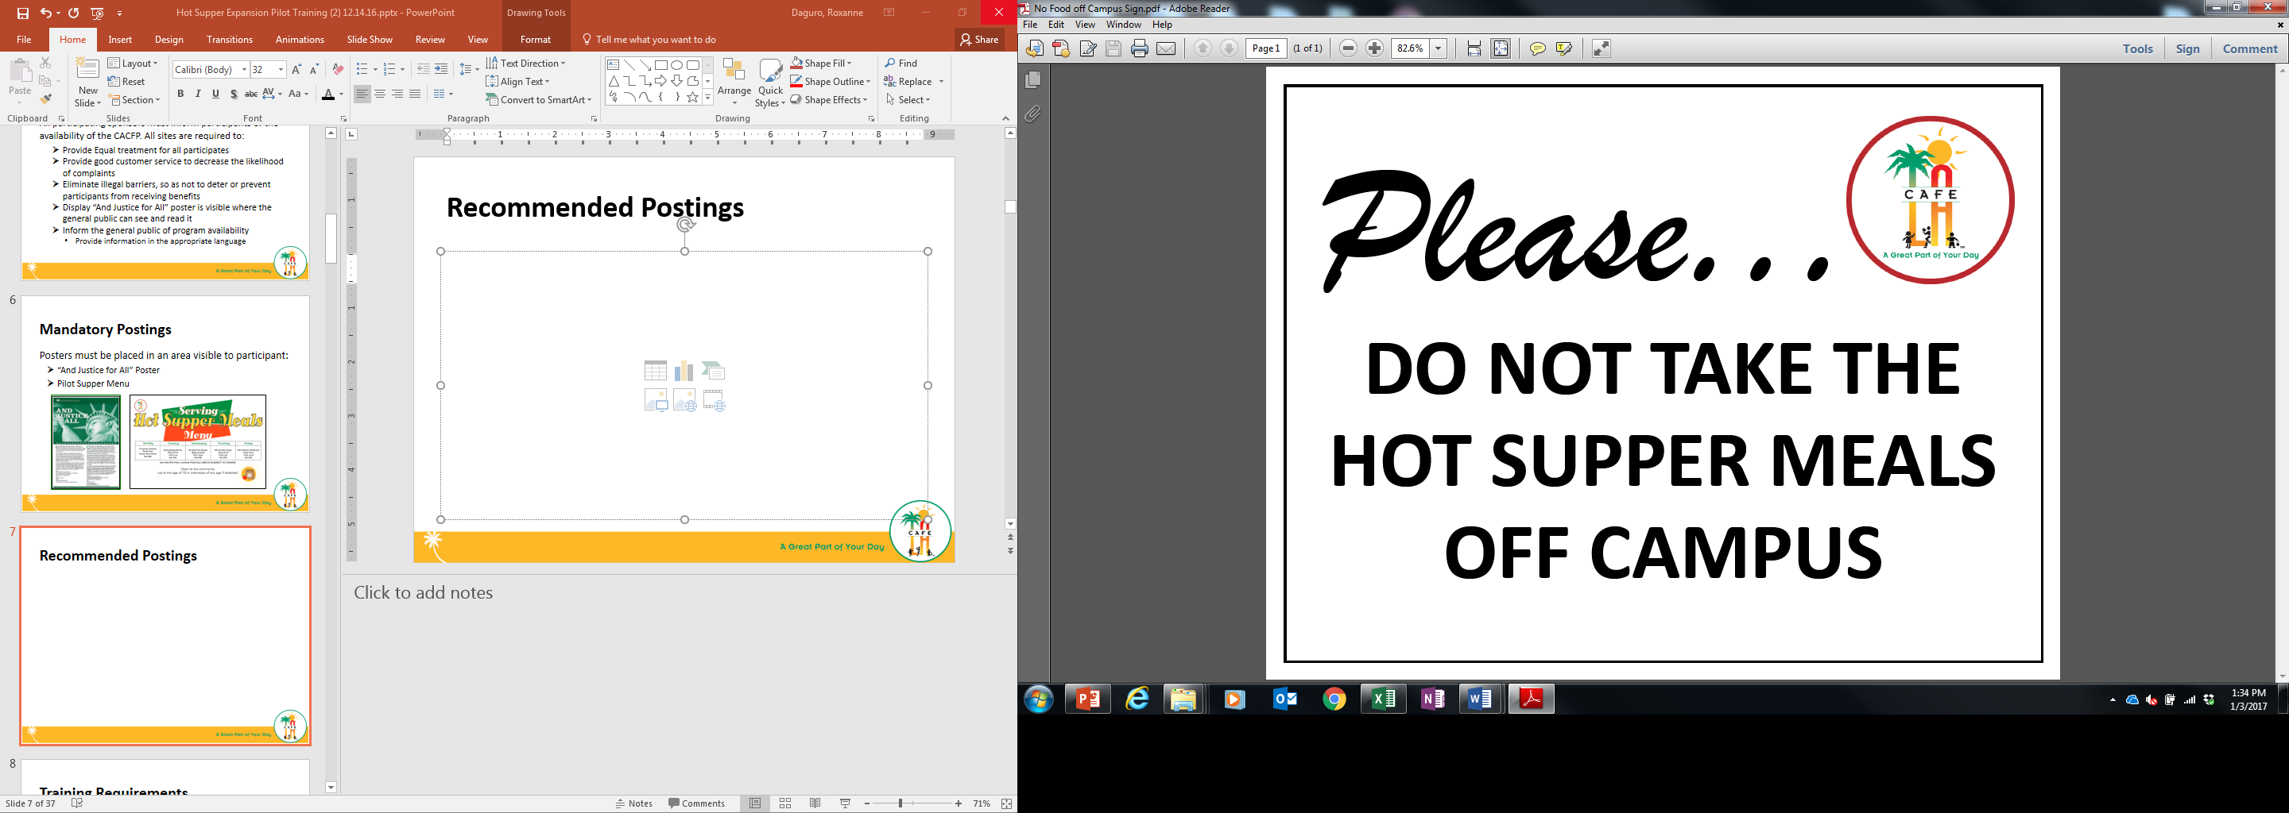

Eating Area Posters
Used to aid students in where to eat supper meals.
Notes:
TELL: Continue to post the Hot Supper marketing material for visual appeal and instruction.

Slide 12
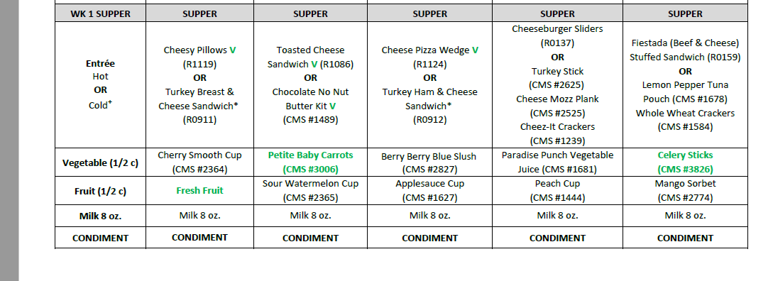
Supper Menu: Entrée
There are two entrée options to choose from for supper. Every day, choose from a hot or cold option to serve.
Do not serve both entrée options
All entrée items count towards 2 components:
Meat/ meat alternate & grain

Slide 13
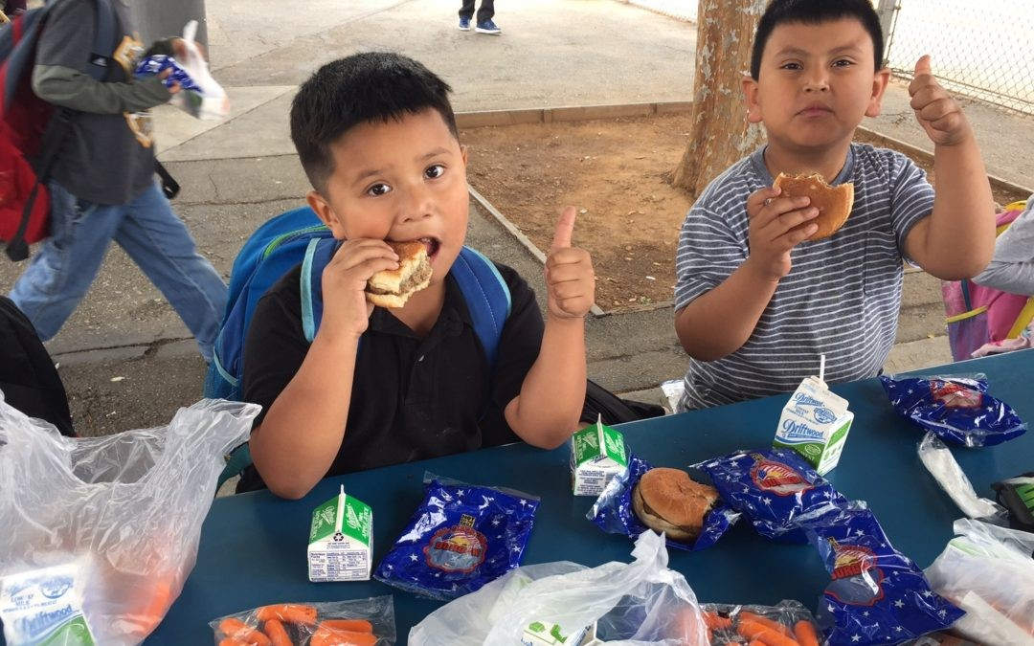
Supper Entrée Selection
When deciding between a hot and cold supper item, serve the entrée that will drive the most participation from students at your site.
Serve the more popular item from the menu
Increased participation results in greater revenue
Our service goal is customer satisfaction over convenience

Slide 14
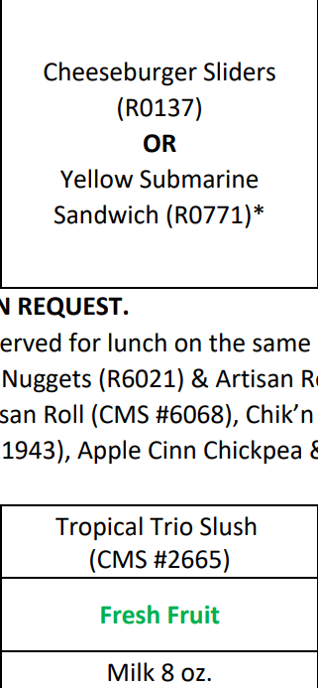
Entrée Satisfaction Activity
If a majority of students are going to want the Cheeseburger entrée, then offer it on the menu rather than the Yellow Submarine Sandwich.
Let’s put ourselves in our student’s perspective.
How many times a week would you like to receive a cold sandwich before you stopped coming to the cafeteria for supper?
If you were a student at your school, in any grade, what entrée would you select from the menu?

Slide 15
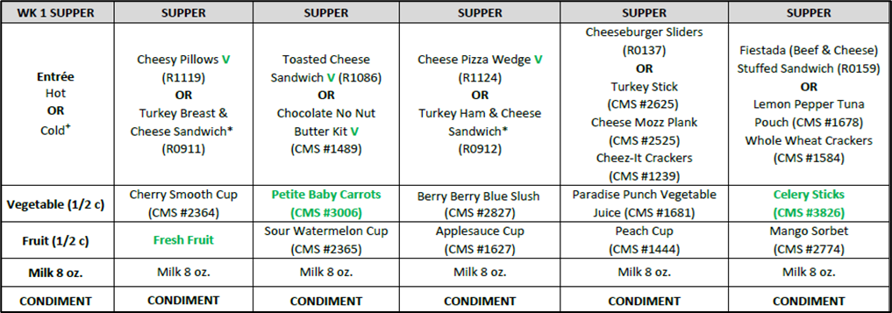
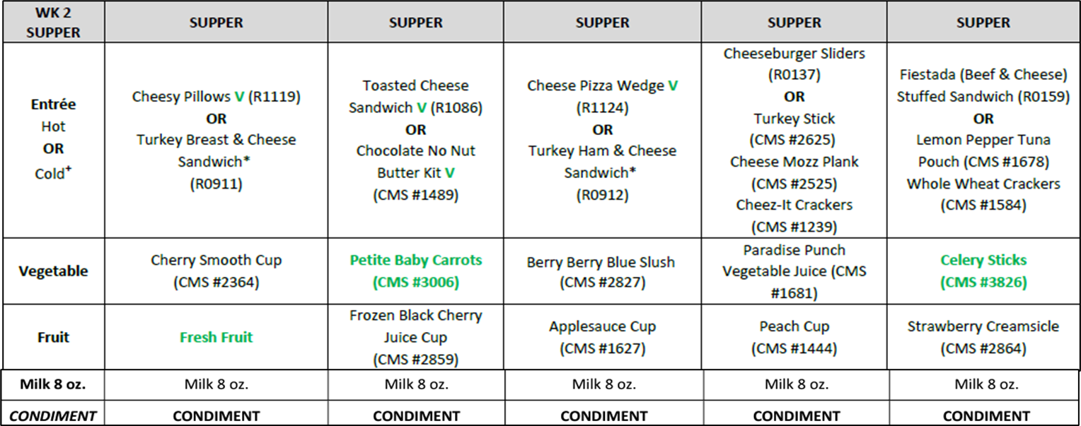
2-Week Menu Rotation
WEEK 1
WEEK 2
A rotating menu helps with forecasting and to reduce leftover stock.
Assess participation weekly to help when projecting during EZ - Steps
Review weekly shopping lists to avoid over/under ordering product

Slide 16
Menu Guidelines
Hot or cold entrée must be served every day : not both
All offerings must be available to every participant
All 5 components must be offered; only 3 are required to be selected
Offer 2 different types of milk, offer lactose free when requested

Slide 17
MEAL PATTERNS & SUBSTITUTIONS
Ensure portion size and component type meet reimbursable meal requirements.
Posted menu must indicate substitutions
Cross out former food item and write substitution made in RED pen
Baby Carrots
Notes:
TELL: Substitutions happen, ensure portion size and component type meet reimbursable meal requirements. And remember, the posted menu must indicate substitutions.

Slide 18
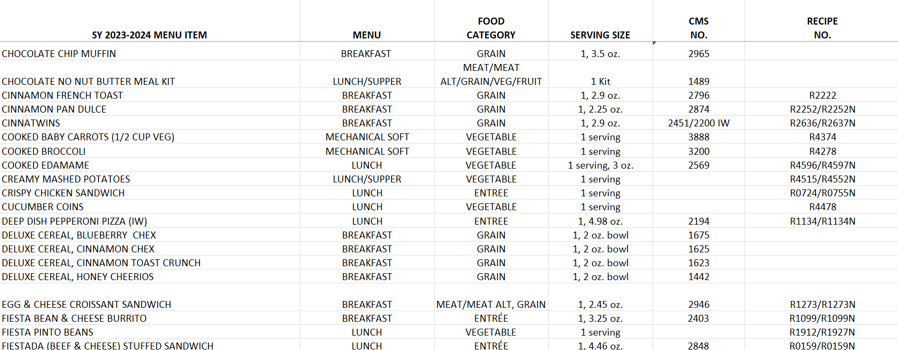
Making Substitutions
When making substitutions, managers refer to the Menu Components Contribution List for an in depth look at the contributions of items offered on the menu. Located on the food services website in Menu’s under Menu Resources.
For substitutions items being used must match in:
Oz equivalency
Grain component
Fruit – Fruit
Vegetable - Vegetable

Slide 19
Unequal Component Substitution
MEAT & GRAIN
MEAT
Breaded Chicken Tenders
Chicken Drumsticks
VS
VEGETABLE
FRUIT
Cherry Smooth Cup
Frozen Strawberry Creamsicle
Notes:
TELL: Let’s identify the components of the following menu items. What components make up the Buffalo Chicken Bites?
CLICK
TELL: That’s right, meat and grain. And the Chicken Drumstick?
CLICK
TELL: Meat. Is that an equal substitution of components? No. Let’s take a look at another example. What component is the Cherry Smooth Cup?
CLICK
TELL: That’s right, it is vegetable. Now what about the Frozen Wild Cherry Cup?
CLICK. It’s a fruit. Is that an equal substitution of components. No, it is not.

Slide 20
Chocolate Milk Rule
The CACFP guidelines restricts the serving of chocolate milk to students under the age of six.
Offer unflavored milk to children under six
Children six or older can choose between unflavored or chocolate milk
To ensure compliance, ask children their age if they appear to be less than six years old.
Notes:
TELL: Now let’s talk about chocolate milk. The CACFP guidelines restricts the serving of chocolate milk to students under the age of six. Children under six must be offered unflavored milk. However, children six or older can choose between unflavored or chocolate milk.

Slide 21





Reimbursable Meals
Supper meal service adheres to OVS guidelines.
3 of the 5 meal components must be selected to complete a reimbursable meal.
Student is not required to take a vegetable or fruit during supper

Slide 22
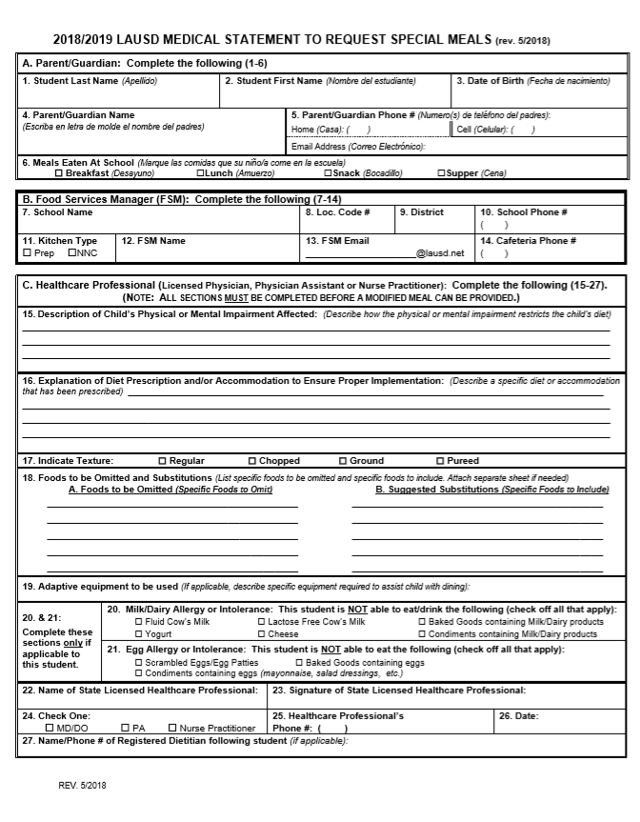
Special Dietary Needs
Students who require a special meal can complete the “Medical Statement to Request Special Diets” form. Food Services Managers will:
Provide the form to families for completion by the child’s treating physician
Submit the completed form to specialdiet@lausd.net
Make substitutions provided by the Nutrition Specialist
Notes:
TELL: Ensure that temperatures recorded at the Start of Service are within the allowable serving range for safety reasons. Please note that temperatures of cold supper kits and cold food items must also be recorded on the Food Temperature Log.

Slide 23
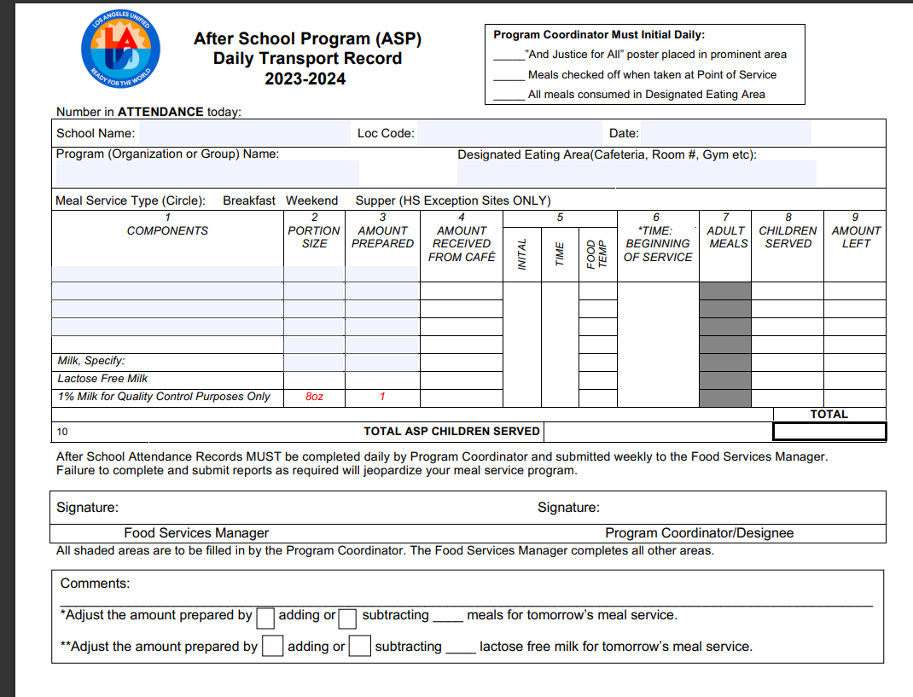
Supper Transport Record
The Supper Transport Record is used when supper meals are served by ASP staff AND when the Cafeteria is closed during supper service.
Manager or Food Service Staff will:
Pre-fill the header with school name, location code, date, etc.
Pre-fill components portion size and amount prepared.
Once received ASP staff will then fill amount received, temp each item and document all counts for meals served.
ASP coordinator must sign at the end of service before returning transport record.
Manager will sign once record is returned. Signifying all fields have been properly filled.

Slide 24
HOW TO SPOT A REIMBURSABLE MEAL

Slide 25
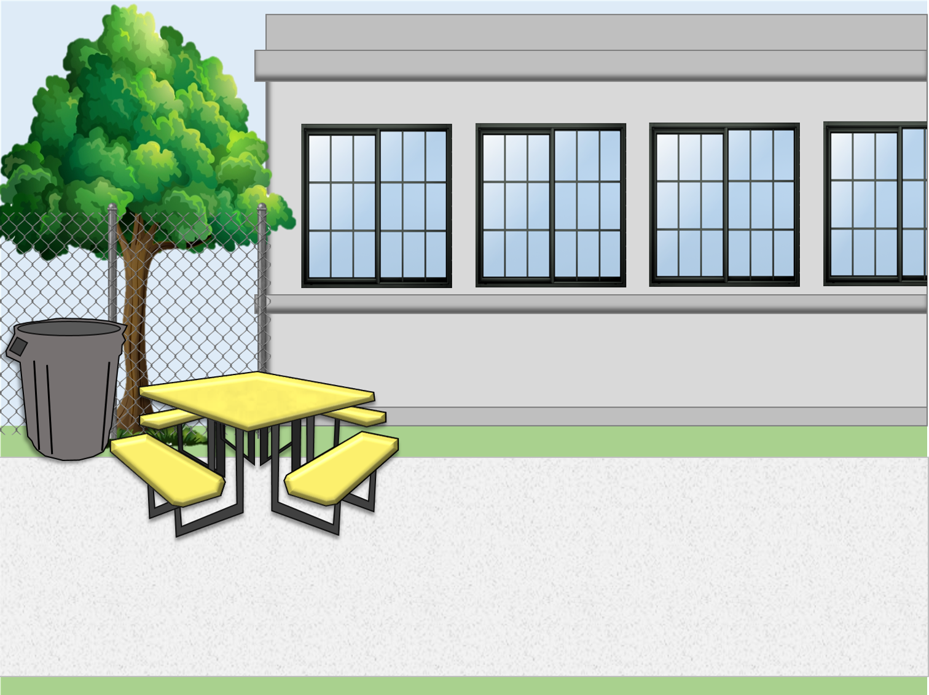
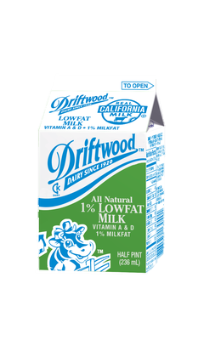










Today’s Menu Items
1 component food items
2 components entrée
Is this a reimbursable meal?

Slide 26
Today’s Menu Items
1 component food items
2 components entrée
Is this a reimbursable meal?

Slide 27
Today’s Menu Items
1 component food items
2 components entrée
Is this a reimbursable meal?

Slide 28
REMINDER
Student is not required to take a vegetable or fruit during supper
3 of the 5 meal components must be selected to complete a reimbursable meal.

Slide 29
Supper Cart Set Up
Because of the OVS model, a supper cart and the BIC dolly may need to be used together to serve supper.
Store food items in BIC insulated bags before service
Use BIC dolly to carry additional bags to supper area on campus
Use the shelf space on cart to store 3lb trays and sporkettes
Highly recommended to set up near a lunch table in the designated eating
area.

Slide 30


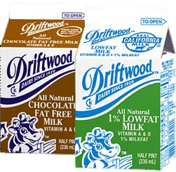

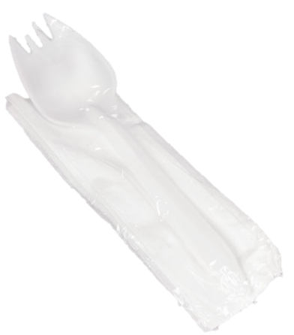
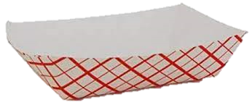

Supper Cart Set Up Example
Your set up may differ according to your participation counts, campus and weekly menu.
Store less popular items in same bag to maximize space
Do not crush or squeeze food items into bags; use an additional bag
This model allows for OVS

Slide 31
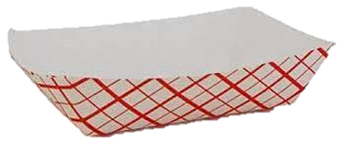
Supper Service Example
Staff must ensure reimbursable meals are served BEFORE recording the meals on the ASP/Community Forms. Meals served that are not reimbursable cannot be claimed.
Notes:
“Staff must ensure reimbursable meals are served BEFORE recording the meals on the ASP/Community Forms. Meals served that are not reimbursable cannot be claimed.”

Slide 32
ASP Staff must ensure reimbursable meals are served BEFORE recording the meals on the ASP/Community Forms. Meals served that are not reimbursable cannot be claimed.
Meal service lasts for 30 mins immediately after the Bell rings.
Redirect program students to the program serving area to receive their meals.
Community Cart
Service
Food Services Staff serves meals to participants from the community
Communicate with ASP to ensure at least one point of service remains open for the entire 30-minute meal service.
Meals are consumed in the designated eating area. No food may leave the campus.
ASP Staff assists at the Supper carts and the first 10 mins of community service.
*Exceptions may apply. AFSS approval is required to serve at alternate serving times.
Notes:
TELL: Let’s review the schematic of the community cart service. Meal service begins immediately after the dismissal bell rings, and lasts for 30 minutes.
CLICK
TELL: Food Services Staff serves meals to participants from the community. Redirect program students to the program serving area to receive their meals.
CLICK
TELL: ASP Staff assists at the carts or gates for 10 minutes.
CLICK
TELL: Staff confirms reimbursable meal is received and ensures participant has written their name on the Community Roster.
CLICK
TELL: Meals are consumed in the designated eating area. No food may leave the campus.
CLICK
TELL: Communicate with ASP to ensure at least one point of service remains open for the entire 30-minute meal service.

Slide 33
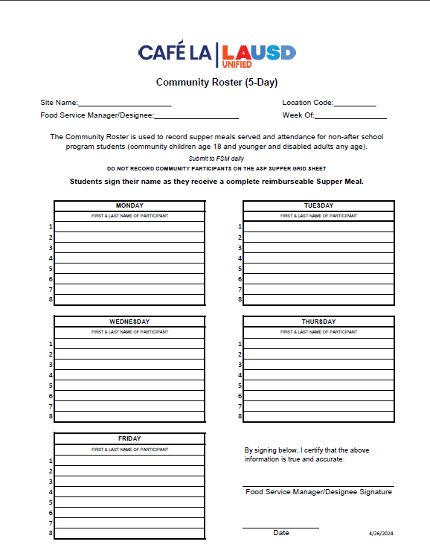
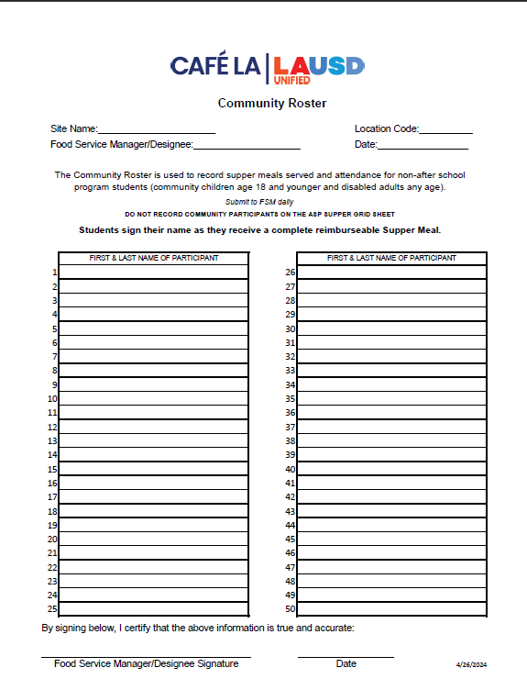
Counting and Claiming Forms
ASP Supper Grid Sheet
Community Roster
5-Day
1-Day
5-Day
1-Day
Notes:
TELL: Let’s talk about the Counting and Claiming forms. There are 2 versions of the ASP Supper Grid Sheet and the Community Roster: a 5-day and 1-day. Let’s begin with the ASP Supper Grid Sheet.

Slide 34
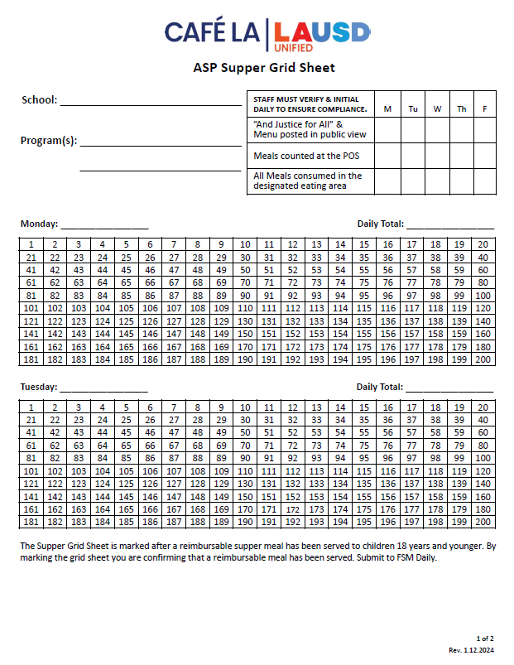
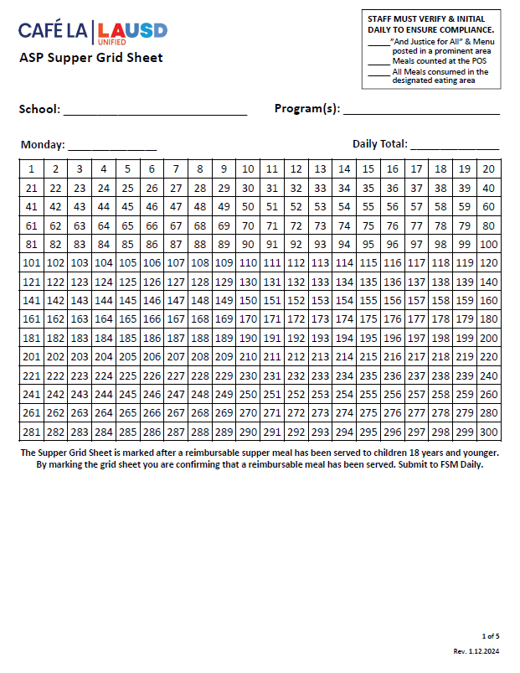
ASP Supper Grid Sheet
These forms record reimbursable meals distributed to the afterschool program students only.
Only trained staff may record meals.
Complete heading, date, and record all programs.
Verify and initial the compliance box daily.
POS staff should focus solely on counting reimbursable meals.
Mark each meal in numerical order with a slash or x AFTER a reimbursable meal is served.
Record total meal counts daily.
Submit to FS Manager daily.
5-Day
1-Day
Notes:
TELL: The ASP Supper Grid Sheet records reimbursable meals distributed to the after school program students only. Only trained FS/ASP staff may record the meals distributed. To begin, complete the heading, date, and record all programs. ASP staff must verify and initial the compliance box daily. To claim meals for reimbursement, confirm meal is reimbursable before marking. Then, mark each meal in numerical order with a slash or X. Lastly, record the total meal counts daily. Remember to collect the ASP Supper Grid Sheet daily.

Slide 35
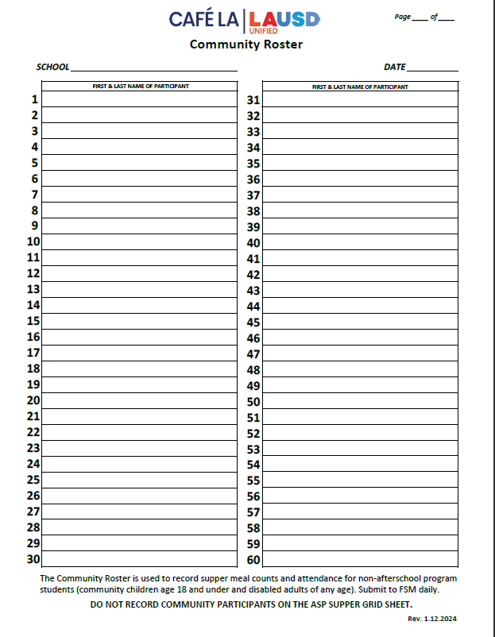
Community Roster
This form records the attendance and reimbursable meals received by community participants.
Ensure first & last names are written legibly.
FS Staff ensures a reimbursable meal is selected before names are recorded
Young children may be assisted with writing their names.
A Roster is required at all service locations.
To ensure accuracy in meal accounting, the POS staff should focus solely on counting reimbursable meals
Submit to FS Manager daily.
1 2
Nicole Waterford
Hannah Bankole
Notes:
TELL: The Community Roster records the attendance and reimbursable meals received by community participants. Ensure first and last names are written legibly. Young children may be assisted with writing their names. This form is required at all service locations. Incomplete names listed may be included in the meal count. However, make every effort to obtain the full name at the next supper service. Remember to collect Community Roster daily.

Slide 36
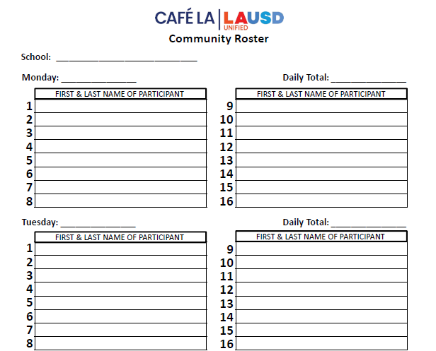

Community Roster Required at ASP Service
Happy El
ASP staff distributes supper meals to program and community participants.
However, some ASP Services do not have any community participants.
10/2/2023
0
ZERO PARTICIPANTS
Is the Community Roster required if
there are no community participants?
10/3/2023
0
ZERO PARTICIPANTS
Yes!
ASP staff will confirm that the count is zero and fill the blank form.
Include the school name and date
Submit to the Food Services Manager daily to be filed.
Notes:
TELL: ASP staff distributes supper meals to program and community participants. However, some ASP Services do not have any community participants.
ASK: Is the Community Roster required if there are no community participants?
CLICK
TELL: Yes! Confirm that the count is 0 and file the blank form. Include the school name and date. This blank form must be collected daily.

Slide 37
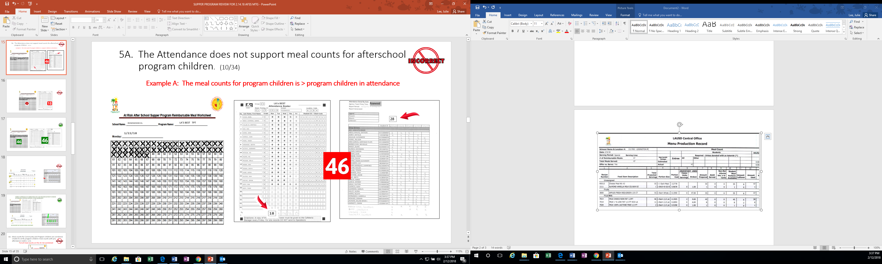
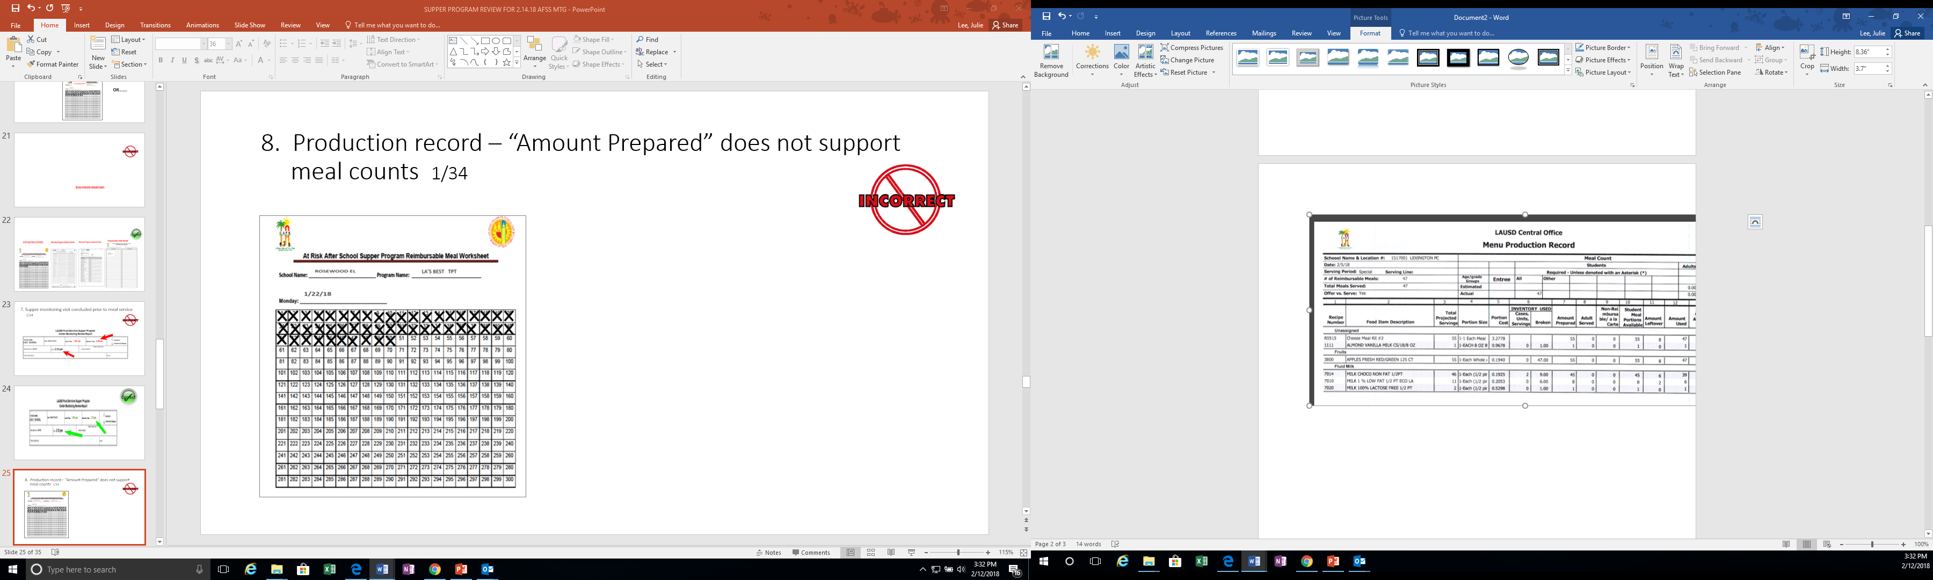
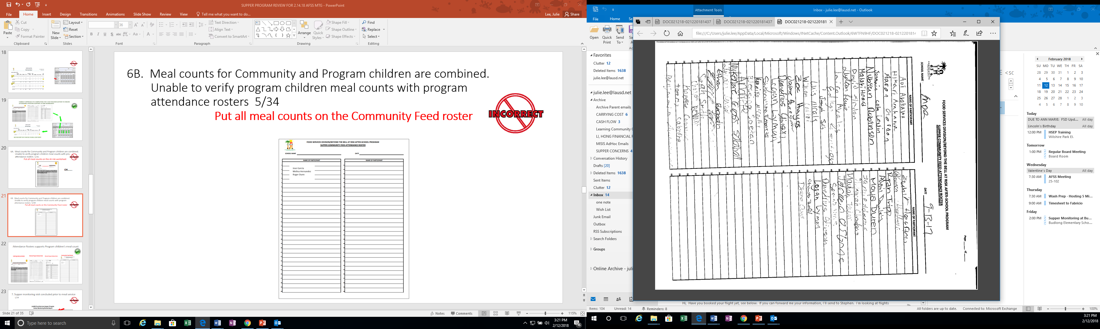
PRODUCTION RECORDS MEAL COUNTS
47
34
81
PRODUCTION RECORDS
(Reimbursable Meals)
ASP Supper Grid Sheet
Community Roster
Reimbursable meal counts on the Production Record must support the ASP Grid Sheet and the Community Roster.
Notes:
TELL: Reimbursable meal counts on the Production Record must support the meal counts on the ASP Grid Sheet and the Community Roster.

Slide 38
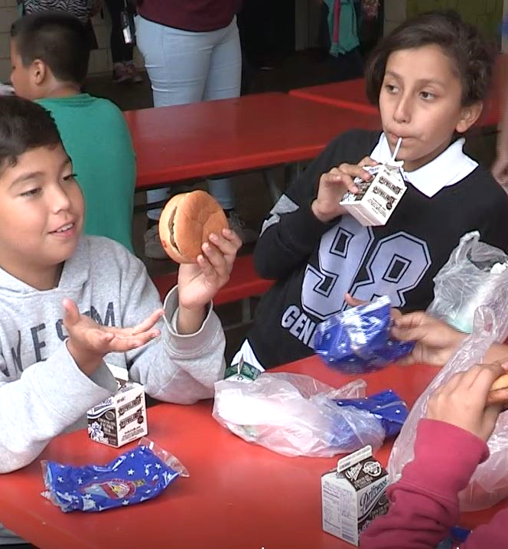
Do Not Back Out Leftovers
“Backing out” is when leftovers are subtracted from the meals prepared to determine the meal count.
“Backing out” leftovers is strictly prohibited
Meal counts are obtained from the amounts recorded on the ASP Supper Grid Sheet and the Community Roster
It is not possible to claim more meals than the amount prepared on the production worksheet
Meals must be recorded accurately
Notes:
TELL: “Backing out” is when leftovers are subtracted from the meals prepared to determine the meal count.
“Backing out” leftovers is strictly prohibited. Meal counts are obtained from the amounts recorded on the ASP Supper Grid Sheet and the Community Roster. Remember, it is not possible to claim more meals than the amount prepared on the production worksheet. All meals must be recorded accurately.

Slide 39
Claiming for
Reimbursement
Claiming is the request for reimbursement that FSD submits to the California Department of Education. FSD obtains this information from CMS.
Meal counts are obtained from ASP Supper Grid Sheet and Community Roster combined
Manager inputs the total meal count under “free” in CMS Daily Entry each day
Notes:
TELL: Claiming is the request for reimbursement that FSD submits to the California Department of Education. FSD obtains this information from CMS. Meal counts are obtained from ASP Supper Grid Sheet and Community Roster combined. Manager inputs the total meal count under “free” in CMS Daily Entry each day

Slide 40
Meals are prepared by Food Services Staff & are ready for service.
ASP Staff ensures reimbursable meal is received, then marks participant on the appropriate form.
ASP Supper Grid Sheet & Community Roster are required at the point of service.
ASP
SERVICE
Meal service begins immediately after the dismissal bell rings, and lasts for 30 minutes.
Meals are consumed in the designated eating area. No food may leave the campus.
ASP Staff distributes meals to program students & participants from the community.
At least one point of service must be open for the entire 30-minute meal service.
*Exceptions may apply. AFSS approval is required to serve at alternate serving times.
Notes:
TELL: Let’s review the schematic of the ASP service. Meals are prepared by Food Services Staff & are ready for service.
CLICK
TELL: Meal service begins immediately after the dismissal bell rings, & lasts for 30 minutes.
CLICK
TELL: ASP Staff distributes meals to program students & participants from the community.
CLICK
TELL: ASP Staff ensures reimbursable meal is received, then marks participant on the appropriate form. Please note that ASP Supper Grid Sheet & Community Roster are required at the point of service.
CLICK
TELL: Meals are consumed in the designated eating area. No food may leave the campus.
CLICK
TELL: At least one point of service must be open for the entire 30-minute meal service.

Slide 41
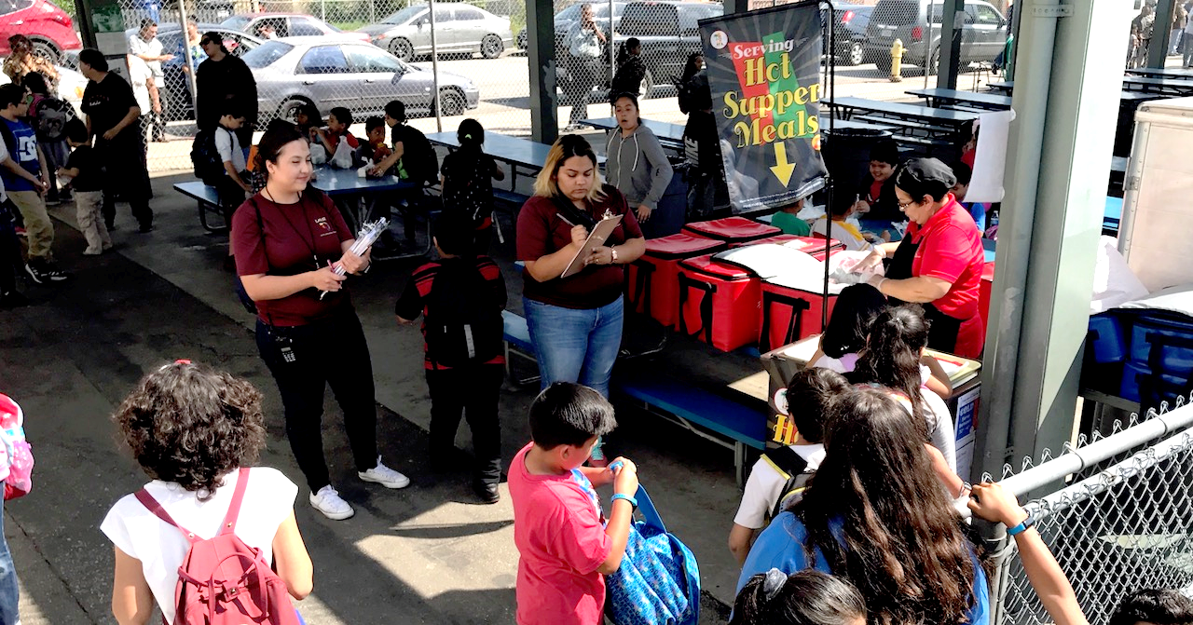
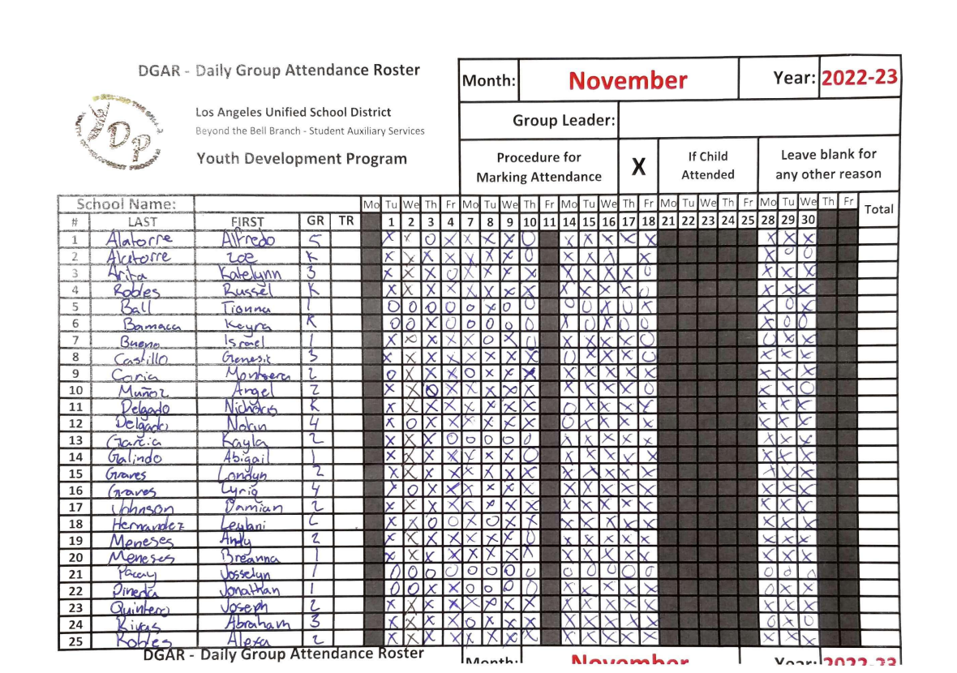
Program Attendance Rosters
Program attendance rosters record students present in afterschool programs and support the meal counts on the ASP Supper Grid sheet.
Attendance may be:
Taken before or after meal service
Greater than or equal to meal counts
Meal counts cannot exceed the attendance
BTB must submit rosters to FSM weekly
Notes:
TELL: Program Attendance Rosters record students present in afterschool programs and support the meal counts on the ASP Supper Grid sheet. Attendance may be: taken before or after meal service, greater than or equal to meal counts. However, meal counts cannot exceed the attendance. These attendance rosters must be submitted to FSM weekly. As pictured, the correct attendance rosters are taken manually by hand.

Slide 42
Original Source Defined
The CDE requires that we use After School Program (ASP) attendance rosters that are “Original Source Documents”.
Actual rosters used the day attendance is taken by hand.
Photo copies of these rosters are acceptable
Re-created rosters are not acceptable
Rosters must be available for the CDE auditor at the time of their visit
Notes:
TELL: The CDE requires that we use After School Program (ASP) attendance rosters that are “Original Source Documents”. This entails: actual rosters used the day attendance is taken by hand, photo copies of these rosters are acceptable. However, re-created rosters are not acceptable. Lastly, rosters must be available for the CDE auditor at the time of their visit.

Slide 43
Early Dismissal Policy
Example: Regular dismissal time is at 2:30pm.
Meal service times are contingent upon school dismissal.
Cut-Off Time: | Before 1:00 pm | After 1:00 pm
Rule: | Students are served at the regular dismissal time | Students are served at the early dismissal time
Scenario: | Students are dismissed at 12:50pm | Students are dismissed at 1:20pm
Service Time: | Students are served at *2:30pm | Students are served at 1:20pm
*Exceptions may apply. AFSS approval is required to serve at alternate serving times.
Notes:
TELL: Meal service times are contingent upon school dismissal. Let’s Review the Early Dismissal Policy Chart. Early release days are now categorized into 2 simple categories.
CLICK TELL: If the students are released before 1pm, Hot supper will be served at the regular dismissal time. For example. Let’s say the regular school dismissal is at 2:30pm.
CLICK
TELL: Let’s explore this scenario. Students are released at 12:50 pm.
CLICK
TELL: According to the Early Dismissal policy, Hot Supper will be served at 2:30 pm. Please note that *Exceptions may apply. AFSS approval is required to serve at alternate serving times.
CLICK
TELL: Let’s look at a different scenario. If the students are released earlier then their regular dismissal, but after 1pm. Then Hot supper will be served Immediately after the early dismissal time.
CLICK
TELL: Let’s explore this scenario. Students are released at 1:20 pm.
CLICK
TELL: According to the Early Dismissal policy, Hot Supper will be served at 1:20 pm.

Slide 44
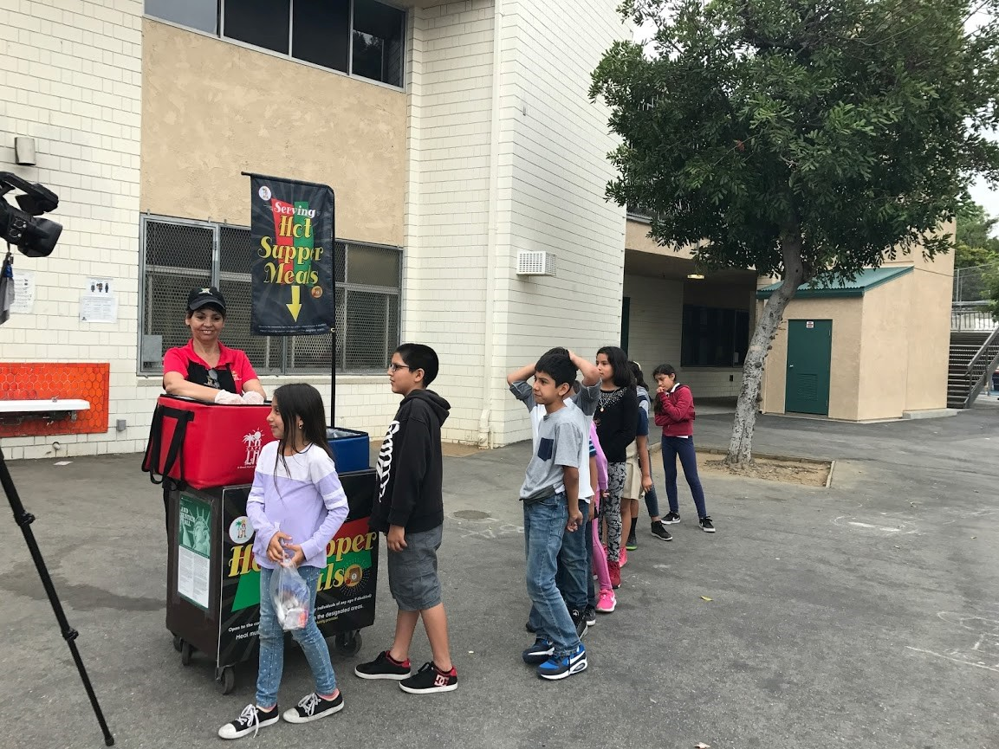
Early Release Students
Service time may be adjusted to accommodate students released before the regular dismissal bell on a regular basis.
These students may include:
Special Education Students
Bussed Students
Other Eligible Programs
Note: Include any changes to service times in the Supper Meal Program Online Form with AFSS approval
Example: The school’s dismissal is at 2:30pm, but Special Ed students are released at 2:15pm. Serving time is 2:15-3:00pm.
Notes:
TELL: Service time may be adjusted to accommodate students released before the regular dismissal bell on a regular basis.
These students include, Special Education students and bussed students, and other eligible programs. Note: Any change in the service time must be included in the Change of Supper Meal Service Form. For example: The school’s dismissal is at 2:30pm, but Special Ed students are released at 2:15pm. Serving time is 2:15-3:00pm.

Slide 45
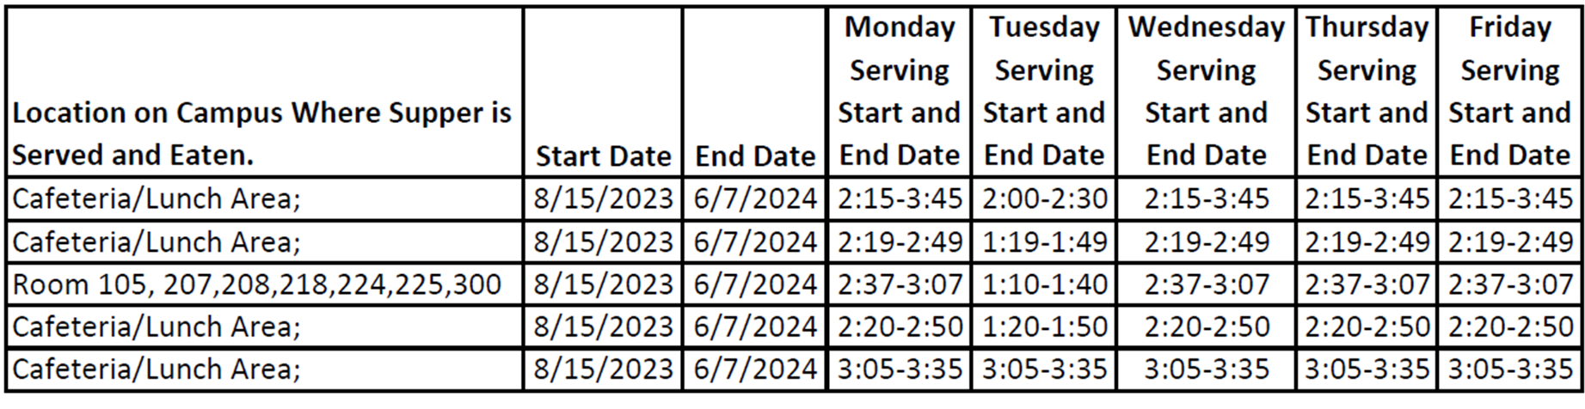
Review the spreadsheet for accuracy
Accurate Meal Service Times
Enter time(s), date(s), and designated eating area(s) on the Permanent Supper Meal Online Form.
Update the Temporary/Short Term Supper Program Online Form (6 days or less) as changes occur
Notes:
TELL: Enter service time(s), date(s), and designated eating area(s) on the Permanent Supper Meal Online Form. If you have a Saturday program, use the new Saturday Supper online form. Remember to update the Temporary/Short Term Supper Program Online Form for changes that are 6 days or less. Lastly, review the spreadsheet for accuracy.

Slide 46
Exceptions in High Schools
High schools with YS Supper Coordinators may continue to distribute supper meals (cold) at varying times and in different locations, Forms below are still required.
Supper Meal Count Form
Community Feed Attendance Roster
Cold Supper Second Service Guidelines:
Cold supper may begin no earlier than 30 minutes after the end of Hot Supper Service
Service for up to 1 continuous hour
No supper service after 5pm
Note: Included all serving times in the Change of Supper Meal Service Form.
Notes:
TELL: High schools with YS Supper Coordinators may continue to distribute cold supper meals at varying times and in different locations. However, they are still required to complete the Supper Meal Count Form and Community Feed Attendance Roster. When serving cold supper as a second service, cold supper service may begin no earlier than 30 minutes after the end of Hot Supper Service and may serve for up to 1 continuous hour. There will be no supper service after 5pm. Note: Serving times must be included in the Change of Supper Meal Service Form.

Slide 47
Food Services Manager Role
Order Food
Staff the Program
Collect & Verify Documents
CMS Daily Entry
File Records
Monitor Program
Notes:
TELL: The review the role of the Food Services Manager. FSMs will order food items based on the hot supper menu.
CLICK TELL: They will ensure that their program is staffed accordingly.
CLICK
TELL: Collect & verify all documents for accuracy.
CLICK
TELL: Enter daily meal counts in CMS Daily Entry.
CLICK
TELL: Maintain & file all records.
CLICK
TELL: Monitor program (3 per year) & provide corrective action.

Slide 48
Food Services
Staff Role
Pre-Service
Prepare & pack supper meals according to the menu for all service areas
Notes:
TELL: Before supper service begins, Food Services staff will prepare & pack the hot supper meals according to the menu for all service areas.

Slide 49
Food Services
Staff Role
During Service
Distribute supper meals to community participants
Ensure reimbursable meals are marked on the community roster
Direct all participants to the designated eating area
Ensure no food leaves the campus

Slide 50
Food Services
Staff Role
Post Service
Count & record all leftovers
Check the temperatures of leftovers. Cold items may be returned to stock. Discard all hot items
Clean & sanitize insulated bags & carts

Slide 51
ASP Staff
Assist with forms at the carts or gates for the first 10 minutes
Distribute meals to program students and/or community
Supervise & direct students to the designated eating area
Make sure program is open to the community, monitor gates
Clean spills, wipe tables, pick up trash & empty bins
Total daily attendance for all programs on the first page

Slide 52
ASP Staff
WILL NOT
Prepare any food items
Push community carts out to designated areas
Remove hot food from warmers or ovens

Slide 53
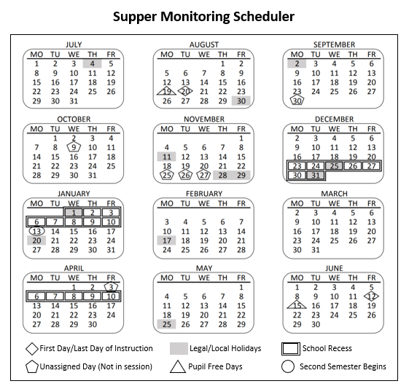
Monitoring Dates
The Supper Monitoring Scheduler is a tool to ensure monitoring dates are varied per CDE standards.
AFSS provides FSM with dates
FSM records dates on scheduler as a reminder to complete
1st, 2nd and 3rd monitoring must be completed by the following dates:
1st – 9/20/24
2nd – 2/14/25
3rd – 5/2/25
Note: Do not post to ensure the monitoring is conducted unannounced.
Notes:
TELL: The Supper Monitoring Scheduler is a tool to ensure monitoring dates are varied per CDE standards. AFSS provides FSM with scheduled monitoring dates. Then, FSM records dates on scheduler as a reminder to complete monitorings.

Slide 54
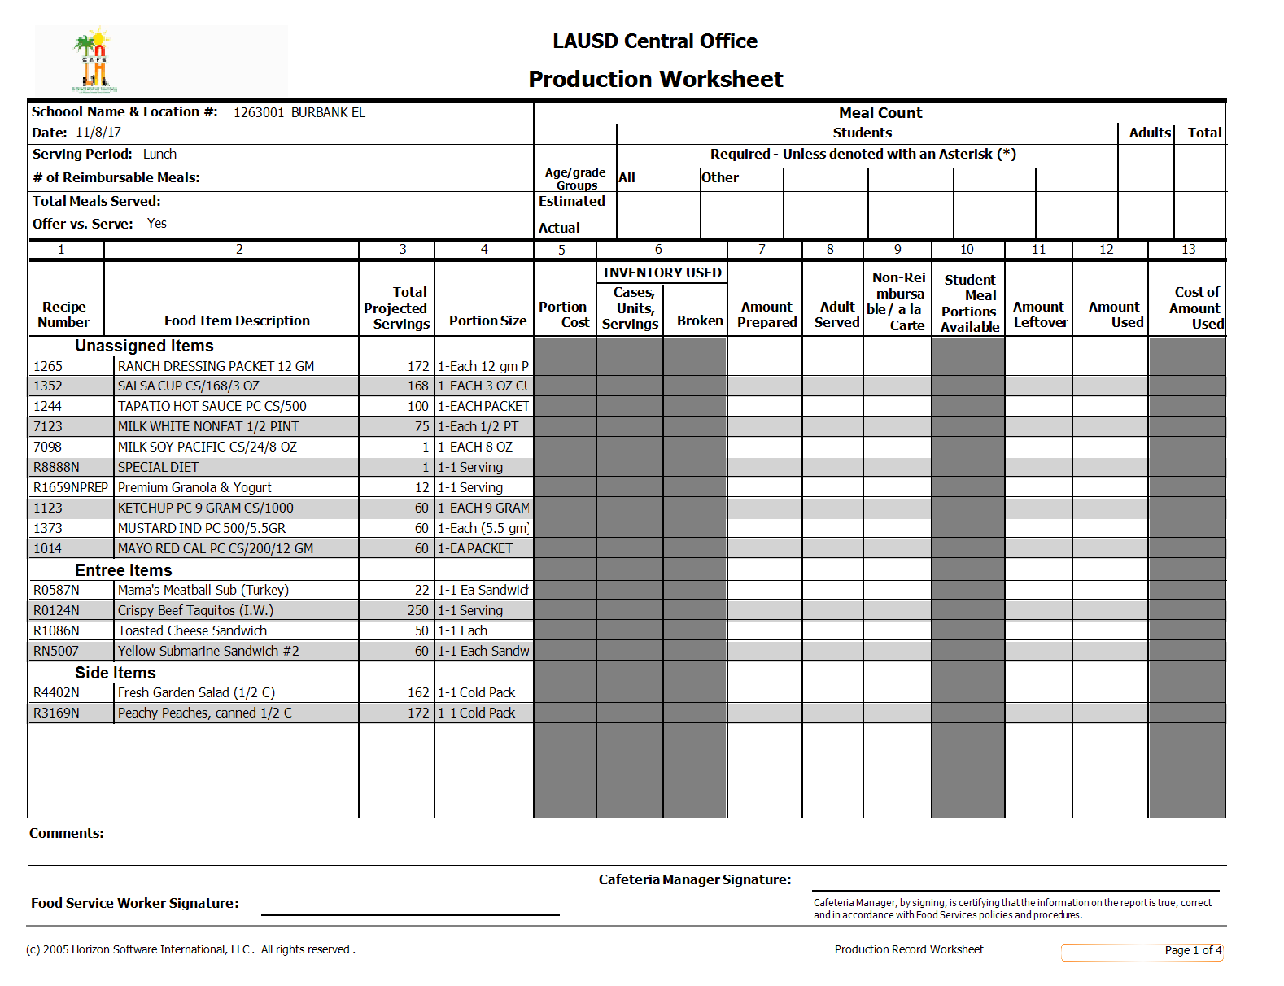
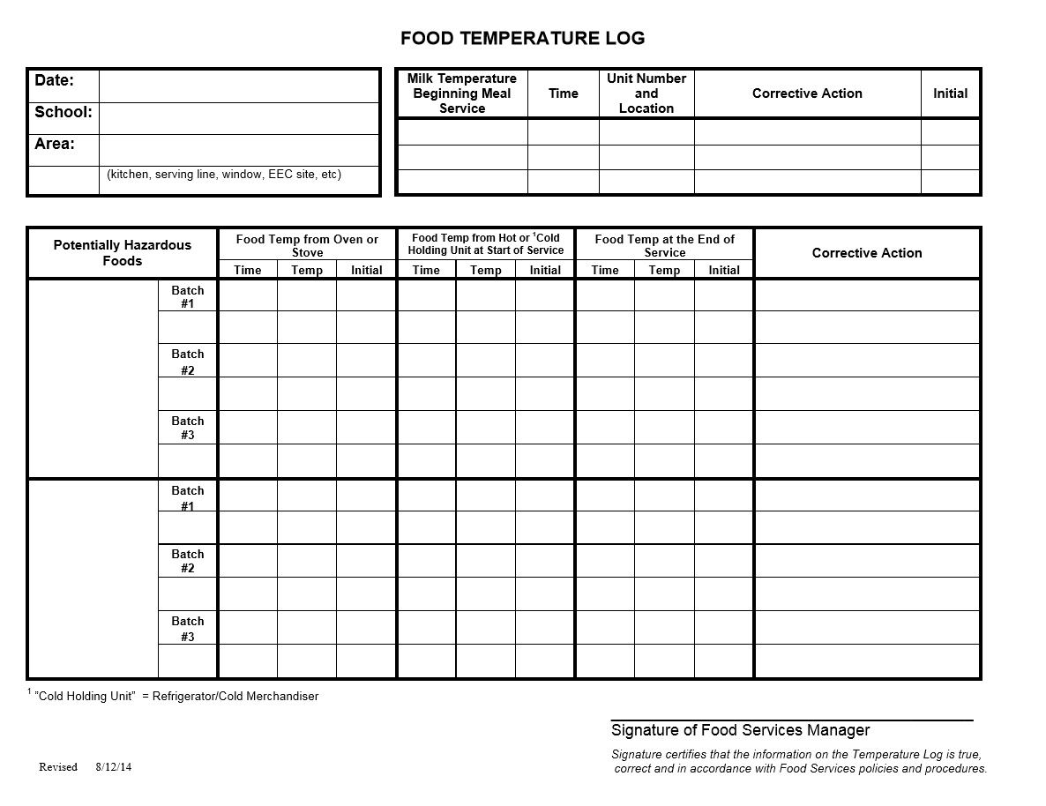
Six Documents Required to Complete a Monitoring
1
2
3
ASP Supper Grid Sheet
Community Roster
ASP Attendance Rosters
4
5
6
Production Worksheets
Food Temperature Log
FSD & ASP Training Sign-In Sheets
Notes:
TELL: Here are the six documents required to complete a Supper Monitoring. ASP Supper Grid Sheet, Community Roster, ASP Attendance Roster, FSD and ASP Training Sign-in Sheets, Production Worksheets, and the Food Temperature Log. Any missing documents will result in a deficient monitoring.

Slide 55
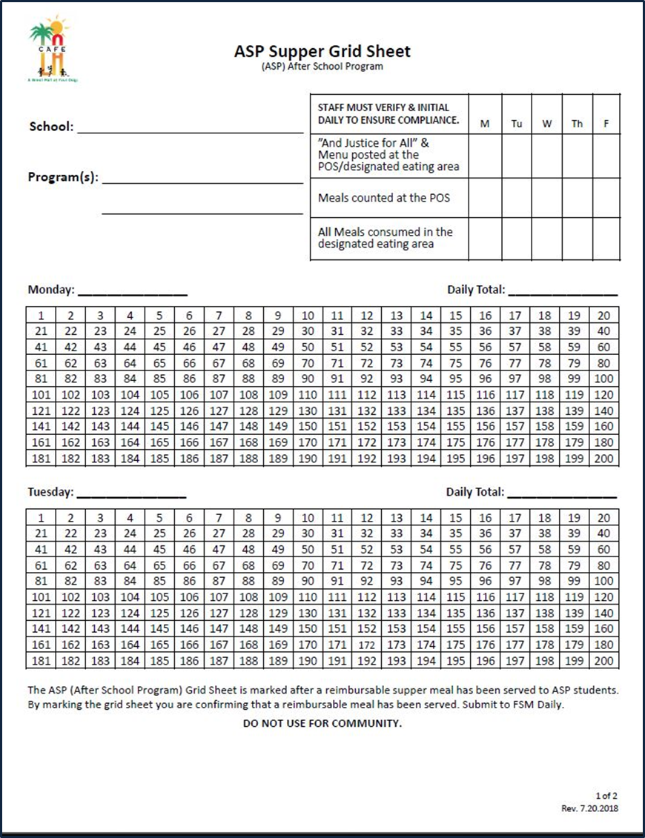
How often are these forms submitted?
Community Roster
ASP Supper Grid Sheet
Program Attendance Roster
DAILY
WEEKLY
DAILY
Notes:
TELL: Let’s review. How often are these forms submitted? The ASP Supper Grid Sheet?
CLICK TELL: Daily. How about the Community Roster?
CLICK
Tell: Daily as well. And the Program Attendance Rosters?
CLICK
TELL: Weekly.

Slide 56
Handling Challenges
Student attempts to walk out of campus with the supper meal.
Redirect students to eat in the designated eating area.
Parent is rude or is upset after being reminded of rules.
Inform administration of the incident and request assistance.
Despite your efforts, supper regulations are not being followed.
Inform AFSS that
your repeated efforts are unsuccessful.
Notes:
TELL: Here is a guide on handling challenges. Student attempts to walk out of campus with the supper meal.
CLICK
TELL: Redirect students to eat their meal in the designated eating area. Parent is rude or is upset after being reminded of rules.
CLICK
TELL: Inform administration of the incident and request assistance. Despite your efforts, supper regulations are not being followed.
CLICK
TELL: Inform AFSS that your repeated efforts are unsuccessful.

Slide 57

Saturday Meal
Service
Saturday Meal Service can be classified into two different programs on campus:
Expanded Learning Opportunity Programs (ELOP) - supper served
Instructional - breakfast and lunch served
Instructional programs refer to the Saturday Meal Service training for additional information.

Slide 58
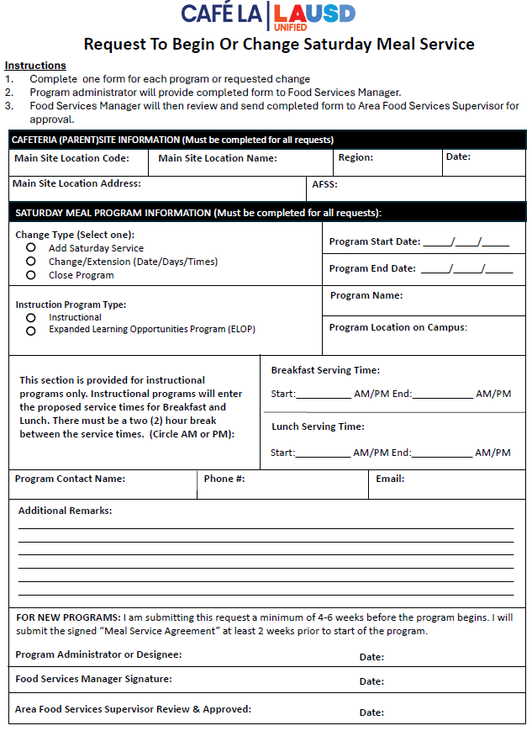
Saturday Meal Service
For Expanded Learning
Opportunity Programs (ELOP)
A Request to Begin or Change Saturday Meal Service form must be completed before the start of any Saturday program on site.
Must be submitted 4-6 weeks before the start of the program.
Once completed by the program administrator, form must be signed by the Area Food Services Supervisor.
Notes:
TELL: The ASP Supper Grid Sheet records reimbursable meals distributed to the after school program students only. Only trained FS/ASP staff may record the meals distributed. To begin, complete the heading, date, and record all programs. ASP staff must verify and initial the compliance box daily. To claim meals for reimbursement, confirm meal is reimbursable before marking. Then, mark each meal in numerical order with a slash or X. Lastly, record the total meal counts daily. Remember to collect the ASP Supper Grid Sheet daily.

Slide 59
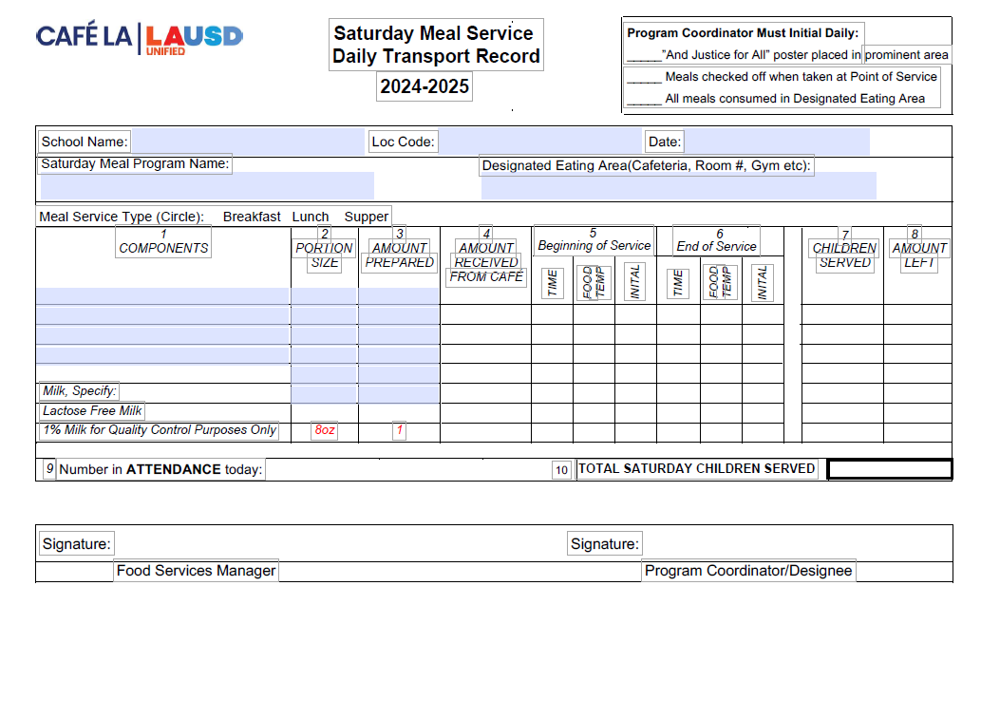
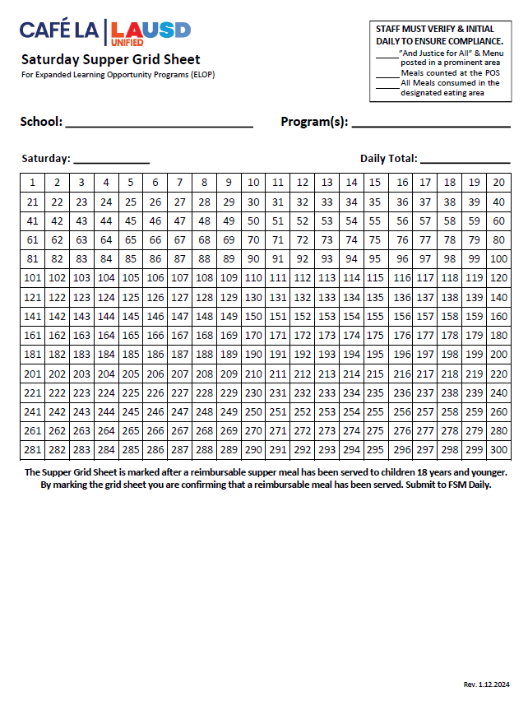
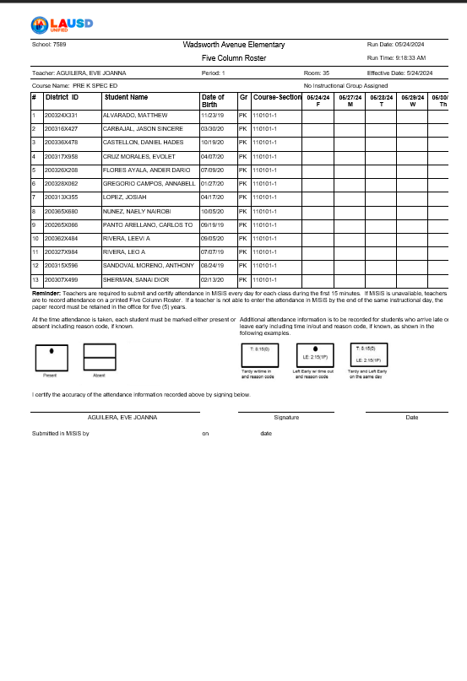
Saturday Meal Service Daily Forms
1
2
Saturday Daily Transport Record
Saturday Supper Grid Sheet
3
4
Saturday Program Attendance Rosters
Production Worksheets
Notes:
TELL: Here are the six documents required to complete a Supper Monitoring. ASP Supper Grid Sheet, Community Roster, ASP Attendance Roster, FSD and ASP Training Sign-in Sheets, Production Worksheets, and the Food Temperature Log. Any missing documents will result in a deficient monitoring.

Slide 60
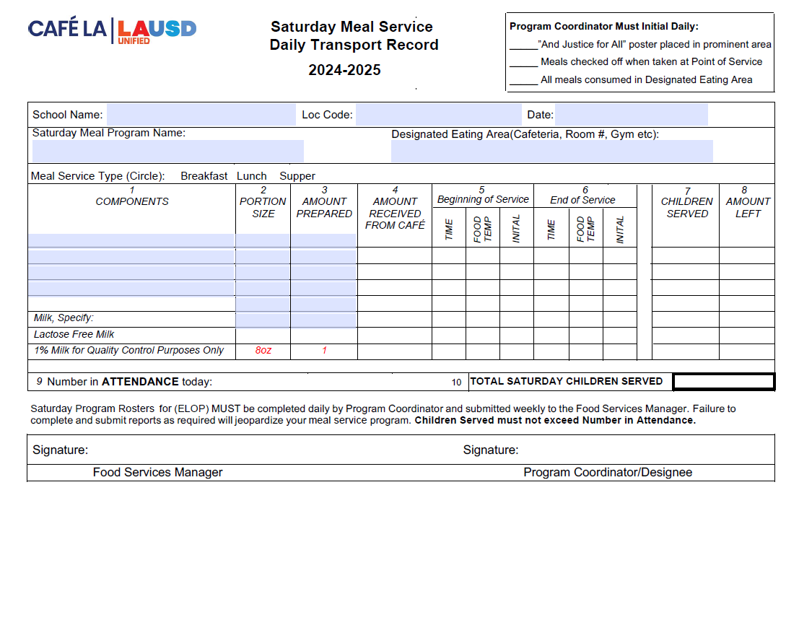
Saturday Daily Transport Record
The Saturday Meal Service Daily Transport Record varies from the traditional transport record and will say Saturday Meal Service.
Once completed Saturday program staff will sign the bottom of the form and submit back to the FSM
Saturday program staff are required to temp all perishable menu items before and after each meal service, record the temperature on the transport record, initial, then sign.
Instructions have changed to reflect Saturday Program guidelines.
FSD Managers will sign once they have received the returned form.

Slide 61




SATURDAY MENU AT A GLANCE
The Saturday Recovery Menu can be found on the FSD webpage under the Menu tab.
Once the FSM has chosen an Entrée Option. They will then choose which option they would like to serve. For instance:
FSM will choose from the entrée options provided on the Saturday Recovery Menu for Saturday service.
Only ONE Entrée is offered for Supper on Saturdays.
OR
Yellow Submarine Sandwich
Tuna Sandwich
DO NOT SERVE ALL OPTIONS

Slide 62
SATURDAY AFTER SERVICE OVERVIEW

Slide 63









Saturday Program staff will leave all left over items in the designated refrigeration unit for pick up on the following Monday
Only whole untampered with fruits and non-perishable items will be returned to stock.
All other items will be discarded
Return to Stock
Discard

Slide 64






In the event Saturday service meal items are left out of the refrigeration unit
And all items have spoiled.
Manager will discard all items

Slide 65


Don’t worry. We’ll leave a note on the forms next Saturday to remind Saturday Program Staff to leave all food in the designated refrigeration unit
Please leave all leftovers in designated refrigeration unit. Thank you!
-Management

Slide 66







Once I’ve discarded all perishable items. I can now enter my productions and daily entry for Saturday Meal Service.
Queen Bee designs

Slide 67

Good Nutrition All Day Long
Providing healthy meals shouldn’t stop once the last bell rings. Often times, parents are still at work when their children get out of school.
Serving hot supper meals allows children to receive three nutritious meals a day to support their growing bodies and learning needs.
Notes:
TELL: Providing healthy meals shouldn’t stop once the last bell rings. Often times, parents are still at work when their children get out of school. Serving hot supper meals allows the children to receive three nutritious meals a day to support their growing bodies and learning needs. Doing this will ensure that together, we are continuing to provide good nutrition all day long.

