Slide 1

SUPPER PROGRAM FOR ASP STAFF
5/28/26

Slide 2
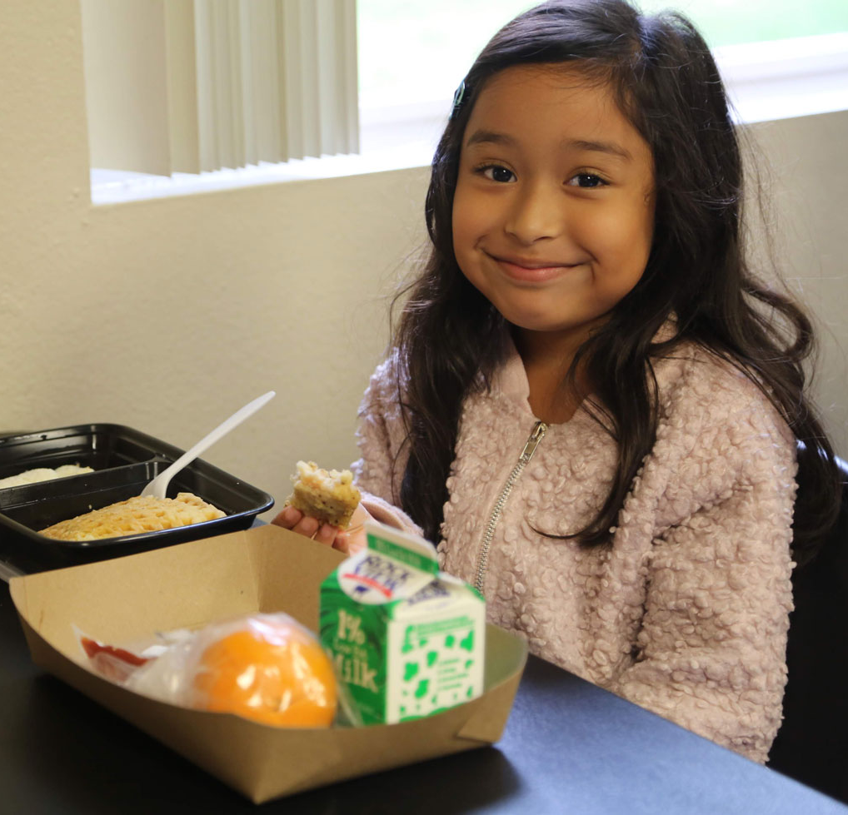
Supper Program Eligibility
There must be an enrichment program on site to offer the Supper Program.
  Schools must be greater than 50% eligible
  Community children under the age of 18 are eligible
  Adults over 18 with disabilities may participate

Slide 3
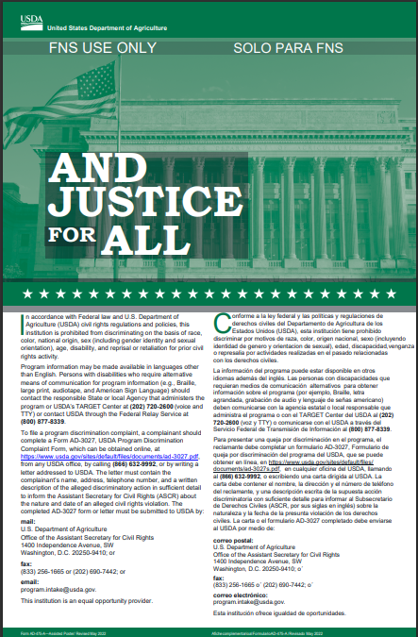
Civil Rights Requirements
All operating sites are required to ensure:
  Equal treatment for all participants
  Good customer service to decrease complaints
  Illegal barriers that prevent participants from receiving benefits are eliminated
  “And Justice for All” poster is displayed where the general public can see and read it
  General public is informed of program availability
    Provide information in the appropriate language

Slide 4
Annual Training
Food Service Division (FSD) is required to provide annual Child and Adult Care Food Program(CACFP) supper training to all Food Services Staff (FS Staff), After School Early Childhood Program (AECP) Staff, and After School Program (ASP) Staff before the start of every school year, new program, and to new employees.

Slide 5
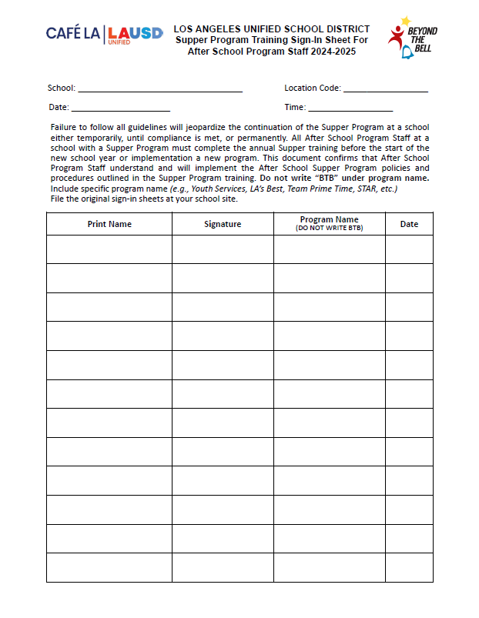
ASP Training Sign in Sheet
ASP staff must be trained prior to working the Supper Program. ASP staff must complete the Supper Program Training located on MyPLN. To verify training completion the “Supper Program Training Sign-in Sheet” is used.
A copy of the completed certification must be shown to the FSM on site
A copy of the “Supper Program Training Sign-in Sheet” will be given to ASP staff for their records
The sign-in sheet must be completed at the beginning of the school year before any food is served.
Do not write BTB

Slide 6
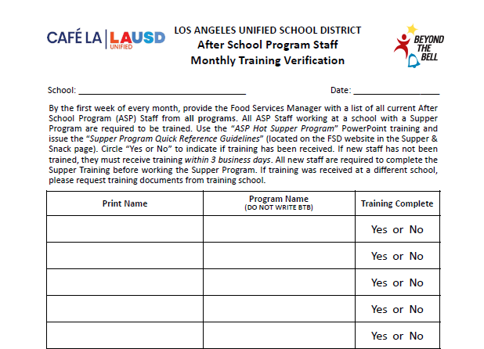
ASP Staff Training
Verification
Happy Elementary
10/18/2026
Due to regular ASP staff turnover, complete the ASP Staff Monthly Training Verification.
  Names will be compared with Supper Program Training Sign-In Sheets.
  FSM will Identify staff in need of training
John Miller
Youth Services
Elizabeth Lee
LA’s Best
George Wilson
LA’s Best
Ann Davis
STAR
Michelle Susette
Boys & Girls Club
Do not write BTB

Slide 7
Early Dismissal Policy
Example: Regular dismissal time is at 2:30pm.
    Meal service times are contingent upon school dismissal.
Cut-Off Time: | Before 1:00 pm | After 1:00 pm
Rule: | Students are served at the regular dismissal time | Students are served at the early dismissal time
Scenario: | Students are dismissed at 12:50pm | Students are dismissed at 1:20pm
Service Time: | Students are served at *2:30pm | Students are served at 1:20pm
    *Exceptions may apply. AFSS approval is required to serve at alternate serving times.

Slide 8
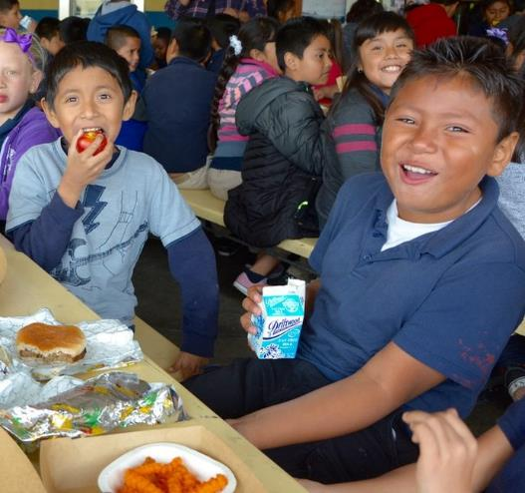
Early Release Students
Service time may be adjusted to accommodate students released before the regular dismissal bell on a regular basis.
These students may include:
  Special Education Students
  Bussed Students
  Other Eligible Programs

Slide 9
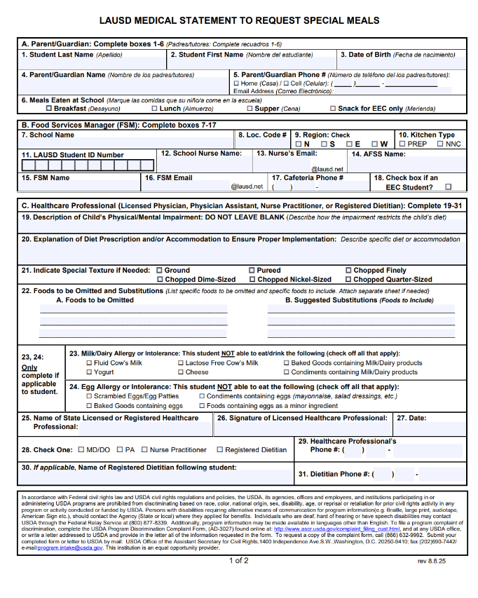
Special Dietary Needs
    Students who require a special meal can complete the “Medical Statement to Request Special Diets form”. ASP will:
    Provide the form to families for completion by the child’s treating physician
    Submit the completed form to the FSM

Slide 10
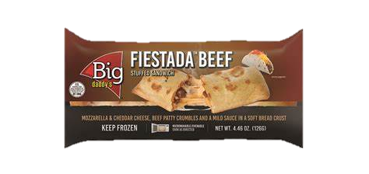

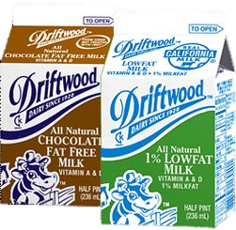

Offer Vs Serve
Must offer all 5 Food Components:
  Grain
  +
  Meat/Meat Alternate
Vegetable
Fruit
Milk
(MUST offer 2 varieties:
1 must be unflavored)
Only 3 components are required to be selected
Student is NOT required to take a fruit or vegetable

Slide 11
Flavored Milk Rule
The CACFP guidelines restricts the serving of flavored milk to students under 1st grade.
  Offer unflavored milk to children in grades kinder and under.
  Children in 1st grade and above can choose between unflavored or flavored milk.

Slide 12
How to spot a Reimbursable Meal

Slide 13
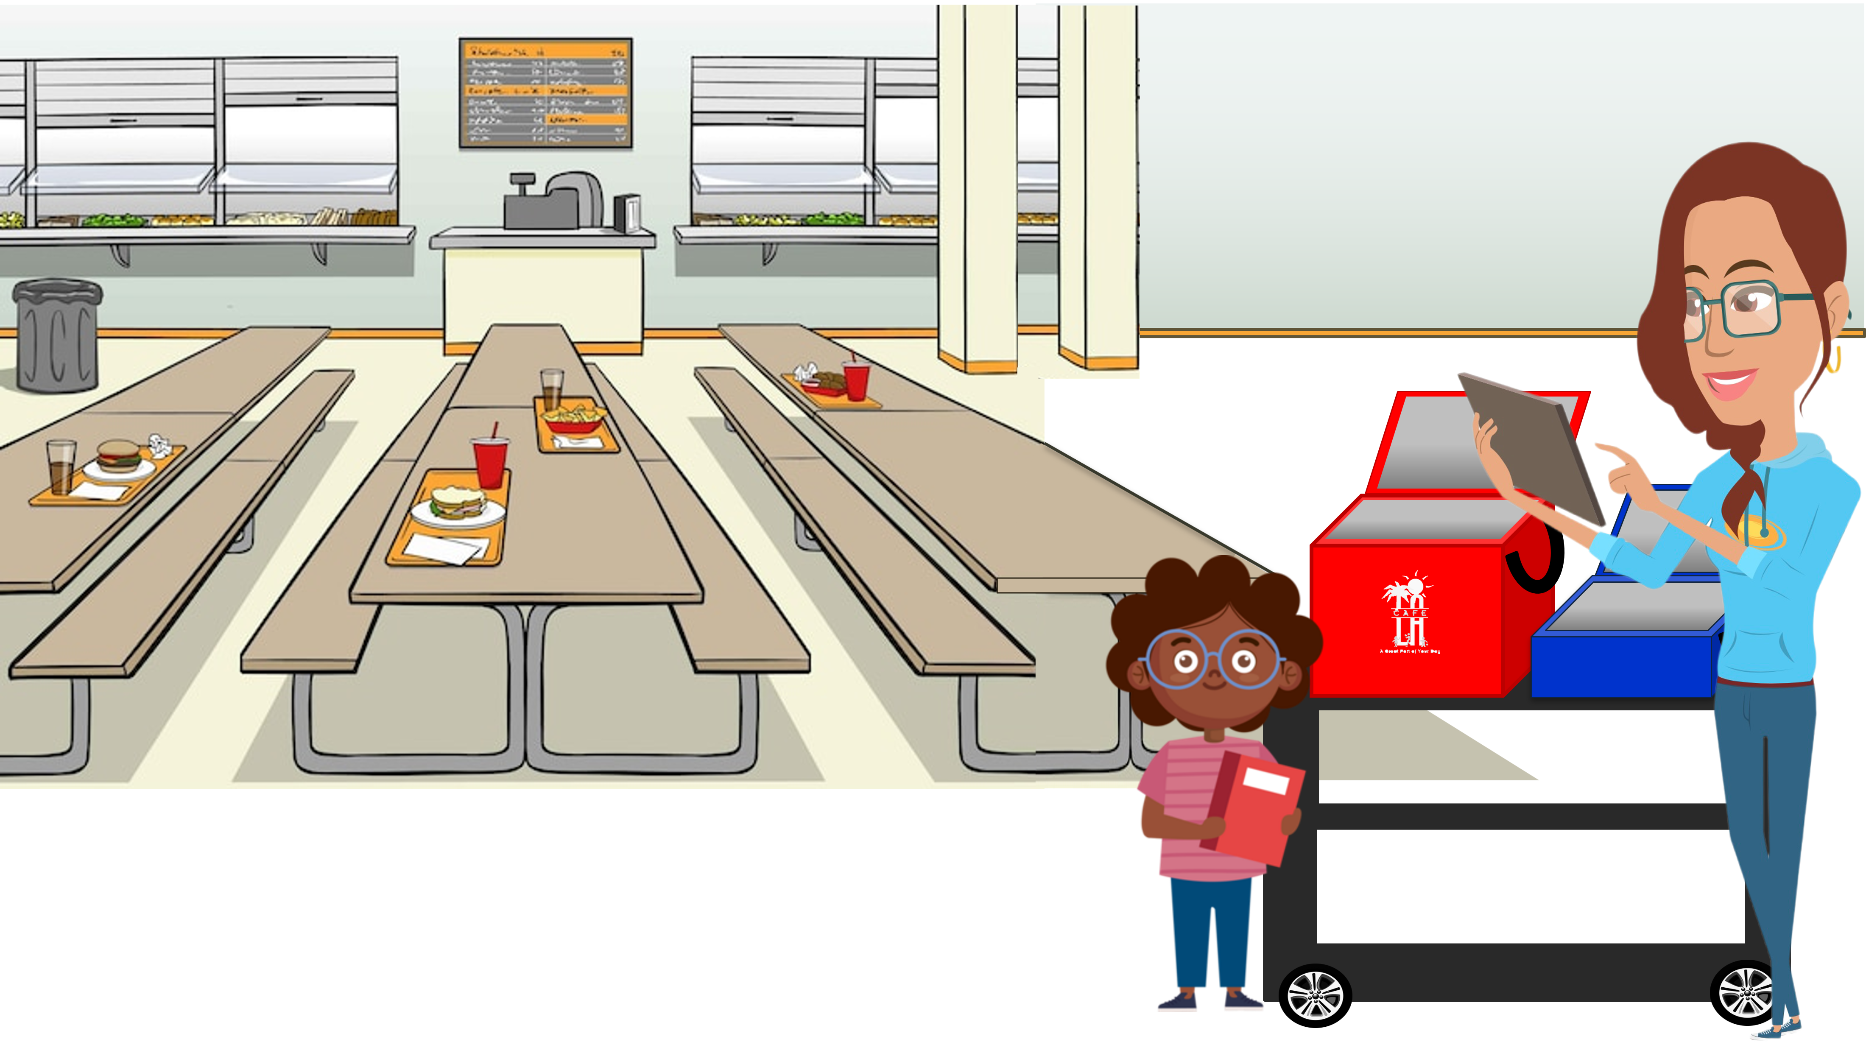
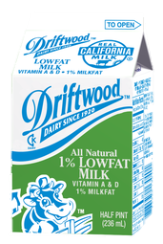

Today’s Menu Items
Is this a reimbursable meal?
1 component food items
2 components entrée

Slide 14
Today’s Menu Items
What about this meal?
1 component food items
2 components entrée

Slide 15
Today’s Menu Items
Last one! Is this a reimbursable meal?
1 component food items
2 components entrée

Slide 16
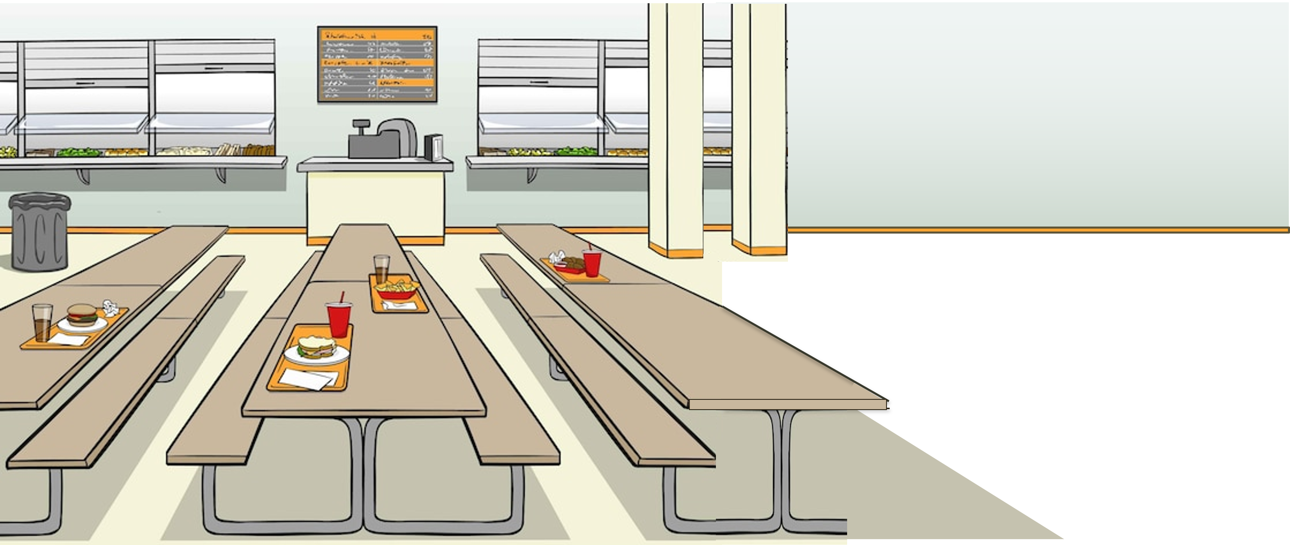

REMINDER
Student is not required to take a vegetable or fruit during supper
3 of the 5 meal components must be selected to complete a reimbursable meal

Slide 17
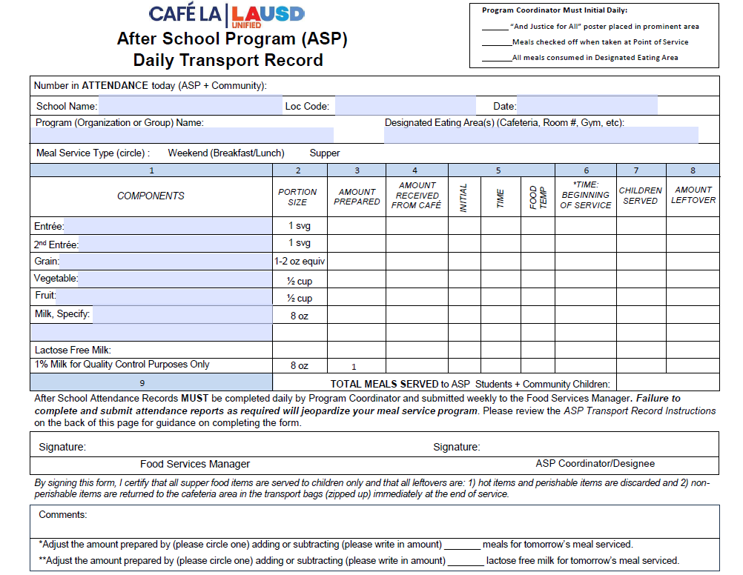
HACCP
Guidelines
ASP Staff are required to follow all HACCP guidelines.
Three(3) clean, sanitized, and calibrated thermometers will be provided by the Food Services Manager to ASP Staff along with sanitation wipes.
ALL potentially hazardous items, hot and cold, must be temped and recorded onto the Supper Daily Transport Record by ASP staff.
FSM will add one carton of milk for temperature-taking purposes.

Slide 18



HACCP
Guidelines
Continued…
When temping pre-packaged items such as packaged fruits and vegetables:
38
Sandwich the thermometer between two pre-packaged items to temp.
Do not puncture the bag of the pre-packaged item.
This can be done with all pre-packaged items such as carrots, apple slices, celery and so forth.
Cold items must temp 41 and below.

Slide 19
Supper Cart Set Up
Because of the OVS model, a supper cart and the BIC dolly may need to be used together to serve supper.
Store food items in BIC insulated bags before service.
Use BIC dolly to carry additional bags to supper area on campus.
Use the shelf space on cart to store 3lb trays and sporkettes.
It is highly recommended to set up near a lunch table in the designated eating
area.

Slide 20
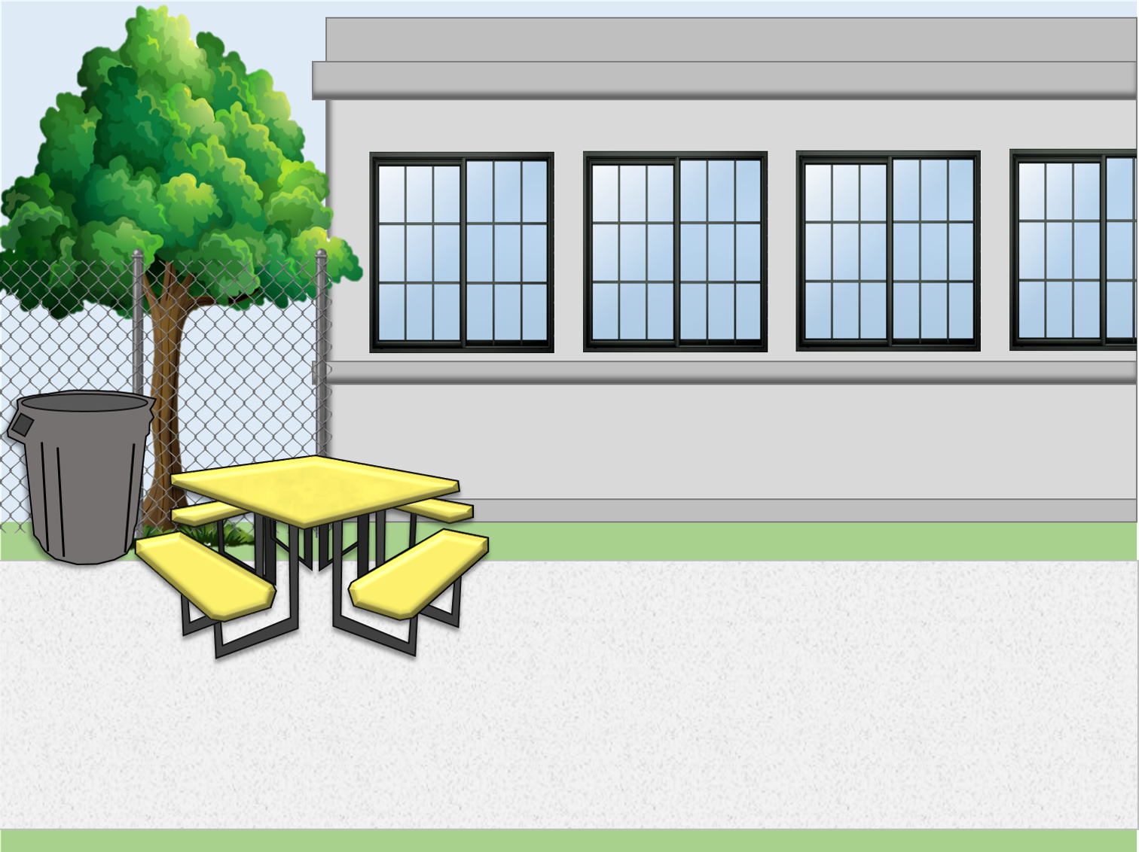

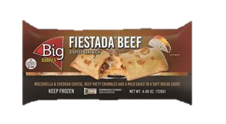

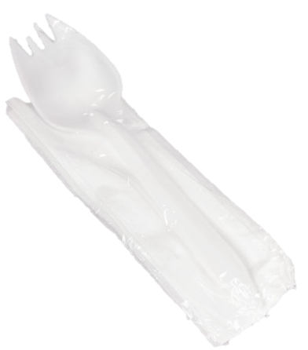
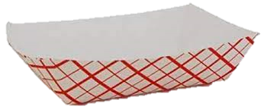

Supper Cart Set Up Example
Your set up may differ according to your participation counts, campus and weekly menu.
Store less popular items in same bag to maximize space.
Do not crush or squeeze food items into bags; use an additional bag.
This model allows for OVS.

Slide 21


Supper Service Example
Staff must ensure reimbursable meals are served BEFORE recording the meals on the ASP/Community Forms. Meals served that are not reimbursable cannot be claimed.

Slide 22

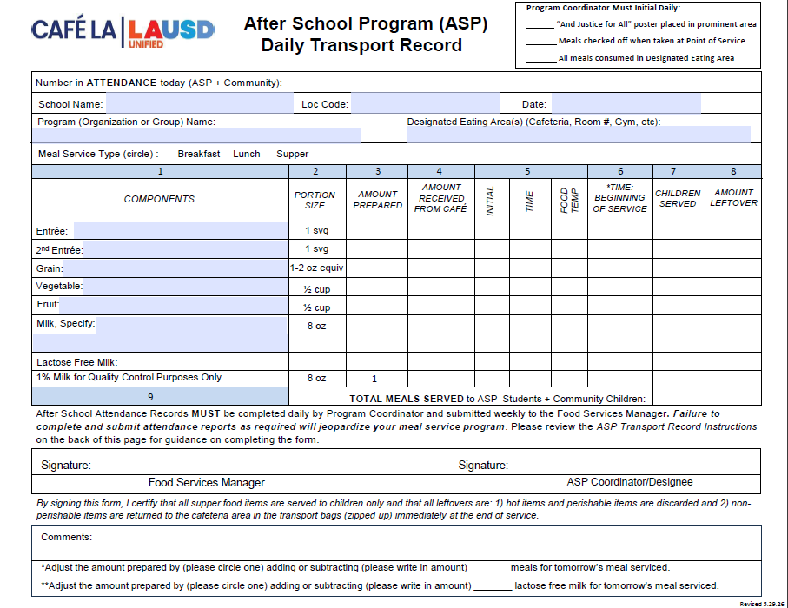


Supper
    The look of the transport has changed but its function has not!
    The Supper Transport Record is used when FSD Staff are not present for the complete duration of the serving period or when food is served by persons not from the FSD.
    Areas added to the transport record to make more space for :
      Multiple entrees
      Different milk types
      Grains served

Slide 23
Supper Transport Record
    FSM or designee will fill the header with school name, location code, program, date, program organization, and designated eating area.
FSM will circle the meal type
    FSM or designee will fill column 1, 2 and 3.
Once received ASP staff will then fill column 4 - 9 and the number in attendance at the top of the form. (this includes taking the temperature of each item)
Halle Bailey
Chloe Bailey
ASP coordinator must sign at the end of service before returning transport record.
    FSM will sign once record is returned. Signifying all fields have been properly filled.

Slide 24
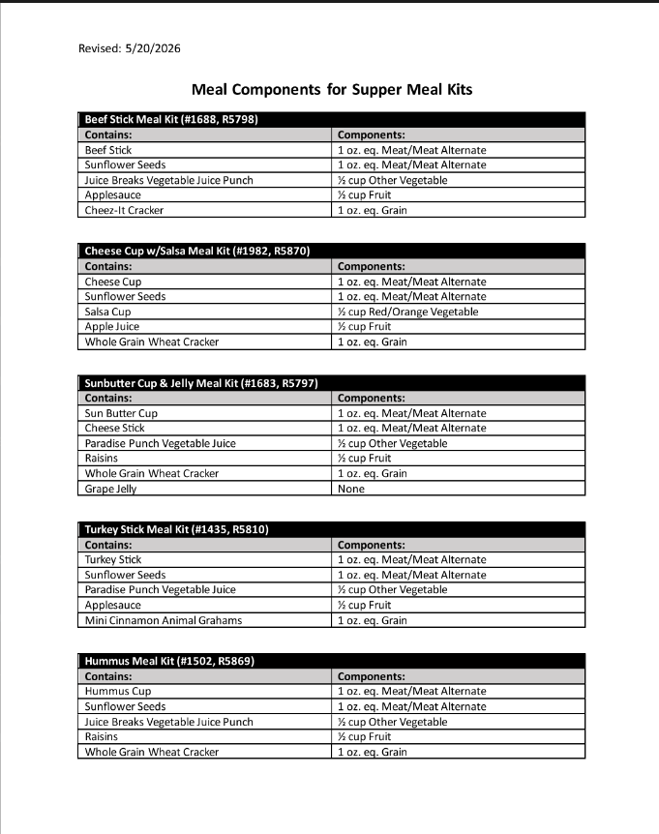
Meal Components for Supper Meal Kits
The “Meal Components for Supper Meal Kits” menu is used to detail components of all meal kits served during supper service.
Step 1: Document the meal kit on the “Daily Transport Record” specifying the meal kits name and catalog number.
Step 2: Staple the “Meal Components for Supper Meal Kits “ menu to the Daily Transport Record.
Write all components of each Meal Kit on the “Daily Transport Record”.
Or

Slide 25
Counting and Claiming Forms
ASP Supper Grid Sheet
Community Roster
5-Day
1-Day
5-Day
1-Day

Slide 26
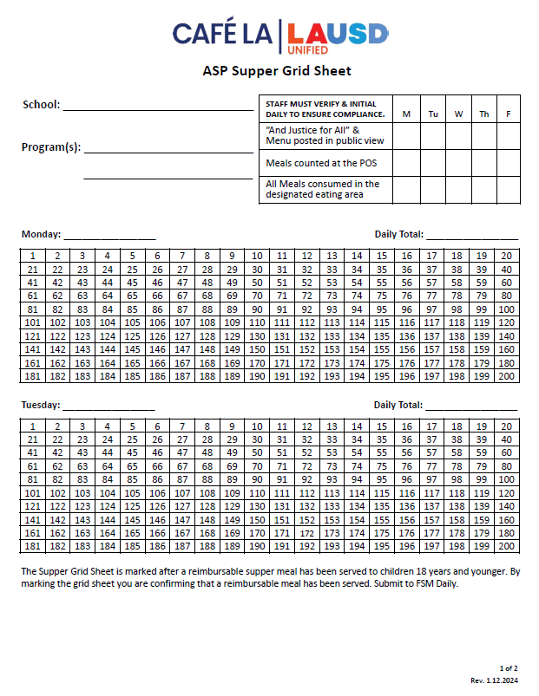
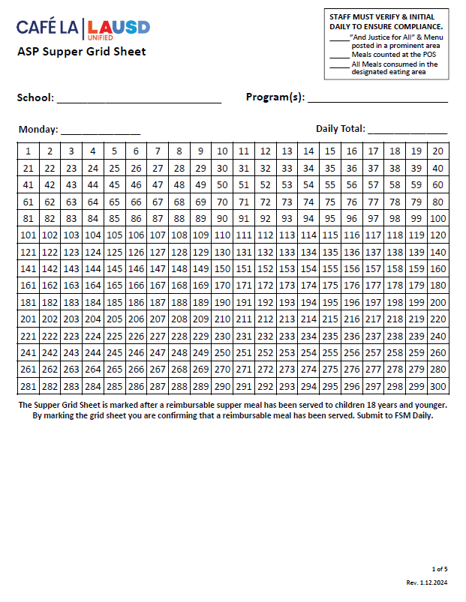
ASP Supper Grid Sheet
These forms record reimbursable meals distributed to the afterschool program students only.
Only trained staff may record meals
Complete heading, date, and record all programs
Verify and initial the compliance box daily
POS staff should focus solely on counting reimbursable meals
Mark each meal in numerical order with a slash or x AFTER a reimbursable meal is served
Record total meal counts daily
Submit to FS Manager daily
5-Day
1-Day

Slide 27
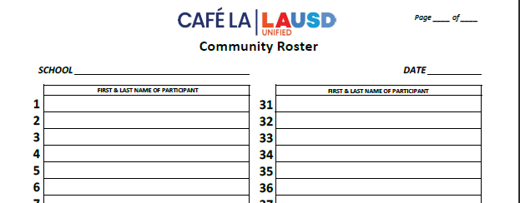
Community Roster
    This form records the attendance and reimbursable meals received by community participants.
      Ensure first & last names are written legibly
      FS or ASP Staff ensures a reimbursable meal is selected before names are recorded
      Young children may be assisted with writing their names
      A community Roster is required at all service locations
      To ensure accuracy in meal accounting, the POS staff should focus solely on counting reimbursable meals
      Submit to FS Manager daily
1 2
Nicole Waterford
Hannah Bankole

Slide 28
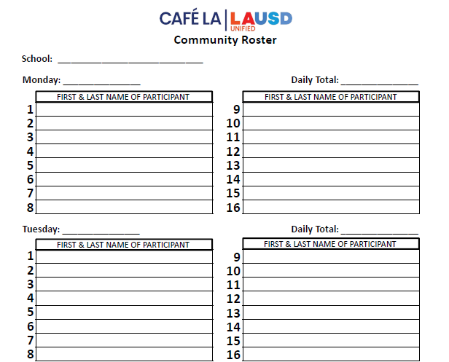

Community Roster Required at ASP Service
Happy El
    ASP staff distributes supper meals to program and community participants.
    However, some ASP Services do not have any community participants.
10/2/2023
0
ZERO PARTICIPANTS
  Is the Community Roster required if
  there are no community participants?
10/3/2023
0
ZERO PARTICIPANTS
Yes!
    Confirm that the count is zero and fill the blank form
      Include the school name and date
      Submit to the Food Services Manager daily

Slide 29
After School Program Service
Meals are prepared by Food Services Staff; FS Staff then transports ASP supper meals to the ASP staff just before service
ASP Staff distributes meals to program students & assists with serving participants from the community for the first ten minutes of service.
Meals are consumed in the designated eating area. ASP staff assist with ensuring no food leaves the campus.
Meal service begins immediately after the dismissal bell rings, and lasts for 30 minutes.
ASP Supper Grid Sheet & Community Roster are required at the point of service.
ASP Staff ensures reimbursable meal is received before placing an "x" on the meal count form.
    *Exceptions may apply. AFSS approval is required to serve at alternate serving times.

Slide 30
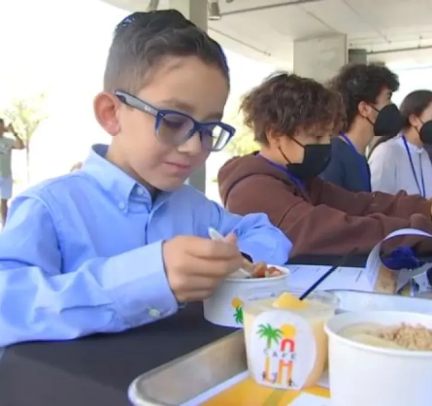
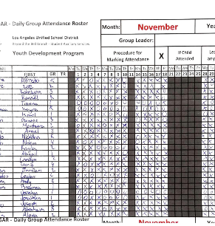
Program Attendance Rosters
    Program attendance rosters record students present in afterschool programs and support the meal counts on the ASP Supper Grid sheet.
    Attendance Rosters must be:
      Greater than or equal to meal counts to support meal claims
      Include student names:
        Can be electronic or manual copies
        Must be submitted weekly
        If rosters are not submitted weekly contact your AFSS

Slide 31
Distribute meals to program students and assist community for the first 10 minutes or as needed.
Supervise & direct students to the designated eating area.
ASP
Meal Service
Make sure program is open to the community.
Follow all HACCP guidelines when serving menu items.
Clean spills, wipe tables, pick up trash & empty bins.
Responsibilities
Total daily attendance for all programs and record accurate meal counts.
Ensure no food is taken from campus.

Slide 32
In the event there are no FS staff on site at the end of service:
ASP Leftovers
ASP staff are to discard all hot and refrigerated items and return all non perishable items to the cafeteria or designated space.
If a refrigerated space has been delegated ASP staff may return all refrigerated items to the delegated refrigeration unit.
Responsibilities

Slide 33
ASP Staff
WILL NOT
Prepare any food items
Push community carts out to designated areas
Remove hot food from warmers or ovens
Serve participants inside the kitchen area

Slide 34
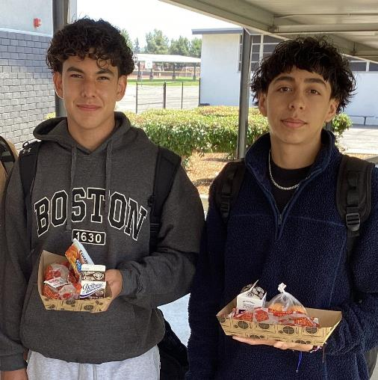
Good Nutrition
All Day Long
    Providing healthy meals shouldn’t stop once the last bell rings. Often times, parents are still at work when their children get out of school.
    Serving hot supper meals allows children to receive three nutritious meals a day to support their growing bodies and learning needs.

