Slide 1

Social Networking
Positives of Social Networking
Negatives of Social Networking
Safety of Social Networking
Types of Social Network Opportunities
Original Presentation Created by Lori Kesilman – Palisades Middle School

Slide 2

What is
“Social Networking?”
Definition: (n.) the use of a website to connect with people who share personal or professional interests, place of origin, education at a particular school, etc.

Slide 3

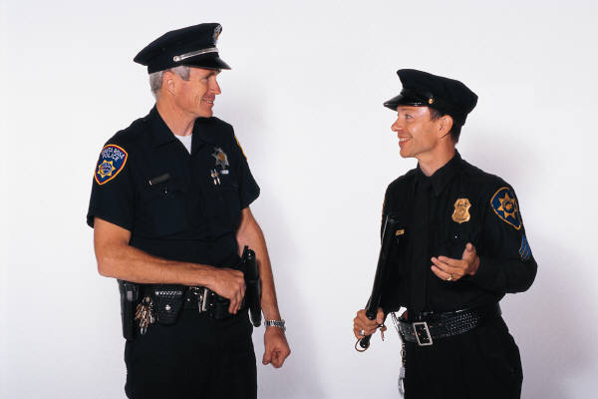

Safety
Since most social networking sites don't require much information it is easy for predators to stalk victims.
Once you post images and other personal information on a social networking site, it is easy for other people to access your site.
Once you post any media or personal information on some sites, others can claim ownership to this material.

Slide 4
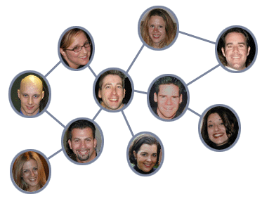
The PROS…
Interpersonal communication is made simpler, and allows people to remain connected.
Meeting new people is easy, and more common.
Makes it easier for people who have a common interest to meet and/or keep in touch

Slide 5
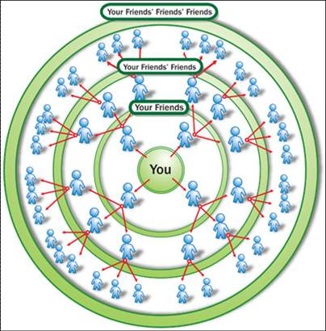

Business & Trade
Online communities aide in conducting businesses.
Sites like eBay and Craig’s list allow users to exchange goods.

Slide 6

Love & Wellness
Many turn to sites like eHarmony and match.com in search of dates.
People can exchange personal info and communicate to create relationships.
Healthcare professionals are using social networks to manage institutional knowledge.
These sites are also used to highlight individual physicians and institutions.

Slide 7
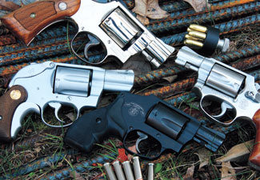
Justice
In February 2006, a 16-year-old Colorado boy was arrested for juvenile possession of a firearm after police saw pictures that he had posted on MySpace of himself posing with rifles and handguns. He was later convicted in 2006.
The Criminal Justice System has jumped on the bandwagon and has begun to use social networking sites as evidence in many criminal investigations.
Sites like Facebook and MySpace are the top sites used by police to prosecute criminals.

Slide 8

The NEGATIVES…
The internet is not temporary. Once something is made public, it is archived.
      Pictures
      Words
      Way Back Machine
Bullying
It can affect a potential school or job
‘Friends’ may not always be who they say they are

Slide 9
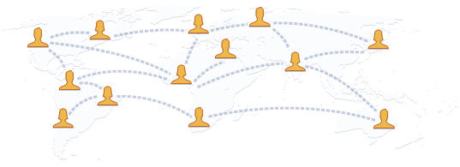
Facebook
Facebook is more of a lifestyle play which allows users to connect with each other.
Founded in February 2004, Facebook is a social utility that helps people communicate more efficiently with their friends, family and coworkers

Slide 10
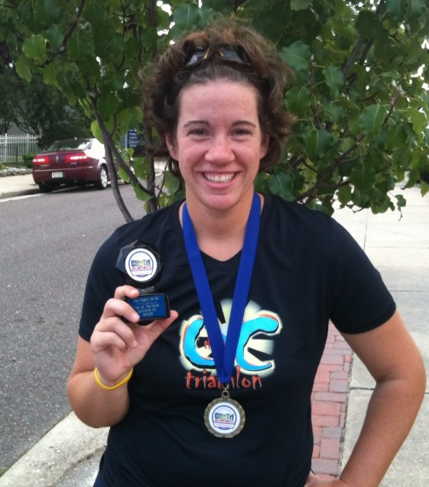
Facebook Stats.
# 1 Photo Sharing application.
60 million active users since 2007
More than ½ users are outside of college.
Demographic of 25 and older.
65 billion views per month
Average amount spent on site is 20 minutes per day.

Slide 11


twitter
Started as a side project in March of 2006.
Used to stay connected with friends, relatives, and coworkers
This means you can step in and out of the flow of information as it suits you
Users are very much in control of whose updates they receive, when they receive them, and on what device.

Slide 12
As a parent I will…
Let my kids be a part of social networking sites with the following precautions:
    I will set the privacy controls
    I will keep the computer in a public space
    I will know their passwords
    I will only let them be a part of sites like MySpace and Facebook if you they accept me, the parent, as a friend
    I will limit online time

