Slide 1

Gr. 4 Partial Content Specialty Model
Gr. 3 to Gr. 4 Family Transition Mtg.
June 16, 2025
Notes:
John

Slide 2
BENEFITS
FOR STUDENTS:
FOR TEACHERS:
Change of environment to prevent monotony
Improved social interaction and behavior
Opportunity to move throughout the day
Increased student engagement
Learning from a “specialized” teacher
More focused instruction better meets specific educational and behavioral needs
Multiple teaching styles
Increased opportunity for academic achievement
Better prepared for expectations and transitions in Middle School
Teachers become “specialists” in their subjects
Specific professional development based on subject matter
Collaboration among colleagues for planning and interacting with students
Collaboration among colleagues regarding behavioral concerns, parent meetings, educational meetings for testing referrals
Higher morale among teachers
More focused workload
Notes:
John:
I would like to start off by speaking to some of the benefits of the Partial Content Specialty Model (or Departmentalization). The perceived benefits that I will share have been collected through sample studies, research from site visits as well as collaboration with educators.
A. First, teachers who “specialize” in one area of core content are able to increase their own knowledge and proficiency in that content and thereby increase students’ proficiency. This often led to increased test scores and academic achievement. Research indicated that this is particularly true in mathematics. A Columbia University study indicated, “ Departmentalization may not only provide an immediate increase in the mathematical proficiency of students, but evidence suggests that it may provide an increase in the mathematical proficiency of the students for years to come, benefitting them throughout the rest of their lives.”
B. Students have more teachers who know them and care about them every day instead of just one classroom teacher. Teachers have the opportunity to share their observations and most importantly to share different approaches they use to reach individual students successfully. In effect, a struggling student has a team of teachers working together to help them.
C. Anecdotal observations and academic studies indicate that behavior problems often decrease under departmentalization. Students gain organizational skills as they learn how to keep track of assignments for multiple teachers, and they gain confidence that they can handle the transition to a fully departmental Gr. 5 model and then middle school.
D. Teachers can receive targeted professional development based on subject matter to address and upgrade skills. Furthermore, studies have shown that while departmentalization increases the number of students a specialized teacher teaches, this does not adversely affect assessments or pedagogy.
In fact, educators have found they had more time to prepare lessons with depth in their core areas as they no longer had to attend meetings for other subjects or prepare materials and lessons for other subjects. Findings revealed, in the upper elementary grade, teacher preference for the departmentalized instructional model over the self-contained model due to more focused and quality instruction in specific subject areas, and increased self-efficacy.

Slide 3
PREPARATION
We’ve done it!
Initial development included opinions from all stakeholders, PPLT members provided parent and community input.
In the initial development of a content specialty model teachers, administrators and members of Central Office made site visits to area schools that have implemented departmentalization to gather third-party viewpoint as to viability.
A flexible master schedule has been created.
Notes:
John

Slide 4
How it Will Work at WEC
We have implemented a partial content specialty model. Students will be assigned to a homeroom, but they will move throughout the day to different classrooms for core subjects.
Essentially, the grade will be broken up into two teams with half the grade level and two teachers on each team. On each team, the teachers will split the core subject areas.
For example, on Team A, Teacher 1 will teach Math and Science, and Teacher 2 will teach ELA and Social Studies.
Notes:
Pete

Slide 5
How it Will Work at WEC
Students will follow a schedule each day, and every student will have a copy of his/her own schedule for easy reference. There will be 8 periods in a day, including core subjects, specials, lunch/recess and W.I.N. (What I Need).
Notes:
Pete

Slide 6
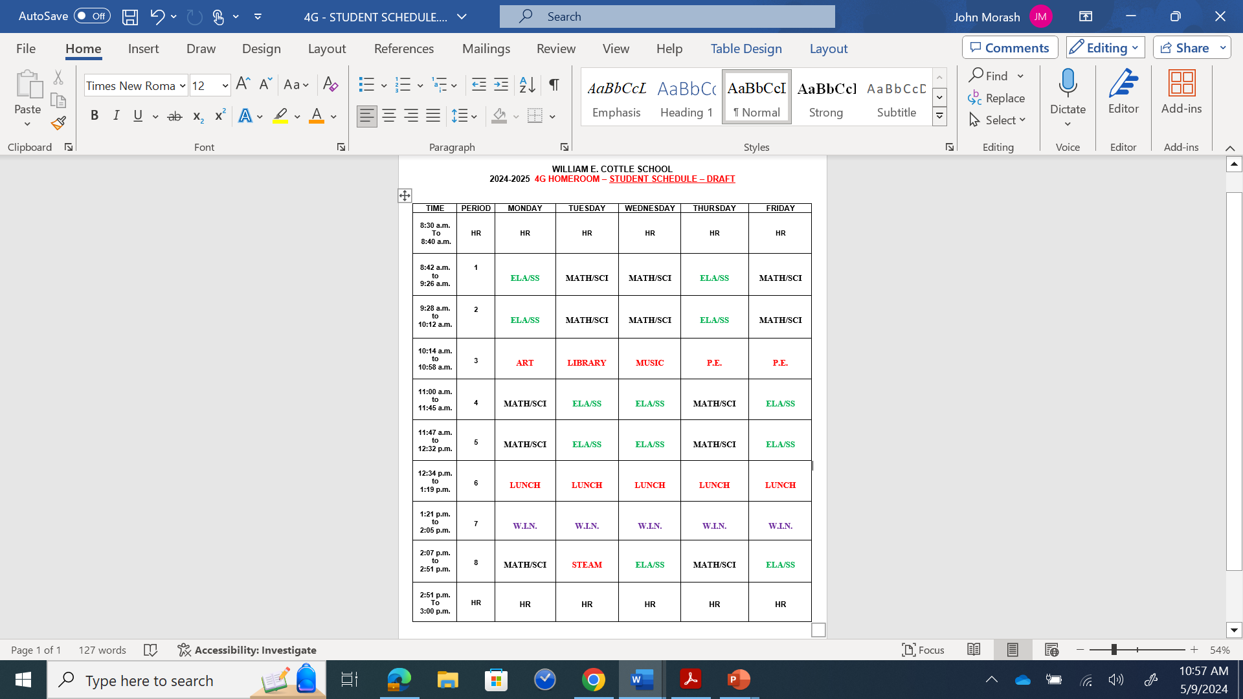
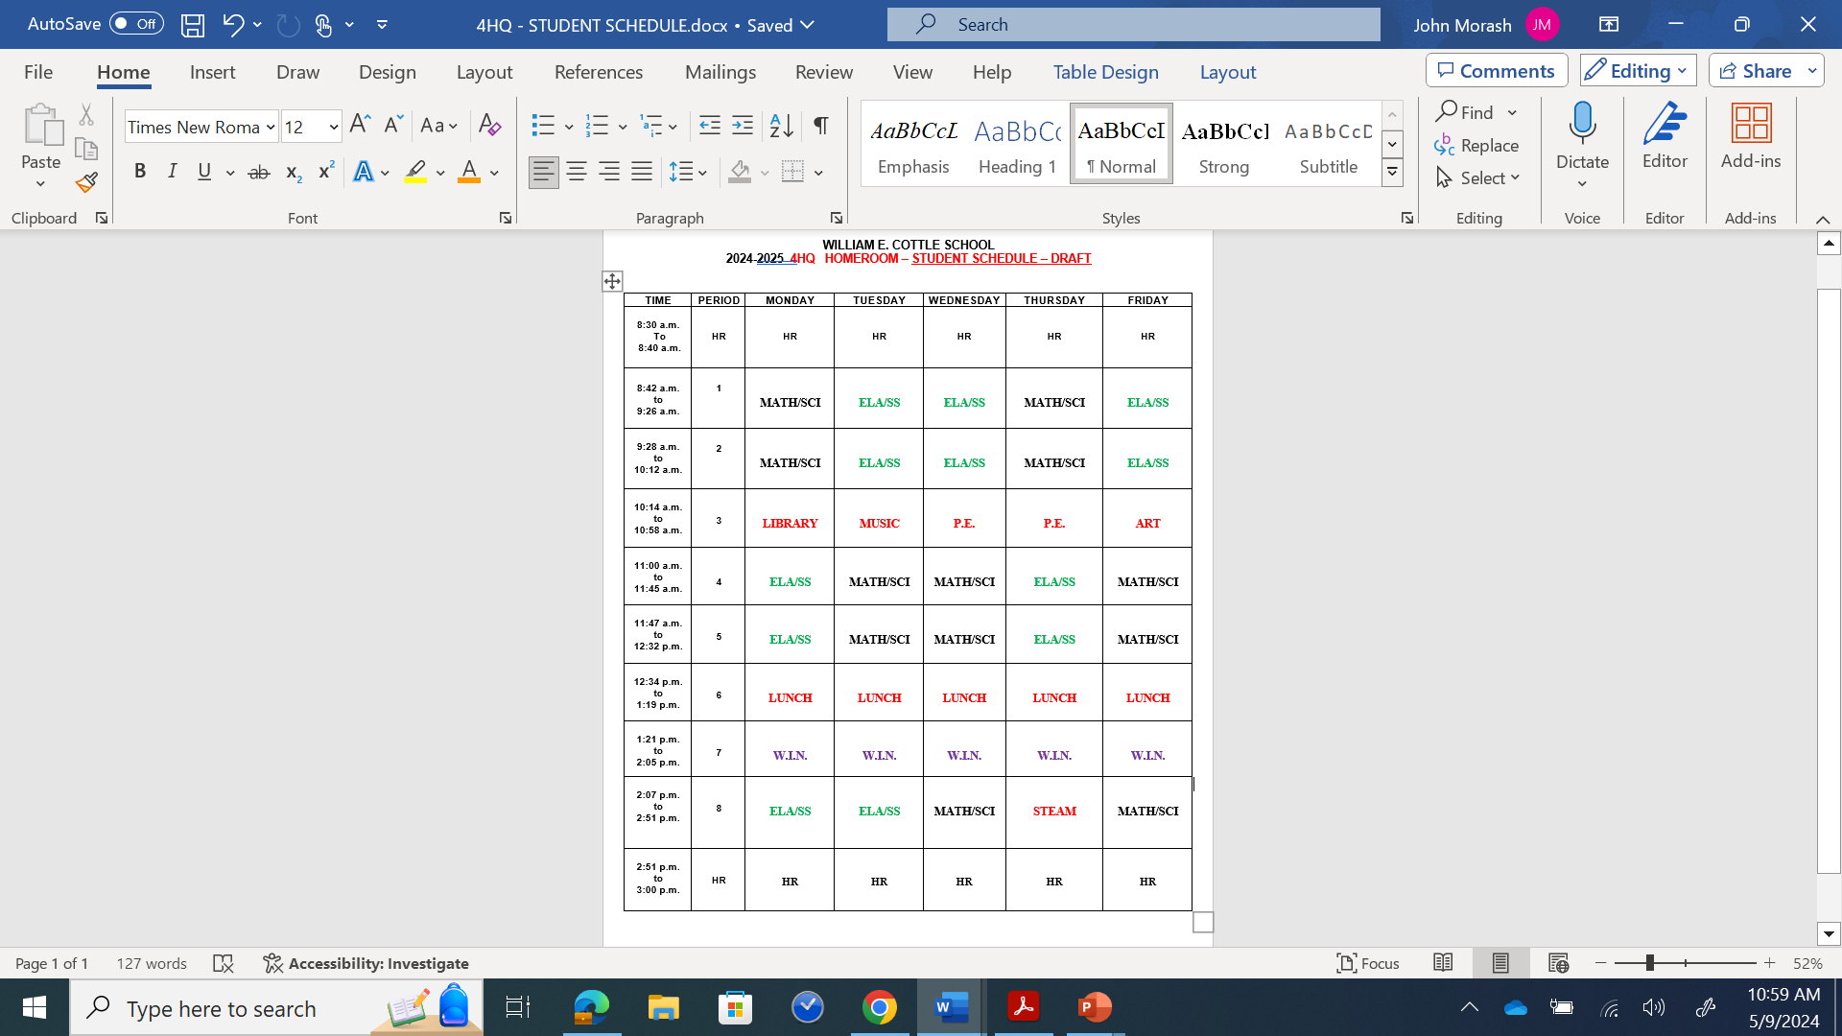
Notes:
John

Slide 7

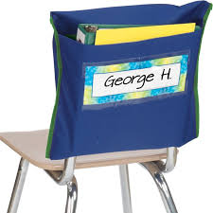
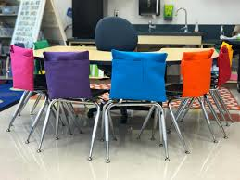
Nuts and Bolts
The students will not have lockers. However, the students will have “Chair Pockets” placed on the back of chairs. This is where students coming in from another Homeroom can store their materials while in another classroom, or the students may bring the whole “Chair Pocket” with them between classes.
Notes:
Pete

Slide 8
Nuts and Bolts
First day of School will look different for Grade 4.
  Orientation with clear expectations from Admin.
  Homeroom Teachers will review schedules and routines
Notes:
Pete

Slide 9
Homerooms/Placement
As always, placement will be a very careful, collaborative process among teachers, school psychologists, learning specialists and administration to create carefully balanced and heterogeneously mixed classes.
Notes:
John

Slide 10
Special Activities
4th Grade Circus
Wax Museum
Band/Strings Concerts
Theater Performance
Notes:
Vinny

Slide 11
PD and Planning Time
More focused C.P.T. (Common Planning Time)
Targeted PD based on subject area
Notes:
Pete

Slide 12
Final Thoughts and Observations
Gr 4 WEC teachers are experienced professionals knowledgeable in Gr 4 curriculum
Content Specialty Model does NOT mean there will be “major curriculum changes”
It DOES mean a chance for more focused lessons and deeper understanding of core concepts for ALL students
Notes:
Pete

Slide 13

THANK YOU!
ANY QUESTIONS?
Notes:
John

