Slide 1

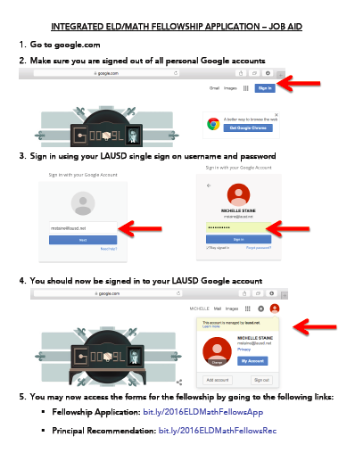
Integrated ELD/Math Fellowship
Only 60 spots
Deadline on February 5th
New Requirement: 50% ELs of More in Teacher’s Classroom
Please put the flyer and job aid in the hands
of your teachers as soon as possible.

Slide 2

Poll Everywhere – Status Check

Slide 3
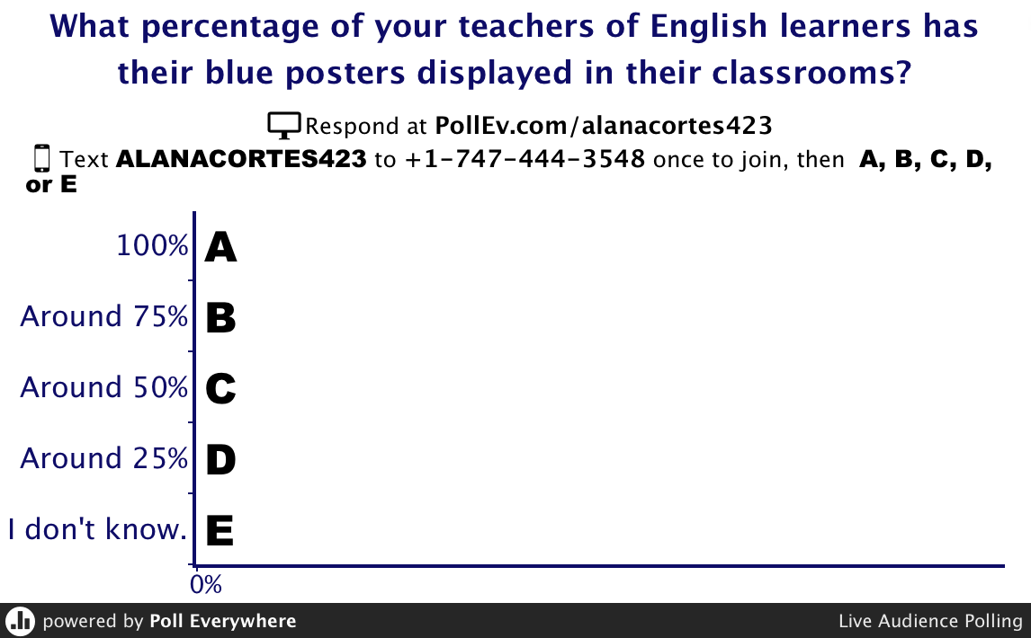
Poll Everywhere
Let’s Go
Live

Slide 4
Poll Everywhere Results
Question | November Results | January Results
100% of EL teachers have blue posters up | 33% | 48%
I don’t know about teachers having blue posters up | 18% | 0%
100% of EL teachers have class set of CC game cards | 30% | 38%
I don’t know about teachers having CC game cards | 30% | 16%

Slide 5
Poll Everywhere Results
Question | November Results | January Results
Read 3 days of Start Smart | 68% | 82%
Haven’t yet read 3 days of Start Smart | 32% | 18%
Taught a Start Smart Lesson | 25% | 46%
Haven’t yet taught a Start Smart Lesson | 75% | 52%
Have used the SPF with students | 25% | 39%
Haven’t yet used the SPF with students | 75% | 61%

Slide 6
Let’s Do One More Poll, But First..
an Activity
Take out your Essence of the Standard handout and a writing tool.
Put everything else away (notes, phone, computer, other materials.)
Now, for 5 quiet minutes, see how many strands you can write down on the handout without referencing other resources (that means you can’t reference your elbow partner either.)
If you can put the strands in the correct mode or process, great. Even better would be if you can put in the correct strand number.

Slide 7
Let’s Do One More Poll, But First..
an Activity
Write on the edge of your paper how many strands you were able to write down.
Now you can turn to your elbow partner to help each other to write additional strands.
Finally, look at your ELD Standards to complete and correct the strands on your paper.

Slide 8
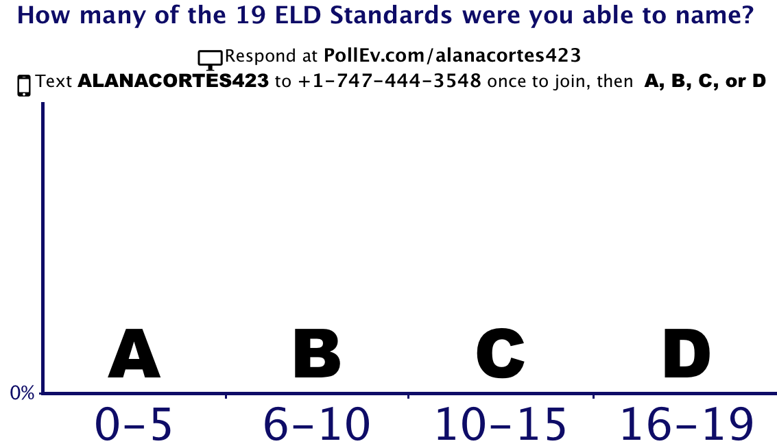
Poll Everywhere
Let’s Go
Live
Set a personal goal for how many strands you will know next month.

Slide 9
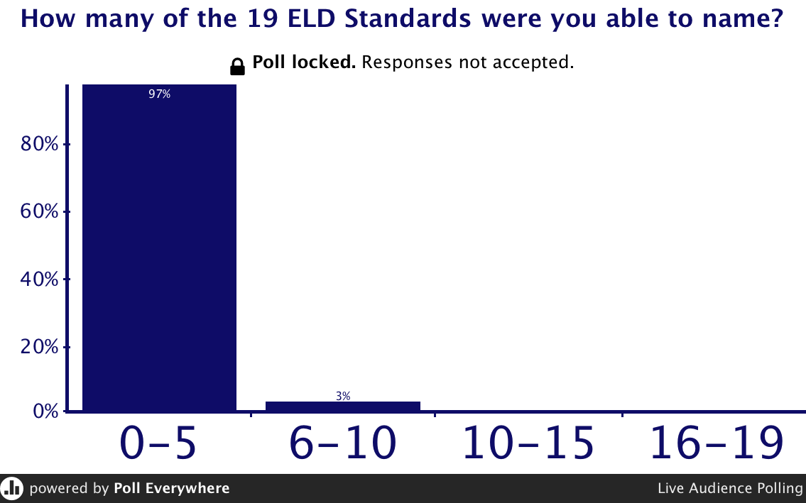
Our Results…

Slide 10


Slide 11
ELD Intervention Brainstorm
Think about ELD interventions that have been provided or could be provided at your school site.
Think about those English learners who get stuck at Intermediate level on CELDT for 3 or more years.
Jot down your ideas on your graphic organizer.

Slide 12

Turn to a partner
and share
Turn together, type (engage in A2, joint writing)
and share with our EL Designee Community
http://tiny.cc/ldw-intervention

Slide 13
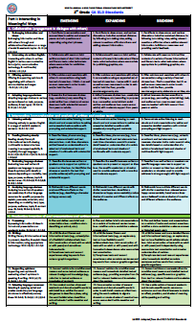
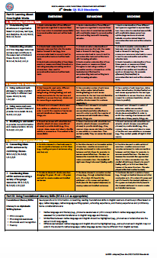
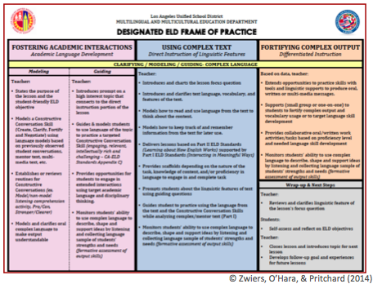

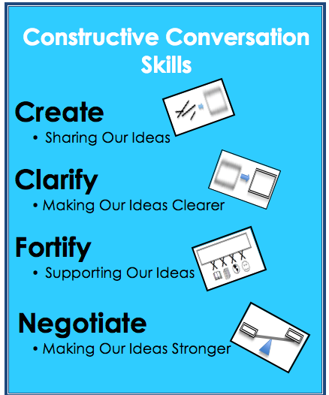
ELD Classroom
Practice

Slide 14
What We Want to Observe in Our Classrooms During ELD
Brainstorm
What are specific elements of effective instruction or guiding principles of learning in ELD instruction?
What are explicit teacher or student behaviors that are called out in our Designated ELD Frame of Practice?
What is observable evidence of teaching and learning during ELD? (i.e. instructional strategies, learning activities, behavioral outcomes, artifacts, routines, practices)

Slide 15
http://tiny.cc/ldw-eldpractice
What we
want to observe during ELD

Slide 16
MMED’s
Comprehensive ELD
Observation Tool
Let’s Connect
What We
Discussed
with

Slide 17
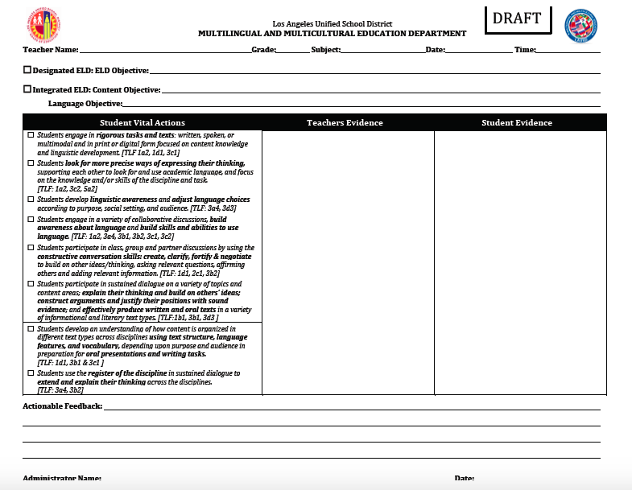
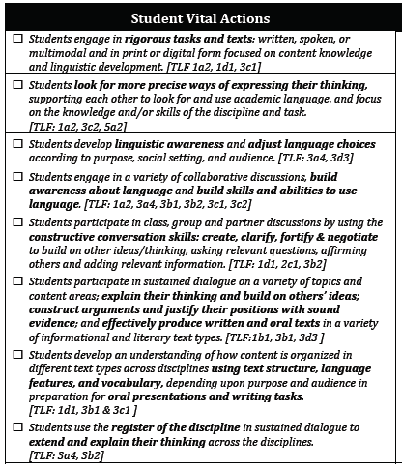
for self

Slide 18
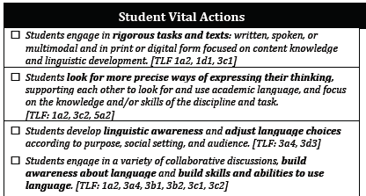
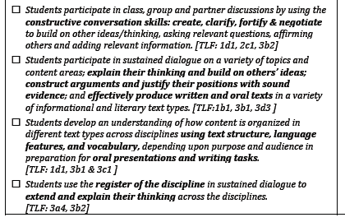

Slide 19
Consider what we surfaced regarding what we want to observe during ELD and where there is a direct connection to the Student Vital Actions.

Slide 21
Thoughts About Use of the Observation Tool (by Administrators)
Record student and teacher language that provides evidence regarding student vital actions
Check off student vital actions that were observed
Align actionable feedback to the student vital actions and/or the ELD Standards
Possibly predetermine which student vital action(s) you will be looking for during observations

Slide 22
As we continue to learn about
Designated ELD instruction
based on the Frame of Practice,
keep the
Student Vital Actions
in mind.

Slide 23


Slide 24
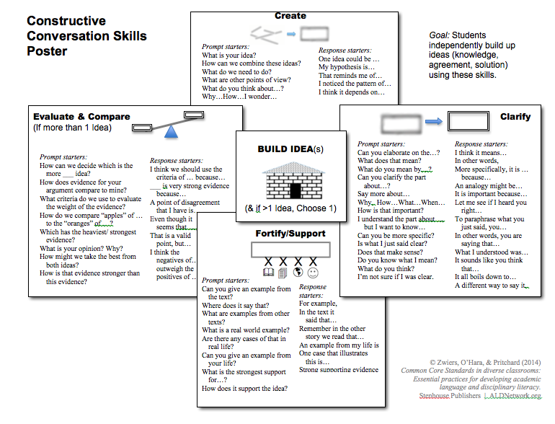
Constructive
Conversation Skills
Placemat
Create
Negotiate
Clarify
Fortify/Support

Slide 25
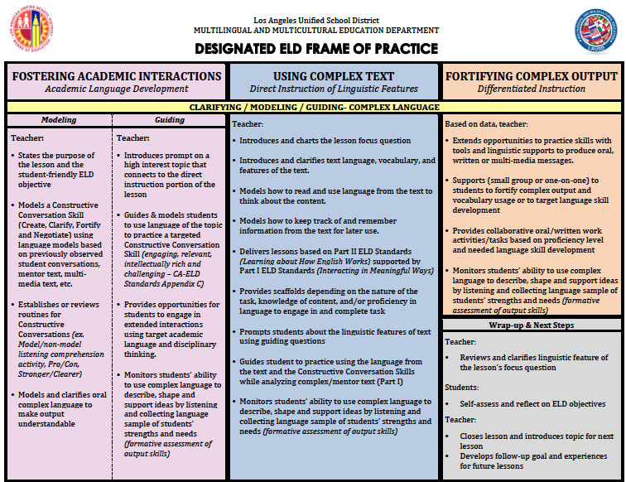
Our area of focus…
Using Complex Text
We started this practice during Start Smart
We started this practice during Start Smart
© Zwiers, O’Hara, & Pritchard (2014)

Slide 26
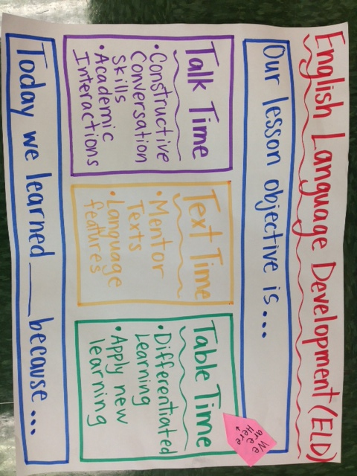
Frame of Practice
We are here

Slide 27
Understanding Mentor Text
A mentor text is identified from a selection that has been used during ELA and other content areas, after being read for students to get basic comprehension of the selection.
A mentor text can contain several connected sentences (6-8) in which each sentence can lend itself to teaching the ELD Standard that has been selected to teach.
The sentences should be complex and rich enough to have discussions about the structure, meaning, word choice, etc.

Slide 28
Let’s Apply the Standards to a Mentor Text
CA ELD Standard for Grade 4
  Part II: Learning About How English Works
  B: Expanding and Enriching Ideas
  4. Using nouns and noun phrases (Expanding) Expand noun phrases in a variety of ways (e.g. adding adjectives to noun phrases or simple clause embedding) in order to enrich the meaning of sentences and add details about ideas, people, things, etc.)
  Step 1: Turn the standard into a “focus question,”
  e.g., How Do Noun Phrases Add Detail to a Text?
Structure/What?
Purpose/Why?

Slide 29
Day 1 Lesson
A Drop of Water
There are few objects you can make that have both the dazzling beauty and delicate precision of a soap bubble. Shown here at actual size, this bubble is a nearly perfect sphere. Its shimmering liquid skin is five hundred times thinner than a human hair.
Bubbles made of plain water break almost as quickly as they form. That’s because surface tension is so strong the bubbles collapse. Adding soap to water weakens water’s surface tension. This allows a film of soapy water to stretch and stretch without breaking.

Slide 30
Day 2 Lesson
A Drop of Water
There are few objects you can make that have both the dazzling beauty and delicate precision of a soap bubble. Shown here at actual size, this bubble is a nearly perfect sphere. Its shimmering liquid skin is five hundred times thinner than a human hair.
Bubbles made of plain water break almost as quickly as they form. That’s because surface tension is so strong the bubbles collapse. Adding soap to water weakens water’s surface tension. This allows a film of soapy water to stretch and stretch without breaking.

Slide 31
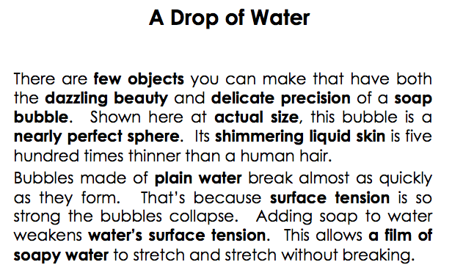
Questioning Protocol for Day 2: Step 2
Create text analysis guiding questions:
Guiding Question #1: Read sentence #1. Look at the noun phrases in bold.
  What words were added to the nouns?
  What details do they add to the nouns?
Guiding Question #2: Read sentence #2. Look at the noun phrases in bold.
  What words were added to those nouns?
  What details do they add to the nouns?
Guiding Question #3:Read sentence #3. Look at the noun phrases in bold.
  What were words added to those nouns?
  What details do they add to the nouns?
Guiding Question #4:Read sentence #4. Look at the noun phrases in bold.
  What words were added to those nouns?
  What details do they add to the nouns?

Slide 32
Questioning Protocol: Step 2
Guiding Question# 5: Read sentence #5. Look at the noun phrases in bold.
    What words were added to those nouns?
    What details do they add to the nouns?
Guiding Question# 6 Read sentence #6. Look the noun phrases in bold.
    What words were added to those nouns?
    What details do they add to the nouns?
Guiding Question# 7 Read the last sentence. Look the noun phrases in bold.
    What words were added to the nouns?
    What details do they add to the nouns?
Wrap Up Guiding Question: How do all the noun phrases enrich our understanding of the text?

Slide 33
Test Your Understanding with a…
Mentor Text Match-Up
With a Partner:
Read each text
Match each text with one ELD Standard and one Guiding Question:
  Which Part II standard and Guiding Question best apply or do not? Why?
  Have a Constructive Conversation
Mentor Text | Part II ELD Standard | Guiding Questions

Slide 34
Make a Mask
You can make a mask, too! First, get a plate. Cut holes into it. Check that you can see.
Next, color the mask. Paste fun things on it. Soon you will have a mask!
Last, tape a band on the back of the mask. Put the mask on. Who are you?
Part II: How English Works
A: Structuring Cohesive Texts
1. Understanding Text Structure. (Expanding): Apply understanding of how different text types are organized to express ideas (e.g., how a story is organized sequentially with predictable stages versus how an informative text is organized by topic and details) to comprehending texts and writing texts in shared language activities guided by the teacher and with increasing independence.
Guiding Question:
Let’s look at the sentence.
What word tells you when the action is happening?
How does it help connect the actions?
Notes:
1 minute
Review matches whole group.
For each text, ask:
What standard does this text exemplify (Mentor text)
What Guiding Question best fits this text. Why?
Elicit responses from participants.
You may have participants refer to their Standards at a Glance or Matrices as a resource if necessary.

Slide 35
Part II: How English Works
B. Expanding & Enriching Ideas.
4. Using nouns and noun phrases. (Expanding Level) Expand noun phrases in a growing number of ways (e.g., adding a newly learned adjective to a noun) in order to enrich the meaning of sentences and to add details about ideas, people, things, etc., with increasing independence.
Swimming along, sometimes at great speed, sometimes slowly and leisurely, sometimes resting and exchanging ideas, sometimes stopping to sleep, it took them a week to reach Amos’ home shore. During that time, they developed a deep admiration for one another. Boris admired the delicacy, the quivering daintiness, the light touch, the small voice, the gemlike radiance of the mouse. Amos admired the bulk, the grandeur, the power, the purpose, the rich voice, and the abounding friendliness of the whale.
Guiding Question:
Let’s look at the sentence.
What are the noun phrases?
How does each noun phrase add details about…?
Notes:
1 minute
Review matches whole group.
For each text, ask:
What standard does this text exemplify (Mentor text)
What Guiding Question best fits this text. Why?
Elicit responses from participants.
You may have participants refer to their Standards at a Glance or Matrices as a resource if necessary.

Slide 36
Part II: How English Works
B. Expanding & Enriching Ideas.
3. Using verbs and verb phrases. (Expanding Level) Use a growing number of verb types (e.g., doing, saying, being/having, thinking/feeling) and verb tenses appropriate for the text type and discipline to convey time (e.g. simple past for retelling, simple present for a science description).
Days were long and lonely. The hills spread out as far as forever. Nights, me and Ma and my brothers and Baby Betsy would sit out and wait for a shooting star to sail across the sky. Once in a while a crow flew by. That’s all the excitement there was.
My brothers worked up some furrows. They planted corn and potatoes and beans. Then they ran around climbing trees, skinning their knees. But after all the water was fetched and the wash was done, after the soap was made and the fire laid, after all the beds were fixed and the floor was swept clean, I’d sit outside our cabin door with Baby Betsy, so bored I thought I’d die.
Guiding Question:
Let’s look at the sentence.
What kinds of verbs are in the sentence?
How do these verbs convey or show a sense of time?
Notes:
1 minute
Review matches whole group.
For each text, ask:
What standard does this text exemplify (Mentor text)
What Guiding Question best fits this text. Why?
Elicit responses from participants.
You may have participants refer to their Standards at a Glance or Matrices as a resource if necessary.

Slide 37
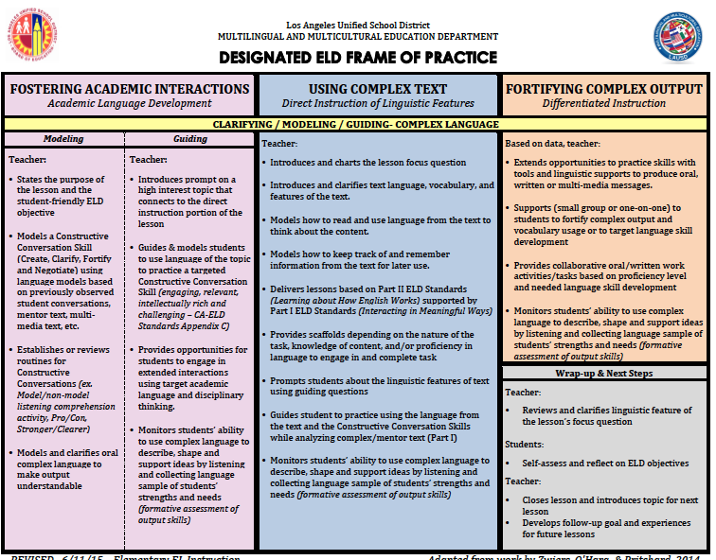
Direct Instruction of Linguistic Features
Mentor Text

Slide 38
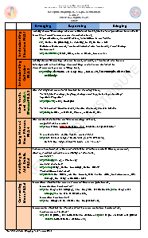
Planning: Using Complex Text
Identify a grade level ELD Standard from Part II. Find a previously read mentor text that exemplifies that standard.
Turn the standard into a focus question.
Identify examples of the linguistic feature in each sentence.
Create two text analysis guiding questions considering the ELD Standard-Part II and a wrap-up question.
The mentor text will be used for two or more days to address the identified linguistic feature (Part II ELD Standard.)
CA ELD Standards at a glance & How English
Works
Matrices

Slide 40
Which
Student Vital Actions are supported through the teacher actions outlined in the Frame of Practice?

Slide 41
What We Want to Observe in Our Classrooms During ELD
What are specific elements of effective instruction or guiding principles of learning in ELD instruction?
What are explicit teacher or student behaviors that are called out in our Designated ELD Frame of Practice?
What is observable evidence of teaching and learning during ELD? (i.e. instructional strategies, learning activities, behavioral outcomes, artifacts, routines, practices)

Slide 42
http://tiny.cc/ldw-eldpractice
What else do we
want to observe during ELD

Slide 43
Phase-In Plan for ELD Standards
2013-2014
2014-2015
2015-2016
Awareness
Implementation
Transition

Slide 44

2015-2016 ELD Standards Implementation Plan

Slide 45
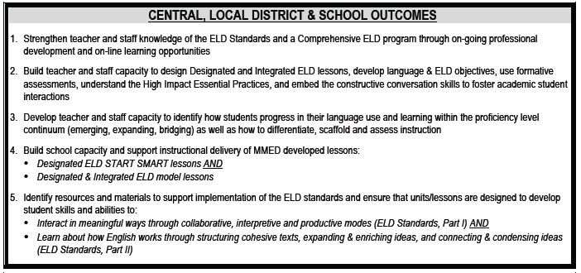
Central, Local District
& School Outcomes

Slide 46


