Slide 1

ESC West Network Meeting
Preview of Designated ELD Time Block
– Instructional Approach and Resources –
May 20, 2015

Slide 2
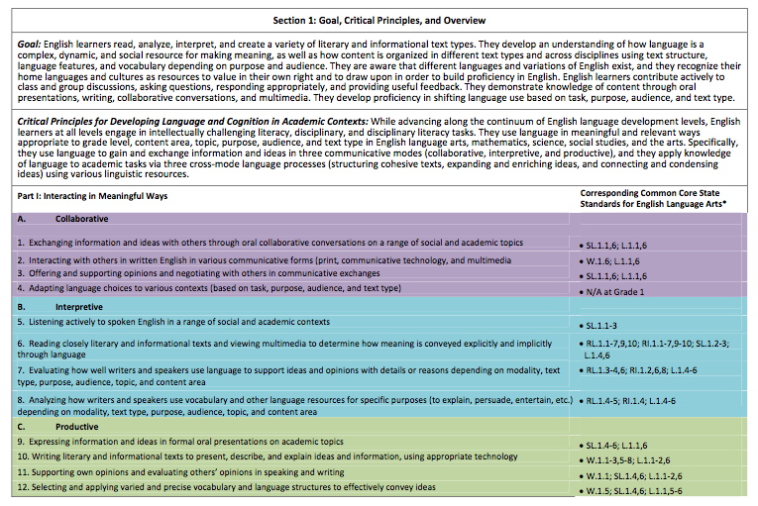
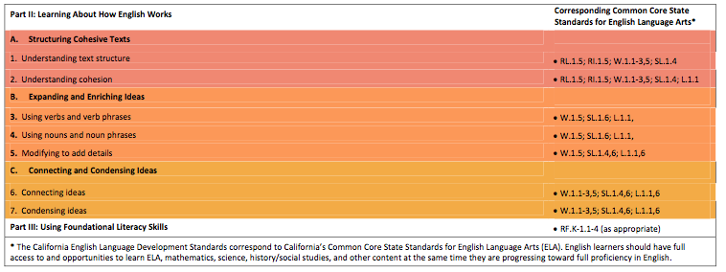
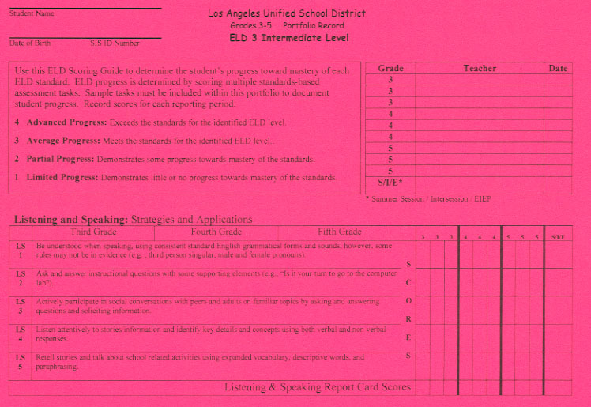
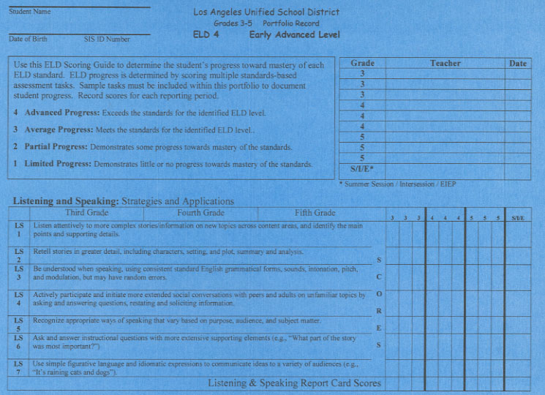
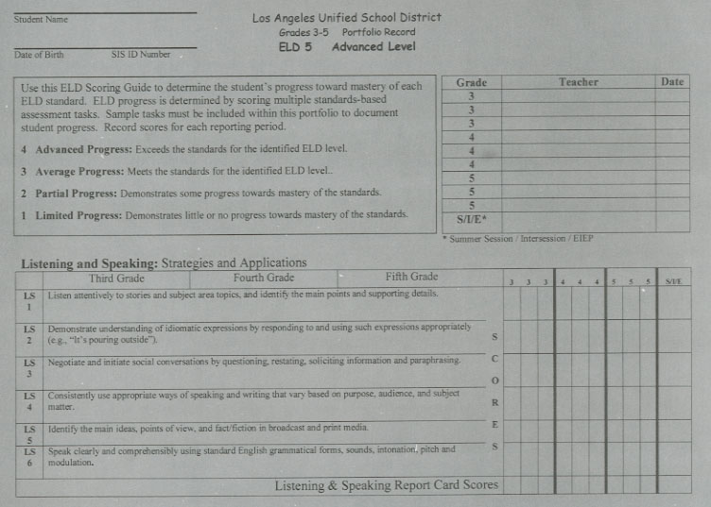
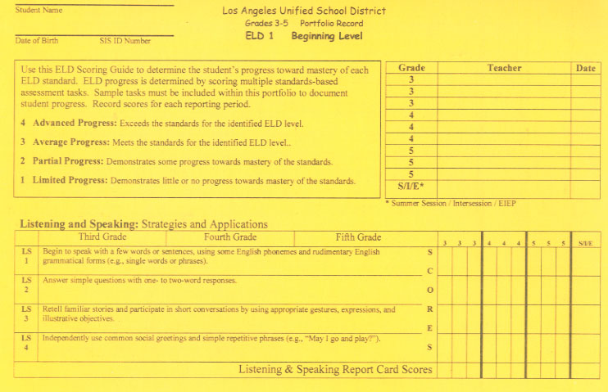
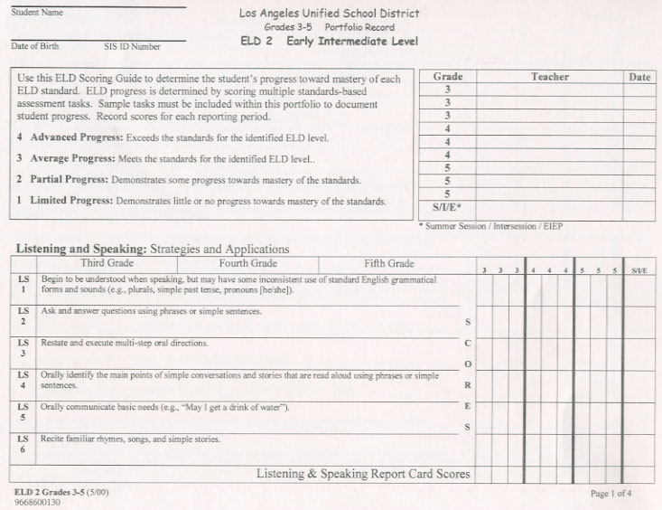
What are some of the significant differences between our old and new standards?
1999 CA ELD Standards
2012 CA ELD Standards
Significant differences
in standards
call for
significant differences
in instructional approach.
Notes:
Slide 18: (3 minutes)
Purpose:
To begin to understand the shifts in the organization of the 2012 CA ELD Standards.
How:
Have participants discuss the question in their table groups. Debrief responses.
Participants should identify:
Four Language Domains- Listening, Speaking, Reading & Writing
Grade Spans- K-2 and 3-5
Five ELD Levels

Slide 3
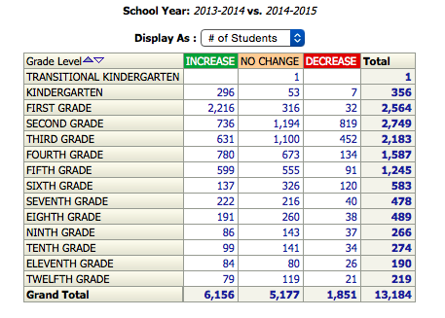
ESC West K-12
CELDT Annual Change
AMAO 1
We have a need for a
significant difference
in instructional approach.

Slide 4
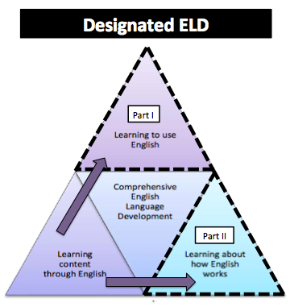
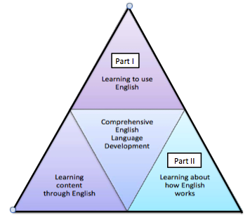
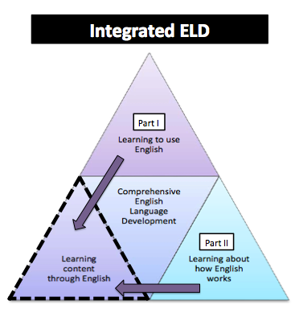
Comprehensive ELD

Slide 5
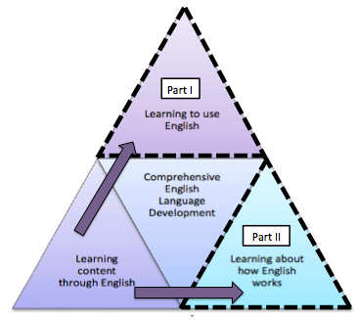
Designated ELD
PURPOSE
Separate and protected time during the regular school day Ch. 2 Pg. 91
CA ELD Standards are the focal standards that build into and from content instruction Ch. 2 Pg. 91
Focus on the critical language students need to develop for content learning Ch. 2 Pg. 91
Engage in a variety of collaborative discussions to build awareness about language and build skills and abilities to use language Ch. 2 Pg. 91
Content focus is derived from ELA and other areas of the curriculum, not separate and isolated .Ch. 2 Pg. 91
OUTCOME
ELs learn about how English works for successful participation in academic tasks across content areas through use of discourse practices, grammatical structures, and vocabulary. Ch. 2 pg. 91

Slide 6
The Big Shift:
Defining Academic English Language
Before some perceived Academic Language as…
Vocabulary
Now CCSS/ELD Standards clearly define Academic Language as…
Sentences, Clauses,
Phrases
Text Structures
Vocabulary

Slide 7
Designated ELD
PURPOSE
Separate and protected time during the regular school day Ch. 2 Pg. 91
CA ELD Standards are the focal standards that build into and from content instruction Ch. 2 Pg. 91
Focus on the critical language students need to develop for content learning Ch. 2 Pg. 91
Engage in a variety of collaborative discussions to build awareness about language and build skills and abilities to use language Ch. 2 Pg. 91
Content focus is derived from ELA and other areas of the curriculum, not separate and isolated .Ch. 2 Pg. 91

Slide 8
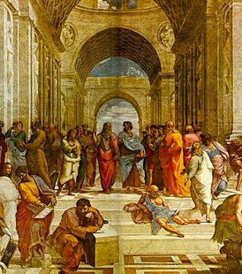

The Metaphor of a Painting
Words
Sentences
Message
Paint
Forming of
Figures
Painting
RF: Can be thought of as

Slide 9
Complex Language Demands
“Common Core Standards in Diverse Classrooms” by Jeff Zwiers, page 7
Dimensions | Features | Skills
Message | Clarity & coherence Register for participants & purposes Density of ideas and their relationships Message organization & structure (visuals, paragraphs) Organization of sentences | Create a logical flow of and connections between ideas, knowing how ideas develop and need to develop Match language with the purpose of the message (Clear, complete, focused, logical, appropriate to the discipline) Create, clarify, fortify, & negotiate ideas
Sentence | Sentence structure (compound/complex) & length Transitions & connectives Complex verb tenses and passive voice Pronouns and references | Craft sentences to be clear Use of a variety of sentence types to clarify a message and condense information Combine ideas, phrases, and clauses.
Word/ Phrase | Cross-disciplinary terms Figurative expressions & multiple meanings Content vocabulary Affixes, roots, and transformations | Choose and use the best words and phrases communicate Figure out the meaning of new words and terms Use and clarify new words to build ideas or create products

Slide 10
Designated ELD
PURPOSE
Separate and protected time during the regular school day Ch. 2 Pg. 91
CA ELD Standards are the focal standards that build into and from content instruction Ch. 2 Pg. 91
Focus on the critical language students need to develop for content learning Ch. 2 Pg. 91
Engage in a variety of collaborative discussions to build awareness about language and build skills and abilities to use language Ch. 2 Pg. 91
Content focus is derived from ELA and other areas of the curriculum, not separate and isolated .Ch. 2 Pg. 91

Slide 11

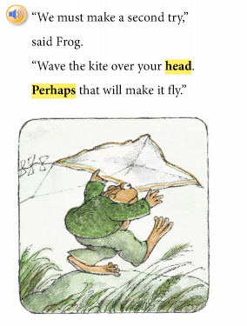
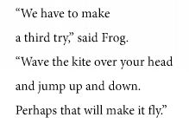
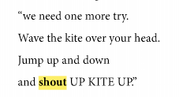
ELA
Designated ELD

Slide 12
ELD Standards, Part I

Slide 13
ELD Standards, Part II

Slide 14
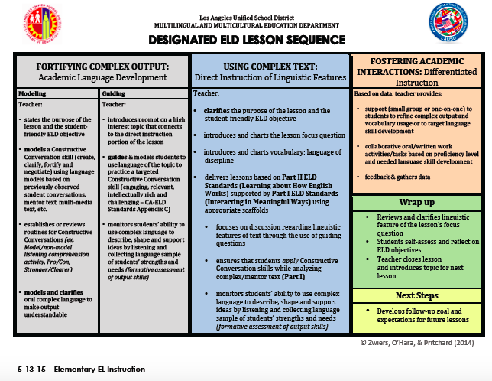

Slide 15
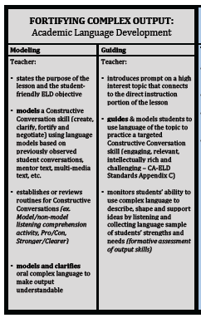
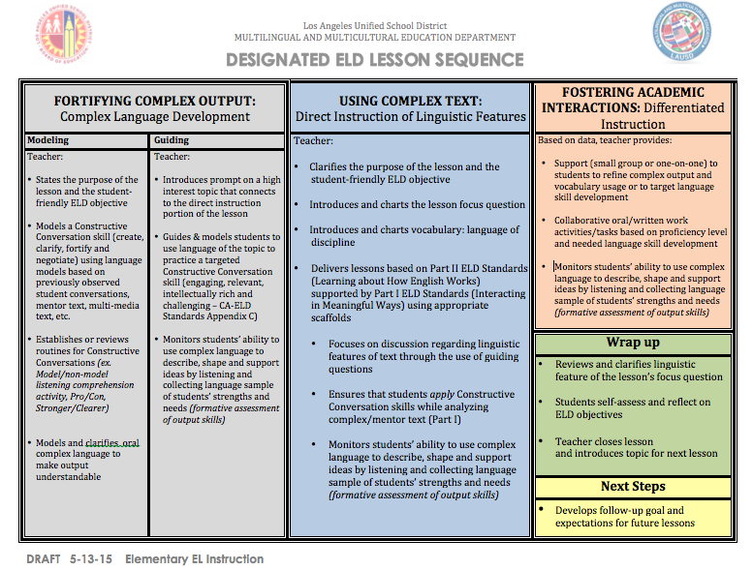
Academic
Language
Development

Slide 16
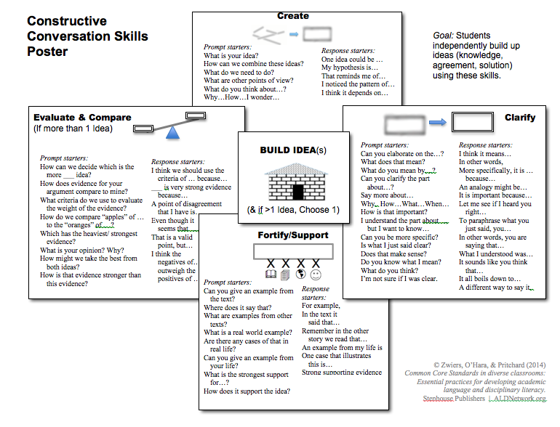
Create
Negotiate
Clarify
Fortify/Support

Slide 17
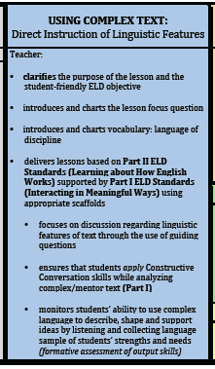
Direct Instruction
of Linguistic Features

Slide 18
Designated ELD

Slide 19
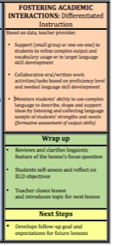
Differentiated Instruction,
Wrap Up and
Next Steps

Slide 20
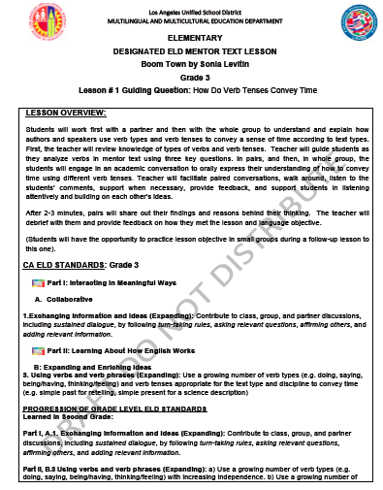
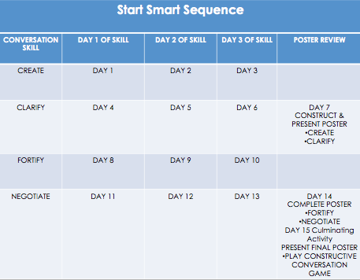
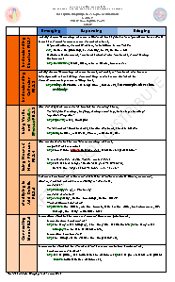
Resources to Support
Designated ELD
15-Day
Start Smart
Lessons
Designated ELD
Sample Lessons
How English
Works
Matrices

Slide 21
Professional Development Opportunities
What | Who
Summer Master Plan Institute | EL Designees
MMED Summer ELD PD | Teachers of English Learners
Thank you for sending your EL Designees and
your teachers of English learners to these p.d. opportunities.
Remember you can now send
more than 2 teachers to the ELD PD.

Slide 22


