Slide 1
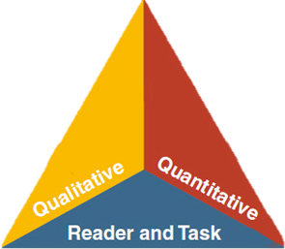

LANGUAGE
LITERACY
LEARNING
Session 3: CA ELD Standards
Theory and Research
MULTILINGUAL & MULTICULTURAL EDUCATION DEPARTMENT
Notes:
Slide 1: Session 3 was created for a minimum of 55 minutes. You can ask participants to read Appendix C before coming to the session
Add your name to the presentation
Why/Purpose: Remind participants that this is the third of four sessions in transitioning to the new CA ELD Standards.
How:
You will guide participants through the information while modeling instructional strategies that could be transferred to classroom practice

Slide 2
ELD Transition Sessions
Session 1: ELD Standards Introduction --
          Shifts, Layout, & Development
Session 2: Proficiency Levels
Session 3: Theory that Informs Layout (Appendix C)
Session 4: How English Works (Appendix B)
Notes:
Slide 3: (1 minute)
Why/purpose: make the participants aware that this is the third of the four sessions.
How: Give participants a few seconds to read over the slide to see flow of the four sessions

Slide 3
Objectives
Understand the linguistic demands of the Common Core State Standards and their connection to the California ELD Standards
Delve into the research that informs the layout of the ELD Standards
Notes:
Slide 2: (1 min)
Why/Purpose: To orient the participants to today’s objectives.
How:
Tell the participants:
In today’s session you will continue to deepen your understanding about the research, layout and connection of the ELD standards to the Common Core States Standards. Additionally, we will be briefly sharing the initial implementation plan.
*

Slide 4

District Instructional Priorities
Master Plan
(The Who)
TGDC
Teaching &
Learning
Framework
(The How)
Common Core
(The What)
Notes:
*
Slide 3: (1 min)
Why/Purpose: Review the priorities
How: Tell the participants:
The Teaching and Learning Framework will also be used alongside both the Master Plan and the Common Core State Standards. All three initiatives are actually woven together. Clearly, the Common Core State Standards signify “What” we teach, while the Master Plan signifies the “Who” we teach, and The Teaching and Learning Framework speaks to “How” we teach in LAUSD. When all three are woven together the outcome is that all LAUSD students will graduate College Prepared and Career Ready.

Slide 5
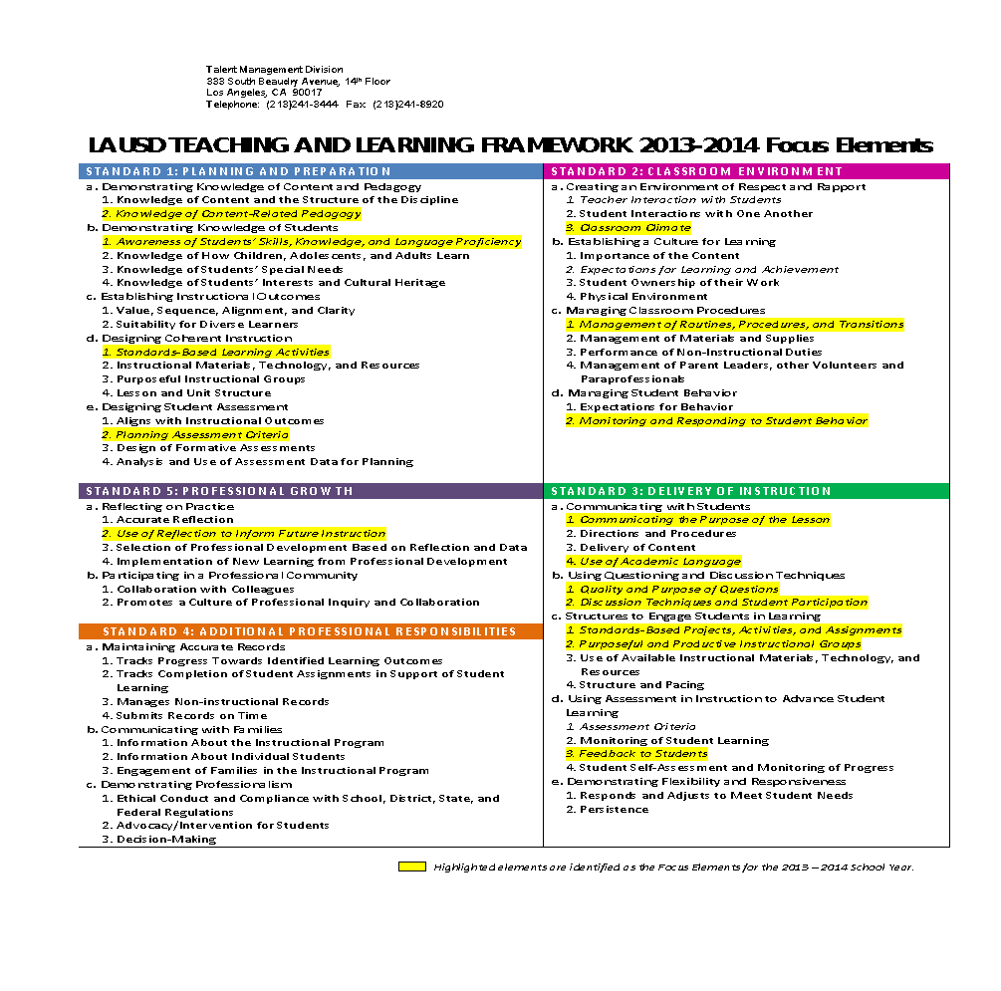



LAUSD TEACHING AND LEARNING FRAMEWORK 2014-2015 FOCUS ELEMENTS
Notes:
Slide 4: (1 min)
Why/Purpose: To connect our work as educators and our professional goals.
How: Read the 3 focus elements, tell the participants that the arrows point to the highlighted focus elements that apply to the work we will engage in today.
*

Slide 6

Guiding Principles
English Learners (ELs) are held to the same high expectations of learning established for all students.
ELs develop full receptive and productive proficiencies in English in the domains of listening, speaking, reading & writing.
ELs are taught challenging academic content that enables them to meet performance standards in all content areas.
ELs receive instruction that builds on their previous education and cognitive abilities and that reflects their language proficiency levels.
ELs are evaluated with appropriate and valid assessments that are aligned to state and local standards and that take into account the language development stages & cultural backgrounds of the students.
The academic success of ELs is a responsibility shared by all educators, the family and the community.
English Learner Master Plan, 2012,
Pages 2-3
Notes:
Slide 5: (1 min)
Why/Purpose: The Master Plan’s Guiding Principles inform every aspect of our work with English learners.
How:
Tell the participants that during this presentation the focus is on guiding principles 2 and 4.
*

Slide 7
Phase-In Plan for CA ELD Standards
2014-2015
2015-2016
Transition
Implementation
Notes:
Slide 6: (1 min)
Why/Purpose: To ensure participants know that we are in the Transition Phase of the phase in Plan
How: Tell the participants:
Let’s take a few minutes to take a look at the phase-in plan
Our phase-in plan is aligned to the state’s plan and as the state releases additional information we will continue to update this plan…our district has been working to identify needs and tools that will be developed for our work during this phase.
Eventually the CELDT will be replaced and we are expecting a new assessment in 2017.

Slide 8

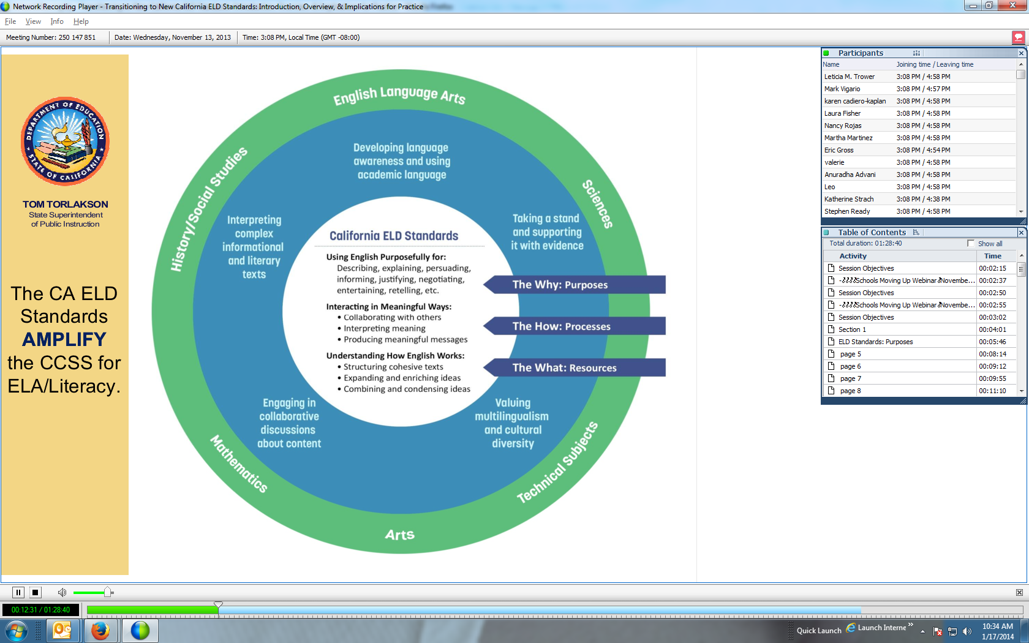
What must students be able to do with language?
ELA | MATH | SCIENCE
Comprehend and evaluate complex texts across a range of types and disciplines Construct effective arguments and convey intricate or multifaceted information Discern a speaker’s key points Request clarification and ask relevant questions Build on others’ ideas Articulate their own ideas, and confirm they have been understood | Understand and use stated assumptions, definitions, and previously established results in constructing arguments Make conjectures and build a logical progression of statements to explore the truth of their conjectures Justify their conclusions, communicate them to others, and respond to the arguments of others | Construct explanations and designated solutions Engaging in argument from evidence Obtain, evaluate, and communicate information
Notes:
Slide 7: (1 minute)
Purpose: Review of the language demands across the content areas
What: Alignment to CCSS
Why: To visually show how the ELD Standards align and correlate to the new CCSS
How: The CA ELD Standards highlight and amplify those Common Core State Standards for ELA and other content areas. They promote ELs’ abilities to interact in meaningful ways during rich instruction so that they develop both English and content knowledge. CA ELD Standards guide teachers to build ELs’ knowledge about how the English language works in different contexts to achieve specific communicative purposes.
After animation flies in: The ELD standards amplify the CCSS for ELA and other content areas

Slide 9

Dr. Lily Wong Fillmore
LISTENING TASK: Jot down poignant phrases that resonate with you.
Instructional Strategies: Use of Visual Media & Listening Task
Notes:
Slides 8-9: (8 min. total) 3 min 20 sec. for Slide 12 (video)
Why/Purpose: Build a sense of urgency for the need for language instruction for English Learners.
How: Tell participants they will view a short video by a nationally recognized professor, Dr. Lily Wong Fillmore, on the importance of language instruction. As they view the video, they will jot down phrases they hear that resonate or are relevant to their practice as educators.
There is a transcript that can be given to participants. (if you choose to use the transcript, consider and address how this will impact the use of a listening task.)
*

Slide 10

Share with an elbow partner a thought around what Lily Wong Fillmore stated that resonated with you.
Instructional Strategy:
Elbow Partners
Notes:
Slide 9: 4 min. total each partner shares for 2 minutes.
Why/Purpose: To develop a common understanding of what was said and to build a common purpose.
How: Ask the participants to turn to an elbow partner and share. Each partner should share one point at a time so they both have a turn sharing a thought that resonated with them.
Ask for 1 or 2 participants to share their thoughts with the whole group.
Close by saying that we will look at the 2012 CA ELD Standards and the research behind them.

Slide 11
Purpose of 2012 CA ELD Standards
Designed to be used in tandem with CCSS for ELA & Literacy
Highlight and amplify the critical knowledge about language and skills using language in CCSS for ELA/Literacy necessary for ELs to be successful in school and life
Provide fewer, clearer, higher standards so teachers can focus on what’s most important
Strengthen ELD opportunities in core content instruction and in targeted ELD in light of new content standards
Notes:
Slide 10: 1 min.
Why: To justify the need for the 2012 CA ELD Standards
How:
Ask: So why do we need the 2012 CA ELD Standards?
Point to each bullet point and paraphrase them one by one.
*

Slide 12

CA ELD Standards Overview
Overview & Proficiency Level Descriptors (PLDs):
Alignment to CCSS for ELA & Literacy
CA’s EL Student
Proficiency Level Descriptors (PLDs)
Structure of the grade level standards
Grade Level Standards
Section 1: Goal, Critical Principles, At-a-glance Overview
Section 2: Elaboration on Critical Principles
  Part I: Interacting in Meaningful Ways
  Part II: Learning About How English Works
  Part III: Using Foundation Skills
Appendices:
Appendix A: Foundational Literacy Skills
Appendix B: Learning About How English Works
Appendix C: Theory and Research
Appendix D: Context, Development, Validation
Glossary of Key Terms
Notes:
Slide 11: 1 min.
Why/Purpose: To orient them to the organization of the CELDS
How? Tell participants:
These are all of the sections of the documents found in the CDE. Begins with Overview, then it goes into grade level standards, appendices, and glossary.
Today our work will revolve around Appendix C which gives the theoretical and research background of the CELDS
*

Slide 13
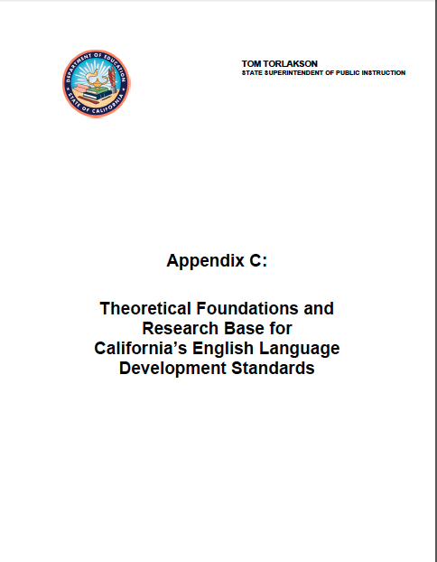
CA 2012 Adopted ELD Standards
Appendix C:
Theoretical Foundations and Research Base
Connection
Notes:
Slides 12-15 (28 min. total)
Why/Purpose: Appendix C provides a rich resource for teachers regarding the theoretical foundations and research base connection for the ELD standards, including valuable information regarding interacting in meaningful and intellectually challenging ways, scaffolding, developing academic English, the importance of vocabulary and grammatical and discourse-level understandings.
How:
Slide 16 - Explain that the participants will have an opportunity to learn about the theoretical foundations and the research base connections of the CA ELD Standards.
*

Slide 14
Information Processing of CA ELD Standards Appendix C
Refer to CELDS Appendix C
At your table, form quads - groups of 4.
Number off 1- 4
Notes:
Slide 13
How: Have participants number off from 1 to 4. After they have numbered off, conduct a check of the room by having all the 1s raise their hands, then the 2s, then the 3s and finally the 4s.

Slide 15
Appendix C
Everyone reads the “Overview” (pg. 1)
Also read your assigned section:
  Theoretical Foundations and Research Base & Interacting in Meaningful and Intellectually Challenging Ways (pg.1-2)
  Scaffolding (pg. 3-5)
  Developing Academic English & the Importance of Vocabulary (pg. 5-6)
  Importance of Grammatical and Discourse Level Understanding (pg. 6-8)
Notes:
Slide 14
How: Direct participants to the sections of Appendix C that they will be reading. All participants will read the “overview” on page 1 and their assigned section. Inform the participants that they will have 8 minutes to read their two sections.
All participants read their assigned section:
Theoretical Foundations and Research Base & Interacting in Meaningful and Intellectually Challenging Ways (pp.1-2)
Scaffolding (pp. 3-5)
Developing Academic English & The Importance of Vocabulary (pp. 5-6)
Importance of Grammatical and Discourse Level Understanding (pp. 6-8)

Slide 16
Expert Group
Meet with your Expert group (everyone should have the same number)
With your Expert group, you have 5 minutes to select 3 main points from your section to share with your home group
Notes:
Slide 15: (5 Min.)
How: Have participants move to sit with their expert groups. Have them assign a timekeeper. They will need their copy of Appendix C and something to write with.
Inform them that they will have 5 minutes as an expert group to determine the 3 main points from their assigned section that they will share in their home group. They should take notes on the 3 main points they will share with their home groups.

Slide 17
Home Group
Return to your Home Group
Share your 3 main points (Each member has 2 minutes to share, 8 minutes total)
Instructional Strategy:
Expert / Home Groups
Notes:
Slide 15: (8 Min.)
How:
Have them assign a timekeeper. Ensure that each group has a number one, two, three and four. Inform the home groups that they will have 2 minutes each to share their 3 points, 8 minutes total in time. At the end of the 8 minutes, ask for one volunteer per section to share the one important point discussed from their section.

Slide 18
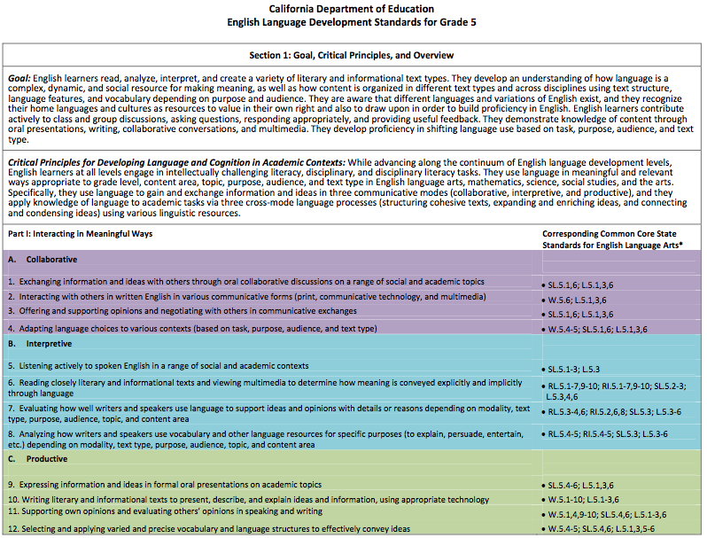
  A. Collaborative Mode Strand 1
  Exchanging information and ideas with each other through oral collaborative conversation on a range of social and academic topics.
  B. Interpretive Mode Strand 6
  Reading closely literary and informational texts and viewing multimedia to determine how meaning is conveyed explicitly and implicitly through language.
  C. Productive Mode Strand 11
  Supporting own opinions and evaluating others’ opinions in speaking and writing.
Notes:
Slide 16: (1 minute)
Why/Purpose: To make the connection between what was read, the activity they engaged in and classroom practice. We want to highlight some of the strands that you learned about in session 2.
How: Tell participants that the activity they engaged in focuses on the 3 modes of communication (collaborative, interpretive, productive) Read each mode as it appears. The goal is to recognize that every task should incorporate these modes.

Slide 19
Quote
Language is the medium in which teaching and learning take place in schools; the medium through which we transform and develop our thinking about concepts; and in this way language and content are inextricably linked (Halliday, 1993). For this and other reasons, language has been referred to as the “hidden curriculum” of schooling and why school success can be seen as largely a language matter (Christie, 1999). (Appendix C pg. 7)
Notes:
Slides 17-18 (6 minutes total) Slide 17 (1 minute)
Why/Purpose: Teachers need to have the opportunity to take the information back from Appendix C and see how it applies and is relevant to their students and teaching practice. Teachers should have opportunity to ponder the information given in context of their work and begin to formulate thinking about how it can change and improve their practice.
How: Tell the participants that they will now have an opportunity to make a connection between Appendix C and their classroom practice.

Slide 20
Here’s What! | So What? | Now What?
Language is the medium in which teaching and learning take place in schools; the medium through which we transform and develop our thinking about concepts; and in this way language and content are inextricably linked (Halliday, 1993). For this and other reasons, language has been referred to as the “hidden curriculum” of schooling and why school success can be seen as largely a language matter (Christie, 1999).
To encourage interacting in meaningful ways, I will…
For scaffolding academic English, I will…
To bring more attention to language, I will…
Instructional Strategy:
Here’s What!, So What?, Now What?
Notes:
Slide 18: (5 minutes )
How:
Hand out Graphic Organizer (Here’s What! So What? Now What?) to the teachers.
Let the teachers know that they will be hearing the quote and will be reflecting on what the quote means to them based on what they experienced in this PD.
Read out to the quote to the group.
Tell the teachers to write their interpretation of the quote in the So What? column.
Tell the teachers to write their commitments in the Now What? Column using the three sentence starters.

Slide 21

Instructional Strategies
Chalk Talk | Here’s What!, So What?, Now What?
Turn and Talk | Graphic Organizer
Line Up | Expert Group/ Home Group
Collaborative Groups | Turn and Talk
Chunking The Text | Whole Group Share Out
3-2-1 | Use of Visual Media: Videos
Whole Group Share Out | Listening Task
Elbow Partner Discussions
Notes:
Slide 19: (1 min.)
Why/Purpose: Make the connection for the teachers between the instructional strategies used and experienced during this session and the use of these Instructional strategies in their classroom
How: Read the instructional strategies to the participants. Ask “Might you have any questions about these instructional strategies?” Today we implemented the strategies in bold print.

Slide 22
Objectives:
Understand the linguistic demands of the Common Core State Standards and their connection to the California ELD Standards
Delve into the research that informs the layout of the ELD Standards
Notes:
Slide 20: (30 seconds)
Why/Purpose: Review today’s objectives.
How: Read each objective. Have participants put thumbs up if this objective was met or thumbs down if it was not yet met.
*

Slide 23

Notes:
Slide 21:
Thank the participants for their engaged participation.

Slide 24
Materials Needed
HIDE THIS SLIDE
Speakers for video
Appendix C copies
Graphic Organizer (slide 22)
Optional: Transcript of Video
Notes:
Slide 22:
Hide this slide. It provides a list of the materials needed for this session. Appendix C can be accessed in CDE website and may be downloaded on participants’ computers.

