Slide 1
Review of the Layout of CA ELD Standards

Slide 2
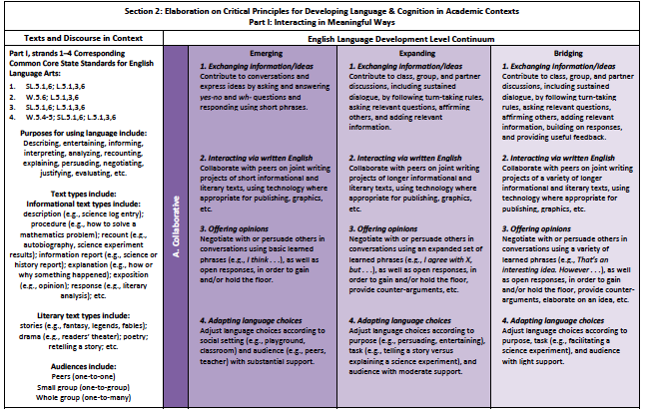

Section 2
Teacher Resources
Proficiency levels
Strands
Modes
Language of the Standards
Table Copy
Notes:
5 minutes
Purpose: Participants will understand that Section 2 is the actual grade level standards. It also has standards listed by the 3 levels of proficiency – Emerging, expanding, and bridging.
How:
The grade specific standards are divided into two sections.
Section 2 has the language of the standards. This is where you will find what guides your instruction.
There are 3 proficiency levels in the new CA ELD Standards. The proficiency levels are: Emerging, Expanding, and Bridging Say – The mode is listed here again. The first mode, collaborative and the strands are listed in Section 2. Under each strand are the actual standards for the corresponding grade level.
Say – Section 2 also lists the teacher resources and CCSS aligned with the ELD Standards

Slide 3
The Essence of the ELD Standards

Slide 4
ELD Standards
What?
Read: Essence of ELD Standards
How?
Modified Jigsaw Triad Activity
Form a triad:
Partner A: Part I A. Collaborative
Partner B: Part I B. Interpretive
Partner C: Part I C. Productive
Notes:
2 minutes for explanation and composition of the triad
Purpose: Participants will understand and dig in deeper to the language of the standards and the essence of Part I-Interacting in Meaningful Ways.
How:
Jigsaw Triad Activity
Form a triad
Identify how is Partner A and Partner B and Partner C
Each person will read a mode
Strand 1 will be modeled

Slide 5
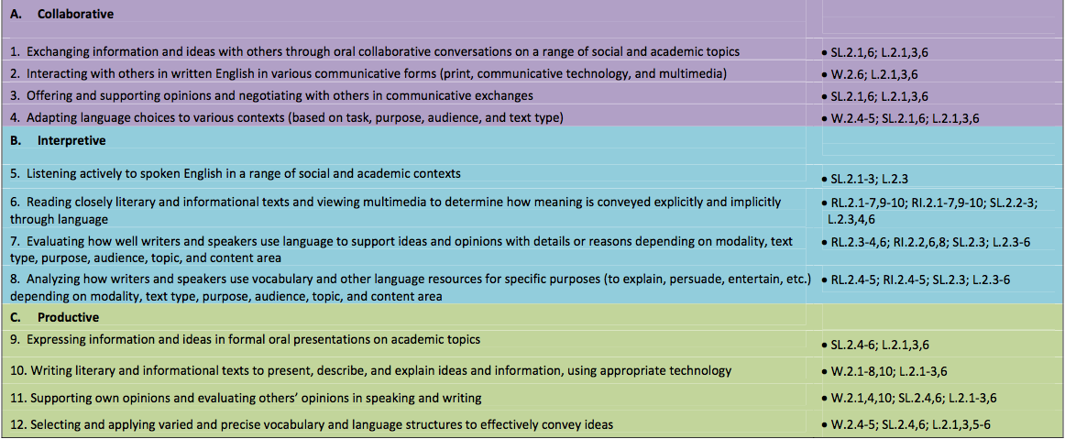
Notes:
One minute
Purpose: is to model the task with the first Strand and Standard
Click:
red box will help to focus on the strand

Slide 6
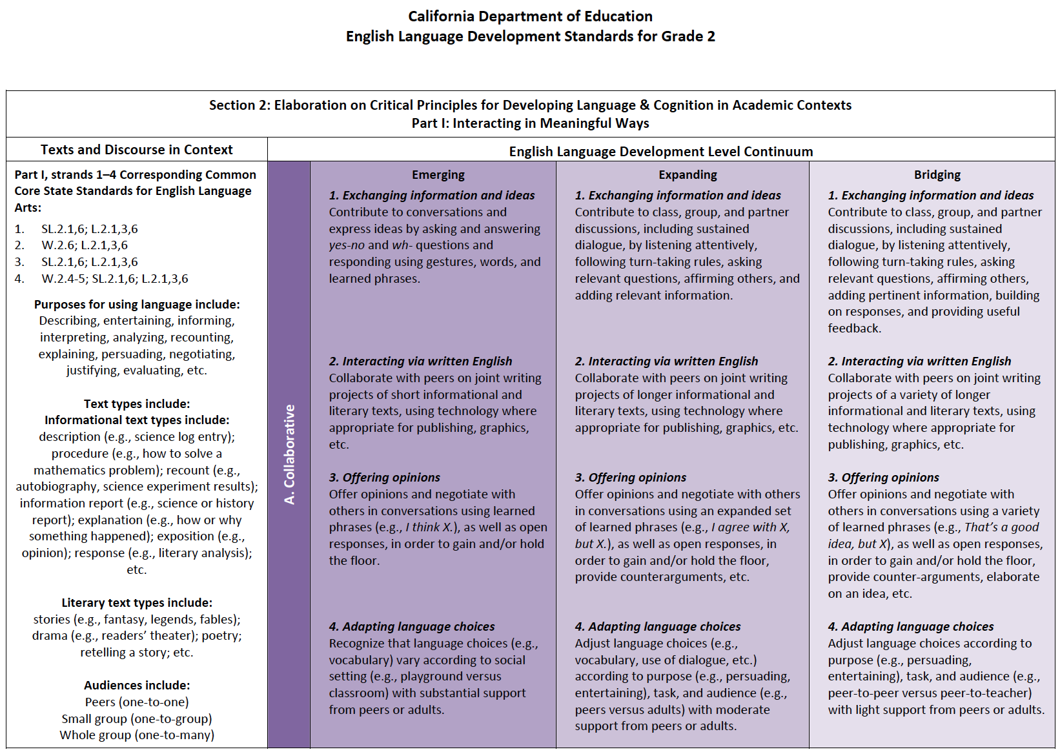
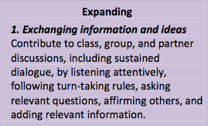
Notes:
2 minutes
Purpose: focus on the Standard and the language of the standard at the expanding level
Click
Box will show the standard
Read the standard
There are 3 proficiency levels in the new CA ELD Standards.
Analyze the grade specific standards for its essence. at the expanding level only.
For this activity you will focus at the expanding level only
Click
The essence of the standard is underlined

Slide 7
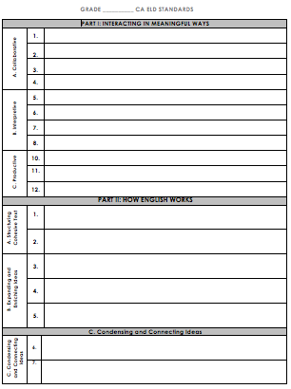
Model the Process
Contribute to discussion
Handout #1
Notes:
One minute
Purpose: to take note of the essence of the Modes

Slide 8
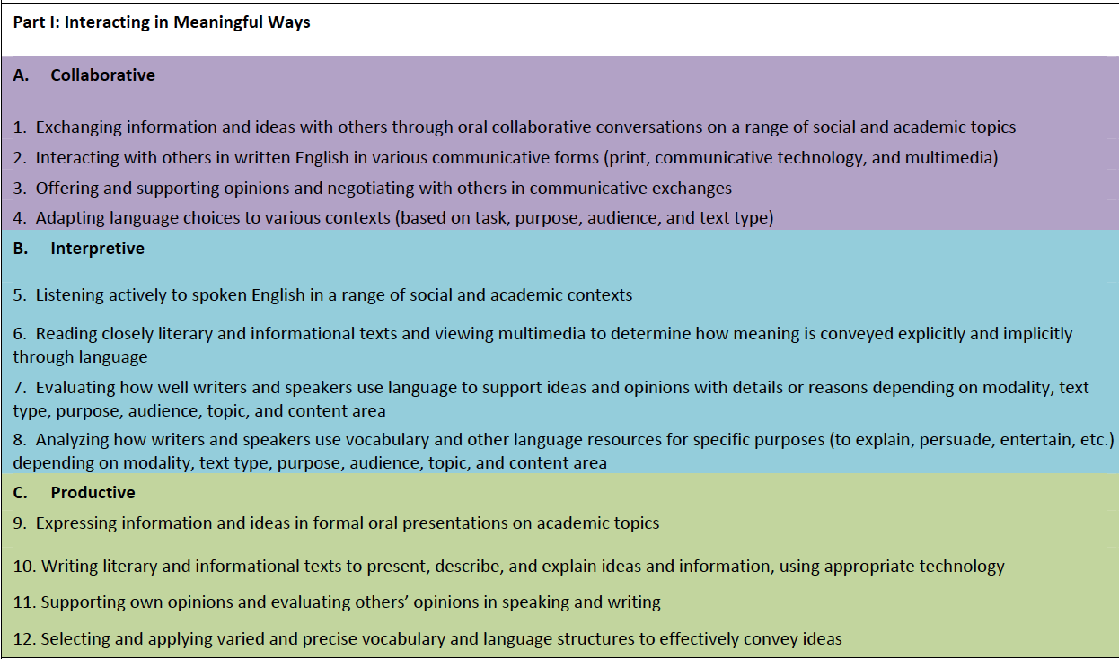
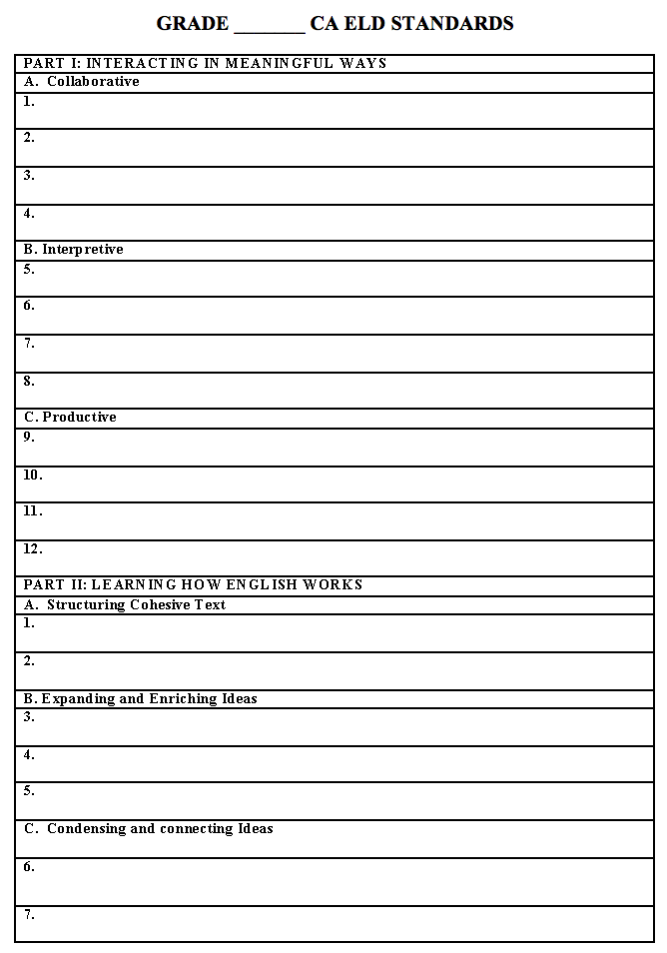
Part 1: Interacting in Meaningful Ways
Table group:
Analyze your assigned Mode at the Expanding Level
Read the standard for its essence
Write a short phrase (3-4 words) that captures the essence of the standard
Share in a Round Robin Fashion with your table group your analysis of your assigned Mode
Take notes from your group members
Group Share
Notes:
7 minutes
Purpose: to dig in deeper to the language of the standards
How:
Read the directions on the process
Ask for any clarity
Ask a few participants to share their finds on one or two of the standard

Slide 9
ELD Standards
What?
Read: Essence of CA ELD Standards
How?
Modified Jigsaw Triad Activity
Form a triad:
Partner A: Part II A. Structuring Cohesive Texts
Partner B: Part II B. Expanding and Enriching Ideas
Partner C: Part II C. Connecting and Condensing Ideas
Be prepared to share
Notes:
2 minutes for explanation and composition of the triad
Purpose:
Participants will understand the essence of Part II-Learning About How English Works
How:
Jigsaw Triad Activity
Form a triad
Identify how is Partner A and Partner B and Partner C
Each person will read their assigned processes
Write the structure (what) and purpose (why) of the processes on the worksheet
You will model the first one for them

Slide 10
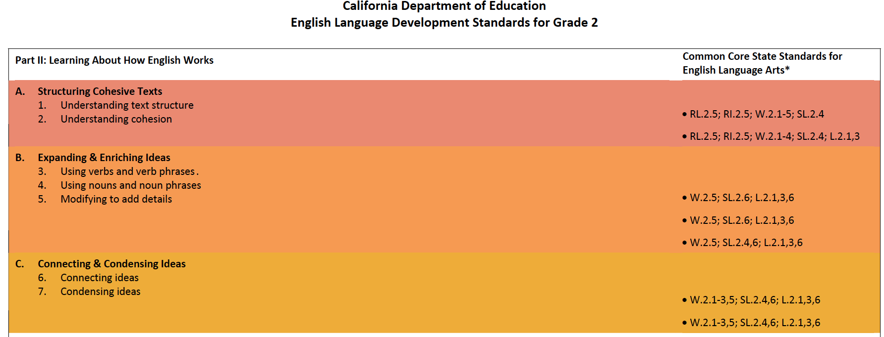
Notes:
One minute
Purpose: is to model the task with the first Strand and Standard
Click:
red box will help to focus on the strand

Slide 11
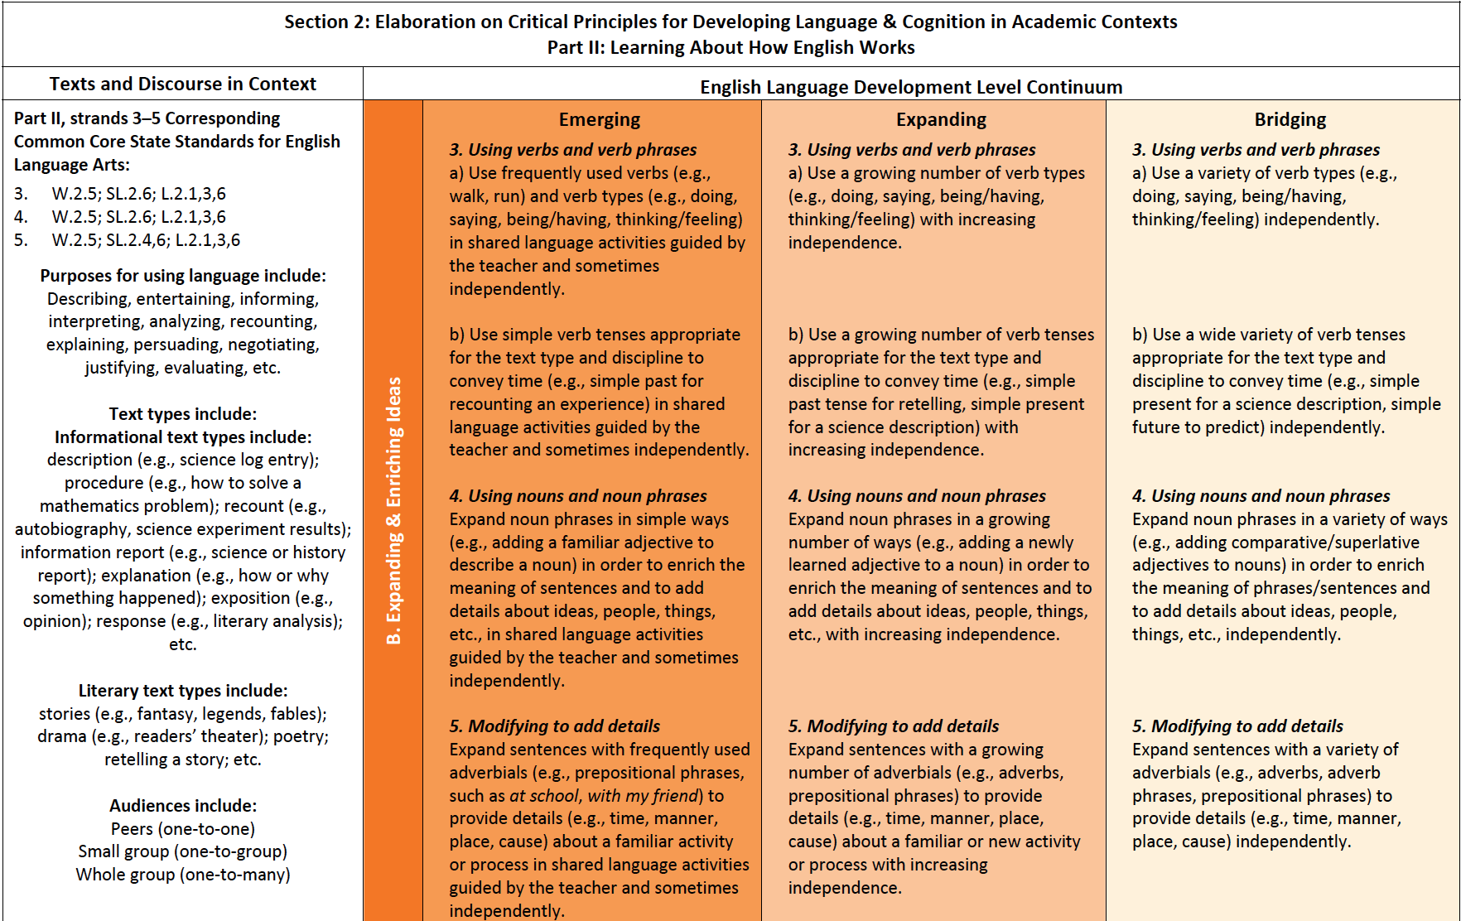
Purpose/Why?
Structure/What?
Notes:
2 minutes
Purpose: focus on the Standard and the language of the standard at the expanding level
Click
Box will show the standard
Read the standard
There are 3 proficiency levels in the new CA ELD Standards.
Analyze the grade specific standards for the structure (what) and purpose (why)
For this activity you will focus at the expanding level only
Click
The essence of the standard is underlined

Slide 12
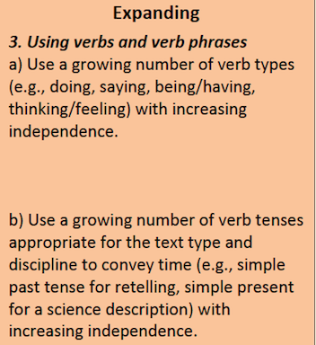
Structure/What?
Purpose/Why?
Notes:
2 minutes
Purpose: focus on the Standard and the language of the standard at the expanding level
Click
The structure (what) and purpose (why) of the standard is underlined

Slide 13
Model the Process
Contribute to discussion
Verbs tenses convey a sense of time
Handout #1
Notes:
One minute
Purpose: to take note of the structure and purpose of the processes

Slide 14
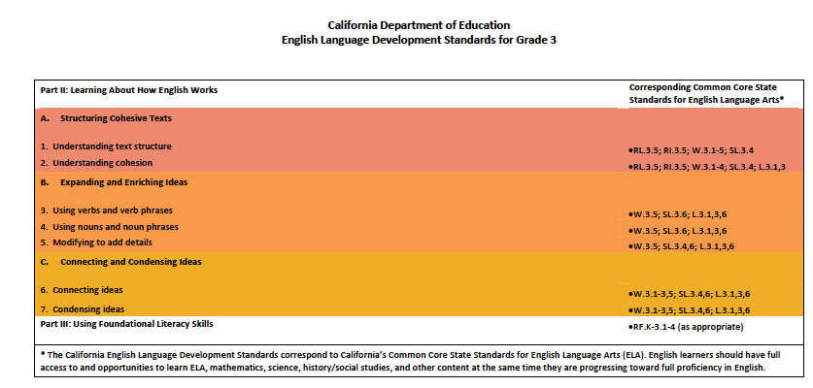
CA ELD Standards Part II: Learning About How English Works
Table group:
Analyze your processes at the Expanding Level
Analyze the purpose (why) and the structure (what) of the ELD standards
Share with your triad your findings of Part II-Learning About How English Works standards
Be prepared to share
Notes:
5 minutes
Purpose: to dig in deeper to the language of the standards
How:
Read the directions on the process
Ask for any clarity
Asks few participants to share their finds on one or two of the standard

