Slide 1
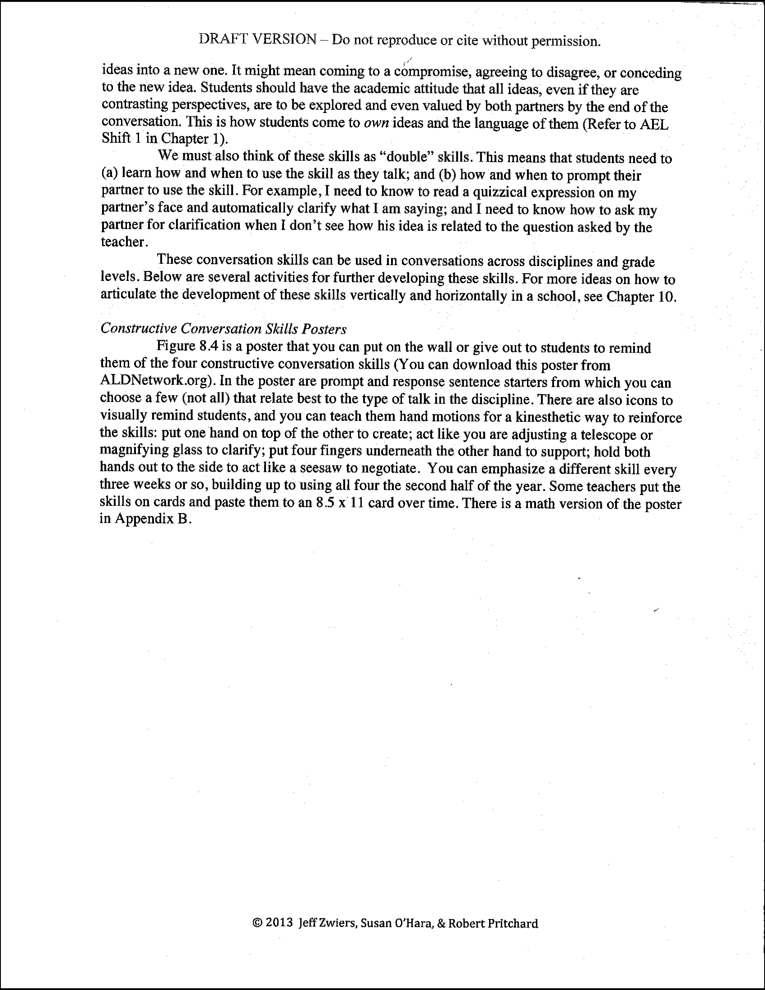
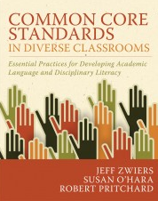
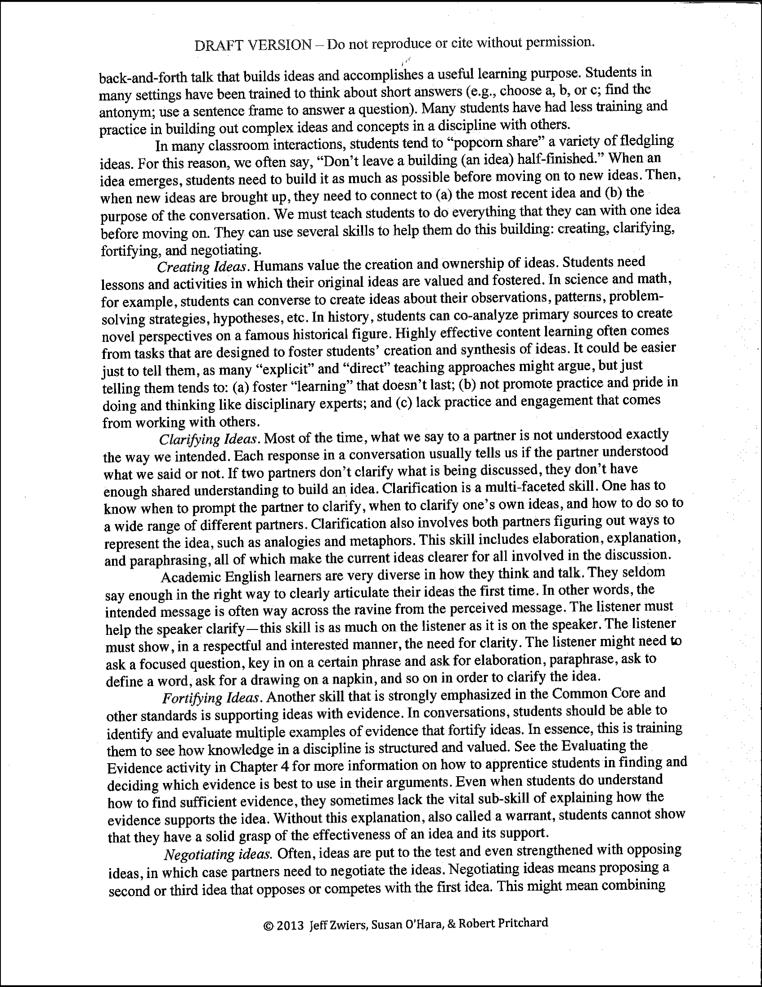

Constructive Conversation Skills: What are the defining characteristics of each skill?
Read pgs. 188-189 individually and highlight key points.
Notes:
20 minutes Fostering Academic Interactions
5 minutes

Slide 2


Constructive Conversation Skills
Two-Buck Summary
Number off 1-4
1 – Create, 2 – Clarify, 3 – Fortify, 4 – Negotiate
What are the most important defining characteristics of each skill?
Each word in your summary costs 10 cents and you only have $2 to spend.
Your answer should be no more than… 20 words.
Be ready to share out the skill you are assigned to.
Notes:
20 minutes Fostering Academic Interactions
10 minutes

Slide 3
Form original ideas—that I value and own–about my observations, patterns, problem-solving strategies, etc. to foster synthesis of ideas.
Propose, evaluate, and compare additional idea that opposes or competes with original idea to compromise, agree to disagree, or concede.
“Double” Skills
Use
Prompt
Provide or prompt for representations, elaborations, and explanations to clarify for sufficient shared understanding to build up an idea.
Identify, evaluate, and present multiple examples of evidence and explain (provide a warrant) how that evidence supports my idea.
Notes:
20 minutes Fostering Academic Interactions
5 minutes

