Slide 1
Building the Language Skills Assessed on CELDT

Slide 2
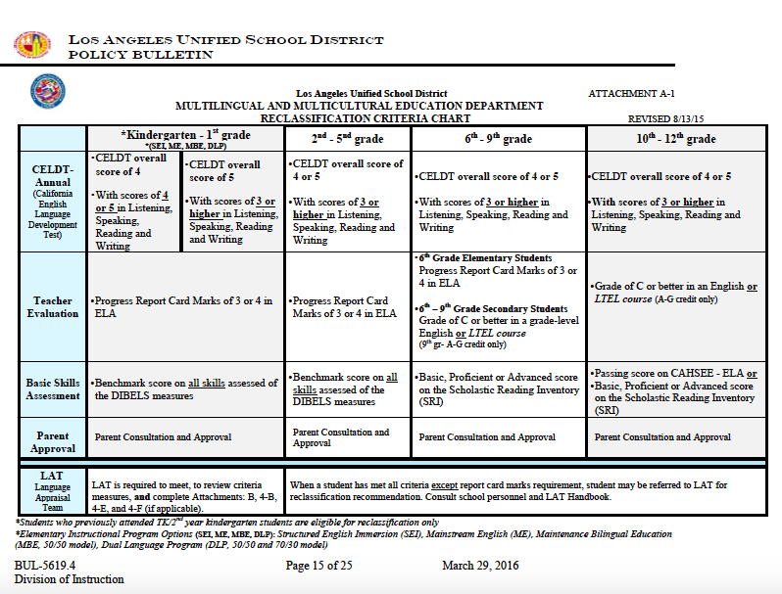
The Reclassification Criteria
1
2
3
4

Slide 3
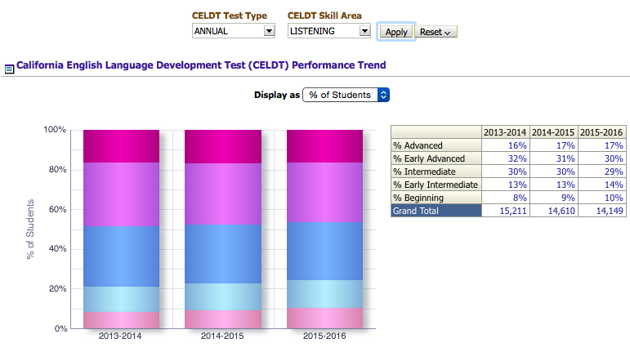
CELDT Listening – LD West

Slide 4
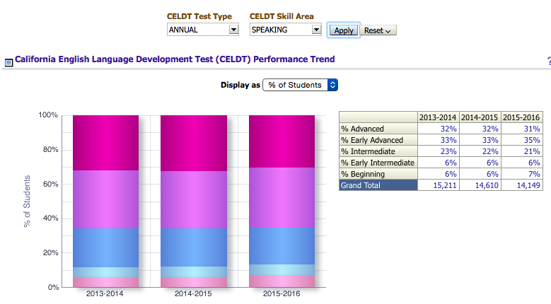
CELDT Speaking – LD West

Slide 5
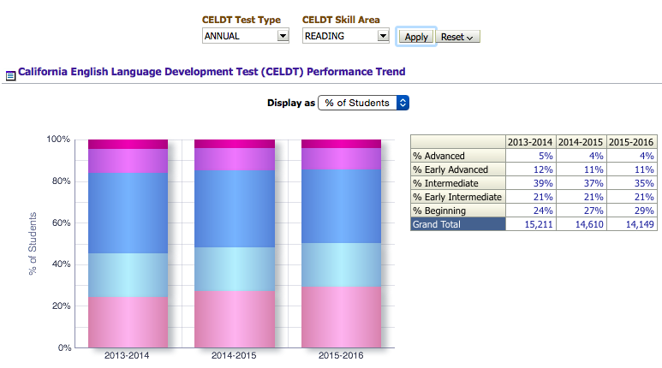
CELDT Reading – LD West

Slide 6
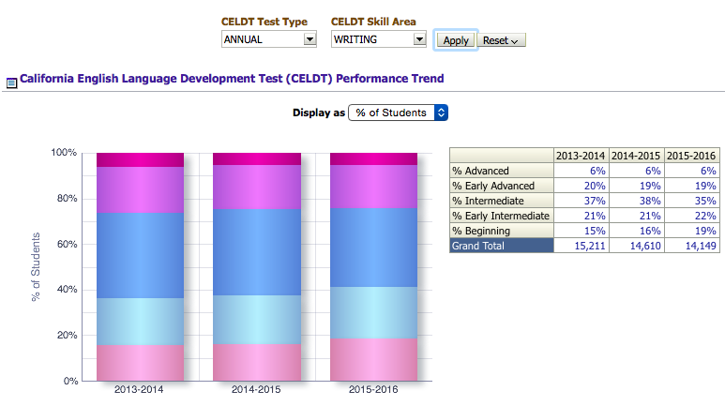
CELDT Writing – LD West

Slide 7
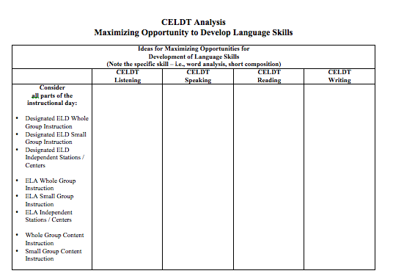
Effective Practices
Consider for a moment:
what activities/lessons throughout the year you already do to build the skills assessed on CELDT
what else you could do to maximize the opportunity to develop these skills over the course of the instructional day
what you learned last year regarding the new ELD Standards, Constructive Conversation skills and the Designated ELD Frame of Practice that supports students in developing the skills assessed on CELDT
Document your initial thoughts on your graphic organizer.

Slide 8
Maximizing Opportunity to Develop
Language Skills All Day Long & All Year Long

Slide 9

Sharing Effective Practices
In a moment, you will find a partner.
Walk and talk with your partner as you visit
the various CELDT released question
posters in the room.
Consider:
what activities/lessons throughout the year you already do to build the skills assessed on CELDT
what else you could do to maximize the opportunity to develop these skills over the course of the instructional day
what you learned last year regarding the new ELD Standards, Constructive Conversation skills and the Designated ELD Frame of Practice that supports students in developing the skills assessed on CELDT
Document your ideas on the poster and on your graphic organizer.

Slide 10
Based on the data, please visit the charts for:
Middle and High Schools
Reading (21% 4s/5s)
Writing (33% 4s/5s)
Listening (34% 4s/5s)
Kinder and 1st
Listening (45% weight)
Speaking (45% weight)
2nd through 6th
Reading (12% 4s/5s K-5)
Writing (21% 4s/5s K-5)

Slide 11

Gallery Walk

Slide 12

You will soon have access to a powerpoint with pictures of all charts we generated together containing our ideas to support students in their language development.

Slide 13
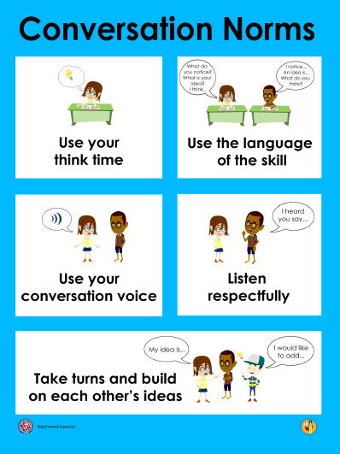
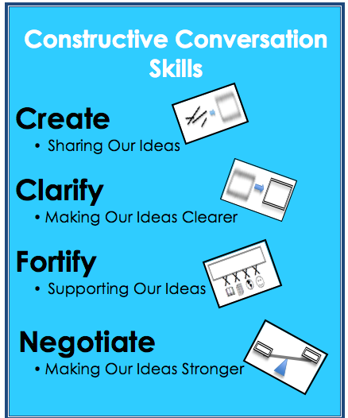
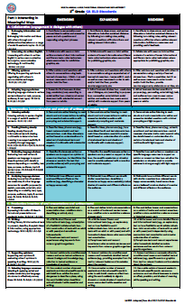
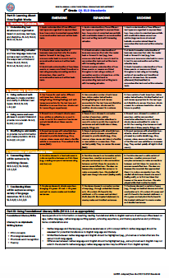
Local District West
Elementary EL Cadre
Spring, 2016
Ideas to Support
Language Skill Development
Throughout the Day and
Throughout the Year
Reading and Writing Focus

Slide 14

Reading Domain
Word Analysis

Slide 15
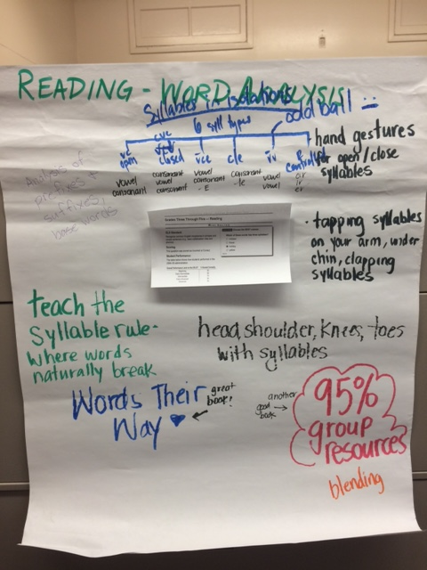

Slide 16
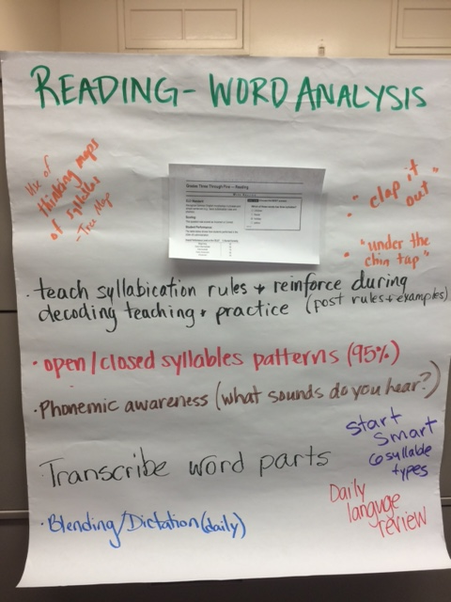

Slide 17
Reading Domain
Fluency and Vocabulary

Slide 18
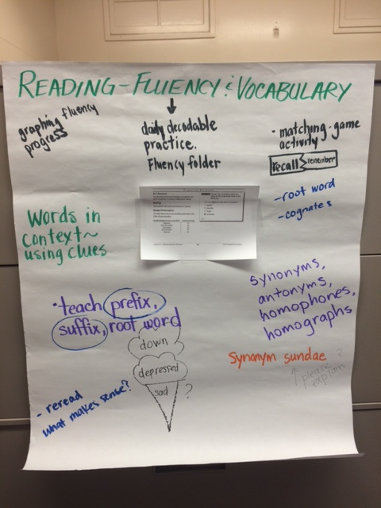

Slide 19
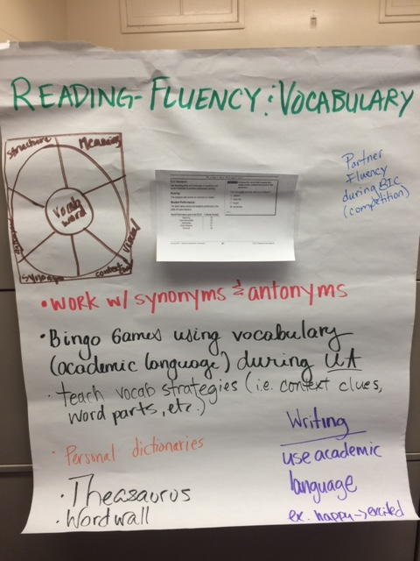

Slide 20
Reading Domain
Reading Comprehension

Slide 21
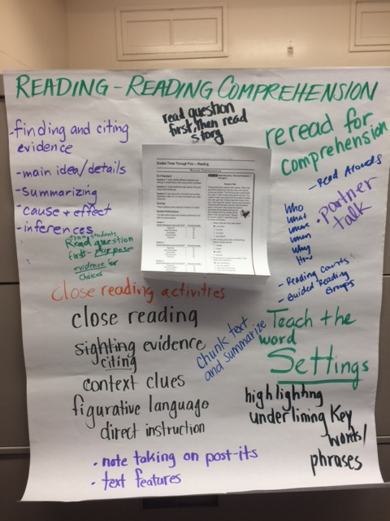

Slide 22
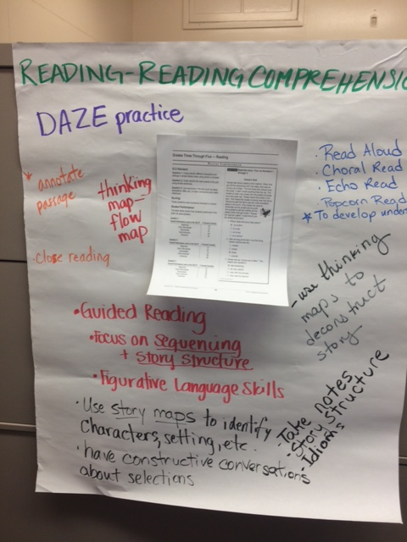

Slide 23

Writing Domain
Grammar and Structure

Slide 24
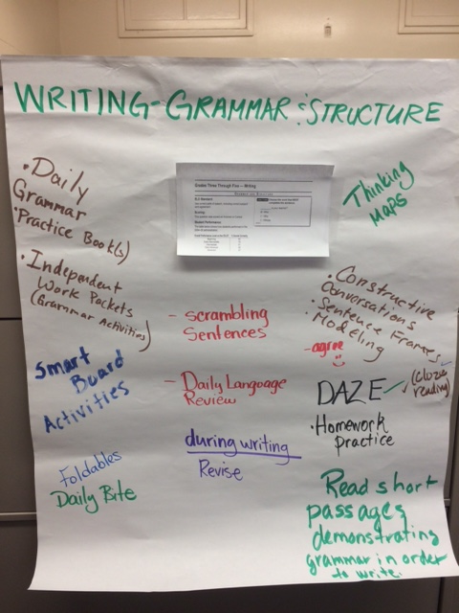

Slide 25
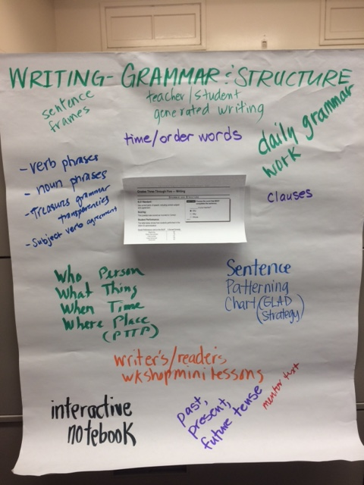

Slide 26
Writing Domain
Sentences

Slide 27
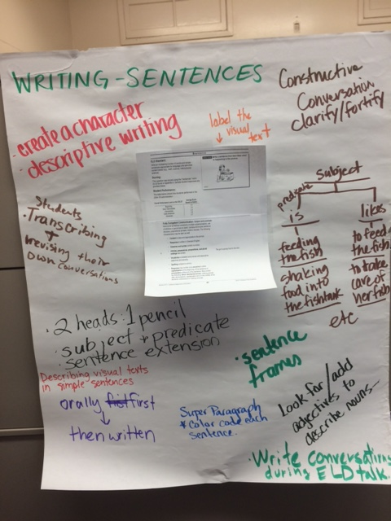

Slide 28
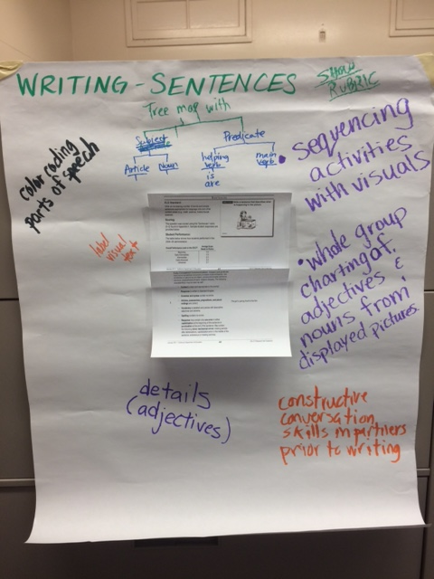

Slide 29
Writing Domain
Short Composition

Slide 30
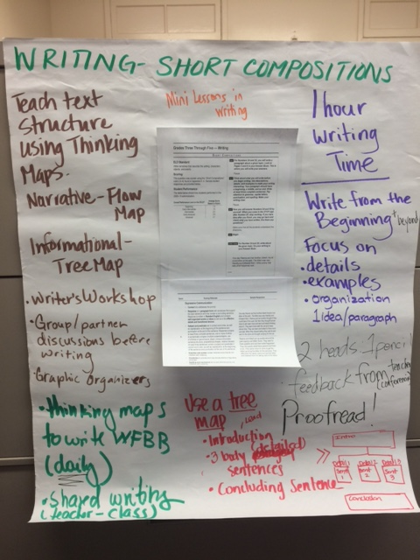

Slide 31
