Slide 1
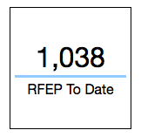
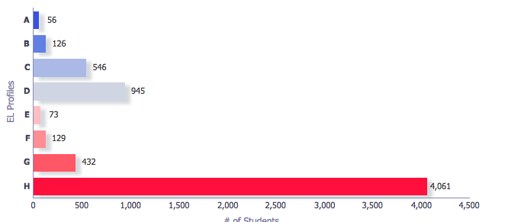
Please go onto the EL Dashboard through mmed.lausd.net and
Write down how many students you have reclassified thus far and how many students are in:
        Profile A
        Profile B
        Profile C
        Profile D
        Profile E
        Profile F’
        Profile G
        Profile H

Slide 2
Monitoring of Key Practices to Impact English Learner Reclassification
LD West
EL Designee Meeting
February 23, 2017
Notes:
Set up parking lot before presentation.
1 minute
Introduce self.
Explain that there is a parking lot in case there are any questions that need to be researched or are not on the topic at hand. They can put a post-it on the chart with their name and school and we can get back to them about their question.

Slide 3
Engaged Participant Outcomes
Review the updated monthly Reclassification Rate Monitoring Report
Review Annual CELDT progress
Set commitments to impact student learning and teacher support
Notes:
1 minute
Read the outcomes.

Slide 4
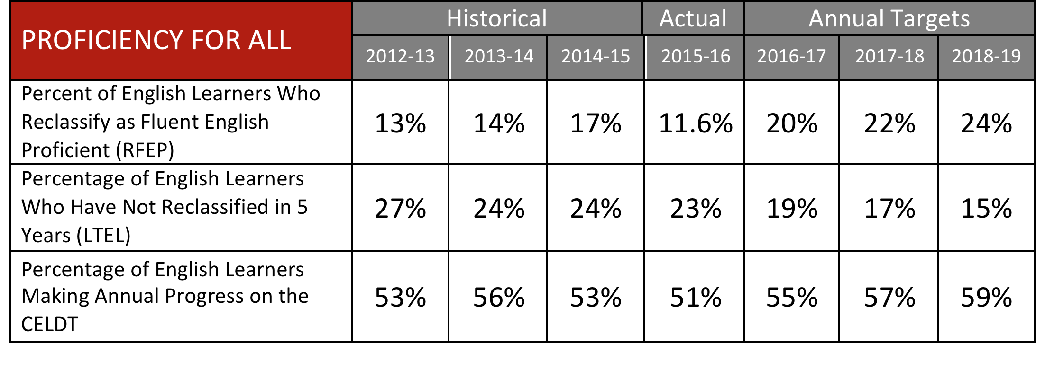
Three LCAP Measures that have Implications for Reclassification of English Learners
Oct. 2016 - Oct. 2017: New LCAP Target 22%
Notes:
The District’s LCAP goal for 16-17 was 20%. We anticipate that the 16-17 reclassification rate will be around 17%.
22% is the reclassification goal that we are currently working towards and will be captured through CALPADS in October 2017.

Slide 5
System Support
As we lead reclassification efforts, what systems, structures and evidence will result in improved student learning and teacher effectiveness for English Learners?
Notes:
1 minute
Say: As discussed in previous meetings, our essential question continues to guide our work in schools and in providing leadership to teachers on reclassification efforts.

Slide 6
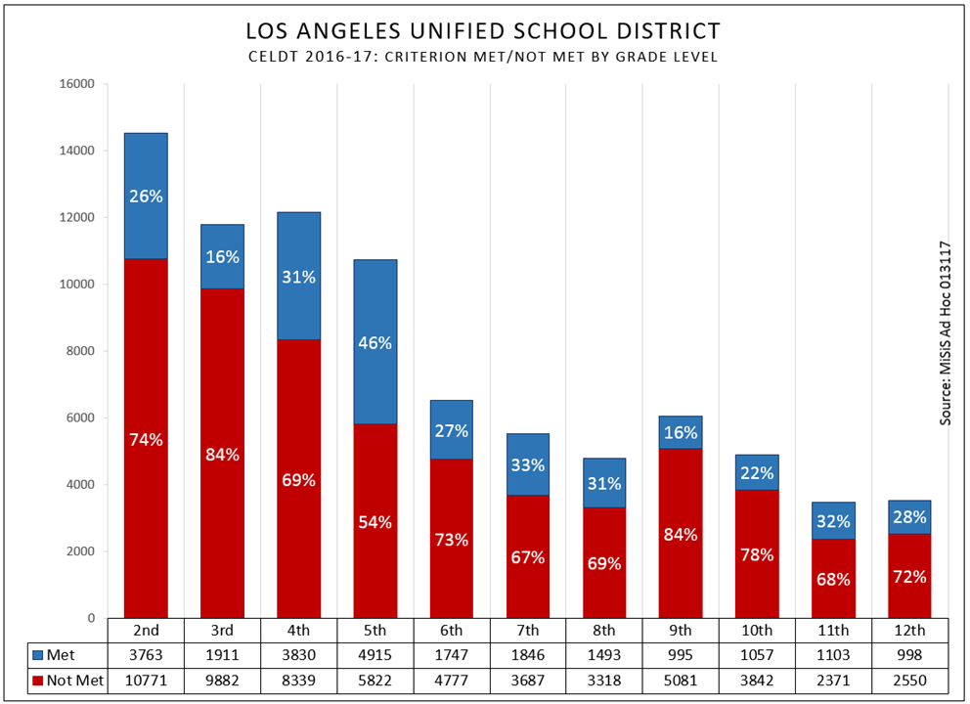
16-17 CELDT results grades 2-12
Notes:
4 minutes
Say: These are the 16-17 CELDT results for grades 2-12 shown by met/not met. The blue bar shows the students who met the CELDT requirements for reclassification with an overall score of early advance or advance with no domain below a 3. The red bar shows the students who did not score as English proficient as measured by CELDT. Some students who did not meet CELDT will have one more opportunity to improve their scores in March.
TABLE TALK: With the people in your table, knowing that the CELDT consists of four components (Listening, Speaking, Reading, and Writing), discuss how might teachers prepare these students for the second opportunity? (After table discuss, ask for 2 or 3 people to share out.)

Slide 7

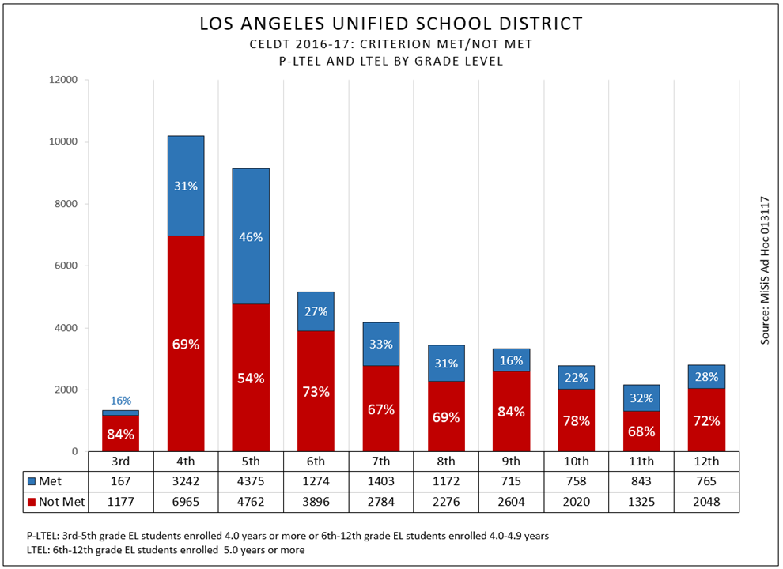
16-17 CELDT results P-LTEL & LTEL students
Notes:
2 minutes
This graph shows the CELDT results of PLTEL and LTEL students only. This subgroup of students must be closely monitored. It is highly recommended that they receive before, during and afterschool interventions to ensure their success.
The second CELDT opportunity will be provided to these students in grades 4th through 12^{tth} who have not already met the CELDT criteria for reclassification. That means it will be offered to all the students in the red in this graph except for the third graders. Consider what supports you can offer these students before, during and after school to help them capitalize on the second chance CELDT opportunity.

Slide 8
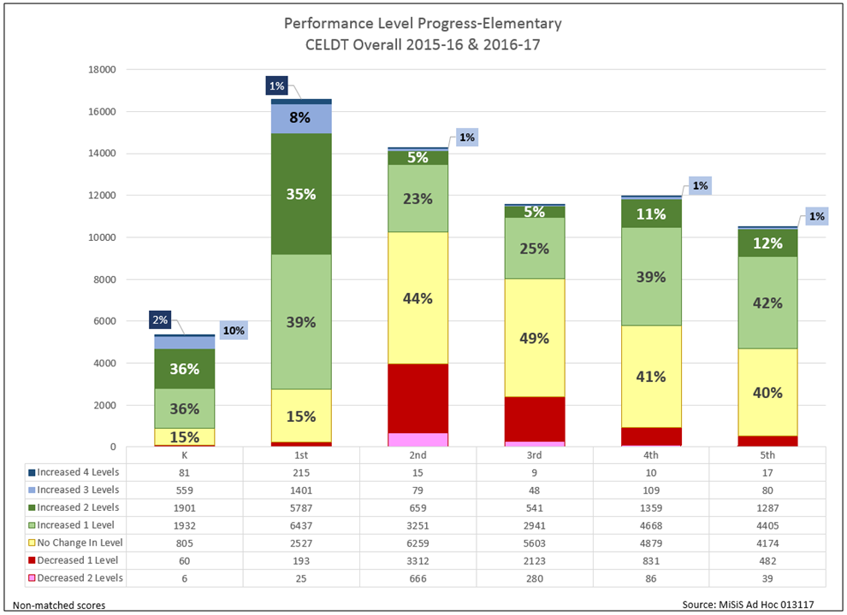
CELDT results comparison K-5
Notes:
2 minutes
This graph is a comparison of CELDT results from 15-16 to 16-17. green to blue are gains in CELDT level, yellow depicts “no change” in CELDT level and pink and red ”depict” a drop or regression in CELDT level.
Consider what next steps will you take with students who show no change or regress? What next steps will you take for students who made several levels of gain in proficiency? Think about and identify the practices in classrooms that led to gains/losses?

Slide 9
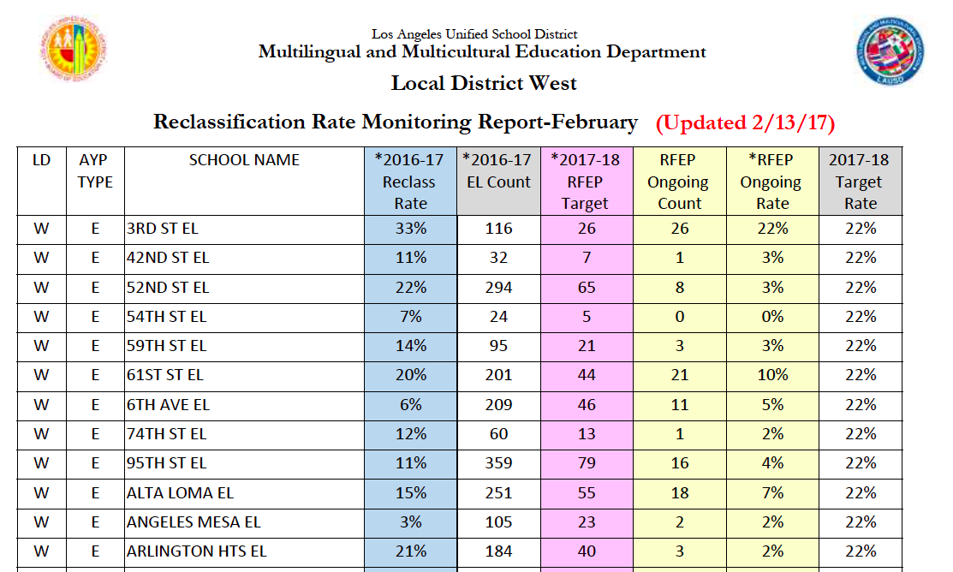
Objective #1
Use of Reclassification Data
Notes:
2 minutes
The Reclassification Rate Monitoring Report for February captures our progress in reclassifying students as of February 13, 2017.
Please note the two yellow columns. (Click on animation) As of February 13th, the RFEP Ongoing Count column captures how many students have been reclassified thus far this year at your school. (Click on animation) In the purple column is your RFEP Target, the number of students you want to reclassify in order to meet the 22% reclassification target. (Click on animation) The RFEP Ongoing Rate is your current reclassification rate based on the number of students reclassified thus far. (Click on animation) Our goal being for each school to get to 22%.
Now that the data is in MiSiS, data analysis should occur to see what support students need in language development based on the CELDT results.

Slide 10
Objective #1
Use of Reclassification Data
32 Schools With Double Digit
Reclassification Rate
61st St. Fairburn Westminster
Beethoven Hancock Park Westpost
Braddock La Salle Westside
Brentwood Laurel Wilton
Broadway Lawson Bancroft
Canfield Manhattan Place Le Conte
Carson-Gore Marquez Twain
Carthay Overland Palms MS
Charnock Palisades
Cheremoya Topanga and…
Clover Valley View
Community Van Ness
Notes:
Our schools are making progress towards the 22% goal. LD West has reclassified 996 English learners.
However, we have some schools I would like to recognize.
The following 32 schools are already at a double digit reclassification rate on their way to the 22% goal. (Click animation.)

Slide 11
Objective #1
Use of Reclassification Data
9 schools that have hit
the 22% Reclassification Rate and
are still striving to increase their rate
3rd Street (26 students) Burroughs (38 students)
Canyon (1 student) Revere (19 students)
Cowan (2 students) LACES (7 students)
Paseo (9 students)
Walgrove (5 students)
West Hollywood (3 students)
Notes:
And the following 9 schools have already met their 22% reclassification rate and are striving to increase their rate even further.

Slide 12
Next opportunity to reclassify
Planning for upcoming reclassification opportunity:
Elementary | Secondary
LAUSD-CELDT March 13-March 24, 2017 Single Track schools | LAUSD-CELDT March 13, 2017-March 24, 2017 Single Track schools
Reporting Period 2 Marks: Submit: February 9-March 3, 2017 Used as criteria until June. 2017 | Reading Inventory: Submit: April 24th – May 26th, 2017 Used as criteria until June 2017
Students eligible to take “Second Chance CELDT”:
2nd - 6th grade students who are in Profiles E and F (students who met MOY/RI)
4th - 6th grade P-LTELs and LTELS who are in Profile G and H
Notes:
2 minutes
We always want to be attentive to the upcoming opportunities for students to meet reclassification criteria.
(Click for animation)
Say: Right now, the grading window for reporting Period 2 marks is open. Students who have met the CELDT requirements, and have met DIBELS requirement will reclassify if they earn ELA Period 2 marks.
(click for animation)
Say: For students who did not meet the CELDT requirement, a second opportunity – the LAUSD CELDT will be offered from March 6- March 17.
(click for animation)
Say: The students who will be eligible to take “Second Chance CELDT” include 2nd-6th grade students who are in Profile E and F (students who met MOY/RI) and 4th-6th grade P-LTELs and LTELs who are in Profile G and H

Slide 13
Elementary Roadmap to Reclassification
Remember the expanded number of students getting the opportunity to take Second Chance CELDT!
Notes:
2 minutes
During the month of February principals and teachers should review the results of the first semester assessments and begin to plan and implement appropriate differentiation and interventions. In grade level meetings, teachers, out-of-class support personnel and school leaders should identify successful practices and begin to look for patterns and trends for SSPT
(click on animation)
Say: As stated in the last slide, the grading window for second reporting period grades closes on March 3rd. This is a perfect opportunity to have conversations with teachers whose students are only missing grades to reclassify.
(click on animation)
Say: For many students who did not meet the CELDT criteria, the Second chance CELDT will be offered in March.
(click on animation)
Say: More students are being afforded the opportunity to take second chance CELDT.
(click on animation)
Say: Then, for students who did not meet MOY, they will have an opportunity to reclassify with EOY that will be offered starting in May. While we don’t recommend testing students at the beginning of the testing window, it is also important not to wait until the last days to give the students EOY.

Slide 14

Mid Year Reflect and Plan
Instructionally, what has worked? What were some challenges? What adjustments will you make?
How might you lead staff to identify, design and implement appropriate interventions for English Learners who have not met benchmark expectations? By subgroup--LTELs, newcomers, less than 5 years.
What are some supports you will need to help implement these instructional adjustments/decisions?
Identify 3 commitments you will make to celebrate, support and monitor student success
Notes:
Principals as part of our mid year review and planning, take a few minutes to plan your next steps using these guiding questions.
In pairs share 3 commitments you will make to your students who still need supports.

Slide 15
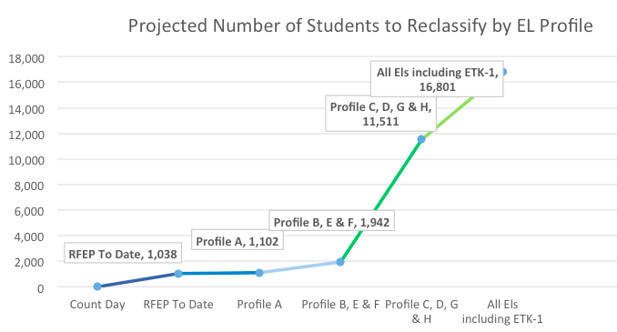
Focused interventions by student profiles will result in goal achievement
Once our Profile A students are reclassified we have 1102 RFEPs to date
Our LDW RFEP
Target # is approximately
3,700
Notes:
This projection graph shows how we can meet our goal of 22% reclassification for Local District West.
Use animations:
(Click Animation) Our LDW RFEP Target is approximately 3,700 students.
(Click Animation) Once our Profile A students are reclassified we will have 1110 RFEPs to date.

Slide 16
Focused interventions by student profiles will result in goal achievement
With your strategic efforts, interventions and supports we can hit our goal and help our English learners with language growth and literacy succcss.
With current RFEPs to date and all
Profile A, B, E and F students we would have 1,942 new RFEPs.
We need around 1,758 students from the remaining 9,569 students in Profiles C, D, G and H to hit 22%!
Our LDW RFEP
Target # is approximately
3,700
Notes:
(Click Animation) With the students we already reclassified this year and all students in Profile A, B, E and F, we will have 2040 reclassified students.
(Click Animation) We will need to reclassify around 1,660 students from the remaining 9,550 students in Profiles C, D, G and H to hit 22% as a local district.
(Click Animation) If we are strategic in our efforts, interventions and supports, both schools and the local district can meet this goal.

Slide 17

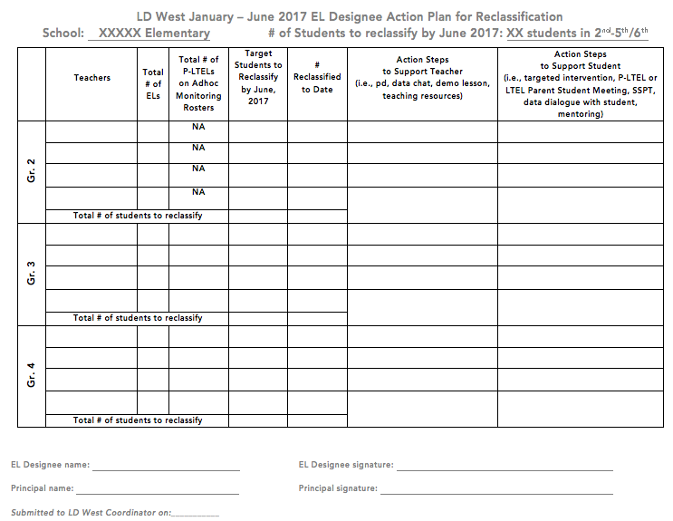
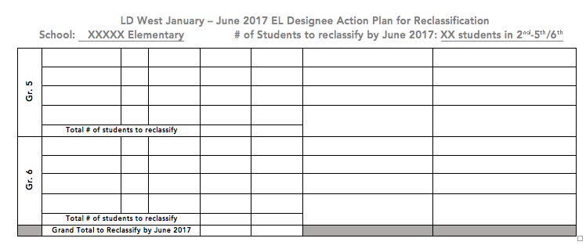
Reclassification Action Plan
Get into triads with people
from other tables
with your reclassification
action plan in hand.

Slide 18
Reclassification Action Plan
Share:
What your reclassification target number is from the Reclassification Rate Monitoring Report
What number of students you have reclassified thus far
What number of students you have targeted in the plan for reclassification and whether it will get you to the 22% goal
What process you took to complete the action plan
What action steps are built into the action plan

Slide 19

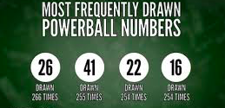
Get your
numbers
handy….
PLAN
No…
not these
numbers

Slide 20
Get your
numbers
handy….
PLAN
These numbers:
target #
# reclassified and
# in each profile

Slide 21
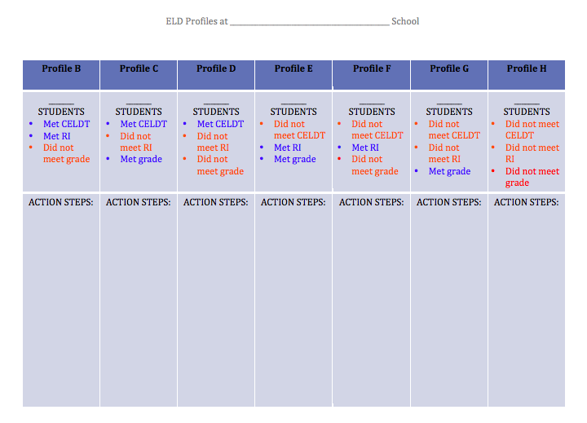
Objective #1
Use of Reclassification Data
Notes:
2 minutes
The Reclassification Rate Monitoring Report for February captures our progress in reclassifying students as of February 13, 2017.
Please note the two yellow columns. (Click on animation) As of February 13th, the RFEP Ongoing Count column captures how many students have been reclassified thus far this year at your school. (Click on animation) In the purple column is your RFEP Target, the number of students you want to reclassify in order to meet the 22% reclassification target. (Click on animation) The RFEP Ongoing Rate is your current reclassification rate based on the number of students reclassified thus far. (Click on animation) Our goal being for each school to get to 22%.
Now that the data is in MiSiS, data analysis should occur to see what support students need in language development based on the CELDT results.

Slide 22
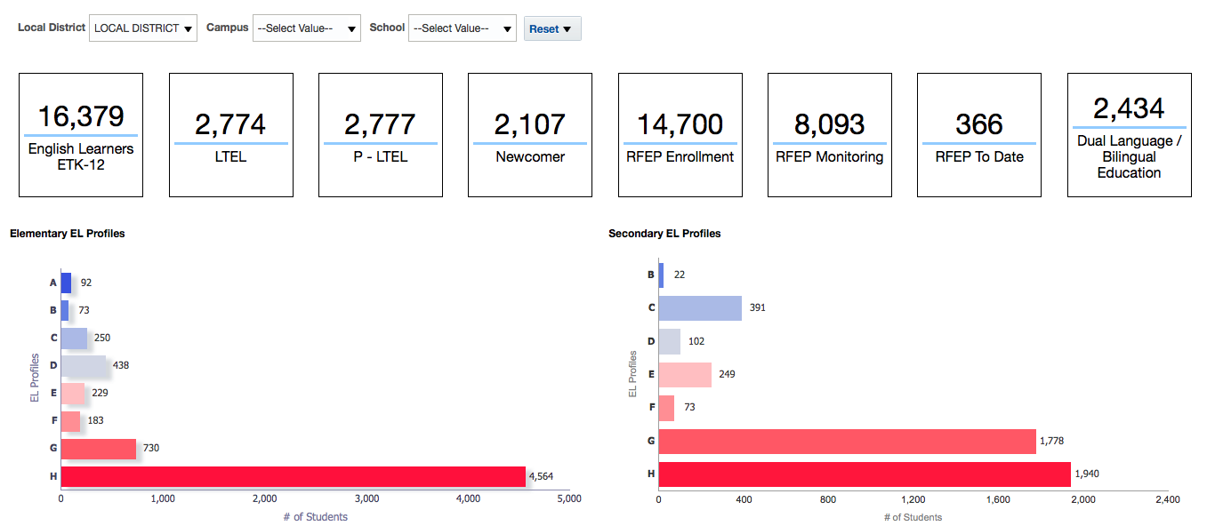
Reclassified thus far
The Profiles

Slide 23
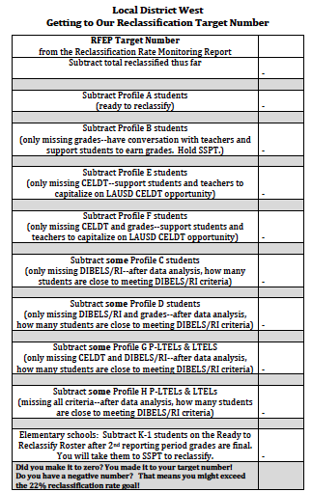

Getting to Our Reclassification Target Number
Stand Up, Hand Up, Pair Up

Slide 24
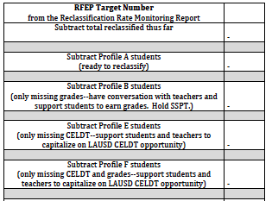
65
8
57
6
51
3
48
14
34
12
22

Slide 25
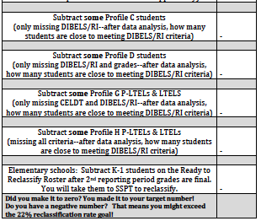

Slide 26
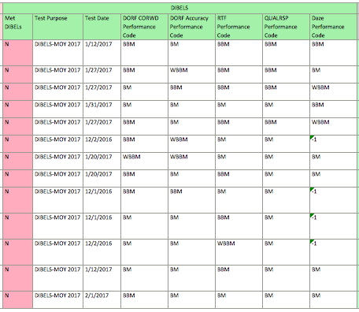

Slide 27
22
7
15
5
10
3
7
7
0
14
-14

Slide 28



Slide 29
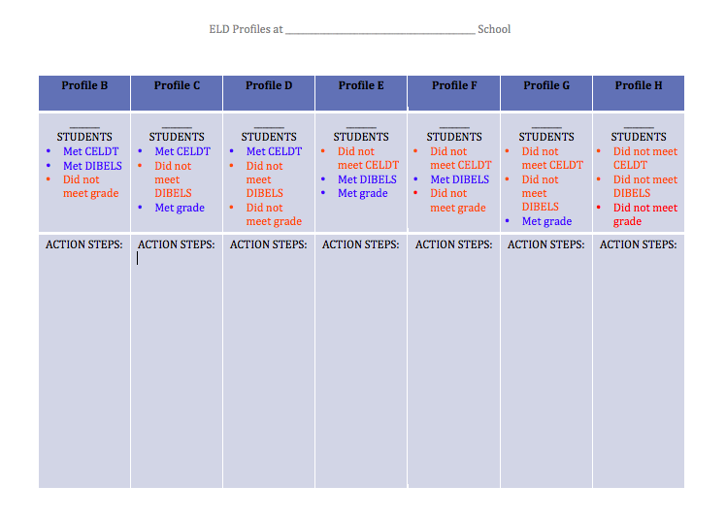

Action Steps to Implement
Based on all the conversation with your colleagues this morning, write down at least 3 action steps you will take when you return to the school site:
Notes:
6 minutes
Read slide. Provide 4 minutes for principals to write down their ideas
(click for animation)
Say: Now turn to your partner, and discuss what action steps you will take to help the students in the profiles be successful. (2 minutes)
Pause for conversation

