Slide 1
READING FOUNDATIONAL SKILLS
Notes:
Let’s take a closer look at Part III

Slide 2
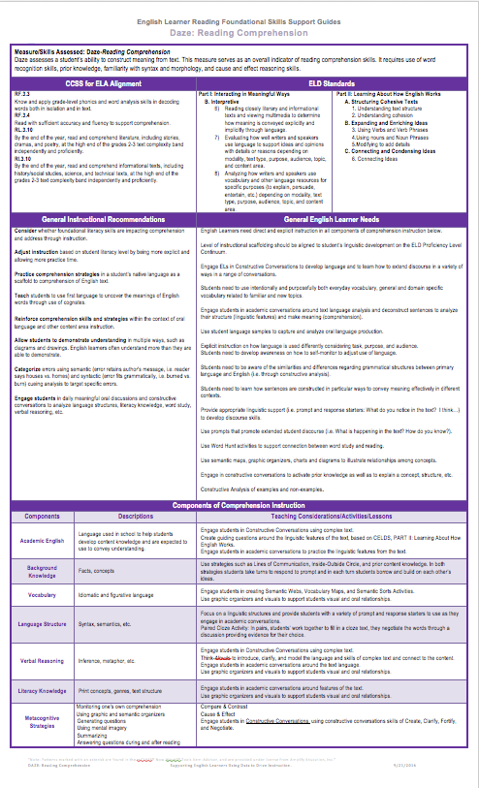
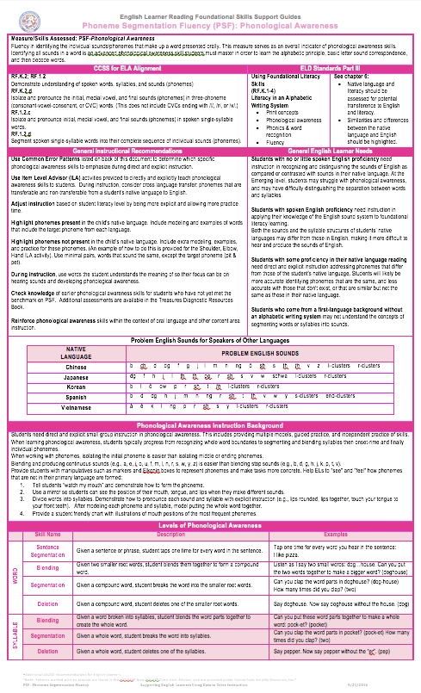
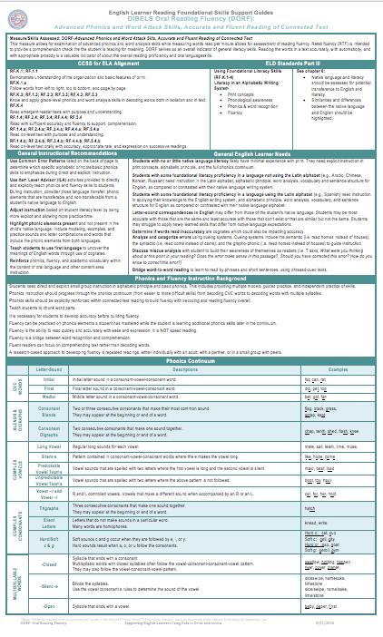
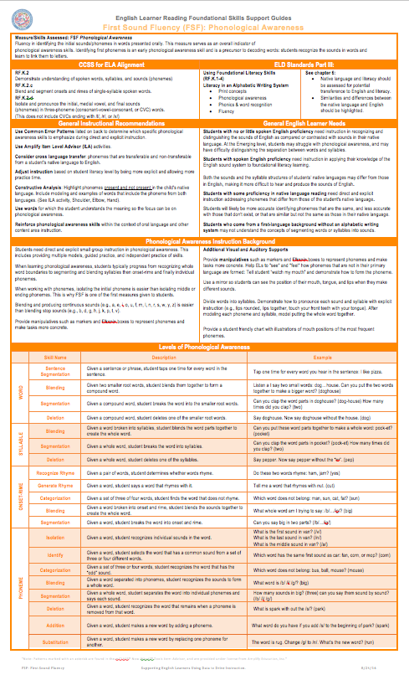
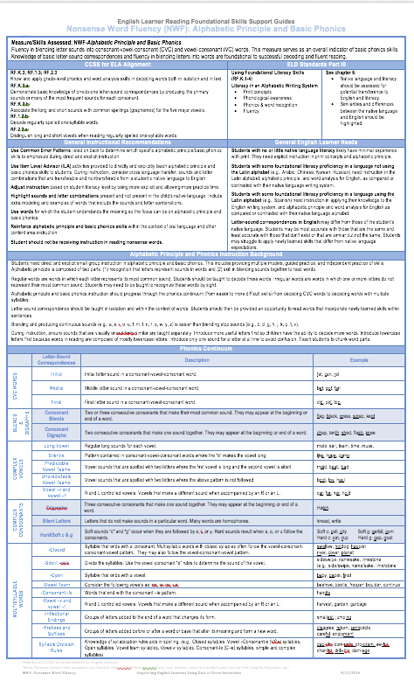
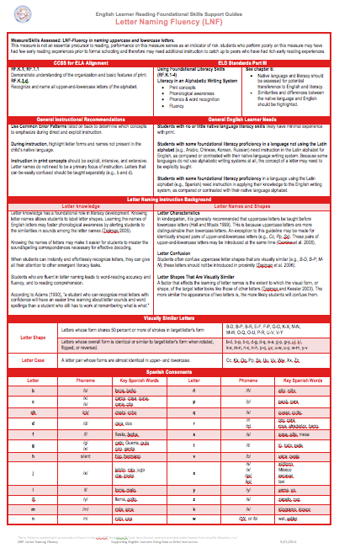
EL SUPPORT GUIDES
What measure are my students struggling with?

Slide 3
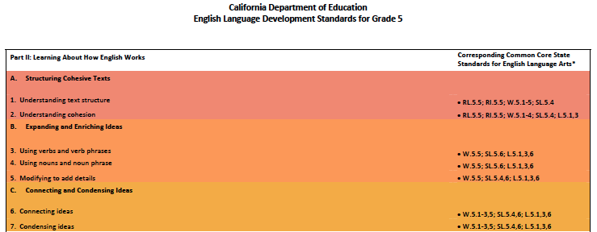
Section I, Part II: Learning About How English Works
Section I, Part III: Foundational Skills
Part III: Using Foundational Literacy Skills is about instructional considerations based on knowledge of the literacy and language of English Learners how to apply when teaching Reading Foundational Skills
Notes:
2 minutes
Why/Purpose: To understand the layout of the new ELD Standards Parts II (How English Works and Part III (Foundational Literacy Skills)
How:
Say: Part II is the same at each grade level. Part 2 of section 1 is learning about how English works. It lists 3 Processes.
Part III: Using Foundational Literacy Skills: The foundational literacy skills will be addressed through the English Language Arts time (covered in Appendix A)

Slide 4

CA ELD Standards Section I
Part III: Using Foundational Literacy Skills
Part III: Using Foundational Skills RF.K-1.1-4; RF.2.3-4 (as appropriate)
Teachers of ELs must determine if they should teach RF standards from previous grade level or advance to next level depending on proficiency level and level of literacy of students (as appropriate)
Part III Section 1: The corresponding CCS ELA RF standards are highlighted, it covers the progression from previous grade level(s)
How do you make that determination?
  Consider the data
  What else do we consider?
Notes:
Purpose: Bring awareness to PART III: Using Foundational Literacy Skills, expectations and CCS ELA RF s role inn connection with this part.
Section I of the CA ELD standards offers us an overview for each the grade level. For Part III, we see the reference to CCS ELA RFs with a note to apply them appropriately. That means, considering the grade level, the Foundational Literacy Continuum in tandem with the English Language Development proficiency level continuum.
FOR EXAMPLE, IN GRADE 2 A TEACHER AFTER ASSESSING LITERACY SKILLS OF STUDENT MAY NEED TO START TEACHING A SPECIFIC RF STANDARD FROM GRADE K OR 1ST.

Slide 5
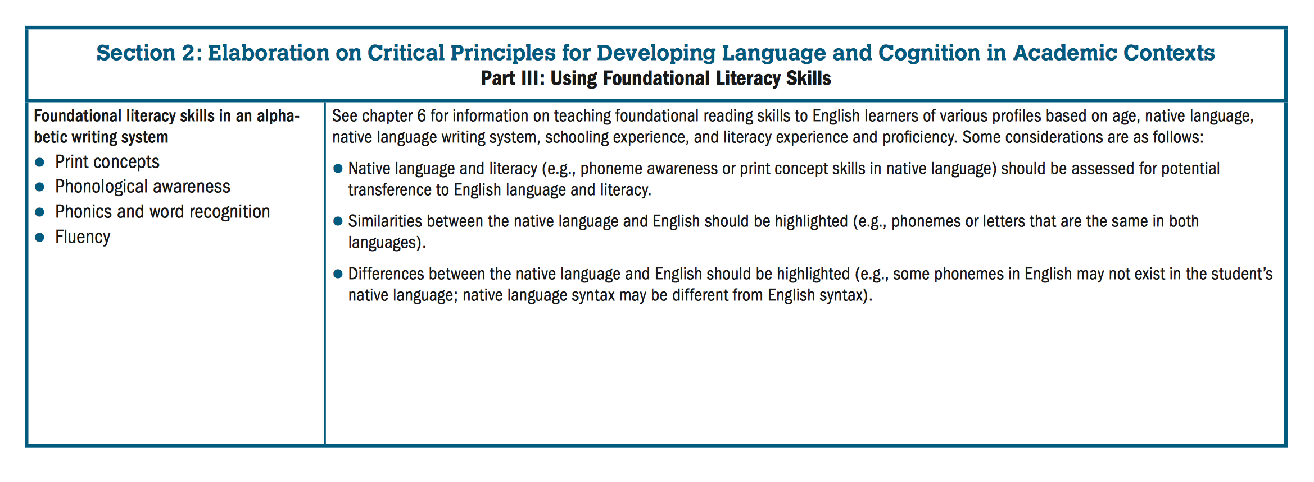
CA ELD Standards Section 2
Part III: Using Foundational Literacy Skills
Essential Question: What might be the unique opportunities and challenges faced by a student learning to read in a second language?
Part III Section 2: Foundational Skills are organized into 4 elements
Part III Section 2: Foundational Skills specific to grade level and highlights the need to consider proficiency levels, age, native language, grade level when planning instruction and determining which RF Standards to teach
Notes:
2 minutes
Purpose: Section 2 of the CA ELD standards encompasses the actual standards and it is specific by grade level. For Part III, we see a reference to the Foundational literacy skills organizing elements, as per their continuum alongside with a reference to key considerations regarding students language and literacy characteristics.
It also orients us to Chapter 6 of CA ELD Standards.

Slide 6
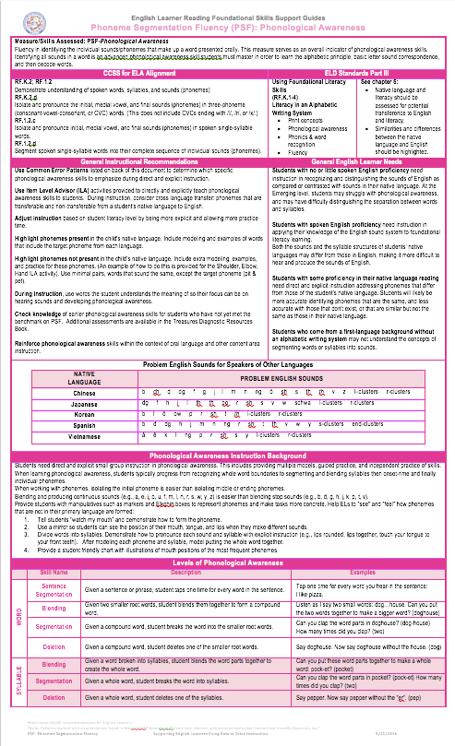
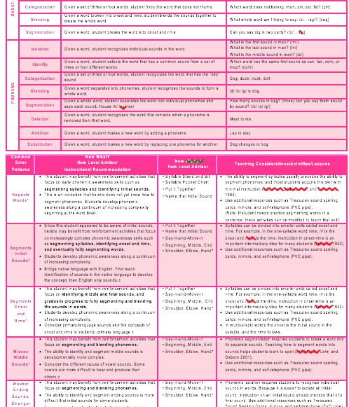
AHA! Protocol
As you read mark:
  ✔️ significant/agree
  ! new ideas
  ? questions
Notes:
2 minutes
Purpose: To introduce the EL Support Guides and to orient participants to the EL Support Guides format and basic content components.
Let participants know that this is one of the Six EL Support Guides that were developed by MMED in collaboration with Amplify to support teachers of English Learners as they plan instruction for Foundational Skills.
There is one EL Support Guide per Skill/Measure being assessed in DIBELS Next. The EL Support Guide being used for the introduction to the format and content of the guides is for the Phoneme Segmentation Fluency Measure.
Participants will use Handout to work on this activity.
Explain AHA! protocol.

Slide 7
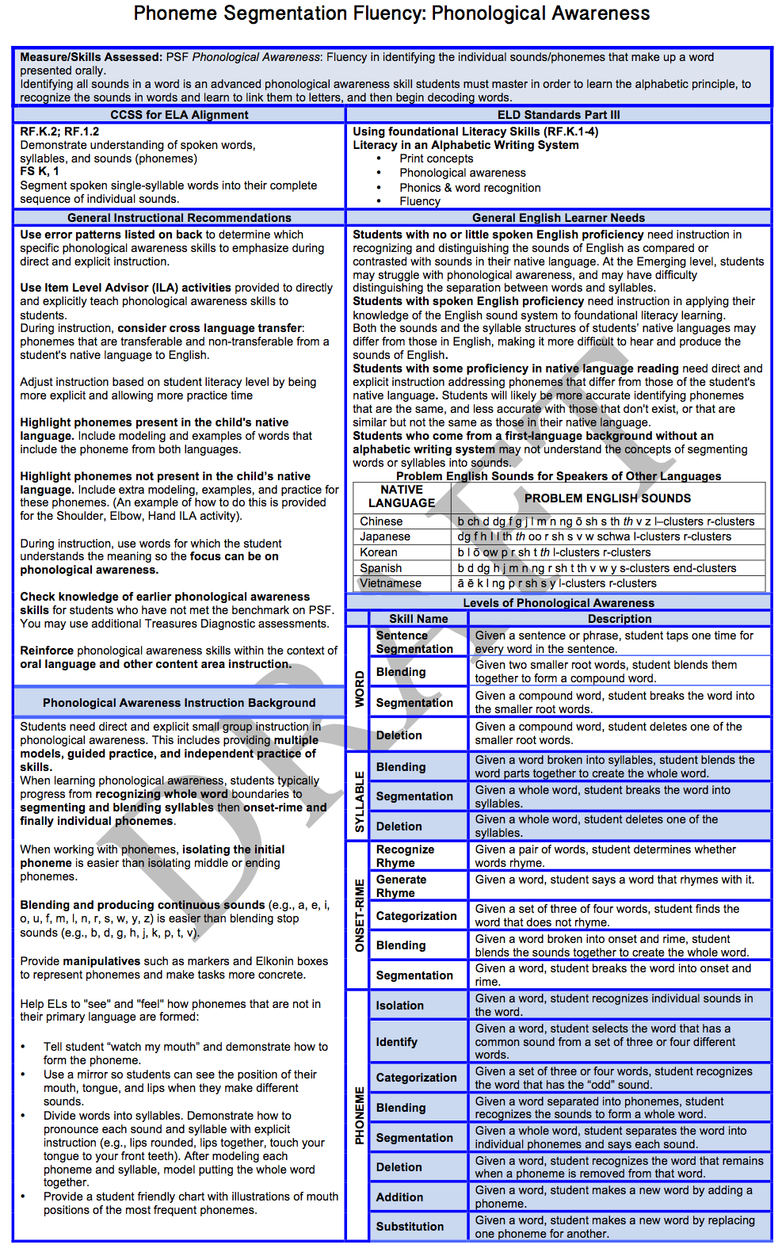
Key Features
(front)
CA ELD Standards Section 2 - Part III: Using Foundational Literacy Skills
Measure/Skills assessed
CCSS ELA and CELDS Alignment
General Instructional Recommendations for all students
General EL Needs
Phonological Awareness Instruction Knowledge
Levels of Phonological Awareness
Notes:
2 minutes
First, debrief findings with group. Then, click animation and explain one section at a time
Click animation:
Top section defines the skill/measure that is assessed in DIBELS Next
Click animation:
Next section refers to the specific CCS ELA Foundational Skills Standards and the alignment to PART III of the CA ELD Standards
Click animation:
These General Instructional Recommendations are some key recommendations for all students related to the specific skill/ measure that is assessed.
Click animation:
The General English Learners Needs refer to specific needs that should be considered and addressed when planning Foundational Skills instructions. They are also aligned to the skill being taught.
Click animation:
Phonological Awareness Instruction Knowledge provides teachers with key information about the skill/ measure.
Level of Phonological Awareness shows the Phonological Awareness continuum. As teachers analyze error patterns they can use this information to decide what is the entry level of instruction in that continuum.

Slide 8
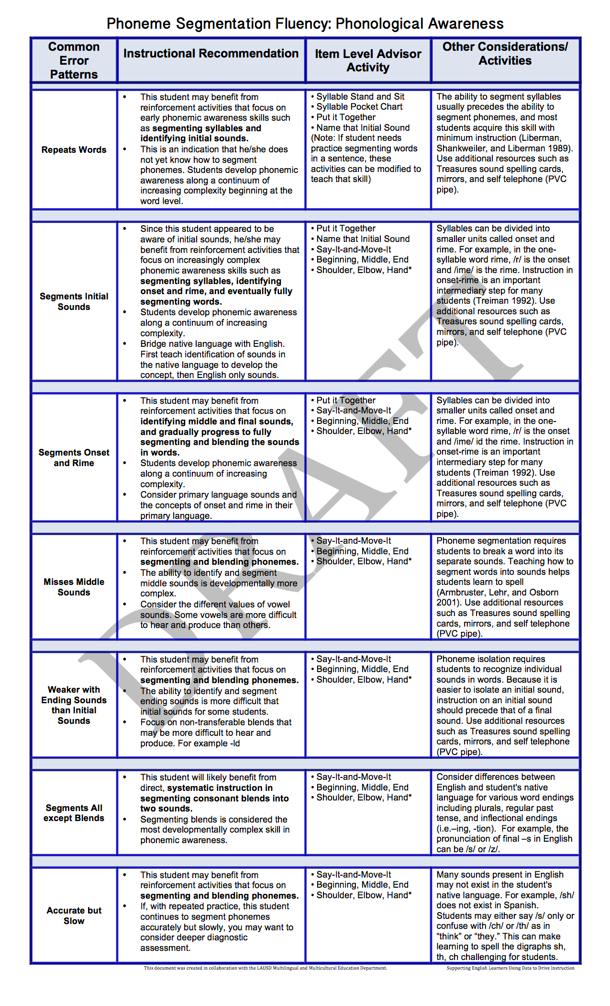
Key Features
(back)
CA ELD Standards Section 2
Part III: Using Foundational Literacy Skills
List of Common Error Patterns
For each:
  Instructional Recommendations
  Item Level Advisor Activity
  Other Considerations/Activities
Notes:
2 minutes
Click animation and explain one section at a time
Click animation:
This section lists the error patterns that are considered in DIBELS Next assessment.
Click animation:
These are instructional recommendations for each particular error pattern.
Click animation:
This column provides a list of the lessons that can be used to address each error pattern. Teachers can access these listed lessons in the Amplify platform, through the Item Level Advisor Activities.
Click animation:
The last column provides teachers with Other Considerations and Activities to address ELs needs as teachers plan Foundational Skills instruction. They are also connected to each specific error pattern.

Slide 9
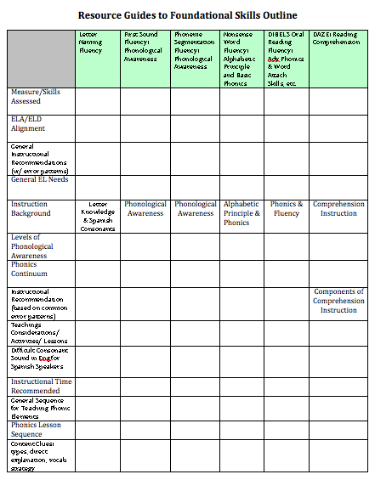
What measure are my students struggling with?

Slide 10
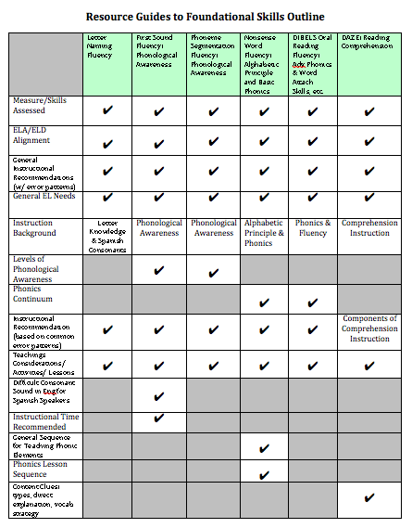

Slide 11
To delay instruction that targets meaning making until after children have acquired foundational skills is to serve children poorly.
ELA/ELD Framework Ch. 3 p 139

