Slide 1
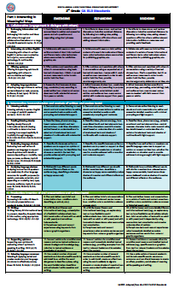
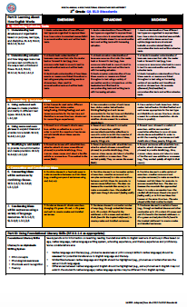
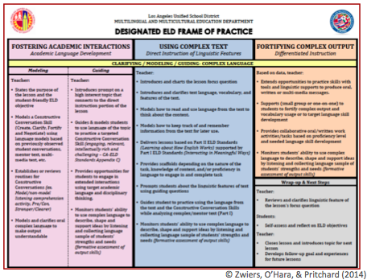
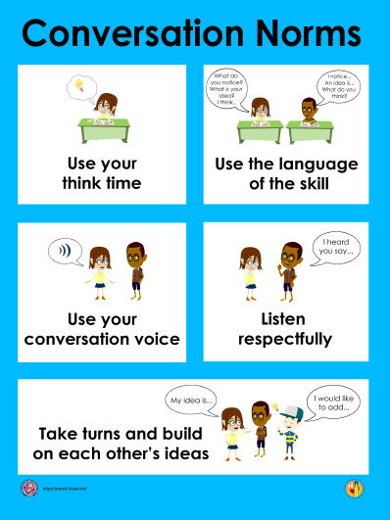
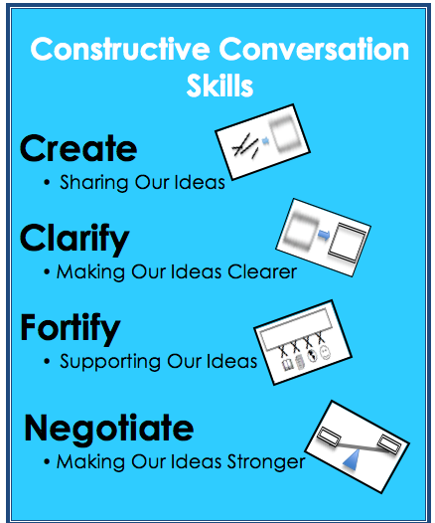
Designated ELD
LD West
Network Meeting
January 2016

Slide 2
What We Want to Observe in Our Classrooms During ELD
Brainstorm
What are specific elements of effective instruction or guiding principles of learning in ELD instruction?
What are explicit teacher or student behaviors that are called out in our Designated ELD Frame of Practice?
What is observable evidence of teaching and learning during ELD? (i.e. instructional strategies, learning activities, behavioral outcomes, artifacts, routines, practices)
Consider Start Smart,
Constructive Conversations and SPFs

Slide 3
answergarden.ch/view/249068
What we
want to observe during ELD

Slide 4
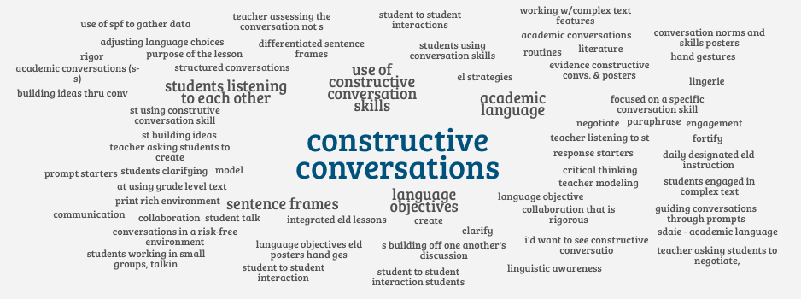
Our Answer Garden
What We Want to Observe During ELD

Slide 5
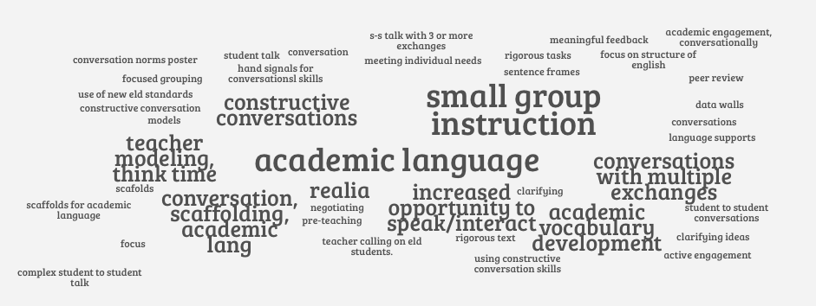
Our Answer Garden
What We Want to Observe During ELD

Slide 6
MMED’s
Comprehensive ELD
Observation Tool
Let’s Connect
What We
Discussed
with

Slide 7
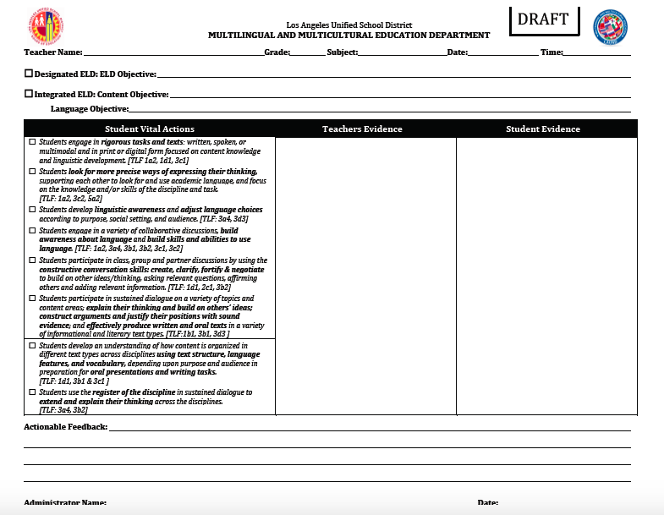
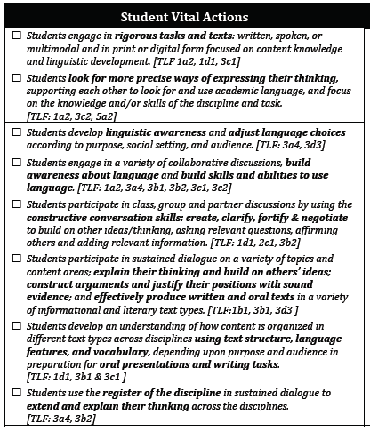

Slide 8
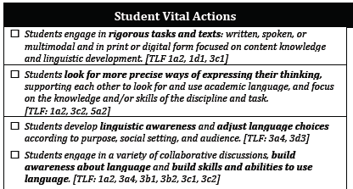
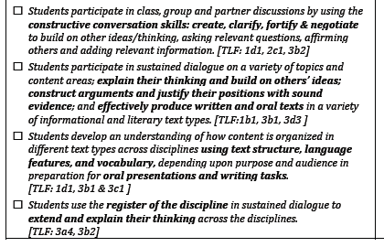

Slide 9
Consider what we surfaced regarding what we want to observe during ELD and where there is a direct connection to the Student Vital Actions.

Slide 11
Thoughts About Use of the Observation Tool
Check off student vital actions that were observed
Record student and teacher language that provides evidence regarding student vital actions
Align actionable feedback to the student vital actions and/or the ELD Standards
Possibly predetermine which student vital action(s) you will be looking for during observations

Slide 12
As we delve into
Designated ELD,
Instruction After Start Smart,
keep the
Student Vital Actions
in mind.

Slide 13

Notes:
The use of the skills of create, clarify, fortify, and negotiate in a conversation will support student learning of content and support deeper understanding of the content.
Students will be explicitly taught these skills in the designated ELD Start Smart Lessons.
The work is led by Jeff Zwiers, author of Common Core Standards in Diverse Classrooms.

Slide 14
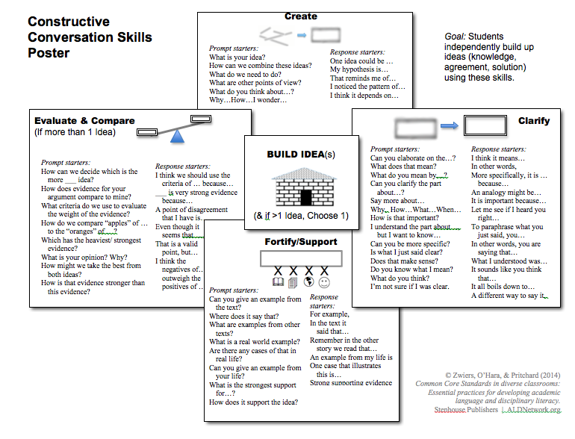
Constructive
Conversation Skills
Placemat
Create
Negotiate
Clarify
Fortify/Support
Notes:
As adults we have learned to use the skills of create, clarify, fortify, and negotiate in a conversation. Students needs to be explicitly taught these skills. These skills are important because they are the foundation for the Designated ELD lessons and support the ELD standards specially Interacting in Meaningful Ways. They will be an essential part of the routines and procedures for our daily ELD. They are the way we will meet the new CA ELD Standards Part I: Interacting in Meaningful Ways. It is how we will move our ELs from access to ownership.

Slide 15
Understand the Essential Elements of a Designated ELD Lesson

Slide 16
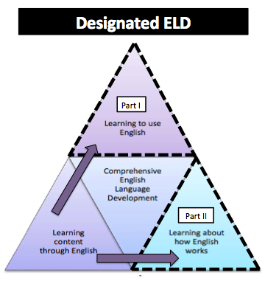
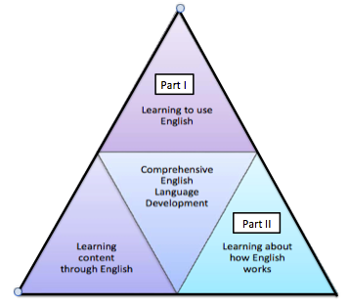
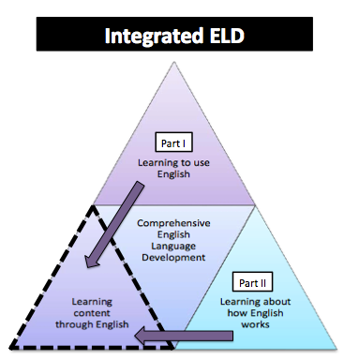
Comprehensive ELD
Notes:
1 minute on this slide
A Comprehensive ELD program includes both Designated and Integrated ELD.
Click animation (Designated ELD):
Designated ELD is the specific time of the day in which students are learning English.
Click animation (Integrated ELD):
Integrated ELD is throughout the day as ELs are learning content and the language of the discipline.

Slide 17
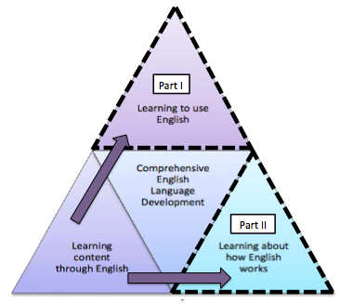
Designated ELD
PURPOSE
Separate and protected time during the regular school day. Ch. 2 Pg. 91
CA ELD Standards are the focal standards that build into and from content instruction. Ch. 2 Pg. 91
Focus on the critical language students need to develop for content learning. Ch. 2 Pg. 91
Engage in a variety of collaborative discussions to build awareness about language and build skills and abilities to use language. Ch. 2 Pg. 91
Content focus is derived from ELA and other areas of the curriculum, not separate and isolated..Ch. 2 Pg. 91
OUTCOME
ELs learn about how English works for successful participation in academic tasks across content areas through use of discourse practices, grammatical structures, and vocabulary. Ch. 2 pg. 91
Notes:
4 min. this slide
Click animation(red box):
Bullet 1: speak to
the continuation of a separate and protected time period, 45-60 minutes daily
Click on animation fly out.
Click animation(red boxes):
Bullets 3 and 4: speak to our focus on the critical language students need to develop for content learning, building awareness about language, and building skills and abilities to use language.
Click on animation fly out.
Click animation
Bullets 2 and 5: speak to the use of the ELD Standards during the designated time block. We will be lifting a small piece of text that’s been covered during content instruction out of content and bringing it in to designated ELD to look at how English works. Thus building into and from content instruction.
Click on animation fly out.
Click animation
Outcome: Choral read the outcome.

Slide 18

Build “Into” and “From”
Content Instruction
ELA &
Content Areas
INTO
FROM
Designated ELD
Notes:
30 seconds

Slide 19
Build “Into” and “From”
Content Instruction
The language demands identified during content instruction inform what needs to happen during Designated ELD. The language from content is taken “Into” Designated ELD to be explicitly taught.
During Designated ELD we use the CA ELD Standards for instruction. The new language learning is taken “From” Designated ELD to support successful participation in academic tasks during ELA and other content areas.

Slide 20
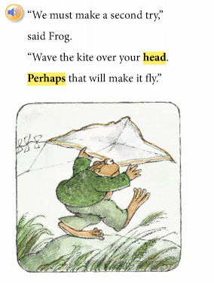

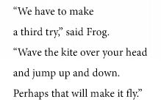
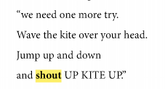
Designated ELD
1st. Grade ELA
i.e. Story elements, character traits, etc.
i.e. linguistic features of text
ELD Standards Part II-Understanding Cohesion (connecting words and phrases)
ELD Standards Part II-7
Connecting Ideas-Combined clauses to make connections and join ideas..
Notes:
5 minutes on this slide
During English Language Arts, teachers will teach the story and all that comes with it such as: vocabulary, comprehension, story elements (such as sequence, plot, themes), character traits, etc.
Click on animation (“Designated ELD”):
During Designated ELD, teachers will lift a portion of the reading FROM the content (from ELA in this example) and take it INTO Designated ELD as a mentor text to examine language more closely. Things such as predictable language patterns or the language used to combine clauses are examples of what might be taught during this time.
Click animation (red underlines):
In order to teach Part II of the CA ELD Standards-Understanding Cohesion, we will highlight the language that shows sequencing and order (i.e. second try, third try, one more try).
Click animation (red box 1):
In order to teach PART II of the CA ELD Standards –Connecting Ideas, we will highlight how a simple sentence, “Wave the kite over your head.”
Click animation (red box 2):
expands into a compound sentence by combining clauses to make connections and join ideas, “Wave the kite over your head and jump up and down.”
Click animation (red box 3):
and finally “Wave the kite over your head. Jump up and down and shout UP KITE UP!”
Ask participants to share their response with an elbow partner: How does this example support your understanding of “Into” and “From”?

Slide 21
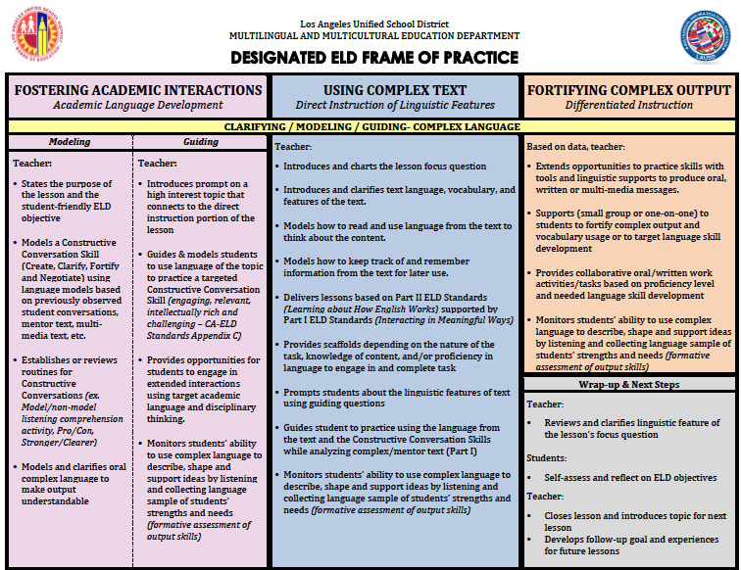
The Next Step
Using Complex Text
We started this practice during Start Smart
We started this practice during Start Smart
© Zwiers, O’Hara, & Pritchard (2014)

Slide 22
A New Practice
Using Complex Text
© Zwiers, O’Hara, & Pritchard (2014)
Notes:
3 minutes on this slide
This is the new Designated ELD Frame of Practice for daily instruction, which is comprised of three parts:
Fostering Academic Interactions
Using Complex Text
Fortifying Complex Output
Tell participants, these three parts can be thought of as:
Click animation 1:
Talk time to learn conversation skills
Click animation 2:
Text time to learn the linguistic features of English through examining a small portion of a mentor text
Click animation 3:
Table time to meet the individual needs of students
Click last animation:
We will begin by focusing in on Constructive Conversation Skills.

Slide 23
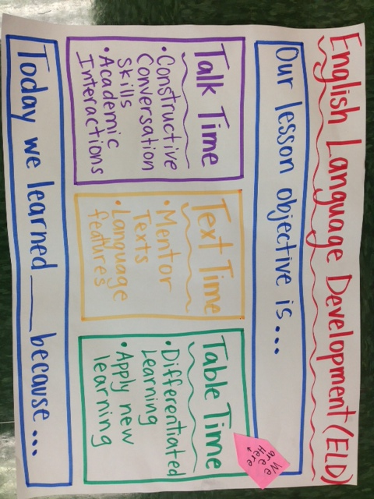
Frame of Practice
We are here

Slide 24


Understanding Complex Text
A. The people cried.
-Tears
-Sadness
B. The cry of the people
-outcry, a collective cry, protest, revolution, determination, frustration
Notes:
Click animation 1: “The people cried”
Ask participants, “What do you imagine or visualize when you read this sentence?”
Click animation 2 and 3: “tears, sadness”
These might be some examples of what you would visualize.
Click animation 4: “The cry of the people.”
Ask participants, “What do you imagine or visualize when you read this sentence?”
Click animation 5 and 6: “outcry, protest, etc.”
These might be some examples of what you would visualize. But the text only has five words in it, how did you come up with so many other words?
Sentence A is very literal.
Sentence B, seems like a simple sentence, but it is complex because it contains subtext and layered messaging. As Dr. Wong Fillmore states, it’s informationally dense.
Our ELs may interpret sentence B as they would sentence A, in a very literal way. We are wanting to give our ELs access to more complex text, but we have to teach them how the changing “cry” from a verb to a noun changes the function in a sentence thus giving it a different meaning.

Slide 25
Understanding Mentor Text
A mentor text is identified from a selection that has been used during ELA and other content areas, after being read for students to get basic comprehension of the selection.
A mentor text can contain several connected sentences (6-8) in which each sentence can lend itself to teaching the ELD Standard that has been selected to teach.
The sentences should be complex and rich enough to have discussions about the structure, meaning, word choice, etc.
Notes:
2 minutes
Share with participants these essential characteristics of a Mentor Text:
Mentor text in the context of Designated ELD refers to the portion of connected sentences that are lifted from a selection used in ELA.
The selection should be read and taught during ELA enough times for students to get basic comprehension.
It should be a paragraph or passage taken straight from the selection. Depending on the grade level it may be comprised of 6 to 8 sentences.
All sentences in the mentor text should illustrate unquestionably the selected ELD Standard from Part II : Learning about How English Works.

Slide 26
Let’s Apply the Standards to a Mentor Text
CA ELD Standard for Grade 4
  Part II: Learning About How English Works
  B: Expanding and Enriching Ideas
  4. Using nouns and noun phrases (Expanding) Expand noun phrases in a variety of ways (e.g. adding adjectives to noun phrases or simple clause embedding) in order to enrich the meaning of sentences and add details about ideas, people, things, etc.)
  Step 1: Turn the standard into a “focus question,”
  e.g., How Do Noun Phrases Add Detail to a Text?
Notes:
1 min.
HOW: Consider the CA ELD standards for your particular grade level and the proficiency levels of your students. After you have selected a particular standard from Part II Learning about How English Work, turn the standard into a focus question. This focus question will guide the mentor text analysis.

Slide 27
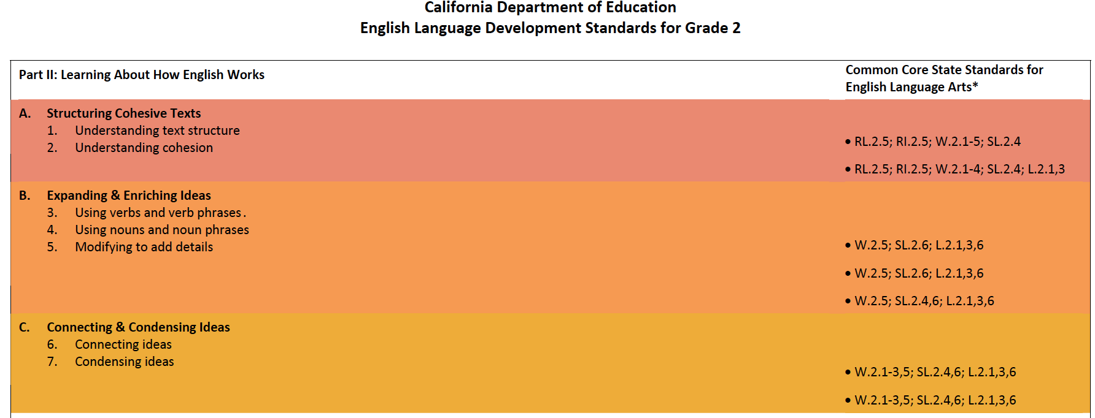
Notes:
1 min.
Share with participants that we always select the mentor text based on Part II ELD standards.
We are going to model analyzing Part II.
Click:
The red box will help to focus on the strand

Slide 28
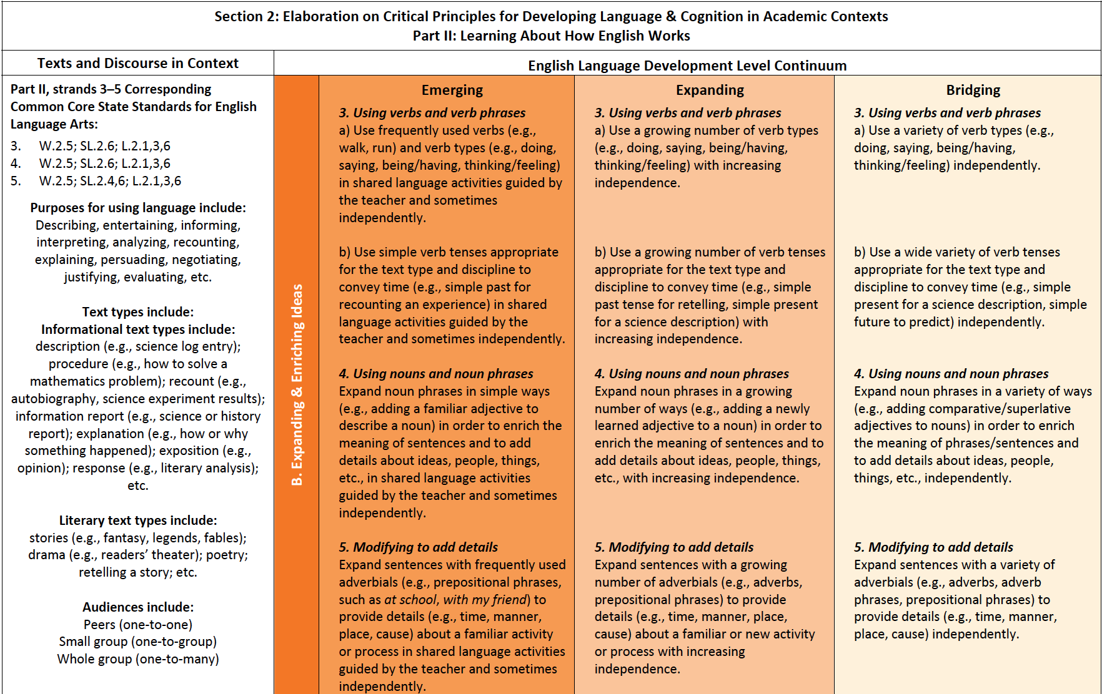
Structure/What?
Purpose/Why?
Notes:
1 minute
Purpose: Focus on the Standard and the language of the standard at the expanding level.
Click
Box will show the standard.
Read the standard.
There are 3 proficiency levels in the new CA ELD Standards.
Analyze the grade specific standard for the structure (what) and purpose (why).
For this activity you will focus at the expanding level only.

Slide 29
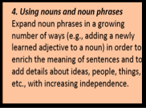
Structure/What?
Purpose/Why?
Notes:
1 minute
Purpose: Focus on the standard and the language of the standard at the expanding level.
Click
The structure (what) and purpose (why) of the standard is underlined.

Slide 30
Let’s Apply the Standards to a Mentor Text
CA ELD Standard for Grade 4
  Part II: Learning About How English Works
  B: Expanding and Enriching Ideas
  4. Using nouns and noun phrases (Expanding) Expand noun phrases in a variety of ways (e.g. adding adjectives to noun phrases or simple clause embedding) in order to enrich the meaning of sentences and add details about ideas, people, things, etc.)
  Step 1: Turn the standard into a “focus question,”
  e.g., How Do Noun Phrases Add Detail to a Text?
Structure/What?
Purpose/Why?
Notes:
1 min.
Both the structure (what) and the purpose (why) for each standard should be clearly stated in the focus question and be considered when analyzing a mentor text.

Slide 31
Day 1 Lesson
A Drop of Water
There are few objects you can make that have both the dazzling beauty and delicate precision of a soap bubble. Shown here at actual size, this bubble is a nearly perfect sphere. Its shimmering liquid skin is five hundred times thinner than a human hair.
Bubbles made of plain water break almost as quickly as they form. That’s because surface tension is so strong the bubbles collapse. Adding soap to water weakens water’s surface tension. This allows a film of soapy water to stretch and stretch without breaking.

Slide 32
Day 2 Lesson
A Drop of Water
There are few objects you can make that have both the dazzling beauty and delicate precision of a soap bubble. Shown here at actual size, this bubble is a nearly perfect sphere. Its shimmering liquid skin is five hundred times thinner than a human hair.
Bubbles made of plain water break almost as quickly as they form. That’s because surface tension is so strong the bubbles collapse. Adding soap to water weakens water’s surface tension. This allows a film of soapy water to stretch and stretch without breaking.

Slide 33
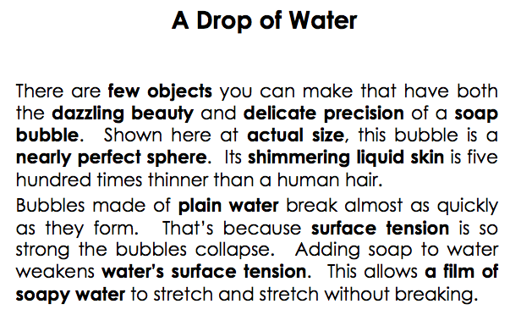
Questioning Protocol for Day 2: Step 2
Create text analysis guiding questions:
Guiding Question #1: Read sentence #1. Look at the noun phrases in bold.
  What words were added to the nouns?
  What details do they add to the nouns?
Guiding Question #2: Read sentence #2. Look at the noun phrases in bold.
  What words were added to those nouns?
  What details do they add to the nouns?
Guiding Question #3:Read sentence #3. Look at the noun phrases in bold.
  What were words added to those nouns?
  What details do they add to the nouns?
Guiding Question #4:Read sentence #4. Look at the noun phrases in bold.
  What words were added to those nouns?
  What details do they add to the nouns?
Notes:
3 mins
How: Ask participants to think back to their analysis of Part II ELD Standards.
The guiding questions should be methodically tight to the ELD Standard addressing both the grammatical structure (what) and the purpose for using that specific linguistic feature(why).
The guiding questions should be systematic and address all sentences in the selected mentor text.
There should be a question that addresses structure (what) and a question that addresses the purpose (why).
Note: This does not mean one question begins with the word “what” and one question begins with the word “why.” The focus of the question is on what and why.

Slide 34
Questioning Protocol: Step 2
Guiding Question# 5: Read sentence #5. Look at the noun phrases in bold.
    What words were added to those nouns?
    What details do they add to the nouns?
Guiding Question# 6 Read sentence #6. Look the noun phrases in bold.
    What words were added to those nouns?
    What details do they add to the nouns?
Guiding Question# 7 Read the last sentence. Look the noun phrases in bold.
    What words were added to the nouns?
    What details do they add to the nouns?
Wrap Up Guiding Question: How do all the noun phrases enrich our understanding of the text?
Notes:
1 min
Share with participants how teachers will craft a final guiding question that wraps-up the mentor text analysis and reconnects with the focus question. This wrap-up question asks students to use their entire analysis of the mentor text to arrive at a deeper understanding of the whole text.

Slide 35
Test Your Understanding with a…
Mentor Text Match-Up
With a Partner:
Read each text
Match each text with one ELD Standard and one Guiding Question:
  Which Part II standard and Guiding Question best apply or do not? Why?
  Have a Constructive Conversation
Mentor Text | Part II ELD Standard | Guiding Questions

Slide 36
Make a Mask
You can make a mask, too! First, get a plate. Cut holes into it. Check that you can see.
Next, color the mask. Paste fun things on it. Soon you will have a mask!
Last, tape a band on the back of the mask. Put the mask on. Who are you?
Part II: How English Works
A: Structuring Cohesive Texts
1. Understanding Text Structure. (Expanding): Apply understanding of how different text types are organized to express ideas (e.g., how a story is organized sequentially with predictable stages versus how an informative text is organized by topic and details) to comprehending texts and writing texts in shared language activities guided by the teacher and with increasing independence.
Guiding Question:
Let’s look at the sentence.
What word tells you when the action is happening?
How does it help connect the actions?
Notes:
1 minute
Review matches whole group.
For each text, ask:
What standard does this text exemplify (Mentor text)
What Guiding Question best fits this text. Why?
Elicit responses from participants.
You may have participants refer to their Standards at a Glance or Matrices as a resource if necessary.

Slide 37
Part II: How English Works
B. Expanding & Enriching Ideas.
4. Using nouns and noun phrases. (Expanding Level) Expand noun phrases in a growing number of ways (e.g., adding a newly learned adjective to a noun) in order to enrich the meaning of sentences and to add details about ideas, people, things, etc., with increasing independence.
Swimming along, sometimes at great speed, sometimes slowly and leisurely, sometimes resting and exchanging ideas, sometimes stopping to sleep, it took them a week to reach Amos’ home shore. During that time, they developed a deep admiration for one another. Boris admired the delicacy, the quivering daintiness, the light touch, the small voice, the gemlike radiance of the mouse. Amos admired the bulk, the grandeur, the power, the purpose, the rich voice, and the abounding friendliness of the whale.
Guiding Question:
Let’s look at the sentence.
What are the noun phrases?
How does each noun phrase add details about…?
Notes:
1 minute
Review matches whole group.
For each text, ask:
What standard does this text exemplify (Mentor text)
What Guiding Question best fits this text. Why?
Elicit responses from participants.
You may have participants refer to their Standards at a Glance or Matrices as a resource if necessary.

Slide 38
Part II: How English Works
B. Expanding & Enriching Ideas.
3. Using verbs and verb phrases. (Expanding Level) Use a growing number of verb types (e.g., doing, saying, being/having, thinking/feeling) and verb tenses appropriate for the text type and discipline to convey time (e.g. simple past for retelling, simple present for a science description).
Days were long and lonely. The hills spread out as far as forever. Nights, me and Ma and my brothers and Baby Betsy would sit out and wait for a shooting star to sail across the sky. Once in a while a crow flew by. That’s all the excitement there was.
My brothers worked up some furrows. They planted corn and potatoes and beans. Then they ran around climbing trees, skinning their knees. But after all the water was fetched and the wash was done, after the soap was made and the fire laid, after all the beds were fixed and the floor was swept clean, I’d sit outside our cabin door with Baby Betsy, so bored I thought I’d die.
Guiding Question:
Let’s look at the sentence.
What kinds of verbs are in the sentence?
How do these verbs convey or show a sense of time?
Notes:
1 minute
Review matches whole group.
For each text, ask:
What standard does this text exemplify (Mentor text)
What Guiding Question best fits this text. Why?
Elicit responses from participants.
You may have participants refer to their Standards at a Glance or Matrices as a resource if necessary.

Slide 39
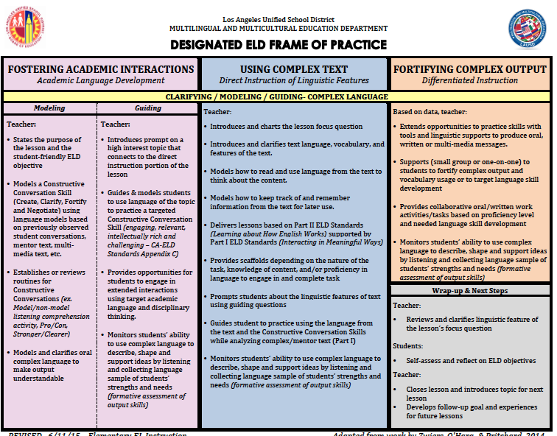
Direct Instruction of Linguistic Features
Mentor Text

Slide 40
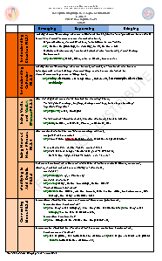
Planning: Using Complex Text
Identify a grade level ELD Standard from Part II. Find a previously read mentor text that exemplifies that standard.
Turn the standard into a focus question.
Identify examples of the linguistic feature in each sentence.
Create two text analysis guiding questions considering the ELD Standard-Part II and a wrap-up question.
The mentor text will be used for two or more days to address the identified linguistic feature (Part II ELD Standard.)
CA ELD Standards at a glance & How English
Works
Matrices

Slide 41
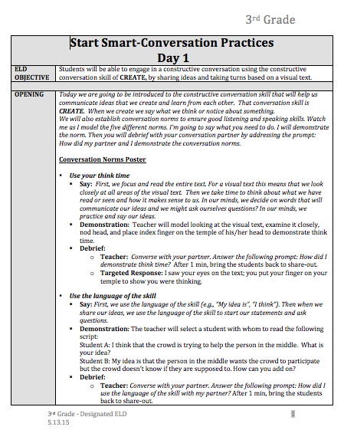
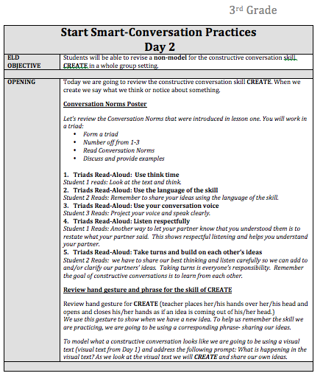
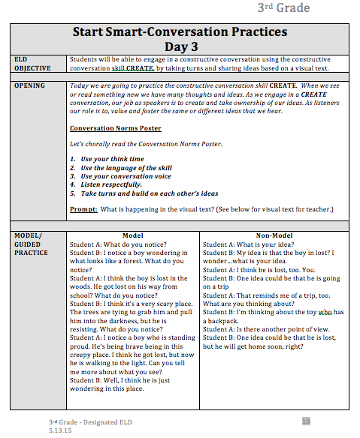
Resources to Support
Comprehensive ELD
15-Day
Start Smart
Lessons
CA ELD Standards at a Glance & How English
Works
Matrices
Designated ELD &
Integrated ELA/ELD
Sample Lessons
Notes:
Purpose: review the resource that will be available for teachers through the MMED website

Slide 42
Access Resources on the
MMED Website
lausd.net
Go to Offices
Click on Multilingual and Multicultural Education Department
Under Departments, click on the English Learner Instruction, Elementary
http://achieve.lausd.net/site/Default.aspx?PageID=1839

Slide 44
Which
Student Vital Actions are supported through the teacher actions outlined in the Frame of Practice?

Slide 45
What We Want to Observe in Our Classrooms During ELD
What are specific elements of effective instruction or guiding principles of learning in ELD instruction?
What are explicit teacher or student behaviors that are called out in our Designated ELD Frame of Practice?
What is observable evidence of teaching and learning during ELD? (i.e. instructional strategies, learning activities, behavioral outcomes, artifacts, routines, practices)

Slide 46
What else do we
want to observe during ELD

Slide 47
Phase-In Plan for ELD Standards
2013-2014
2014-2015
2015-2016
Awareness
Implementation
Transition

Slide 48

2015-2016 ELD Standards Implementation Plan

Slide 49
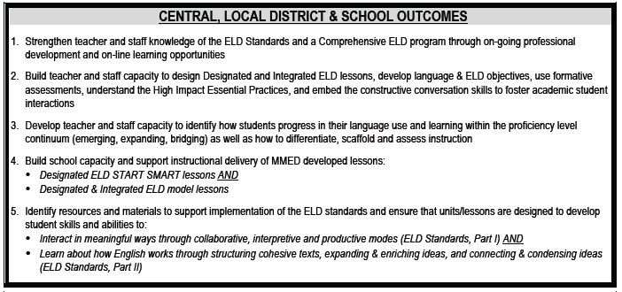
Central, Local District
& School Outcomes

Slide 50


