Slide 1
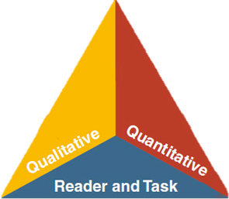
LANGUAGE
LITERACY
LEARNING
Sessions 1 and 2:
CA ELD Standards, Standards Progression &
ELD Proficiency Levels
Notes:
Slide 1: Session 1 was created for a minimum of 55 minutes. You can ask participants to read Appendix D before coming to the session
Add your name to the presentation
Why/Purpose: As a state and the district are transitioning into the 2012 New CA ELD standards, this is the first of 4 sessions that will assist us in this process.
How:
Say: We are going to be presenting 4 session that will deepen your understanding of the new ELD standards while also providing you with strategies that can be transferred into classroom practice.

Slide 2
Chalk Talk: CA ELD Standards
Read the Appendix D quotes on the perimeter of the room silently.
Respond to the quote by either:
Adding your comment, reflection, or idea
Responding to someone else’s comment
Notes:
Slide 2: SILENT SOFT START (3 minutes)
Why/Purpose: The Chalk Talk silent activity is use to ground/ orient participants to the work they will begin doing with the CA English Language Development Standards. In this case, participants will work with Appendix D of the CELDS to learn about the information on pages 1-3 that include The Context for the CA ELDS, Purposes and Intended Users, and Key Factors in supporting EL success.
How: Remind participants that this is a reflective process. Explain how activity can be utilized in a classroom or PD setting.
Process
The facilitator explains VERY BRIEFLY that Chalk Talk is a silent activity. No one may talk at all and anyone may add to the Chalk Talk as they please.
Participants responds to the quote by adding a comment, reflection or idea or by responding to someone someone else’s comment
After allotted time is completed, facilitator calls out some of the participants responses
Materials: Chart Paper and Quotes that are used for the Chalk Talk:
The quotes are the from Pages 1- 3 of Appendix D. The intent of Appendix D is to call the specific needs that students have serve. Facilitators should remind participants that the sequence of content in the CLEDS document is in draft form, and therefore subject to change prior to final publishing .

Slide 3
ELD Transition Sessions
Session 1: ELD Standards Introduction
Shifts, Layout, & Development
Session 2: Proficiency Levels
Session 3: Theory that Informs Layout (Appendix C)
Session 4: How English Works (Appendix B)
Notes:
Slide 3: (1 minute)
Why/purpose: make the participants aware that this is the first and second of the four sessions.
How: Give participants a few seconds to read over the slide to see flow of the four sessions

Slide 4
Objectives
Explore the context, development and validation of CA ELD Standards (Appendix D)
Become familiar with the layout of the ELD standards
Understand CA ELD Standard Shifts
Discuss and develop an understanding of the Proficiency Levels
Examine and arrange the progression of the CA ELD Standards
Notes:
Slide 4: (1 minute)
Why/Purpose: To give participants the objectives for the presentation
How: The facilitator will say: “Today’s objectives are to:
Explore the context, development and validation of CA ELD Standards (Appendix D)
Become familiar with the layout of the ELD standards
Understand CA ELD Standard Shifts

Slide 5
LAUSD Students
LAUSD Classrooms
EO/IFEP/RFEP/EL/SEL
Standard English Learner Programs
57 Schools
Reclassified English Learners
138,000
Dual Language and Bilingual Programs
79 programs
English Learners
157,000
Long Term English Learners
38,000
Special Education English Learners
45% of SWD are ELs
Notes:
Slide 5: ( 2 minutes)
LAUSD classrooms are composed of diverse learners who require rigorous instruction that is designed to meet their linguistic and academic needs. When done successfully all youth achieve.

Slide 6

Guiding Principles
English Learners (ELs) are held to the same high expectations of learning established for all students.
ELs develop full receptive and productive proficiencies in English in the domains of listening, speaking, reading & writing.
ELs are taught challenging academic content that enables them to meet performance standards in all content areas.
ELs receive instruction that builds on their previous education and cognitive abilities and that reflects their language proficiency levels.
ELs are evaluated with appropriate and valid assessments that are aligned to state and local standards and that take into account the language development stages & cultural backgrounds of the students.
The academic success of ELs is a responsibility shared by all educators, the family and the community.
English Learner Master Plan, 2012,
Pages 2-3
Notes:
Slide 6: (1 minute)
Why/Purpose: The six guiding principles of the EL Master Plan are presented here to remind participants that they serve as a strong statement of values that guide all of our work in serving English Learners (ELs).
How: The facilitator will remind participants of the Six Guiding Principles from the EL Master Plan (pages 2-3) Review guiding principles. Highlight number 1 and 4 as a focus for this session.
Additional Notes: The guiding principles slide must be in every presentation.
*

Slide 7

District Instructional Priorities
Master Plan
(The Who)
TGDC Teaching &
Learning
Framework
(The How)
Common Core
(The What)
Notes:
Slide 7: (1 Minute)
Why/Purpose: To emphasize the how the three district initiatives work together in our work serving our English Learners
How: The facilitator will state the following:
“This visual shows how our district’s three initiatives are woven together in our work in servicing our English Learners. The Common Core State Standards signify “What” we teach, while the Master Plan signifies the “Who” we teach (English Learners), and The Teaching and Learning Framework speaks to “How” we teach in LAUSD. When all three are woven together the outcome is that all LAUSD students will graduate College Prepared and Career Ready.” In this presentation we will begin to see how the CA English Language Standards will be used by teachers to support the Mastery of English development

Slide 8
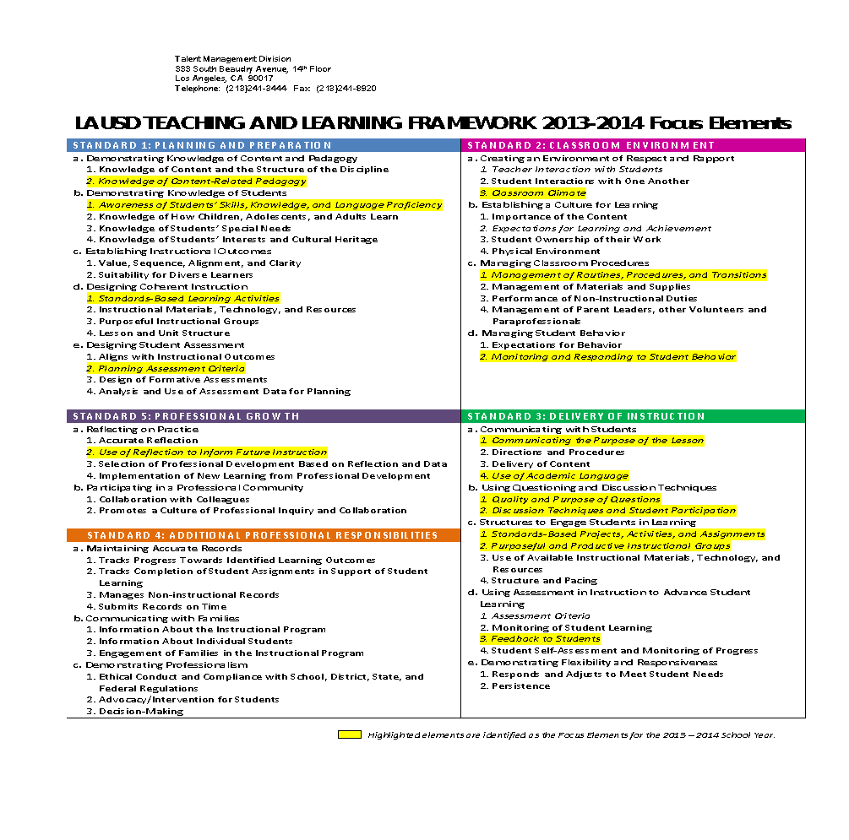



LAUSD TEACHING AND LEARNING FRAMEWORK 2014-2015 FOCUS ELEMENTS
Notes:
Slide 8: (1 Minute)
Why/Purpose: To connect our work as educators and our professional goals.
How: Read the 3 focus elements, tell the participants that the arrows point to the highlighted focus elements that apply to the work we will engage in today.
*

Slide 9
CA Legislative Process for Development & Validation of the New CA ELD Standards
2011 Assembly Bill Complete Revised
Stakeholder Review
2 Public Hearings
Focus group Review:
County Office of Educations
Principals
Faculty of ELs
Researchers
Oral Written feedback over over one month period.
Teachers,
Principals
County Administrators
Advocacy groups
Community members
CA State Board Adoption
November 2012
http://www.cde.ca.gov/sp/el/er/eldstandards.asp
Notes:
Slide 9: (2 minutes)
Why/Purpose: To explain the Development and Validation Process for the new CA ELD Standards
How: Considering the diversity of the student population in LAUSD and California and the District’s instructional priority of implementing Common Core, we need the new California ELD Standards which will work in tandem with the Common Core to support the language development of our English learners. Our Master Plan Guiding Principles illustrate the values we hold as we engage in learning and implementing the new standards. The strong practices of an effective teacher that are highlighted in the Teaching and Learning Framework will further support us in this process.
The facilitator explains the process for Development and Validation by reading the flow map. This was the process for development; various stakeholders provided input in the process.
For more information see Appendix D pages 7-8
The quotes are from Pages 1- 3 of Appendix D. The intent of Appendix D is to call the specific needs that students have serve. Facilitators should remind participants that the sequence of content in the CA ELD Standards document is in draft form, and therefore subject to change prior to final publishing .
Highlight the CDE website (hyperlink) on the lower left hand corner of the slide for the links to CA ELD Standards

Slide 10
Phase-In Plan for ELD Standards
2013-2014
2014-2015
2015-2016
Awareness
Transition
Implementation
Notes:
Slide 10: (1 minute)
Purpose
To ensure that participants know how LAUSD is phasing in the ELD Standards. LAUSD is following the CA roll out of the new ELD standards
How
Say, “Let’s take a minutes to look at the phase-in plan, which is aligned with the state’s plan:
Awareness – During this time, district leadership (directors, principals and central/ESC staff were provided information sessions around the NEW ELD standards
Transition – building resources, implementing needs assessments, and continued learning for the school sites
Implementation – expansion of professional learning and alignment of curriculum instruction and assessment along with integration throughout the district. At the end of this phase students will be assessed using the new assessment: ELPAC (English Language Proficiency Assessment for California). ELPAC will replace CELDT.

Slide 11
CCSS for English Learners
What are the BENEFITS of CCSS for English Learners?
What are the CHALLENGES of CCSS for English Learners?
Instructional Strategy:
Graphic Organizer
Turn & Talk
Notes:
Slides 11 –:15 (9 minutes)These slides are all connected, but should be chunked into slides 11-12 (5 minutes) and 13-15 (4 minutes).
(After posing questions, allow 4 minutes for participants to turn and talk)
Why/Purpose: Allowing participants to speak to their experiences in teaching the CCSS is beneficial and validating of their knowledge. The graphic organizer supports the organization of their thinking and talking to their partner supports their understanding. Calling out the instructional move will support their implementation of this strategy in their classroom.
How:
Ask participants what the benefits and challenges in teaching CCSS are for ELs.
Use the T-chart to support participants in thinking about the BENEFITS and CHALLENGES of the CCSS.
Give participants 30 seconds of think time and then ask them to turn and talk with a partner. After 4 minutes, have them share out to the whole group.
Proceed to slide 11 after the whole group share out.
*

Slide 12
CCSS for English Learners
What are the BENEFITS of CCSS for English Learners?
What are the CHALLENGES of CCSS for English Learners?
Use of complex text and
text-dependent questioning which no longer relegates English Learners to the exclusive use of simplified text
Students make claim and use supporting evidence to make an argument
A focus on oral language development for all students as called for in EL Master Plan
Provide access to complex text to students of varying English proficiency levels as called for in the EL Master Plan
Understand language and text of argument, its structures and ways to use supporting evidence
Students will need to discern and use formal registers of language that are designed for the audience, task and purpose
Instructional Strategy:
Whole Group Share Out
Notes:
Slide 12 - This the share out slide for slide 10 (2 minutes)
Why/Purpose: Specifically call out the 3 main benefits and challenges with the CCSS. This will ensure that the 3 main ideas are brought out to the group.
How: Review the benefits and challenges. If people called out some of the items on the slides, you may want to begin with those. Ensure to speak to the fact that the benefits are also the challenges and vice versa.
*

Slide 13

ELA/Literacy CCSS
What must students be able to do with language?
“Students can, without significant scaffolding:
comprehend and evaluate complex texts across a range of types and disciplines
construct effective arguments and convey intricate or multifaceted information
discern a speaker’s key points
request clarification and ask relevant questions
build on others’ ideas
articulate their own ideas, and confirm they have been understood”
(CCSS for ELA Literacy in History/ Social Studies, Science and Technical Subjects, p.7)
Notes:
Slide 13: (2 minutes)
Why: Highlight how language is embedded in CCSS Literacy without scaffolding. One of the benefits of the CCSS is that it brings language to the forefront. At the same time the language demands of the CCSS are complex and require language production from students. For example in ELA/ literacy all students including English Learners are expected to use academic language to construct effective arguments, request clarification, articulate their own ideas. The Standards insist that instruction in reading, writing, speaking, listening, and language be a shared responsibility within the school.
How: Bring attention to Master plan Guiding principle #1: All students are held to the same high expectation for learning.

Slide 14
Math CCSS
What must students be able to do with language?
“Mathematically proficient students:
understand and use stated assumptions, definitions, and previously established results in constructing arguments
make conjectures and build a logical progression of statements to explore the truth of their conjectures
justify their conclusions, communicate them to others, and respond to the arguments of others”
(CCSS for Mathematics, p.6)
Notes:
Slide 14: (1 minute)
Why: highlight that in Math CCSS proficient students are expected to be able to articulate their thinking processing using specific language of the content area. Students will use language to build logical progression of statements, justify their conclusion and respond to the arguments of others
How: Mathematically students will use language to build logical progression of statements, justify their conclusion and respond to the arguments of others. The language students use in Mathematics looks differently than it did in Literacy.

Slide 15

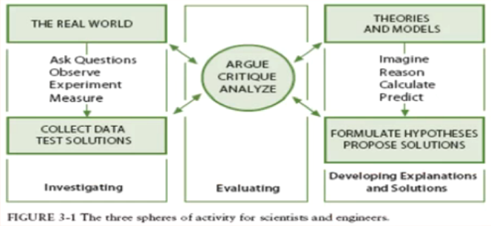
Next Generation Science Standards
What must students be able to do with language?
What are the language demands within the essential science practices:
construct explanations and designated solutions
engaging in argument from evidence
obtain, evaluate, and communicate information
K-12 Science Framework
NRC 2012 pg 45, 49
Notes:
Slide 15: (1 minute)
Lastly in science students will be using language to constructing explanations, engaging in argument, and communicating information
Why: Language needs to be supported differently depending on the content areas. In science students will be using language to constructing explanations, engaging in argument, and communicating information.
How: Highlight that students will be expected to use the language of science to engage in argument and construct explanations

Slide 16
Why?
Instructional Strategy:
Turn & Talk
Notes:
Slide 16: (2 minutes) If language is embedded within CCSS, then why do we have ELD Standards?
The CCSS specify that the standards are intended to apply to all students including English learners.
Both the National Governors Association Center for Best Practices and the Council of Chief State School Officers believe that all students should be held to the same high expectations outlined in the Common Core Standards -this includes English Learners---
EL students may require additional time, appropriate instructional support and aligned assessments as they acquire both English language proficiency along with content area knowledge
The ELD standards are designed to address the dual challenge faced by ELs as they learn both language and content.
Facilitators should point participants to Master Plan Guiding plan guiding principle #1 and 6)
ELs are a complex group of students with a variety of needs and they come with varying levels of both language and literacy proficiency. ALL teachers are responsible for addressing the needs of ELs through knowing and using the ELD standards for English learners

Slide 17
Purpose of The New ELD Standards
Designed to be used in tandem with CCSS for ELA & Literacy
Highlight and amplify the critical knowledge about language and skills using language in CCSS for ELA/Literacy necessary for ELs to be successful in school and life
Provide fewer, clearer, higher standards so teachers can focus on what’s most important
Strengthen ELD opportunities in core content instruction and in targeted ELD in light of new content standards
Notes:
Slide 17: (2 minutes)
Why/Purpose: To ensure that participants understand the purpose of the new ELD Standards.
How: Paraphrase the purpose of the new ELD CA standards:
To be used in tandem with CCSS ELA
Highlight and amplify critical knowledge about language and skills using CCSS ELA
Provide fewer, clearer and higher standards
Strengthen ELD opportunities in content instruction and in targeted ELD

Slide 18
Appendix D
Goals of the CA ELD Standards | What CA ELD Standards are NOT
Fewer, Clearer, and Higher Standards | The CA ELD standards are not to be used in isolation from CCSS
Promote EL abilities to interact in meaningful ways during rich instruction so that they both develop English and content knowledge | The CA ELD standards are not to be used piecemeal at a given proficiency level
Develop proficiency in shifting register based on content. | The CA ELD standards do not provide an exhaustive list of all the linguistic processes.
Be aware that different languages and variations of English exist and recognize their home languages and cultures as resources to value in their own right and draw upon in building proficiency in English | The CA ELD standards are not a curriculum or a curriculum framework
Notes:
Slide 18: (2 minutes)
Why/Purpose: To call attention to the Goals of the CA ELD Standards, as well as, misconceptions or “ What the CA ELD Standards Are Not.” Highlight the opportunities for students to interact to make CA ELD standards more interactive
How: The facilitator will first explain the goals by saying: “English learners must simultaneously successfully engage in challenging academic activities, as set by the CCSS, while developing proficiency in advanced English. The CA ELD Standards are intended to support this dual endeavor by providing fewer, clearer, and higher standards:
Fewer: Those standards that are necessary and essential for development and success;
Clearer: A coherent body of standards that have clear links to curriculum and assessments;
Higher: Alignment with the elevated standards of the Common Core State Standards for ELA.”
The facilitator will continue reading the remainder of the goals, then continue with “What CA ELD Standards Are Not.”
Additional Notes: This could be made into an activity where you cut the goals and ‘what the CA ELD are not’ into strips and then have participants sort them in to the two columns.

Slide 19
Key Conceptual Shifts in 2012 CA ELD Standards
FROM A CONCEPTUALIZATION OF…
TO UNDERSTANDING…
English viewed as a set of rules
English viewed as a meaning-making resource with different language choices based on audience, task, and purpose
5 proficiency levels
3 proficiency levels; Emerging, Expanding, Bridging
(Proficiency Level Descriptors (PLDs): Determine early stages and exit for each level)
Standards in Grade Spans
(K-2, 3-5, 6-8, 9-12)
Standards in grade level/spans that parallel CCSS
(K, 1, 2, 3, 4, 5, 6, 7, 8, 9-10, 11-12)
Standards and PLDs focusing on four isolated domains: listening, speaking, reading and writing as isolated domains
Standards and PLDs focusing on modes of communication (collaborative, interpretive, and productive); and language knowledge awareness and use (interweaving S, L, R, W)
Notes:
Slide 19: (2 minutes)
Purpose: To ensure that participants understand the purpose of the new ELD Standards.
How
English is a meaning making resource that students use based on audience, task and purpose
We have moved from 5 proficiency level to 3. Each proficiency level has an early stage and an exit level.
The grade levels/spans parallel CCSS
The focus is on language development (modes of communication: collaborative, interpretive, productive) and having an understanding of how English works

Slide 20
CA ELD Standards Overview
Overview & Proficiency Level Descriptors (PLDs):
Alignment to CCSS for ELA & Literacy
CA’s EL Student
Proficiency Level Descriptors (PLDs)
Structure of the grade level standards
Grade Level Standards
Section 1: Goal, Critical Principles, At-a-glance Overview
Section 2: Elaboration on Critical Principles
Part I: Interacting in Meaningful Ways
Part II: Learning About How English Works
Part III: Using Foundation Skills
Appendices:
Appendix A: Foundational Literacy Skills
Appendix B: Learning About How English Works
Appendix C: Theory and Research
Appendix D: Context, Development, Validation
Glossary of Key Terms
Notes:
Slide 20: (2 Minutes)
Why/Purpose: To allow time for participants to become familiar with the various sections for the CA ELD Standards Book.
Materials needed: ELD Standards Book.
How: Presenter takes time to help familiarize participants with the lay out of the CELDs book by having them tab the four sections above: Overview, Grade level standards, Appendices, Glossary.
The facilitator will say,
Here is the overview section (show the section and then explain the components briefly)
Here is the grade level section (show the section and then explain the components briefly)
Facilitator should point out that section 1 contains the goal, critical principle and At a Glance Overview of Section 2. The language of the standards is found on Section 2
Here are the appendices (show the section and then explain the components briefly).
During this session, we will focus on the layout and structure of the Grade level Standards.

Slide 21
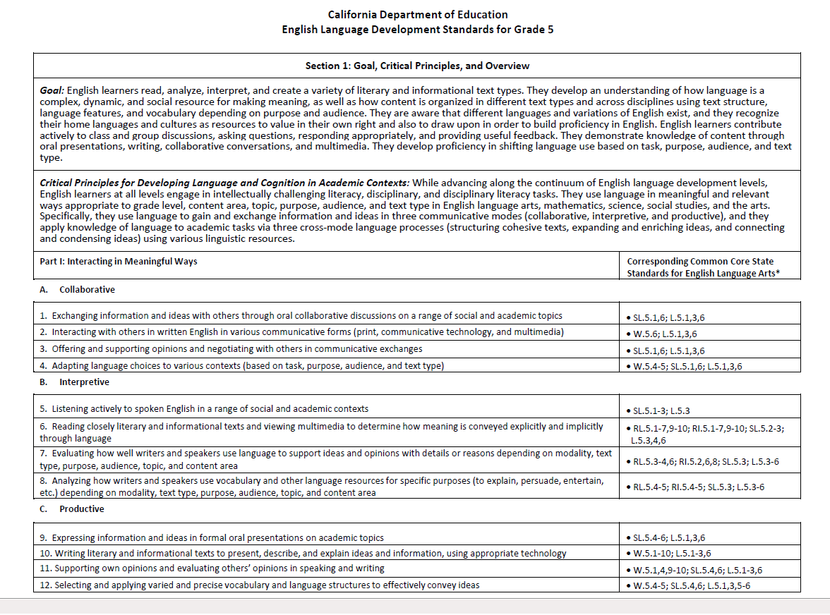
Layout of the CA ELD Standards
On your own, scan pages 1-2 from your grade level
What do you notice?
Turn and Talk
Instructional Strategy:
Turn & Talk
Handout
Notes:
Slide 21: (8 minutes)
Purpose:
To understand the various components of the CA ELD Standards Books (grade level standards)
How:
Say: “In this section you will have a chance to look at the first 3 pages of your grade level standards to familiarize yourself with the layout and various components”
Let participants share out what they notice and what are some new findings. Let them do this using the Turn and Talk strategy

Slide 22
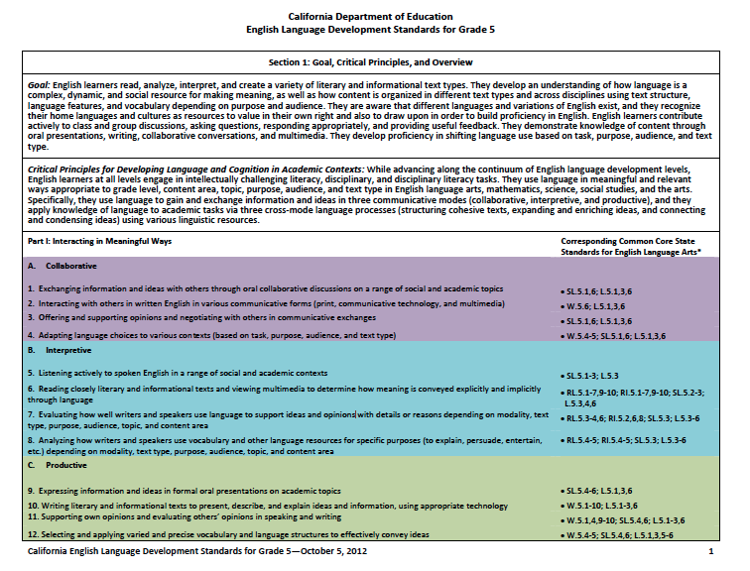
ELD Standards Layout
Section I, Part I: Interacting in Meaningful Ways
Handout
Notes:
Slides 22– 24: (11 minutes )These slides are all connected, but should be chunked into slides 22-23 (3 minutes) and 24-25 (8 minutes).
Why/Purpose: to understand the layout of the new ELD Standards
How:
We’ve had an opportunity to look at our grade level standards. Now we are going to look at the structure, layout and the various components within each grade level.
The grade-specific standards are divided into two sections.
Section 1 has 3 parts: Part I: Interacting in meaningful ways, Part II How English works and Part III Foundational Skills
This section highlights: Part 1 of the CA ELD Standards Interacting in Meaningful Ways. I

Slide 23
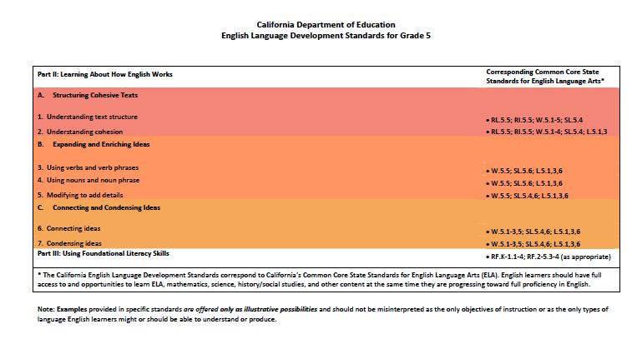
ELD Standards Layout
Section I, Part II: Learning About How English Works
Section I, Part III: Foundational Skills
Handout
Notes:
Slide 23: (1 minute)
Why/Purpose: To understand the layout of the new ELD Standards Parts II(How English Works and Part III (Foundational Literacy Skills)
How:
Say: Part II is the same at each grade level. Part 2 of section 1 is learning about how English works. It lists 3 Processes.
Part III: Using Foundational Literacy Skills: The foundational literacy skills will be addressed through the English Language Arts time (covered in Appendix A)

Slide 24

Section 1
{
For every Grade level, the ELD Standards have the same ‘Section 1’
The only thing that differs on page 1-2 of the ELD Standards for each grade level is the CCSS standards it corresponds to.
The same Goal is listed at each grade level
The same Critical Principles for Developing
Language and Cognition in Academic Contexts
is at each grade level
Part I of the ELD Standards: Interacting in Meaningful Ways. It is the same at each grade level. It lists 3 Modes (Ways of Using Language)
Collaborative
Interpretive
Productive
The Strands appear beneath.
Part II: Learning about How English Works. It is the same at each grade level. It lists 3 Processes (Purpose for using Language)
Structuring Cohesive Texts
Expanding and Enriching Ideas
Connecting and Condensing Ideas
Part III: Using Foundational Literacy Skills
Notes:
Slide 24: (5 minutes)
Purpose:
Participants will understand that for every Grade level, the ELD Standards have the same ‘Section 1’ with the exception of the corresponding common core state standards. There are three parts to section 1. Part one is divided into modes and Part two is divided into 3 process.
Say: “For every Grade level, the ELD Standards have the same ‘Section 1”
The same goal is listed at each grade level
The same Critical Principles for Developing Language and Cognition in Academic Contexts is at each grade level
(Facilitator and participants highlight the bold)
Part I is the same at each grade level. Part 1 of the CA ELD Standards is interacting in meaningful ways. It lists 3 Modes 1. The modes is the ways of using language and there are three listed under the mode.
Collaborative
Interpretive
Productive
(Facilitator and participants highlight the bold and write MODES)
Say: There are 4 strands under each mode. Since there are 3 modes and 4 strands under each mode, there are total of 12 strands under Part 1 of Section 1.
(Facilitator will have the participants point to the strands) Say: Take a minute to look a the language and highlight some of the language you see there.
Say: Part II is the same at each grade level. Part 2 of section 1 is learning about how English works. . It lists 3 Processes
A. Structuring Cohesive Texts
B. Expanding and Enriching Ideas
C. Connecting and Condensing Ideas
The Strands appear beneath.
(Facilitator and participants highlight the bold and write PROCESSES)
The only thing that differs on page 1 of each grade level is the CCSS standards it corresponds to.
Part 3 is the foundational literacy skills.

Slide 25
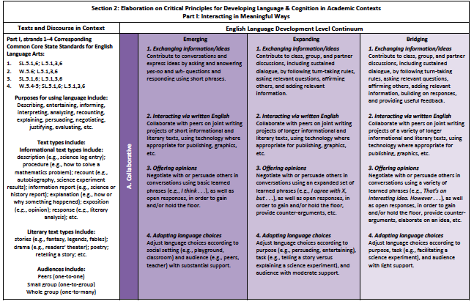
Section 2
Teacher Resources
Proficiency levels
Strands
Modes
Language of the Standards
Handout
Notes:
Slide 25: (3 minutes)
Purpose: Participants will understand that Section 2 is the actual grade level standards per each strands listed in section 1. It also has standards listed by the 3 levels of proficiency – Emerging, expanding, and bridging.
How:
The grade specific standards are divided into two sections.
Section 2 has the same components and the language of the standards. This is where you will find what guides your instruction.
There are 3 proficiency levels in the new CA ELD Standards. The proficiency levels are: Emerging, Expanding, and Bridging (Have participants label or highlight the document as you speak to each section)
Say – The mode is listed here again. The first mode, collaborative and the strands are listed in Section 2. Under each strand are the actual standards for the corresponding grade level. (Have participants label or highlight the document as you speak to each section)
Say – Section 2 also lists the teacher resources and CCSS aligned with the ELD Standards. (Have participants label or highlight the document as you speak to each section)

Slide 26
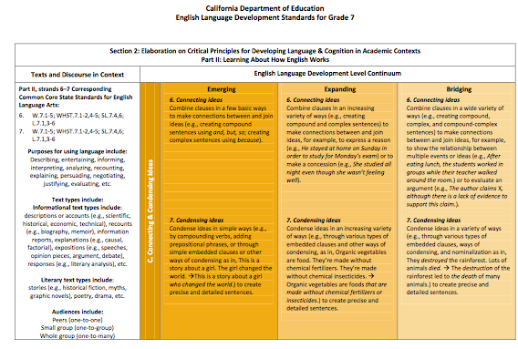
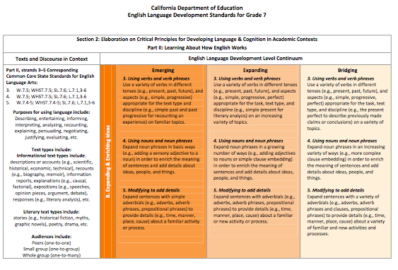
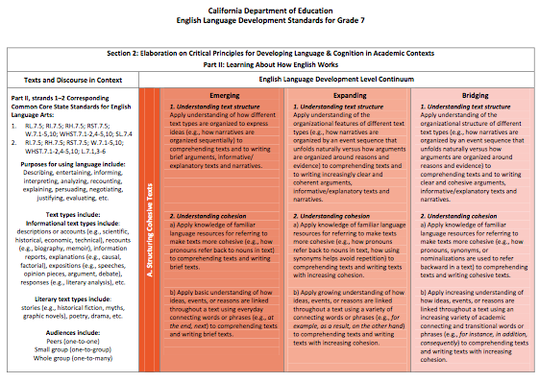
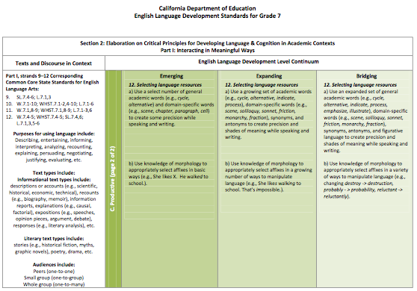
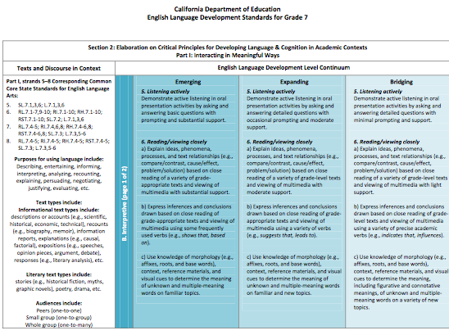
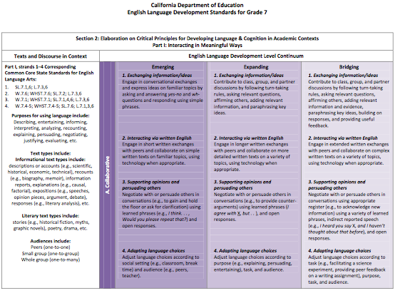
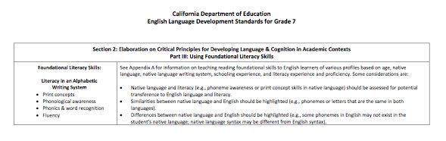
Deeper Understanding of Section 2
Part II: 3 Processes
Part I: 3 Modes
Part III: Foundational Skills
Notes:
Slide 26: (1 minute)
Purpose:
Purpose is to make a connection to Section 1 (overview of the standards) & Section 2 (elaboration of the standards)
Section 2:
Part I of the standards has the 3 modes of communication (Interacting in Meaningful Ways). An elaboration of the critical principles (language of the standards) can be found under each of the strands.
Part II of the standards has the 3 processes (Purposes for using language). Here too, there’ elaboration of the critical principles (language of the standards) that can be found under each of the strands.
Each page shows of one of the modes of communication and processes organized by Proficiency Level Descriptors (PLDs)

Slide 27
Checking for Understanding
Part I of Section 1:Interacting in Meaningful Ways - Modes is divided into: ____________,_____________, and ___________
Which section has the specific grade level CA ELD standards?
Section 1
Section 2
True or False – The only thing that differs on Section 1 of the ELD Standards for each grade level is the CCSS standards it corresponds to.
Collaborative
Interpretive
Productive
TRUE!
Partner Talk
Notes:
Slide 27: (1 minute)
Purpose: To check for participant’s understanding of the layout of the standards.
Say: Take a look at these questions. Talk to your elbow partner (about 2 minutes) and see if you can answer these questions without looking.
After two minutes, share answers.

Slide 28
Key Conceptual Shifts in 2012 CA ELD Standards
FROM A CONCEPTUALIZATION OF…
TO UNDERSTANDING…
English viewed as a set of rules
English viewed as a meaning-making resource with different language choices based on audience, task, and purpose
5 proficiency levels
3 proficiency levels; Emerging, Expanding, Bridging
(Proficiency Level Descriptors (PLDs): Determine early stages and exit for each level)
Standards in Grade Spans
(K-2, 3-5, 6-8, 9-12)
Standards in grade level/spans that parallel CCSS
(K, 1, 2, 3, 4, 5, 6, 7, 8, 9-10, 11-12)
Standards and PLDs focusing on four isolated domains: listening, speaking, reading and writing as isolated domains
Standards and PLDs focusing on modes of communication (collaborative, interpretive, and productive); and language knowledge awareness and use (interweaving S, L, R, W)
Notes:
Slide 28: (1 minute)
Purpose: To ensure that participants understand the purpose of the new ELD Standards. It addresses how instruction might need to change as we move forward. This is a review of some of the shift that we covered through this session
How:
Paraphrase and emphasize these shifts:
English is a meaning making resource that students use based on audience, task and purpose
We have moved from 5 proficiency level to 3. Each proficiency level has an early stage and an exit level.
The grade levels/spans parallel CCSS
The focus is on language development (modes of communication: collaborative, interpretive, productive) and having an understanding of how English works

Slide 29
Key Conceptual Shifts in 2012 CA ELD Standards
FROM A CONCEPTUALIZATION OF…
TO UNDERSTANDING…
Language acquisition as an individual and lock-step linear process
Language acquisition as a non-linear, spiraling, dynamic, and complex social process
Language development focused on accuracy and grammatical correctness, often isolated from content areas
Language development focused on effective collaboration, interpretation, and communication across the disciplines. Discourse, text structure, syntax, and vocabulary addressed within meaningful contexts.
Use of simplified texts and activities, often separate from content knowledge
Use of complex texts and intellectually challenging activities with content integral to language learning
Notes:
Slide 29: (2 minutes)
Purpose:
To ensure that participant
How
Say: The First Shift addresses how our concepts of language acquisition have evolved. It also addresses the spiraling nature of the ELD standards. For example, students don’t learn the present tense, then the past tense, then the future tense. Rather, we learn language based on the context in which it is used and the related skills. As a traveler, we learn basic communication phrases. In contrast, in K-12 settings, we learn language via the types of conversations and texts we use to learn (e.g., text book, magazines, videos on the plant cycle). In each of these cases the tense and grammar may vary, and ELs cannot be expected to “wait to learn that tense” or “form” prior to being exposed to it.
The 2nd shift addresses how we have moved from focusing primarily on accuracy to a focus on how language is used. In the example above, a beginning EL who watched a video on the plant cycle may now need to work with another student to outline or draw the key concepts derived from this video, a teacher may provide a graphic organizer for the student to demonstrate the “steps”.
While this is Science, it is also Language Arts in that the student must use this information to write a short description. EL teachers may draw from what the Science lesson is and how the science lesson uses language.
In one setting, we are demonstrating an “understanding of content” and the other we provide “direction on writing a summary”. Students learn language by interacting in meaningful ways around intellectually challenging content (having collaborative discussions, interpreting texts, arguing for a position, etc.).
In addition, teachers can make strategic choices about teaching their students how the language in these situations (e.g., an argument) is structured. This is how the ELD standards focus on both meaning and form.
The 3rd shift addresses how cognitive challenge and content are conceptualized in the 2012 ELD Standards.
For example, students at all levels of proficiency can participate in a collaborative discussion around the plant cycle. However, students at emerging levels will likely need more support, such as the graphic organizer mentioned or sentence frames, than bridging students in order to fully participate and demonstrate understanding along with use of language in context. This shift reflects the movement from ELD to teach “grammar ” in isolation from content and for the content teacher to teach content in isolation of language. Both teachers work from the “content” (e.g., Science/ EL) to meaning making.

Slide 30
Objectives
Explore the context, development and validation of CA ELD Standards (Appendix D)
Become familiar with the layout of the ELD standards
Understand CA ELD Standard Shifts
Discuss and develop an understanding of the Proficiency Levels
Examine and arrange the progression of the CA ELD Standards
Notes:
Slide 30: (1 minute)
Why/Purpose: To transition into Session 2 and to give participants the objectives for the second half of the presentation
How: The facilitator will say: “We have just completed the first half of our professional development during which we worked together to meet the first three objectives. Now we will:
Discuss and develop an understanding of the Proficiency Levels
Examine and arrange the progression of the CA ELD Standards

Slide 31

Line Up Activity
Decide where you place in a line up from novice to expert
Instructional Strategy:
Line Up Activity
Notes:
Slides 31-34 (10 minutes). Slide 2 (3 minutes)
Purpose/Why: Engage participants in a GROUNDING ACTIVITY in order to start making connections to the learning of the session
How: Let the participants know that they will be standing up and moving around for this Line Up Activity. Let them know that they do not need any writing tools or paper to complete this assignment. They will return back to their seats after this activity. Before asking participants to stand up, let them know the process first. They will see a series of slides with activities. Based on their own self-assessment of where they fall, they will place themselves somewhere in the line up from “novice” to “expert.”
Suggestions: Make two signs that can be located in opposite sides of the room. One sign will read “NOVICE” and the other will read “EXPERT.” Anticipate how the participants will stand up and line up before the participants arrive.

Slide 32
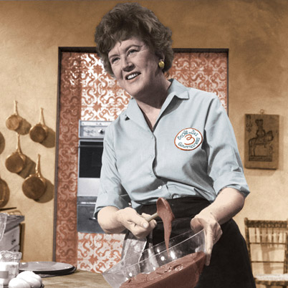
Cooking
Notes:
Slide 32 (2 minutes)
Purpose/Why: To have participants move and make a connection to the level of scaffolding that is needed for each activity.
How: Shows the picture demonstrating the activity and asks the participants to line up from “novice” to “expert.” Allow the participants to negotiate their place in the line up continuum. Tell the participants to look around and notice the different levels of expertise in the room.

Slide 33

Dancing
Notes:
Slide 33: (2 minutes)
Purpose/Why: To have participants move and make a connection to the level of scaffolding that is needed for each activity.
How: Shows the picture demonstrating the activity and asks the participants to line up from “novice” to “expert.” Allow the participants to negotiate their place in the line up continuum. Tell the participants to look around and notice the different levels of expertise in the room. Say: “NOTICE how some of you have changed place in the line up. Some may have more expertise in this area than the previous.”

Slide 34

Writing a Research Paper
Notes:
Slide 34: (2 minutes)
Purpose/ Why: To have participants move and make a connection to the level of scaffolding that is needed for each activity.
How: Shows the picture demonstrating the activity and asks the participants to line up from “novice” to “expert.” Allow the participants to negotiate their place in the line up continuum. Tell the participants to look around and notice the different levels of expertise in the room. NOTICE how some of you have changed place in the line up. Some may have more expertise in this area than the previous. (There will be a direct connect to this activity later on in the session when talking about the importance of appropriate scaffolding).
Ask participants to share out an activity in which they would need more support and the type of support they think they would need.

Slide 35
CA ELD Standards
Overview & Proficiency Level Descriptors (PLDs):
Alignment to CCSS for ELA & Literacy
CA’s EL Student
Proficiency Level Descriptors (PLDs)
Structure of the grade level standards
Grade Level Standards
Section 1: Goal, Critical Principles, At-a-glance Overview
Section 2: Elaboration on Critical Principles
Part I: Interacting in Meaningful Ways
Part II: Learning About How English Works
Part III: Using Foundation Skills
Appendices:
Appendix A: Foundational Literacy Skills
Appendix B: Learning About How English Works
Appendix C: Theory and Research
Appendix D: Context, Development, Validation
Glossary of Key Terms
Notes:
Slide 35 (1 minute)
Purpose/Why: Show the pieces of the document and orient participants to the CA ELD Standards Resources. The next activity will review pieces of the Overview and Proficiency Levels and orient them to the CA ELD Standards Resources.
How: Show the slide, highlight the green box as part of the Overview document which is part of the standards. The next activity will dig into the Proficiency Level Descriptors (ELD Levels).

Slide 36

CA ELD Overview & Proficiency Levels
Overview of the Proficiency Level Descriptor
Read paragraph 1 from page 5
Share Out
Organization of the Proficiency Level Descriptors
Tab page 6
Handout
Notes:
Slide 36 (3 minutes)
Purpose/Why: Ground participants to the ELD Standards book and highlight how it is a resource to inform their practice
How: Identify the section of the ELD Standards book that will be referenced (OVERVIEW OF CELDS & PROFICIENCY LEVELS) in the next section. Have participants locate the pages in their book and tab them. Have participants read ONLY THE FIRST PARAGRAPH of p 5. Have them share out quickly and have them tab p 6.

Slide 37
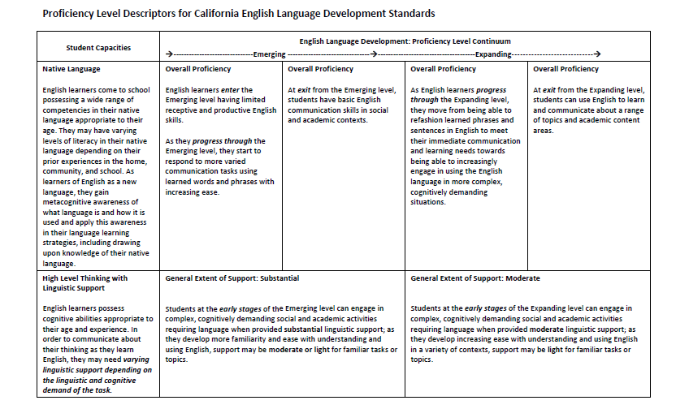
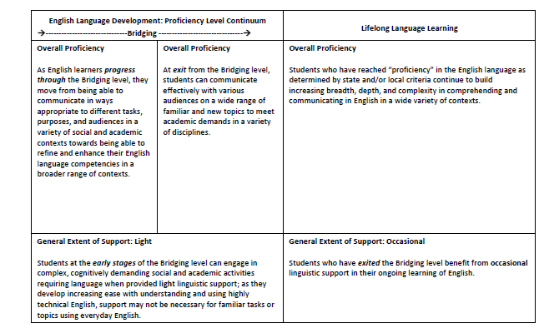
Proficiency Level Descriptors Overview
Overall Proficiency: General descriptor of ELs’ abilities through the continuum
Linguistic support varies depending on the linguistic and cognitive demands of tasks
p. 8-9
Notes:
Slide 37: (3 minutes)
Purpose/Why: To familiarize participants with the PLDs (PROFICIENCY LEVEL DESCRIPTORS) and to get the gist of the PLDs.
How: Participants scan the document and highlight what stands out. Ask participants to share out in whole group what stood out about the levels of support and the native language (student capacity), and the continuum.

Slide 38
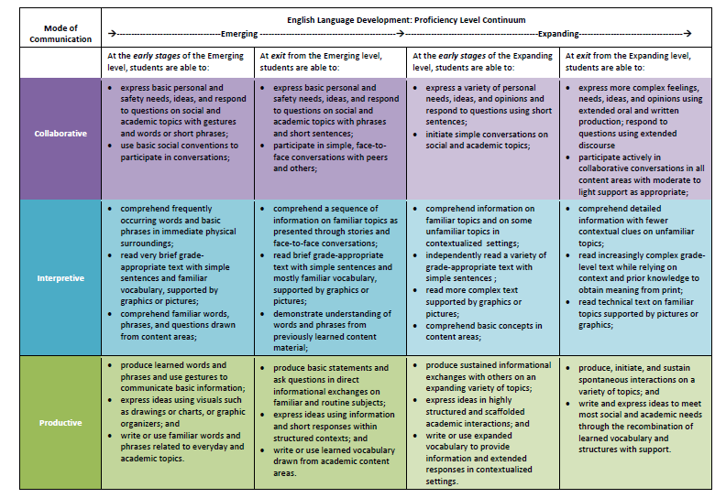
Proficiency Level Descriptors
Provides three proficiency levels:
Emerging, Expanding, and Bridging at early and exit stages
Describes students’ knowledge, skills, and abilities across a continuum, identifying what ELs know and can do
p.10-13
Notes:
Slide 38: (3 minutes)
Purpose/Why: To ground the participants in the documents before they move on to the next activity where they will look at the horizontal level of support within a standard.
How: Facilitator highlights the PLD document, calling out the levels moving from EMERGING to EXPANDING. Call out the ENTRY and EXIT stages. Call out how each section has the descriptions of “WHAT ELs KNOW and CAN DO” by mode. (DO NOT READ EACH BOX).

Slide 39

CA ELD Standards
Overview & Proficiency Level Descriptors (PLDs):
Alignment to CCSS for ELA & Literacy
CA’s EL Student
Proficiency Level Descriptors (PLDs)
Structure of the grade level standards
Grade Level Standards
Section 1: Goal, Critical Principles, At-a-glance Overview
Section 2: Elaboration on Critical Principles
Part I: Interacting in Meaningful Ways
Part II: Learning About How English Works
Part III: Using Foundation Skills
Appendices:
Appendix A: Foundational Literacy Skills
Appendix B: Learning About How English Works
Appendix C: Theory and Research
Appendix D: Context, Development, Validation
Glossary of Key Terms
Notes:
Slides 39 (3 minutes for all slides)
Purpose/Why: Show the pieces of the document and orient participants to the CA ELD Standards Resources. Today’s sessions will review pieces of the Overview and Proficiency Levels. The first activity supports an understanding of the progressions of the standards by looking at standards from Part 1 and standards for Part 2.
How: Show the slide, highlight the brown box that review Part1 & Part 2 , then click on the next slides. Slide 12 visually shows Part 1 (interacting in meaningful ways) and Slide 13 visually shows (How English Works)

Slide 40
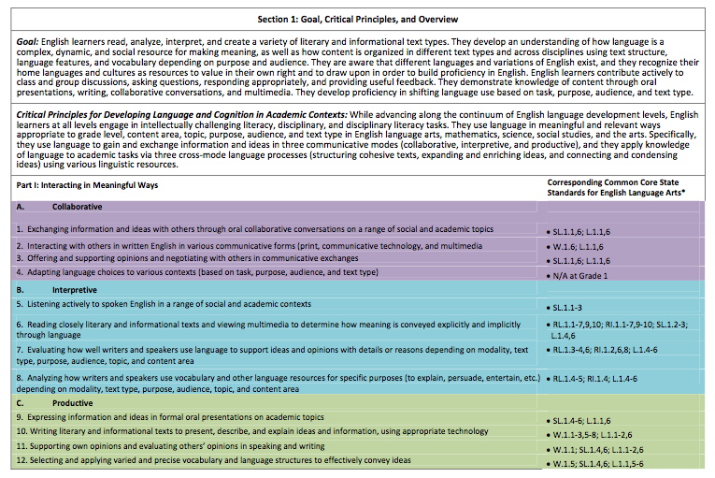
ELD Strands
Notes:
Slide 40 (1 minute)
Purpose/Why: To visually show participants what Part 1 of the standards looks like and set up the vertical progression activity that they will engage in.
How: Click and arrow will appear. Tell participants that today some of them will engage in an activity that will focus on standard 1 from the Collaborative Mode in Part 1: Interacting in Meaningful Ways

Slide 41
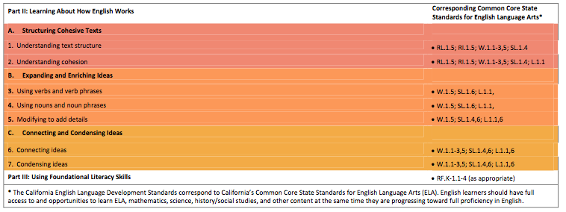
ELD Strands
Notes:
Slide 41 (1 minute)
Purpose/Why: To visually show participants what Part 2 of the New CA ELD Standards looks like and set up the vertical progression activity that they will engage in.
How: Click and arrow will appear. Tell participants that today some of them will engage in an activity that will focus on standard 1 from the Processes section in Part 2: Learning About How English Works

Slide 42
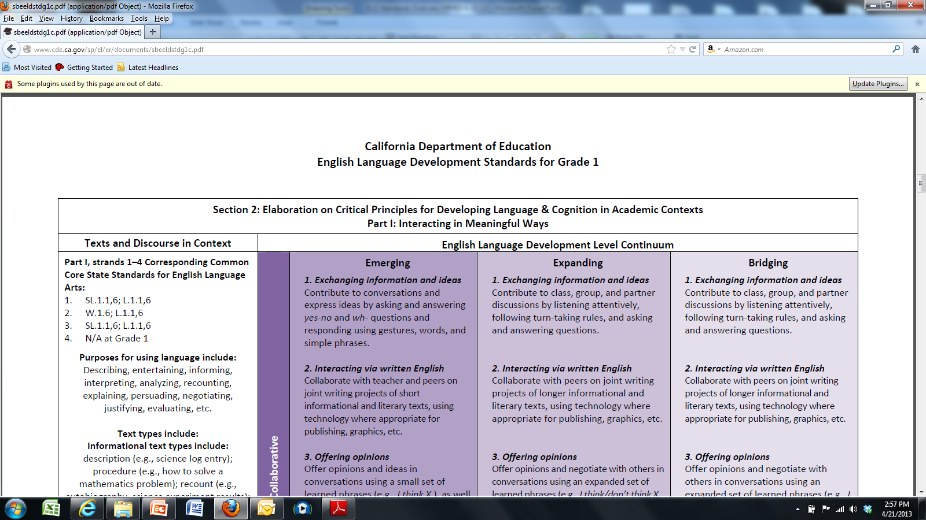
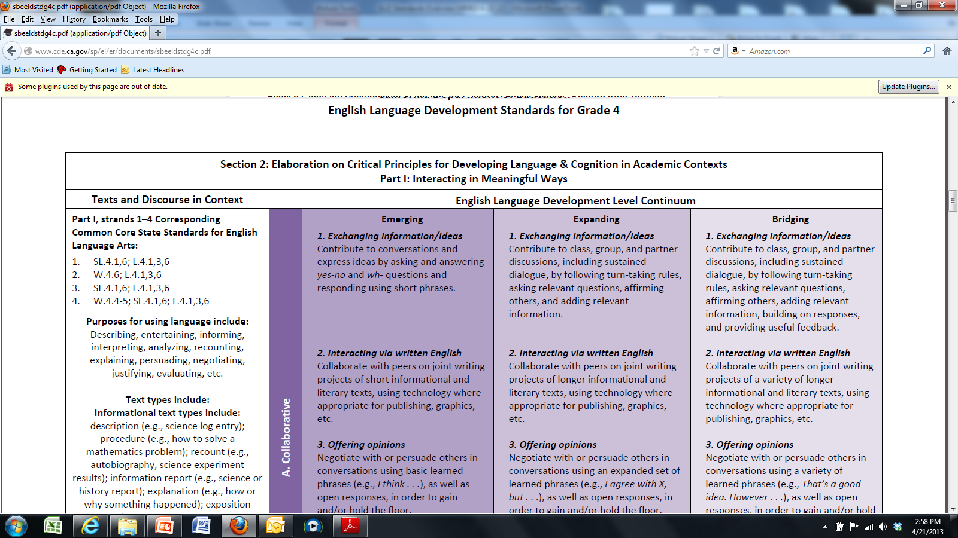
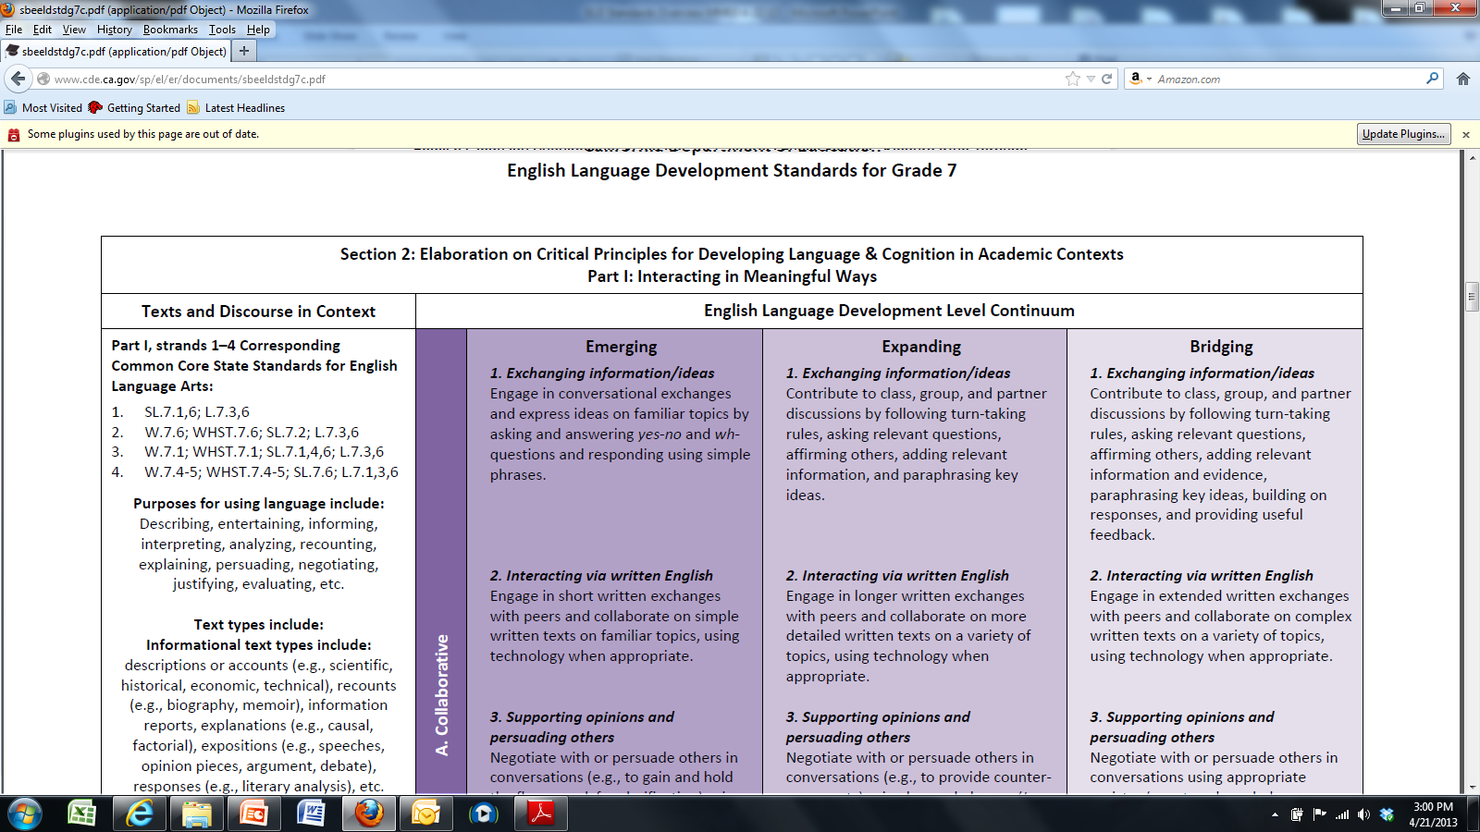
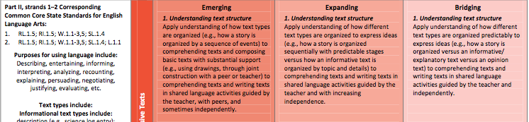
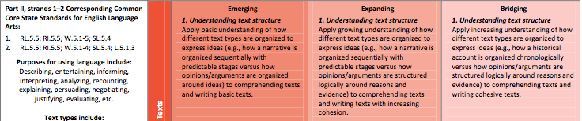
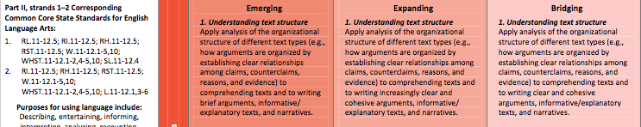
Vertical Progression
Your task is to arrange the grade level standards in order from K to 12th grade
Work with an elbow partner
Keep your strips folded
Use the “Expanding” Descriptor as your focus/anchor.
To confirm your order, refer to the Emerging or Bridging Proficiency Levels
Mode: Collaborative
Process: Text Structure
Notes:
Slides 42-43 (12 minutes= 10 minutes for activity, 2 minutes for debrief)
Purpose/Why: To dig into the standards and understand the language within the progression of the standards
How: There are two sets of standards. Collaborative (purple strips) and Text Structures (orange strips)
Participants are asked to sit in groups of four
One pair will work with the Collaborative Standards and the other pair with the Text Structure Standards
Participants will look at the vertical progression of the ELD Standards by manipulating the strips and putting them in order based on key words that show greater level of specification. Recommend to participants to look at the Expanding descriptors as a guide to put the strips in progression. (Ensure that the white section of the strip is folded- the white section has the grade level for the standard and may decrease the rigor of the activity).
Suggestion: Make copies in color to support and differentiate the learning between modes and processes.

Slide 43
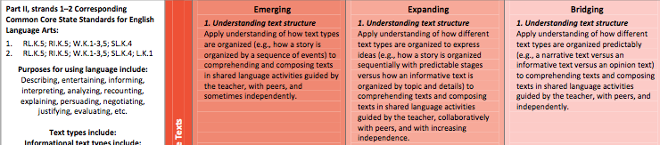
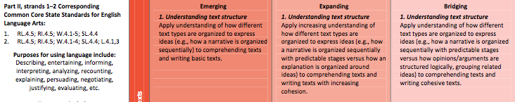
Vertical Progression
Mode: Collaborative
Before you unfold your strips, share out your process for ordering the strips
Now, unfold your strips and look for patterns and trends
Share out
Process: Text Structure
Notes:
Slide 43 (2 minutes)
Purpose/Why: To negotiate meaning and understanding around the standards and the Progression activity
How:
To debrief:
What patterns and trends did you notice?
How many strips are there?
Why do we have 11 strips (K-12)? (grade level standards, but 9/10 and 11/12 are together)
Point out that some standards are worded the same
Point out that participants are engaging in the three modes of communication by virtue of this exercise

Slide 44

Vertical Progression
Find a pair with a different set of standards
Share patterns and trends
Think of a lesson from today, what opportunities did you provide your students that addressed these standards?
Instructional Strategy:
Collaborative Groups
Notes:
Slide 44- 5 minutes
Why/Purpose: Allow for discussions within quads to make meaning of the standards and gain a deeper understanding of the standards
How: Have the pairs go back to a quad. If teams were able to be in groups of 4 at beginning of activity have them now work with their team members. Ensure that the pairs with the purple strips share with the pairs with the orange strips. You may structure the share out, allowing 2 minutes per pair.

Slide 45
A Horizontal Look
What level of support would you need to move through the continuum in an area where you considered yourself to be a novice?
Notes:
SLIDE 45 (1 minute)
Purpose/ Why: To have participants make connections to their experience from the beginning of the session and the levels of support of EL students found in the standards.
How: Ask participants the question on the slide and have them do a quick share out. Participants should highlight that they would need practice, guidance, and support to move from novice to expert.

Slide 46
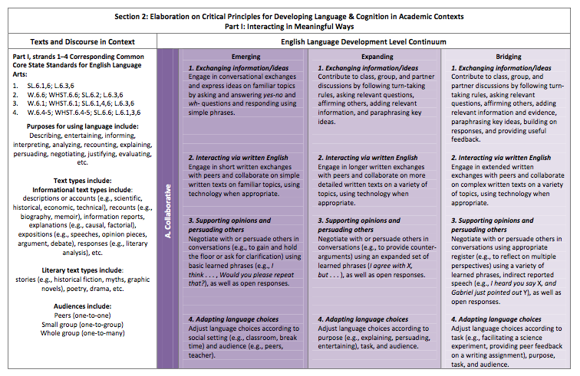
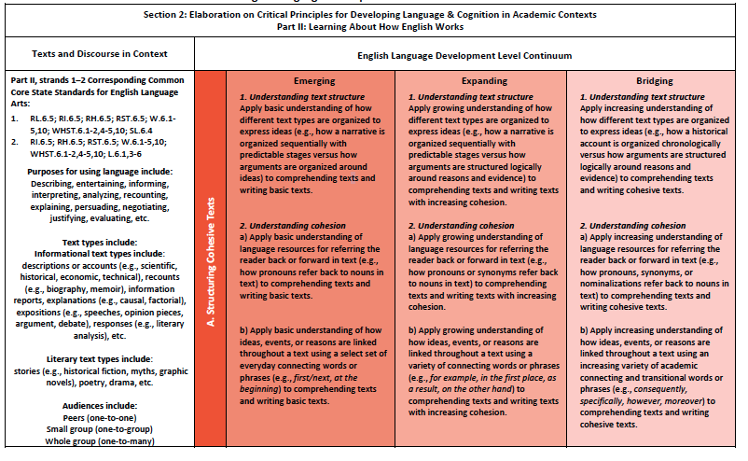
A Horizontal Look
With your partner read through the first Collaborative Standard
Highlight the changes that occur horizontally across the continuum
What did you notice?
Share out
Repeat the process for Understanding Text Structure
Notes:
Slide 46 (5 minutes)
Purpose/Why: To allow participants to see how standards and expectations for students horizontally progress through the proficiency levels for each standard.
How: Participants work with their their teams of four to highlight changes in the continuum. Have participants begin with the purple (COLLABORATIVE STRIPS) and then move on to the orange (PROCESSES STRIPS). Allow for discussions between quads

Slide 47

Instructional Strategies
Chalk Talk | 3-2-1
Turn and Talk | Whole Group Share Out
Line Up | Chunking
Collaborative Groups
Notes:
Slide 47: 1 minutes
Purpose
To share those instructional strategies that were used during the presentation to support classroom instruction.
How
Say, “These instructional moves were used during the presentation to help us process the content. These moves can be used in your classroom to help students process content.”
Today we implemented the strategies in bold print.

Slide 48
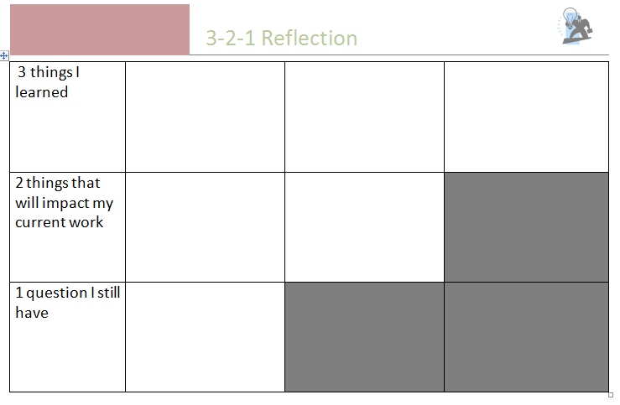
3 – 2 – 1
Notes:
Slide 48: (2 minutes)
Why: To reflect on learning our learning for today.
How
Say, “Please take a moment to reflect on your learning during this session. Please use the graphic organizer projected to record:
3 things you learned
2 things that will impact your work
1 question you still have”

