Slide 1
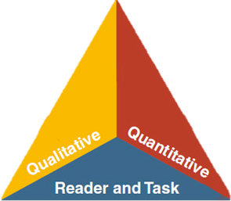

LANGUAGE
LITERACY
LEARNING
Session 2: CA ELD Standards Progression &
ELD Proficiency Levels
MULTILINGUAL & MULTICULTURAL EDUCATION DEPARTMENT
Notes:
Slide 1: (1 minute) Introduction. Add you name to the slide
Purpose/Why: Remind participants that this is the 2nd of 4 sessions in transitioning to the New CA ELD Standards
How: You will guide participants through the information while modeling instructional strategies that could be transferred to classroom practice.

Slide 2

Line Up Activity
Decide where you place in a line up from novice to expert
Instructional Strategy:
Line Up Activity
Notes:
Slides 2-5 (10 minutes). Slide 2 (3 minutes)
Purpose/Why: Engage participants in a GROUNDING ACTIVITY in order to start making connections to the learning of the session
How: Let the participants know that they will be standing up and moving around for this Line Up Activity. Let them know that they do not need any writing tools or paper to complete this assignment. They will return back to their seats after this activity. Before asking participants to stand up, let them know the process first. They will see a series of slides with activities. Based on their own self-assessment of where they fall, they will place themselves somewhere in the line up from “novice” to “expert.”
Suggestions: Make two signs that can be located in opposite sides of the room. One sign will read “NOVICE” and the other will read “EXPERT.” Anticipate how the participants will stand up and line up before the participants arrive.

Slide 3
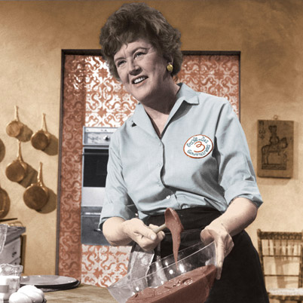
Cooking
Notes:
Slide 3 (2 minutes)
Purpose/Why: To have participants move and make a connection to the level of scaffolding that is needed for each activity.
How: Shows the picture demonstrating the activity and asks the participants to line up from “novice” to “expert.” Allow the participants to negotiate their place in the line up continuum. Tell the participants to look around and notice the different levels of expertise in the room.

Slide 4

Dancing
Notes:
Slide 4: (2 minutes)
Purpose/Why: To have participants move and make a connection to the level of scaffolding that is needed for each activity.
How: Shows the picture demonstrating the activity and asks the participants to line up from “novice” to “expert.” Allow the participants to negotiate their place in the line up continuum. Tell the participants to look around and notice the different levels of expertise in the room. Say: “NOTICE how some of you have changed place in the line up. Some may have more expertise in this area than the previous.”

Slide 5

Writing a Research Paper
Notes:
Slide 5: (2 minutes)
Purpose/ Why: To have participants move and make a connection to the level of scaffolding that is needed for each activity.
How: Shows the picture demonstrating the activity and asks the participants to line up from “novice” to “expert.” Allow the participants to negotiate their place in the line up continuum. Tell the participants to look around and notice the different levels of expertise in the room. NOTICE how some of you have changed place in the line up. Some may have more expertise in this area than the previous. (There will be a direct connect to this activity later on in the session when talking about the importance of appropriate scaffolding).
Ask participants to share out an activity in which they would need more support and the type of support they think they would need.

Slide 6
ELD Transition Sessions
Session 1: ELD Standards Introduction
          Shifts, Layout, & Development
Session 2: Proficiency Levels
Session 3: Theory that Informs Layout (Appendix C)
Session 4: How English Works (Appendix B)
Notes:
Slide 6: (1 minute)
Why/purpose: make the participants aware that this is the first of the four sessions.
How: Give participants a few seconds to read over the slide to see flow of the four sessions

Slide 7
Objectives
  Discuss and develop an understanding of the Proficiency Levels
  Examine and arrange the progression of the CA ELD Standards
Notes:
Slide 7: (1 minute)
Purpose/Why: To make participants aware of the objectives for the session
How: Review the 2 bullets with participants

Slide 8
Adapted from George Washington University
Guiding Principles
English Learners (ELs) are held to the same high expectations of learning established for all students.
ELs develop full receptive and productive proficiencies in English in the domains of listening, speaking, reading & writing.
ELs are taught challenging academic content that enables them to meet performance standards in all content areas.
ELs receive instruction that builds on their previous education and cognitive abilities and that reflects their language proficiency levels.
ELs are evaluated with appropriate and valid assessments that are aligned to state and local standards and that take into account the language development stages & cultural backgrounds of the students.
The academic success of ELs is a responsibility shared by all educators, the family and the community.
English Learner Master Plan, 2012,
Pages 2-3
Notes:
Slide 8: (2 minutes)
Why/Purpose: The six guiding principles of the EL Master Plan are presented here to remind participants that they serve as a strong statement of values that guide all of our work in serving English Learners (ELs).
How: The facilitator will remind participants of the Six Guiding Principles from the EL Master Plan (pages 2-3) Review guiding principles. Highlight number 1 and 4 as a focus for this session.
Additional Notes: The guiding principles slide must be in every presentation.

Slide 9

District Instructional Priorities
Master Plan
(The Who)
TGDC
Teaching &
Learning
Framework
(The How)
Common Core
(The What)
Notes:
Slide 9 (2 minutes)
Purpose/Why: Highlight that the Teaching and Learning Framework will also be used alongside both the Master Plan and the Common Core State Standards. All three initiatives are actually woven together. Clearly, the Common Core State Standards signify “What” we teach, while the Master Plan signifies the “Who” we teach, and The Teaching and Learning Framework speaks to “How” we teach in LAUSD.
How: Talk to the slides and highlight how the integration of all 3 priorities support LAUSD students with graduating College Prepared and Career Ready.

Slide 10
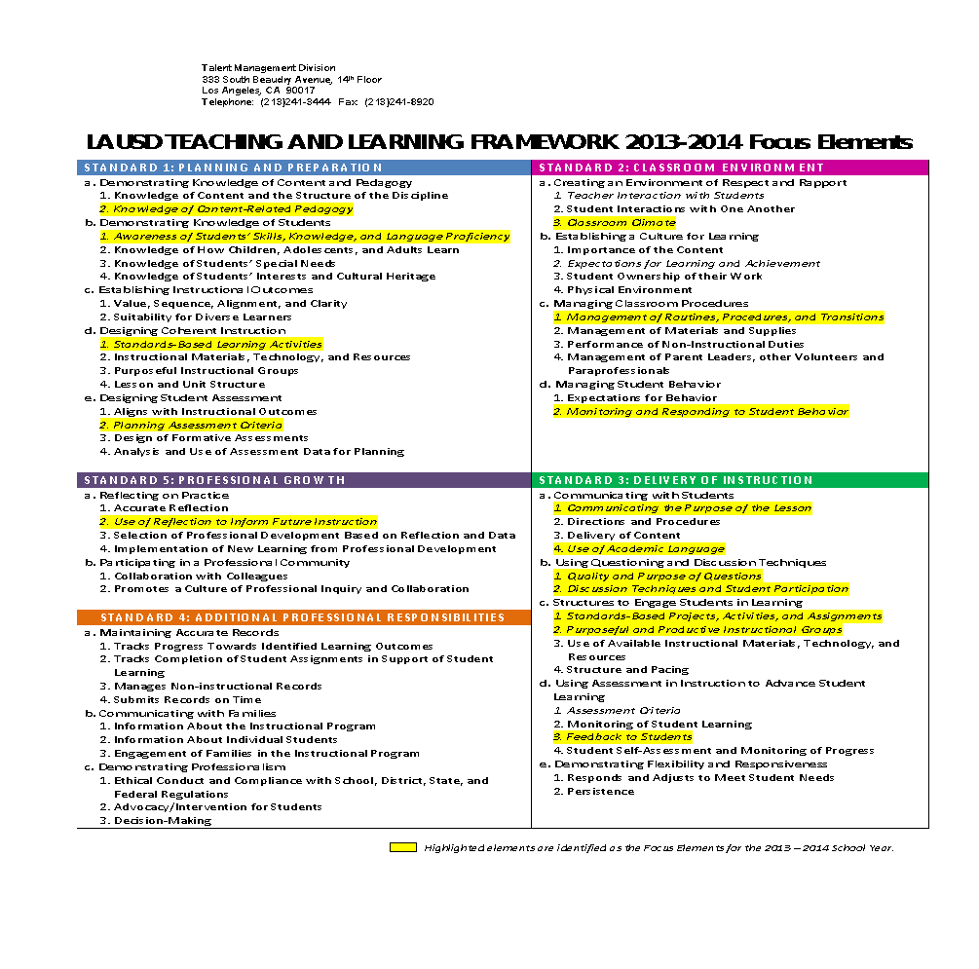



LAUSD TEACHING AND LEARNING FRAMEWORK 2014-2015 FOCUS ELEMENTS
Notes:
Slide 10: (1 min)
Why/Purpose: To connect our work as educators and our professional goals.
How: Read the 3 focus elements, tell the participants that the arrows point to the highlighted focus elements that apply to the work we will engage in today.
*

Slide 11
Phase-In Plan for CA ELD Standards
2014-2015
2015-2016
Transition
Implementation
Notes:
Slide 11: (2 minutes)
Purpose/ Why: Review the phase in plan and highlight how it is aligned to the state’s plan. As participants go through the year and sessions, they will have a better understanding of the New CA ELD Standards
How: Tell participants that this year we are the transition year. As we move to the Transition year, the state and district will be building resources, implementing needs assessments, and continue to provide learning opportunities for stakeholders. Next year, we will be in the Implementation year where there will be expansion of professional learning and alignment of curriculum instruction and assessment along with integration throughout the district.

Slide 12

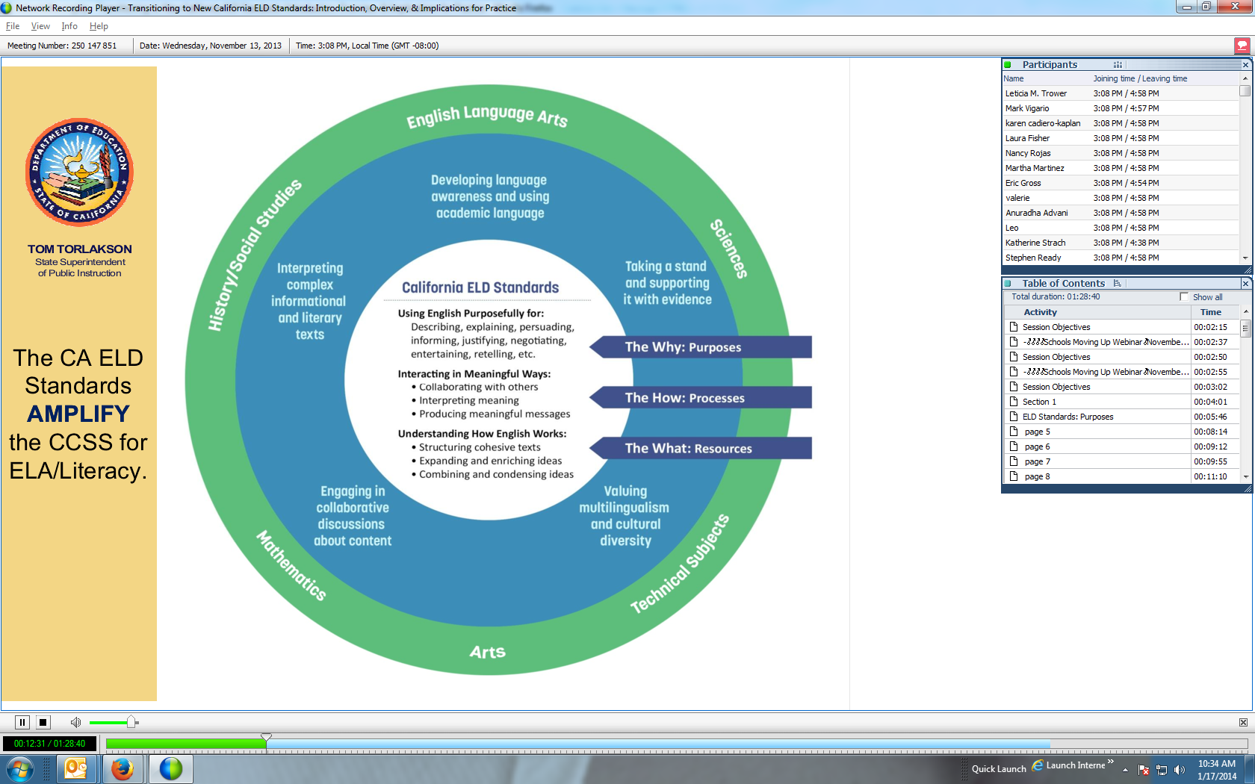
What must students be able to do with language?
ELA | MATH | SCIENCE
Comprehend and evaluate complex texts across a range of types and disciplines Construct effective arguments and convey intricate or multifaceted information Discern a speaker’s key points Request clarification and ask relevant questions Build on others’ ideas Articulate their own ideas, and confirm they have been understood | Understand and use stated assumptions, definitions, and previously established results in constructing arguments Make conjectures and build a logical progression of statements to explore the truth of their conjectures Justify their conclusions, communicate them to others, and respond to the arguments of others | Construct explanations and designated solutions Engaging in argument from evidence Obtain, evaluate, and communicate information
Notes:
Slide 12 (1 minute)
Purpose/Why: To visually show how the ELD Standards align and correlate to the new CCSS and review the language demands across content areas
How: Review the language demands of each column. Remind participants that the CA ELD Standards highlight and amplify the Common Core State Standards so that students develop both English and content knowledge. Remind participants that the CA ELD Standards guide teachers to build ELs’ knowledge about how the English language works in different contexts to achieve specific communicative purposes.

Slide 13
CA ELD Standards
Overview & Proficiency Level Descriptors (PLDs):
Alignment to CCSS for ELA & Literacy
CA’s EL Student
Proficiency Level Descriptors (PLDs)
Structure of the grade level standards
Grade Level Standards
Section 1: Goal, Critical Principles, At-a-glance Overview
Section 2: Elaboration on Critical Principles
  Part I: Interacting in Meaningful Ways
  Part II: Learning About How English Works
  Part III: Using Foundation Skills
Appendices:
Appendix A: Foundational Literacy Skills
Appendix B: Learning About How English Works
Appendix C: Theory and Research
Appendix D: Context, Development, Validation
Glossary of Key Terms
Notes:
Slide 13 (1 minute)
Purpose/Why: Show the pieces of the document and orient participants to the CA ELD Standards Resources. Today’s session will review pieces of the Overview and Proficiency Levels. The first activity will review pieces of the Overview and Proficiency Levels and orient them to the CA ELD Standards Resources.
How: Show the slide, highlight the green box as part of the Overview document which is part of the standards. The next activity will dig into the Proficiency Level Descriptors (ELD Levels).

Slide 14

CA ELD Overview &
Proficiency Levels
Overview of the Proficiency Level Descriptor
  Read paragraph 1 from page 5
  Share Out
Organization of the Proficiency Level Descriptors
  Tab page 6
Handout
Notes:
Slide 14 (3 minutes)
Purpose/Why: Ground participants to the ELD Standards book and highlight how it is a resource to inform their practice
How: Identify the section of the ELD Standards book that will be referenced (OVERVIEW OF CELDS & PROFICIENCY LEVELS) in the next section. Have participants locate the pages in their book and tab them. Have participants read ONLY THE FIRST PARAGRAPH of p 5. Have them share out quickly and have them tab p 6.

Slide 15
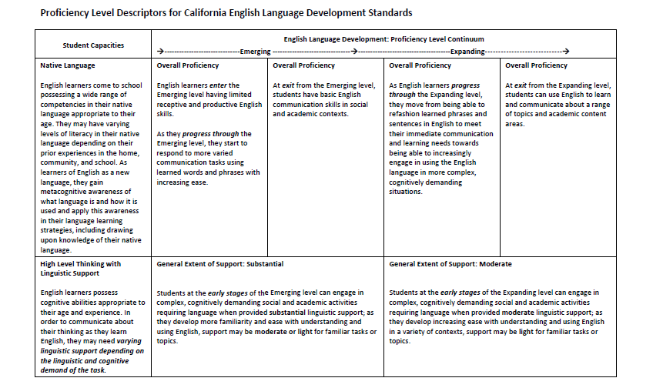
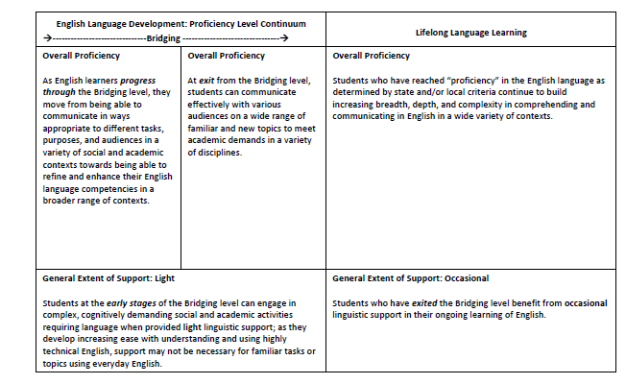
Proficiency Level
Descriptors Overview
Overall Proficiency: General descriptor of ELs’ abilities through the continuum
Linguistic support varies depending on the linguistic and cognitive demands of tasks
p. 8-9
Notes:
Slide 15: (3 minutes)
Purpose/Why: To familiarize participants with the PLDs (PROFICIENCY LEVEL DESCRIPTORS) and to get the gist of the PLDs.
How: Participants scan the document and highlight what stands out. Ask participants to share out in whole group what stood out about the levels of support and the native language (student capacity), and the continuum.

Slide 16
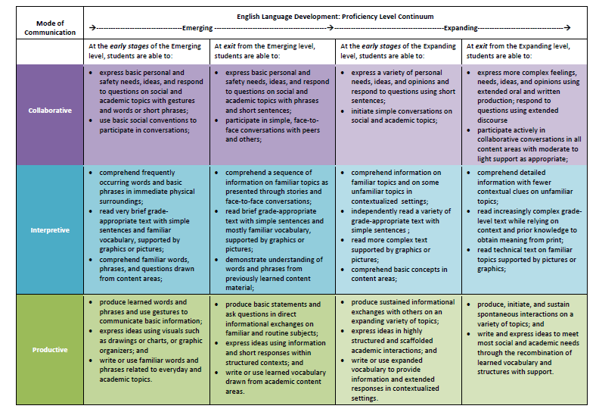
Proficiency Level Descriptors
Provides three proficiency levels:
  Emerging, Expanding, and Bridging at early and exit stages
Describes students’ knowledge, skills, and abilities across a continuum, identifying what ELs know and can do
p.10-13
Notes:
Slide 16: (3 minutes)
Purpose/Why: To ground the participants in the documents before they move on to the next activity where they will look at the horizontal level of support within a standard.
How: Facilitator highlights the PLD document, calling out the levels moving from EMERGING to EXPANDING. Call out the ENTRY and EXIT stages. Call out how each section has the descriptions of “WHAT ELs KNOW and CAN DO” by mode. (DO NOT READ EACH BOX).

Slide 17

CA ELD Standards
Overview & Proficiency Level Descriptors (PLDs):
Alignment to CCSS for ELA & Literacy
CA’s EL Student
Proficiency Level Descriptors (PLDs)
Structure of the grade level standards
Grade Level Standards
Section 1: Goal, Critical Principles, At-a-glance Overview
Section 2: Elaboration on Critical Principles
  Part I: Interacting in Meaningful Ways
  Part II: Learning About How English Works
  Part III: Using Foundation Skills
Appendices:
Appendix A: Foundational Literacy Skills
Appendix B: Learning About How English Works
Appendix C: Theory and Research
Appendix D: Context, Development, Validation
Glossary of Key Terms
Notes:
Slides 17-19 (3 minutes for all slides)
Purpose/Why: Show the pieces of the document and orient participants to the CA ELD Standards Resources. The next activity supports an understanding of the progressions of the standards by looking at standards from Part 1 and standards for Part 2.
How: Show the slide, highlight the brown box that review Part1 & Part 2 , then click on the next slides. Slide 18 visually shows Part 1 (Interacting in meaningful ways) and Slide 19 visually shows (How English Works)

Slide 18
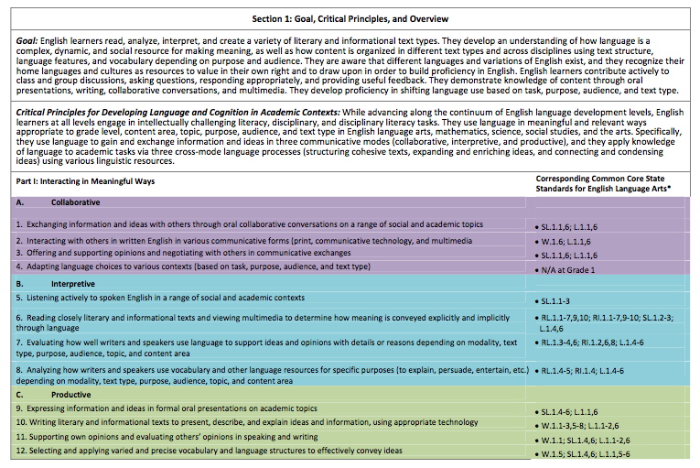
ELD Strands
Notes:
Slide 18 (1 minute)
Purpose/Why: To visually show participants what Part 1 of the standards looks like and set up the vertical progression activity that they will engage in.
How: Click and arrow will appear. Tell participants that today some of them will engage in an activity that will focus on standard 1 from the Collaborative Mode in Part 1: Interacting in Meaningful Ways

Slide 19
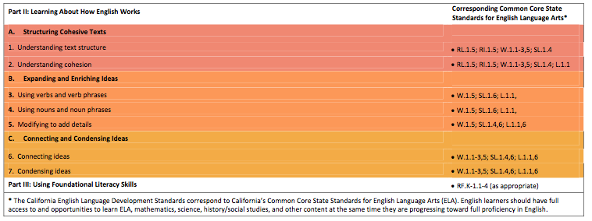
ELD Strands
Notes:
Slide 19 (1 minute)
Purpose/Why: To visually show participants what Part 2 of the New CA ELD Standards looks like and set up the vertical progression activity that they will engage in.
How: Click and arrow will appear. Tell participants that today some of them will engage in an activity that will focus on standard 1 from the Processes section in Part 2: Learning About How English Works

Slide 20
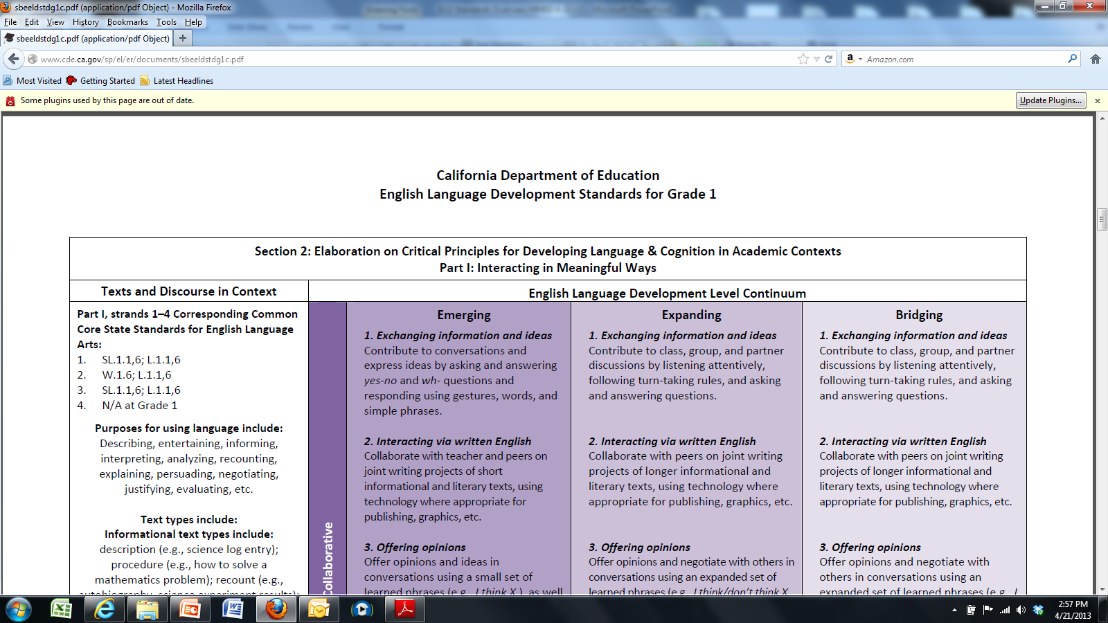
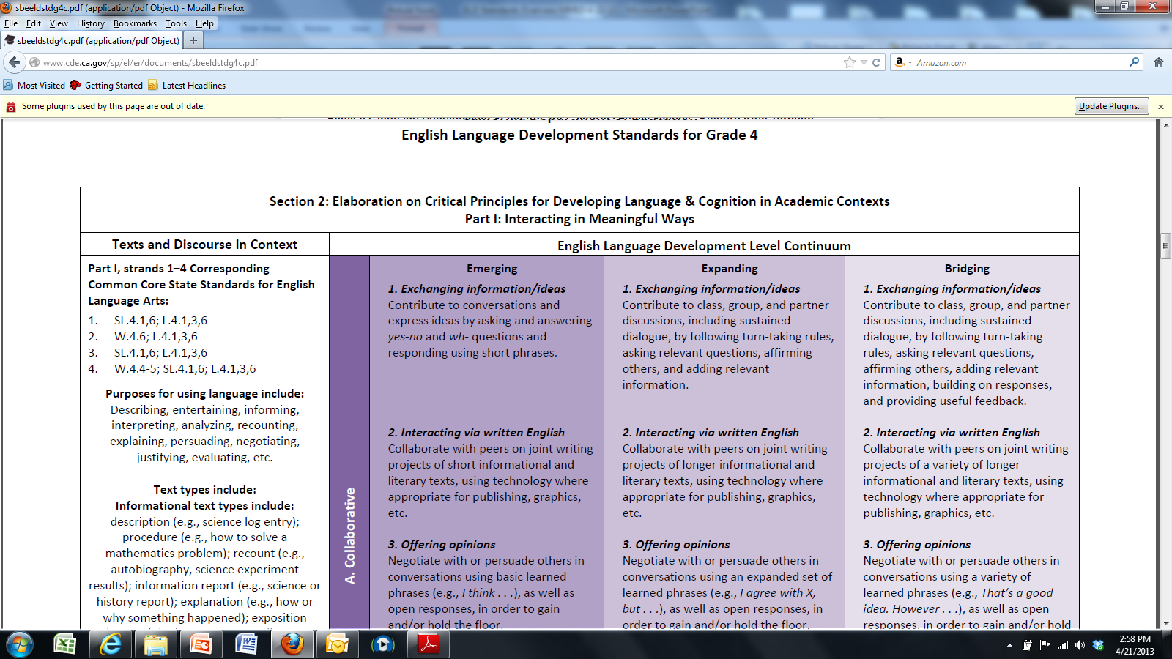
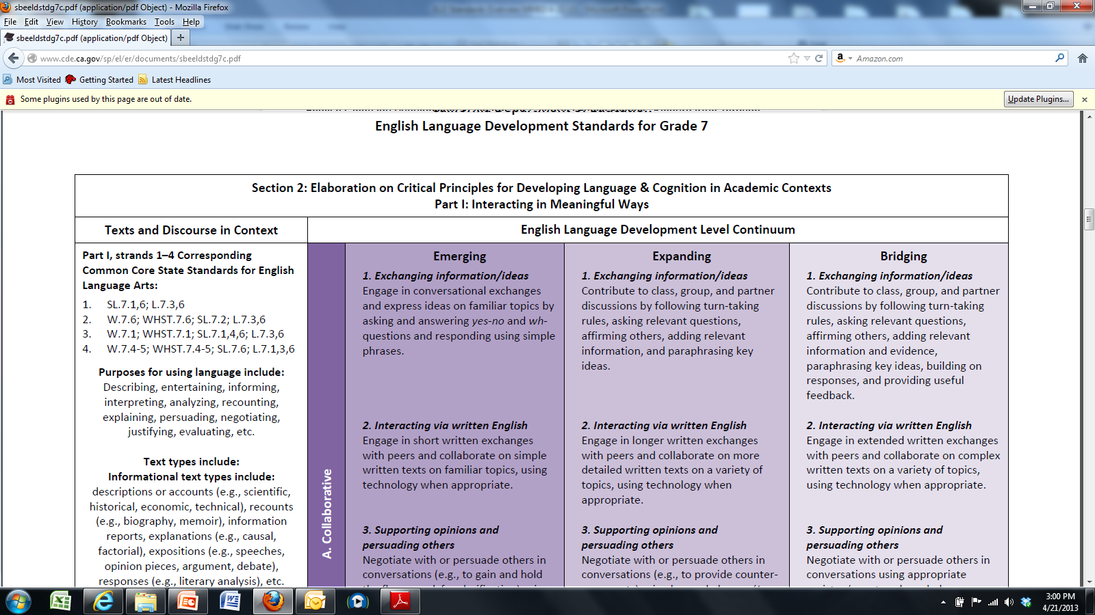
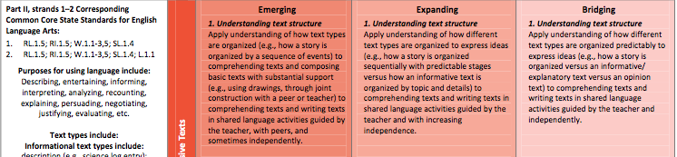
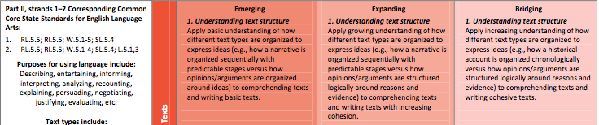
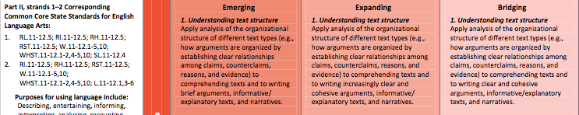
Vertical Progression
Your task is to arrange the grade level standards in order from K to 12th grade
Work with an elbow partner
Keep your strips folded
Use the “Expanding” Descriptor as your focus/anchor.
To confirm your order, refer to the Emerging or Bridging Proficiency Levels
Mode: Collaborative
Process: Text Structure
Notes:
Slides 20-21 (12 minutes= 10 minutes for activity, 2 minutes for debrief)
Purpose/Why: To dig into the standards and understand the language within the progression of the standards
How: There are two sets of standards. Collaborative (purple strips) and Text Structures (orange strips)
Participants are asked to sit in groups of four
One pair will work with the Collaborative Standards and the other pair with the Text Structure Standards
Participants will look at the vertical progression of the ELD Standards by manipulating the strips and putting them in order based on key words that show greater level of specification. Recommend to participants to look at the Expanding descriptors as a guide to put the strips in progression. (Ensure that the white section of the strip is folded- the white section has the grade level for the standard and may decrease the rigor of the activity).
Suggestion: Make copies in color to support and differentiate the learning between modes and processes.

Slide 21
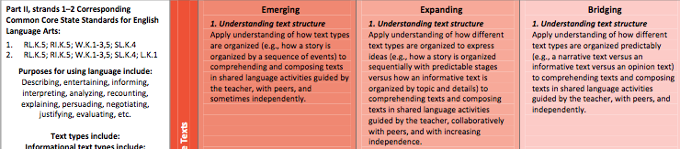
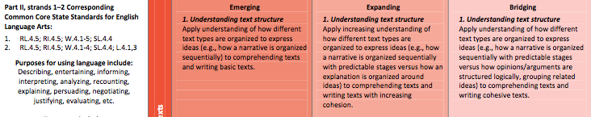
Vertical Progression
Mode: Collaborative
Before you unfold your strips, share out your process for ordering the strips
Now, unfold your strips and look for patterns and trends
Share out
Process: Text Structure
Notes:
Slide 21 (2 minutes)
Purpose/Why: To negotiate meaning and understanding around the standards and the Progression activity
How:
To debrief:
What patterns and trends did you notice?
How many strips are there?
Why do we have 11 strips (K-12)? (grade level standards, but 9/10 and 11/12 are together)
Point out that some standards are worded the same
Point out that participants are engaging in the three modes of communication by virtue of this exercise

Slide 22

Vertical Progression
Find a pair with a different set of standards
Share patterns and trends
Think of a lesson from today, what opportunities did you provide your students that addressed these standards?
Instructional Strategy:
Collaborative Groups
Notes:
Slide 22- 5 minutes
Why/Purpose: Allow for discussions within quads to make meaning of the standards and gain a deeper understanding of the standards
How: Have the pairs go back to a quad. If teams were able to be in groups of 4 at beginning of activity have them now work with their team members. Ensure that the pairs with the purple strips share with the pairs with the orange strips. You may structure the share out, allowing 2 minutes per pair.

Slide 23
A Horizontal Look
What level of support would you need to move through the continuum in an area where you considered yourself to be a novice?
Notes:
Slide 23 (1 minute)
Purpose/ Why: To have participants make connections to their experience from the beginning of the session and the levels of support of EL students found in the standards.
How: Ask participants the question on the slide and have them do a quick share out. Participants should highlight that they would need practice, guidance, and support to move from novice to expert.

Slide 24
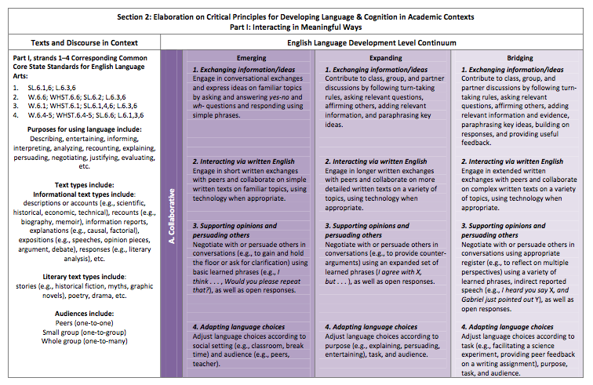
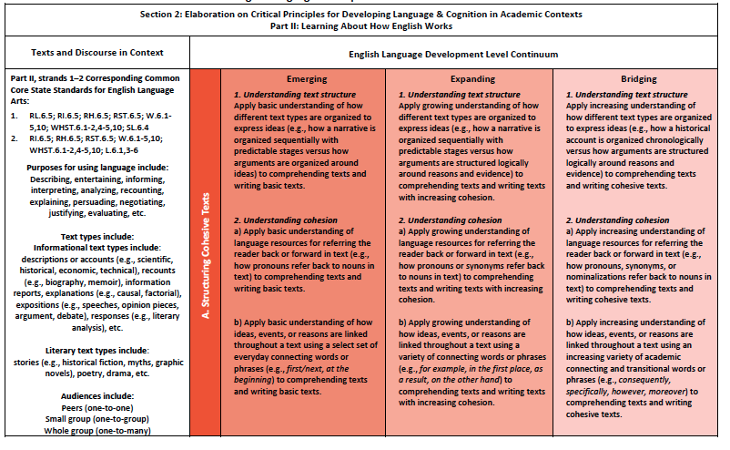
A Horizontal Look
With your partner read through the first Collaborative Standard
Highlight the changes that occur horizontally across the continuum
What did you notice?
Share out
Repeat the process for Understanding Text Structure
Notes:
Slide 24 (5 minutes)
Purpose/Why: To allow participants to see how standards and expectations for students horizontally progress through the proficiency levels for each standard.
How: Participants work with their their teams of four to highlight changes in the continuum. Have participants begin with the purple (COLLABORATIVE STRIPS) and then move on to the orange (PROCESSES STRIPS). Allow for discussions between quads

Slide 25

Instructional Strategies
Chalk Talk | 3-2-1
Turn and Talk | Whole Group Share Out
Line Up | Chunking The Text
Collaborative Groups | Whole Group Share Out
Notes:
Slide 25: 1 minutes
Purpose
To share those instructional strategies that were used during the presentation to support classroom instruction.
How
Say, “These instructional moves were used during the presentation to help us process the content. These moves can be used in your classroom to help students process content.”
Today we implemented the strategies in bold print.

Slide 26

Reflection
Notes:
Slide 26

