Slide 1

Module 1:
Elementary Progress Report ELD Marking Guidance
CA ELD Standards Grading Alignment
Notes:
The Multilingual & Multicultural Education Department has developed a two-module series called Elementary Progress Report ELD Marking Guidance. The module will serve as a tool to assist elementary teachers of English Learners during this time of transition in communicating student progress using the current progress report with the 2012 CA ELD Standards.
Module 1 focuses on aligning the new CA ELD Standards with the 4 Language Domains.

Slide 2
2012 CELDS
How do we align the New CA ELD Standards (CELDS) to the L/S/R/W domains to provide grades?
Notes:
Grades will be recorded based on the current progress report card. But, how do we align the NEW CA ELD Standards or (CELDS) to the Listening, Speaking, Reading, and Writing domains in order to provide our students with grades that communicate their progress?

Slide 3
Key Conceptual Shifts in
2012 CA ELD Standards (CELDS)
2012 CELDS
Standards and Proficiency Level Descriptors (PLDs) focusing on four isolated domains: listening, speaking, reading and writing as isolated domains
Standards and Proficiency Level Descriptors (PLDs) focusing on modes of communication (collaborative, interpretive, and productive); and language knowledge awareness and use (interweaving L, S, R, W)
Language acquisition as an individual and lock-step linear process.
Language acquisition as a non-linear, spiraling, dynamic, and complex social process
Notes:
Let’s begin by reviewing two Key Conceptual Shifts in the 2012 CA ELD Standards or CELDS.
We have made the shift from targeting isolated domains to standards and proficiency level descriptors or PLDs that focus modes of communication and language awareness—all of which interweave each of the 4 language domains.
We have also shifted from viewing language as a individual an lock-step linear process to one that is non-linear, spiraling, dynamic, and socially complex.

Slide 4
What is New?
2012 CELDS
CA ELD Standards (CELDS)
Proficiency levels:
  Emerging
  Expanding
  Bridging
ELD 15-Day Start Smart Lessons with Constructive Conversation Skills
Designated ELD Frame of Practice
New Progress Report Card to be piloted at some LAUSD schools
Notes:
Given these shifts, let’s review what’s new. Again, this is where we are now—in full implementation of the new 2012 CA ELD Standards or CELDS.
We are also incorporating the new proficiency levels of Emerging, Expanding, and Bridging. Students will no longer be recorded on the report cards based on ELD Portfolio levels 1-5.
ELD 15-Day Start Smart lessons that highlight Constructive Conversation Skills have been rolled out at schools along with the Designated ELD Frame of Practice to support instruction of the CA ELD Standards.
There is a new report card on the horizon that will be piloted at some LAUSD schools. At this time, however, we will be utilizing the current report card that is in MiSiS.

Slide 5
Four Domains
Old Format
Listening
Speaking
Reading
Writing
English Learners will still receive an ELD grade of a 1, 2, 3, or 4 for each of the four domains based on the current progress report card.
Notes:
Schools will continue to use the same progress report card from last school year.
As such, teachers of ELs will continue to provide progress marks for their ELs using the 4 domains of Listening, Speaking, Reading, and Writing.
English Learners will still receive an ELD grade of a 1, 2, 3, or 4 for each of the four domains based on the current progress report card.

Slide 6
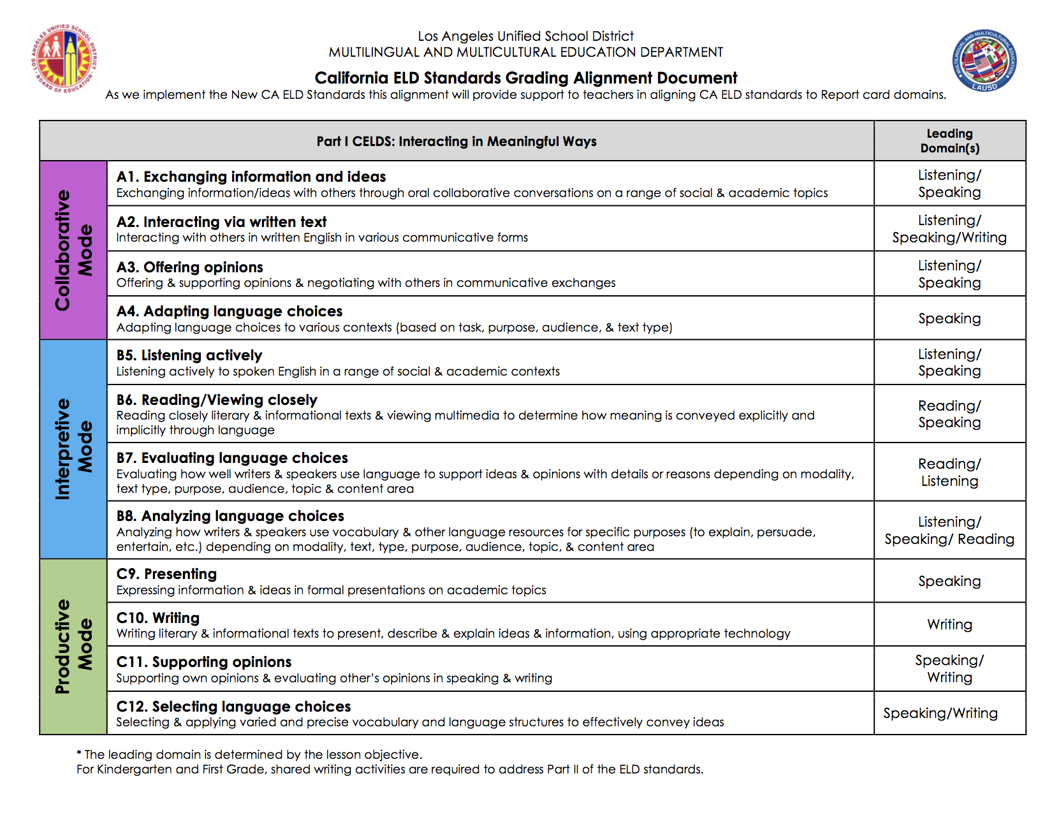
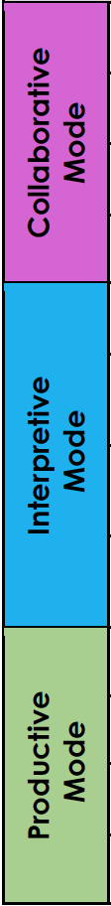
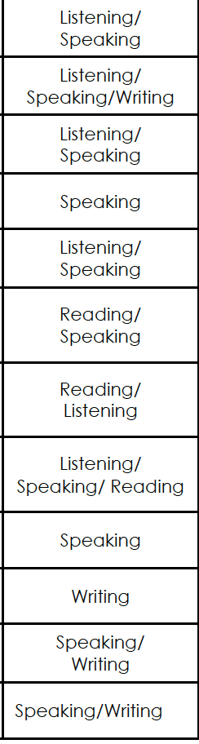
Alignment – CELDS Part I
Leading Domain(s)
Notes:
As we are in full implementation of 2012 CA ELD standards the Multilingual and Multicultural Education department has created a Grading Alignment document to provide support to teachers in aligning the new CELDS to the current progress report card—which is still organized by language domain.
1. Here we see the alignment for the Part I CELDS – Interacting in Meaningful Ways
2. Note that three modes of communication are listed
3. Collaborative
4. Interpretive
5. And Productive along with each of the 12 strands for Part I
6. Let’s take a look at an example of from Part 1 A. Collaborative Mode – Strand 1 – Exchanging Information and Ideas. The standard for this strand across all grade levels calls for students to Exchange Information and Ideas with others through oral collaborative conversations on a range of social and academic topics. Although the new CELDS interweave all four language domains of Listening, Speaking, Reading, and Writing, when we consider the language of demands of the standard within this particular strand, Listening and Speaking are truly at its core and thus are listed as the Leading Domains.
7. We have listed Leading Domains for each of the 12 strands in Part I. However, it bears noting that in order to accurately determine the leading domain we must consider the language demands of each task—in other words, the Leading Domain is truly determined by the lesson objective.

Slide 7
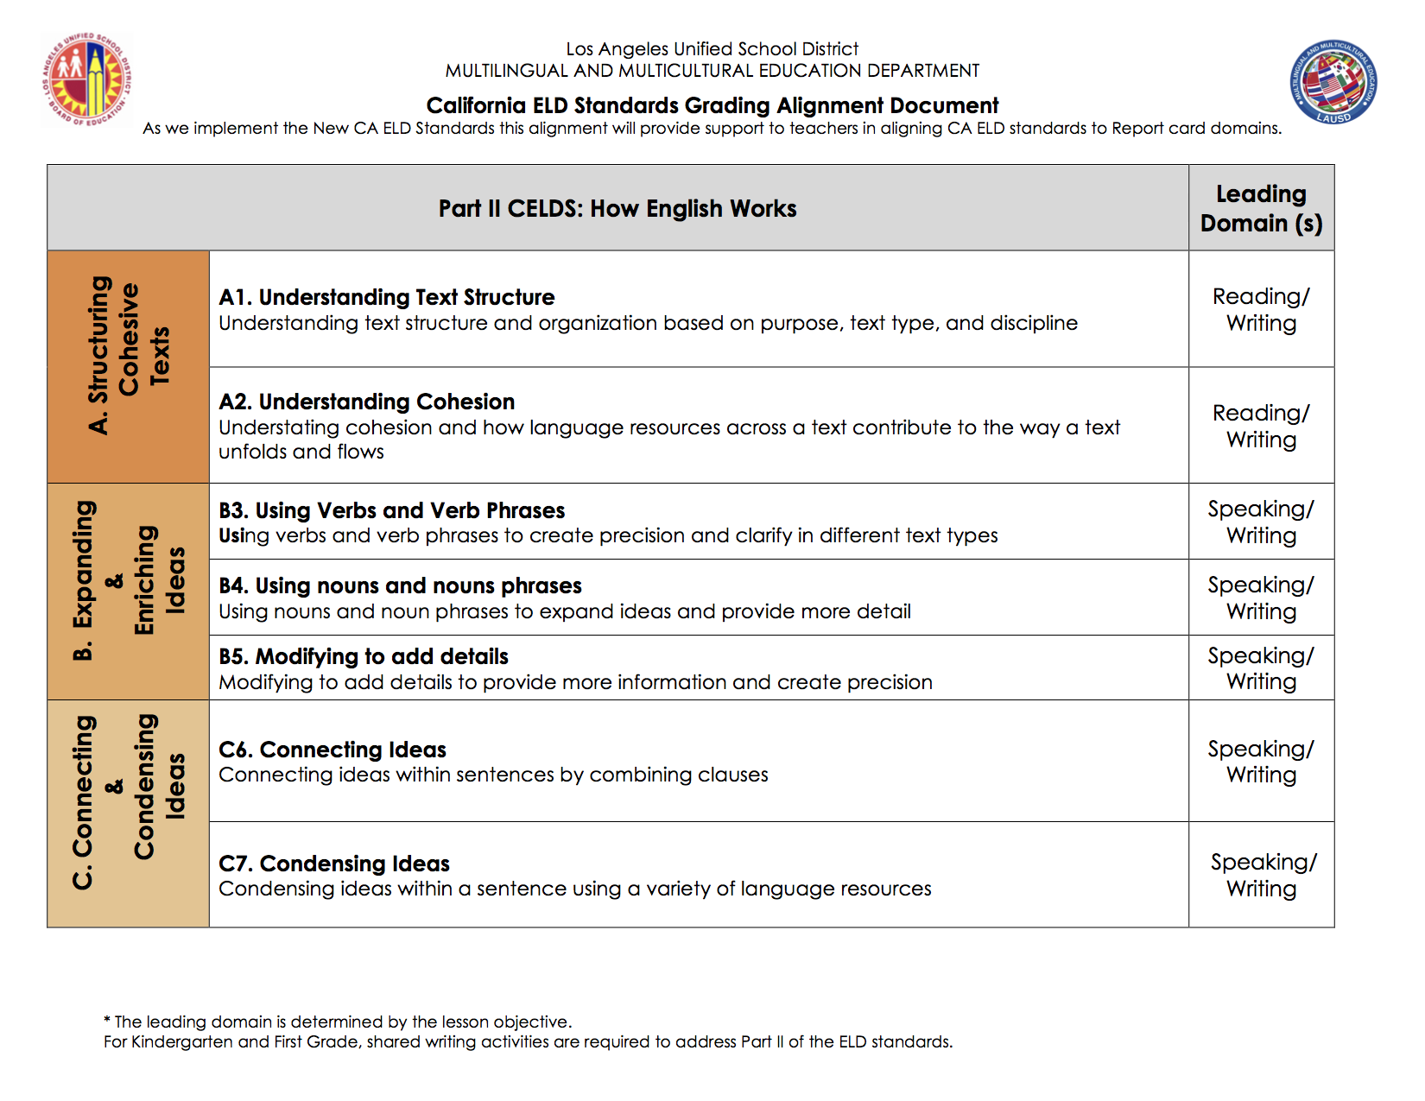
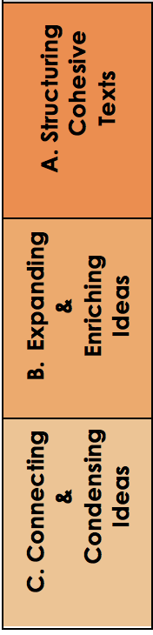
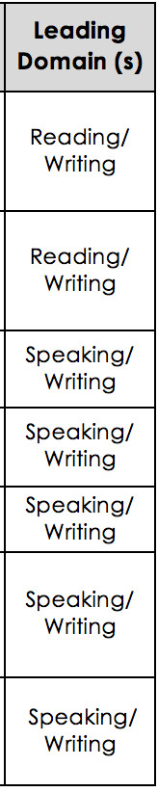
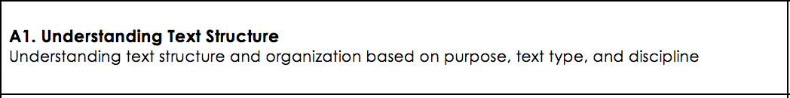
Alignment – CELDS Part II
Leading Domain(s)
Notes:
1. Here we see the alignment for the Part 2 CELDS – How English Works
2. Note that three Processes are listed
3. Structuring Cohesive Texts
4. Expanding & Enriching Ideas
5. And Connecting & Condensing Ideas along with each of the 7 strands for Part 2
6. Let’s take a look at an example of from Part 2 A. Structuring Cohesive Texts – Strand 1—Understanding Text Structure which calls for students to understand text structure organization based on purpose, text type, and discipline. As previously mentioned the new CELDS interweave all four language domains of Listening, Speaking, Reading, and Writing. However, when we consider the language of demands of the standard across all grade levels for this particular strand, we determined that Reading and Writing are truly at its core and thus are listed as the Leading Domains.
7. We have listed Leading Domains for each of the 7 strands in Part II as well. Even so, it bears repeating that we must consider the language demands of each task when determining the leading domains.

Slide 8
Let’s Practice
Processing – 10-15 minutes
In a group of 3 to 4, choose a grade level to focus on.
Access the ELD standards for that grade level.
Read the language at expanding proficiency level for a standard.
Refer to the alignment and discuss the “leading domains” identified for the standard you read.
    Think about why those domains were highlighted and how might you explain this alignment to your colleagues.
Read another standard and follow the same protocol.
Notes:
Let’s take some time to process this new information.

Slide 9
Reviewed:
Closing
key shifts in the ELD Standards
new resources and materials available to support implementation of the ELD Standards
alignment of the new CA ELD Standards (CELDS) and the four language domains
Notes:
In closing, let’s take a moment to review what we covered in Module 1.
We reviewed… (read slide)
Thank you for your continued dedication to our students and their families.

