Slide 1

Module 2:
Elementary Progress Report ELD Marking Guidance
Elementary Progress Report ELD Marking Guidance
Notes:
Welcome to Module 2. This presentation will serve as a tool to assist elementary teachers of English Leaners during this time of transition in communicating student progress using the current progress report with the 2012 CA ELD Standards.

Slide 2
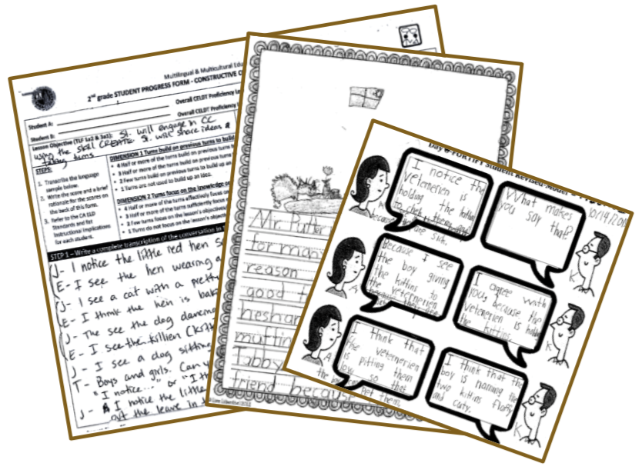

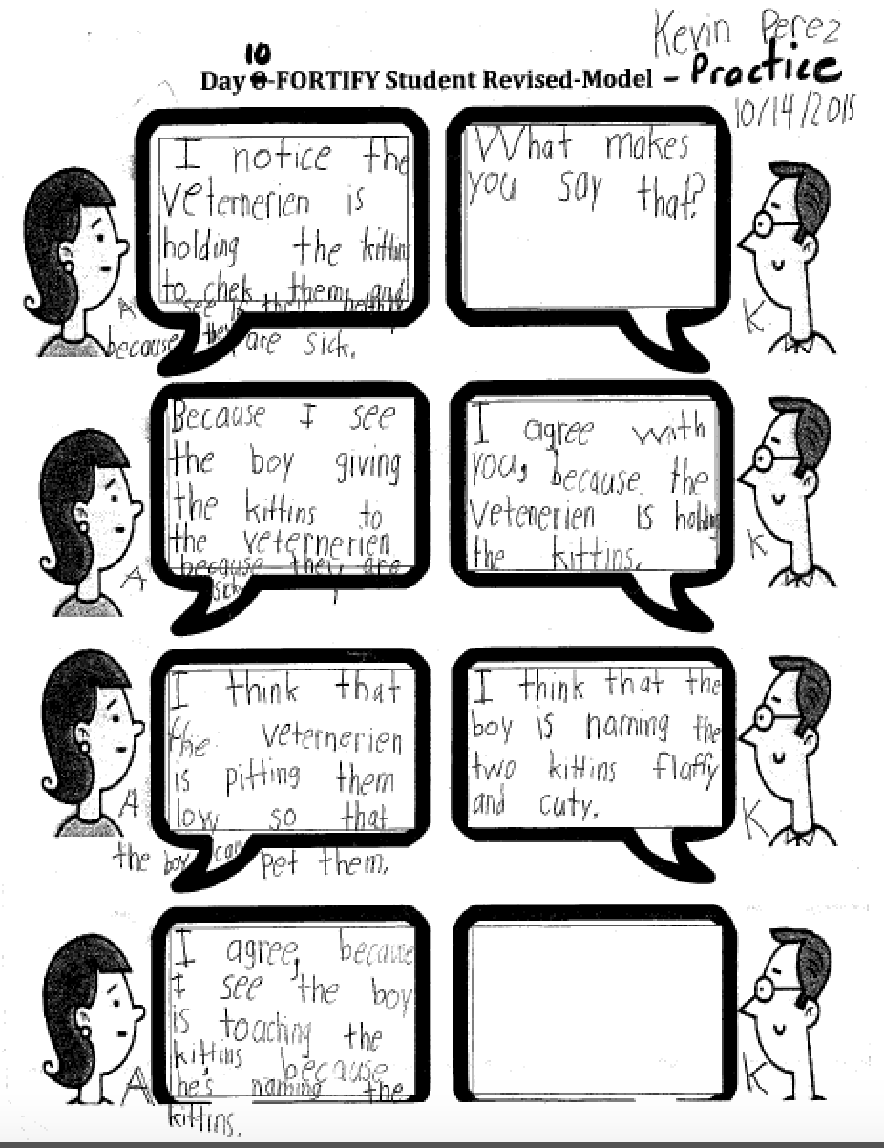
Student Work Samples
Grading Guidance
Identify student work and teacher observations (e.g. SPF, Content Area work, formal and informal assessments) –Designated & Integrated ELD.
Student Progress Form
Content Area Work-ELA
Informal Observations
Designated & Integrated ELD
Notes:
As with any content area, in order to assess student progress we start with collecting a variety of student work samples—which should include Student Progress Forms or SPFs, Content Area Work, as well as formal and Informal assessments collected during Designated and Integrated ELD.
Please note that student work should not be limited to the Designated ELD Start Smart Unit.

Slide 3
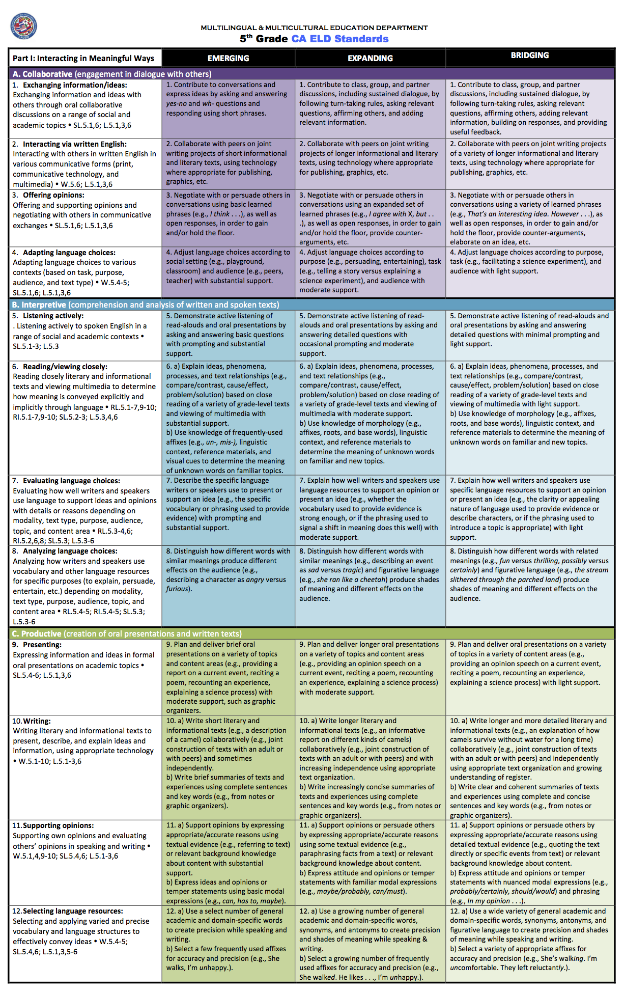
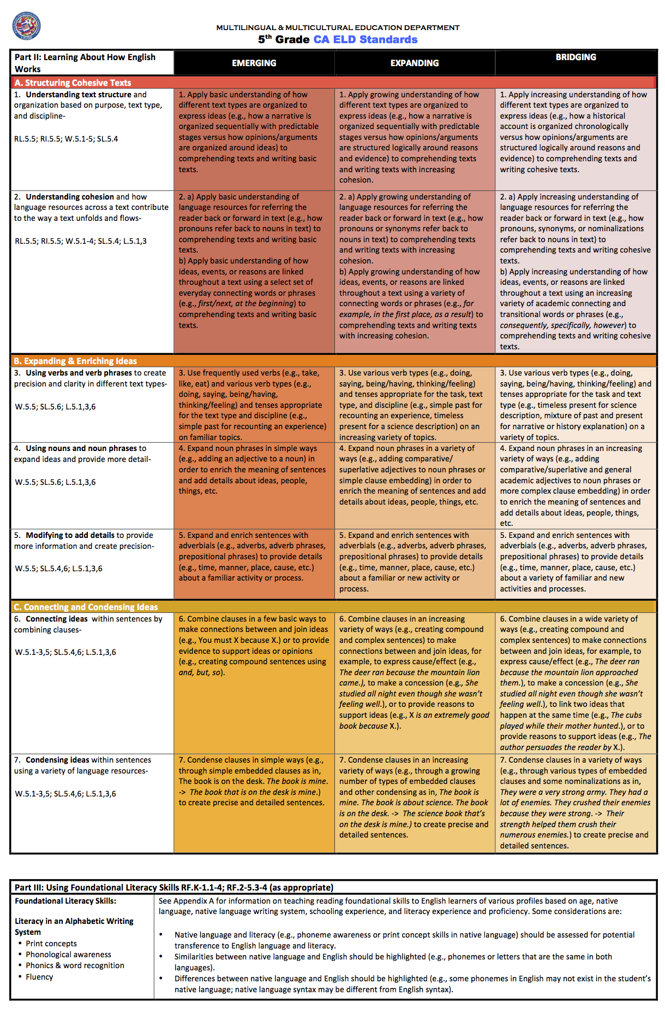
Use the Standards At A Glance (SAG)
Standards At A Glance
Notes:
Once you have collected your student work samples, refer to the Standards at a Glance. Review the standards for Part I and Part II and consider which ones were addressed.

Slide 4
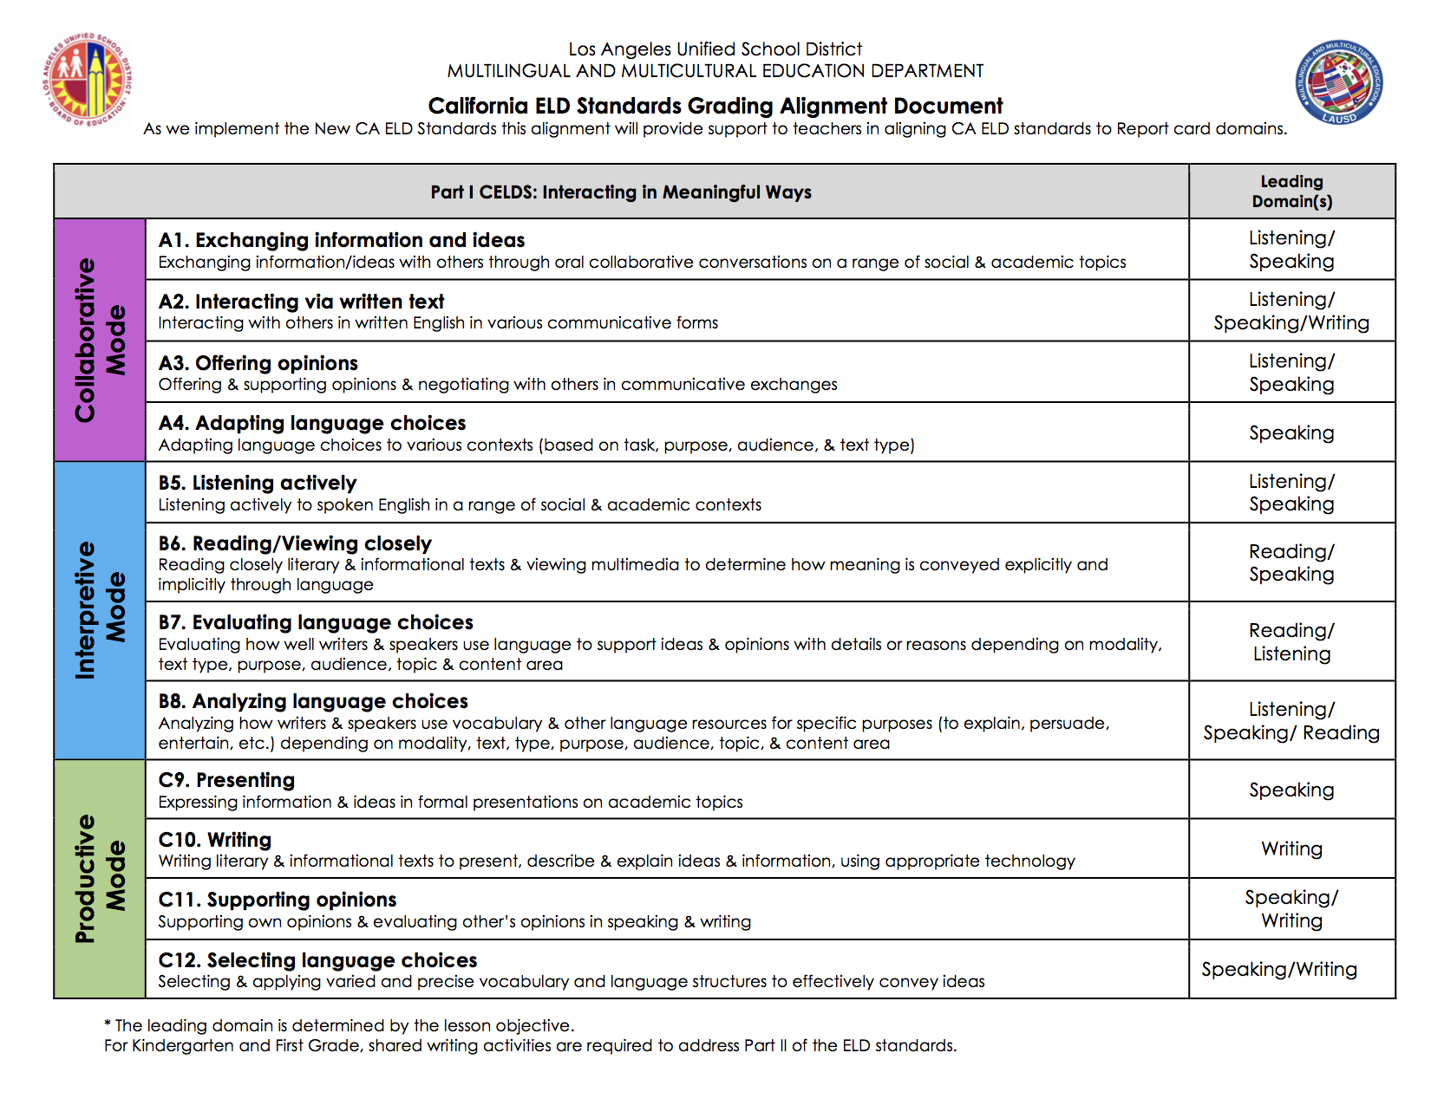
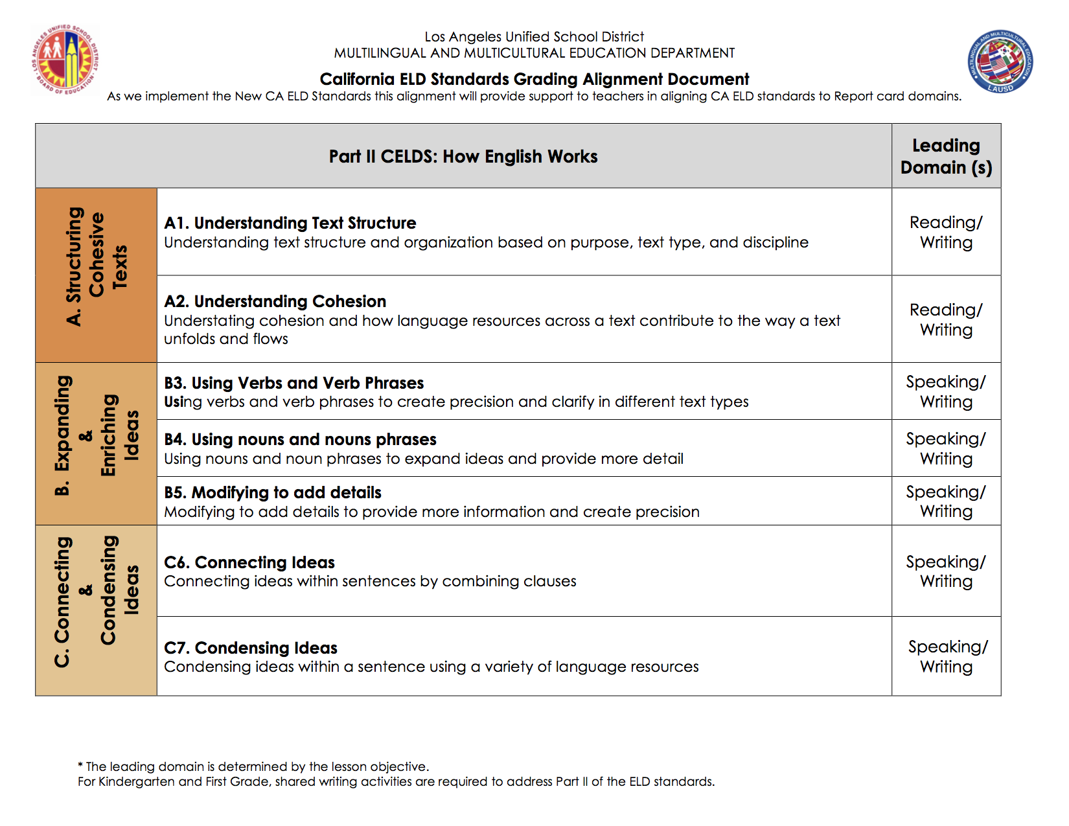
Grading Alignment
From
Module 1
Aligns CELDS to Language Domains
Notes:
You may find it helpful to refer to the CELDS Grading Alignment Document as you review the student work, ELD standards that were addressed, and determine the Overall Progress Report Card Marks.
This is the same document that was introduced to you in Module 1 that provides an alignment between the new CELDS and the Language Domains.

Slide 5
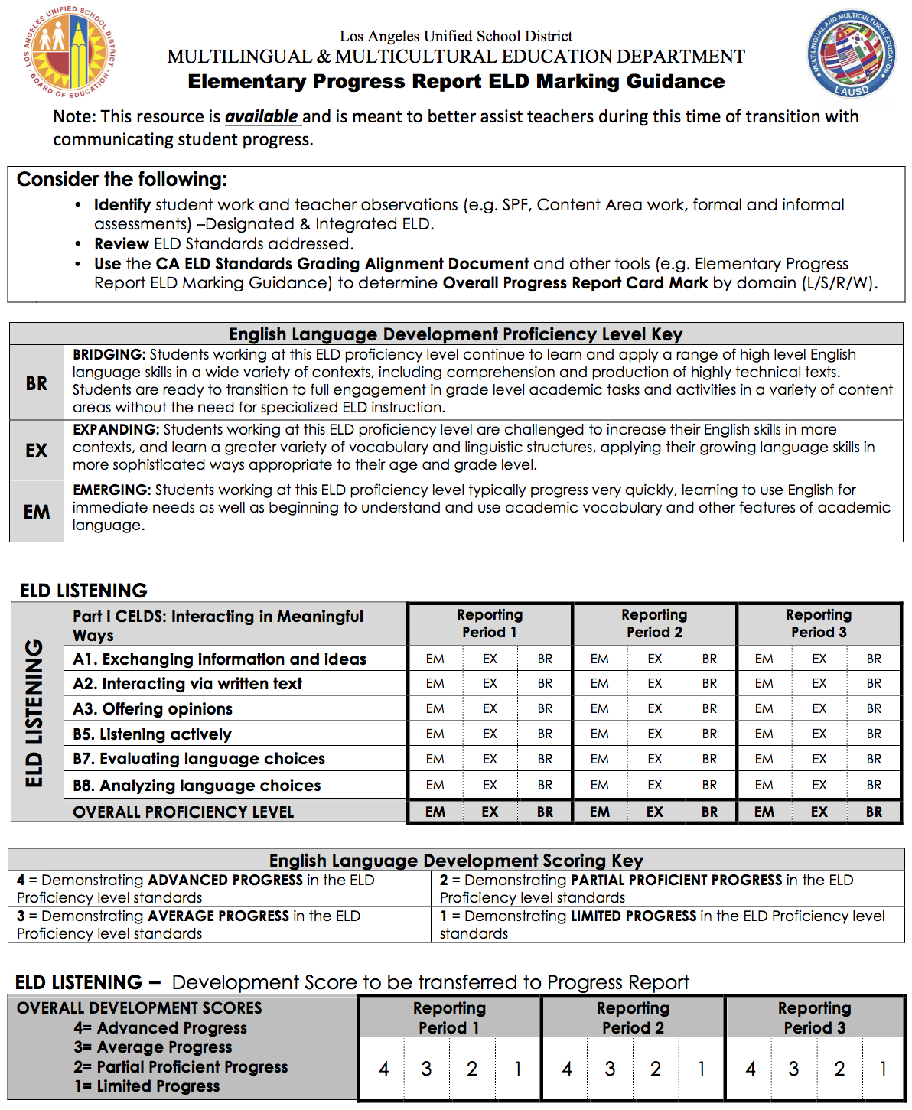
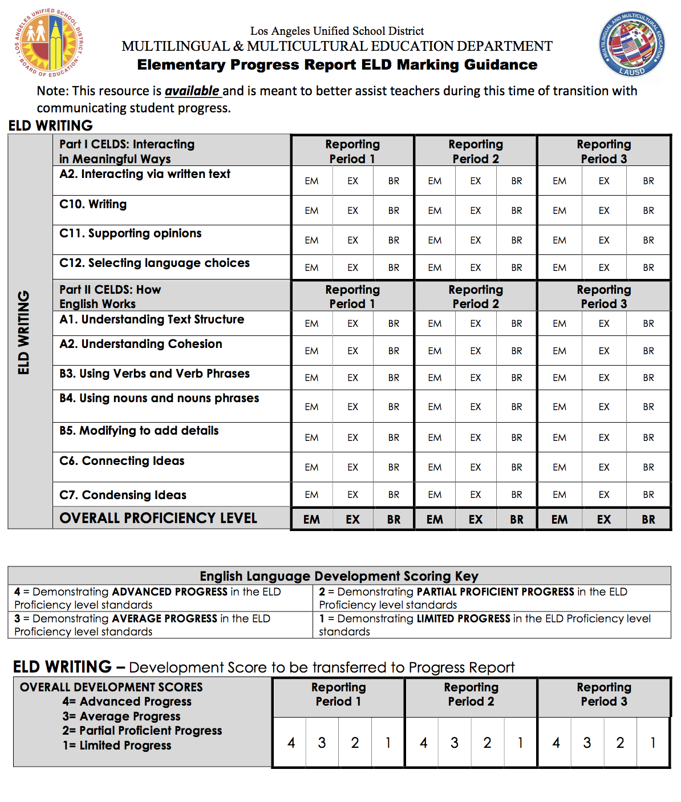
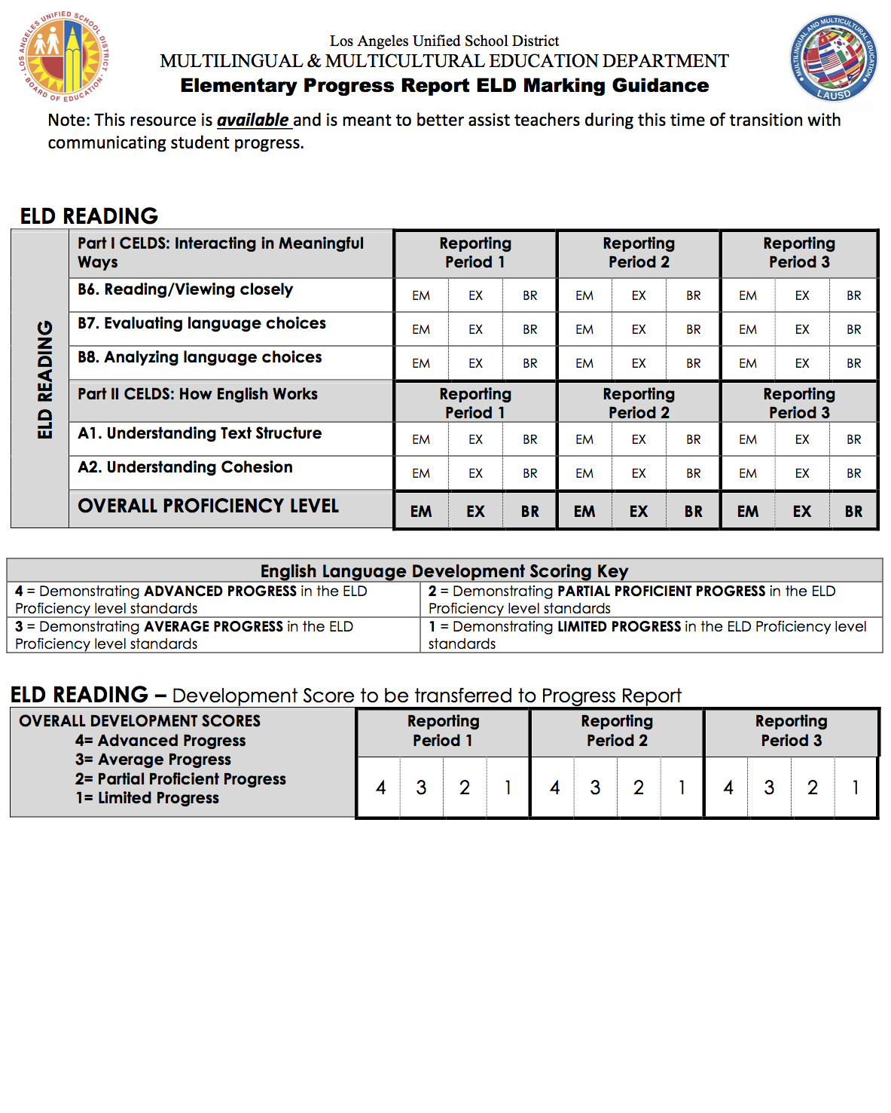
Marking Guidance
4 Page Document – 1 page per Language Domain
Notes:
In addition to the CELDS Grading Alignment Document, the Elementary Progress Report ELD Marking Guidance Tool is a resource that is available for Teachers of English Learners. This tool is meant to better assist teachers during this time of transition with communicating student progress.

Slide 6
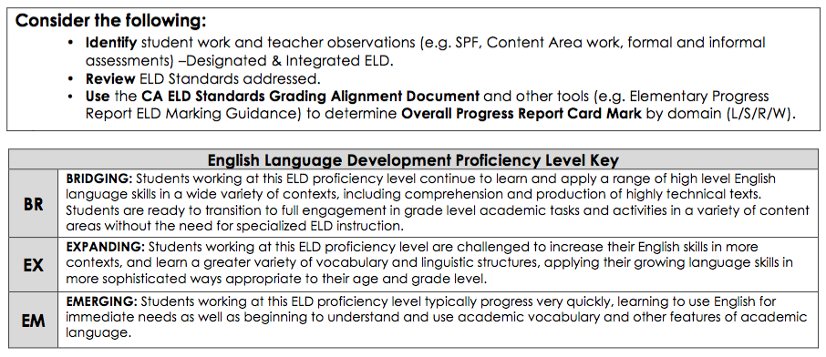
Let’s take a look at some of the features…
Marking Guidance
Notes:
At the top of the tool, you’ll notice a Key that describes the characteristics of the 3 proficiency levels—Emerging, Expanding, and Bridging

Slide 7
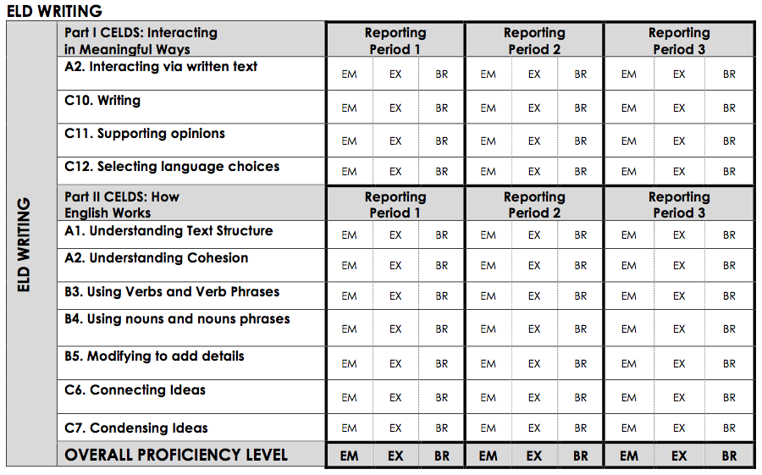
Each page has a Language Domain
Marking Guidance
Notes:
Next, you’ll notice that each of the 4 language domains are represented along with the CELDS; these are the same standards listed on the CELDS Grading Alignment Document you were introduced to in Module 1. For each of the domains, there is a section for Reporting Period 1, Reporting Period 2, and Reporting Period 3. This feature makes is possible for the teacher to document the student’s progress throughout the year.
Underneath that, there is a section for teachers to document the Overall Proficiency Level for each Reporting Period within that language domain.

Slide 8
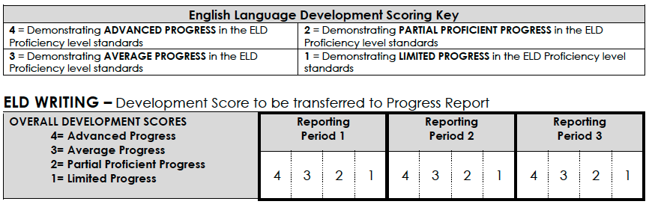
Each page has a Language Domain
Marking Guidance
Notes:
Finally, you’ll notice that an English Language Development Scoring Key is included. Students will still be receiving a score of 4, 3, 2, or 1 based on their progress within their Overall Proficiency Level.
Those scores may then be transferred to the Progress Report.

Slide 9
We reviewed:
Closing
how to communicate student progress using the current progress report with the 2012 CA ELD Standards
how to use the various tools to determine Overall Progress Report Marks
Notes:
In closing, in this module we reviewed… (read slide)
Thank you for participating in the Elementary Progress Report Marking Guidance Modules.

