Slide 1
Chalk Talk
This is a silent activity.
Please grab a couple of sticky notes and something to write with.
Go to one of the profile scenario posters and read the scenario.
Think of possible supports that can be given to the student or the teacher of the student.
Write each idea on a separate post-it and leave the sticky note on the poster.
Notes:
4 minutes
Explain the activity using the bullet points on the slide.
Give them 2 minutes at the poster.
After the two minutes, have the participants return to their seats.
Let them know we will return to the posters at the end of the pd. (You do not need to discuss the responses at this time.)

Slide 2
Monitoring of Key Practices to Impact English Learner Reclassification
LD West
Network Meeting
February 15, 2017
Notes:
Set up parking lot before presentation.
1 minute
Introduce self.
Explain that there is a parking lot in case there are any questions that need to be researched or are not on the topic at hand. They can put a post-it on the chart with their name and school and we can get back to them about their question.

Slide 3
Engaged Participant Outcomes
Review the updated monthly Reclassification Rate Monitoring Report
Review Annual CELDT progress
Brainstorm best practices to strategically provide instructional support for ELs based on their reclassification data profiles (EL Profiles)
Notes:
1 minute
Read the outcomes.

Slide 4
System Support
As we lead reclassification efforts, what systems, structures and evidence will result in improved student learning and teacher effectiveness for English Learners?
Notes:
1 minute
Say: As discussed in previous meetings, our essential question continues to guide our work in schools and in providing leadership to teachers on reclassification efforts.

Slide 5

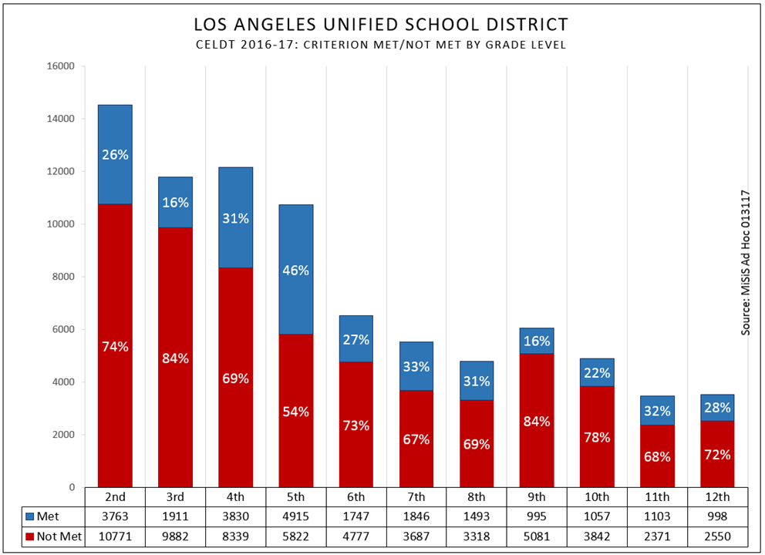
16-17 CELDT results grades 2-12
Notes:
4 minutes
Say: These are the 16-17 CELDT results for grades 2-12 shown by met/not met. The blue bar shows the students who met the CELDT requirements for reclassification with an overall score of early advance or advance with no domain below a 3. The red bar shows the students who did not score as English proficient as measured by CELDT. Some students who did not meet CELDT will have one more opportunity to improve their scores in March.
TABLE TALK: With the people in your table, knowing that the CELDT consists of four components (Listening, Speaking, Reading, and Writing), discuss how might teachers prepare these students for the second opportunity? (After table discuss, ask for 2 or 3 people to share out.)

Slide 6
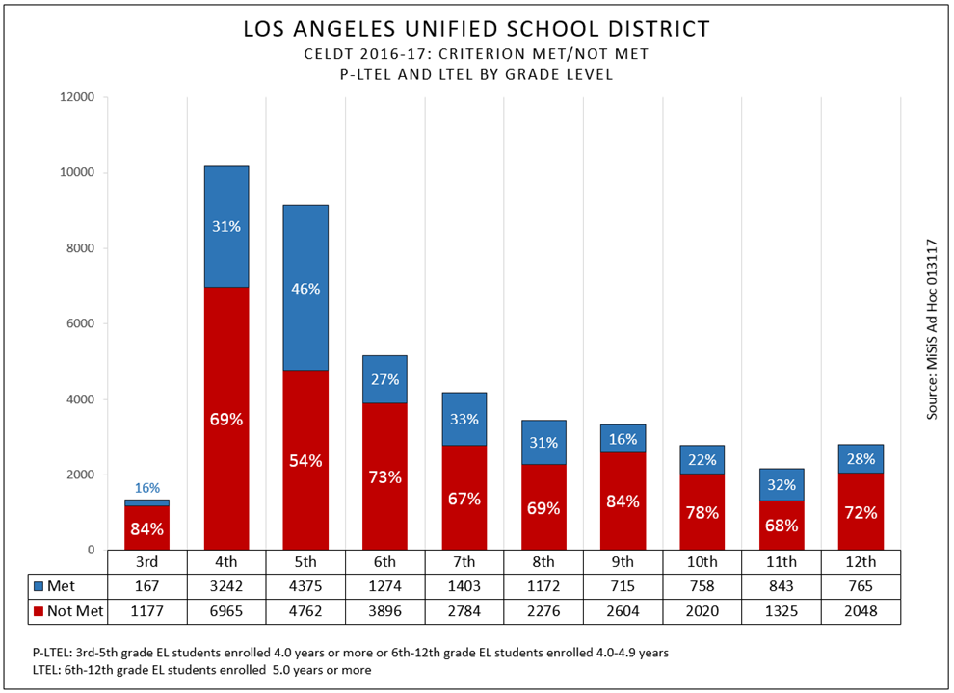
16-17 CELDT results P-LTEL & LTEL students
Notes:
2 minutes
This graph shows the CELDT results of PLTEL and LTEL students only. This subgroup of students must be closely monitored. It is highly recommended that they receive before, during and afterschool interventions to ensure their success.
The second CELDT opportunity will be provided to these students in grades 4th through 12^{tth} who have not already met the CELDT criteria for reclassification. That means it will be offered to all the students in the red in this graph except for the third graders. Consider what supports you can offer these students before, during and after school to help them capitalize on the second chance CELDT opportunity.

Slide 7
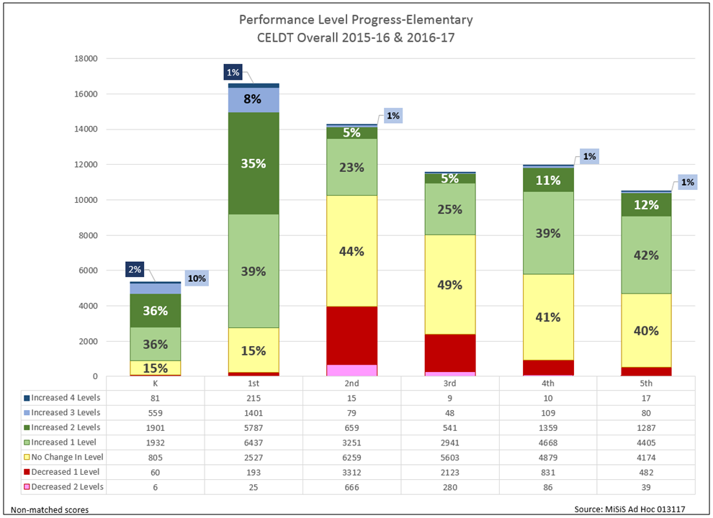
CELDT results comparison K-5
Notes:
2 minutes
This graph is a comparison of CELDT results from 15-16 to 16-17. green to blue are gains in CELDT level, yellow depicts “no change” in CELDT level and pink and red ”depict” a drop or regression in CELDT level.
Consider what next steps will you take with students who show no change or regress? What next steps will you take for students who made several levels of gain in proficiency? Think about and identify the practices in classrooms that led to gains/losses?

Slide 8
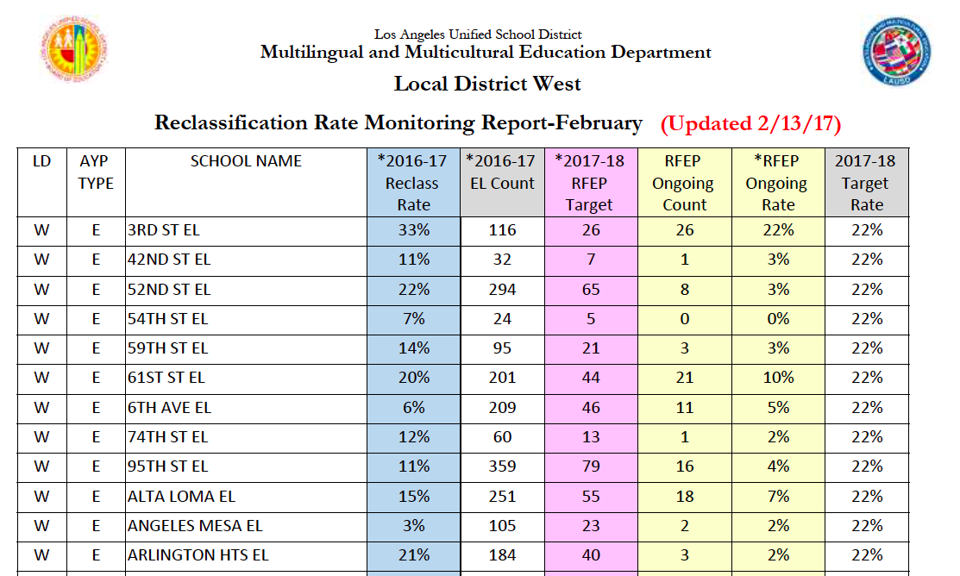
Objective #1
Use of Reclassification Data
Notes:
2 minutes
The Reclassification Rate Monitoring Report for February captures our progress in reclassifying students as of February 13, 2017.
Please note the two yellow columns. (Click on animation) As of February 13th, the RFEP Ongoing Count column captures how many students have been reclassified thus far this year at your school. (Click on animation) In the purple column is your RFEP Target, the number of students you want to reclassify in order to meet the 22% reclassification target. (Click on animation) The RFEP Ongoing Rate is your current reclassification rate based on the number of students reclassified thus far. (Click on animation) Our goal being for each school to get to 22%.
Now that the data is in MiSiS, data analysis should occur to see what support students need in language development based on the CELDT results.

Slide 9
Next opportunity to reclassify
Planning for upcoming reclassification opportunity:
Elementary | Secondary
LAUSD-CELDT March 6-March 17, 2017 Single Track schools | LAUSD-CELDT March 6, 2017-March 17, 2017 Single Track schools
Reporting Period 2 Marks: Submit: February 9-March 3, 2017 Used as criteria until June. 2017 | Reading Inventory: Submit: April 24th – May 26th, 2017 Used as criteria until June 2017
Students eligible to take “Second Chance CELDT”:
2nd - 6th grade students who are in Profiles E and F (students who met MOY/RI)
4th - 6th grade P-LTELs and LTELS who are in Profile G and H
Notes:
2 minutes
We always want to be attentive to the upcoming opportunities for students to meet reclassification criteria.
(Click for animation)
Say: Right now, the grading window for reporting Period 2 marks is open. Students who have met the CELDT requirements, and have met DIBELS requirement will reclassify if they earn ELA Period 2 marks.
(click for animation)
Say: For students who did not meet the CELDT requirement, a second opportunity – the LAUSD CELDT will be offered from March 6- March 17.
(click for animation)
Say: The students who will be eligible to take “Second Chance CELDT” include 2nd-6th grade students who are in Profile E and F (students who met MOY/RI) and 4th-6th grade P-LTELs and LTELs who are in Profile G and H

Slide 10
Elementary Roadmap to Reclassification
Remember the expanded number of students getting the opportunity to take Second Chance CELDT!
Notes:
2 minutes
During the month of February principals and teachers should review the results of the first semester assessments and begin to plan and implement appropriate differentiation and interventions. In grade level meetings, teachers, out-of-class support personnel and school leaders should identify successful practices and begin to look for patterns and trends for SSPT
(click on animation)
Say: As stated in the last slide, the grading window for second reporting period grades closes on March 3rd. This is a perfect opportunity to have conversations with teachers whose students are only missing grades to reclassify.
(click on animation)
Say: For many students who did not meet the CELDT criteria, the Second chance CELDT will be offered in March.
(click on animation)
Say: More students are being afforded the opportunity to take second chance CELDT.
(click on animation)
Say: Then, for students who did not meet MOY, they will have an opportunity to reclassify with EOY that will be offered starting in May. While we don’t recommend testing students at the beginning of the testing window, it is also important not to wait until the last days to give the students EOY.

Slide 11
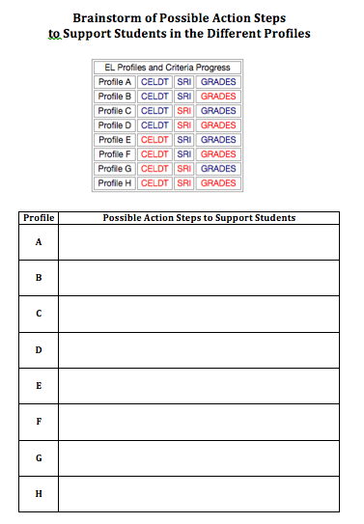
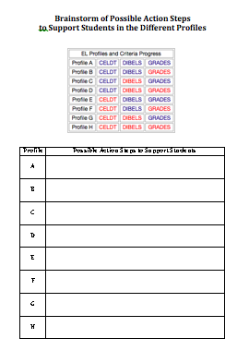
EL Support Brainstorm
Get into triads or quads. You will be assigned a profile to focus on.
In your group, brainstorm possible action steps you can take to support the students and teachers of the students in that profile. Share the best practices you have used at your site.
On the graphic organizer jot down notes from your conversation. Be prepared to share out.
Use your graphic organizer to capture ideas from other teams as they share.
Notes:
2 minutes
Read slide. Tell them you will model before releasing them to work in their triads and quads.
Ask them to take out the graphic organizer from their packet.

Slide 12

Reclassify immediately. Create certificates for students. Hold reclassification assembly and invite parents. Create reclassification bulletin board. Congratulate your teachers and EL Designee for all the hard work
Notes:
27 minutes
1 minute
Model with Profile A - These are some possible actions that can be taken for students in Profile A
Read slide
2 minutes
Hand out a profile card to each team (B through H). Go back to the other slide so they can see the steps they will follow.
3 minutes
Give them 3 minutes to brainstorm.
21 minutes (3 minutes times 7 profiles)
Call each team up one team at a time to share their brainstorms. Remind the participants to take notes on their graphic organizers of the best practices and ideas that the other teams are sharing.

Slide 13
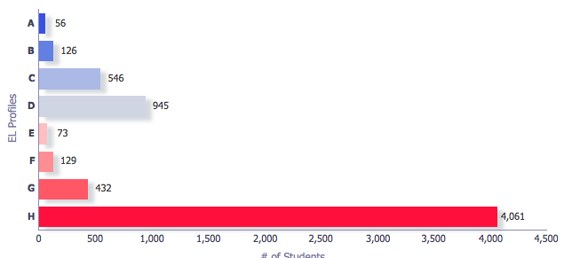
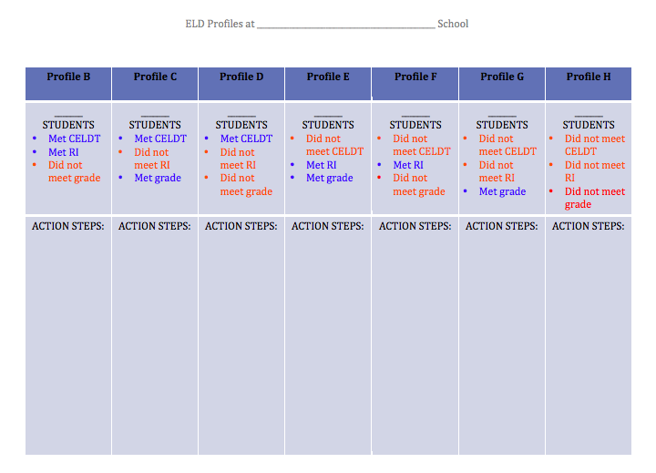
First Semester Reclassification Progress- Next Steps
Go into EL dashboard through mmed.lausd.net and log into
the EL Dashboard to pull your number of students by profile to write on the Action Step form.
Notes:
3 minutes
Ask principals to go into EL dashboard to pull their data to write on their action step page on the back of the brainstorm page.

Slide 14
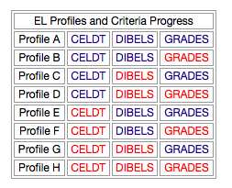
First Semester Reclassification Progress- Next Steps
Reclassify immediately!
Hold SSPT meeting. Discuss grades and support with teachers.
Literacy support!
Literacy and Grades support!
After close data analysis, provide targeted language, literacy and academic support!
Students in Profile H must be disaggregated into subgroups as follows:
less than 5 years in program
P-LTELs,
LTELs
Newcomers
Language support!
Language and Grades support!
Language and literacy support!
Notes:
2 minutes
Now that CELDT results are in MiSiS, we want to go the EL Dashboard to inform targeted instruction and support. For every profile, we must consider taking action. (Click on animations and read action steps to be considered. )
Note to presenter: The last animation for Profile H is meant to have principals consider that Profile H students have wide variety of particular needs based on years in program and must be analyzed carefully. Some of our students are on the cusp of leaving Profile H others are recently arrived and data analysis will help determine supports needed.

Slide 15
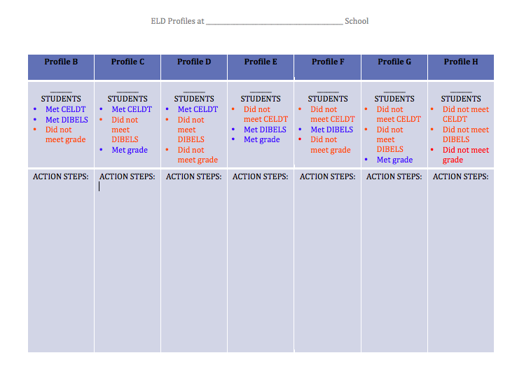

Action Steps to Implement
Based on the best practices and suggestions previously shared by your colleagues, write down at least 3 action steps you will take when you return to the school site:
Notes:
6 minutes
Read slide. Provide 4 minutes for principals to write down their ideas
(click for animation)
Say: Now turn to your partner, and discuss what action steps you will take to help the students in the profiles be successful. (2 minutes)
Pause for conversation

Slide 16
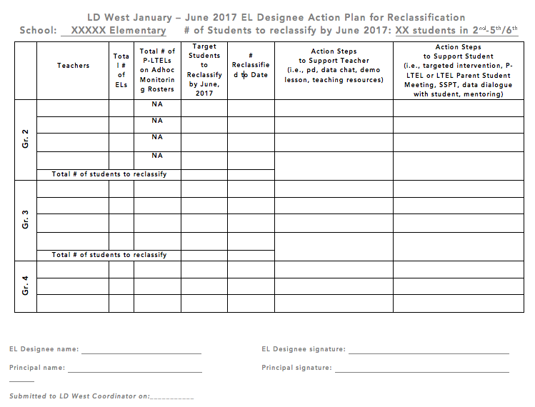
Elementary EL Designees…
Have generated ideas on how to support students of the different profiles and their teachers
Are working on an EL Designee Reclassification Action Plan to strategically support target students
When you get back to your campus, please have a conversation with your EL Designee about strategic actions, supports and interventions that can be put in place to support your students and their teachers.
Notes:
2 minutes
Read slide
(click for animation)

Slide 17
Engaged Participant Outcomes
Review the updated monthly Reclassification Rate Monitoring Report
Review Annual CELDT progress
Brainstorm best practices to strategically provide instructional support for ELs based on their reclassification data profiles (EL Profiles)
Notes:
1 minute
Read the outcomes to determine if we met them.

Slide 18
Chalk Talk Revisited
Consider the profile scenario poster you visited before.
Now that we have shared best practices and brainstormed ways to support students in the different profiles, tell an elbow partner about the student scenario you viewed before and what additional strategy you can now offer to support that student.
Notes:
4 minutes
Say: Now that we have had time to share best practices to support students in different EL profiles, let’s revisit the Profile Scenario posters that you viewed at the beginning of this presentation. With a partner, discuss the profile scenario poster that you visited earlier and what additional support you would add now to help that student’s success and progress toward reclassification.

