Slide 1
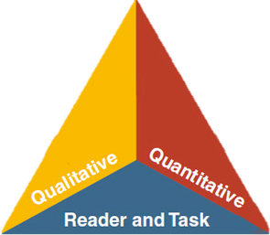

LANGUAGE
LITERACY
LEARNING
Session 4:
CA ELD Standards-Appendix B
MULTILINGUAL & MULTICULTURAL EDUCATION DEPARTMENT
Notes:
Add your name as the presenter.
Slide 1: (1 minute) Introduction. Add you name to the slide
Purpose/Why: Remind participants that this is the last of 4 sessions in transitioning to the New CA ELD Standards
How: You will guide participants through the information while modeling instructional strategies that could be transferred to classroom practice.

Slide 2

How have you supported your ELs?
Grounding – Rally Robin
Rally Robin Directions:
Participants partner up
Partner 1 – Scenario 1 Superintendent Cheryl Hildreth is at your school site and asks, “How have you supported your ELs?” Respond to the Superintendent.
Partner 2 – Scenario 2 A parent of an English learner asks you, “How have you supported your ELs?“ Respond to the parent.
Partner Discussion:
  How did the language of the conversation change?
  What was different?
Notes:
Slides 2 (4 minutes).
Purpose/Why: Engage participants in a GROUNDING ACTIVITY (Rally Robin) in order to start making connections to the learning of the session
How: Let the participants know that they will partner up: Partner 1 and 2 answer question based on the registered provided in the directions. Partner 1 answers question in a conversation to to Dr. Deasy and partner 2 to a parent. Discuss how the two conversations differ

Slide 3
ELD Transition Sessions
Session 1: ELD Standards Introduction
          * Shifts, Layout, & Development
Session 2: Proficiency Levels
Session 3: Theory that Informs Layout (Appendix C)
Session 4: How English Works (Appendix B)
Notes:
Slide 3: (1 minute)
Why/purpose: make the participants aware that this is the third of the four sessions.
How: Give participants a few seconds to read over the slide to see flow of the four sessions

Slide 4
Objective
To gain a deeper understanding of Appendix B: The California English Language Development Standards
Part II: Learning About How English
Works
Notes:
Slides 3 (1 minute).
Purpose: In today’s session you will continue to deepen your understanding about the research, layout and connection of the ELD standards to the Common Core State Standards.
Please know that as we go through today’s learning I will be using a hand signal to bring us back as a group.

Slide 5
Adapted from George Washington University
Guiding Principles
English Learners (ELs) are held to the same high expectations of learning established for all students.
ELs develop full receptive and productive proficiencies in English in the domains of listening, speaking, reading & writing.
ELs are taught challenging academic content that enables them to meet performance standards in all content areas.
ELs receive instruction that builds on their previous education and cognitive abilities and that reflects their language proficiency levels.
ELs are evaluated with appropriate and valid assessments that are aligned to state and local standards and that take into account the language development stages & cultural backgrounds of the students.
The academic success of ELs is a responsibility shared by all educators, the family and the community.
English Learner Master Plan, 2012,
Pages 2-3
Notes:
Slide 12 (1 minute).
Purpose/ Why: The guiding principles slide must be in every presentation.
How: Show the 6 Guiding Principles. For this particular presentation we will be focusing more on guiding principle 3 and 4.

Slide 6

District Instructional Priorities
Master Plan
(The Who)
TGDC
Teaching &
Learning
Framework
(The How)
Common Core
(The What)
Notes:
*
Slide 14: (1 min)
Why/Purpose: Review the priorities
How: Tell the participants:
The Teaching and Learning Framework will also be used alongside both the Master Plan and the Common Core State Standards. All three initiatives are actually woven together. Clearly, the Common Core State Standards signify “What” we teach, while the Master Plan signifies the “Who” we teach, and The Teaching and Learning Framework speaks to “How” we teach in LAUSD. When all three are woven together the outcome is that all LAUSD students will graduate College Prepared and Career Ready.

Slide 7
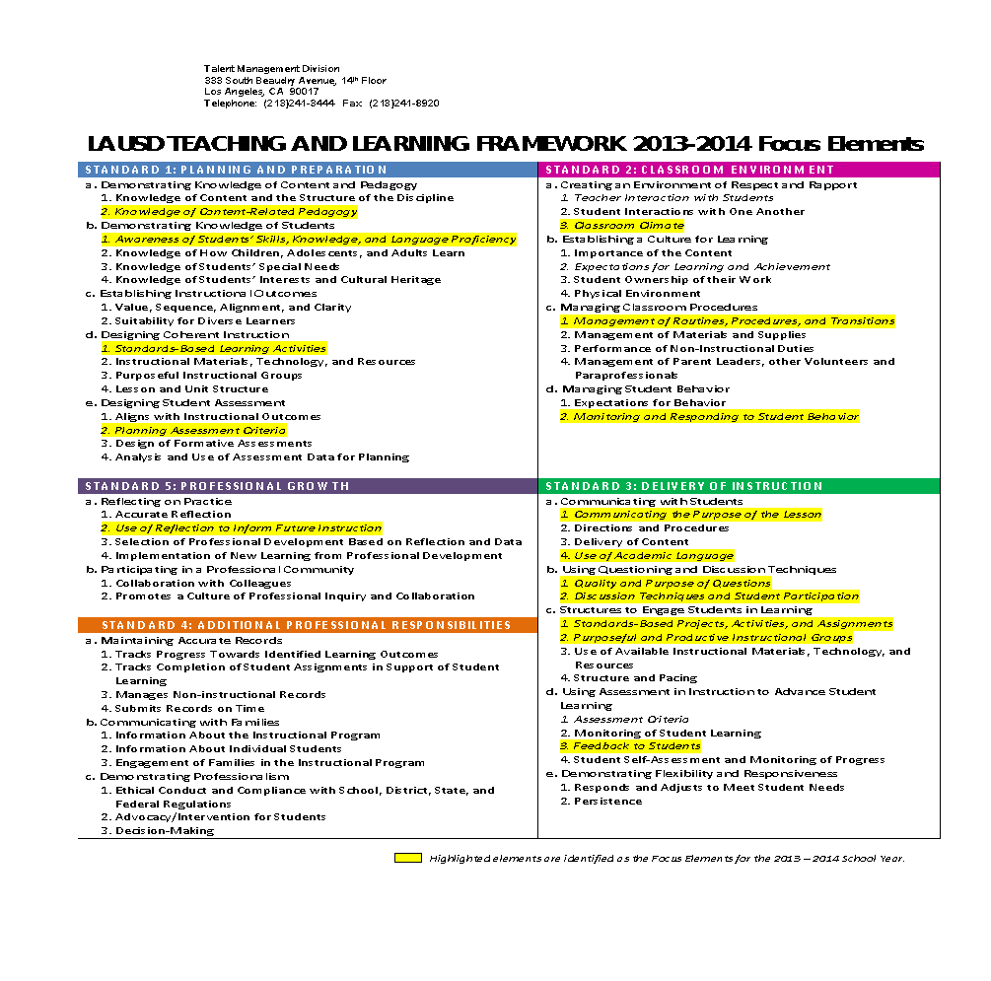



LAUSD TEACHING AND LEARNING FRAMEWORK 2014-2015 FOCUS ELEMENTS
Notes:
Slide 4: (1 min)
Why/Purpose: To connect our work as educators and our professional goals.
How: Read the 3 focus elements, tell the participants that the arrows point to the highlighted focus elements that apply to the work we will engage in today.
*

Slide 8
Phase-In Plan for CA ELD Standards
2014-2015
2015-2016
Transition
Implementation
Notes:
Slide 6: (2 minutes)
Purpose/ Why: Review the phase in plan and highlight how it is aligned to the state’s plan. As participants go through the year and sessions, they will have a better understanding of the New CA ELD Standards. Purpose: To know what the standards are Engagement with the new CELDS by exploration of the new CELDS by engagement through practical applications
How: Tell participants that this year we are the transition year. As we move to the Transition year, the state and district will be building resources, implementing needs assessments, and continue to provide learning opportunities for stakeholders. Next year, we will be in the Implementation year where there will be expansion of professional learning and alignment of curriculum instruction and assessment along with integration throughout the district.
Let’s take a few minutes to take a look at the phase in plan
Our phase in plan is aligned to the state’s plan and as the state releases additional information we will continue to upate this plan…our office will be convening a working group to identify additional needs and tools that we may develop
As you can see in the awareness stage there is mention of brokers of expertise.. unveiled their brokers of expertise website which has additional resources for us to use, you can see from this plan that CELDT is also being revamped and we are expecting a new assessment in 2017.
Take a look at this plan and see the various components of each stage….
Timeline reflects the STATES ELD standards implementation actions
Awareness – is introduction of ELD standards planning systems of implementation and establishing collaborations in this stage we have identified the need to put together a WORKING group
Transition – building resources, implementing needs assessments, and continued learning
Implementation – expansion of professional learning and alignment of curriculum instruction and assessment along with integration throughout the district

Slide 9

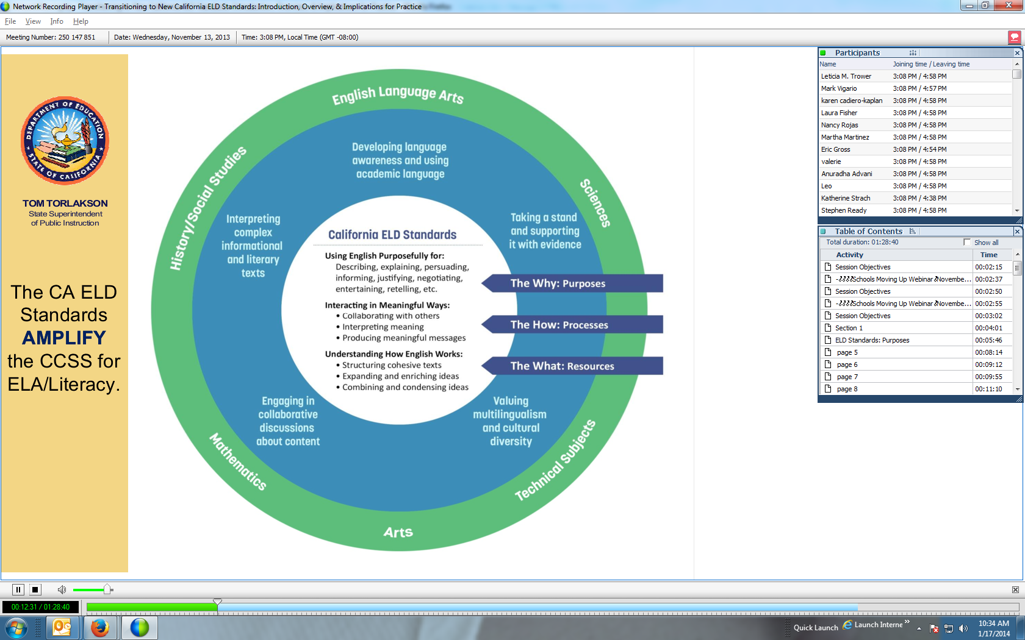
What must students be able to do with language?
ELA | MATH | SCIENCE
Comprehend and evaluate complex texts across a range of types and disciplines Construct effective arguments and convey intricate or multifaceted information Discern a speaker’s key points Request clarification and ask relevant questions Build on others’ ideas Articulate their own ideas, and confirm they have been understood | Understand and use stated assumptions, definitions, and previously established results in constructing arguments Make conjectures and build a logical progression of statements to explore the truth of their conjectures Justify their conclusions, communicate them to others, and respond to the arguments of others | Construct explanations and designated solutions Engaging in argument from evidence Obtain, evaluate, and communicate information
Notes:
Slide 15 (1 minute)
Purpose/Why: To visually show how the ELD Standards align and correlate to the new CCSS and review the language demands across content areas
How: Review the language demands of each column. Remind participants that the CA ELD Standards highlight and amplify the Common Core State Standards so that students develop both English and content knowledge. Remind participants that the CA ELD Standards guide teachers to build ELs’ knowledge about how the English language works in different contexts to achieve specific communicative purposes.

Slide 10

CA ELD Standards Overview
Overview & Proficiency Level Descriptors (PLDs):
Alignment to CCSS for ELA & Literacy
CA’s EL Student
Proficiency Level Descriptors (PLDs)
Structure of the grade level standards
Grade Level Standards
Section 1: Goal, Critical Principles, At-a-glance Overview
Section 2: Elaboration on Critical Principles
  Part I: Interacting in Meaningful Ways
  Part II: Learning About How English Works
  Part III: Using Foundation Skills
Appendices:
Appendix A: Foundational Literacy Skills
Appendix B: Learning About How English Works
Appendix C: Theory and Research
Appendix D: Context, Development, Validation
Glossary of Key Terms
Notes:
Slide 9: 1 min.
Why/Purpose: To orient them to the organization of the CELDS
How: Tell participants:
These are all of the sections of the documents found in the CDE. Begins with Overview, then it goes into grade level standards, appendices, and glossary.
Today our work will revolve around Appendix B which gives the theoretical and research about learning How English Works

Slide 11

Appendix B: The California English Language Development Standards
Part II: Learning About How English Works
Notes:
Slides 9-19 ( minutes)
Why/Purpose: Understand Appendix B: how English Works
How:
Explain that the participants will have an opportunity to learn about the New CA ELD standards and how English Works by reading Appendix B
Additional Information: For this session, we will do a close reading of Appendix B. Here are the sections and how they are chunked:
Slide 9: introduction
Slide 10: video with guiding question
Slide 11: Close reading of page 1 ¶ and 2
Slide 12: Looking at the shifts based
Slide 13 – 19:
Structuring cohesive texts
Understanding text structures Page 6 - 7, Paragraphs 3 – 4
Understanding cohesion Page 9, 2nd - 3rd paragraphs
Expanding and Enriching ideas
Using verbs and verb phrases
Using nouns and noun phrases
Connecting and condensing ideas

Slide 12
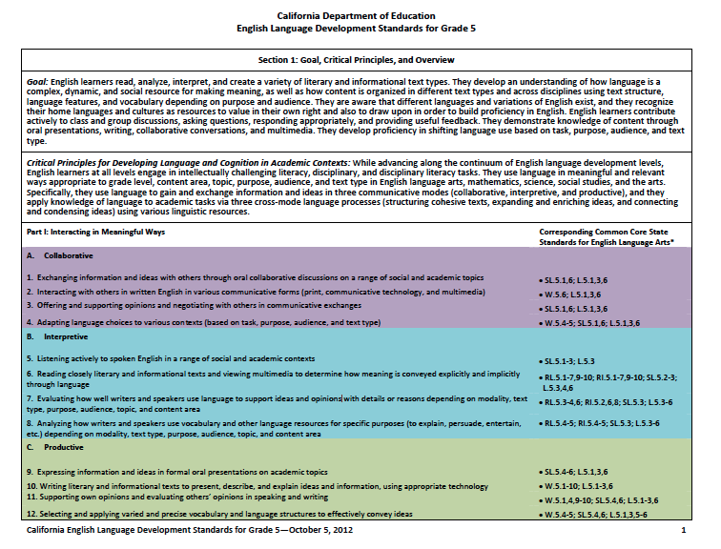
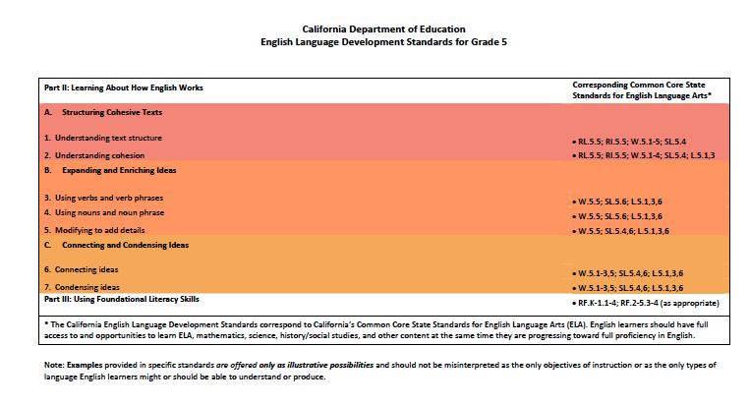
Notes:
Purpose:
Participants will understand that for every Grade level, the ELD Standards have the same ‘Section 1’ with the exception of the corresponding common core state standards. There are three parts to section 1. Part one is divided into modes and Part two is divided into 3 process.
Say: “For every Grade level, the ELD Standards have the same ‘Section 1”
The same goal is listed at each grade level
The same Critical Principles for Developing Language and Cognition in Academic Contexts is at each grade level
(Facilitator and participants highlight the bold)
Part I is the same at each grade level. Part 1 of the CA ELD Standards is interacting in meaningful ways. It lists 3 Modes 1. The modes is the ways of using language and there are three listed under the mode.
Collaborative
Interpretive
Productive
Say: There are 4 strands under each mode. Since there are 3 modes and 4 strands under each mode, there are total of 12 strands under Part 1 of Section 1.
(Facilitator will have the participants point to the strands) Say: Take a minute to look a the language and highlight some of the language you see there.
Say: Part II is the same at each grade level. Part 2 of section 1 is learning about how English works. . It lists 3 Processes
A. Structuring Cohesive Texts
B. Expanding and Enriching Ideas
C. Connecting and Condensing Ideas
The Strands appear beneath.
(Facilitator and participants highlight the bold and write PROCESSES)
The only thing that differs on page 1 of each grade level is the CCSS standards it corresponds to.
Part 3 is the foundational literacy skills.

Slide 13

Listening Task : What are some linguistic resources that ELs need to be successful in literacy development?
Instructional Strategies:
Use of Visual Media & Listening Task
Notes:
Session 10: (4 minutes video, 4 minute discussion)
Purpose: To gain a deeper understanding of the instructional implications and opportunities that we face with the recent shifts
How: Provide transcript of video to ensure that participants can comprehend and highlight some of the the key points as they read. ELS and complex text and providing students supports for cohesion and language structures
Guiding Question: What are some linguistic resources that ELs need to be successful in literacy development?
Participants may use a different color pen or highlighter to indicate notes from this activity.
Note: as video observation becomes part of classroom instruction, this is a scaffold for understanding for students as well.

Slide 14
Implications for instruction
Opportunities for ELs
Learning How English Works
Notes:
(1 Min. )
Purpose: Note-taking tool for reading

Slide 15
Implications and Opportunities
    Read page 1, first 2 paragraphs only
    Highlight key points from the first two paragraphs. Please be ready to share
Handout
Notes:
Slide 21: (5 minutes)
Purpose: Review pp. 1-2 and discuss with an elbow partner
How: Ensure that participants focus on the definition of Academic English.
Make connections to learning about craft and structure in CCSS language arts. Refer to p. 1, paragraph 3 THE GOAL….
Group share (2-3 volunteers)

Slide 16
The Big Shift:
Defining Academic English Language
Before some perceived Academic Language as…
Vocabulary
Now CCSS/ELD Standards clearly define Academic Language as…
Sentences, Clauses,
Phrases
Text Structures
Vocabulary
Instructional Strategy:
Turn and Talk
Notes:
Slide 22: (1 Minute)
Why/Purpose: To understand the big shift that is called by the New CA ELD Standards.
How:
It’s important to stress that before (CA SS) Academic Language was thought of thru the perspective of Vocabulary. Now under the CCSS, Academic Language is much more than just vocabulary. It focuses not only on vocabulary in the text , but how the text is structured. These structured in terms of the clauses, phrases, and whole written and oral texts and how this affects meaning. These pieces need to be broken down and analyzed so students get to that meaning.

Slide 17

Reading Groups
Form four reading groups
Each group will be responsible for their reading assignment
Notes:
How: Participants will be divided in three reading groups.

Slide 18
Appendix B: Reading Assignments
    Group 1: Text-Level Understandings READ the first two paragraphs of this section on pages 6 and 7 AND the last two paragraphs of the section on page 9
    Group 2: Sentence- and Clause-Level Understandings READ Page 11, paragraph 1 through the top of page 13
    Group 3: Phrase Level Understandings READ your section on pages 13 and 14
    Group 4: Word Level Understandings READ your section on pages 14 and 15

Slide 19
    Key Concepts/Ideas Protocol
    In your reading groups:
      Read assigned pages in Appendix B, marking key concepts and ideas
      After reading, take turns sharing and exploring the concepts and ideas marked
      Chart key ideas
Instructional Strategy:
Chunking the Text
Notes:
Reading Protocol: (5 minutes)
Purpose: Information Processing: Exploring and Discovering
How: Individually reading assignments, marking key concepts and ideas
When participants have finished reading each assigned sections, they take turns sharing and exploring the concepts and ideas marked by each participant. Each group will chart key ideas

Slide 20
Whole Group Share Out
    Group 1: Text-Level Understandings Pages 6, 7 and 9
    Group 2: Sentence- and Clause-Level Understandings Pages 11-13
    Group 3: Phrase Level Understandings P Pages 13-14
    Group 4: Word Level Understandings Pages 14-15
Instructional Strategy:
Whole Group Share Out
Notes:
How: Participants will share out in order what the key concepts/ideas. This is an opportunity to clarify any misconceptions or misunderstandings about the reading
Why/Purpose: We are chunking the text for reader’s ease of understanding not because it follows the standards in a linear fashion.
Key ideas:
Group 1:
Text Level Understanding focuses on the structure of text.
In elementary the primary structure of a story is orientation, complication, and resolution. In secondary, texts are more dense with meaning and authoritatively presented, and highly structured. One highly prominent structure both in CCSS and in the CA ELD Standards is argument
Students need time to work with these new structures and how cohesion(how information ”hangs together, how it unfolds, or how it flows) is created through a variety of language resources.
One important focus that teachers need to maintain when teaching their students to better understand text structure and cohesion is meaning.
An example of what is meant by keeping “meaning” as the focus of structure and cohesion is how the whole purpose of writing an argument is to persuade others.
Group 2: Connecting and Condensing Ideas:
Process C (along with Process B) is particularly important to students in secondary when encountering the densely packed language of science and history.
Essential to teach how to combine clauses:
Teach them about clauses by deconstructing sentences (strategy: master sentences). This will allow teachers to analyze the structure (linguistic features) and derive meaning (comprehension).
Practice combining clauses.
Lead discussions with students to unpack sentences within densely packed texts
Revise writing.
Group 3:
Long noun phrases is a language resources used to add details and make writing more interesting.
Showing students how to deconstruct noun phrases to derive meaning show occur across disciplines. In secondary settings, ELD teachers will show students how to deconstruct long noun phrases that may be critical for comprehension.
This process will apply to prepositional phrases or embedded clauses.
Teachers engage students in these practices of deconstructing and constructing long noun phrases in purposeful ways while keeping a clear focus on meaning.
Another special language resource students will encounter as they progress into secondary schooling is nominalization.
Nominalization is a prominent feature in academic texts. It occurs when verbs and adjectives are transformed into nouns.

Slide 21
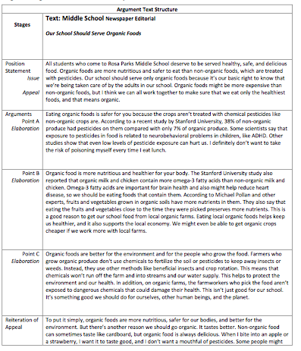
Let’s Practice and Apply!
In your reading groups:
Read pg. 8
Find one example that illustrates key concepts from your reading assignment
Handout
Notes:
How:

Slide 22
^{Whole Group Share Out}
    Group 1- Text Level Understandings
Text Structure:
  Argument Stages: Position Statement, Arguments (Points of Elaboration), and Reiteration of Appeal
Cohesion:
  Farmers who grow organic produce don’t use chemicals to fertilize the soil or pesticides to keep away insects or weeds. Instead, they use other methods like beneficial insects and crop rotation . This means that chemicals won’t run off the farm and into streams and our water supply. This helps to protect the environment and our health. In addition, on organic farms, the farmworkers who pick the food arent’ exposed to dangerous chemicals that could damage their health. This isn’t just good for our school.
    CA-ELD Standards Appendix B, p.8 Point C-Elaboration
Notes:
How: Participants will share out in order what the key concepts/ideas. This is a opportunity to clarify any misconceptions or misunderstandings
Bring reading groups together and ask them to cite evidence form text as they share their findings.
Group 1 may share regarding Text structure the stages in building an argument. Regarding cohesion, one possible example comes from Point C-Elaboration on page 8
In slide, the selection that marks cohesion is highlighted in red.
This selection is based is based on the reading on p. 9, paragraph 2.

Slide 23
^{Whole Group Share Out}
Group 2 – Sentence- and Clause-Level Understandings
Clause combining
Omega-3 fatty acids are important for brain health and also might help reduce heart disease, so we should be eating foods that contain them
    CA-ELD Standards Appendix B, p.8 Point B-Elaboration
Notes:
Group 2 may share from Point B-Elaboration , line #3 “Omega 3-fatty acids are important for brain health…”
This sentence is an example of connecting and condensing ideas . It contains two independent clauses linked by AND and one dependent (subordinated sentence) clause linked by SO. The later has an embedded clause introduced by THAT. The connectors are highlighted in red.
This selection is based on reading form p. 11, paragraphs 1-3.

Slide 24
^{Whole Group Share Out}
Group 3 – Phrase Level Understandings
Noun phrases:
  Healthy, safe, and delicious food
Prepositional phrases:
  from local organic farms
Embedded clause:
  The farmworkers who pick the food aren’t …
Notes:
HOW: Facilitator will call the third group to share out.
Group 3: The examples are selected based on the reading from pp. 13-14. There are other possible answers. Ask participants to use their readings to explain their selections, when needed.
The head nouns in the noun phrases and prepositional phrases are highlighted in green. The embedded clause and the nominalization example are underlined.

Slide 25
^{Whole Group Share Out}
Group 4 – Word Level Understandings
Nominalization:
  Some scientists say that exposure to…
    CA-ELD Standards Appendix B, p.8 Point A-Elaboration
Notes:
HOW: Facilitator will call out last group to share out.
Group 3: The examples are selected based on the reading from pp. 13-15. There are other possible answers. Ask participants to use their readings to explain their selections, when needed.
The head nouns in the noun phrases and prepositional phrases are highlighted in green. The embedded clause and the nominalization example are underlined.

Slide 26
Notes:
Why/Purpose: To review the main goal of Part II as it’s also interconnected with Part I
How: Main goal is to guide teachers to support ELLs in ways appropriate to their grade level and English language proficiency level to unpack meaning in written and oral texts they encounter across disciplines and to make informed choice about how to use language appropriately.

Slide 27
Implications for instruction
Opportunities for ELs
Learning How English Works
Notes:
(2 Min. )
Purpose: Debrief –
Key points:
Implications for teachers;
1 Over the course of the unit, Teachers lead ELs in multiple readings and guide them through multiple layers to understand complex texts across disciplines.
2 Teachers will highlight particular language features that are typically found in different text types
Opportunities for ELLs.
1 Students engage in collaborative discussions, debate content in texts, analyze and evaluate the meaning of texts, as well as use of various language resources
2 At the end of each unit, students will engage in a culminating activity demonstrating how to apply independently disciplinary language resources when presenting their ideas

Slide 28
The Big Shift:
Defining Academic English Language
Before some perceived Academic Language as…
Vocabulary
Now CCSS/ELD Standards clearly define Academic Language as…
Sentences, Clauses,
Phrases
Text Structures
Vocabulary
Instructional Strategy:
Turn and Talk
Notes:
Slide (1 Minute)
Why/Purpose: To remind participants that the big shift that is called by the New CA ELD Standard
How: Participants will partner up and explain the slide to their elbow partner.
It’s important to stress that before CCSS, Academic Language was thought of through the perspective of Vocabulary. Now under the CCSS, Academic Language is much more than just vocabulary. It focuses not only on vocabulary in the text , but how the text is structured. These structured in terms of the clauses, phrases, and whole written and oral texts and how this affects meaning. These pieces need to be broken down and analyzed so students get to that meaning.

Slide 29

Instructional Strategies
Chalk Talk | 3-2-1
Turn and Talk | Whole Group Share Out
Line Up | Expert Group/ Home Group
Collaborative Groups | Rally Robin
Chunking The Text | Listening Task
Graphic Organizer | Elbow Partner Discussions
Turn and Talk
Whole Group Share out
Use of Visual Media: Videos
Notes:
Slide 28: (1 min.)
Why/Purpose: Make the connection for the teachers between the instructional strategies used and experienced during this session and the use of these Instructional strategies in their classroom
How: Read the instructional strategies to the participants. Today we implemented the strategies in bold print.

