Slide 1
Welcome to our DESIGNATED Eld PD
Please sit with your grade level team.
Notes:
Resources needed for this training:
White paper for flow maps
Copies of at least the first 3 lessons of Revised Start Smart 1.0 of one grade level (ideally all 15 lessons of the grade levels the teachers teach)
Lesson Resources packet

Slide 2

What’s new for Designated ELD in 2016-17?
Notes:
1 min.
In 2015-2016, our district rolled out resources and materials that supported the implementation of the ELD standards. As we move into the second year of implementation, the district has developed revised and additional resources that continue to support the implementation in its second year.

Slide 3
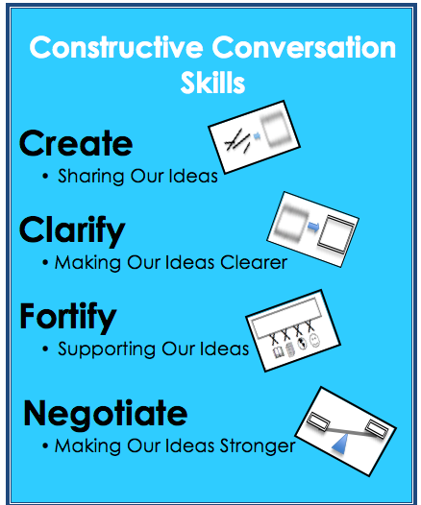
START SMART 1.0
Revised
Notes:
1 min.
At our school site, we are familiar with the 15-Day Start Smart Lessons that were rolled out last year to teach the Constructive Conversations Skills. The following slides will highlight the revisions and improvements to the Start Smart lessons based on input from teachers and observation of implementation. We are calling this Start Smart 1.0 Revised. These lessons will be the first of three resources focused on student’s use of the Part I ELD Standards. We ask that you think of your prior knowledge of Start Smart as a foundation for your understanding of the improvements.
GOAL: Students learn the norms, the skills and the language of the skills

Slide 4
Start Smart 1.0 REVISED
Constructive Conversation Skills Skills taught in isolation
Visual Texts
SPF
Code Models Revise Non-Model
Oral Presentation of Poster
August - September
15 Lessons
Notes:
2 min.
Referring back to your knowledge of the original Start Smart lessons taught last year, what are the similarities and differences in the basic components of Start Smart? Share with an elbow partner.
Take all reasonable responses, then share the following:
Some of the key characteristics to highlight is the suggested window of implementation. It is suggested that Start Smart 1.0 Revised be taught August-September, much as last year.
You will notice that rather than being 15 days, there are 15 lessons. This allows for more flexibility in implementation, taking into account the unique needs of each classroom.
Constructive Conversations using the 4 skills (Create, Clarify, Fortify, Negotiate) are again highlighted and taught in isolation
Visual texts continue to be the focus of the conversations.
Formative assessment is again collected using the SPF.
The teacher continues to present model conversations and non-models and uses student conversations to engage in revision of non-models.
The lesson series culminates with the opportunity for partners to orally present the poster they created throughout the lesson series.

Slide 5
Ready, Set, Go!
Please form triads by grade level, if possible, or across grade levels.
Count off 1 to 3.
You will read and discuss the Create lessons (Lessons 1-3)
  Number 1s will read Lesson 1.
  Number 2s will read Lesson 2.
  Number 3s will read Lesson 3.
Notes:
2 minutes
Let’s engage in an activity to dig into the the Start Smart 1.0 Revised lessons.
With each click, invite participants to:
Please form triads. (Allow participants to move seats if necessary)
Within your triads, count off numbers 1,2,3.
We will be digging into the Create lessons-Lessons 1,2,and 3.
Number 1s; you will be reading Lesson 1.
Number 2s; you will be reading Lesson 2.
Number 3s; you will be reading Lesson 3.
Facilitator note: If you have multiple teachers of English learners at a grade level, it would be ideal for teachers to have at least the first three lessons copied for their own grade level (or even better, the entire set of 15 lessons) and to keep the teachers in grade level teams. If there are only two teachers at the grade level, you could modify this protocol to have both teachers read lesson 3 and have them work in pairs. If there are four teachers at the grade level, you might want to have the four teachers work together and have the fourth teacher read the same lesson. If you are going to work across grade level, it will work for them to have different grade level material since what they are concentrating on is the flow of the lesson and the major differences in the revised instructional resources.

Slide 6
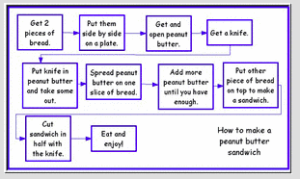
Okay…Start Your Engines…
You have 10 minutes!!!
To do what? Thanks for asking!
  Read and create a Flow Map of the lesson you were assigned.
  Make sure to review the lesson resources for your lesson in the additional packet.
  Take notes about the differences you notice between the Start Smart Revised lessons and the original lessons. These are aspects you will want your teachers to notice or you will want to surface for your teachers.
Notes:
12 minutes
Explain the directions of each bullet:
You will have 10 minutes. What will your task be for this activity?
You will silently read your assigned lesson and design a Flow Map of the lesson.
Click on the Flow Map fly-in.
Here is an example of a Flow Map. In your Flow Map, you will be capturing the components of the lesson you are assigned. (Ensure that participants have paper at their tables to create their Flow Map)
You will have the lesson and resources (color packet) to assist you.
As you read your lesson and refer to your color reference packet, focus on the differences you notice between the original Start Smart lessons taught last year, and the Start Smart 1.0 Revised lessons for this year.

Slide 7
Triad Sharing
In your triad, determine a time keeper.
Now take turns within your triad. Go in order from 1 to 3. Each person gets 3 minutes to share.
Have each member share their Flow Map and the major portions of the lesson.
Have each member note the major differences he or she noticed in the revised lessons.
After all three members have shared. Clarify in your group what you heard were the major differences between the original and revised Start Smart lessons.
Notes:
15 minutes
Let’s share out our findings within our triads.
Explain the directions of each bullet:
Determine a timekeeper within your triad.
Each member of your triad will have 3 minutes to share.
Please share your Flow Map of your assigned lesson, and note the major differences that surfaced within your Start Smart 1.0 Revised lesson.
Once all 3 members of your triad have shared, engage in a conversation clarifying the major differences between the Start Smart original lessons and the Start Smart 1.0 Revised lessons.

Slide 8
Start Smart 1.0 REVISED
Constructive Conversation Skills Skills taught in isolation
Visual Texts
SPF
Code Models Revise Non-Model
Oral Presentation of Poster
August - September
15 Lessons
Notes:
1 min.
Review this slide to surface again the basic components of the Start Smart 1.0 Revised lessons:
15 Lessons
Constructive Conversations using the 4 skills
Visual texts continue to be the focus of the conversations
Formative Assessment-SPF
Model conversations and Non-models
Oral presentation of the poster

Slide 9
START SMART-CONVERSATION PRACTICES
SKILL | LESSON 1 OF SKILL | LESSON 2 OF SKILL | LESSON 3 OF SKILL | POSTER REVIEW
CREATE | Lesson 1 | Lesson 2 | Lesson 3
CLARIFY | Lesson 4 | Lesson 5 | Lesson 6 | Lesson 7 CONSTRUCT & PRESENT POSTER CREATE CLARIFY
FORTIFY | Lesson 8 | Lesson 9 | Lesson 10
NEGOTIATE | Lesson 11 | Lesson 12 | Lesson 13 | Lesson 14 COMPLETE POSTER FORTIFY NEGOTIATE Lesson 15 Culminating Activity PRESENT FINAL POSTER PLAY CONSTRUCTIVE CONVERSATION GAME
Notes:
2 min.
In order for students to understand these four conversation skills, we will dedicate the first months of instruction to the 15 Start Smart lessons, which enable students to learn and practice each Constructive Conversation Skill explicitly.
As with last year, each skill is presented in a three lesson sequence with a review on Day 7 and 14 and 15.
There are 3 days dedicated to each skill and after two skills have been taught, there is a review in order for students to practice the skills in a meaningful way.
For example, days 1, 2, and 3 are devoted to CREATE.
Days 4, 5, and 6 are devoted to CLARIFY.
On day 7, students are asked to construct a poster that illustrates the what they learned about CREATE and CLARIFY.
Click animation: Once again, you will notice that rather than referring to 15 days of instruction, there are 15 lessons, allowing for more flexibility in implementation and taking into account the unique needs of each classroom

Slide 10
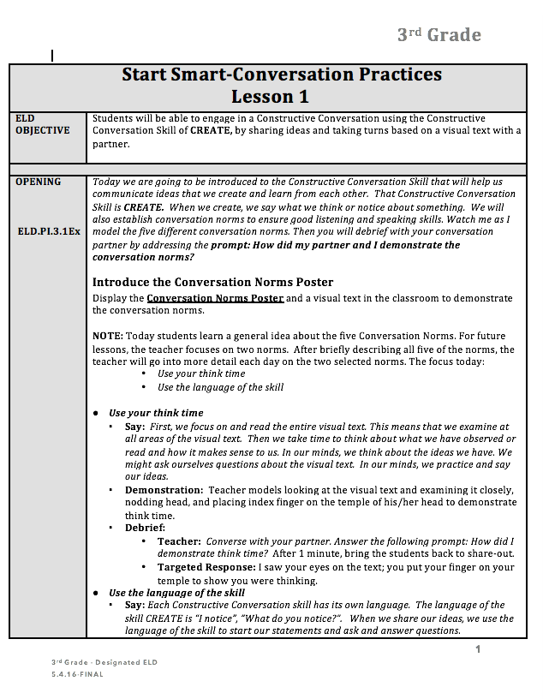
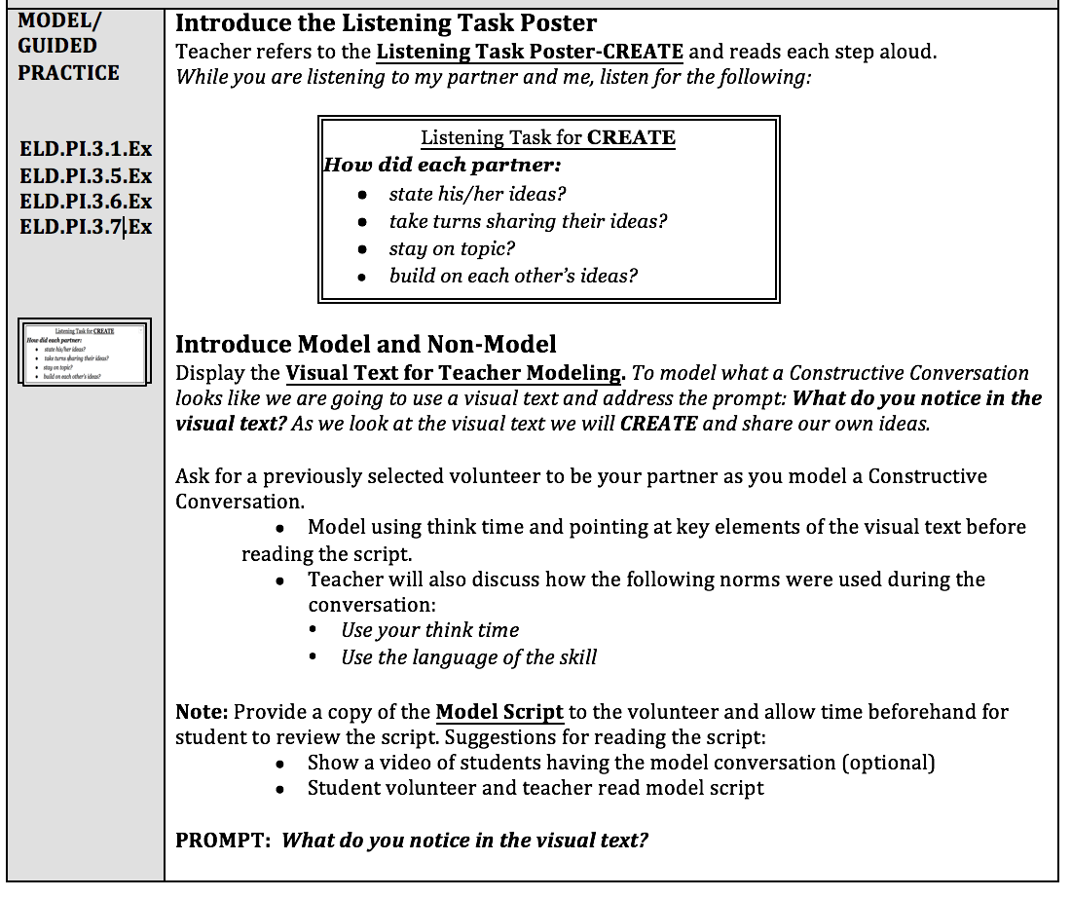
Start Smart 1.0 - ELD Standards Alignment
CA ELD Standards are included in margin for each section of lesson to aid in understanding and assessment
Notes:
1 min.
Let’s take a closer look at the revisions and improvements of the Start Smart 1.0 Revised lessons.
What changes do you notice? (validate all answers then share information below. )
Standards Alignment: In the margin, you will see the ELD standards that each part of the lesson corresponds to.

Slide 11
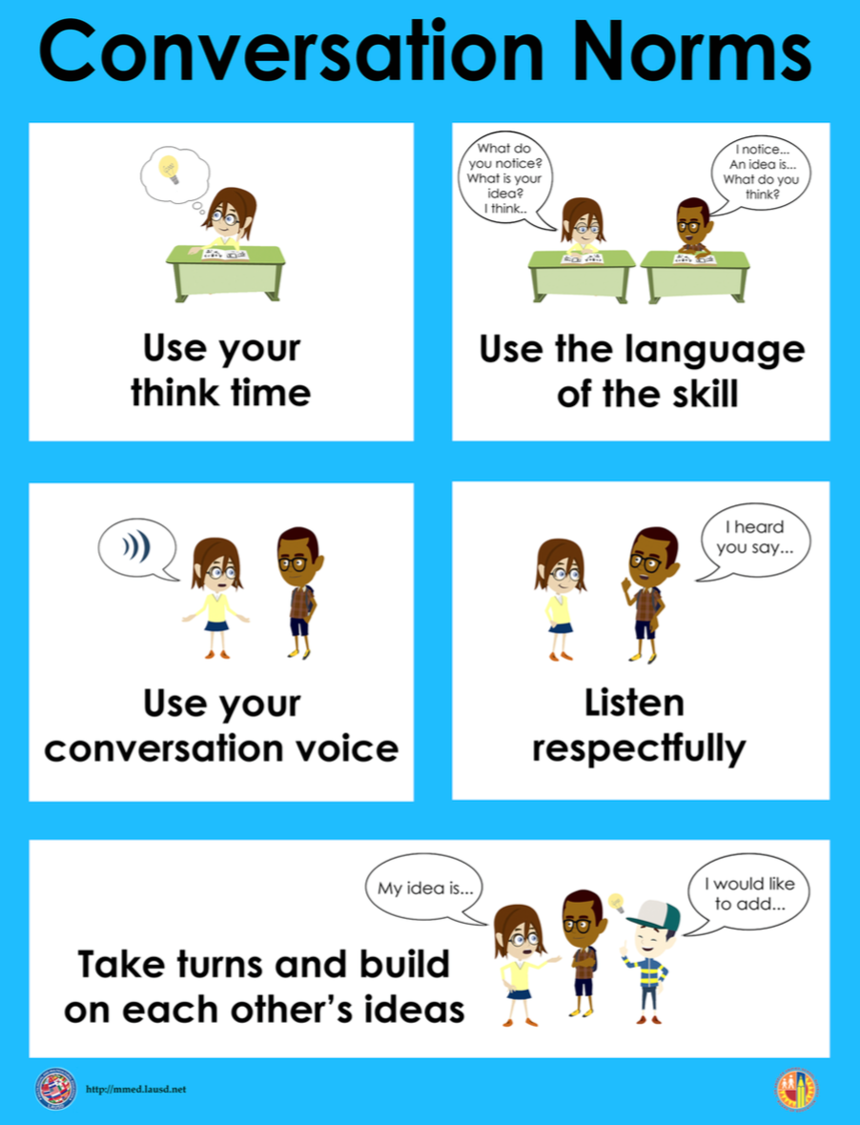
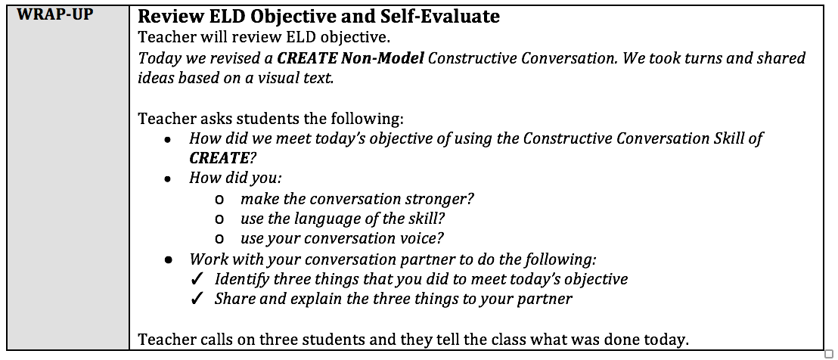
Start Smart 1.0 - Conversation Norms
Students focus on two selected conversation norms each day for a deeper understanding of norms
Conversation norms are added throughout the lesson for continued understanding
Reflection at the end of the lesson to focus on the two norms of the day as part of the wrap up/self-evaluation
Notes:
2 min.
On the screen is part of the introduction to the Conversation Norms.
How has this changed? (validate all answers and click animation and share information on slide)
For deeper understanding and better use, the Conversation Norms have been chunked to two per lesson and are reviewed at the end of each lesson.

Slide 12
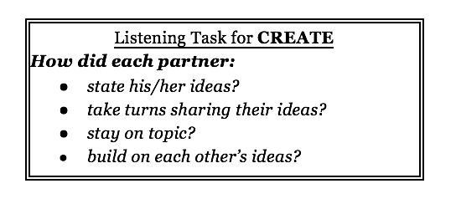
Start Smart 1.0 - Listening Task
Listening Task Posters include open-ended questions for each skill for greater understanding
Notes:
1 min.
Listening Task Poster
One observation during year 1 of implementation was that the way the Listening Task questions lent themselves to yes/ no questions, rather than being used as a tool for deeper reflection.
New listening tasks are open-ended to facilitate deeper student analysis of conversations. How did each partner…?
Teachers can modify their current Listening Task posters by adding a post-it note “How” to make the questions open-ended.

Slide 13
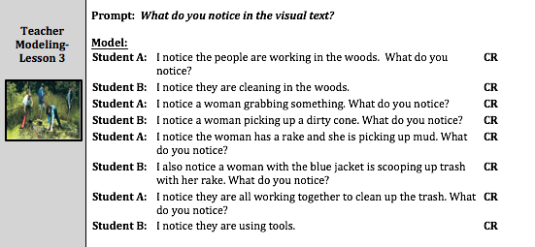
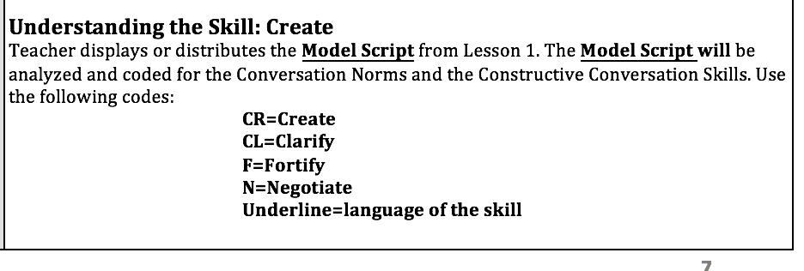
Start Smart 1.0 - Visual Texts & Models and Non-Models
Revised, more rigorous visual texts and Model conversations for greater clarity of each of the skills
Image of required resources lesson in margin to aid in preparation
Conversation Skills are coded in Model
Conversations facilitate metacognition by including multiple skills
Notes:
2 min.
Click through animations and share key information from bulleted items.
Visual texts have been improved and include more photographs and fine art. This is important because complex visual texts are more likely to prompt complex oral language.
Resources in the margin aid with teacher planning and collection of resources for lessons.
Conversation skills are coded because, often a conversation will include multiple skills and the process of using and identifying skills will lead to greater student understanding.
The last fly-in displays the key for coding the skills.

Slide 14
Revised Prompts Starters
Start Smart ‘15-’16 Revised Start Smart 1.0
(CR)What do you notice?
What do you notice?
(CL)What is happening in the text? How do you know?
What do you notice in the visual text? Provide details.
(F)What is happening in this visual text? Provide evidence from the text to support your claim.
What is happening in the visual text? Provide evidence from the text to support your claim. (Each student has to make a claim.)
(N) Various prompts were used. (Visuals were not used)
What is an important idea from this text? Start by stating your claim. Support your claim and come to a consensus.
Notes:
2 minutes
The prompt starters for each Constructive Conversation skill have been revised.
Click 1st animation: The prompt starter for Create has remained the same.
Let’s look at the revised prompt starters for the other three Constructive Conversation skills. (Share remaining prompt starters using the animations.)

Slide 15
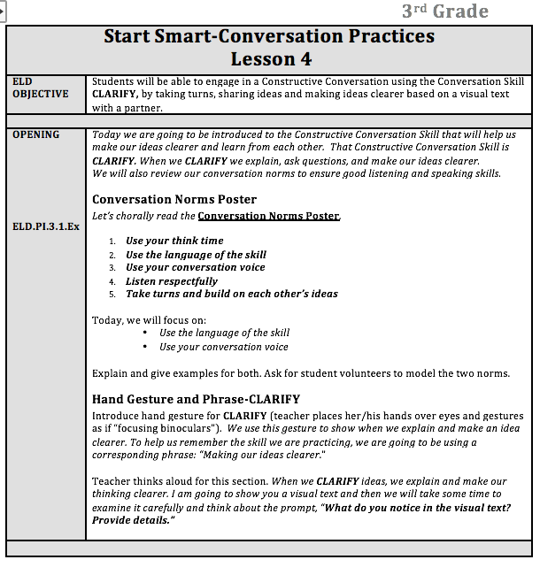
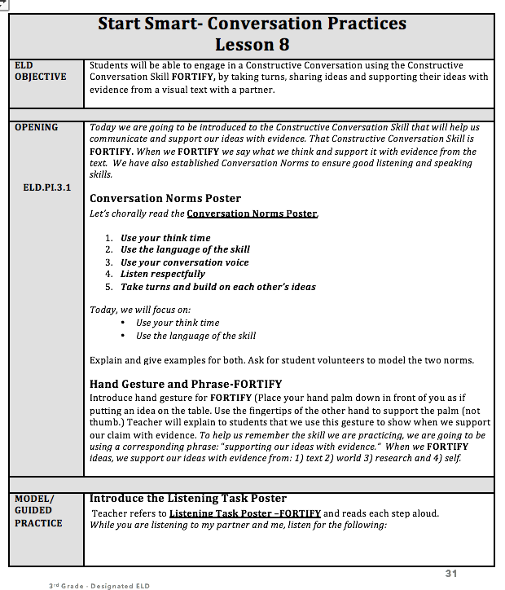
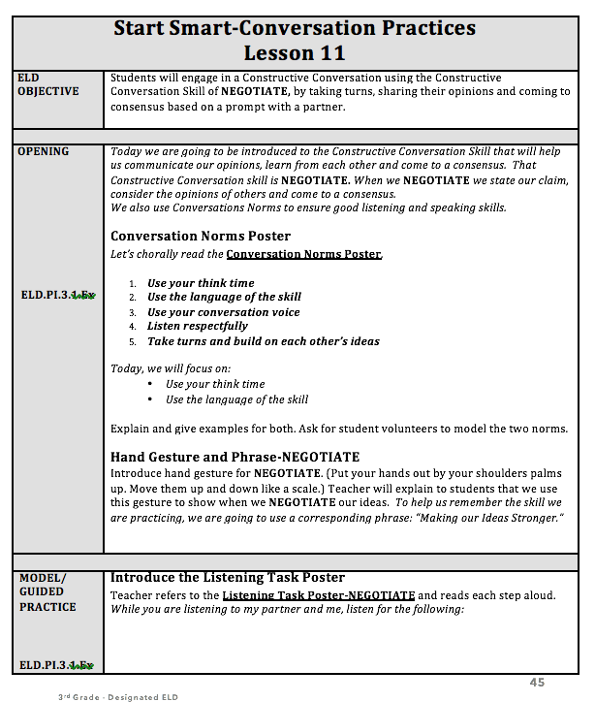
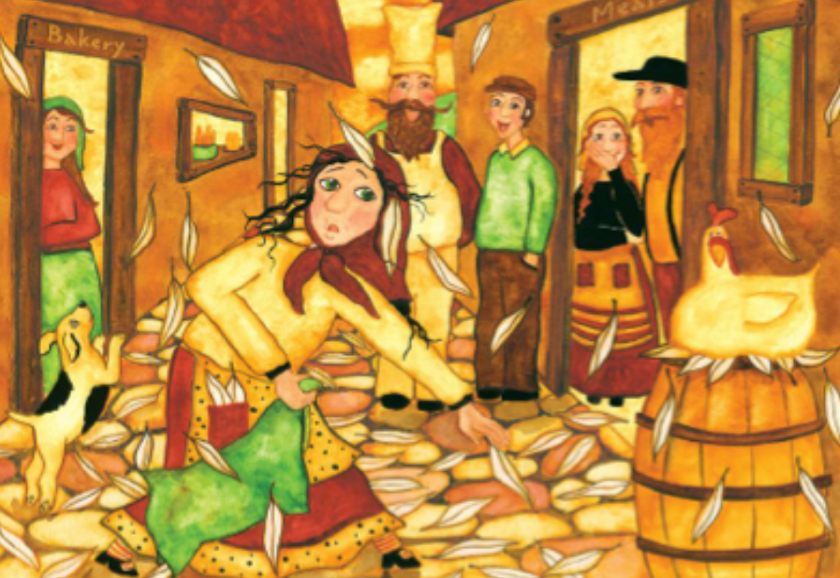

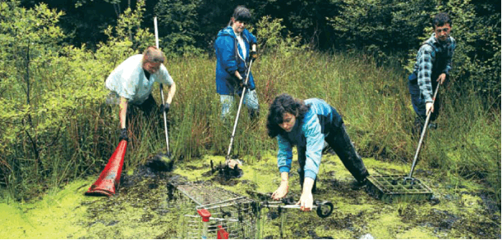

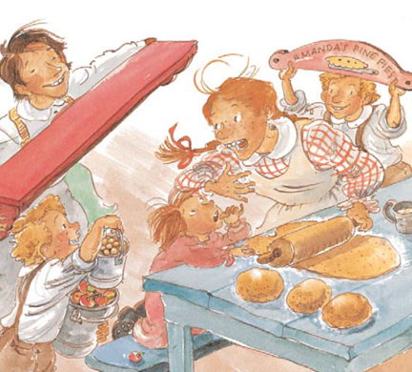


Create
Lessons 1-3
Clarify
Lessons 4-6
Start Smart 1.0 - Visual Text
Visual Text used for two skills to highlight the difference in language and content of CC Skills
  Create & Clarify
  Fortify & Negotiate
T
S
T
S
Fortify
Lessons 8-10
Negotiate
Lessons 11-13
T
S
T
S
T
S
T
S
T
S
T
S
T
S
Notes:
2 min.
Another example of how the lessons have been improved to deepen student use of language is the use of the same visual texts across two skills.
Along with coding responses by skill, this facilitates a deeper understanding of differences between the skills in terms of language and content.
The skills of CREATE and CLARIFY will utilize the same teacher and student visual texts.
The skills of FORTIFY and NEGOTIATE will utilize the same teacher and student visual texts.

Slide 16
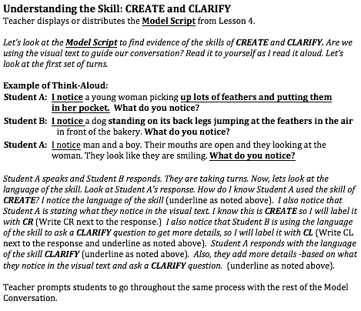
Start Smart 1.0 – Understanding the Skill
Lesson 2:
It includes:
modeling of metacognition by the teacher
practice by student groups to explore, explain and code language and content of CC Skill
provides a model while students revise the NON-Models
Notes:
2 min.
On the screen, you will notice a new part of the Model/Guided Practice.
How will this aid our students? (accept all answers and share:)
The new part, Understanding the Skill section is added in Lesson 2 of each skill with modeling of metacognition by the teacher and practice by student groups to explore, explain and code language and content of CC Skill.
This piece serves as a model when students are revising the NON-Models to make explicit the language of the skills and content of response.
Note that the language of the skill has been underlined and that there is a teacher script for modeling after which students practice identifying the skills.

Slide 17
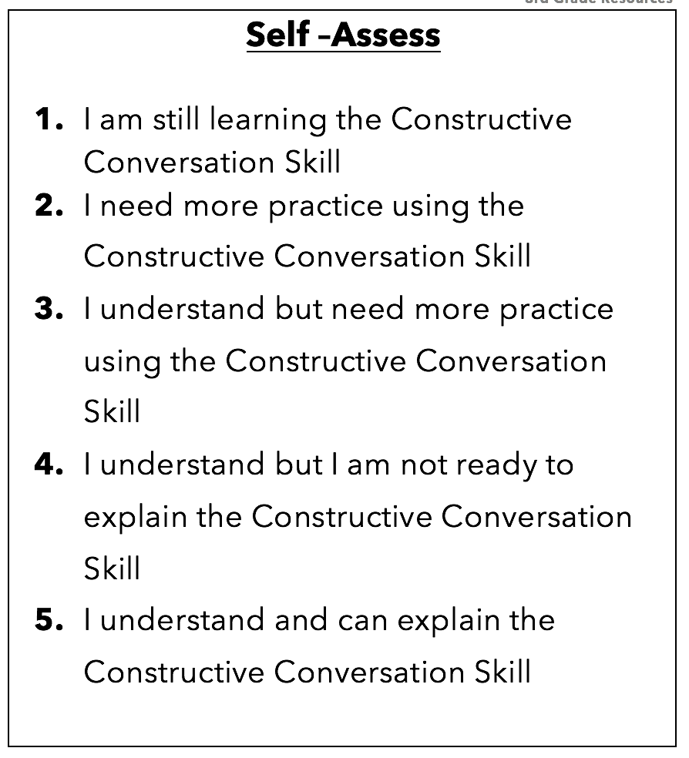
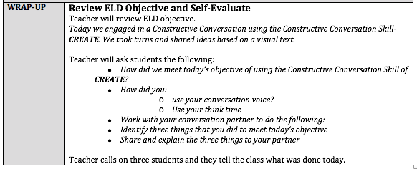
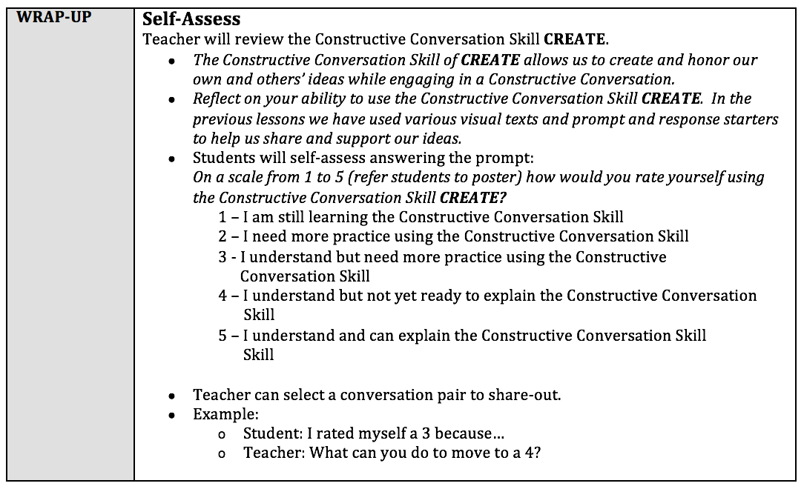
Start Smart 1.0 REVISED
WRAP UP:
Self-Reflection at the end of Lessons 1 and 2 of each skill focuses on the norms
Self-Assessment at the end of Lesson 3 of each skill focuses on the conversation skill and the language of the skill
Notes:
2 min.
The self-reflection now explicitly calls out two norms for students to reflect on closely related to the lesson objectives.
Self assessment of each Constructive Conversation skill in the third lesson of that skill offers students opportunities to metacognitively assess their understanding.

Slide 18
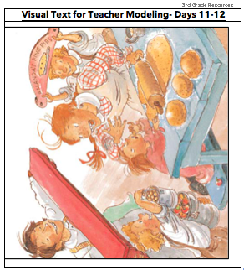
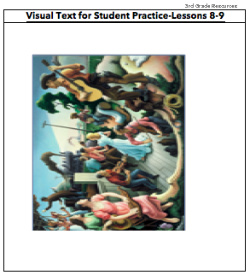
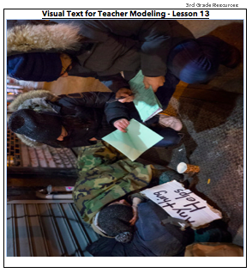
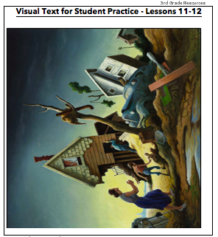
Start Smart 1.0 – Negotiate
Use of a Prompt and a Visual Text
Prompt: What is an important idea from this text? Start by stating your claim. Support your claim and come to a consensus.
Visual Texts for
Teacher Modeling
Visual Texts for
Student Practice
The Negotiate lessons (lessons 11-13) now incorporate both a prompt and visual texts as opposed to just a prompt.
Notes:
1 min.
The skill of NEGOTIATE is enhanced by using a visual text along with a prompt, rather that just a prompt.
The prompt for NEGOTIATE is, What is happening in the visual text? Provide evidence from the text to support your claim. Each student will need to make a claim.
Facilitator Note: Although some of the labels on the individual visual text images are from the fortify lessons (lessons 8-10), these same visuals are used during the negotiate lesson (lessons 11-13). At the time of the creation of this powerpoint, the lesson resource packet was in draft form and a couple of visual texts were not inputted yet into the resources. Most likely no teacher will notice this issue on the slide, but just in case, you have the answer for this.

Slide 19
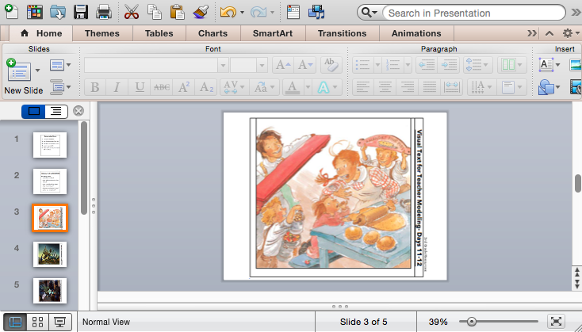
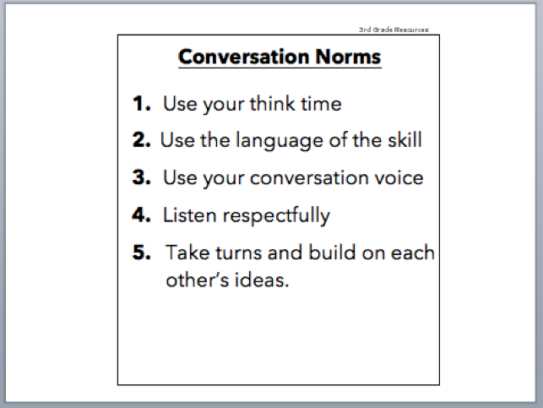
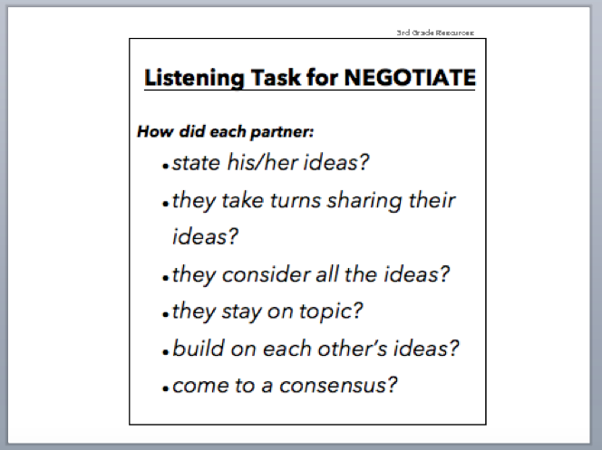
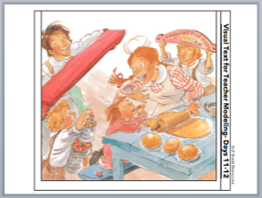
Start Smart 1.0 –
Lesson Resources PowerPoint
There will be/is a PowerPoint by grade level available containing lesson resources such as all the visual texts for the 15 lessons, the Conversation Norms and the revised Listening Tasks.
Notes:
4 min.
MMED has designed a powerpoint per grade that contains the entire library of visual texts plus additional resources such as the revised listening task to support Start Smart 1.0 Revised. This will aide teachers with planning and organization of materials and possibly displaying visuals for students.
Finally, please turn to your partner and share some of the improvements that you have seen today.

Slide 20
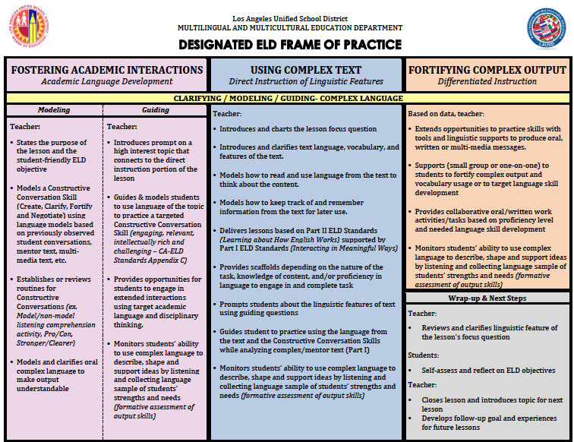
Start Smart 1.0 REVISED | Start Smart 2.0 | Disciplinary Discussions Using Text Sets
Constructive Conversation Skills Skills taught in isolation | Constructive Conversation Skills Paraphrasing is emphasized Create and Clarify together | Constructive Conversation Skills All CC skills applied
Visual Texts | Visual Texts Infographics | Text Sets Multiple Visuals Written Text Audio Text Video
SPF | SPF 2.O | SPF 2.0
Code Models Revise Non-Model | Code Models Revise Non-Model Graphic Organizer | Code Models Graphic Organizers
 |  | Close Reading
 |  | Critical Analysis Questions (SBAC)
 |  | Research and Writing
Oral Presentation of Poster | Oral Presentation & PPT | Oral Presentation Multimedia Presentation
August - September
15 Lessons
November - December
15 Lessons
February - March
20 Lessons
Let’s briefly preview the resources that will be available to support
teaching and learning
during Designated ELD later this year.
Notes:
4 minutes
Let’s briefly preview the resources that will be available this year to support teaching and learning during Designated ELD. (Click to remove animation.)
This is an overview of the resources that will be put into the field this year to support the implementation of the ELD standards during designated ELD. When the resources are available close to the dates shown above, we will review the resources together to support their implementation to support English learners’ language development. This is not a pacing plan, just a suggested timeline.
We have already reviewed Start Smart 1.0 Revised.
A new resource will be available for instructional use during November-December. It is called Start Smart 2.0. These 15 lessons also help students develop their Constructive Conversation Skills, but the lessons go much deeper. The students need Start Smart 1.0 to be ready for 2.0.
During these lessons, the skill of paraphrasing is emphasized.
The skills of Create and Clarify are taught together.
Students will use both a visual text and an infographic on the same theme. An infographic is a resource that often we see in textbooks, such as our social studies or science text books, in which there is a combination of visuals, captions, short paragraphs and sometimes graphs with in a visual resource. Students will be prompted to synthesize information across the two texts.
Teachers will have another progress monitoring tool referred to as SPF 2.0.
Just like in Start Smart 1.0 Revised, coding of models is present and students will engage in revising non-models.
In addition, teachers will model the use of a graphic organizer and students will use a graphic organizer during this lesson series.
The lesson series will culminate in partners creating and using a powerpoint for an oral presentation. Students’ collaborative use of multimedia is part of the ELD Standards. A teacher powerpoint for modeling the creation of a powerpoint will be provided as part of the lesson resources.
In February-March teachers will have an additional set of lessons called Disciplinary Discussions Using Text Sets.
We will maintain our focus on Constructive Conversations skills and in this lesson series all skills will be applied as students discuss disciplinary topics (either a topic from science or social studies.)
Students will use text sets, building on what we did during Start Smart 2.0. A text set includes all of the following: multiple visuals, a written text, an audio text and a video.
We will continue the use of the SPF 2.0, coding models and the use of graphic organizers like we used during Start Smart 2.0.
Students will engage in close reading and will be posed with Critical Analysis Questions, similar to those used in SBAC.
Students will culminate the lesson series with a multimedia oral presentation with a partner.
Between these three lesson series, we utilize the Designated ELD Frame of Practice to design and teach lessons that use grade level complex texts and teach both Parts I and II of the CA ELD standards.
We will have so many resources this year to support teaching and learning this year!!! So…

Slide 21
Let’s Start Off
Our Year with
Start Smart 1.0 Revised
Notes:
Minute
Let’s start off our school year strong for our English Learners during Designated ELD using the Start Smart 1.0 Revised instructional resources.

