Slide 1

Multilingual and Multicultural Education Department
Elementary Designated ELD
Frame of Practice
Part 2: Mentor Text and ELD Objectives
Notes:
1 minute
Welcome participants
We will continue our exploration of the use of ELD Mentor Texts and learn how to incorporate ELD objectives into our lessons

Slide 2
Grounding - Mentor Text Match-Up
With a Partner:
Read each text
Match each text with one ELD Standard and one Guiding Question:
  Which Part II standard and Guiding Question best apply or do not? Why?
  Have a Constructive Conversation
Mentor Text | Part II ELD Standard | Guiding Questions
Notes:
8 minutes
For our grounding, we will practice matching Mentor texts to their focus question and guiding questions.
Read the directions on the slide.
Distribute one envelope to each partner pair with mentor text, standards and Guiding Questions cards.
Distribute Constructive Conversation cards with CREATE, CLARIFY, FORTIFY and NEGOTIATE cards to facilitate conversation.

Slide 3
Make a Mask
You can make a mask, too! First, get a plate. Cut holes into it. Check that you can see.
Next, color the mask. Paste fun things on it. Soon you will have a mask!
Last, tape a band on the back of the mask. Put the mask on. Who are you?
Part II: How English Works
A: Structuring Cohesive Texts
1. Understanding Text Structure. (Expanding): Apply understanding of how different text types are organized to express ideas (e.g., how a story is organized sequentially with predictable stages versus how an informative text is organized by topic and details) to comprehending texts and writing texts in shared language activities guided by the teacher and with increasing independence.
Guiding Question:
Let’s look at the sentence.
What word tells you when the action is happening?
How does it help connect the actions?
Notes:
1 minute
Review matches whole group.
For each text, ask:
What standard does this text exemplify (Mentor text)
What Guiding Question best fits this text. Why?
Elicit responses from participants.
You may have participants refer to their Standards at a Glance or Matrices as a resource if necessary.

Slide 4
Part II: How English Works
B. Expanding & Enriching Ideas.
4. Using nouns and noun phrases. (Expanding Level) Expand noun phrases in a growing number of ways (e.g., adding a newly learned adjective to a noun) in order to enrich the meaning of sentences and to add details about ideas, people, things, etc., with increasing independence.
Swimming along, sometimes at great speed, sometimes slowly and leisurely, sometimes resting and exchanging ideas, sometimes stopping to sleep, it took them a week to reach Amos’ home shore. During that time, they developed a deep admiration for one another. Boris admired the delicacy, the quivering daintiness, the light touch, the small voice, the gemlike radiance of the mouse. Amos admired the bulk, the grandeur, the power, the purpose, the rich voice, and the abounding friendliness of the whale.
Guiding Question:
Let’s look at the sentence.
What are the noun phrases?
How does each noun phrase add details about…?
Notes:
1 minute
Review matches whole group.
For each text, ask:
What standard does this text exemplify (Mentor text)
What Guiding Question best fits this text. Why?
Elicit responses from participants.
You may have participants refer to their Standards at a Glance or Matrices as a resource if necessary.

Slide 5
Part II: How English Works
B. Expanding & Enriching Ideas.
3. Using verbs and verb phrases. (Expanding Level) Use a growing number of verb types (e.g., doing, saying, being/having, thinking/feeling) and verb tenses appropriate for the text type and discipline to convey time (e.g. simple past for retelling, simple present for a science description).
Days were long and lonely. The hills spread out as far as forever. Nights, me and Ma and my brothers and Baby Betsy would sit out and wait for a shooting star to sail across the sky. Once in a while a crow flew by. That’s all the excitement there was.
My brothers worked up some furrows. They planted corn and potatoes and beans. Then they ran around climbing trees, skinning their knees. But after all the water was fetched and the wash was done, after the soap was made and the fire laid, after all the beds were fixed and the floor was swept clean, I’d sit outside our cabin door with Baby Betsy, so bored I thought I’d die.
Guiding Question:
Let’s look at the sentence.
What kinds of verbs are in the sentence?
How do these verbs convey or show a sense of time?
Notes:
1 minute
Review matches whole group.
For each text, ask:
What standard does this text exemplify (Mentor text)
What Guiding Question best fits this text. Why?
Elicit responses from participants.
You may have participants refer to their Standards at a Glance or Matrices as a resource if necessary.

Slide 6

Norms
Presume positive intentions
Place inquiry at the center to allow for processing, probing, and think time
Build a network through respect and support
Be prompt
Notes:
1 minute
Have a volunteer participant read the norms:
Presume positive intentions
Place inquiry at the center to allow for processing, probing, and think time
Be prompt
Build a network through respect and support

Slide 7
Adapted from George Washington University
Guiding Principles
English Learners (ELs) are held to the same high expectations of learning established for all students.
ELs develop full receptive and productive proficiencies in English in the domains of listening, speaking, reading & writing.
ELs are taught challenging academic content that enables them to meet performance standards in all content areas.
ELs receive instruction that builds on their previous education and cognitive abilities and that reflects their language proficiency levels.
ELs are evaluated with appropriate and valid assessments that are aligned to state and local standards and that take into account the language development stages & cultural backgrounds of the students.
The academic success of ELs is a responsibility shared by all educators, the family and the community.
English Learner Master Plan, 2012,
Pages 2-3
Notes:
1 minute
Remind participants that the EL masterplan includes 6 principles that guide our work. Principles 1 and 3 relate to high expectations and providing challenging academic content and will guide our work today.

Slide 8

Agenda
Welcome
Grounding
Homework
ELD Objectives
Closing/Evaluation
Notes:
1 minute
Review agenda
Your homework from Part I was to bring a mentor text and write two guiding questions.

Slide 9
Learning Outcomes
Continue to build understanding of the ELD Frame of Practice for Designated ELD instruction
Understand the connection between mentor text and ELD Part II Standards
Provide and receive feedback on a draft of a Designated ELD Lesson
Understand the connection between ELD Objectives and the ELD Standards
Notes:
1 minute
Have participants read each bullet.

Slide 10
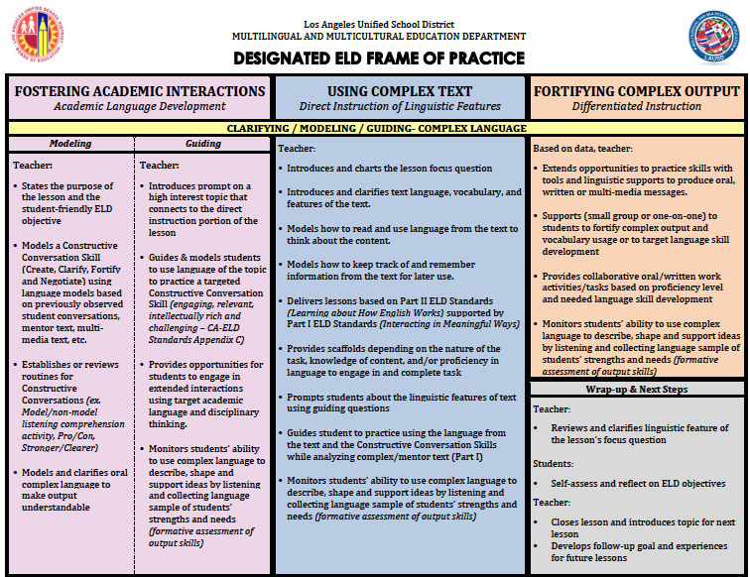
© Zwiers, O’Hara, & Pritchard (2014)
Notes:
1 minute
We are going to continue to build our understanding of the Frame of Practice, focusing on Complex Text.

Slide 11

Build “Into” and “From”
Content Instruction
ELA &
Content Areas
INTO
FROM
Designated ELD
Notes:
30 seconds

Slide 12
Build “Into” and “From”
Content Instruction
The language demands identified during content instruction inform what needs to happen during Designated ELD. The language from content taken “Into” Designated ELD to be explicitly taught.
During Designated ELD we use the CA ELD Standards for instruction. The new language learning is taken “From” Designated ELD to support successful participation in academic tasks during ELA and other content areas.
Notes:
2 minutes on this slide
Read bullet point 1. You might want to use the “circular into and from poster” to make a clearer connection.
Click on animation (second bullet):
Read bullet point 2.

Slide 13
Understanding Mentor Text
A mentor text is from the selection that has been used during ELA or other content areas, after being read for students to get basic comprehension of the selection.
A mentor text can contain several connected sentences (6-8) in which each sentence can lend itself to teaching the ELD Standards that have been selected to teach.
The sentences should be complex and rich enough to have discussions about the structure, meaning, word choice, etc.
Notes:
1 minute
Share with participants these essential characteristics of a Mentor Text:
Mentor text in the context of Designated ELD refers to the fragment or portion that is lifted from a selection used in ELA.
The selection should be read during ELA enough times for students to get basic comprehension.
It should be a paragraph or passage taken straight from the selection. Depending on the grade level it may be comprised of 6 to 8 sentences.
All sentences in the mentor text should illustrate unquestionably the selected ELD Standard from Part II : Learning about How English Works.

Slide 14
Creating Mentor Text Questions Review
CA ELD Standard for Grade 4
  Part II: Learning About How English Works
  B: Expanding and Enriching Ideas
  4. Using nouns and noun phrases (Expanding) Expand noun phrases in a variety of ways (e.g. adding adjectives to noun phrases or simple clause embedding) in order to enrich the meaning of sentences and add details about ideas, people, things, etc.)
  Step 1: Turn the standard into a “focus question,”
  e.g., How Do Noun Phrases Add Detail to a Text?
Structure/What?
Purpose/Why?
Notes:
30 seconds
Last time, we went through this process with the mentor text Soap Bubbles by creating a focus question based on the what and the why of the Part II standard.
Both the structure and the purpose for each standard should be clearly stated in the focus question and be considered when analyzing a mentor text.

Slide 15
Mentor Text—Soap Bubbles
There are few objects you can make that have both the dazzling beauty and delicate precision of a soap bubble. Shown here at actual size, this bubble is a nearly perfect sphere. Its shimmering liquid skin is five hundred times thinner than a human hair.
Bubbles made of plain water break almost as quickly as they form. That’s because surface tension is so strong the bubbles collapse. Adding soap to water weakens water’s surface tension. This allows a film of soapy water to stretch and stretch without breaking.
Notes:
1 minute
The noun phrases are highlighted.

Slide 16
Creating Mentor Text Questions
Guiding Question #1: Read sentence #1. Look at the noun phrases in bold.
  What words were added to the nouns?
  What details do they add to the nouns?
Guiding Question #2: Read sentence #2. Look at the noun phrases in bold.
  What words were added to those nouns?
  What details do they add to the nouns?
Guiding Question #3:Read sentence #3. Look at the noun phrases in bold.
  What were words added to those nouns?
  What details do they add to the nouns?
Wrap Up Guiding Question: How do all the noun phrases enrich our understanding of the text?
Notes:
2 minutes
Then, we looked at creating consistent guiding questions around the what and the why for each sentence. Each question follows a predictable pattern to solidify the understanding of the text feature.
Finally, a wrap up question was added for a text-level understanding Constructive Conversation.

Slide 17
Turn and Talk
How do Part II ELD Standards and guiding questions work together to support successful interaction with complex text?
Share out
Notes:
3 mins
Have participants share their findings
Participants should highlight the essential characteristics of a mentor text , how to teach a part II standard using a mentor text and developing a focus question that highlights the what and the why.

Slide 18
Homework - Processing
Read your partner’s text, standards, and guiding questions
Annotate as you read and consider the following:
  Is the mentor text worthy of analysis?
  Does the standard selected match the text?
  Do the guiding questions focus on the essence of the selected standard?
Choose one mentor text. Have a Clarifying Constructive Conversation around that text.
  Prompt: How would we use this mentor text during Designated ELD?
Repeat the process with the other mentor text
Notes:
15 minutes for slide
1 minute to explain activity to participants
4 minutes to read and annotate
10 minutes of discussion--
5 minutes to discuss one partner’s homework
5 minutes to discuss other partner’s homework

Slide 19
ELD Objectives
Notes:
30 seconds.
Clarify that when we develop lesson objectives for the Designated ELD block of time, we refer to those as ELD Objectives.

Slide 20
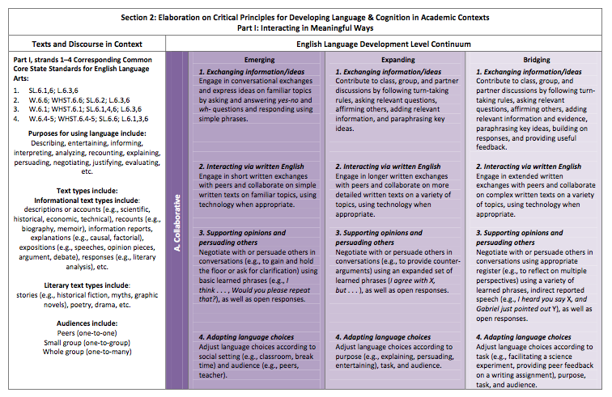
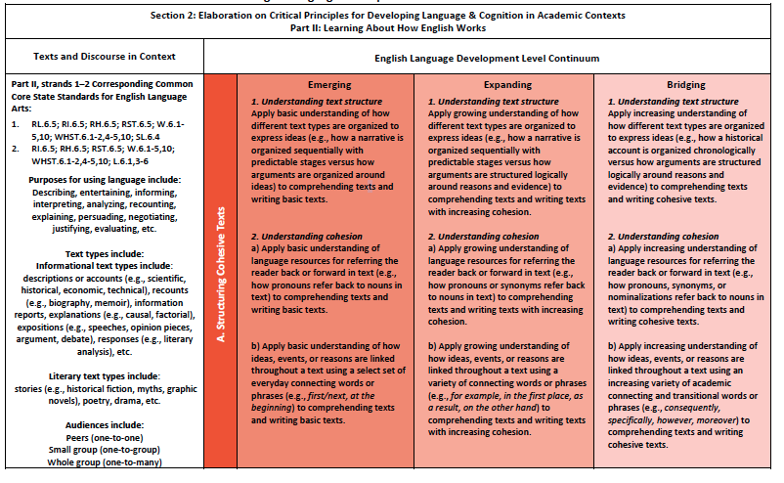
Developing ELD Objectives
Students will be able to (function) (ELD content) using (form/specific language) in a (type of engagement activity).
ELD
Standards
ELD
Objective
Part I: Interacting in Meaningful Ways
Part II: Learning How English Works
Notes:
2 minutes Note: you may want to create a color coded chart of the ELD objective sentence frame and post in front of room as a scaffold
We develop an ELD Objective from the CA ELD Standards, leading with Part II, Learning About How English Works.
Click animation (“Students will be able to…”):
We’ve developed a formula for creating ELD Objectives. We will highlight the function, ELD Content, form and specific language, as well as the type of engagement activity.
Click animation (brackets on ELD Content):
The ELD content portion will come from CA ELD Standards Part II: Learning About How English Works. What are students going to learn about language?
Click animation (function):
The function may come from the Teacher Resource section under Purposes for Using Language (not always, but it’s one place to look for it). How are students going to be asked to use language?
Click animation (form/specific language):
The form and/or specific language will also come from Part II. What might that language sound like?
Click animation (bracket for type of engagement activity):
For the type of engagement activity, you look at Part I: Interacting in Meaningful Ways of the CA ELD Standards. How will students practice language?

Slide 21
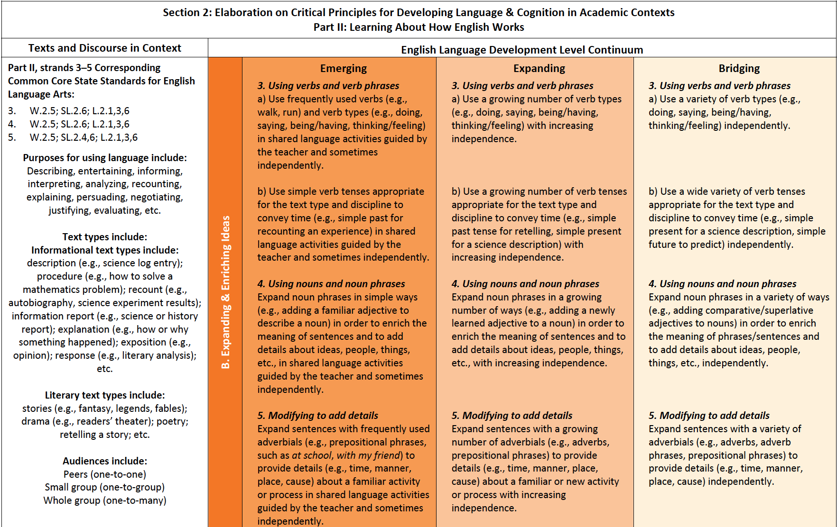
Part II: Learning About How English Works
(ELD Content)
Notes:
30 seconds.
Let’s look at Part II, section B. Expanding and Enriching Ideas to practice with.

Slide 22
When analyzing a Part II ELD standard, ask yourself what is the grammatical structure and why do we use this structure?
Part II:
B. Expanding & Enriching Ideas
3. Using verbs and verb phrases
Use a growing number of verb types (e.g., doing, saying, being/having, thinking/feeling) with increasing independence.
Use a growing number of verb tenses appropriate for the text type and discipline to convey time (e.g., simple past tense for retelling, simple present for a science description) with increasing independence.
Structure/What?
Purpose/Why?
verb tenses
convey time
Notes:
2 minutes
Let’s examine Part II. B 3: Using verbs and verb phrases
Click animation:
Read the question at the top.
Click animation (first bubble):
In this standard the “what” is verb tenses. Students will learn about verb tenses.
Click animation (second bubble):
What is the purpose for examining verb tenses, “the why”? To convey time.

Slide 23
Developing ELD Objectives
Students will be able to (function) (ELD content) using (form/specific language) in a
(type of engagement activity).
ELD
Standards
ELD
Objective
Part II: Learning How English Works
Part I: Interacting in Meaningful Ways
Notes:
30 seconds
Click animation(bracket):
We look to Part I: Interacting in Meaningful Ways to see the type of engagement activity we will be using.

Slide 24
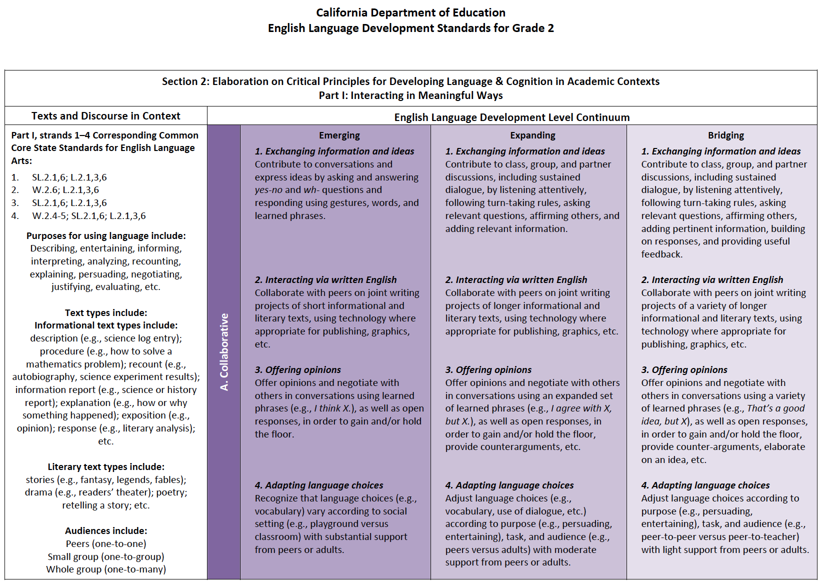
Part I: Interacting in Meaningful Ways
(Type of Activity)
Notes:
30 seconds on this slide.
Let’s look at Part I, section A. Collaborative mode

Slide 25
Part I: Interacting in Meaningful Ways
Guided Practice
Part I
Collaborative (Mode)
1. Exchanging information and ideas
Contribute to class, group, and partner discussions, including sustained dialogue, by listening attentively, following turn‐taking rules, asking relevant questions, affirming others, and adding relevant information.
Contribute to class, group, and partner discussions
Notes:
30 seconds
Ask: How will students collaborate?
Click animation (purple text):
Class and partner discussions.

Slide 26
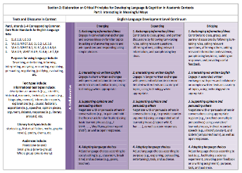
Developing ELD Objectives
Example
Students will be able to analyze verb tenses appropriate to text type and
disciplines to convey time using simple past tense and building on each
other’s ideas during paired and whole group discussions.
Students will be able to (function) (ELD content) using (form/specific
language) in a (type of engagement activity).
analyze
using simple past tense
verb tenses appropriate to text type
disciplines to convey time
building on each
other’s ideas during paired and whole group discussions
Part I: Interacting in Meaningful Ways
Part II: Learning How English Works
Notes:
5 minutes on this slide
Now we will take a look at how it all comes together. Let’s look at the example ELD Objective we created.
Click animation:
Here is our formula (scaffold) –”Students will be able to…”
Click on animation:
The function might come from the Teacher Resources section of the CA ELD Standards. In our example, what is the function? Click animation: Analyze
Click animation:
The ELD Content… Click on animation: …comes from Part II of the ELD Standards. What is the content in this example?
Click on animation:
verb tenses appropriate to text type and disciplines to convey time
Click on animation:
The form/specific language comes from the standards. What is the form or specific language to be used in this example? Click on animation:
…using simple past tense. This is what we will hear from the students, simple past tense.
Click on animation:
The type of engagement activity…. Click on animation:
…comes from Part I: Interacting in Meaningful Ways. What is the type of activity we are having students engage in for this example?
Click on animation:
Building on each other’s ideas during paired and whole group discussions.

Slide 27
Developing ELD Objectives
ELD
Standards
Part II: Learning How English Works
Part I: Interacting in Meaningful Ways
Notes:
1 minute
The ELD Objectives should include both Part I and Part II of the CA ELD Standards.
Notice that Part II is above Part I because Designated ELD leads with Part II.

Slide 28
Part II: Learning About How English Works
(ELD Content)
Part II:
6. Connecting Ideas:
Combine clauses in an increasing variety of ways to make connections between and to join ideas, for example, to express cause/effect
(e.g., She jumped because the dog barked.) with increasing independence.
Structure/What?
Combine clauses
Purpose/Why?
ideas
make connections between and to join
express cause/effect
Function
because
Form/Specific language
Notes:
2 minutes
Let’s examine Part II Standard 6. Connecting Ideas. Read the standard
Click animation (first bubble):
In this standard the “what” is combine clauses. Students will learn how to use combined clauses in an increasing variety of ways.
Click animation (second bubble):
What is the purpose for combining clauses, “the why”? To make connections between and join ideas.
Click animation (specific language):
This standard includes specific language students will use, such as ‘because’.

Slide 29
Part I: Interacting in Meaningful Ways
Guided Practice
Part I
Collaborative (Mode)
1. Exchanging information and ideas
Contribute to class, group, and partner discussions, including sustained dialogue, by listening attentively, following turn‐taking rules, asking relevant questions, affirming others, and adding relevant information.
Contribute to class, group, and partner discussions
Notes:
30 seconds
Now let’s look at Part 1 A. 1. Exchanging information and ideas. How will students use the language?
Click animation (purple text):
Contribute to class, group, and partner discussions.

Slide 30
Practice & Apply
Identify the components of ELD Objectives using Part I and Part II of New CA ELD Standards
Students will be able to (function) (ELD content ) using (form/specific
language) in a (type of engagement activity).
Collaboratively work with a partner to identify the different components
  of the sample ELD Objectives
Be prepared to share
Teacher Resources:
Purposes for Using Language
Part II: Learning
How English Works
Part II: Learning
How English Works OR other sources
Part I: Interacting in Meaningful Ways
Notes:
2 minutes on this slide
Read first bullet.
Click on animation:
The function can be pulled from Part I/II teacher resources section under Purposes for Using Language.
Click on animation:
The ELD Content comes from Part II: Learning About How English Works.
Click on animation:
The form or specific language can come from Part II or other resources or the target language you are teaching such as descriptive words for adjectives/adverbs, noun phrases, etc.
Click on animation:
The type of engagement will come from Part I: Interacting in Meaningful Ways.
Read last two bullets:
Collaboratively work with a partner to identify the different components of the sample ELD Objectives
Be prepared to share

Slide 31
Guided Practice
Example ELD Objective
Students will be able to express cause and effect by combining clauses and joining ideas using specific terms such as because of, since, therefore while working collaboratively in a discussion with a partner.
express cause and effect
combining clauses and joining ideas
because of, since, therefore
collaboratively in a discussion with a partner
Students will be able to (function) (ELD content ) using (form/specific language) in a (type of engagement activity).
Notes:
4 minutes
Read the example ELD Objective
Let participants know that they will identify the components of an ELD Objective.
Give them 2 minutes to read the objective and to process quietly.
After 2 minutes ask:
What is the function? Click animation: express cause and effect
What is the ELD Content? Click animation: by combining clauses and joining ideas
What is the form or specific language? Click animation: because, of since, therefore
What is the type of activity? Click animation: working collaboratively in a discussion with partner

Slide 32
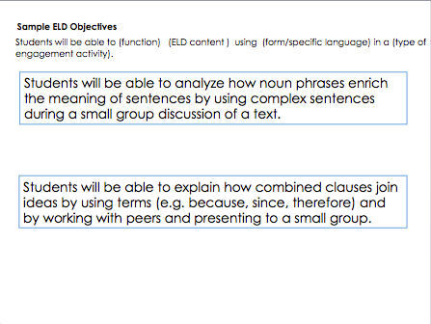
Analyze ELD Objectives
  Students will be able to (function) (ELD content ) using (form/specific language) in a (type of engagement activity).
  READ sample ELD objectives
  Work with a partner to IDENTIFY the following:
    Function (Circle)
    ELD Content (Underline)
    Form/Specific Language (Box)
    Type of Activity (Squiggly Line)
  At the signal, join another pair to COMPARE your responses
  Be prepared to SHARE whole group
Notes:
8 minutes
4 minutes to work with a partner
4 minutes to share their answer with another partner pair
Now participants will engage in an independent practice activity.
Read the directions on the slide
Ask a participant to restate the directions.

Slide 33
Independent Practice-Whole Group Share
Sample ELD Objectives
Students will be able to (function) (ELD content ) using (form/specific language) in a (type of engagement activity).
Students will be able to analyze how noun phrases enrich the meaning of sentences by using complex sentences during a small group discussion of a text.
Students will be able to analyze how noun phrases enrich the meaning of sentences by using complex sentences during a small group discussion of a text.
Students will be able to explain how combined clauses join ideas by using terms (e.g. because, since, therefore) and by working with peers and presenting to a small group.
Students will be able to explain how combined clauses join ideas by using terms (e.g. because, since, therefore) and by working with peers and presenting to a small group.
Notes:
2 minutes
Display the two sample ELD Objectives.
Ask (for each text box):
What is the function?
What is the ELD Content?
What is the form or specific language?
What is the type of activity?
Click on animation (color coded boxes):
Reveal what the components are.

Slide 34
Student-Friendly ELD Objectives
Teacher Example for planning purposes;
Students will be able to analyze verb tenses appropriate to text type to convey time using simple past tense and building on each other’s ideas during paired and whole group discussions.
Example of student-friendly ELD Objectives:
I will analyze verb tenses that show time using simple past tense and build on other’s ideas.
Example of student-friendly ELD Objectives:
  I will analyze verb tenses.
  I will use simple past tense.
  I will build on other’s ideas.
Notes:
2 minutes
ELD Objectives are created to help with planning. A classroom teacher will use the ELD Objective to guide his or her planning of Designated ELD, however…
Click on animation:
For students, we need to make the objective more student friendly. We are not asking teachers to chart the lengthy ELD Objective that was created, but they should consider making this objective more accessible to students.
Give participants time to read the example.
Click on animation:
Here is another example. Give participants time to read this example.
We are not requesting that the student-friendly objectives be written in a specific way. Teachers will have flexibility in how they create student friendly objectives, as long as it is comprehensible to the students.

Slide 35
Student-Friendly ELD Objectives
Independent Practice
Students will be able to analyze how noun phrases enrich the meaning of sentences by using complex sentences during a small group discussion of a text.
Notes:
3 minutes
Let participants know that we will now engage in a guided practice activity for creating student-friendly ELD Objectives.
Directions:
Read the ELD Objective.
Write at least one example of a student-friendly version of this objective
Share example with an elbow partner.
Give participants time to create a student friendly objective.
Have a couple of volunteers share out their examples.

Slide 36
© Zwiers, O’Hara, & Pritchard (2014)
Notes:
2 minutes
Today we worked on continuing to build our understanding of the ELD Frame of Practice and the connection between mentor text and ELD Part II standards a lesson for the Using Complex Text section of the Frame of Practice. And we learned how to craft ELD objectives.
Ask: What might be some new learnings that you would like to share from what we did today?

Slide 37
Planning a Designated ELD Lesson
Read the Using Complex Text section of the ELD Frame of Practice
  Develop your lesson based on Using Complex Text section
  Select a Part II: Learning How English Works standard
  Select a mentor text that exemplifies the linguistic feature of the selected Part II standard
  Turn the standard into a focus question
  Identify examples of the linguistic feature in each sentence
  Create guiding questions for each example
  Write an ELD Objective
Remember to include a Constructive Conversation Skill to open the lesson (Fostering Academic Interactions)
Remember to include the Differentiated Instruction and Wrap Up in your lesson (Fortifying Complex Output)
Create a Flow Map of your lesson highlighting the essential components from the Frame of Practice
Notes:
1 minute
1. Share with particpants that we already planned many of the pieces together (Notice the items that are checked off). There are other points in the Using Complex Text Section of the Designated ELD Frame of Practice that are next steps in planning a complete Designated ELD lesson.
2.When planning a Designated ELD Lesson, the mentor text is used at least for two days: on Day 1 the linguistic feature is identified; on Day 2 and onward the students dig into the grammatical structure being used and its purpose in accordance to the selected ELD Standard.

Slide 38
Learning Outcomes
Continue to build understanding of the ELD Frame of Practice for Designated ELD instruction
Understand the connection between mentor text and ELD Part II Standards
Provide and receive feedback on a draft of a Designated ELD Lesson
Understand the connection between ELD Objectives and the ELD Standards
Notes:
1 minute
Have participants read each bullet.

Slide 39
HANDOUTS
Notes:
Please copy the following handouts before presenting Module 2.
Make 1 Mentor Matching puzzle for each partner pair.

Slide 40
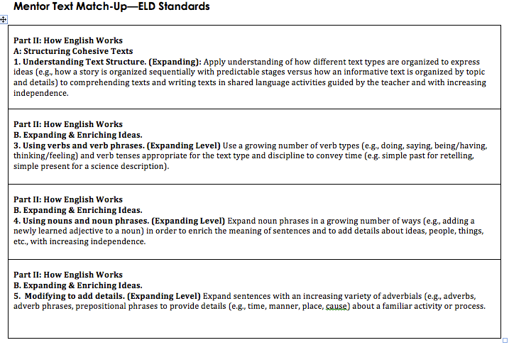

Slide 41
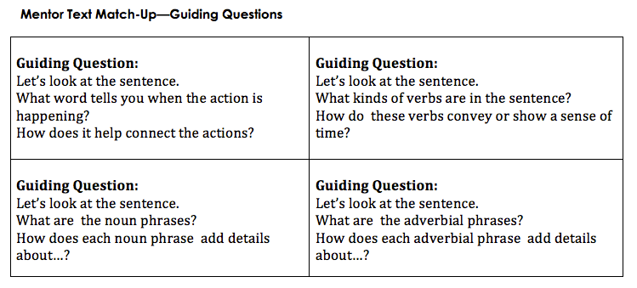

Slide 42
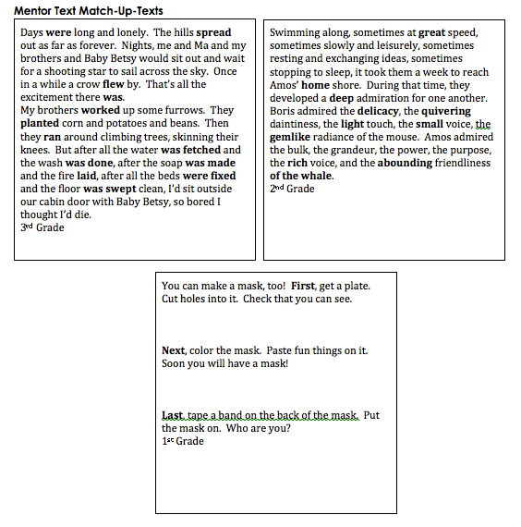

Slide 43
Developing ELD Objectives
Students will be able to (function) (ELD content) using (form/specific language) in a (type of engagement activity).
ELD
Standards
ELD
Objective
Part I: Interacting in Meaningful Ways
Part II: Learning How English Works
Notes:
2 minutes Note: you may want to create a color coded chart of the ELD objective sentence frame and post in front of room as a scaffold
We develop an ELD Objective from the CA ELD Standards, leading with Part II, Learning About How English Works.
Click animation (“Students will be able to…”):
We’ve developed a formula for creating ELD Objectives. We will highlight the function, ELD Content, form and specific language, as well as the type of engagement activity.
Click animation (brackets on ELD Content):
The ELD content portion will come from CA ELD Standards Part II: Learning About How English Works. What are students going to learn about language?
Click animation (function):
The function may come from the Teacher Resource section under Purposes for Using Language (not always, but it’s one place to look for it). How are students going to be asked to use language?
Click animation (form/specific language):
The form and/or specific language will also come from Part II. What might that language sound like?
Click animation (bracket for type of engagement activity):
For the type of engagement activity, you look at Part I: Interacting in Meaningful Ways of the CA ELD Standards. How will students practice language?

Slide 44
Developing ELD Objectives
Example
Students will be able to analyze verb tenses appropriate to text type and
disciplines to convey time using simple past tense and building on each
other’s ideas during paired and whole group discussions.
Students will be able to (function) (ELD content) using (form/specific
language) in a (type of engagement activity).
verb tenses appropriate to text type
disciplines to convey time
using simple past tense
analyze
building on each
other’s ideas during paired and whole group discussions
Part I: Interacting in Meaningful Ways
Part II: Learning How English Works
Notes:
5 minutes on this slide
Now we will take a look at how it all comes together. Let’s look at the example ELD Objective we created.
Click animation:
Here is our formula (scaffold) –”Students will be able to…”
Click on animation:
The function might come from the Teacher Resources section of the CA ELD Standards. In our example, what is the function? Click animation: Analyze
Click animation:
The ELD Content… Click on animation: …comes from Part II of the ELD Standards. What is the content in this example?
Click on animation:
verb tenses appropriate to text type and disciplines to convey time
Click on animation:
The form/specific language comes from the standards. What is the form or specific language to be used in this example? Click on animation:
…using simple past tense. This is what we will hear from the students, simple past tense.
Click on animation:
The type of engagement activity…. Click on animation:
…comes from Part I: Interacting in Meaningful Ways. What is the type of activity we are having students engage in for this example?
Click on animation:
Building on each other’s ideas during paired and whole group discussions.

Slide 45
Practice & Apply
Identify the components of ELD Objectives using Part I and Part II of New CA ELD Standards
Students will be able to (function) (ELD content ) using (form/specific
language) in a (type of engagement activity).
Collaboratively work with a partner to identify the different components
  of the sample ELD Objectives
Be prepared to share
Teacher Resources:
Purposes for Using Language
Part II: Learning
How English Works
Part II: Learning
How English Works OR other sources
Part I: Interacting in Meaningful Ways
Notes:
2 minutes on this slide
Read first bullet.
Click on animation:
The function can be pulled from Part I/II teacher resources section under Purposes for Using Language.
Click on animation:
The ELD Content comes from Part II: Learning About How English Works.
Click on animation:
The form or specific language can come from Part II or other resources or the target language you are teaching such as descriptive words for adjectives/adverbs, noun phrases, etc.
Click on animation:
The type of engagement will come from Part I: Interacting in Meaningful Ways.
Read last two bullets:
Collaboratively work with a partner to identify the different components of the sample ELD Objectives
Be prepared to share

Slide 46
Sample ELD Objectives
Students will be able to (function) (ELD content ) using (form/specific language) in a (type of engagement activity).
Students will be able to analyze how noun phrases enrich the meaning of sentences by using complex sentences during a small group discussion of a text.
Students will be able to explain how combined clauses join ideas by using terms (e.g. because, since, therefore) and by working with peers and presenting to a small group.
Notes:
Copy for Handout

