Slide 1

2018-2019
Budgeting for
Student Success
Title 1-7S046
College-prepared
and
Career-ready
Celina Reynoso
Susan Jamerson
Local District West Title I Coordinators
celina.reynoso@lausd.net
susan.jamerson@lausd.net
(310)914-2134/45

Slide 2
Objectives
To develop a deeper understanding of:
Purpose of Title 1 Program Funds
Most Common Audit Findings
What’s New
Online Single Plan for Student Achievement (SPSA) /Budget Document
Budget Program Guidelines
Budget Development Process
Reminders

Slide 3
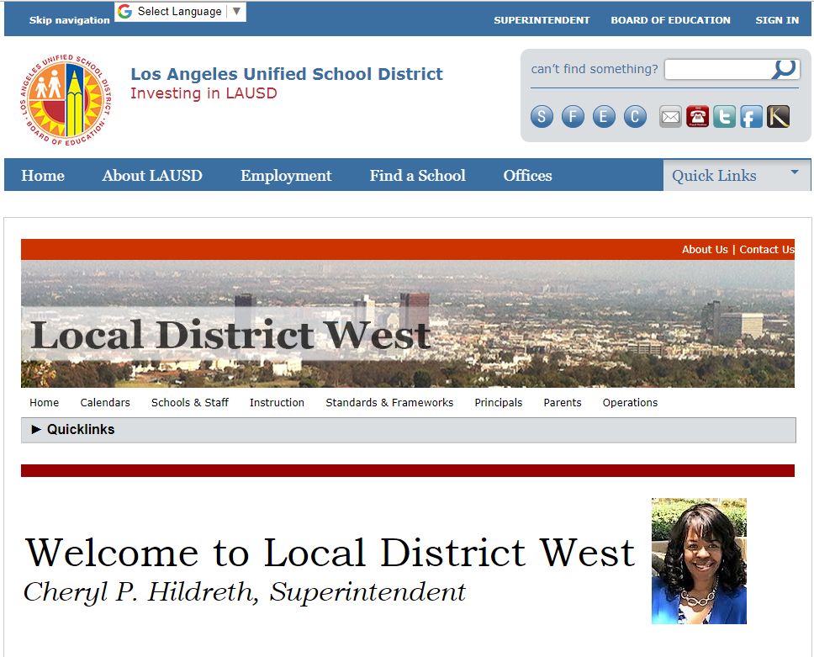
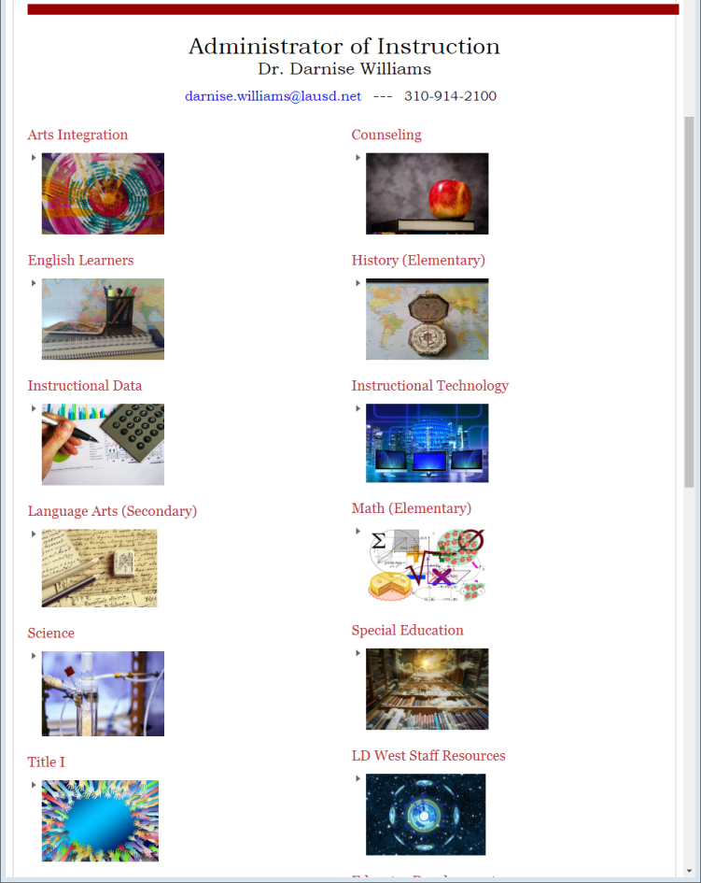
2018-2019 Budget Development Power Points
ldwest.net
Instruction
Title 1

Slide 4

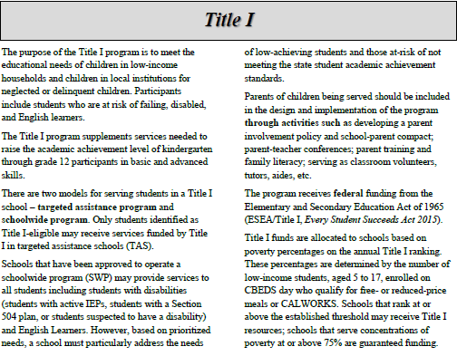

Purpose of Title I
HC: 53
Online:64-65
An instructional program that provides services to low-achieving children to meet academic standards
A federally-funded program designed to serve high-poverty areas for the benefit of economically-disadvantaged children.

Slide 5
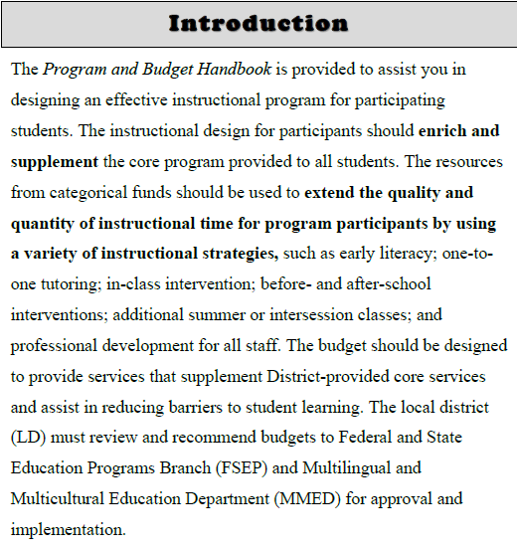
Supplement vs. Supplant
HC: 1
Online:6-7
Resources from the categorical funds should be used to:
Supplement the District provided core services
Extend the quality and quantity of instructional time
Assist with reducing barriers for student learning

Slide 6
2018-2019 School Year Title I Ranking
Eligibility for the free/reduced price meal program is reported to the state via the California Longitudinal Pupil Achievement System (CALPADS) and is then used as part of the calculation in determining a school’s Title I ranking.
Students meeting all three criteria listed below were included in the counts for 2018-2019 Title I ranking:
1. Student must be enrolled at the school by the 2017-18 Fall Census Day (i.e., CBEDS Day) which is October 4, 2017; and
2. Student must be 5 – 17 years old on October 4, 2017; and
3. Student must have submitted a complete 2017-18 meal application by
October 26, 2017 and determined to be eligible for free/reduced-price meals.
Notes:
Lunch app is how schools get funds through LCFF and Title I. If kids don’t turn in app, schools won’t get funding.
(H
For the 2018-2019 school year Title I Ranking, the CBEDS Day is October 4, 2017 and the lunch applications will be due by October 26, 2017.
ow they got the money for this year)

Slide 7
SY 2018-2019
How are schools funded?
  Title l 7S046
  Parent Involvement 7E046
Poverty Percentage | Per Pupil Rate*
65% - 100% | $
50% - 64.99% | $
Poverty Percentage | Per Pupil Rate*
65% - 100% | $
50% - 64.99% | $
Notes:
In 2017-2018 Tier 1 was $669 and Tier 2 was $509. Parent was $11 and $9

Slide 8
Restricted
Federal Budgets with “Strings”
Title I (7S046) for SWP
Title I (70S46) for TAS
Title I Parent Involvement (7E046)
Title III (7T197)
Middle School College and Career Coach Allocation (7T124) – only middle schools or SPAN schools that serve middle school students receive this allocation
Notes:
Others not mentioned are SIG, Gear Up, Perkins, etc.

Slide 9
Title I Allocations
Allocation letters are scheduled
to be emailed to principals on
March 14th by 5 p.m.
Budget Development will be from:
March 14 to April 18, 2018

Slide 10


Title I Models for Serving Students
Targeted Assistance Program (TAS) – this model provides supplemental services to identified children who are low-achieving or at risk of low-achievement.
Schoolwide Program (SWP) - this model funds a comprehensive school plan to upgrade all the instruction in a high-poverty school, without distinguishing between “eligible” and “ineligible” children.
Notes:
2 types of models to serve students. All schools should be SWP, use field trip example in TAS, only identified students go, in SWP all can go.

Slide 11

Flexibility and Accountability
In a Schoolwide program,
the Schoolwide Plan becomes a key document used for audits and compliance monitoring
Expenditures will be reviewed based on the plan
Are the expenditures tied to needs, outcomes, and actions described in the plan?
Are actions and related expenditures clearly defined in the plan?
Are activities and related expenditures based on the comprehensive needs assessment?
Excerpt from LACOE presentation, October 26, 2017
Notes:
But just because it is in the SPSA does not necessarily mean that it will be allowed.

Slide 12
HC: 61
Online:74-75
Conduct comprehensive needs assessment, including data analysis/SPSA Evaluation
Monitor the implementation of the SPSA
Develop measurable objectives and identify strategies/actions/tasks in the SPSA Goal Pages
Cycle of Continuous Improvement
Identify expenditures in the budget related columns and ensure alignment with the strategies/actions tasks described in the SPSA Goal
Develop budgets based upon prioritized expenditures that support the strategies/actions tasks described in the SPSA Goal Page Columns

Slide 13
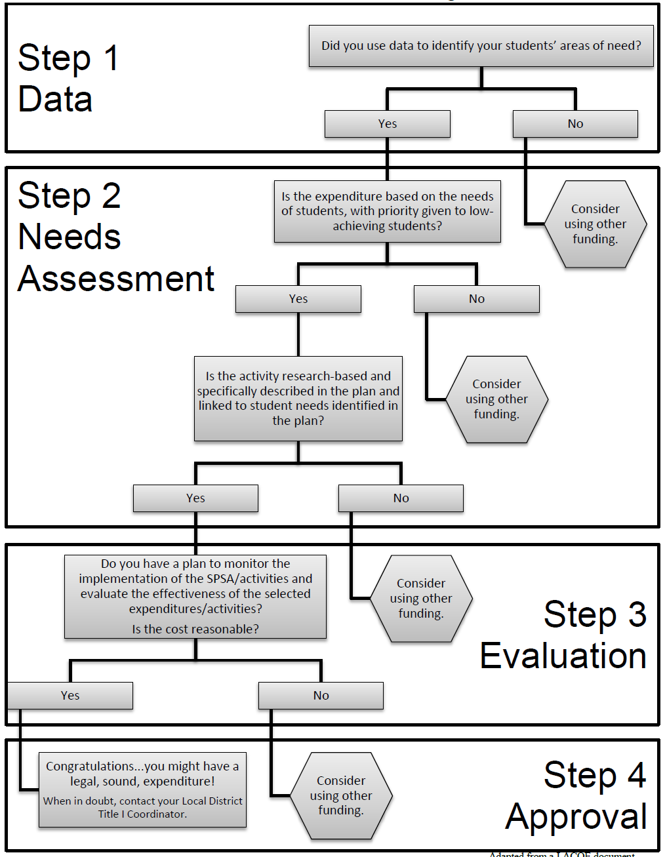
HC: 64
Online:78-79
Title I School Level Decision Making

Slide 14
Title I Cost Principles
(Allowable, Reasonable, and Allocable)
Must be “necessary” (i.e., expenditure is necessary in order to address an identified need and achieve one or more of the goals in the school plan)
Must be “reasonable” (i.e., the cost does not exceed that which would be incurred by a prudent person under the circumstances prevailing at the time the decision was made to incur the cost.)
Must be “allocable” (i.e., the goods or services are chargeable to the program in accordance with relative benefits received.)
Authorized or not prohibited under state or local laws or regulations
Must be adequately documented
Notes:
Based on EDGAR (Education Department General Administrative Regulations) 2 CFR Part 200 section 200.402

Slide 15
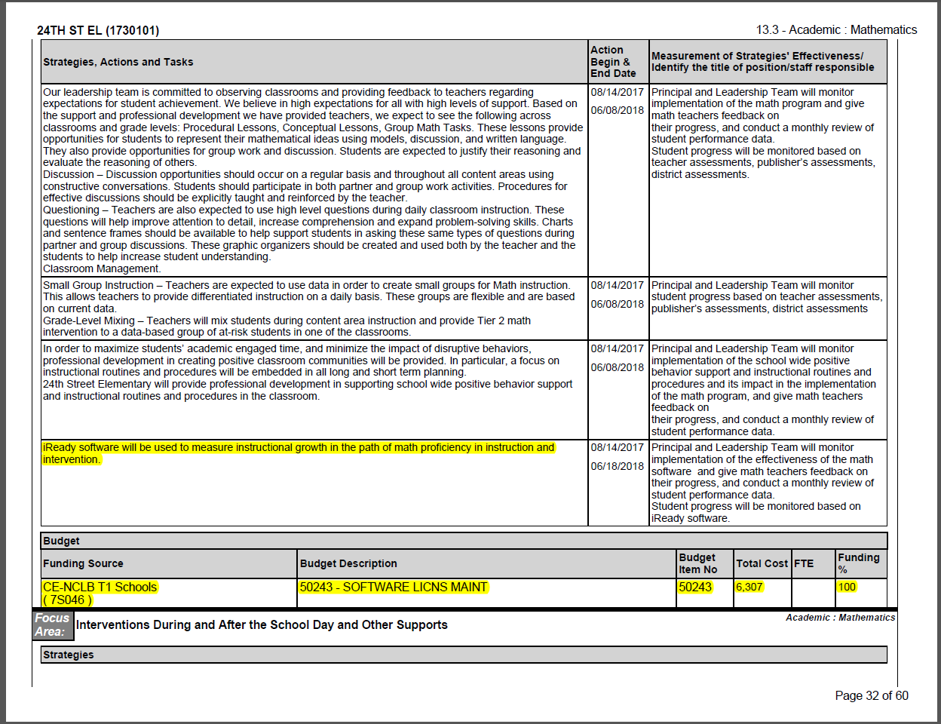
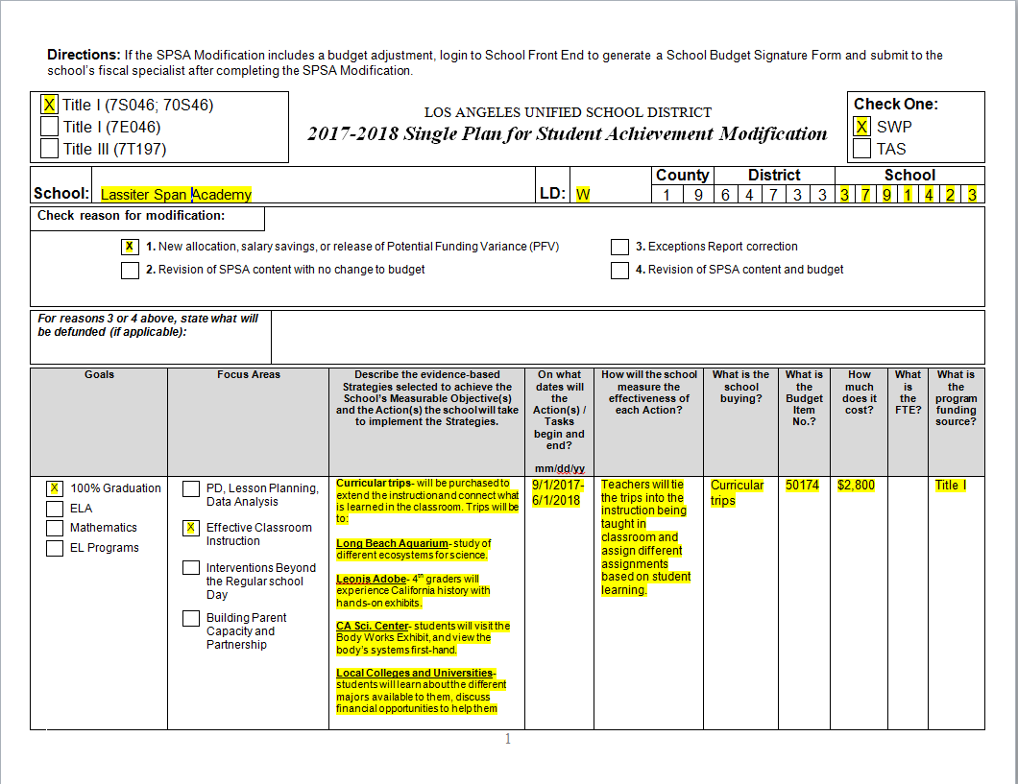
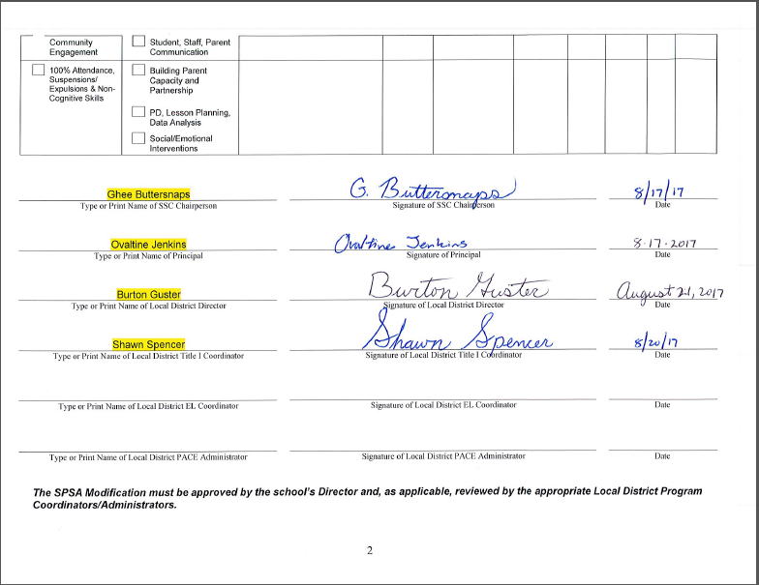
Your SPSA
All Title I purchases must be listed on your school’s approved SPSA or SPSA Modification.

Slide 16
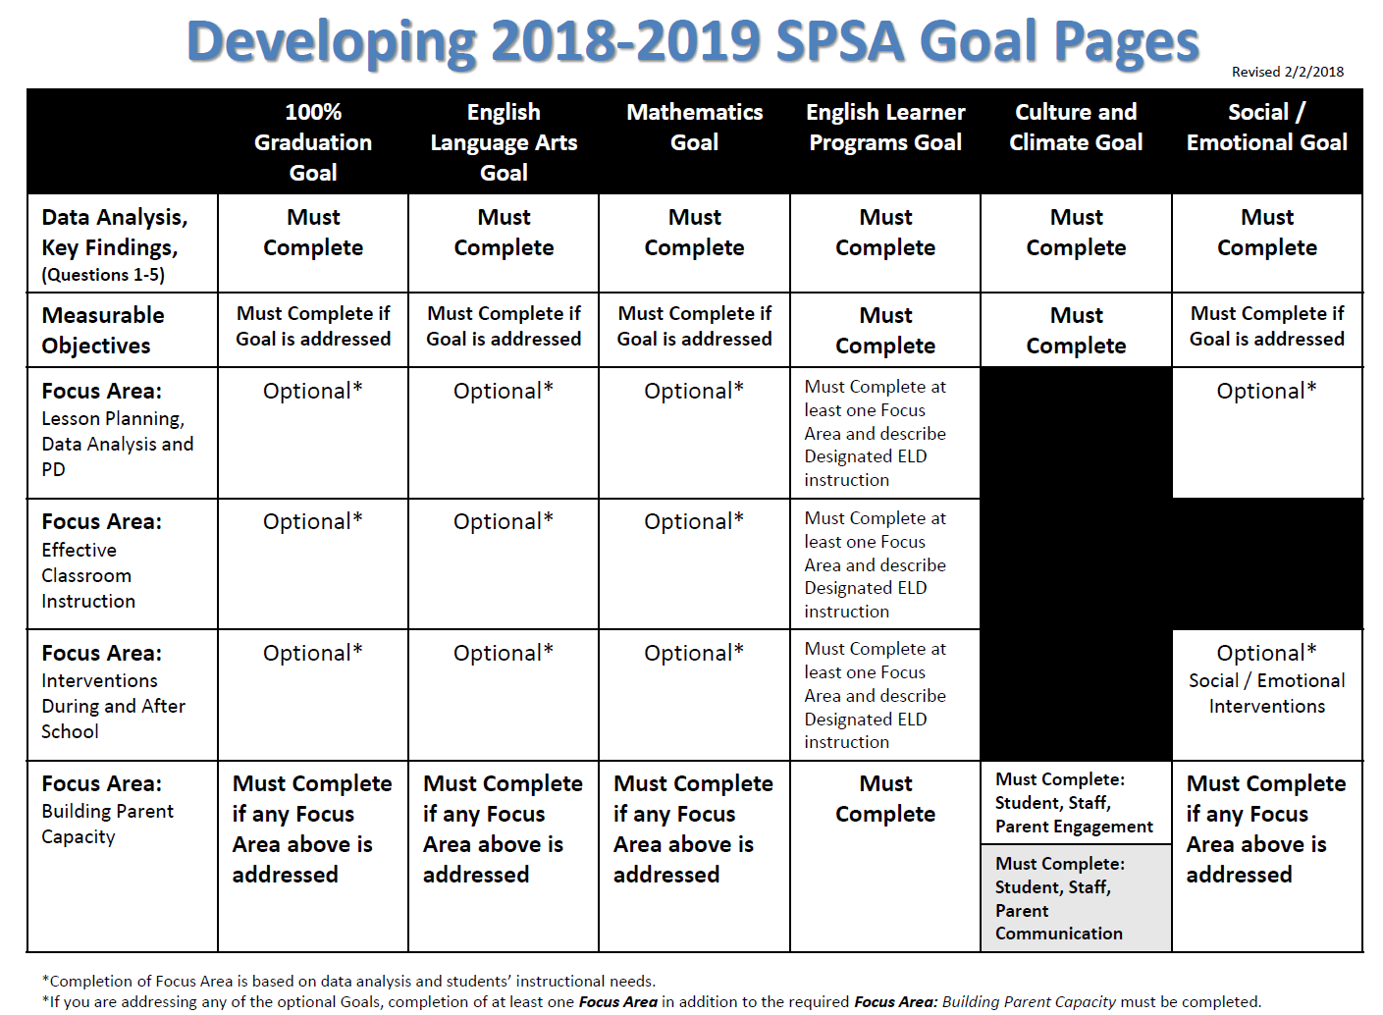

Slide 17
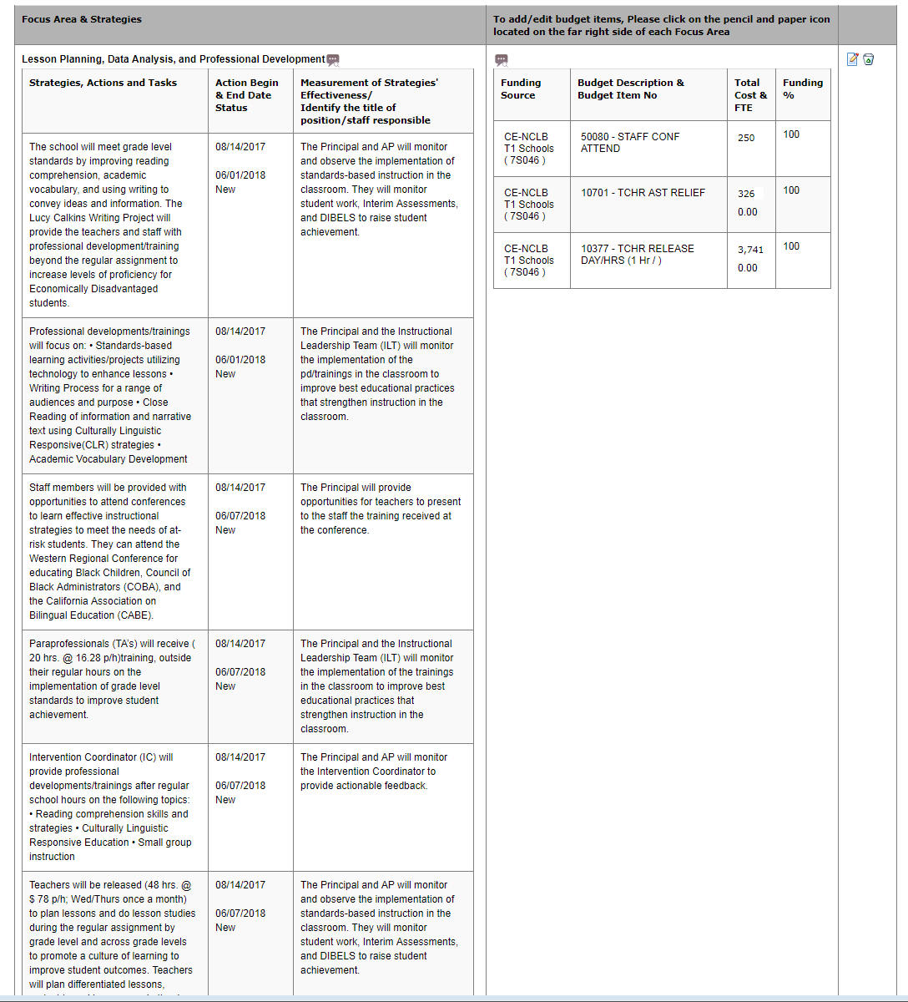
School’s budget items must be aligned to the Strategies, Actions and Tasks otherwise the SPSA will not be approved.
SPSA Goal Page

Slide 18
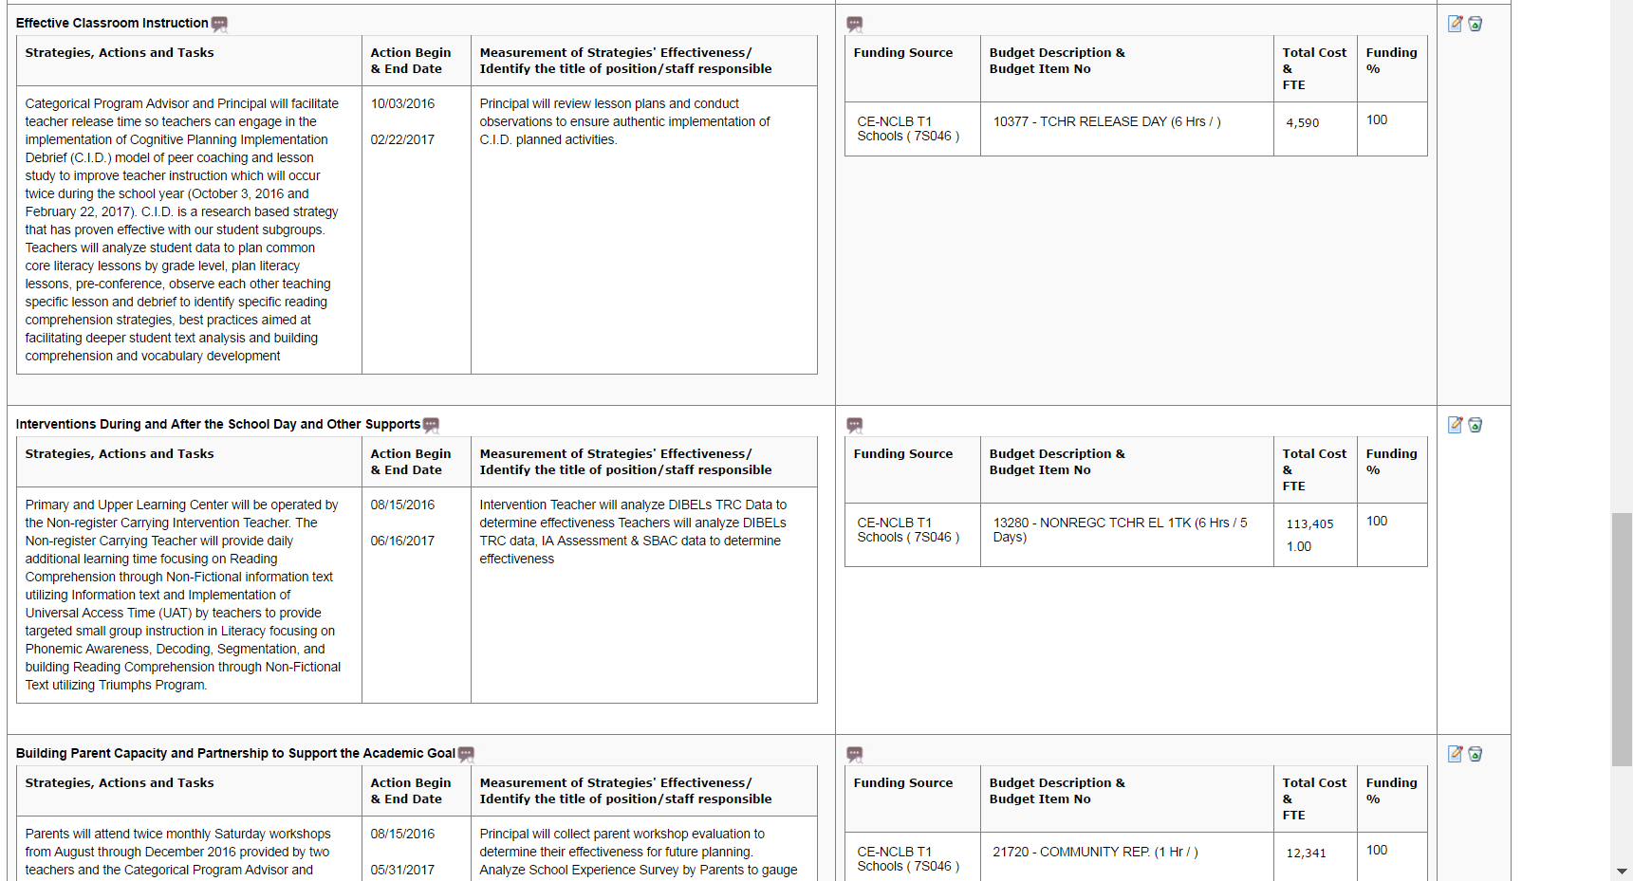
In writing the SPSA, the school will need to be as accurate as possible when listing cost of expenditure. Cost of the expenditure must be listed with the strategy.
SPSA Goal Page
Note: A position must be entered only once

Slide 19

Common Findings during Title I Audits for Other Expenditures (OEs)
Based on our reviews, we have found the following;
SPSA documentation not being submitted during reconciliation of accounts
SIM, available through the School’s Warehouse, is not being purchased through the Warehouse
Items being charged to the wrong line (ex. SLM instead of SIM)
Expenditures not in compliance with Title I regulations
    non-curricular trips
    general supplies, toner
    school website maintenance
Expenditures purchased last school year
were not reconciled by the end of that school year.

Slide 20

Common Findings during Title I Audits on Payroll Expenditures
Schools are not clearing payroll negatives whether the overdrafts are because funds were not budgeted in the commitment line or the funds have exceeded the budgeted amount.
Misconception: Because you have unspent funds in other commitment lines, the negatives will be offset. Wrong, Title I funds are under the purview of School Site Council (SSC) and therefore SSC is the only approving body that can move these funds to the various lines.

Slide 21

What’s New for 2018-2019
Monitoring
The use of all federal funds allocated to school sites (i.e., Title I and Title III) must be adequately described in the Single Plan for Student Achievement (SPSA)
The SPSA is an auditable document during Federal Program Monitoring (FPM) reviews and external annual audits conducted by Simpson & Simpson
All expenditures must be allowable in accordance with program regulations and meet federal cost principles such as “necessary” and “reasonable”.
The FSEP office routinely monitors all Title I expenditures throughout the year.
For expenditures that are questionable:
  FSEP may require additional information and/or documentation (i.e., lesson plan, purpose and intent, who will be attending? how the expenditure will benefit students academically? how does the expenditure support your academic program? the data used to determine the need, how will the effectiveness of this strategy be monitored?).
  In instances where expenditures are deemed unallowable, schools will be required to use non-federal funds to pay back the Title I program.
Notes:
The reasons for changes in Title I Policies are based on audit findings from FPM, Simpson and Simpson and internal audits.

Slide 22


What’s New for 2018-2019
Monitoring
Greater scrutiny on curricular trip destinations
Travel conferences review will be conducted prior to the travel being approved. The Travel Desk will send a copy of the travel form to FSEP to verify that the conference is in the SPSA.
Notes:
The reasons for changes in Title I Policies are based on audit findings from FPM, Simpson and Simpson and internal audits.

Slide 23

What’s New for 2018-2019
New Language On When Title I Funds
Will Be Frozen
Prompt Submission of Title I Related Documents:
If a school has not provided the required documentation by the specific deadlines, the school’s Title I budget will be frozen until the required documentation (completed SPSA, SPSA Evaluation, SSC Certification) has been submitted.
The freezing of a school’s Title I budget will also pertain to missing Categorical Equipment Inventory (CEI) and unpaid paybacks.
Notes:
Title I regulations require that a school has a completed SPSA and a SPSA Evaluation as well as a School Site Council (SSC) that meets state composition requirements in order for the current year’s Title I funds to be expended.

Slide 24

What can I do to ensure
my school is compliant?
Suggestions for avoiding a payback:
Curricular Trips- Have a system in place to ensure your trip requestors are aware of the procedure
Title I Designee- is aware of what items have been described in your school’s SPSA
SAA/Time Reporter- is using control sheets
Schedule meetings with your Fiscal Specialist to review budgets
Maintain copies of SPSA Modifications
DO NOT delete or ignore emails from your LD Title I Coordinator or FSEP office

Slide 25

2018-2019 Program and Budget Handbook
Instructional tool to assist in developing your instructional program for 2018-19

Slide 26
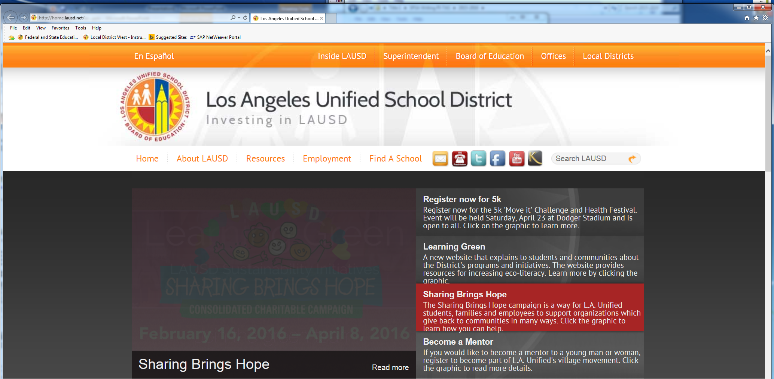
2018-2019 Budget Development Resources
Offices
Federal and State Education Programs

Slide 27
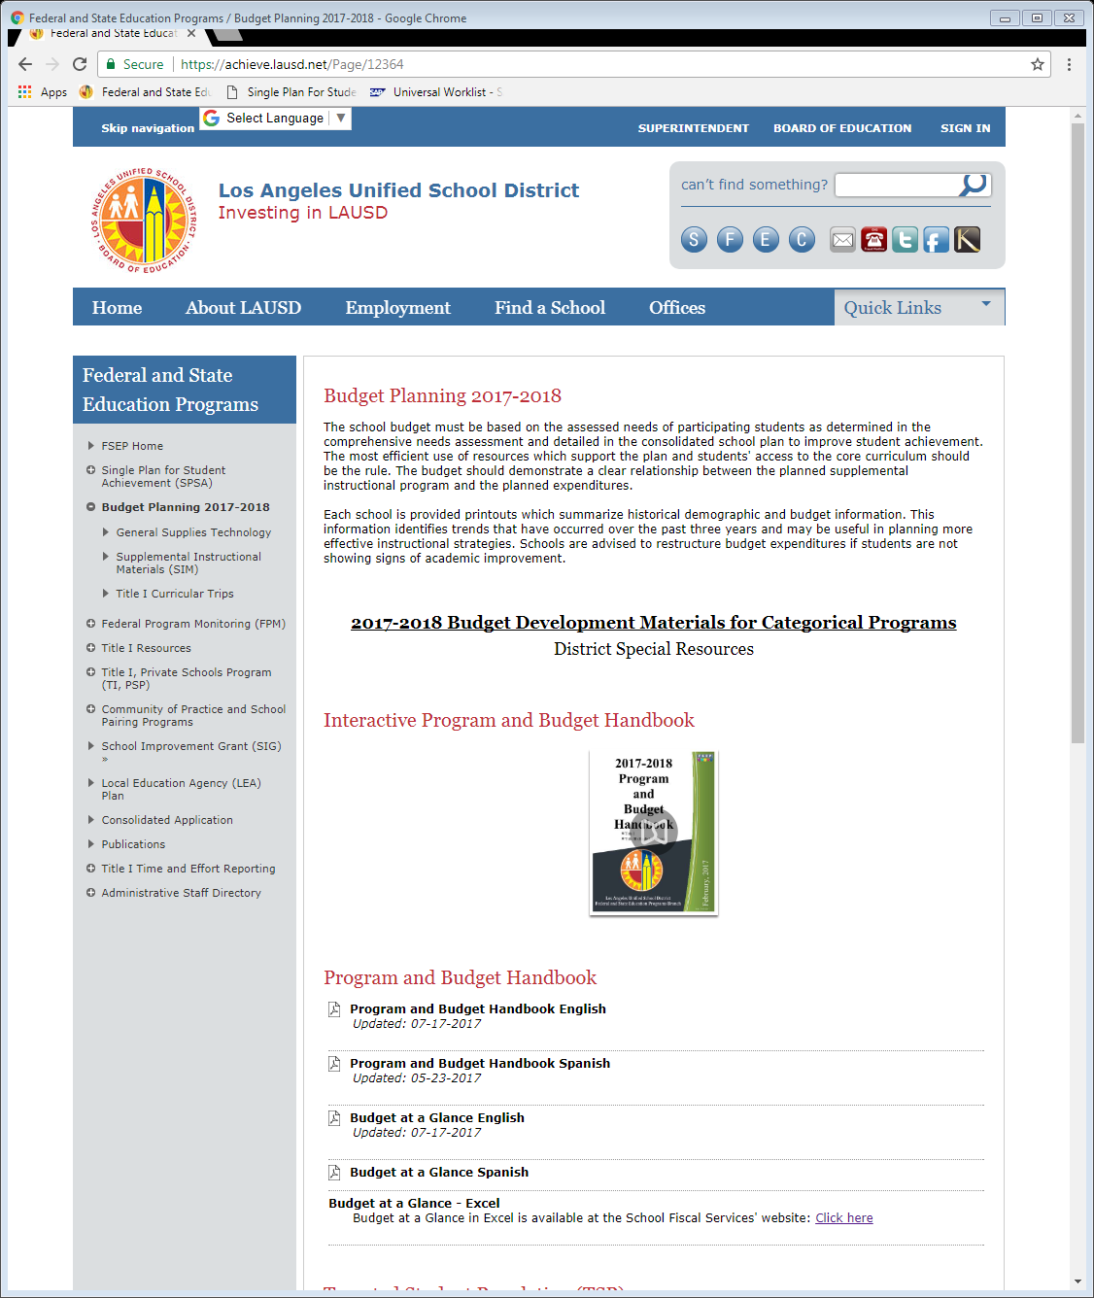
2018-2019 Budget Development Resources
Budget Planning 2018-2019
Handbook

Slide 28

What’s New for 2018-2019
New Title I Resources for the User
Interactive Program and Budget Handbook
https://achieve.lausd.net/Page/12364
Title I Time reporting FAQ and other resources
https://achieve.lausd.net/Page/13242
A list of allowable Title I expenditures for schools to reference with the corresponding budget item number will be on the FSEP website.
CPA Job Description is listed under 2018-2019 Instructional Support section

Slide 29
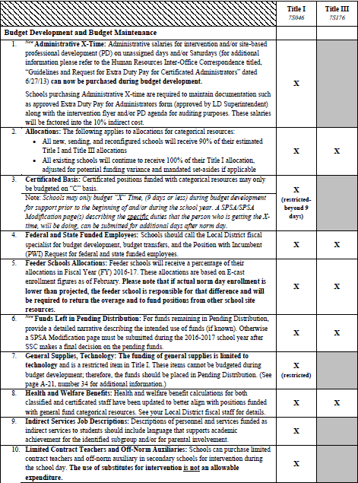
HC: 2-19
Online: 8-25
Budget Guidelines:
Program and Budget Guidelines
Do’s and Don’ts

Slide 30
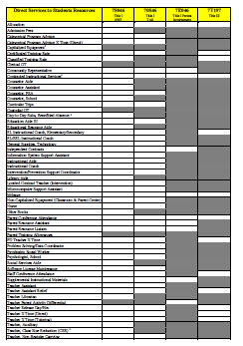
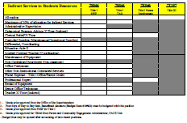
HC: 16-17
Online: 27-28
Budget-At-A-Glance
Direct Services
The following items are now Direct Services and will not count toward the 10% maximum for Indirect Services
CPA X-Time (Indirect)
Differentials – Coordinating
Limited Contract Teacher (Coordinating)
Teacher X-Time (Indirect)
Admin X-Time is still indirect
Indirect Services- 10% maximum

Slide 31
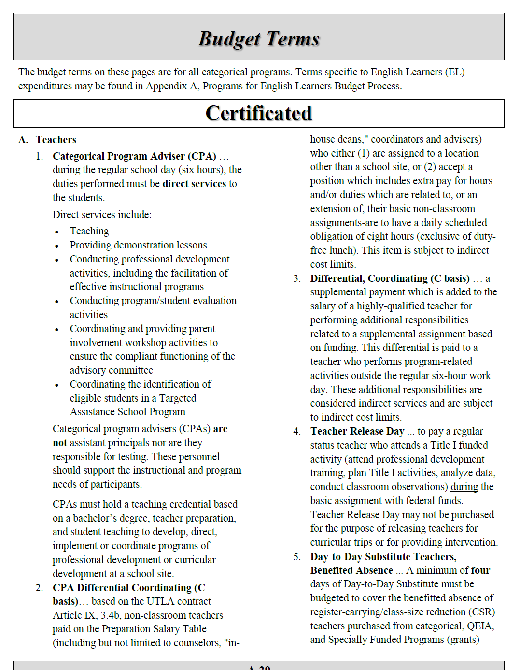

HC: 18-29
Online: 31-42
Certificated
Classified
Unclassified
Contract
Conferences, PD, Curricular Trips
Equipment, Supplies, Expense Reimbursement

Slide 32
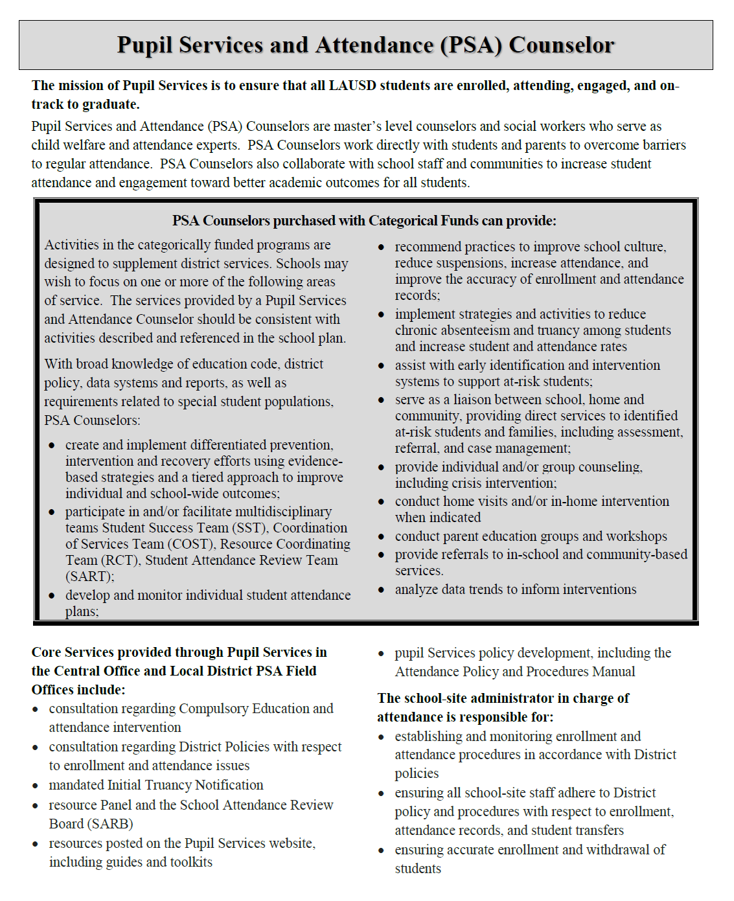

HC: 29-39
Online: 45-55

Slide 33

HC: 40-52
Online: 57-69

Slide 34
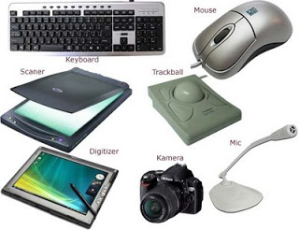
What’s New for 2018-2019
Title I Policy Changes –General Supplies-Technology
Purchasing of General Supplies-Technology:
  Expenditures for General Supplies-Technology are restricted to items of equipment with a total final cost of less than $500 (including tax, shipping, and other ancillary charges)
  Examples include laptops, IPADs, netbooks, projectors, document cameras, e-readers, graphing calculators, classroom printers, Fire sticks, Apple TV, flashdrives/memory cards, speakers, headphones, etc.
Although these items are not required to be listed on the categorical equipment inventory, a red label should be placed on them and the school should have a system in place for tracking and safeguarding these attractive items.

Slide 35



What’s New for 2018-2019
Title I Policy Changes – General Supplies-Technology
Additional technology accessories such as tablet keyboards, extra computer mouse, cases, computer bags may be purchased as General Supplies, Technology if:
The cost of the item is less than $500 per item
The additional technology accessories are purchased with the Capitalized Equipment/Non-Capitalized Equipment/General Supplies Technology Equipment
The number of additional technology accessories purchased matches the number of Capitalized Equipment/Non-Capitalized Equipment/General Supplies Technology Equipment (e.g. 10 iPADs & 10 iPAD cases)
Note: Toner supplies, ink cartridges, bulbs and paper for printers are not Title I allowable

Slide 36


What’s New for 2018-2019
Title I Policy Changes - Equipment
Non-Capitalized Equipment-total cost of $500 to $4,999 (including tax, shipping, and other ancillary charges)
Non Capitalized Equipment for classroom (computers, Duplo, laminator, poster maker)
Non Capitalized Equipment for nonclassroom –Equipment for Title I out-of-
classroom staff will be “nonclassroom equipment”
Capitalized Equipment: equipment purchases of $5,000 or higher. It should be budgeted separately
Ancillary charges: taxes, freight/shipping costs, warranty, E-waste fees, MDM License fees, LAUSD software bundle charges, Computrace charges, and technology equipment set-up fees.

Slide 37

What’s New for 2018-2019
Title I Policy Changes- Equipment
Additional technology accessories not included with the equipment (case, tablet keyboard, etc.) should not be included in the ancillary charges when determining the total cost of Non-Capitalized and Capitalized Equipment. These technology accessories may be purchased as General Supplies- Technology if allowable under Title I.
Although Non-Capitalized Equipment is now unrestricted, Capitalized Equipment (purchases of $5,000 or higher) will remain restricted and will require a manual budget adjustment request. Federal law states that Capitalized Equipment purchased with Title I funds requires prior written approval from the California Department of Education (CDE).
The deadline for submission of a budget adjustment for the restricted item is the end of March with assurances that the equipment will be received by the school on or before May 5th.

Slide 38

What’s New for 2018-2019
Title I Policy Changes – Curricular Trips
The number of destinations should match the number of trips purchased.
Schools may choose to list a few destinations with the same academic purpose if the trip is dependent on the reservation availability (e.g., Aquarium of the Pacific, Santa Monica Pier Aquarium, Cabrillo Beach Marine Museum, Roundhouse Marine Studies Lab).
Curricular trips are to support the core content areas; therefore, they cannot be budgeted for elective classes or physical education.
For curricular trips that might be interpreted as “entertainment” but that the school considers instructional and is requesting to be funded with Title I, the FSEP office may require additional documentation and/or information (i.e., lesson plan, purpose and intent, how the trip will benefit students academically, data used to determine the need) prior to approval. There will be a greater level of scrutiny for these types of destinations.

Slide 39
What’s New for 2018-2019
Title I Policy Changes –
Software Licenses with PD
Software licenses with Professional Development (PD)
If a quote has a separate cost for PD services, schools will need to budget the PD contract under commitment item 580030 (Contracted Instructional Services) in addition to the software license budget item (Renewal – Commitment Item 580020 or New License – Commitment Item 430010)
If the quote does not have a separate charge for the PD, the entire cost can be charged to the Software license commitment item.
Notes:
This policy change is because of Accounting.

Slide 40

What’s New for 2018-2019
Title I Policy Changes – Teacher Auxiliary
Teacher Auxiliary – To minimize confusion at secondary schools
Teacher Auxiliary Budget Item # 13844will be closed in Title I (Position – requires a Job ID #)
If budgeting an auxiliary for a secondary register-carrying teacher assigned to teach one additional class period each day in ELA, mathematics, history/social science and science in SWP school, use budget item #10420, Teacher Auxiliary.
Notes:
Schools will need to be clear in the SPSA on how they will be using Non-Tutor Teacher X-Time.
190004 Coordinator X-Time (Tutor)
Coordinator X-Time (Non-Tutor)

Slide 41


What’s New for 2018-2019
Title I Policy Changes – Teacher X-Time
There are two choices for X-Time (Commitment Item 110004)
Teacher X-time (Tutor) is for X-time for tutoring or intervention.
Teacher X-time (Non-Tutor) replaces PD Teacher X-time and Teacher X-Time Direct/Indirect and can be used for all activities that are not tutoring activities.
Activities are:
  Analyze data, review student work
  Attend mandated Title I or Title III allowable trainings outside of the basic assignment (e.g., after-school, Saturdays)
  Plan, organize, and coordinate locally designed intervention
  Provide/conduct Professional Development for all stakeholders
  Conduct program/student evaluation activities
  Discuss best practices, identify student needs and plan differentiated instruction
  Assist and facilitate the writing of the SPSA
  Coordinate and provide parent involvement workshop activities
  Coordinate the identification of eligible students in TAS program
  Train Community Members/Parents
  Develop/organize/select/evaluate instructional materials
  Develop/monitor/approve program activities and expenditures
  Maintain compliance documents
  Distribute program materials
  Monitor ongoing program compliance
  Develop schedules for program intervention
  Prepare for FPM
Notes:
Schools will need to be clear in the SPSA on how they will be using Non-Tutor Teacher X-Time.
190004 Coordinator X-Time (Tutor)
Coordinator X-Time (Non-Tutor)

Slide 42
What’s New for 2018-2019
Funding Percentages
Funding Percentage Options for Title I personnel have changed
(see #25 of Program and Budget Handbook).
If not listed, the funding options are 50% and 100%
Budget Item # | Budget Item Description | Job Title | Available Funding %
117360 | CAT PRG AD C1T 27/10 | Categorical Program Advisor (CPA) | 50, 60, 70, 80, 90, 100
 |  | All Clerical Personnel including Ed Aide II | 50, 100
13249 13251 13253 13255 13257 13259 13261 | CSR TCHR ELEM GK-G6 1TK | CSR Teacher, Elementary | 20, 40, 50, 60, 80, 100
13263 | CSR TCHR MS G6 | CSR Teacher, MS 6th grade | 20, 40, 50, 60, 80, 100
13641 13643 13644 | CSR TCHR SEC (ELA, HSS, MTH) 1TK | CSR Teacher, Secondary | 20, 40, 50, 60, 80, 100
13713 | CSR TCHR ELD HS | CSR Teacher, Secondary, ELD | 20, 40, 50, 60, 80, 100
14492 | ENG LRNR (EL) COACH-ES | EL Instructional Coach, Elementary | 10, 20, 30, 40, 50, 60, 70, 80, 90, 100
14494 | ENG LRN (EL) COACH-SEC | EL Instructional Coach, Secondary | 10, 20, 30, 40, 50, 60, 70, 80, 90, 100
14498 | EL/SEL INST COACH-EL | EL/SEL Instructional Coach, Elementary | 10, 20, 30, 40, 50, 60, 70, 80, 90, 100
13295 | EL/SEL INST COACH-SEC | EL/SEL Instructional Coach, Secondary | 10, 20, 30, 40, 50, 60, 70, 80, 90, 100
12110 | ITIN ELEM COUNS SCH | Elementary Counselor | 20, 40, 50, 60, 80, 100
13454 | INSTRL COACH EL C1T | Instructional Coach, Elementary | 50, 60, 70, 80, 90, 100
13297 | INSTRL COACH SEC C1T | Instructional Coach, Secondary | 50, 60, 70, 80, 90, 100
14496 | INTVN/PREV SUP COOR | Intervention/Prevention Support Coordinator | 50, 60, 70, 80, 90, 100
 |  | Itinerants (School Nurse, Psychologist, PSW, PSA) | Minimum funding 10%
14188 | MS COL & CAREER COACH | Middle School-College and Career Coach | 50, 100
13280 | NONREGC TCHR EL 1 TK | Non Register Carrying Teacher, Elementary | 20, 40, 50, 60, 80, 100
13646 | NONREGC TCHR SEC | Non Register Carrying Teacher, Secondary | 20, 40, 50, 60, 80, 100
 |  | Paraprofessionals (TA, Ed Aide III, Instructional Aide I, Ed Resource Aide) | 1-hour and 2-hour positions must be 100% funded (cannot multi-fund); 3-hour and above positions can be multi-funded 50% or 100%
26958 | PRNT RSR ASST C1T/7 | Parent Resource Assistant | 20, 40, 50, 60, 80, 100
27011 | PRNT RSR AST ARMC 1T4 | Parent Resource Assistant | 20, 40, 50, 60, 80, 100
27067 | PRNT RSR AST KORC1T4 | Parent Resource Assistant | 20, 40, 50, 60, 80, 100
27124 | PRNT RSR AST SPNC1T5 | Parent Resource Assistant (Spanish) | 20, 40, 50, 60, 80, 100
26594 | PRNT RSR LIASN C1T/7 | Parent Resource Liaison | 20, 40, 50, 60, 80, 100
13205 | PROB SOLV DT CORD C1 | Problem Solving/Data Coordinator | 50, 60, 70, 80, 90, 100
110161 | COUNS SEC C1T 27/10 | Secondary Counselor | 20, 40, 50, 60, 80, 100
108324 | TCHR E LIB C1T C2/20 | Teacher Librarian, Elementary | 50, 100
109026 | TCHR S LIB C1T 27/11 | Teacher Librarian, Secondary | 50, 100
Notes:
This is in response to last year’s issues regarding Parent Resource Assistants and Parent Resource Liaison, this is an older version, names are changed

Slide 43
What’s New for 2018-2019
Close-Up View
Budget Item # | Budget Item Description | Job Title | Available Funding %
14498 | EL/SEL INST COACH-EL | EL/SEL Instructional Coach, Elementary | 10, 20, 30, 40, 50, 60, 70, 80, 90, 100
13295 | EL/SEL INST COACH-SEC | EL/SEL Instructional Coach, Secondary | 10, 20, 30, 40, 50, 60, 70, 80, 90, 100
12110 | ITIN ELEM COUNS SCH | Elementary Counselor | 20, 40, 50, 60, 80, 100
Notes:
This policy change is because of Accounting.

Slide 44
What’s New for 2018-2019
Title I Policy Changes – Restricted Items
Title I Restricted Items
Capitalized Equipment
Certificated Prof Expert
For the 2018-2019 School Year, these items are still not accessible in School Front End. Schools will still have to do a manual budget adjustment request (BAR).
Schools must complete and sign the BAR and attach it with the quote to the online SPSA.
Once the SPSA/Modification has been approved by all Local District approvers, FSEP will receive the notification that a restricted item needs to be approved.
For Capitalized Equipment, FSEP will send a request to CDE and if approved by CDE, FSEP will approve the SPSA/Modification and notify SFP Budget Services to post the money into the restricted item for the school to access.
Notes:
This slide only applies to the fiscal specialists presentation.

Slide 45
What’s New for 2018-2019
Title I Policy Changes - Miscellaneous
All X-time (except for Admin X) are now direct and will not be charged to the 10% Indirect Services
Custodial Supplies for Intervention defined as toilet seat covers, toilet paper, soap, trash bags, and paper towels. (not mops, brooms)
Clerks will be closed. Schools can use Title I funds to purchase Senior Office Technician or Office Technician only.

Slide 46

What’s New for 2018-2019
Title I Policy Changes - Miscellaneous
Schools with grade levels 6-8
Middle School College and Career Coach job description has been revised to reflect that it is an 8-hour position if a differential is paid (like a Coordinator and not a coach) – This only applies to middle schools or SPAN schools with grades 6-8.
Schools will receive 7T124 allocation but there are only two expenditure lines open in this program.
Position
Differential
The school will need to inform SSC of this allocation and the purpose of these funds and that the funds cannot be repurposed as this is a centralized service to schools.
If the school opts to fund the position, the school will need to move the funds from “pending” to the position expenditure and differential expenditure (if needed).
Print out the School Budget Signature Form after the description of the position is added in the SPSA. Sign and submit.

Slide 47

(SPSA)/ Budget Development Process
Director will read the SPSA and TSP Plan for quality of the instructional program
Title I/English Learner/PACE staff will read the SPSA for allowability and alignment of expenditures to strategies

Slide 48
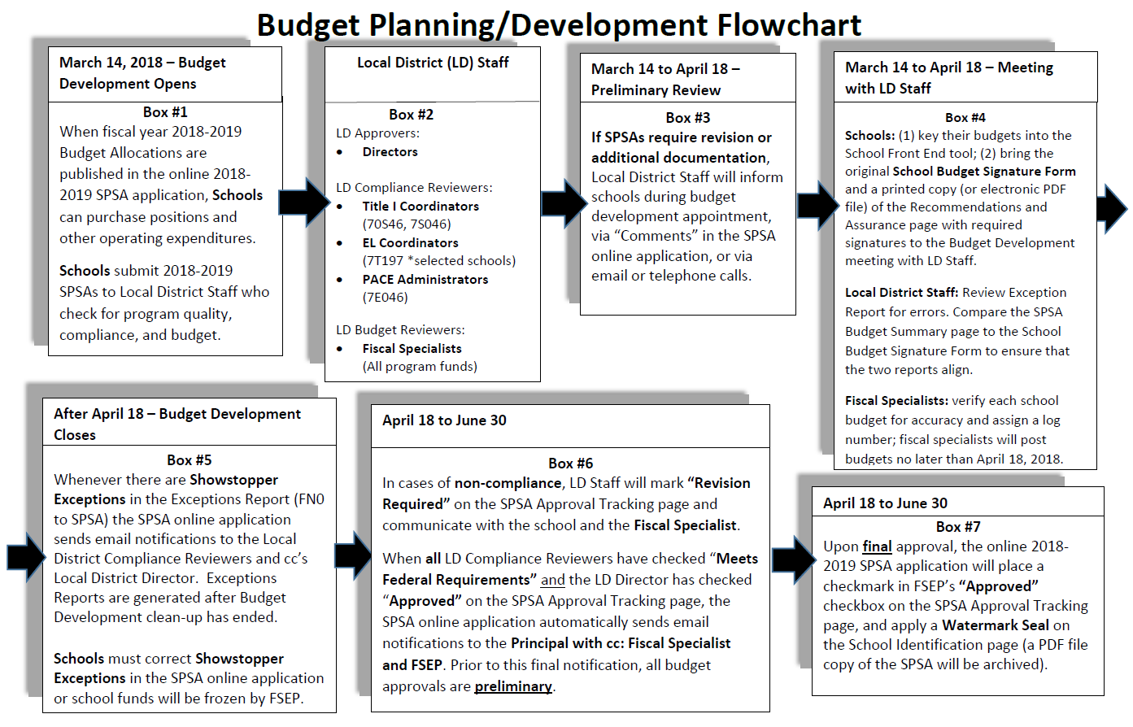
Budget Planning Flowchart
Notes:
Make a full page handout
James’ new chart 2/21/17

Slide 49
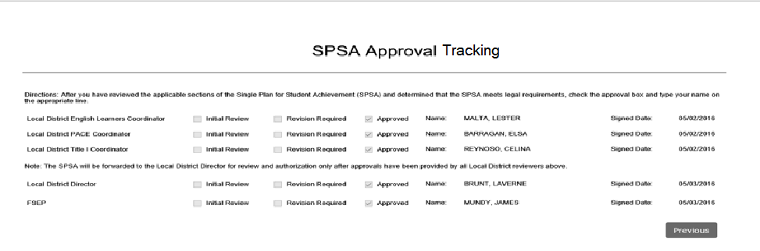
The SPSA Approval Tracking page is used by Local District Coordinators/Administrators and Instructional Directors to track the SPSA Plan approval process. Principals and Designees can view the page but cannot make changes to it.

Slide 50
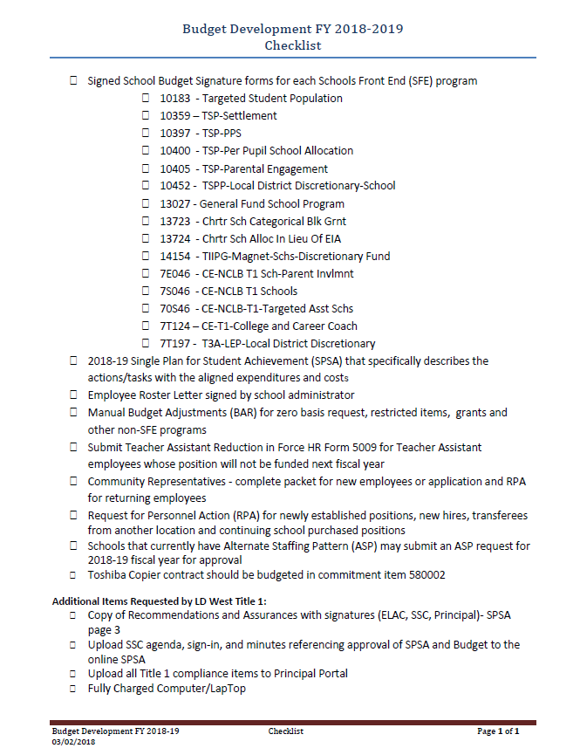

Reminders
What to Bring for BD

Slide 51
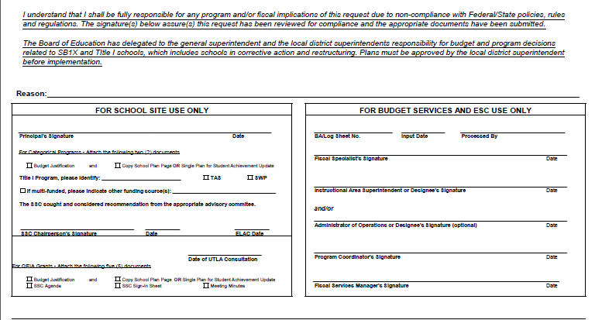
School Budget Signature Page
2018-2098 Budget Development
Principal Signature 03/29/18
X
X
7S046
X
SSC Signature 3/29/18
3/29/18

Slide 52
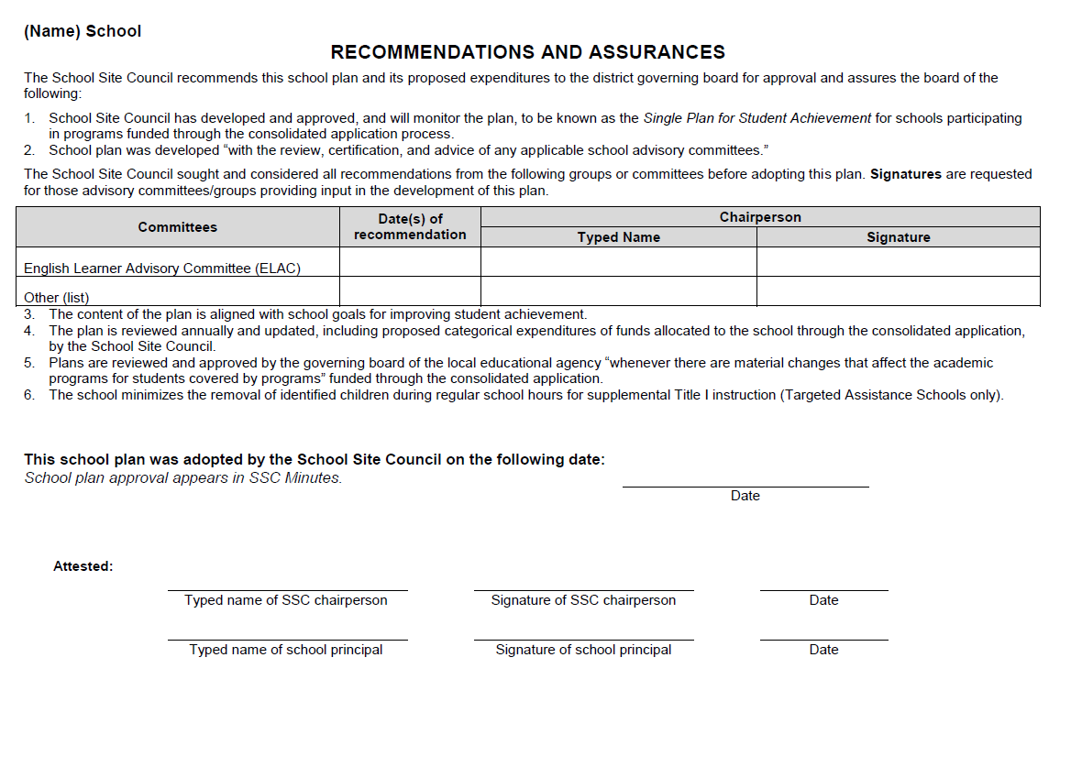
Date
Blue Ink
Date
Blue Ink
Blue Ink

Slide 53
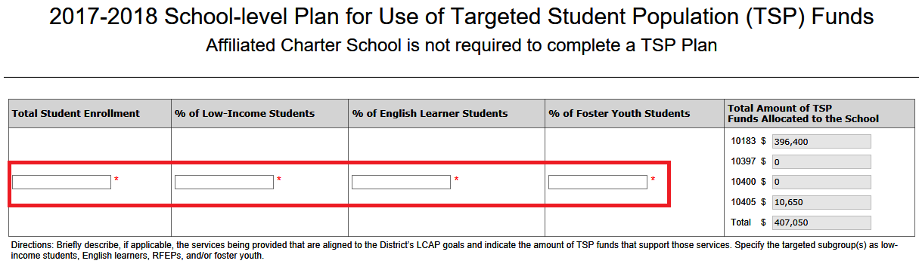
Fill in the required textboxes shown.

Slide 54

In order to approve
preliminary SPSA with Budget
Pending Distribution=$0.00

Slide 55
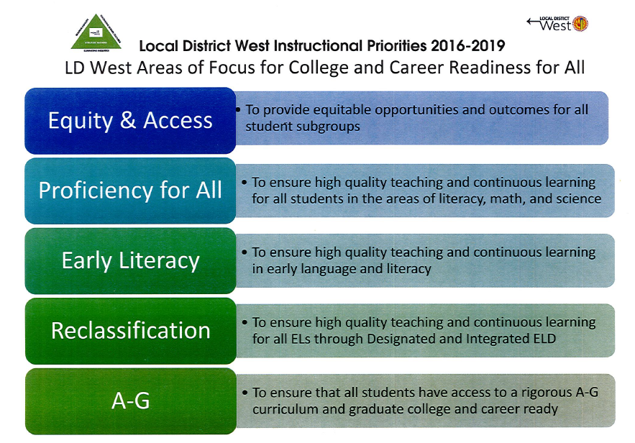

Slide 56
QUESTIONS
QUESTIONS??? QUESTIONS??? QUESTIONS??? QUESTIONS??? QUESTIONS??? QUESTIONS??? QUESTIONS??? QUESTIONS??? QUESTIONS??? QUESTIONS??? QUESTIONS??? QUESTIONS??? QUESTIONS??? QUESTIONS??? QUESTIONS??? QUESTIONS??? QUESTIONS??? QUESTIONS??? QUESTIONS??? QUESTIONS???
QUESTIONS??? QUESTIONS??? QUESTIONS??? QUESTIONS???
QUESTIONS??? QUESTIONS??? QUESTIONS??? QUESTIONS???
QUESTIONS??? QUESTIONS??? QUESTIONS??? QUESTIONS???
QUESTIONS??? QUESTIONS??? QUESTIONS??? QUESTIONS???
QUESTIONS??? QUESTIONS??? QUESTIONS??? QUESTIONS???

