Slide 1

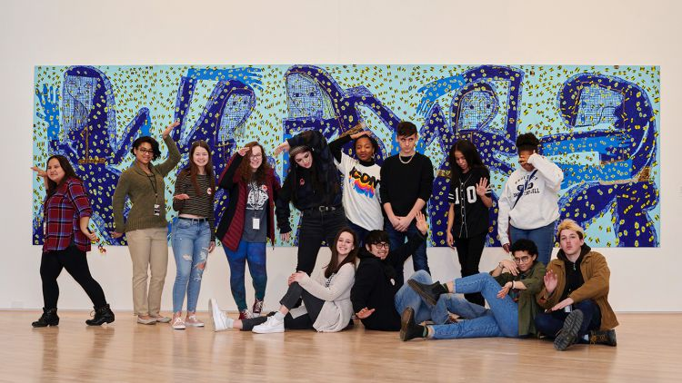

All Are Welcome Here
Human Relations, Diversity & Equity
Student Support and Attendance Services
Notes:
Teacher, please feel free to encourage student participation whichever way you are most comfortable: in the Zoom chat, on a previously shared Jamboard, in break out groups, or all together in a grid view.

Slide 2

Would you rather...
Swim with sharks
Bungee jump
Sky dive
Drive a race car
walk a tight rope 1o stories up

Slide 3
Objectives
1. Learn how to be accepting of LGBTQ people
1
2. Learn how to respond to situations
2
3. Learn about additional support and resources for LGBTQ people
3

Slide 4

A good friend is:
Notes:
Script: brainstorm on characteristics of friends
trustworthy…
caring…
respectful…
loyal…
has your back…

Slide 5

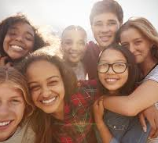
Do we shame people for their race? … No!
Do we shame people for their religion? …. No!
Do we shame people for their weight? … No!
Do we shame people for their gender? … No!
Do we shame people for the sexual orientation or gender identity? … No!
Everyone has a right to be themselves.
Our differences make us unique, interesting, and amazing.
Notes:
Read the slide

Slide 6


If you found out today that your best friend was gay, would you still be their friend?
Of course you would!!
This presentation is about making sure that everyone feels welcome and safe in this class. To do that, we all need to do our part.
Did you know that most of us have a friend or a family member who is LGBTQ?
That’s one of those things we can never tell by looking.

Slide 7

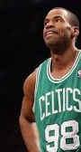
What Should
I Do?
I think my best friend is gay.
Michael Sams
Jason Collins
Notes:
Script:
Your friend might be scared you’ll drop the friendship. Let them know that you’re there for them, and if they ever want to talk, you’re here.

Slide 8
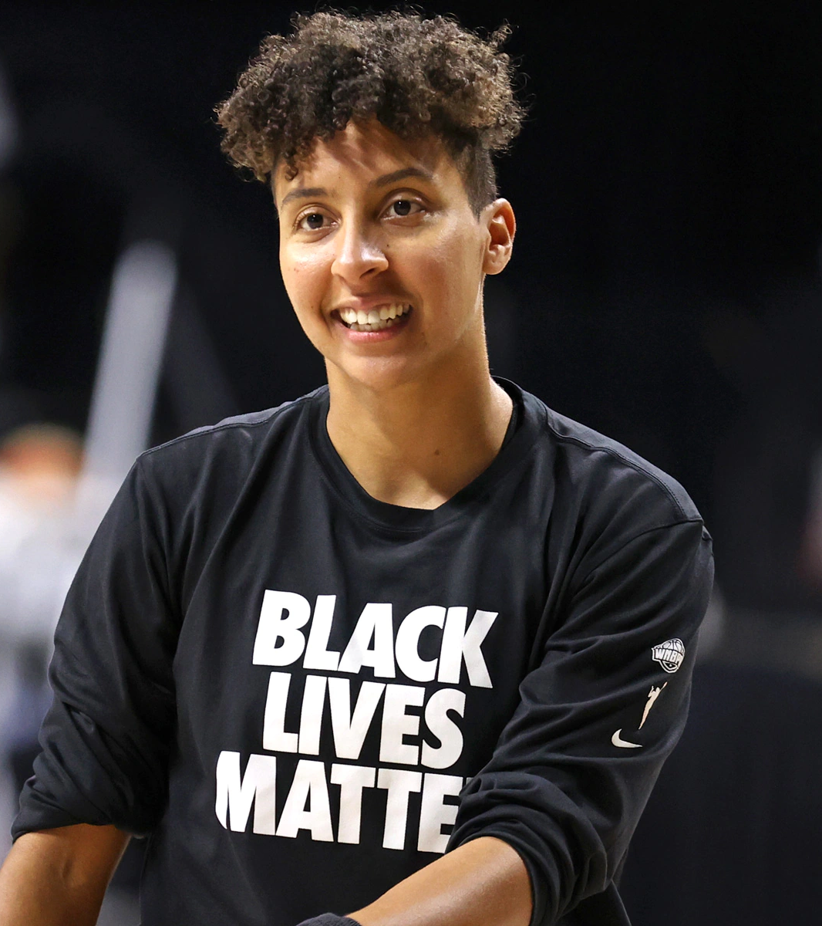
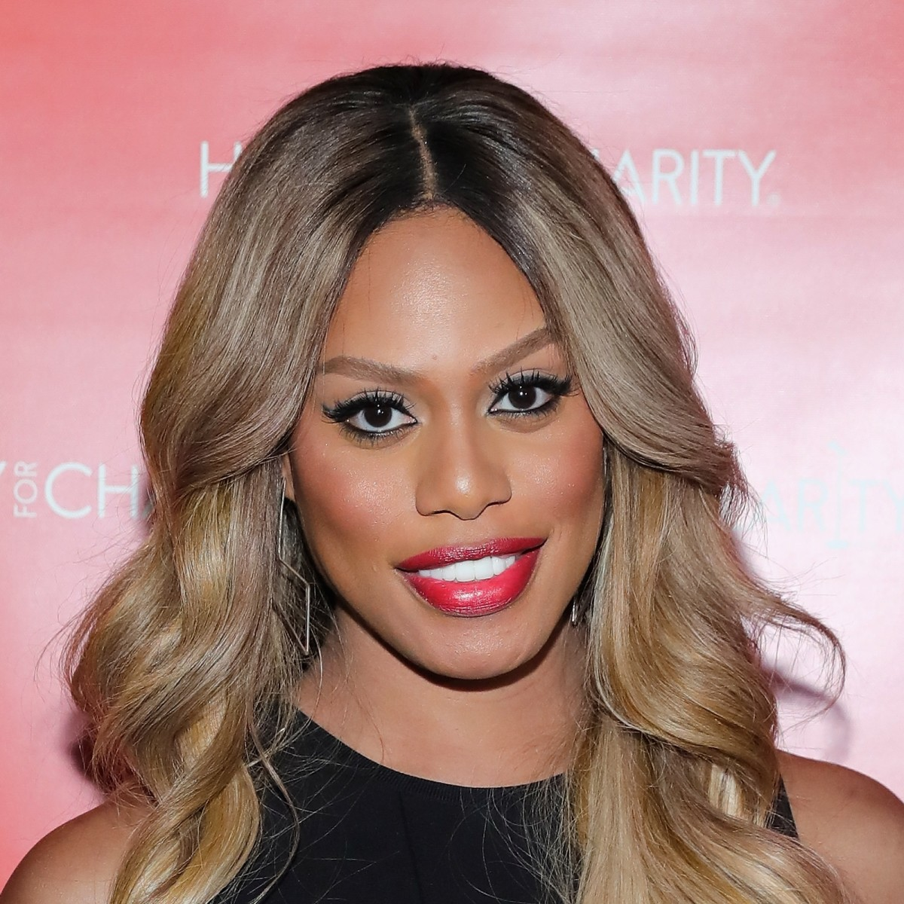
What Should
I Do?
Laverne Cox
One of my classmates came back to school this year and is using a different name and gender.
.
Layshia Clarendon
Notes:
Script:
Easy. Just use the new name and gender. If you slip up, apologize and get it right next time.

Slide 9

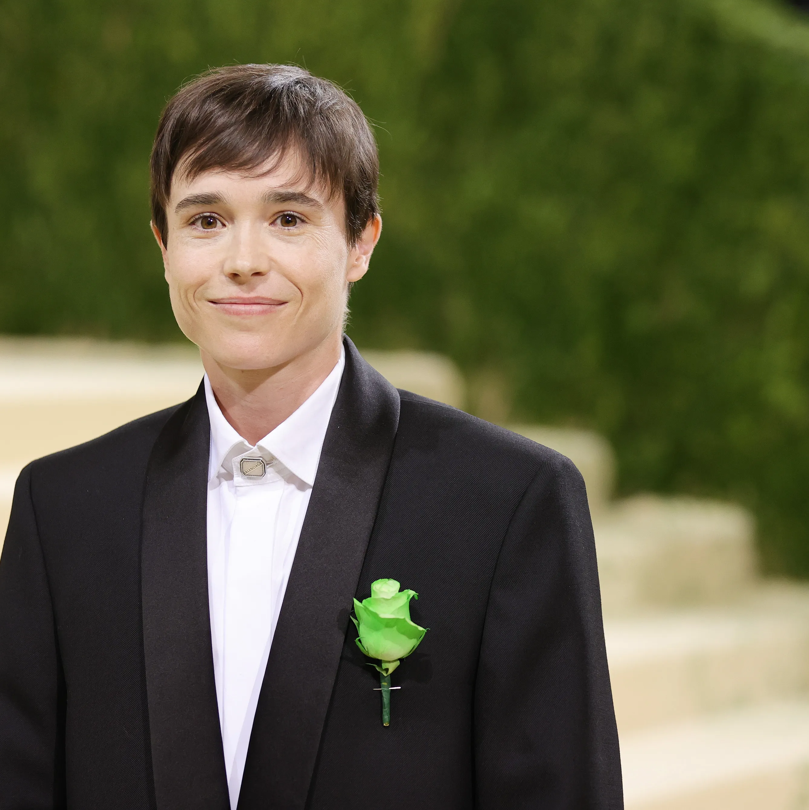
What Should
I Do?
Chris Mosier
One of my friends just told me she is transgender. What does that mean?
Elliot Page
Notes:
Script:
Gender is in our brain; our sex is our private parts. When your friend was born, people thought she was a boy, but she has a girl brain.. So wants to live like a girl.
if you're really a friend; this is your chance to step up. Assure your friend that you’re there for her. Use her new name and pronoun. If you slip up, apologize and get it right next time.

Slide 10
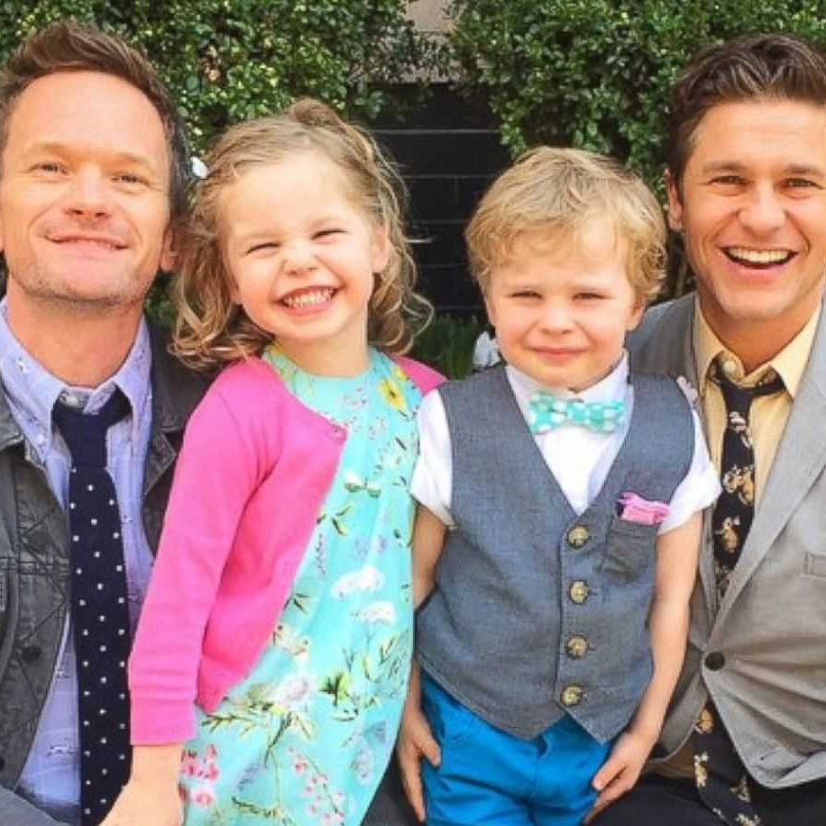
What Should
I Do?
My friend has two moms. Will that make him gay?
Neil Patrick Harris, his partner David Burtka, and their kids.
Notes:
Script:
Not at all. Our parents can't make someone gay! Treat his moms like any other mom.

Slide 11
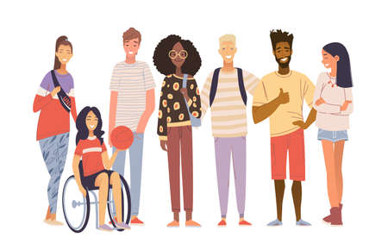
What Should
I Do?
Can you tell if someone is gay?
Notes:
Script:
Once in a while, maybe.. but not reliably. the only way to know for sure is if they tell you.
Did you know that all the athletes pictured in this slide deck are gay?

Slide 12


Names and Pronouns
Using correct names & pronouns shows respect.
Hi, my name is Judy and I use she/her pronouns. What about you?
Notes:
Script:
Let’s call everyone by the name and pronouns they choose.
This may change throughout the year, and that’s ok.
Sometimes, we are going to make mistakes and that’s ok! We’ll correct and move on.
If this is something you would like to discuss privately, let your teacher know. They’ll help you.

Slide 13

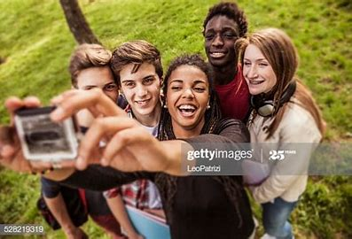
Big Picture
WE ACCEPT EVERYONE!

Slide 14
For additional Support:
LAUSD School Mental Health Hotline: 213.241.3840
The Trevor Project: https://www.thetrevorproject.org/
Teenline: https://teenlineonline.org/
National Suicide Hotline: 1.800.273.8255
GSA Network https://gsanetwork.org/
Gender Spectrum; https://www.genderspectrum.org/
Notes:
Script:
Coming out and being a part of this community is wonderful and can also be challenging. If you or someone you know needs help, please use the resources listed here.

Slide 15

Teacher Feedback Survey
Notes:
Teacher, please complete the survey by scanning the QR code or clicking the link below:

Slide 16
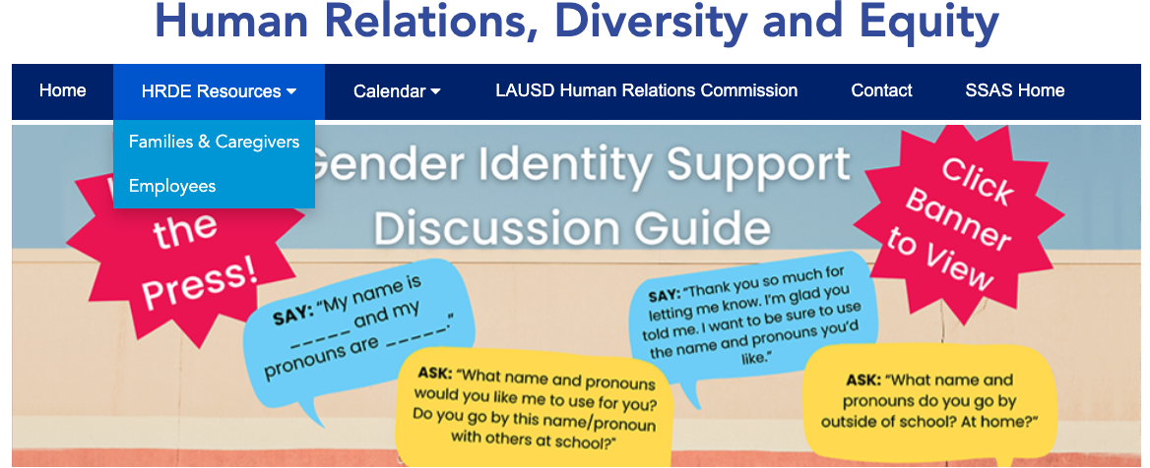
For additional resources visit us at: https://www.lausd.org/human-relations

