Slide 1


Caster Semenya
Stories of Excellence
Human Relations, Diversity & Equity
Student Support and Attendance Services
Notes:
Please feel free to encourage student participation whichever way you are most comfortable: in the Zoom chat, on a previously shared Jamboard, in break out groups, or all together in a grid view. There will be a lot of opportunities for participation throughout this presentation.

Slide 2
If you had ONE hour to do whatever you wanted... would you:
Sleep
Read
Watch tv/movie
Notes:
Feel free to change up the check in you have a check in you prefer!

Slide 3
Objectives
Learn about Caster Semenya.
Discuss gender policing and human rights in international sports.
Reflect on ethics and morality of the decisions of the IAAF.
Notes:
Read the objectives aloud for the students.

Slide 4
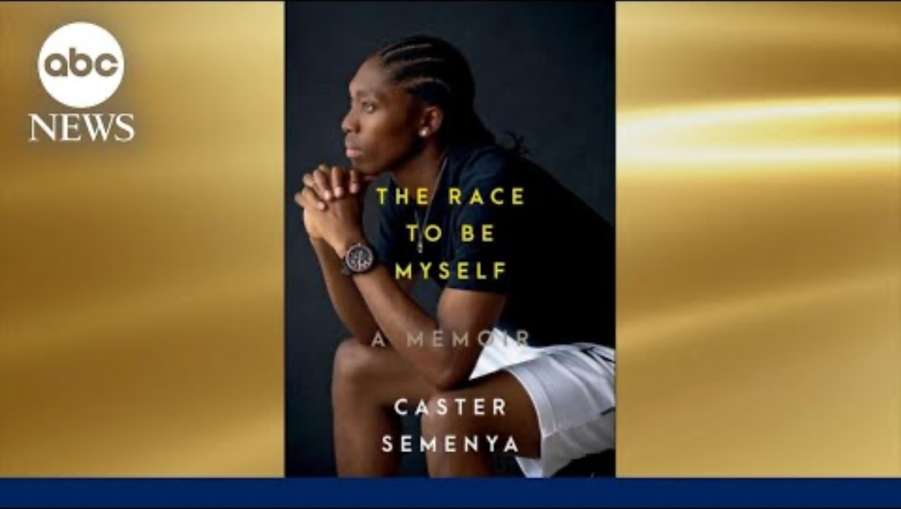
Self-Love
Notes:
https://youtu.be/xSkDNtsZkLA?si=aqiEnpmk41sM9w6A

Slide 5
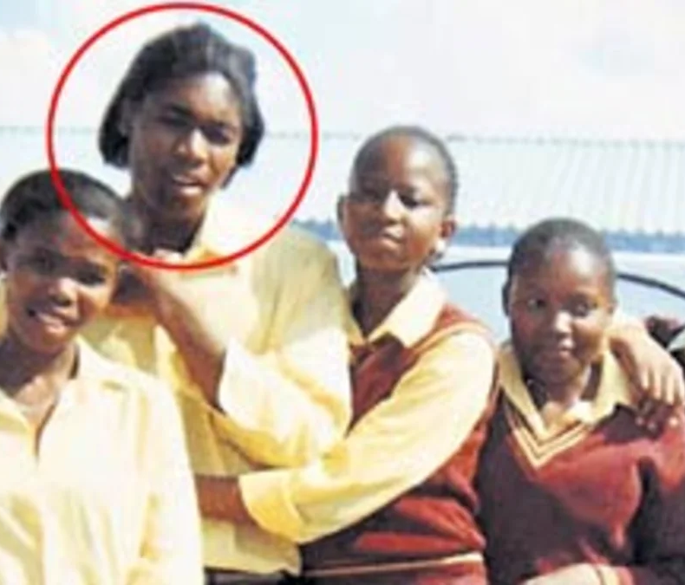
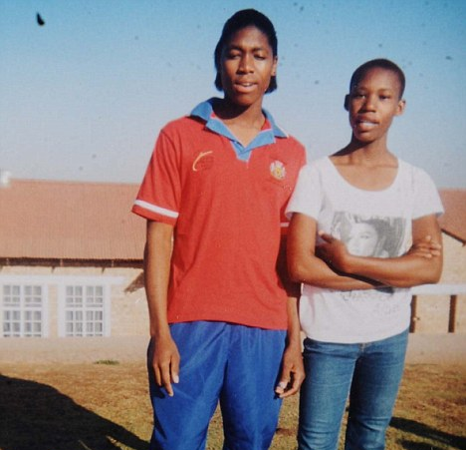
Early Life
Caster Semenya was born in Ga-Masehlong, a village in South Africa.
Caster has 3 sisters and a brother.
Caster was designated female at birth, was raised as and identifies as a woman.
Notes:
Read the slide aloud for the students.

Slide 6
Reflection
What does it mean that Caster Semenya was “designated female at birth"?
Notes:
Read the reflection questions for the students. Invite them to share, via whichever platform you prefer, their own answers to the questions posited. After providing space for students to share, let them know that Gender Assigned at Birth means the anatomical sex of a person based on their identified genitals.

Slide 7
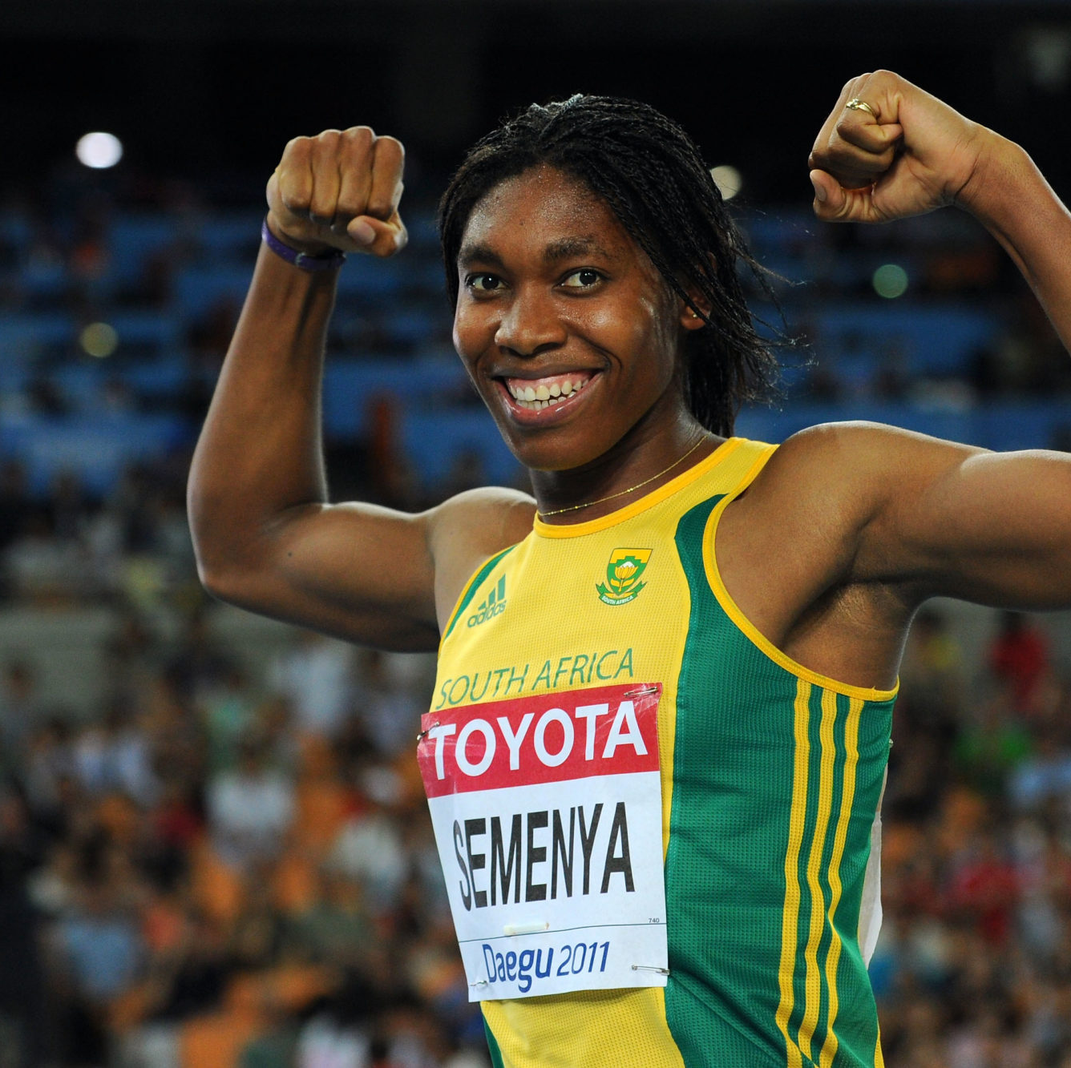
Athleticism
Caster Semenya started running as training for soccer.
Caster loved sports and knew that sports would give her the opportunity to see the world.
At 17 years old, Caster began competing in the Junior World Championships and the Commonweath Youth Games.
  Caster took home medals in almost every race .
At just 18 years old, Caster was voted the Number One Womens 800-meter runner of the year by Track and Field News.
Notes:
Read the slide aloud for the students.

Slide 8
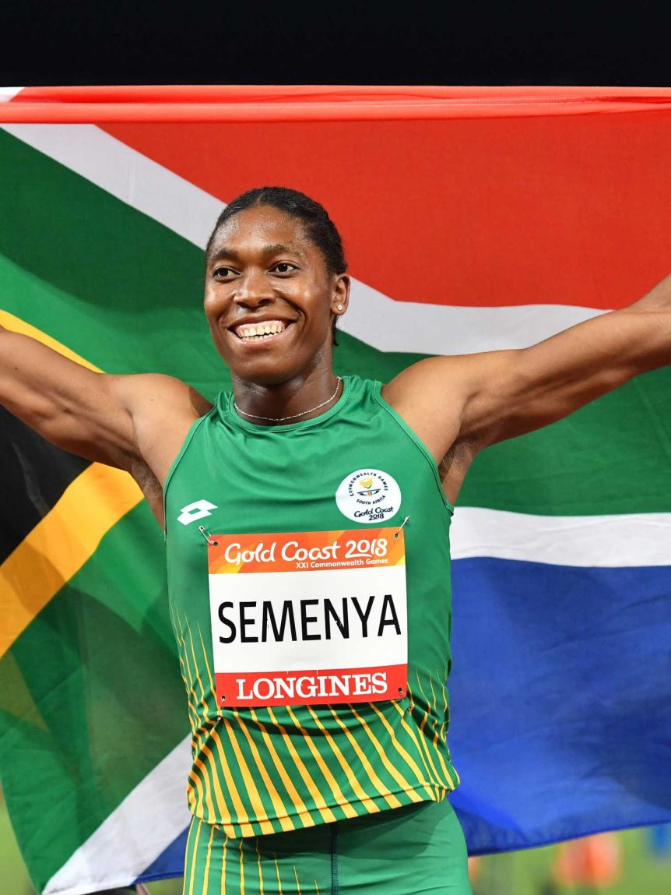
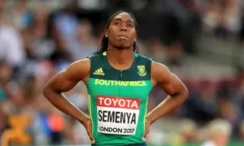
Gender Policing
Due to Caster Semenya's dominance, questions were raised about her sex.
The International Amateur Athletic Federation (IAAF) is the world governing body for the sport of track and field.
The IAAF required Caster to undergo a sex verification test to confirm that Caster is female. The test mandate resulted in public outcry.
  People felt that gender testing was another form of European racism and imperialism.
The IAAF struggled to clarify that they needed to determine whether Caster may have had a "rare medical condition" that gave her an "unfair advantage".
Notes:
Read the slide aloud for the students.

Slide 9
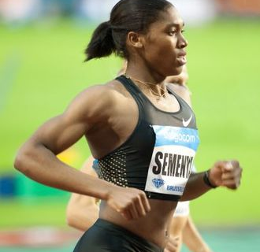
Human Rights Violations?
South African civic leaders and politicians believed the testing was a violation of Caster Semenya's privacy and human rights.
In response to the controversy, in an interview, Caster said "God made me the way I am, and I accept myself."
Caster was not permitted to return to international Track & Field competitions until the test results were cleared by IAAF.
Caster was cleared to rejoin the sport just in time for the 2012 Olympics.
Notes:
Read the slide aloud for the students

Slide 10
Reflection
Do you think it's fair that the IAAF required Caster to undergo sex verification testing? Why or why not?
Notes:
Read the reflection questions for the students. Invite them to share, via whichever platform you prefer, their own answers to the questions posited.

Slide 11
BREAK
If your time is limited, this is a great spot to break!
Content can be continued during next Advisory lesson!

Slide 12
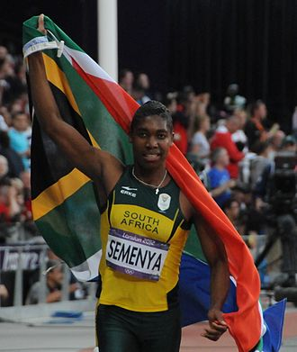
2012 Olympics
At age 21 Caster Semenya carried her country's flag during the opening ceremony of the 2012 Summer Olympics.
Caster won a silver medal in the women's 800 meter race, losing to Russian runner Mariya Savinova.
In November 2015, Mariya Savinova was given a lifetime ban for using performance enhancing drugs at the Olympics.
As a result, Caster's silver medal was upgraded to gold.
Notes:
Read the slide aloud for the students

Slide 13
Reflection
Irony: an event that seems deliberately contrary to what one expects and is often amusing as a result.
Is it ironic that while Caster was being judged/criticized for her natural abilities, her competitor was found to be using drugs to improve her performance?
Notes:
Read the slide aloud for the students. Invite them to share, via whichever platform you prefer, their own answers to the questions posited.

Slide 14
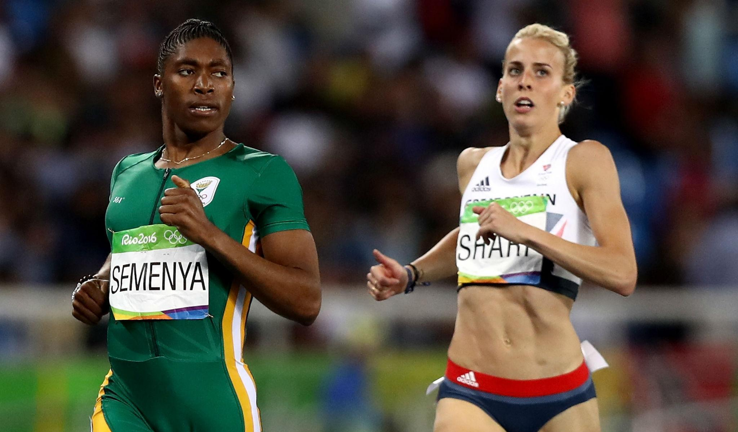
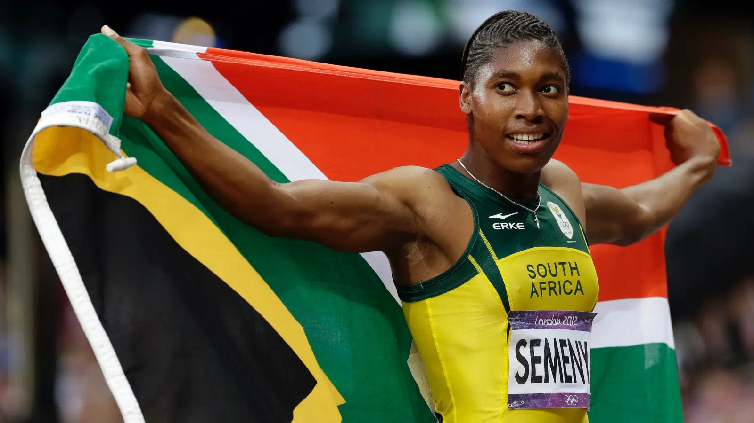
2016 Olympics
Caster won the gold medal in the women's 800 with a time of 1:55.28.
The win reignited controversy over Caster's testosterone levels.
Sixth-placed runner Lynsey Sharp broke into tears, stating "everyone can see it's two separate races."
Fifth-placed Joanna Jóźwik claimed that she was the "first European" and "second white" to finish the race
Bioethicist Katrina Karkazis criticized overall response to Semenya's win as discriminatory.
Notes:
Read the slide aloud for the students

Slide 15
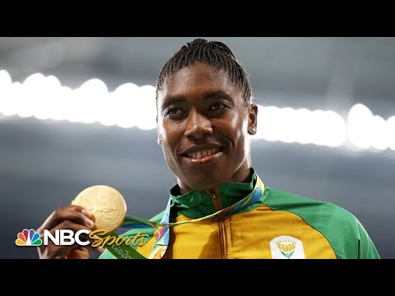
2016
800 meter
Notes:
Play the video for the students. (4:17)
https://youtu.be/anqBSY1qHSk

Slide 16
Reflection
What are your thoughts after seeing the race?
Notes:
Read the reflection questions for the students. Invite them to share, via whichever platform you prefer, their own answers to the questions posited.

Slide 17
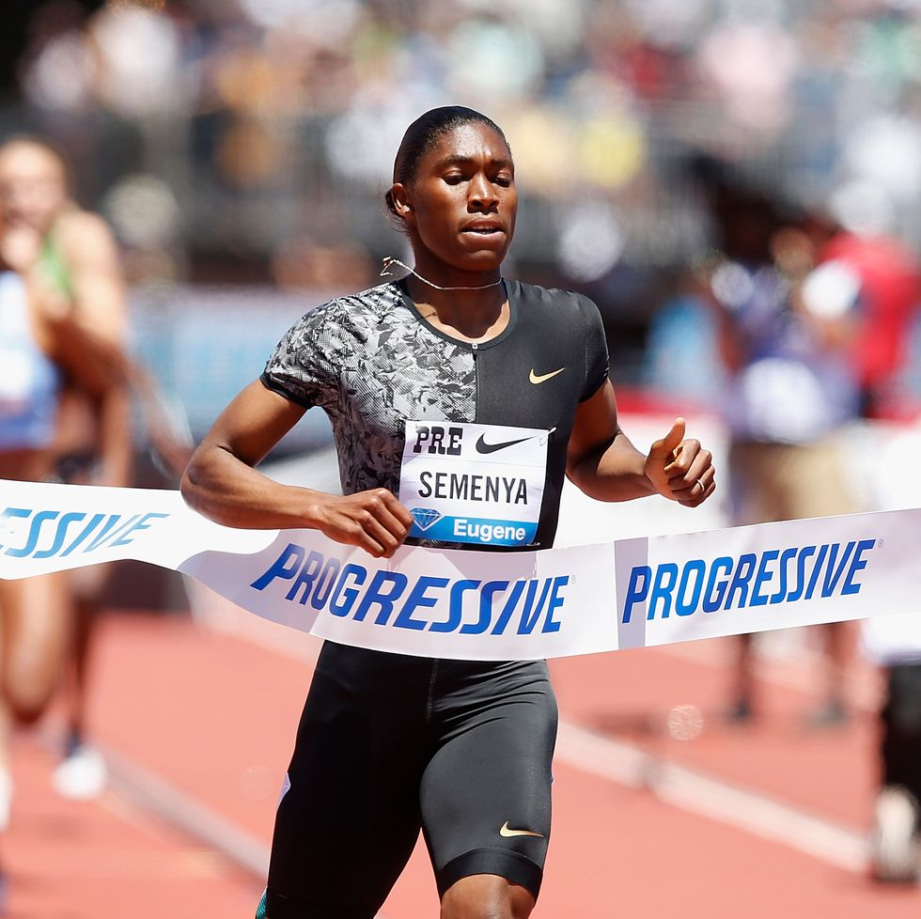
New Challenges
The IAAF never publicized the Caster's sex verification test results.
It is widely assumed that Caster Semenya has a condition called Hyperandrogenemia.
Caster's body naturally produces levels of testosterone that exceed the “normal” female limits, which the IAAF is trying to regulate.
Notes:
Read the slide aloud for the students

Slide 18

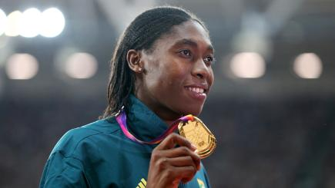
New Rules
In 2018 the IAAF introduced a new rule.
  This rule requires female athletes with conditions like Caster to take medicine to lower their testosterone levels.
  This rule only applies to women competing in races from 400m to a mile.
The IAAF argues that these rules are necessary to 'protect female sport' from 'unfair advantages' like Caster's.
Notes:
Read the slide aloud for the students.

Slide 19
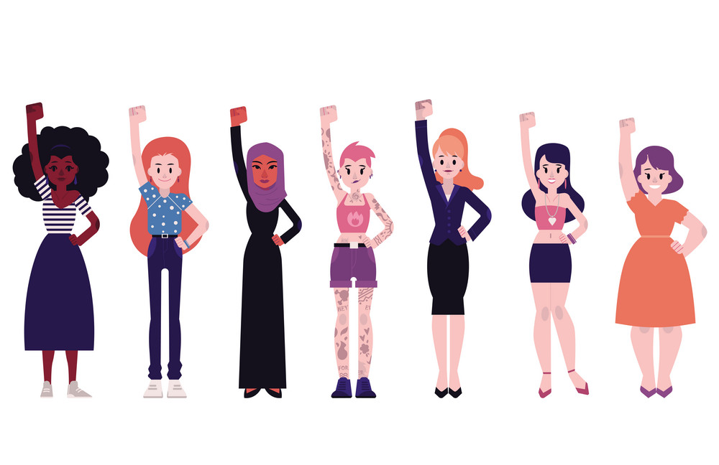
Caster Says...
Caster believes that her genetic gift should be celebrated, not discriminated against.
Caster says this "case is about the rights of women who are born as women, reared and socialised as women – [to] be permitted to compete in the female category without discrimination.”
Caster believes that IAAF’s mandate that she take drugs to reduce testosterone is ethically wrong and poses a health risk.
Notes:
Read the slide aloud for the students

Slide 20
Reflection
Imagine you are in Caster Semenya's shoes.
Would you take the hormone-altering medication in order to keep competing?
Notes:
Read the reflection questions for the students. Invite them to share, via whichever platform you prefer, their own answers to the questions posited.

Slide 21
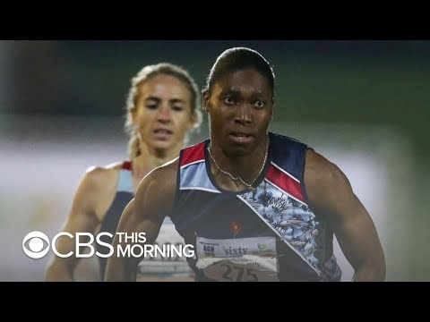
Acceptable Discrimination?
Notes:
Play the video for the students (3:02)
https://www.youtube.com/watch?v=o8-LmHctxv0

Slide 22
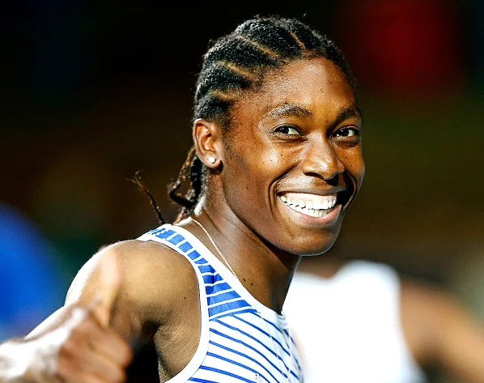
The Future for Caster
Caster Semenya refuses to take the medication to reduce her testosterone.
She plans to run the 200m race, which is not regulated by the same rules as the longer races.
Notes:
Read the slide aloud for the students

Slide 23
Run Free, the Way We Were Born
“I am very disappointed by this ruling, but refuse to let World Athletics drug me or stop me from being who I am,” Semenya said in a statement released by her representatives. “Excluding female athletes or endangering our health solely because of our natural abilities puts World Athletics on the wrong side of history. I will continue to fight for the human rights of female athletes, both on the track and off the track, until we can all run free the way we were born. I know what is right and will do all I can to protect basic human rights, for young girls everywhere.”
Notes:
Read the quote aloud for the students

Slide 24
If you had to pick ONE mode of transportation for the rest of your life...
Fly
Swim
Notes:
Invite the students to engage in the check out question.

Slide 25
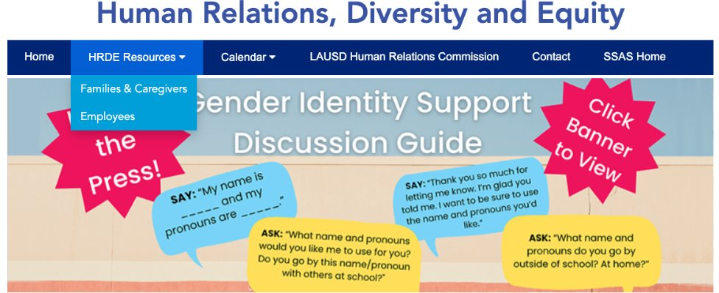
For additional resources, visit us at: https://www.lausd.org/human-relations

Slide 26

Teacher Feedback
Notes:
Teacher, please complete the brief feedback survey by scanning the QR code

