Slide 1
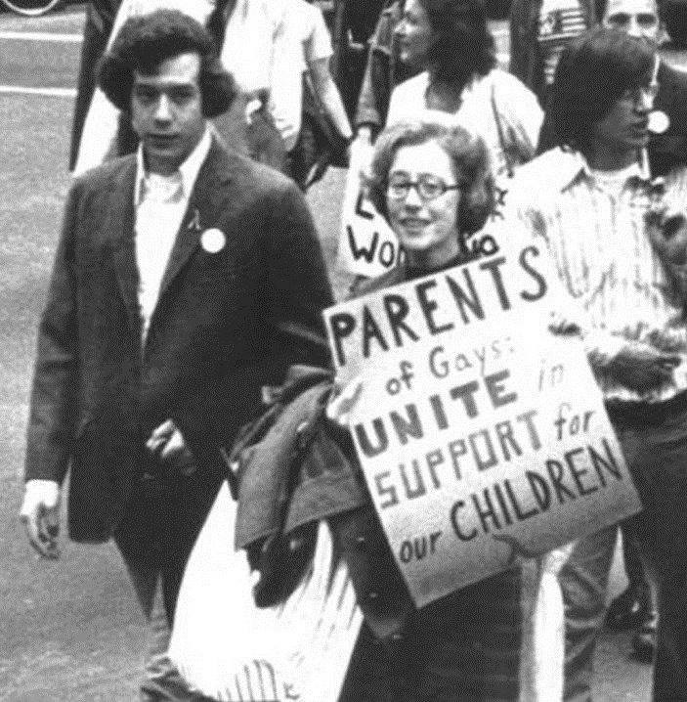

Jeanne Manford
Stories of Excellence
Human Relations, Diversity & Equity
Student Support and Attendance Services

Slide 2
Welcome
Which type of movie do you prefer?
Action
Comedy
scary

Slide 3
Objectives
Learn about Jeanne Manford.
Discuss Jeanne Manford's contributions to the LGBTQ+ community.
Reflect on what it means to have the support of grown-ups in your life.

Slide 4
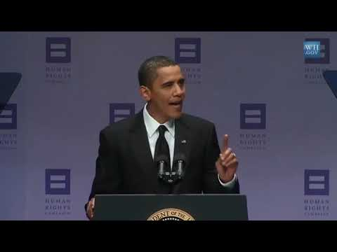
Who is jeanne manford?
Notes:
Play the video for the students
https://youtu.be/9TqHCuwU7bM
(3:02)

Slide 5
Jeanne's life
Jeanne Manford was born in 1920 in New York.
Jeanne married Jules Manford and had 3 children.
In her 30's, Jeanne went back to college and got her teaching degree.
When she was 44 years old, Jeanne started working as an elementary school teacher in New York City.

Slide 6
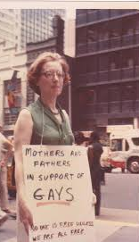
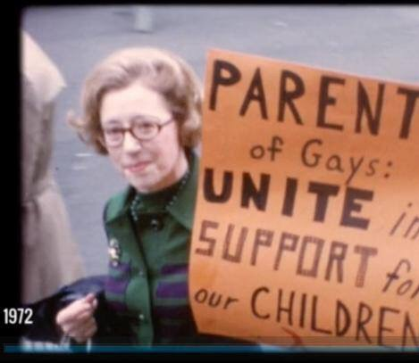
Morty
Jeanne's son Morty came out to his parents as gay when he was 15 years old.
In 1972 Morty was brutally beaten for distributing pro-gay flyers at a New York gala.
Jeanne wrote a letter to the New York Post and gave radio and television interviews in several cities defending her son.
Jeanne marched with Morty at the Christopher Street Liberation Day March.

Slide 7
Reflection
Think about some of the things in your life that are most important to you.
What would it feel like to have a grown up you care about support those parts of your life?

Slide 8
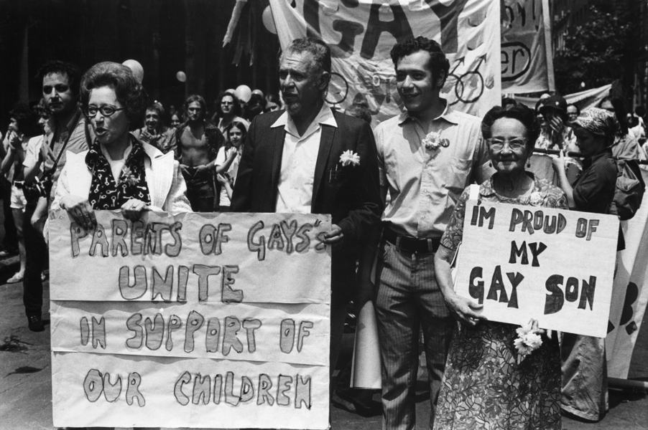
Outpouring of support
Jeanne and her husband's support of Morty at Gay Rights marches quickly earned a lot of positive responses.
California Senator Mark Leno reflected that "for her to step into the street and declare support for her mentally ill, outlaw son – that was no small act... But it was what a mother's love does".
Jeanne even recalled, years later, that the "young people were hugging me, kissing me, screaming, asking if I would talk to their parents".
Notes:
Read the slide aloud for the students.
It's important to note here that at this time, homosexuality was considered a mental illness, and a crime in my parts of the United States.

Slide 9
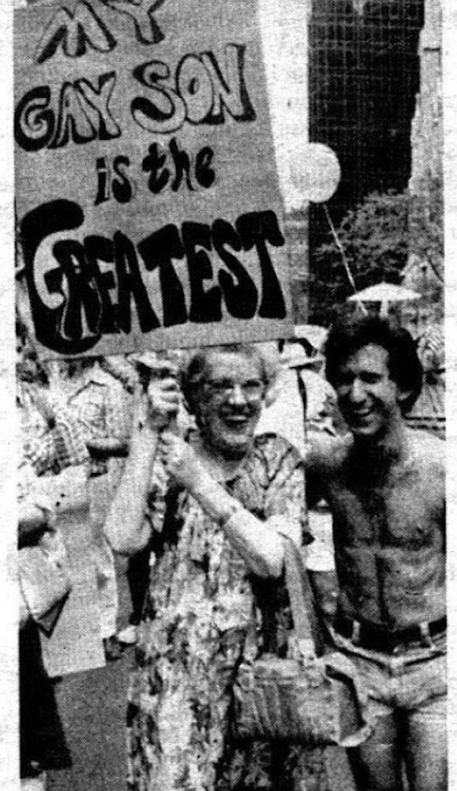
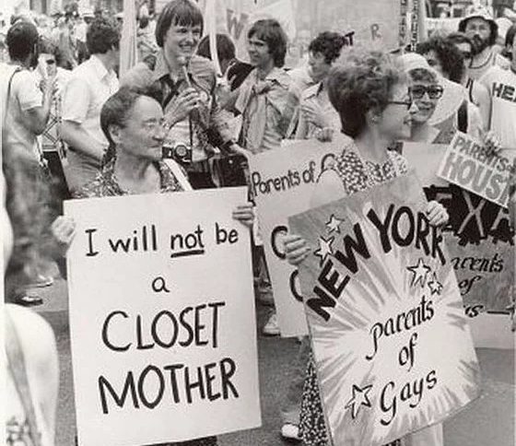
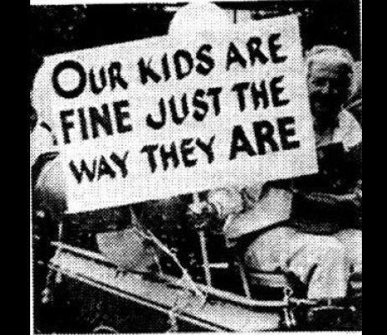
PARENTS OF GAYS
Jeanne and her husband were empowered by the outpouring of support they got for marching with their son.
Together, they decided to create an organization for parents of gays and lesbians.
They began holding meetings at local churches, aiming to build a bridge between the gay community and the heterosexual community.

Slide 10

PFLAG
After the initial launch fo the Parents of Gays movement in New York, similar groups sprang up around the country.
By 1976 the movement had made it to Los Angeles and officially changed their name to PFLAG - Parents, Families and Friends of Lesbians and Gays.
PFLAG still exists today and serves as the larget organization uniting parents, families and allies with the LGBTQ+ community.

Slide 11
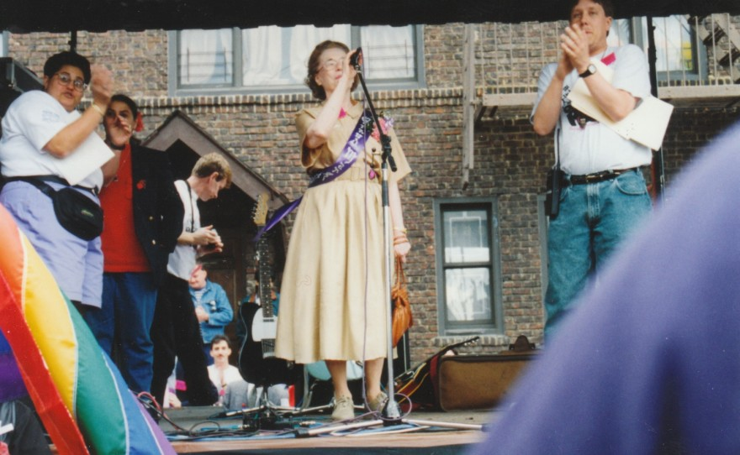
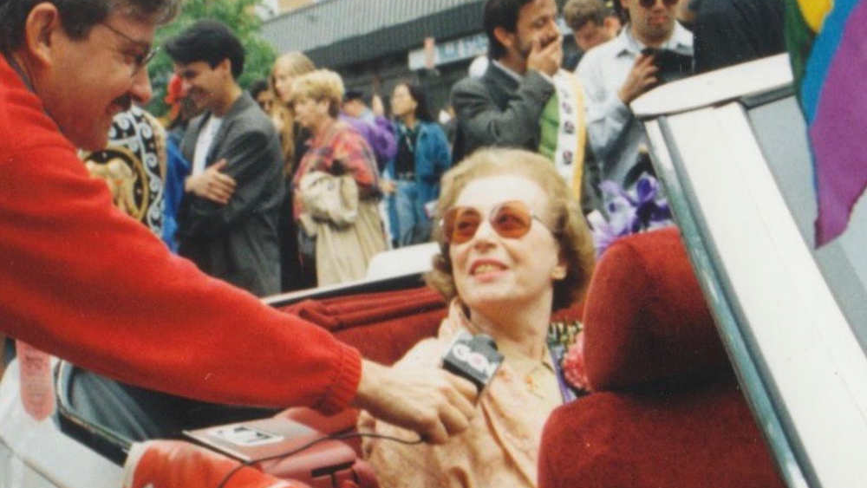
Jeanne's honors and legacy
1991
Jeanne was the grand marshal of the NYC Pride Parade
1993
Jeanne was the grand marshal of the first pride parade in Queens, NY
2012
President Barack Obama honored Jeanne with the Presidential Citizens Medal

Slide 12
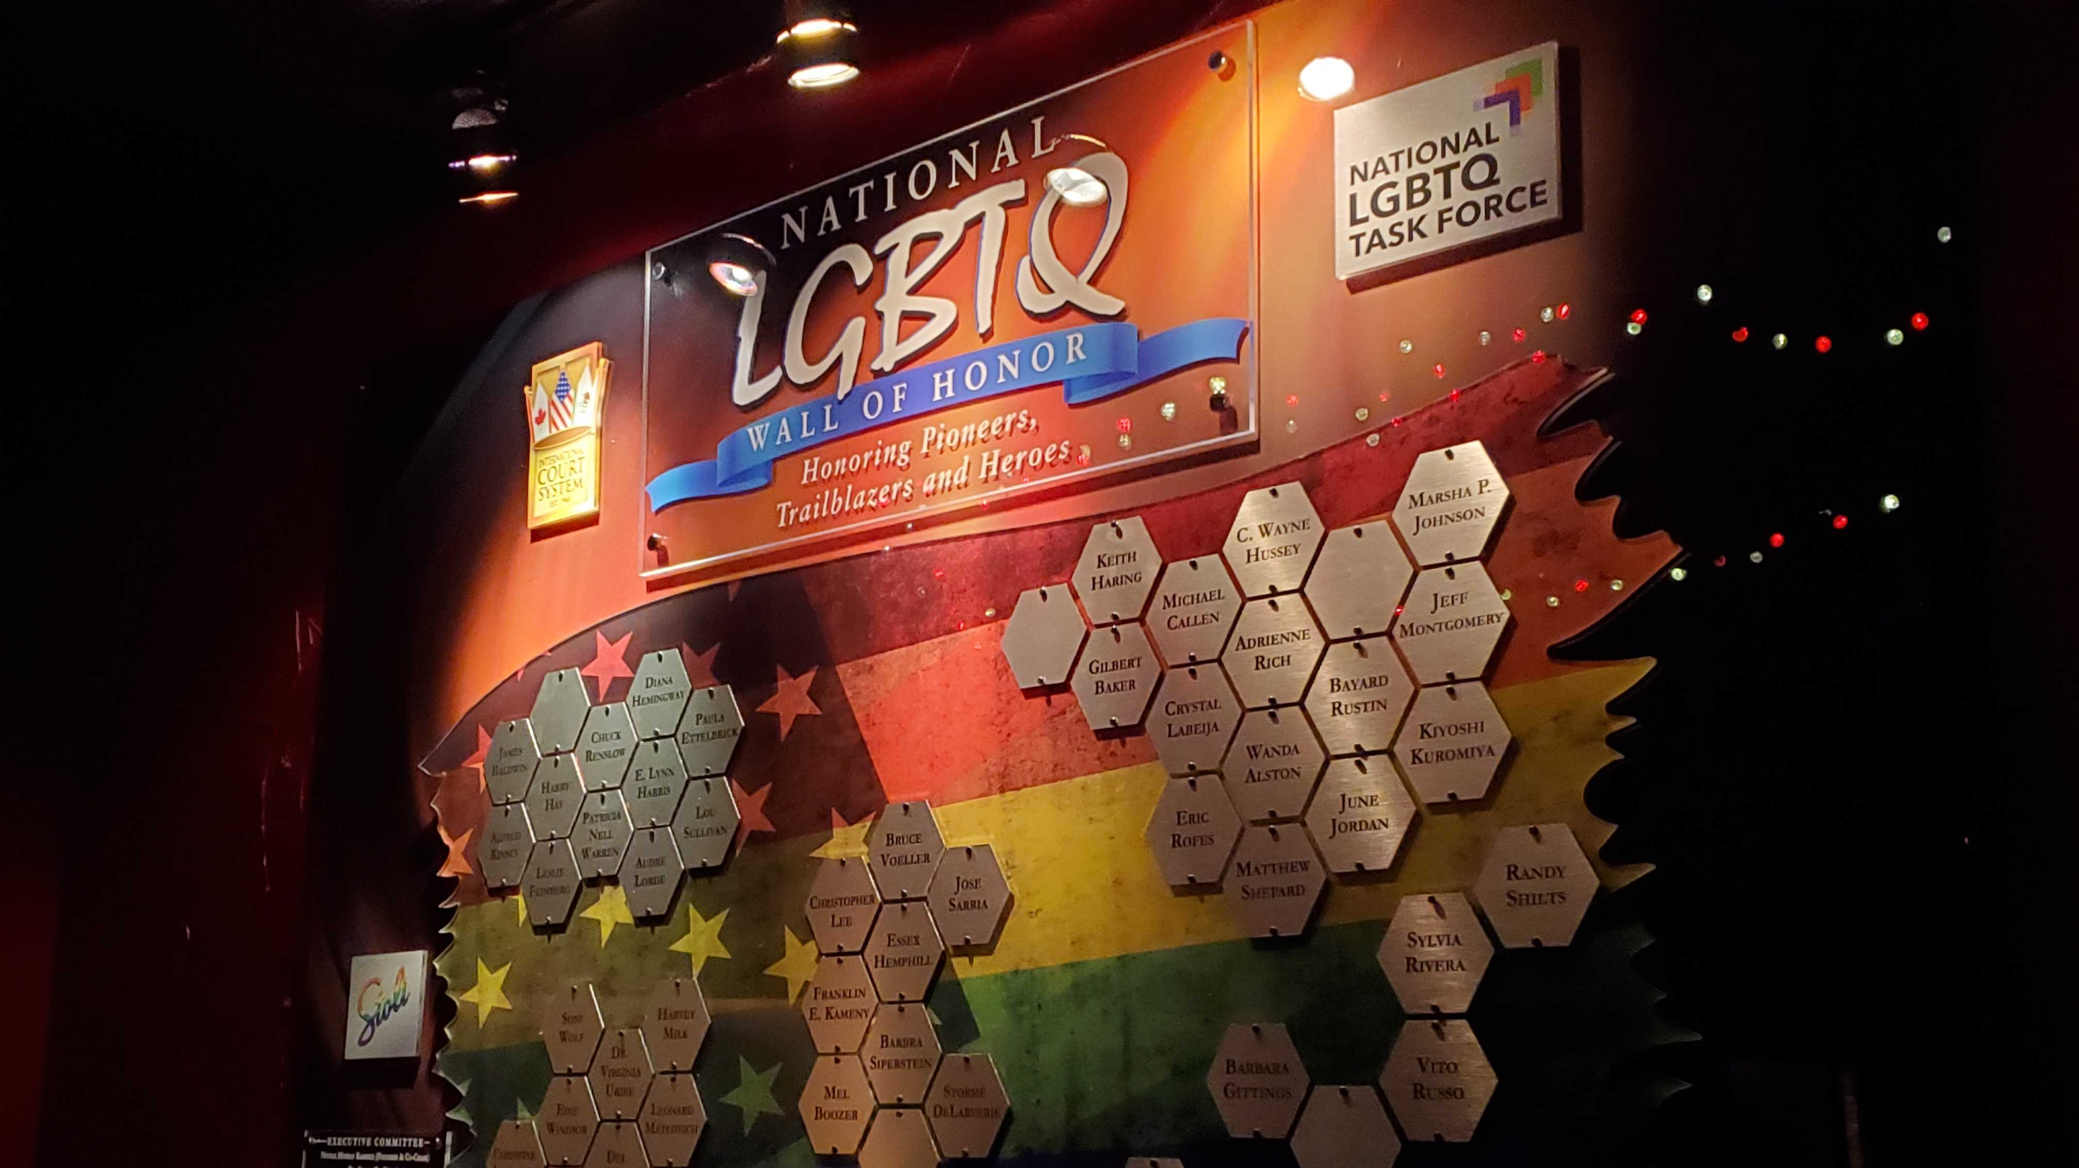
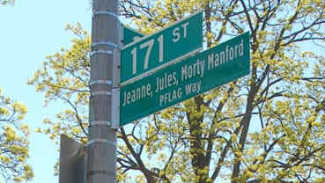
Jeanne's honors and legacy
2014
A street in the Flushing neighborhood of Queens was named "Jeanne, Jules, Morty Manford PFLAG Way"
2017
a US Post Office in Jackson Heights was dedicated to Jeanne and her husband
2019
Jeanne was inducted on the National LGBTQ Wall of Honor within the Stonewall National Monument

Slide 13
Check Out
Would you rather read a book, watch a movie or take a nap?
Book
Movie
Nap

Slide 14
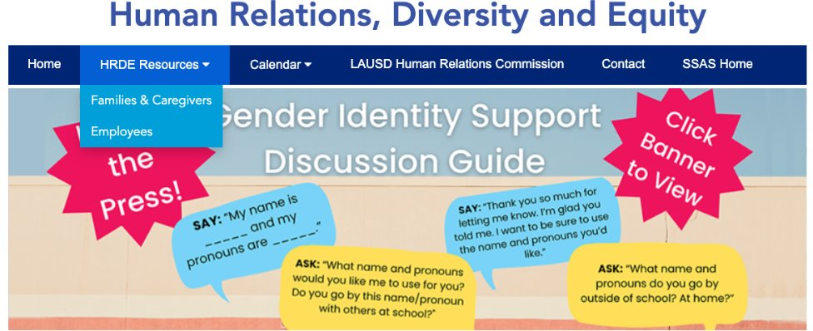
For additional resources, visit us at: https://www.lausd.org/human-relations

Slide 15

Teacher feedback
Notes:
Teacher, please complete a brief feedback survey by scanning the QR code

