Slide 1


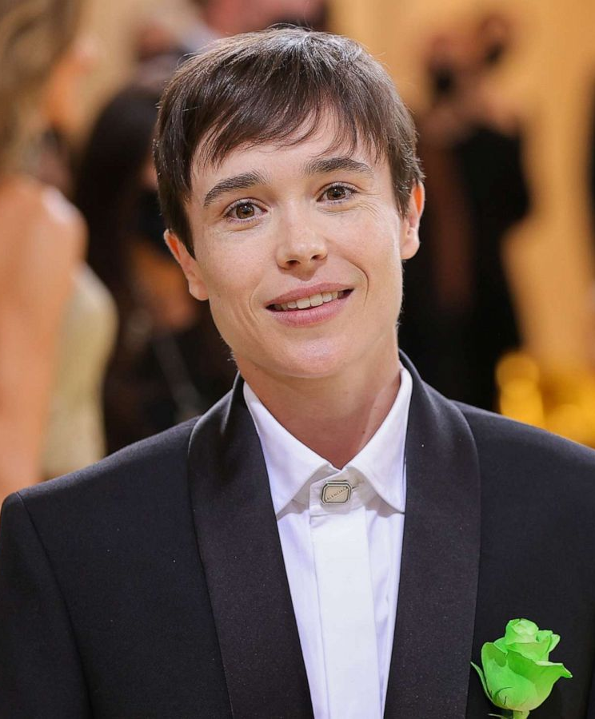

Elliot Page
Stories of Excellence
Human Relations, Diversity & Equity
Student Support and Attendance Services

Slide 2
Welcome!
Do you prefer breakfast or lunch?
Breakfast
Lunch
Notes:
Engage the students in the ice breaker utilizing whichever method you prefer (live discussion, responses in the chat, jamboard, etc.)

Slide 3
Objectives
Learn about actor Elliot Page.
Review Elliot Page's life and career.
Reflect on the impact of Elliot Page's recent announcement.
Notes:
Read the objectives aloud for the students

Slide 4


Early Life
In 1987, Elliot Page was born in Canada.
Elliot was designated female at birth.
Elliot was in his first movie when he was 10 years old.
While in school, Elliot continued to act, landing several small roles in films and TV shows.
At age 18, Elliot shot to stardom and his career as a movie star began.
Notes:
Read the slide aloud for the students

Slide 5

Reflection
What does it mean that Elliot was designated female at birth?
Notes:
Engage the students in the reflection question. Explain to the students that "designated female at birth" means that when someone is born, the doctor designates their gender based on their outward genitalia. This designation may prove to be different than the persons gender identity.

Slide 6



Award Winning
At 18 years old, Elliot received the Austin Film Critics Association Best Actor award for his role in the movie Hard Candy.
Soon after, Elliot portrayed X-Men hero Kitty Pryde.
When he was 20 years old, Elliot was nominated for an Oscar for playing the lead character in the hit movie Juno.
Notes:
Read the slide aloud for the students

Slide 7



Hollywood Star
From 2008 to 2016 Elliot starred in several hit movies.
Notes:
Read the slide aloud for the students. note that these are just the biggest hits from Elliots career thus far. - But that's a LOT of movies!

Slide 8

The Umbrella Academy
In 2017 Elliot was cast in a lead role in the Netflix superhero show, The Umbrella Academy.
Elliot has been nominated for awards for his role in The Umbrella Academy.
Notes:
Read the slide aloud for the students

Slide 9
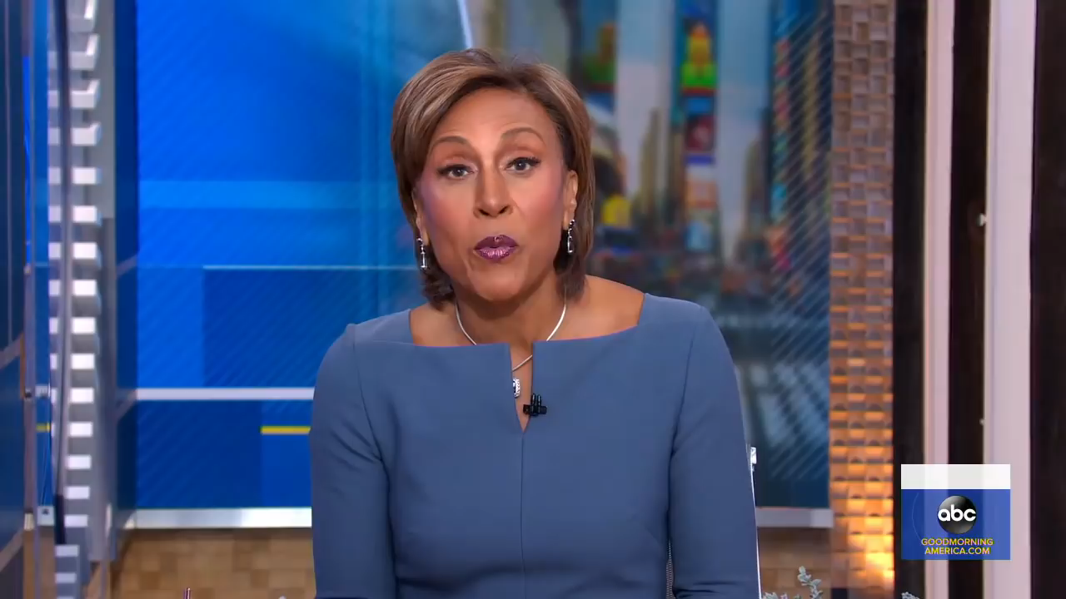
Coming Out
December 1, 2020
Notes:
Play the video for the students (4:46)

Slide 10

Reflection
Elliot starred in a lot of movies in his career, always playing girl characters.
In the video, they said Elliot Page will get to play characters he was born to play, not who Hollywood wanted him to play.
What does that mean?
Notes:
Engages the students in this reflection question

Slide 11
Action
Comedy
Drama
Check Out
Which kind of movie do you prefer?
Notes:
Engage the students in the check out utilizing whichever method you prefer (live discussion, responses in the chat, jamboard, etc.)

Slide 12

For additional resources, visit us at: https://www.lausd.org/human-relations

Slide 13

Teacher Feedback
Notes:
Teacher, please complete the brief feedback survey by scanning the QR code

