Slide 1


Sylvia Rivera
Stories of Excellence
Human Relations, Diversity & Equity
Student Support and Attendance Services

Slide 2
Welcome!
Would you rather have glasses or braces?
Glasses
Braces

Slide 3
Objectives
Learn
about Sylvia Rivera.
Discuss
Sylvia Rivera's life and legacy.
Reflect
on Sylvia Rivera's lasting impact on the LGBTQ+ community.

Slide 4

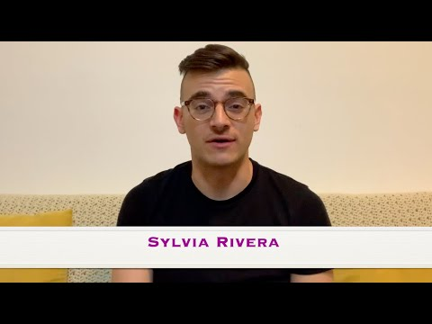
Who is
Sylvia Rivera?
Notes:
https://www.youtube.com/watch?v=2-74Oowzde4
5:14

Slide 5
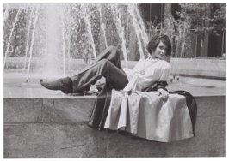
Early Life
Sylvia Rivera was born in 1951 in New York City and designated male at birth.
Sylvia was abandoned by her father at an early age.
Sylvia’s mother died by suicide when she was 3 years old.
Sylvia began living with her grandmother shortly after her mother died.
Sylvia’s grandmother did not approve of her feminine behaviors including her desire to wear makeup.
Sylvia began living on the street at age 11, and soon began living her true identity, as a woman.

Slide 6
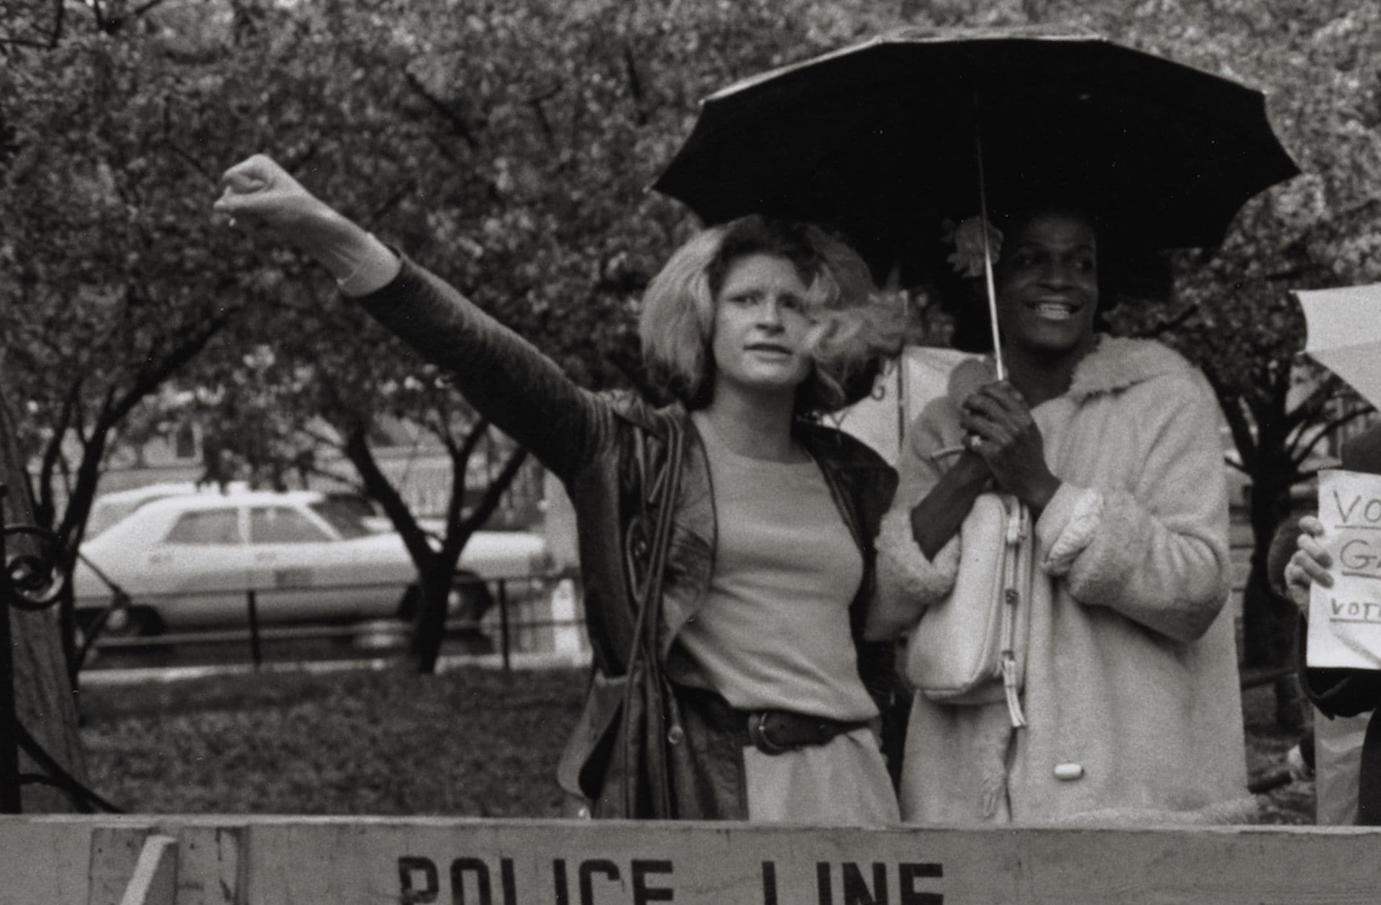
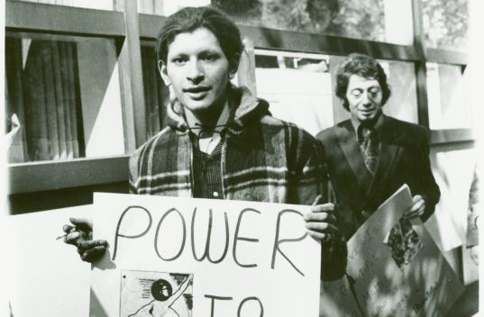
Activism
Sylvia joined the Gay Activists Alliance when she was 18 years old and began fighting for the rights of gay people and drag queens.
After the Stonewall Uprising, Sylvia became a founding member of the Gay Liberation Front.
  The Gay Liberation Front believed in sexual liberation for all people, but also addressed other inequalities such as racism and sexism.

Slide 7
Reflection
Sylvia Rivera experienced a lot of hardship growing up.
Sylvia also engaged in a lot of activism for the liberation of LGBTQ people.
How do you think Sylvia's hardships prepared her to fight so hard for the rights of herself and others?

Slide 8
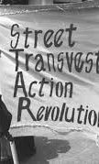
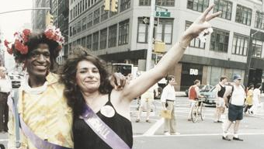
STAR
Fueled by the advocacy of the Gay Liberation Front, Sylvia and her friend Marsha P. Johnson formed STAR (Street Transvestite Action Revolutionaries).
  STAR supported homeless LGBTQ youth with a focus on advocating for rights of Trans people within the movement.

Slide 9
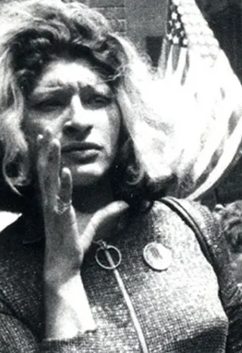
1973 Christopher Street Liberation March
The day of the march, gay activists asked drag queens and other gender non-conforming people to "stay to the back" of the march.
Sylvia stormed the stage and shared an impassioned speech about her personal experience being discriminated by the community she had fought so hard to advocate for.
Sylvia said:
  "I believe in the gay power. I believe in us getting our rights, or else I would not be out there fighting for our rights. That’s all I wanted to say to you people … come and see the people at Star House…. The people are trying to do something for all of us, and not men and women that belong to a white middle class white club..."

Slide 10
Reflection
When Sylvia Rivera stormed the stage at the Christopher Street Liberation March, she said she was fighting for "all of us, and not men and women that belong to a white middle class white club."
What do you think she meant by that?

Slide 11
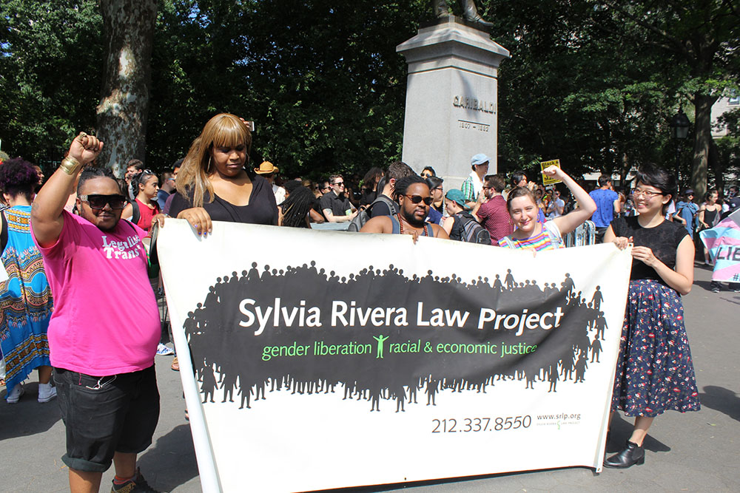
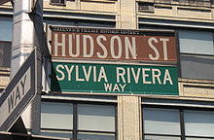
Legacy
After Sylvia's death in 2002, the Sylvia Rivera Law Project was founded.
  The mission of the Sylvia Rivera Law Project is to increase political voice and visibility for low income people and people of color who are intersex, gender nonconforming, and transgender.
  This organization continues Sylvia's work of centralizing systemic racism and poverty, while prioritizing the struggles of queer and transgender people.
In 2005 the corner of Christopher Street and Hudson Ave was renamed Sylvia Rivera Way.
In 2019 New York City announced that monument of Sylvia Rivera & Marsha P Johnson would be installed in Greenwich Village.

Slide 12
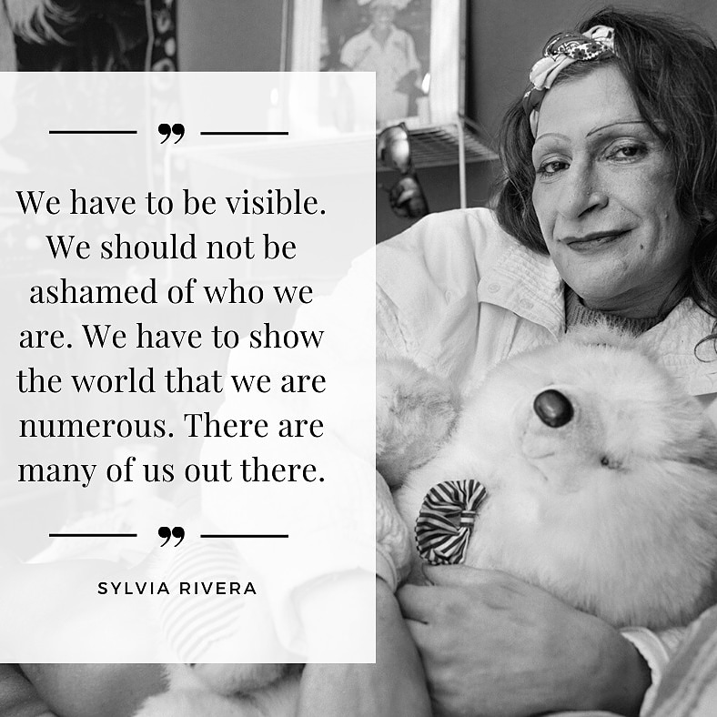

Slide 13
Check Out
Would you rather ride on a train or an airplane?
Train
plane

Slide 14
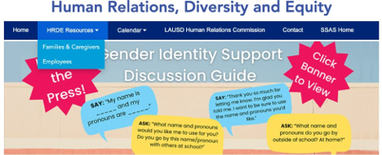
For additional resources, visit us at: https://www.lausd.org/human-relations

Slide 15

Teacher Feedback
Notes:
Teacher, please complete a brief feedback survey by scanning the QR code.

