Slide 1


Let's Talk about Thanksgiving
Parts 1 &2
Human Relations, Diversity & Equity
Student Support and Attendance Services
Notes:
Please feel free to encourage student participation whichever way you are most comfortable: in the Zoom chat, on a previously shared Jamboard, in break out groups, or all together in a grid view. There will be a lot of opportunities for participation throughout this presentation.

Slide 2







Welcome!
Would you rather eat TURKEY or PIE?
Notes:
Invite the students to engage in this brief check in

Slide 3

Objectives
Learn about the different histories of Thanksgiving.
Explore why there may be so many different histories and what it means.
Reflect on how you can honor the true meaning of Thanksgiving.
Notes:
Read the objectives aloud for the students.

Slide 4
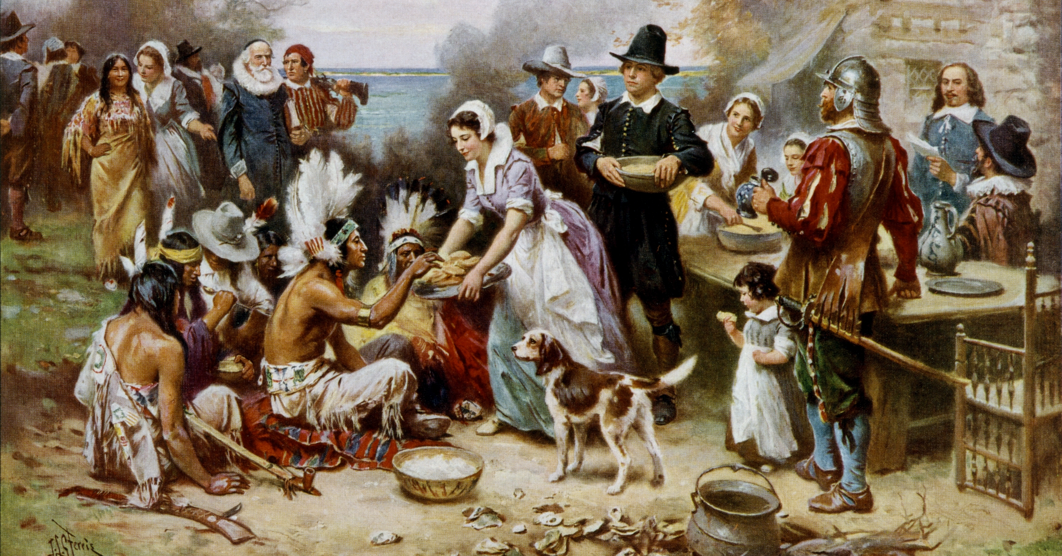
Thanksgiving
What do you know about the history of the holiday we recognize as Thanksgiving?
Notes:
Invite the students to share out regarding their current knowledge around Thanksgiving.

Slide 5
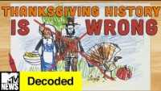
Everything We Know about Thanksgiving is WRONG?
Notes:
Play the video for the students. (3:21)
https://www.youtube.com/watch?v=uFfREh7G3ck

Slide 6
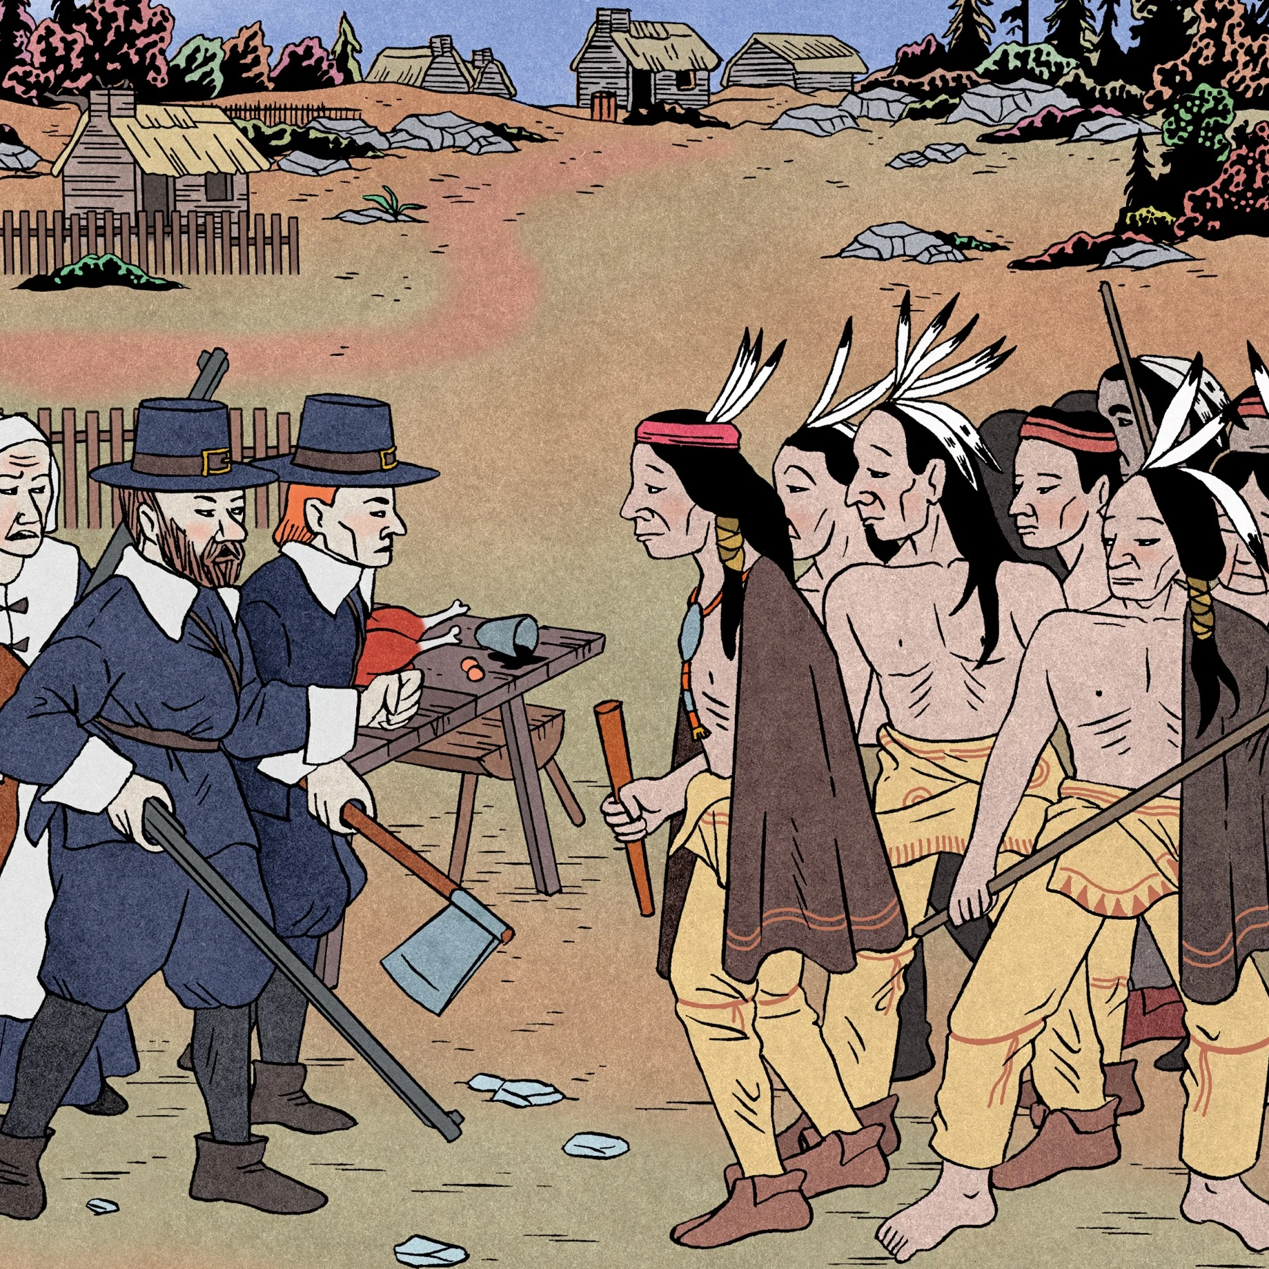
The Two Stories of Thanksgiving
The version we learn in school, starts with the landing of the Mayflower in 1620 in a small bay north of Cape Cod.
In the Native American version, the arrival of the Pilgrims marks the beginning of the end.
Notes:
Read the slide aloud for the students.
Source: https://www.huffpost.com/entry/the-thanksgiving-truth_b_1105181

Slide 7
Reflection
What does it mean "the arrival of the Pilgrims marks the beginning of the end"?
Notes:
Engage the students in the reflection question. Assist in their understanding of what "the beginning of the end means".

Slide 8
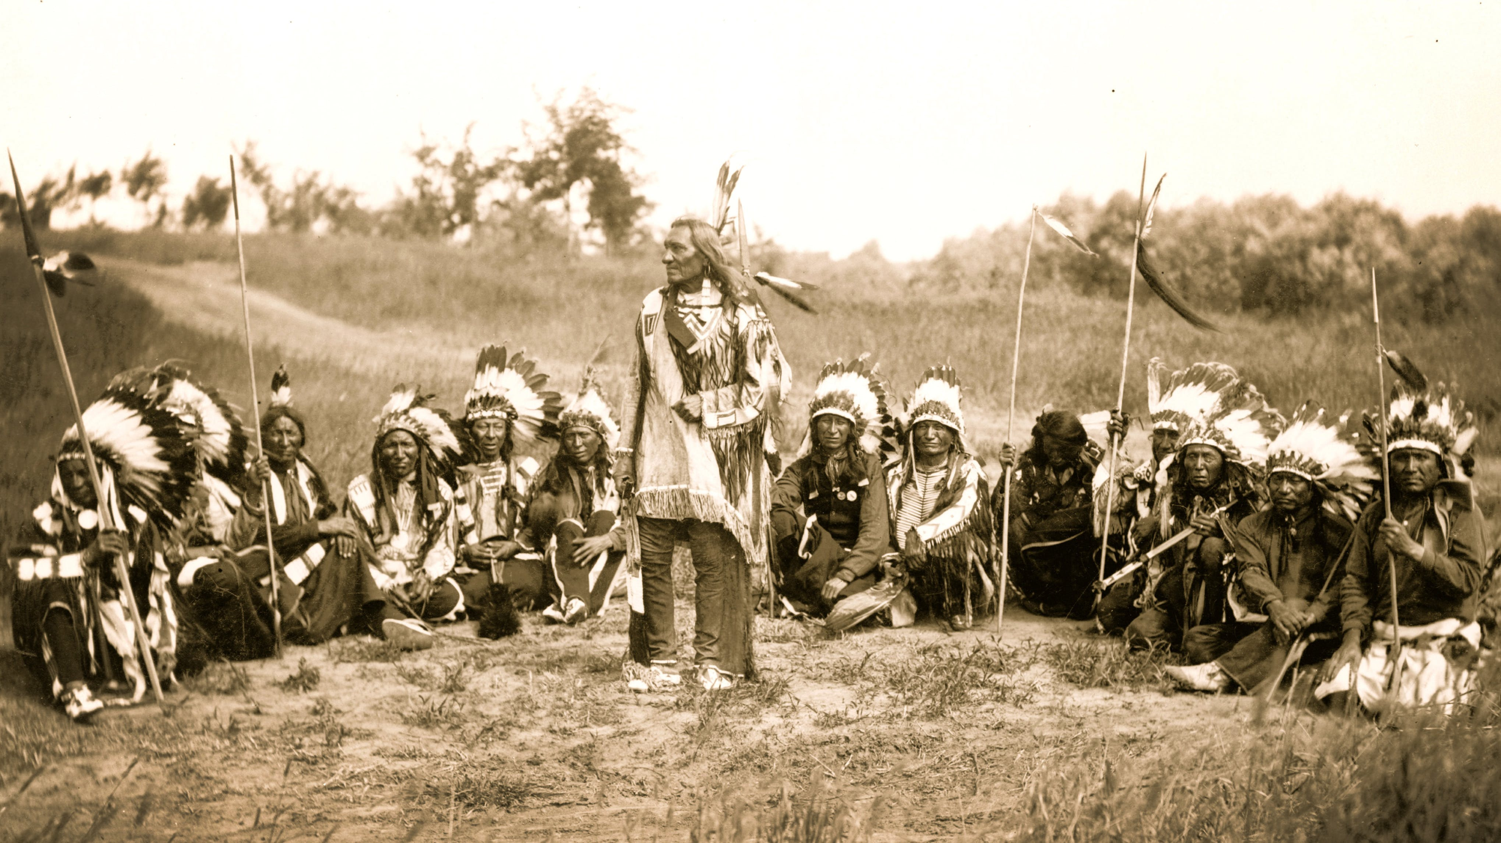
MYTH: The Native American's story begins when the Pilgrims land on Plymouth Rock.
The Indigenous peoples had a hundred years of contact and trade with the Europeans before the pilgrims arrived in 1621.
Years earlier British slaving crews introduced smallpox to the native people; over 90% of the local population died.
Notes:
Read the slide aloud for the students.

Slide 9
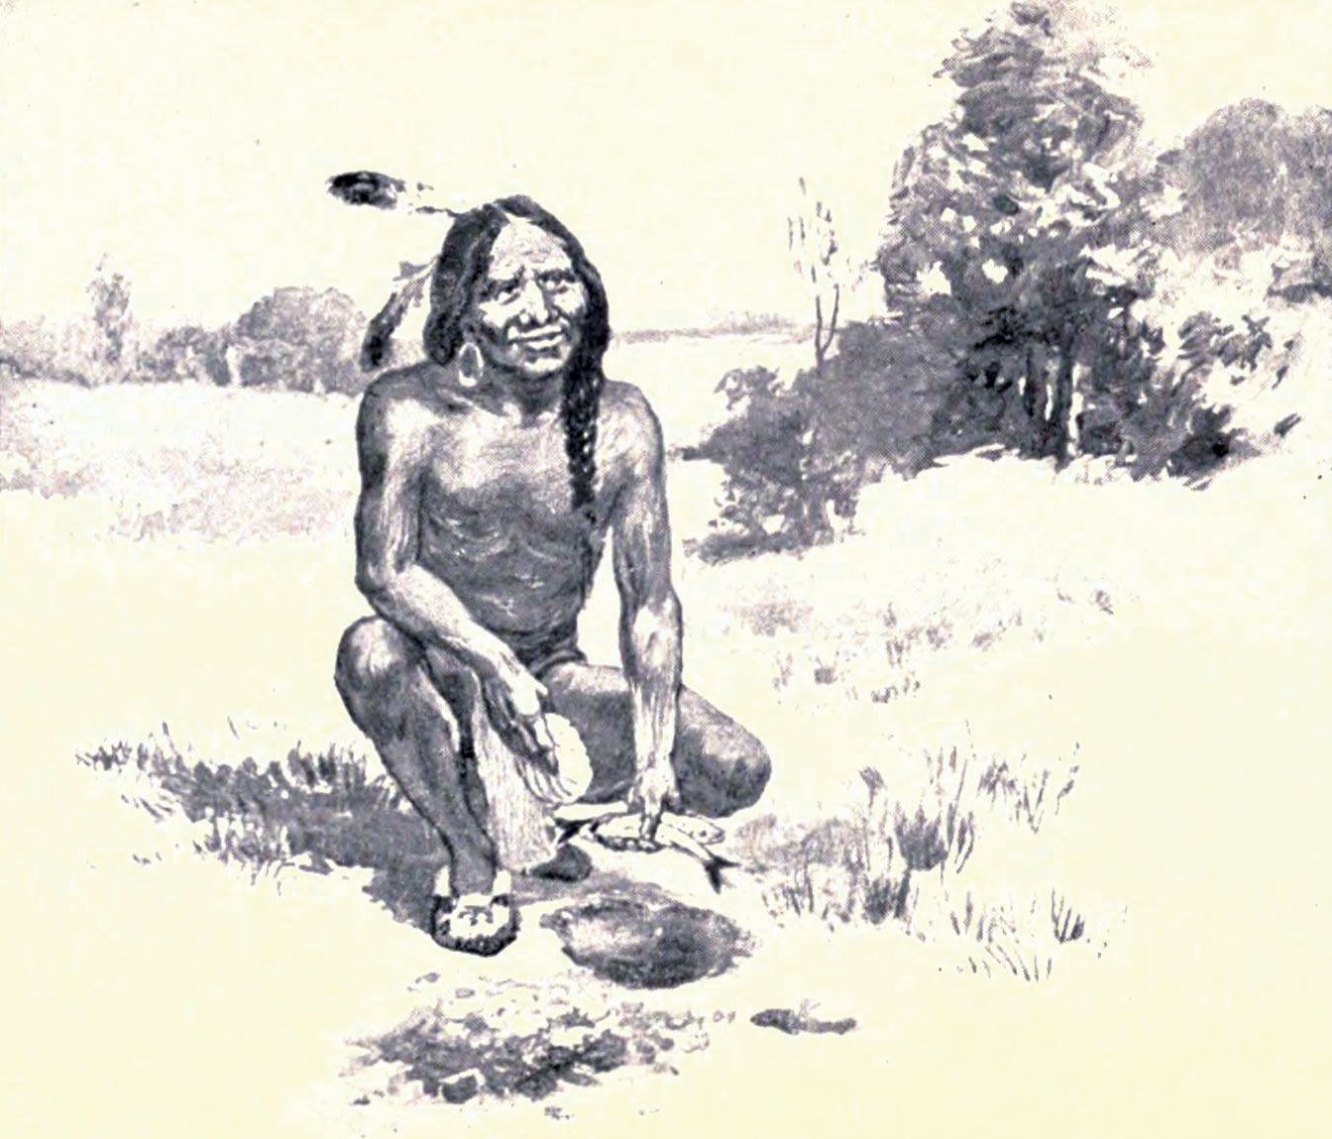
MYTH: Squanto happened to speak English and was happy to help translate.
Tisquantum (Squanto) learned English after being kidnapped and sold into slavery by an English explorer.
Tisquantum escaped and returned home to discover that his tribe, the Patuxet people, had been wiped out by smallpox.
Tisquantum used his English skills as an interpreter between the settlers and other native groups.
Notes:
Read the slide aloud for the students.
https://www.biography.com/political-figure/squanto

Slide 10
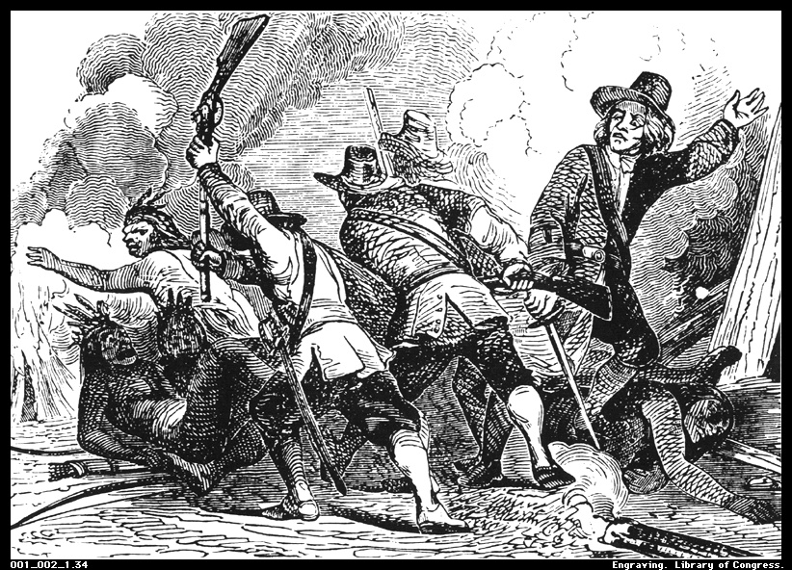
MYTH: Thanksgiving is a celebration of the unity between the Indigenous Peoples and the European Settlers.
Researchers doubt that there was a celebration or unity between the Indigenous Peoples and the European settlers.
European settlers continually pushed the Indigenous Peoples off their land and made them conform to European customs.
Notes:
Read the slide aloud for the students.

Slide 11
BREAK
Time permitting, this would be a great spot to stop, and pick back up during your next session!
Notes:
Time permitting, this would be a great spot to stop, and pick back up during your next session!

Slide 12
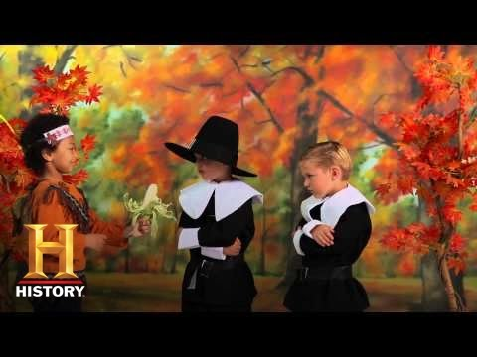
Problematic Story Telling
Notes:
Play the video for the students. 3:05
https://www.youtube.com/watch?v=WumiRK06Yqw

Slide 13
Reflection
What problematic messages did that video share?
Notes:
Engage students in dialogue regarding the problematic messages in the previous video. Some may mention:
Indigenous People genuinely wanted to help the pilgrims get through the cold (they did it as a means of survival and to have an ally against other tribes).
Tisquantum just voluntarily offered a treaty (Tisquantum only spoke English because he had previously been enslaved by Europeans – and he served as a translator as a means of survival).
The Indigenous People gladly taught the pilgrims how to harvest their crops (they did it as a means of survival and to have an ally against other tribes).
the pilgrims had a big party to THANK the native Americans (there is no evidence of unity amongst the two populations - European settlers continually pushed the Indigenous Peoples off their land, engaged in war, and made them conform to European customs)
saying there would never be problems between the English and the natives American again (the colonists engaged in many acts of war and cruelty against the Indigenous peoples for generations to come).

Slide 14
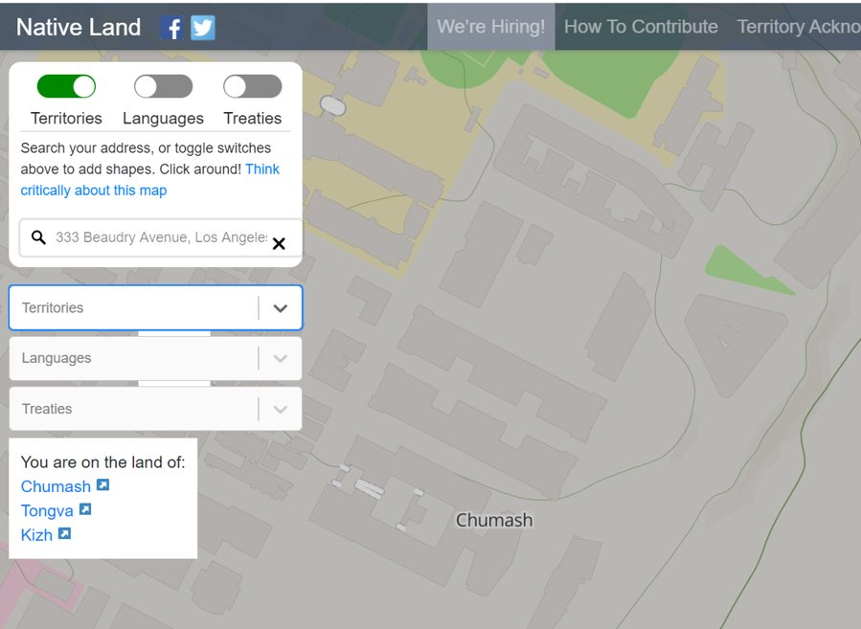
What can YOU do?
Learn about the history of the people whose land you live on!
Type your address into "native-land.ca"
LAUSD headquarters (Beaudry) is on Chumash, Tongva and Kizh land.
Notes:
Read the slide aloud for the students and encourage the students to engage in the activity.

Slide 15
What can YOU do?
Once you have discovered whose land you are on, click on the link and learn more about those nations.
One of the best way we can honor other cultures is by learning more about them!
Notes:
Read the slide aloud.

Slide 16
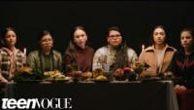
Happy Thanksgiving America
Notes:
Play the video for the students. 1:43
Native American Girls Describe the REAL History Behind Thanksgiving | Teen Vogue - YouTube

Slide 17
Reflection
What are your thoughts or reactions to the video?
Notes:
Invite the student sto share their reaction to the video

Slide 18
Check Out
Please share one or two new things you learned about Thanksgiving.
Notes:
Engage the students in the check out activity.

Slide 19
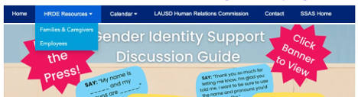
For additional resources, visit us at: https://www.lausd.org/human-relations

Slide 20
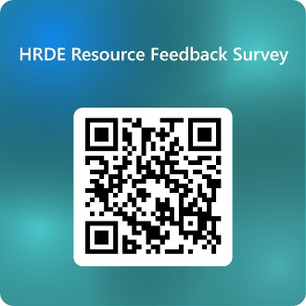
Teacher Feedback Survey
Notes:
Teacher please scan the QR code to complete the feedback survey

