Slide 1
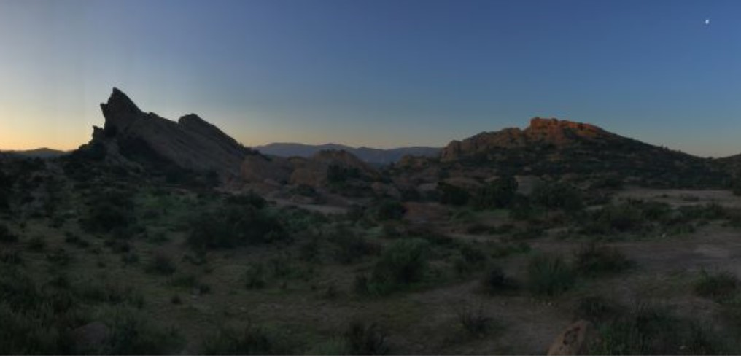

The Fernandeño Tataviam Band of Mission Indians
Recognizing and acknowledging the "people who face the sun".
Human Relations, Diversity & Equity
Student Support and Attendance Services
Steve Deichen, San Fernando Elementary, Guest Contributor
Notes:
Teacher, thank you for choosing to share this Advisory Lesson with your students.

Slide 2
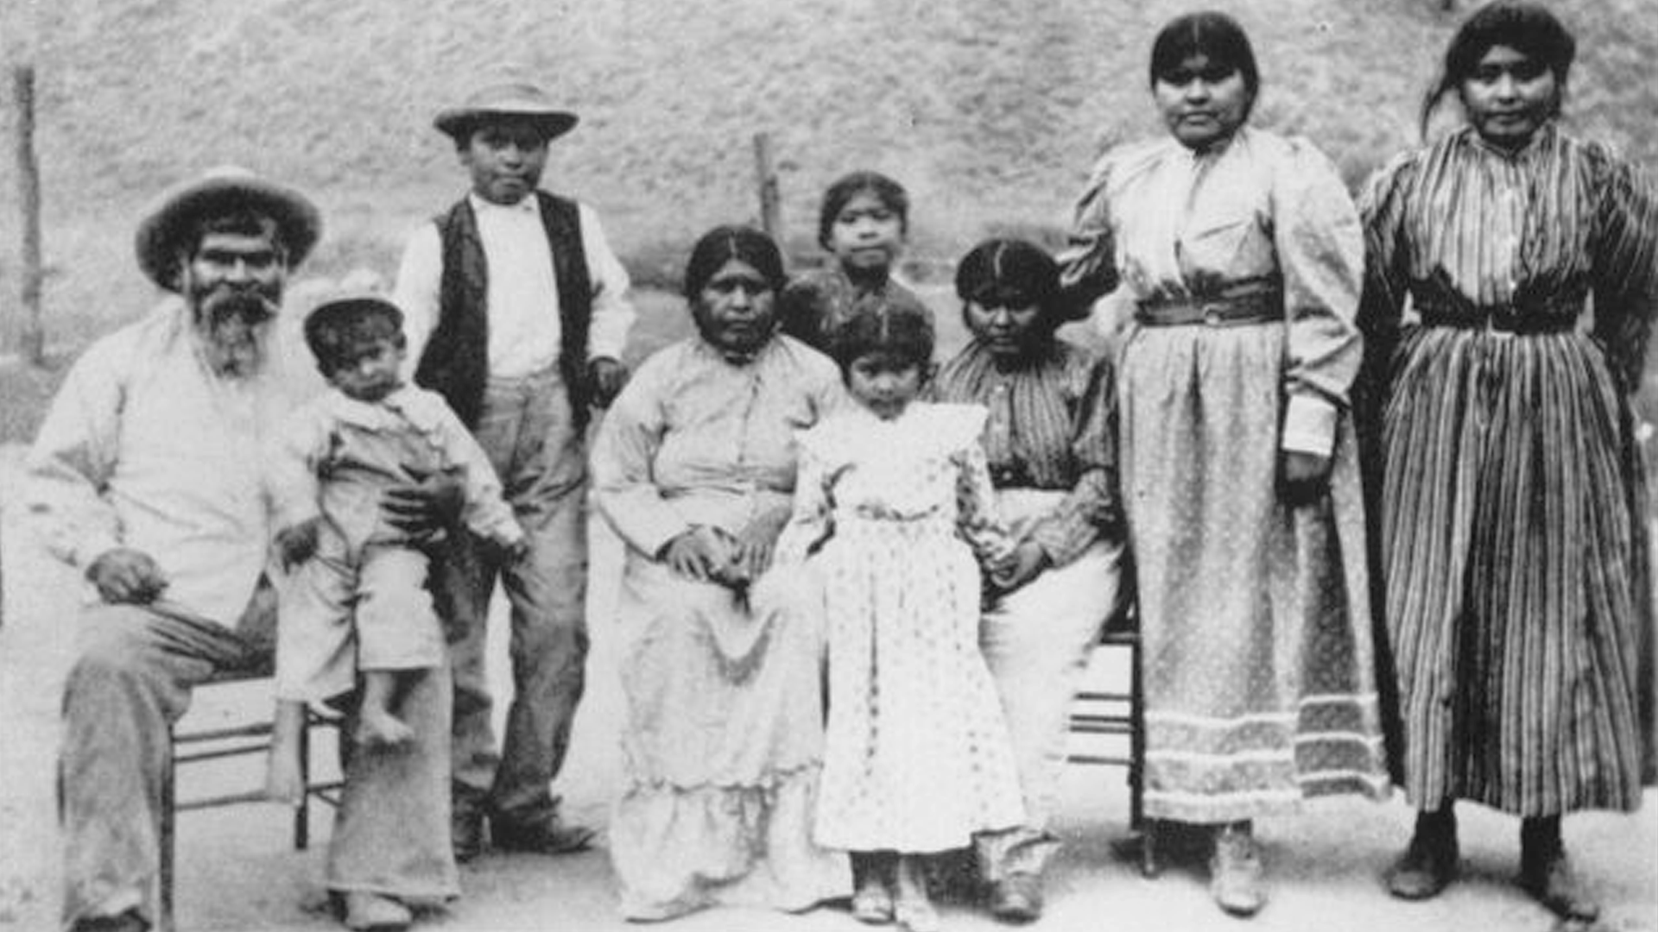
OBJECTIVES
1-Announce Board Resolution
2-Introduce the FTBMI
3-Invite self-reflection
Tataviam ancestor Juan Jose Fustero, his wife, Sinforosa, and his family at their home near Rancho Camulos Museum in Piru, California, circa 1900s. The word “Piru” comes from Pi’iruknga, which means “place of the tule”.
Notes:
Please read the objectives and the picture summary aloud for the students.

Slide 3




would you rather...
discover gold in the local hills
or...
know every local plant used for medicine or food
Notes:
Invite the students to engage in the check in question.

Slide 4

In March of 2021, the Board of Education of the City of Los Angeles passed a resolution which:
...formally recognizes and celebrates the history, cultural heritage, and numerous contributions of the Fernandeño Tataviam Band of Mission Indians.
...urges the Office of Federal Acknowledgement within the Office of the Assistant Secretary – Indian Affairs of the Department of the Interior to grant long overdue formal Federal recognition of The Fernandeño Tataviam Band of Mission Indians.
Have you recognized the Fernandeño Tataviam Band of Mission Indians or asked yourself if you might owe them a debt?
Notes:
Read the slide aloud for the students.

Slide 5
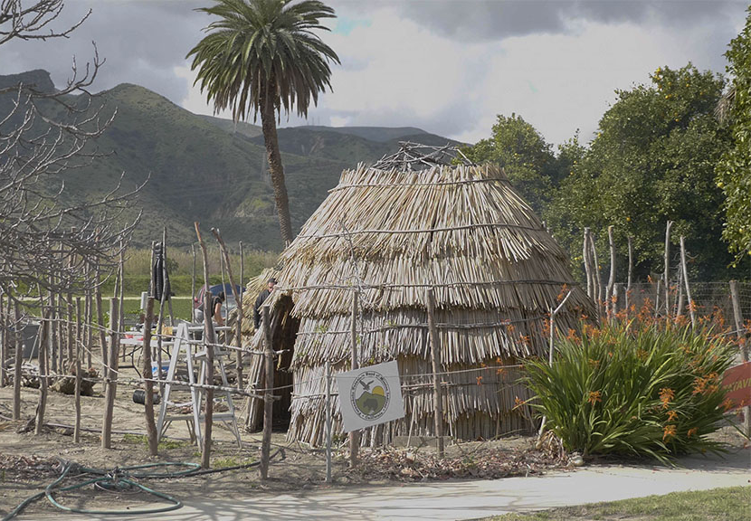
Who are the Fernandeño Tataviam Band of Mission Indians?
The Fernandeño Tataviam Band of Mission Indians lived in northern Los Angeles County for over 2500 years.
Their real name was the Tataviam, but when the Spanish missionaries came in 1797, they enslaved the Tataviam and forced them to build the San Fernando Mission.
The Tataviam land was stolen from them and they were evicted from their own land.
Notes:
Read the slide aloud ofr the students.

Slide 6
450 CE The Tataviam settle in what is now Northern Los Angeles County
1797 The Spanish build Mission San Fernando and force the Tataviam to leave their villages and become forced labor for the mission operations.
1821 The Spanish Mission period ends, and the Mexican period begins. Secularization plans are made, including returning the land to the Tataviam people.
.
1839 Alta California Governor Juan Bautista Alvarado grants what is now Santa Clarita to Antonio Del Valle, officially dispossessing the Tataviam from their ancestral lands.
1846 Mexican rule ends, American military rule begins. There are approximately 150 Tataviam living in the San Fernando Mission area.
1872 The northern half of the San Fernando Valley is sold to developer George Porter and state senator Charles Maclay.
1882-1885 Maclay and Porter legally evict remaining Tataviam leaders and their families, making them homeless on their own lands.
1921 Juan Jose Fustero, possibly the the last full-blooded Tataviam, dies and is buried under what is now Lake Piru
Summarized historical timeline
Notes:
Read the timeline aloud for the students.

Slide 7
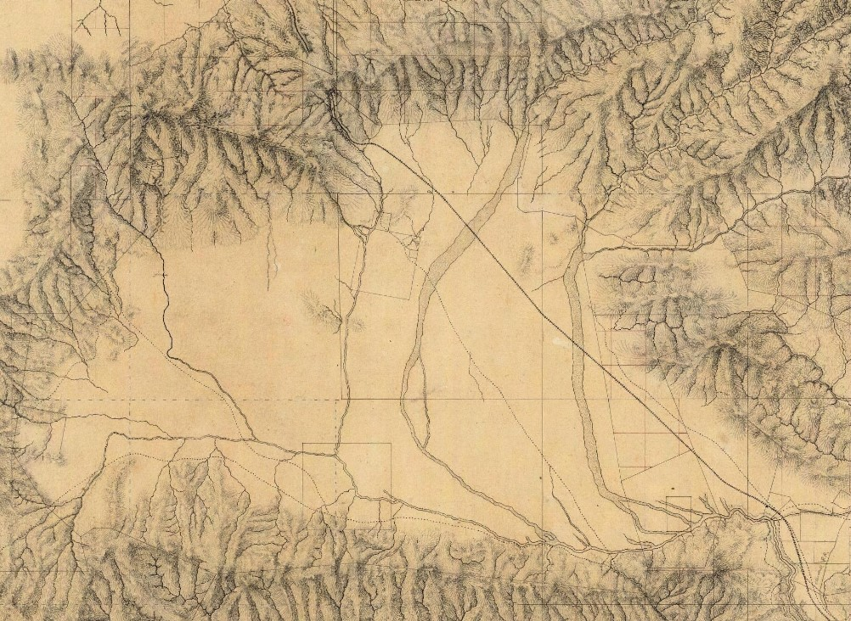
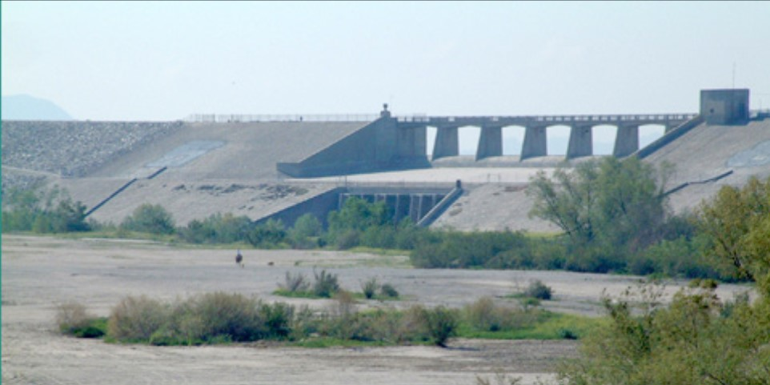
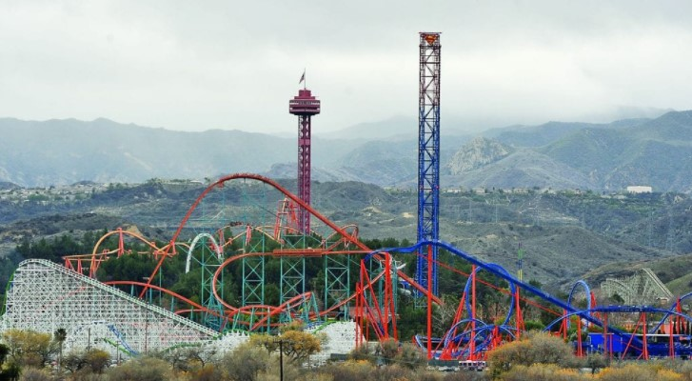
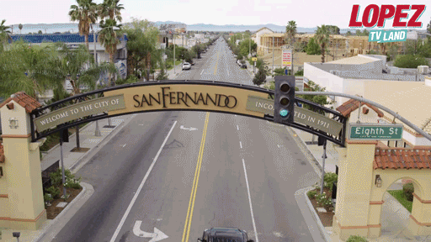
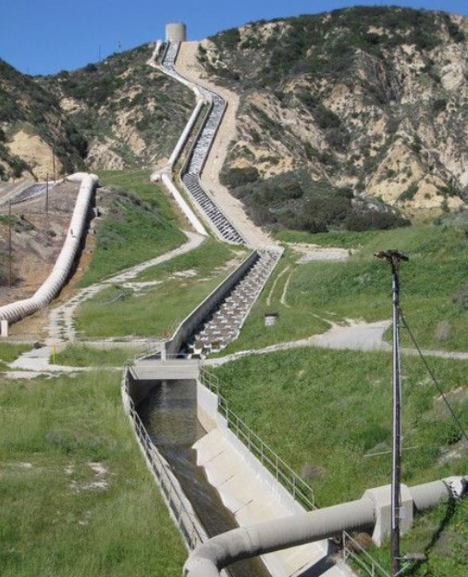
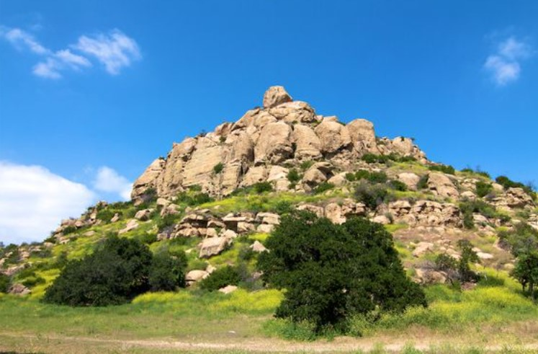
The LA Unified School District currently operates over one hundred schools on ancestral FTBMI land.
Whose land is your school built on ?
CLICK a picture to find out
Lake View Terrace
Valencia
San Fernando
Sylmar
Chatsworth
Notes:
Engage the students in dialogue about the parts of LA that are considered to be Fenandeno Tataviam Band of Mission land. Use the link below to encourage the students to find out whose land they are on. e
http:/native-land.ca Native-Land.ca | Our home on native land (native-land.ca) enter your address to find out on whose land you are on

Slide 8
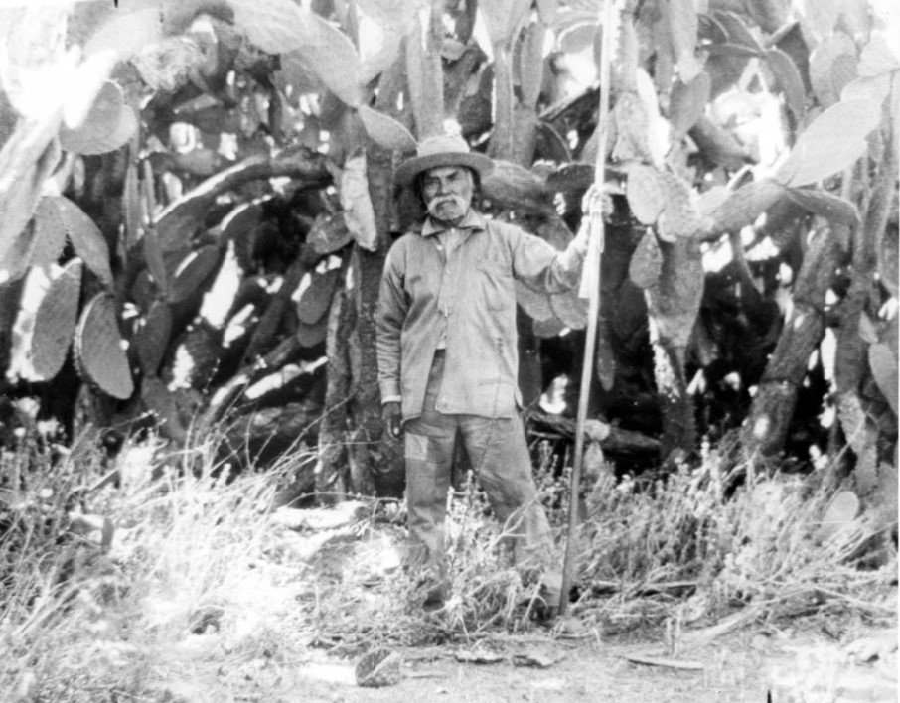
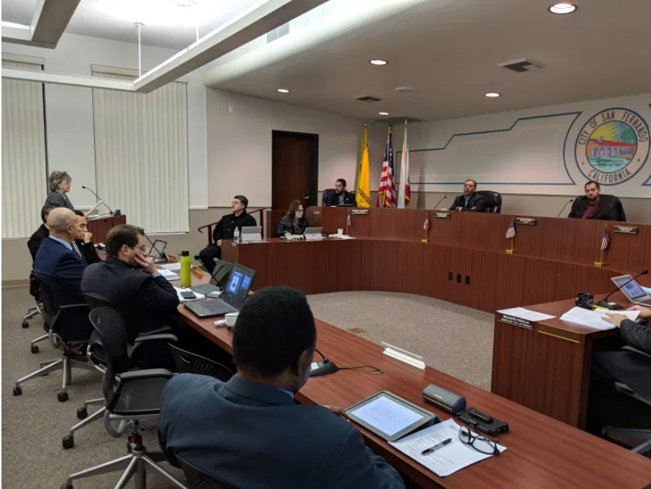
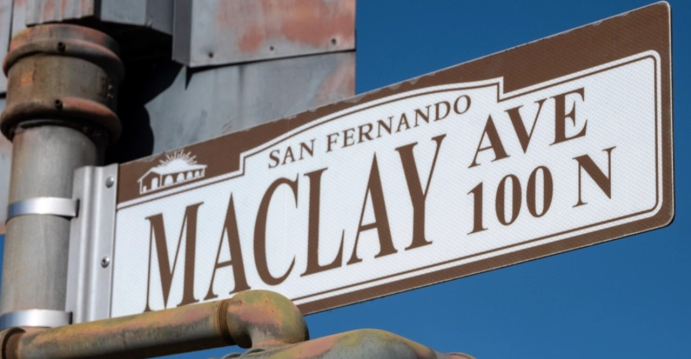
The Fernandeño Tataviam Band of Mission Indians asked the City of San Fernando to adopt a resolution to rename Maclay Avenue as Tataviam Tribe Avenue.
Rogerio Rocha, 1898
Tribal Captain of the Fernandeño Tataviam people
The descendents of California State Senator Charles Maclay disagree.
What do you think?
Notes:
Read the slide aloud for the students. Engage the students in the reflection question.

Slide 9
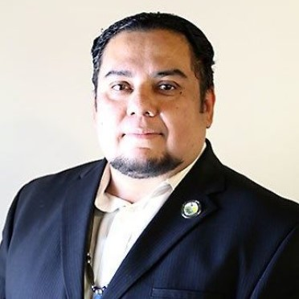
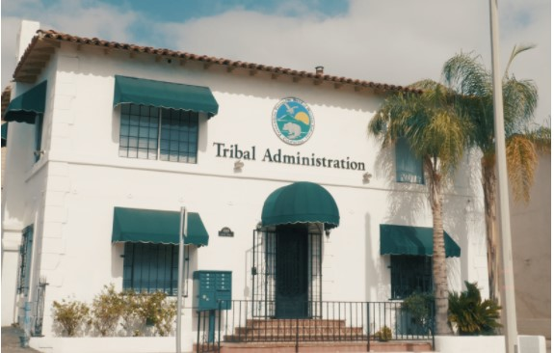
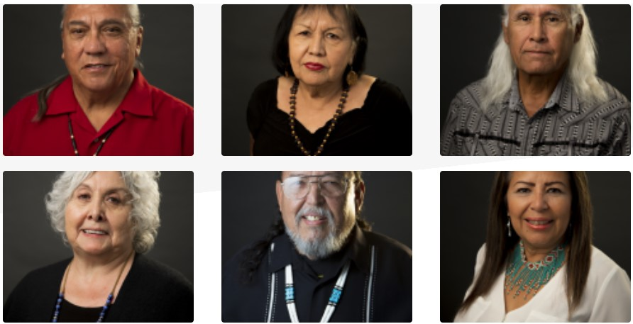
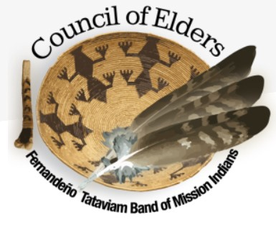
Rudy Ortega Junior
Tribal President
Tribal Headquarters, 1019 2nd St,
San Fernando, CA 91340
BEVERLY SALAZAR FOLKES
DENNIS GARCIA
ALAN SALAZAR
BERNICE FRANCES COOKE
TED GARCIA
KATHY ANN FLORES
Notes:
Share these pictures with the students. Advise the students that these are the Fernandeno Tataviam Band of Mission Indians Council of Elders.

Slide 10
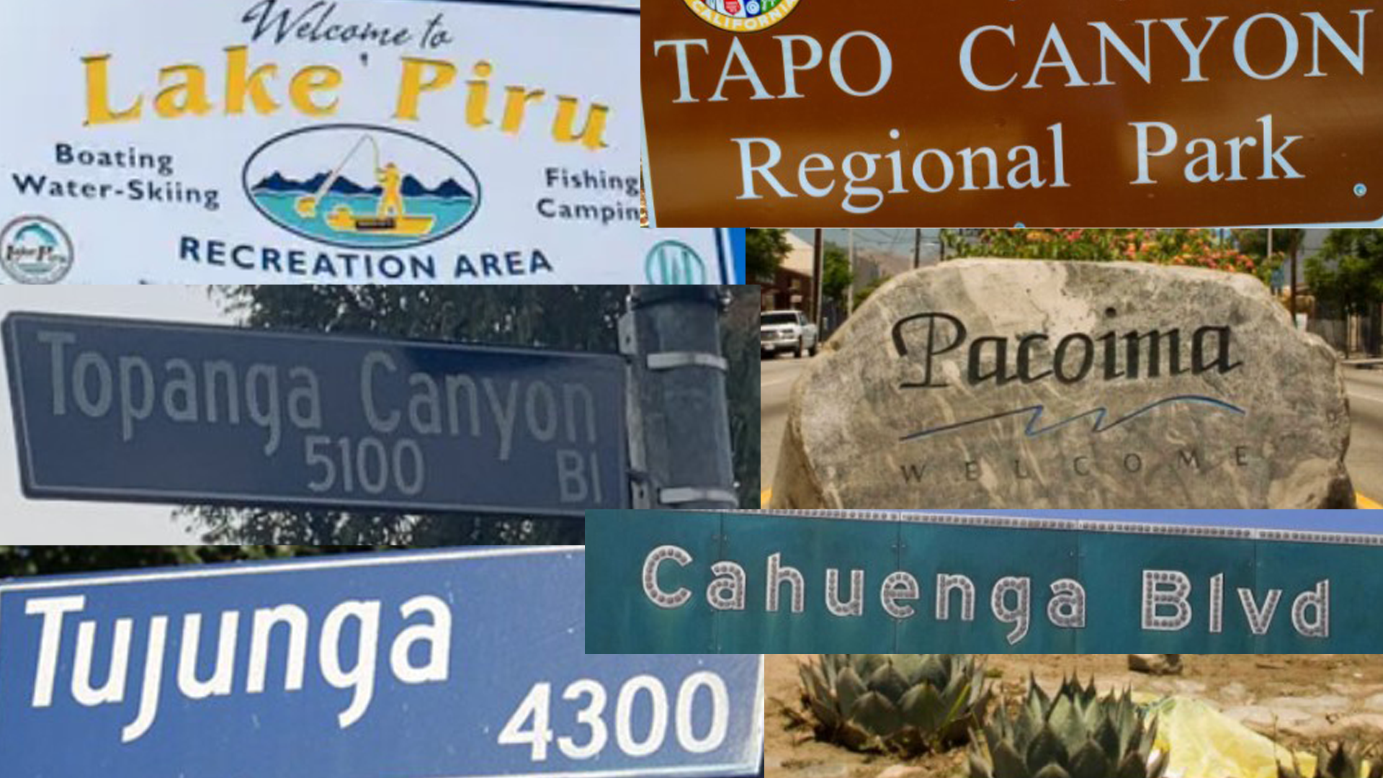
Tataviam place-names
Notes:
Share the pictures with the students. Advise these students that these common place-names are actually from the native Tataviam language.

Slide 11
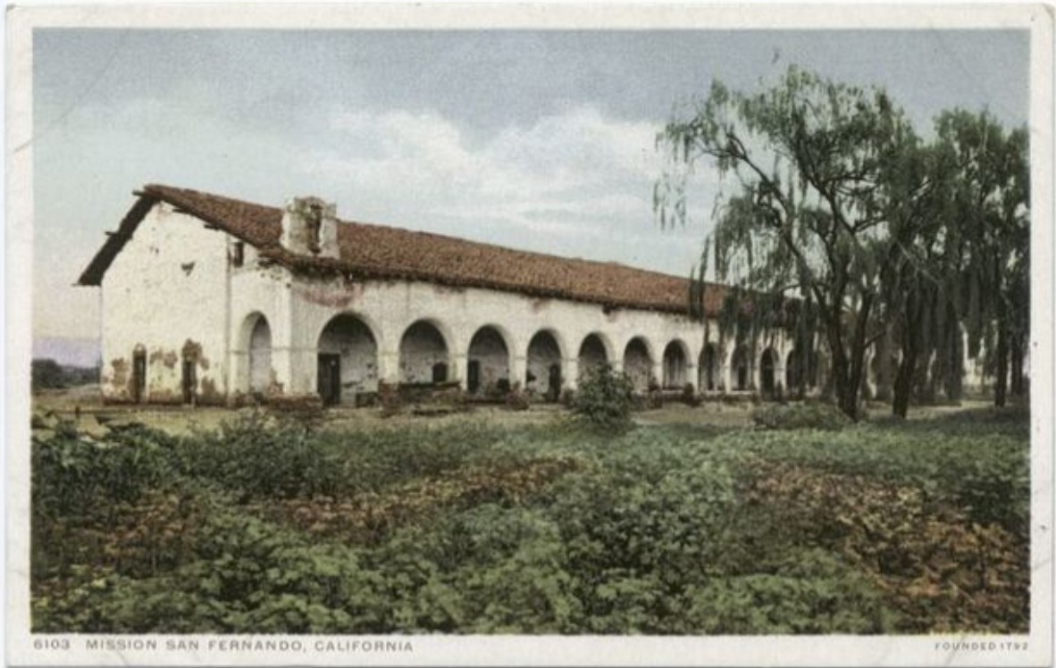
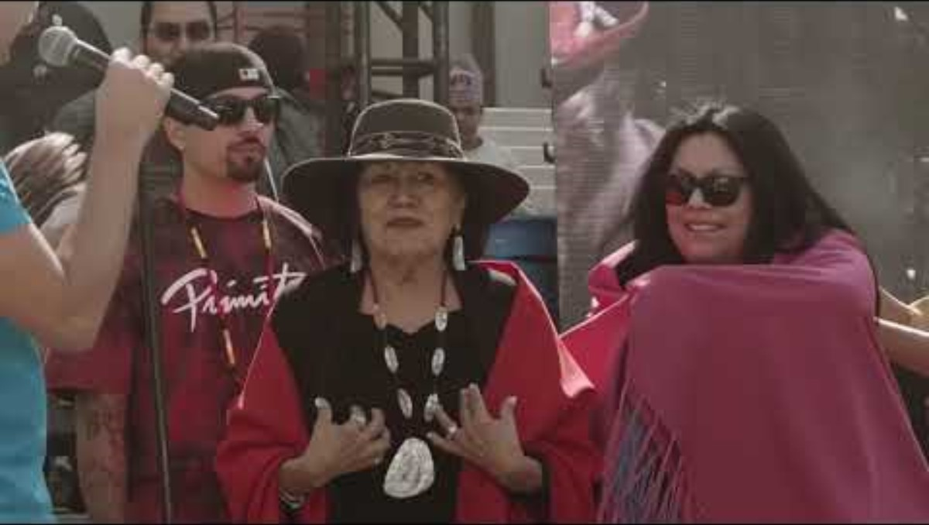
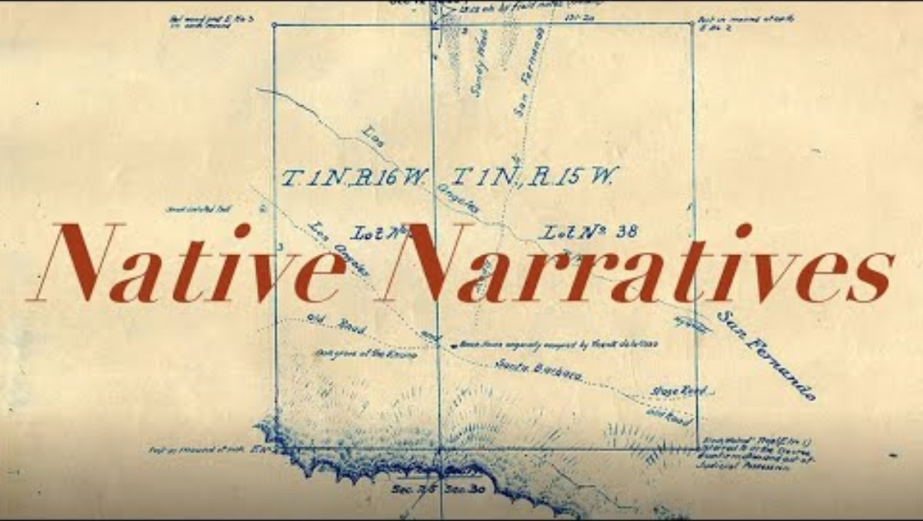

Do you want to know more ?
Notes:
https://youtu.be/W6slaP0oiO4 Fernandeño Tataviam Band of Mission Indians | About (13:05)
https://youtu.be/Kp3SmDsPSEs Native Narratives: History of the Fernandeño Tataviam Band of Mission Indians (10:23)
https://youtu.be/PR7CgCOr85Y People Facing the Sun: The History of the Fernandeno Tataviam Band of Mission Indians (51:03)

Slide 12

Teacher Feedback
Notes:
Teacher please complete a brief feedback survey by scanning the QR code

Slide 13

For additional resources, visit us at: https://www.lausd.org/human-relations

