Slide 1


National Day of Mourning
Human Relations, Diversity & Equity
Student Support and Attendance Services
Notes:
Teacher, thank you for choosing to share this lesson with your students.
Please take the time to review our accompanyling lesson:
Let's Talk About Thanksgiving
For more resources and advisory lessons check out the HRDE Homepage: https://achieve.lausd.net/human-relations

Slide 2

Welcome
Which school subject do you prefer?
History
Math
Science
English
Notes:
Please engage the students in the check in question

Slide 3
Objectives
Learn about National Day of Mourning.
Review the historical significance of this day.
Explore the narratives of what happened when the Pilgrims arrived in America.
Notes:
Read the objectives aloud for the students

Slide 4

What is National Day of Mourning?
Notes:
https://www.youtube.com/watch?v=OW0s8ToCyU8 (4:44)

Slide 5

Reflection
Before today, had you ever heard of the National Day of Mourning?
Notes:
Engage the students in the reflection question

Slide 6

National Day of Mourning
Every Thanksgiving day in Plymouth, Massachusetts, Indigenous Americans gather to observe a National Day of Mourning.
National Day of Mourning began in 1970 as a way for Indigenous people to remember their ancestors and grieve their genocide.
The National Day of Mourning is organized by the United American Indians of New England.
Notes:
Read the slide aloud for the students

Slide 7


History
In 1970, the Commonwealth of Massachusetts planned a celebration of the 350th anniversary of the Pilgrim's arrival to North America (specifically, Wampanoag land).
This organizers wanted to commemorate the friendly relations between the settlers and the Wampanoag people.
Wampanoag leader, Wamsutta, was invited to make a speech at the event.
Upon previewing his planned speech, the organizers of the event determined it was not appropriate.
He was told "the theme of this anniversary celebration is the brotherhood and anything inflammatory would be out of place."
Notes:
Read the slide aloud for the students

Slide 8
Reflection
What do you think Wamustta was planning to say? What could have been so bad it got his speech denied?
Notes:
Engage the students in the reflection question

Slide 9
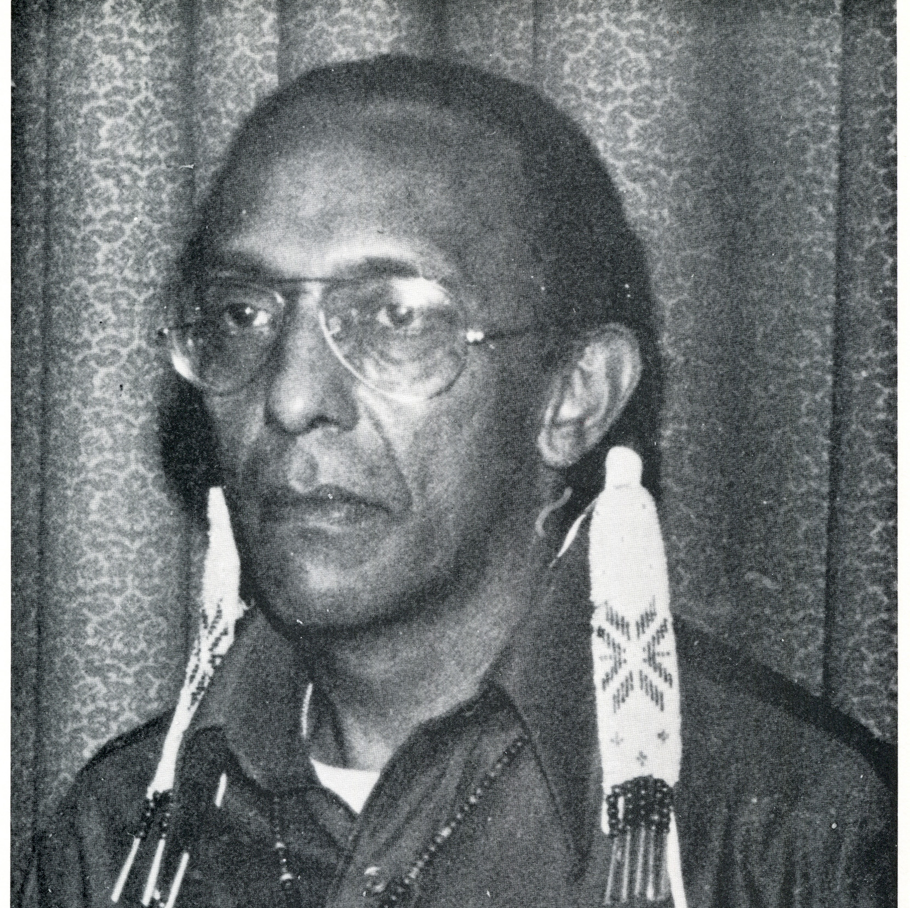
The Protest
Ultimately, Wamsutta decided not to attend the celebration.
Instead, he and his supporters gathered in protest at the statue of Massasoit, the leader of the Wampanoag people when the Pilgrims first arrived.
This statue stands proud atop Cole's Hill, overlooking Plymouth Harbor and the Mayflower replica.
Here, Wamsutta gave his original speech, recounting the first year the Pilgrims were in North America; a retelling of grave openings, stolen supplies like corn and beans, and the sale of the Wampanoag people as slaves for 220 shillings each.
Notes:
Pictured: Wamsutta
Read the slide aloud for the students

Slide 10
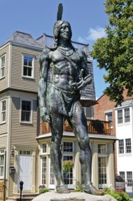
Annual Protests
National Day of Mourning protests are held in the same spot every year.
The objective is to raise awareness of the misrepresentation of the Indigenous people and the colonial experience.
The National Day of Mourning hopes to educate folks about the true history of the colonialization of America and end the national myth.
The protest also hopes to address the ongoing contemporary struggles Indigenous people face.
Notes:
Pictured: the statue of Massasoit
Read the slide aloud for the students

Slide 11
Reflection
What do you think about Wamsutta's move to decline the event and hold his own protest?
Notes:
Engage the students in the reflection question

Slide 12
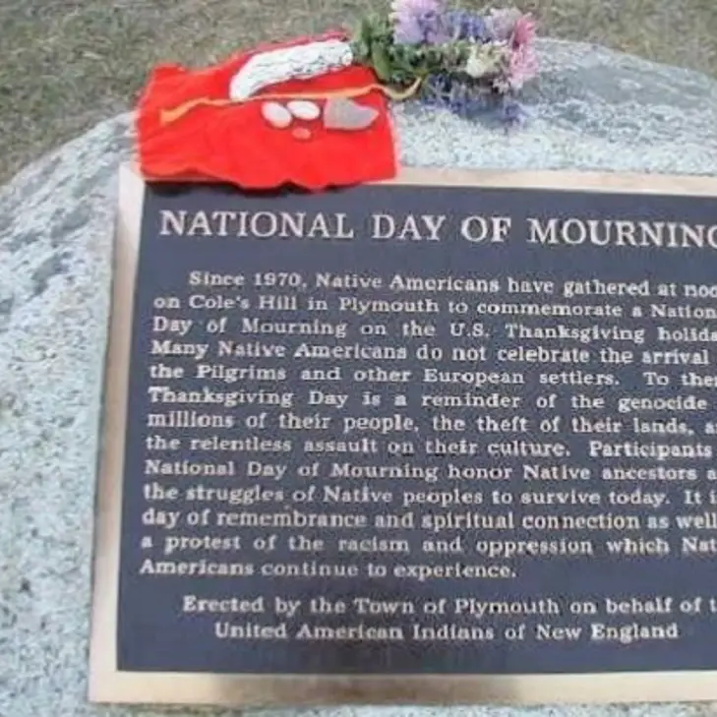
Plaque
The town of Plymouth, Massachusetts has erected a plaque for the National Day of Mourning.
It reads:
  Since 1970, Native Americans have gathered at noon on Cole's Hill in Plymouth to commemorate a National Day of Mourning on the U.S. Thanksgiving holiday. Many Native Americans do not celebrate the arrival of the Pilgrims and other European settlers. To them, Thanksgiving Day is a reminder of the genocide of millions of their people, the theft of their lands, and the relentless assault on their cultures. Participants in National Day of Mourning honor Native ancestors and the struggles of Native peoples to survive today. It is a day of remembrance and spiritual connection as well as a protest of the racism and oppression which Native Americans continue to experience.
Notes:
Read the slide aloud for the students

Slide 13
Reflection
Do you think people are starting to re-think their understanding of Thanksgiving?
Notes:
Engage the students in the reflection question

Slide 14
What can you do?
Check
out the official event website
Read
Wamsutta's suppressed speech
Find
out whose land you are on
Notes:
Teacher: share these links with the students.
Check Out the official event website: http://www.uaine.org/
Read Wamustta's Suppressed Speech: http://www.uaine.org/suppressed_speech.htm
Find out whose land you are on: https://native-land.ca/
Additional Lessons for teacher:
1. National Geographic: https://www.nationalgeographic.org/activity/recognizing-native-american-perspectives-thanksgiving-and-national-day-mourning/

Slide 15
Check Out
Which do you find most relaxing?
Art
Listening to Music
Exercising
Reading
Something else
Notes:
Engage the students in the check out question

Slide 16

Teacher Feedback
Notes:
Teacher, please complete a brief feedback survey by scanning the QR code.

Slide 17

For additional resources, visit us at: https://www.lausd.org/human-relations

