Slide 1
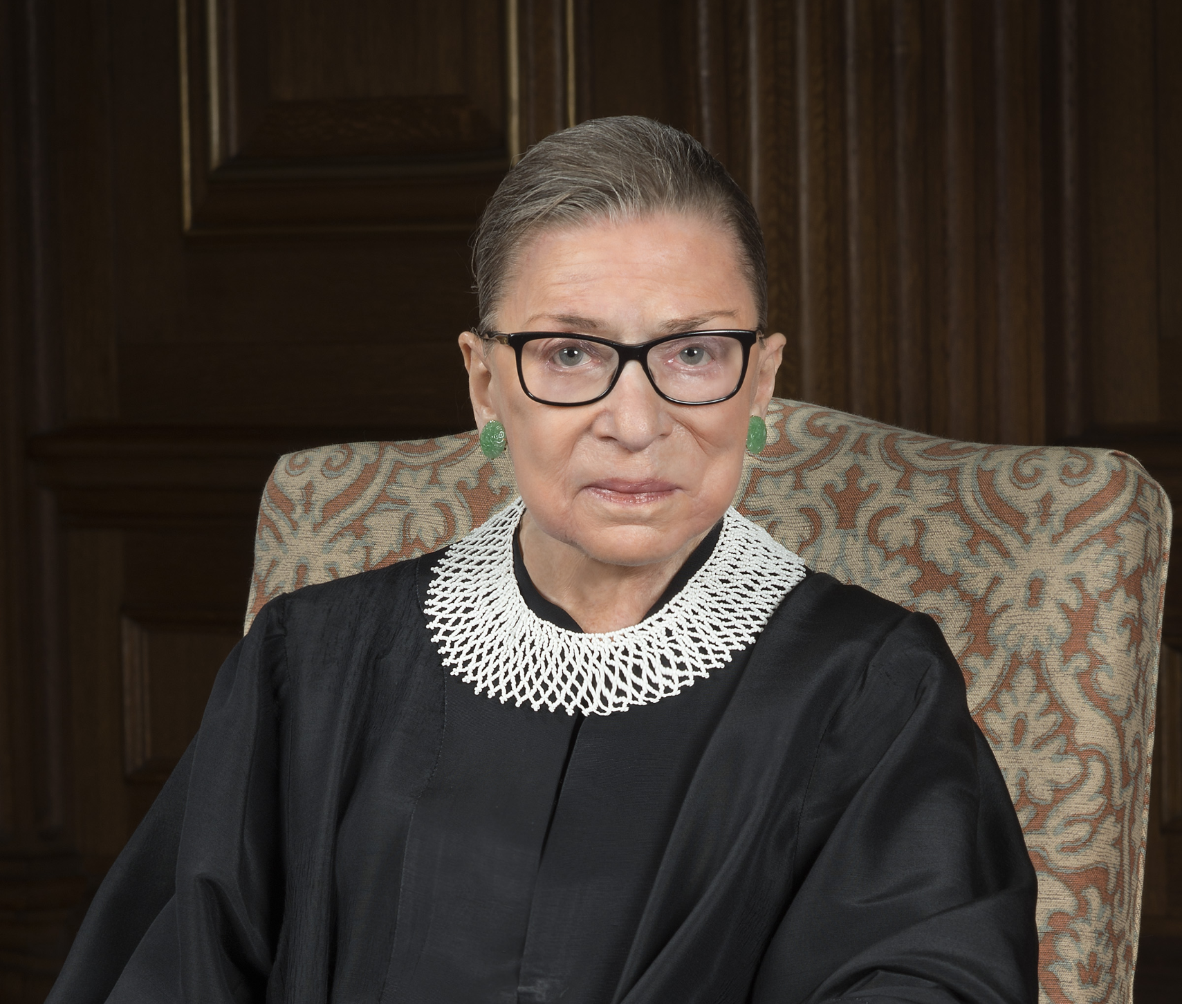

Ruth Bader Ginsberg
Stories of Excellence
Human Relations, Diversity & Equity
Student Support and Attendance Services

Slide 2
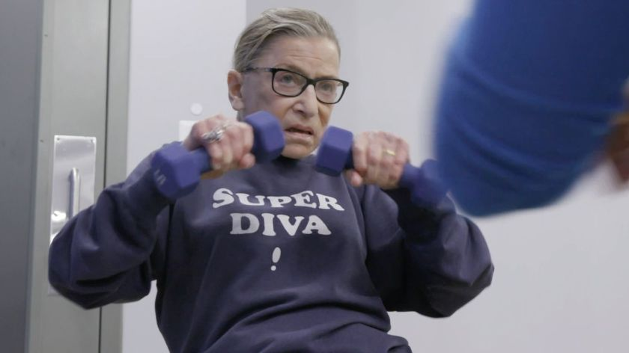
Welcome
Check In
Do you think you will still be exercising when you're in your 80's?

Slide 3
Objectives
Learn about Supreme Court Justice Ruth Bader Ginsburg.
Discuss the impact Ruth Bader Ginsburg had on gender equality.
Reflect on the history of gender discrimination in the United States.

Slide 4
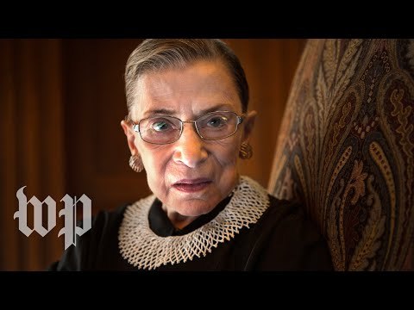
Biography
Notes:
5:01
https://youtu.be/i6Z5_RzMgQI

Slide 5
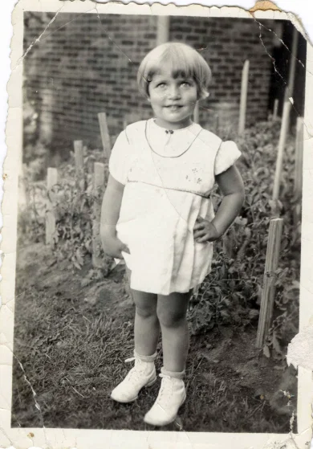
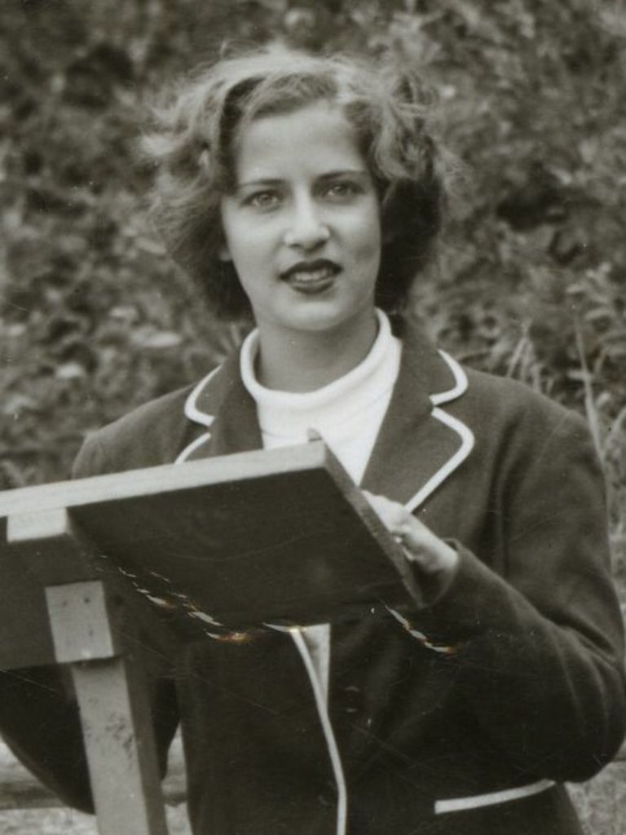
Early Life
Joan Ruth Bader was born in Brooklyn New York in 1933.
She started going by Ruth in grade school because there were several girls in her class named Joan.
Ruth's mother was engaged in Ruth's education, wanting to ensure Ruth got as far as she could academically.
Ruth's mother died the day before Ruth's high school graduation, but her passion for education would live on in Ruth forever.

Slide 6
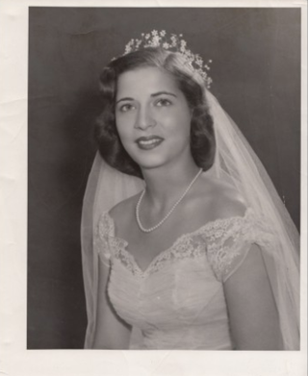

College and Career
Ruth graduated from Cornell University as #1 ranked female student in her class.
While at Cornell, Ruth met her husband, Martin Ginsburg.
After college, Ruth worked at the Social Security Administration.
When Ruth became pregnant with her first child, she was demoted.

Slide 7
Reflection
Ruth Bader Ginsburg was demoted from her first job when she was pregnant.
Why would a company demote a pregnant woman?

Slide 8


Law School and Beyond
Ruth entered Harvard Law School after her daughter was born.
There were only 9 women in the program at the time – and 500 men.
Ruth transferred to Columbia Law School where she tied for first in her class.
After graduation Ruth struggled to get a job because of her gender.

Slide 9
Reflection
Ruth Bader Ginsburg struggled to find a job as a lawyer because she was a woman.
Why do you think law firms preferred hiring male lawyers?

Slide 10
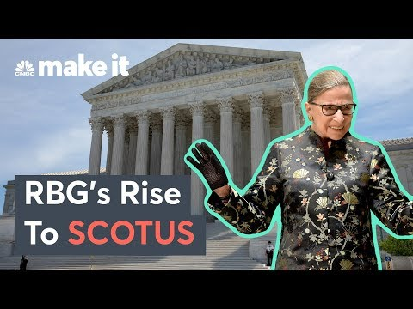
A Woman and a Mother
Notes:
https://www.youtube.com/watch?v=BYpVLHF-UxE
3:59

Slide 11

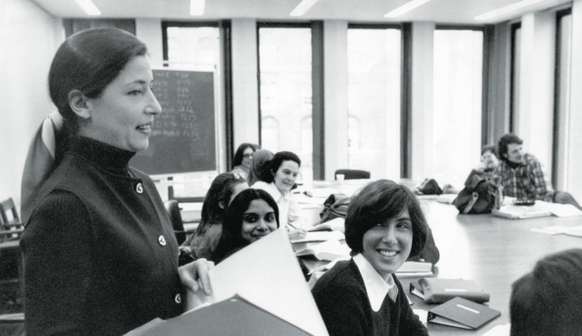
Professor Ginsburg
Ruth got her first job as a Law School Professor at Rutgers University.
Ruth was told she would be paid less than her male colleagues.
Ruth filed a federal discrimination case against the university and won.

Slide 12
Reflection
Ruth Bader Ginsburg was told she would get paid less than her male colleagues because she was a woman.
Do you think it's fair to pay someone less because of their gender identity?

Slide 13
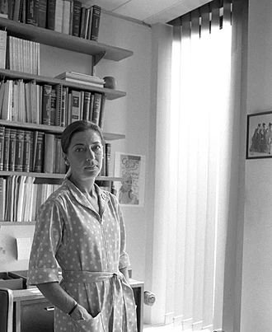
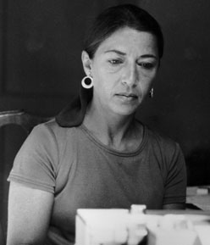
Sex Discrimination
Ruth was dedicated to advancing protections for women.
  1970: Co-founded Women's Rights Law Reporter
  1972: Co-founded Women's Rights Project at the ACLU
  1973-1976: Ruth argued six gender discrimination cases to the Supreme Court and won five!
Ruth worked to make significant legal advances for women under the Equal Protection Clause of the Constitution.

Slide 14
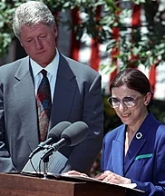
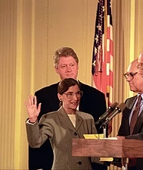
SCOTUS
In 1993 Ruth was nominated by President Bill Clinton as an Associate Justice of the Supreme Court.
Ruth was the 2nd woman in history to serve on the SCOTUS.
Ruth was the 1st Jewish woman to serve on the SCOTUS.

Slide 15
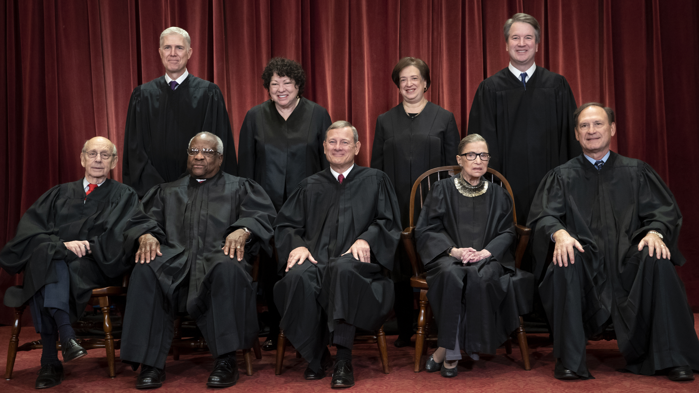
Reflection
In 1993 Ruth Bader Ginsburg was only the 2nd woman ever nominated to the Supreme Court.
As of 2010, there were 3 women serving at the same time on the Supreme Court.
Out of 9 total Supreme Court Justices, do you think it matters what gender they are?

Slide 16
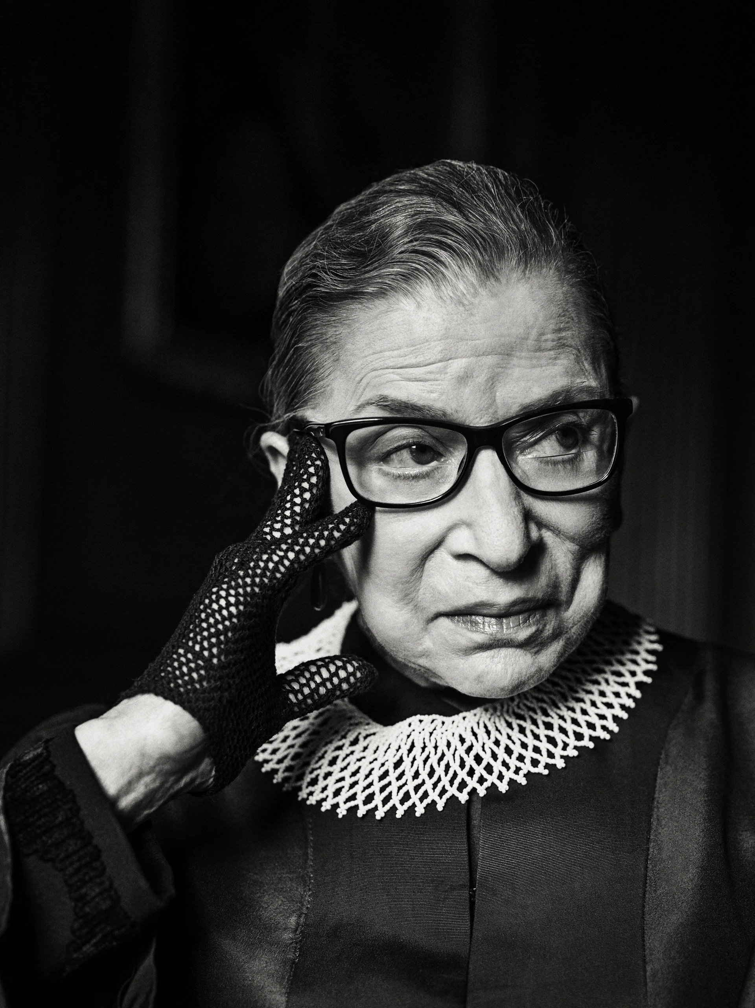
Major Wins
Over Ruth's career, she fought for major victories for women:
  The right to sign a mortgage without a man
  The right to have a bank account without a male co-signer
  The right to have a job without being discriminated based on gender
  The right for women to be pregnant/have kids and work.

Slide 17
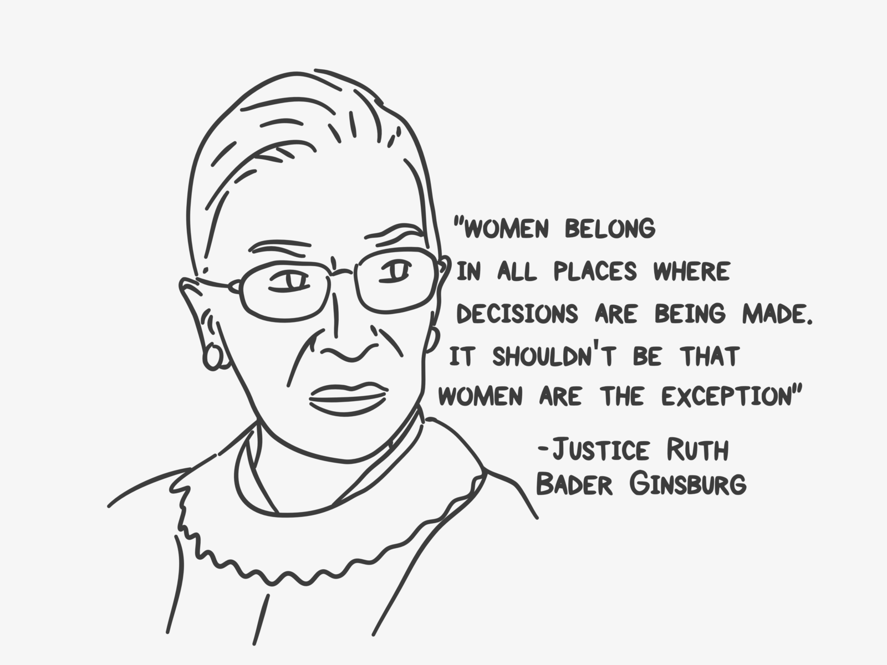
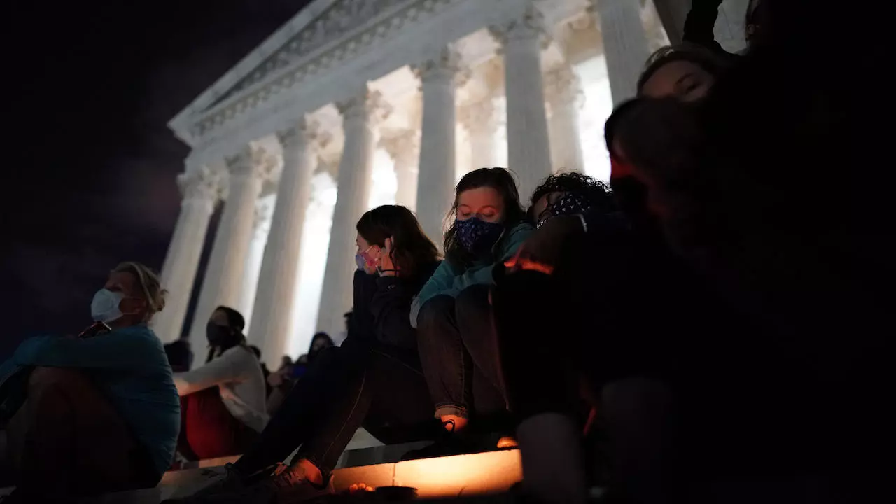
The Legacy Lives On
Ruth Bader Ginsburg died on September 18, 2020 from complications of pancreatic cancer.
That night, and over the course of the weekend, thousands of people gathered at the Supreme Court building in Washington D.C. to honor her.

Slide 18
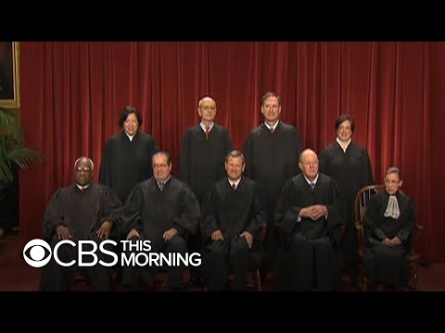
Now What?
Ruth's untimely death left a vacancy on the supreme court.
There was much debate about whether a new Supreme Court Justice should be nominated before the 2020 election.
On October 27, 2002 then-President Donald Trump nominated Amy Coney Barrett to the Supreme Court.

Slide 19
Check Out
What is your favorite flavor of ice cream?

Slide 20
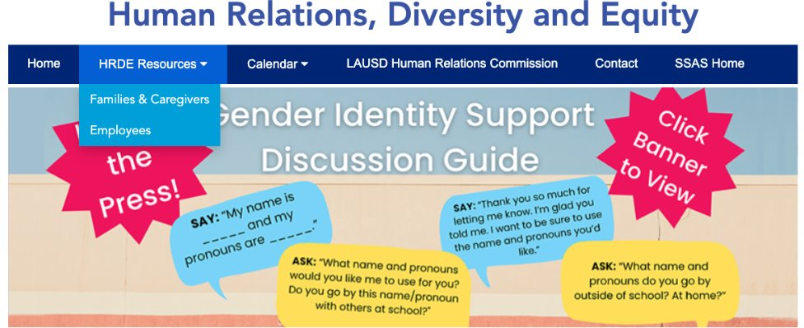
For additional resources, visit us at: https://www.lausd.org/human-relations

Slide 21

Teacher Feedback
Notes:
Teacher, please complete a brief feedback survey by scanning the QR code

