Slide 1
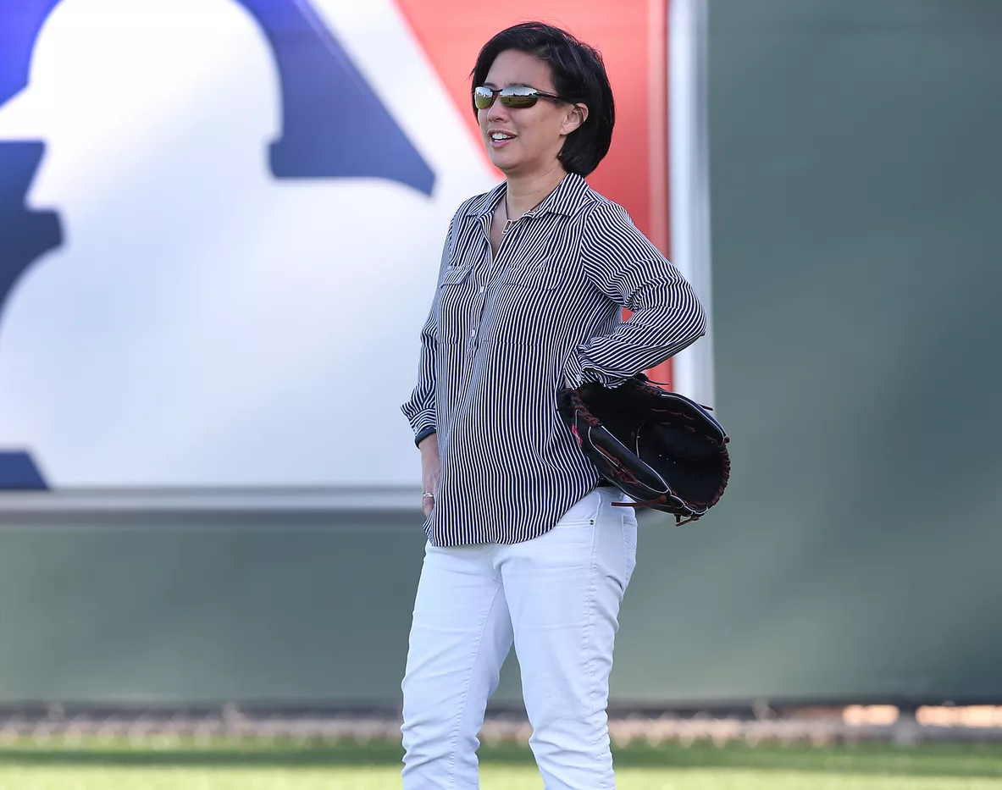

Kim Ng
Stories of Excellence
Human Relations, Diversity & Equity
Student support and attendance services

Slide 2
Welcome
Would you rather be famous for your talent or your money?
Talent
Money
Notes:
Allow the students to participate in the check in utilizing whichever platform you prefer.

Slide 3
Objectives
Learn about Kim Ng.
Discuss the role of women in sports.
Reflect on how gender stereotypes may keep people from pursuing their dreams.
Notes:
Read the objectives aloud for the students

Slide 4
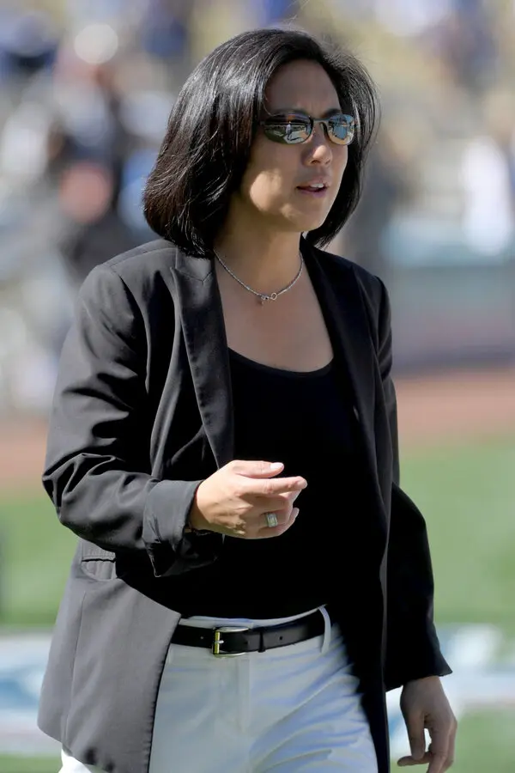
Who is kim ng?
Kim Ng was born in Indiana in 1968.
Kim is the oldest of 5 sisters.
Kim's father is a Chinese-American and Kim's mother was born in Thailand, of Chinese descent.
Kim's family moved to New York before Kim entered elementary school.
Kim's father taught her about baseball when she was young, and she often played stickball on the street in Queens with her friends.
Notes:
Read the slide aloud for the students

Slide 5

Education
Kim attended the University of Chicago.
While in college, Kim played softball all 4 years, and was named MVP infielder.
Kim graduated from the University of Chicago with a degree in Public Policy.
Notes:
Read the slide aloud for the students.

Slide 6

Reflection
Kim Ng's dad taught her about baseball when she was young.
Why did she end up playing softball in college instead of baseball? Does this have anything to do with gender discrimination?
Notes:
Engage the students in the reflection question. If students say "baseball is for boys and softball is for girls" encourage them to reflect on these stereotypes, within your comfort level.

Slide 7
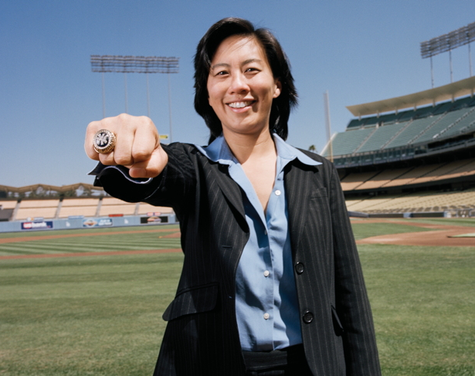
World series champ
Kim Ng began her career as an intern with the Chicago White Sox at age 21.
By the time she was 29, Kim was recruited to work as the Assistant General Manager for the New York Yankees.
At that time, Kim was the youngest Assistant General Manager ever in the history of Major League Baseball.
The Yankees won the World Series all 3 years Kim worked as their Assistant General Manager.
Notes:
Read the slide aloud for the students.

Slide 8
LA Dodgers and Beyond
2001
In 2001 Kim joined the LA Dodgers as Vice President and Assistant General Manager.
2005
In 2005 Kim was interviewed for General Manager position with the Dodgers. The Dodgers hired someone else (a man).
2011
In 2011 Kim left the Dodgers, and became the Senior Vice President of Baseball Operations for all of Major League Baseball.
Notes:
Read the slide aloud for the students.

Slide 9

All the interviews
Since then, Kim interviewed for the General Manager position with the Seattle Mariners, San Diego Padres, Anaheim Angels AND San Francisco Giants.
She did not get any of those positions.
Notes:
Read the slide aloud for the students.

Slide 10
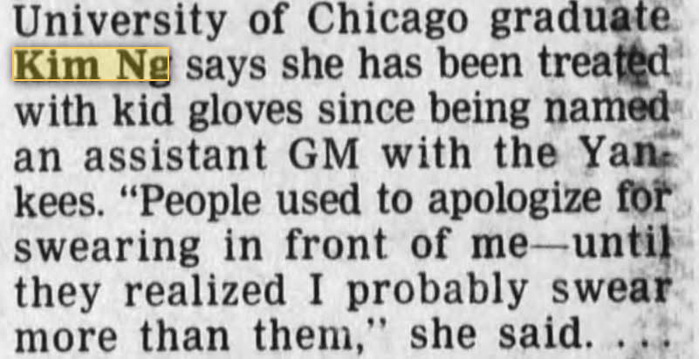
Kid Gloves?
Notes:
Read the quote aloud for the students.

Slide 11
Reflection
Kim Ng's carer advanced quickly as she worked her way up from intern to Senior Vice President of Major League Baseball.
She interviewed for General Manager with 5 different teams before taking the VP job with MLB.
Do you think this has anything to do with gender discrimination?
Notes:
Engage the students in the reflection question. Encourage thoughtful engagement about the roles of females in sports. Make sure the students understand there had never been a femal general manager in any major sport in America before.

Slide 12
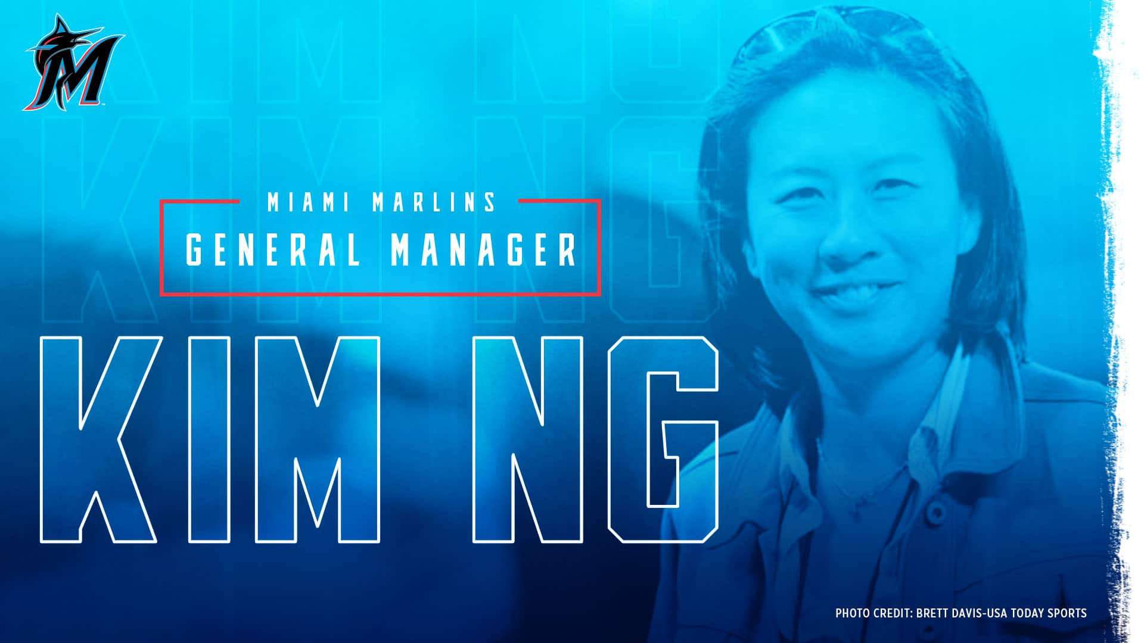
On November 13th, 2020 Kim Ng was named General Manager of the Miami Marlins!
Notes:
Read the slide aloud for the students.

Slide 13
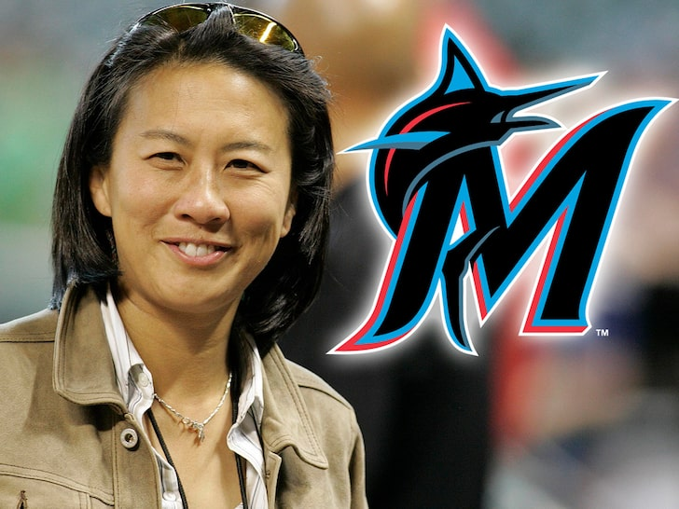
All the firsts
Kim Ng is the first person of Asian descent to serve as a General Manager in Major League Baseball.
Kim Ng is the first woman General Manager for a Major League Baseball Team.
Kim Ng is also the first woman to serve as General Manager for any of the top four major sports leauges in the United States (baseball, football, basketball, hockey).
Notes:
Read the slide aloud for the students.

Slide 14

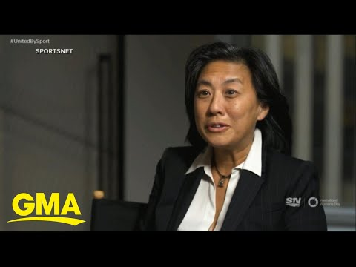
Notes:
Play the video for the students (3min)
https://youtu.be/bZ8fcDvFAj0

Slide 15
Reflection
Kim Ng is the first woman General Manager for any major sport in America.
Why did it take so long for a woman to break that glass ceiling?
Bonus: what does it mean to break the glass ceiling?
Notes:
Engage the students in the reflection. If they haven't heard the saying "break the glass ceiling" explain to them that the glass ceiling representsa barrier that historically prohibits women from advancing toward the top of a hierarchical organization. This barrier can cause women to be prevented from receiving promotions, especially to exective rankings.

Slide 16
Check Out
If you had to pick one of these superpowers, which one would you pick:
X-Ray VIsion
Mind Reading
Notes:
Invite the students to participate in the check out.

Slide 17
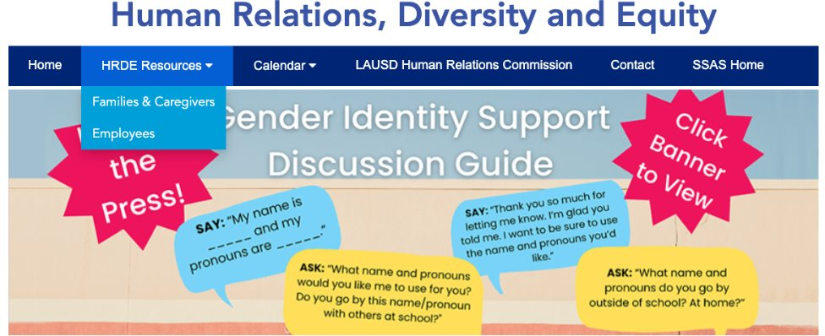
For additional resources, visit us at: https://www.lausd.org/human-relations

Slide 18

Teacher Feedback
Notes:
Teacher, please complete a brief feedback survey by scanning the QR code

